Slide 1
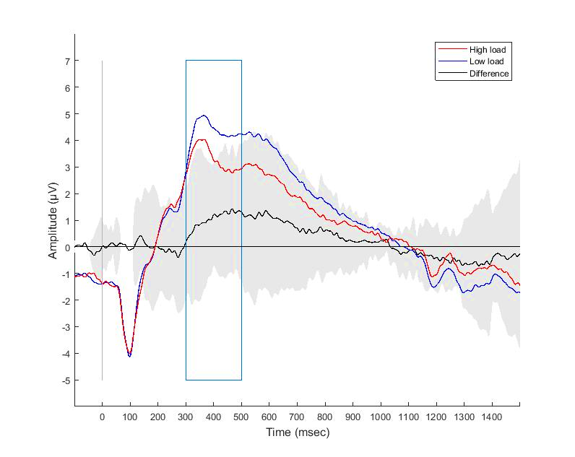
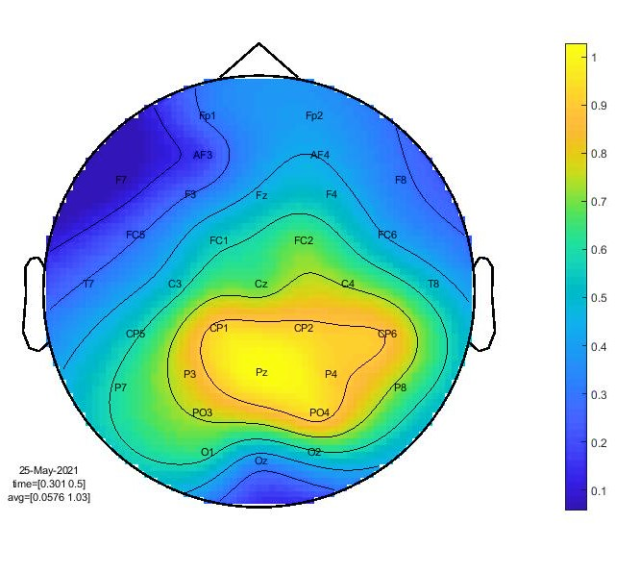





A
P3 component: PZ electrode
B
Difference mean amplitude between high and low WM load (300 – 500 ms)
μV

Slide 2
A
P3 component: PZ electrode
B
Difference mean amplitude between high and low WM load (300 – 500 ms)
μV

