Slide 2
Bird Species Identification
Submitted to : Prof. Priyanka Jangde
Department of Computer Science and Engineering

Slide 3
Supervised by: Prof.
Priyanka Jangde
Team Members
1. Aditya Sharma (0827CS201016)
2. Amit Kumar Yadav (0827CS201031)
3. Aman Verma (0827CS201028)
4. Aashish Pagare (0827CS201005)

Slide 4
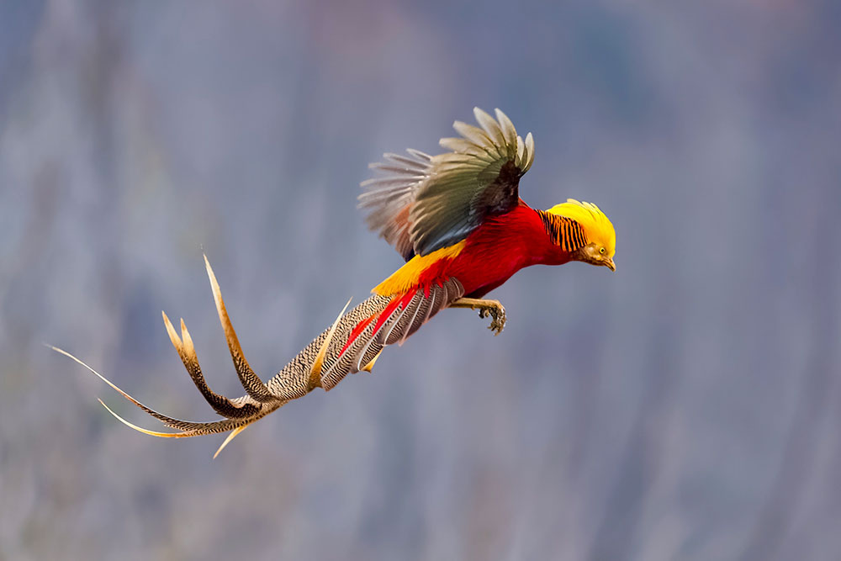
Project Presentation Outline
Abstract
Introduction
Problem Statement
About the Project
Scope
Proposed System

Slide 5
Abstract
Today, more than 10,000 species of birds are in existence and most of them are rarely found, and it is difficult to classify bird species when found.
For example, for different scenarios, birds come with different sizes, forms, colors and from a human viewpoint with different angles. Indeed, the images show different differences that need to be recorded as audio recognition of bird species. It is also easier for people to identify birds in the pictures.
Today, using deep convolutional neural network (DCNN) on Google Net framework bird species classification is possible.
For this experiment, a bird image was converted into a gray scale format that generated the autograph. After examining each and every autograph that calculates the score sheet from each node and predicts the respective bird species after the score sheet analysis.

Slide 6
Introduction
Nowadays, Identification of bird species is a difficult activity sometimes leading to uncertainty. Birds allow us to search certain organisms within the environment as they respond quickly to changes in the atmosphere.
But collecting and gathering bird information requires huge efforts by humans as well as being a much more expensive method.
In such situations, a robust system must be in place that will provide large-scale bird information processing and serve as a valuable resource for scholars, government agencies and so on.
Consequently, naming bird species plays a significant role here for determining which species belongs to a specific image of birds.

Slide 7
The Problem Statement
Nowadays we find a lot of birds in our day-to-day life and find it difficult to segregate its kind, know its type, wonder where it’s from and etc.
There are many applications which identify the bird through its voice and image.
But still, ornithologists are finding it difficult to get a quality application that provides necessary details for betterment in knowing better details about a bird they could see

Slide 8
About The Project
The objective of this project is to contribute a solution to the problem of identification of bird species by providing a quality application to satisfy the same. To identify any bird the image of the bird is uploaded and the system filters through the set of data provided and finds a match and lists its details that include scientific and basic information. There is also an alternate way of searching for a bird if only its name is known.
The name of the bird to be searched is given in the search box and the system displays images and details under its name after filtration through the provided datasets.
If there are no details updated so far about any particular bird the details and images of it will be collected in a form of quiz and will be provided to the department of ornithology for further research about the particular kind.

Slide 9
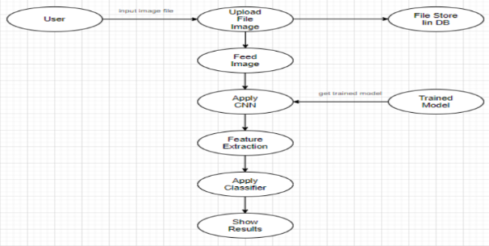
Process Flow Diagram

Slide 10
Scope
It is important to common people and even fresher’s of the department of ornithology to identify a bird they encounter in their day-to-day life.
Through this system we can discover more new species of bird and can identify those that are in the verge of extinction and save them. smooth and faster operations at all levels.

Slide 11
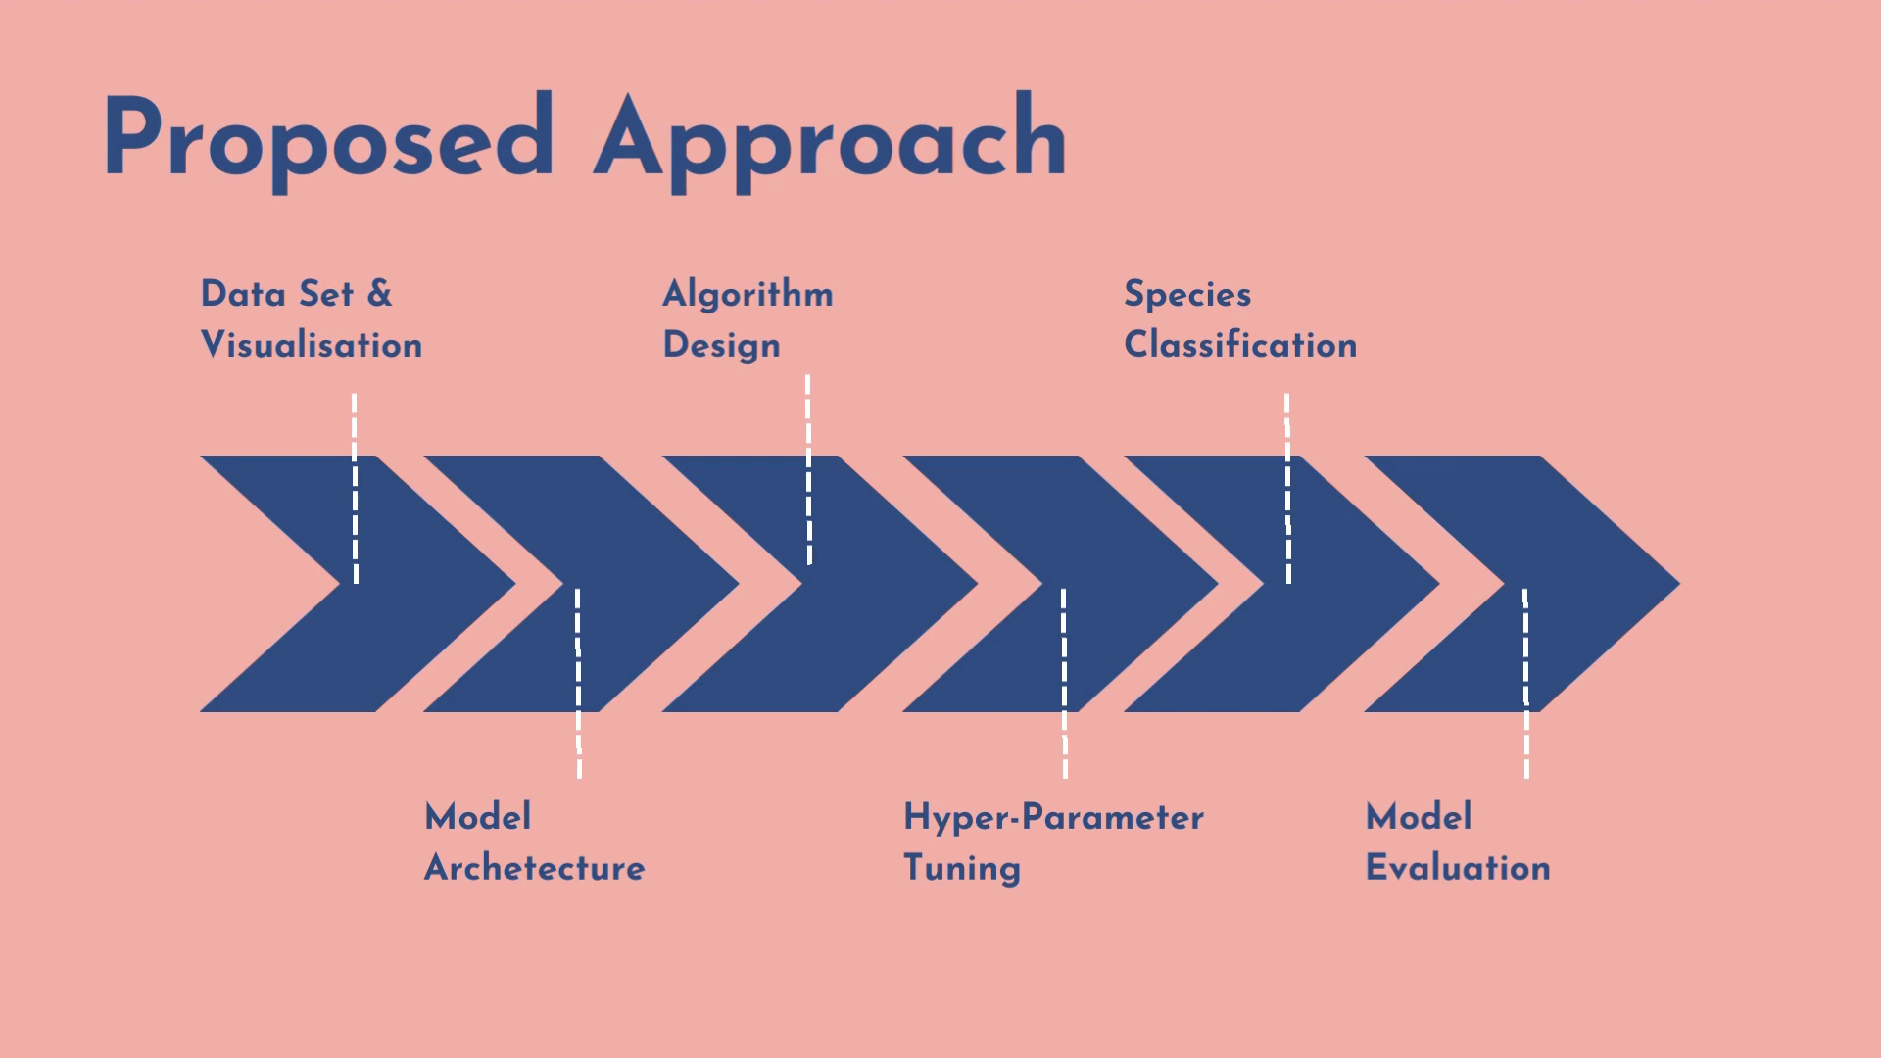

Slide 12
Proposed System And Advantages
The proposed system of bird species identification uses the Convolutional Neural Network (CNN) concepts to identify the species of the birds being searched for using its images that are uploaded instantly.
The system undergoes multiple filtration and series of algorithm to find the match of data of the bird under investigation.
The further result that will be displayed consists of information like its scientific name, family, gene and further scientific information.
Additionally it displays basic information about the bird like its nativity, food it eats, hotspot places of that particular breed, the climate it lives in, and etc.

Slide 13
THANKS

