Slide 1
Matplotlib資料視覺化技術
4060D038 鄭勝峰

Slide 2
Agenda
資料視覺化
Matplotlib
Matplotlib 實戰
折線圖:matplotlib.pyplot.plot
柱狀圖(Bar Chart):matplotlib.pyplot.bar
直方圖(histogram):matplotlib.pyplot.hist
箱形圖 (Box plot):matplotlib.pyplot.boxplot
散佈圖 (Scatter plot):matplotlib.pyplot.scatter

Slide 3
資料視覺化

Slide 4

https://www.cw.com.tw/article/5103844

Slide 5

https://www.ithome.com.tw/news/137860

Slide 6
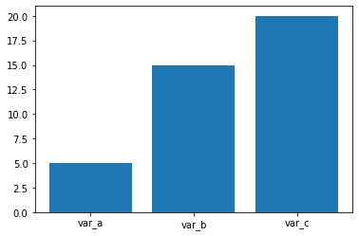
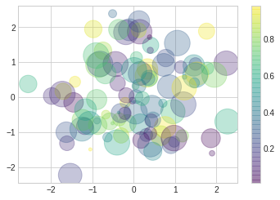
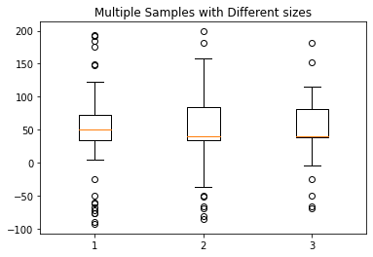
為了清晰有效地傳遞資訊，資料視覺化使用統計圖形、圖表、資訊圖表和其他工具。 可以使用點、線或條對數字資料進行編碼，以便在視覺上傳達定量資訊。

Slide 7
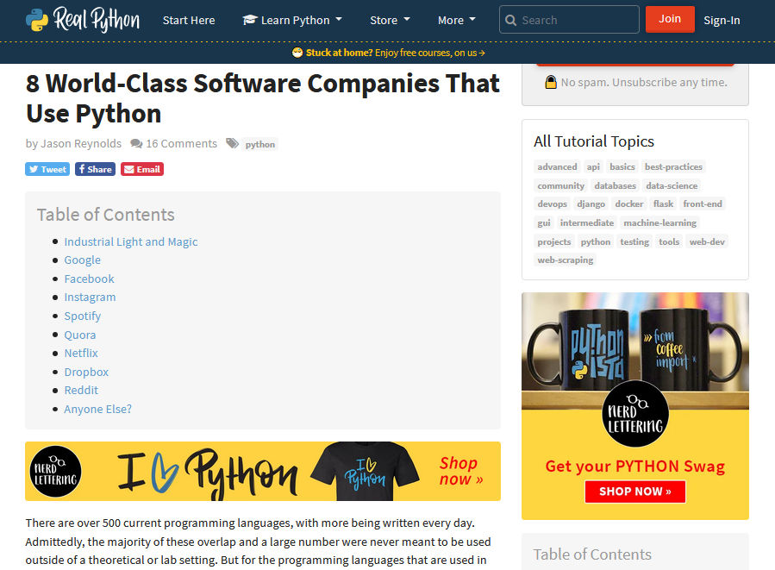
https://realpython.com/world-class-companies-using-python/

Slide 8
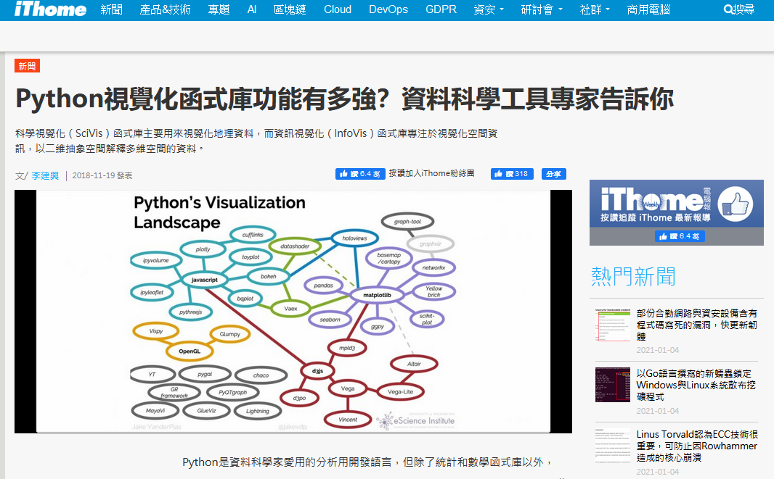
https://www.ithome.com.tw/news/127124

Slide 9
Matplotlib

Slide 10
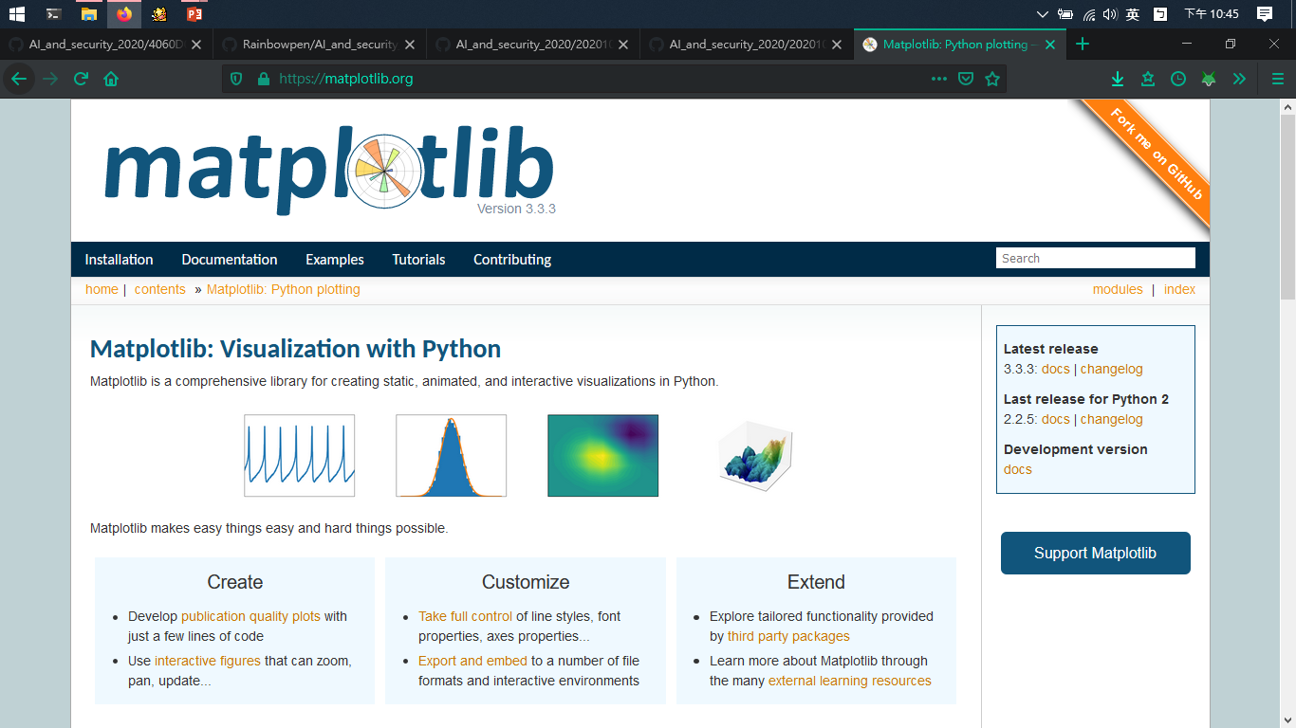
https://matplotlib.org/

Slide 11
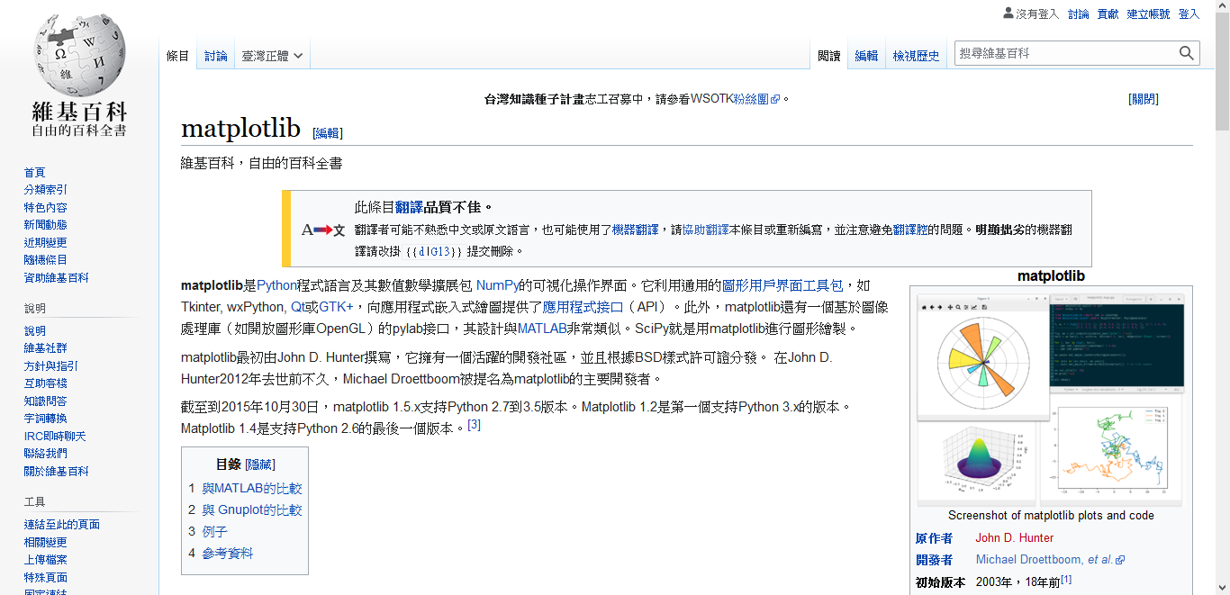
https://zh.wikipedia.org/wiki/Matplotlib

Slide 12
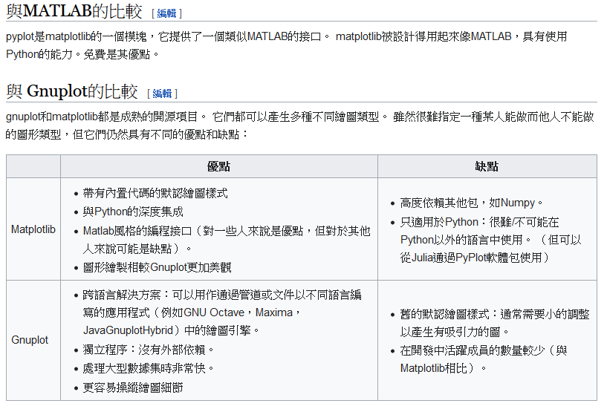
https://zh.wikipedia.org/wiki/Matplotlib#%E4%B8%8EMATLAB%E7%9A%84%E6%AF%94%E8%BE%83

Slide 13
Matplotlib 實戰

Slide 14
折線圖:matplotlib.pyplot.plot
import matplotlib.pyplot as plt
x = [1, 2, 3, 4, 5, 6, 7, 8, 9]
y1 = [1, 3, 5, 3, 1, 3, 5, 3, 1]
y2 = [2, 4, 6, 4, 2, 4, 6, 4, 2]
plt.plot(x, y1, label="line L")
plt.plot(x, y2, label="line H")
plt.plot()
plt.xlabel("x axis")
plt.ylabel("y axis")
plt.title("Line Graph Example")
plt.legend()
plt.show()

Slide 15
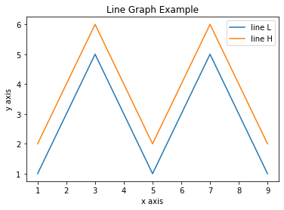

Slide 16
import matplotlib.pyplot as plt
x = [1, 2, 3, 4, 5, 6, 7, 8, 9]
y1 = [1, 3, 5, 3, 1, 3, 5, 3, 1]
y2 = [2, 4, 6, 4, 2, 4, 6, 4, 2]
plt.plot(x, y1, 'r--', label="line L")
plt.plot(x, y2, 'r--', label="line H")
plt.plot()
plt.xlabel("x axis")
plt.ylabel("y axis")
plt.title("Line Graph Example")
plt.legend()
plt.show()

Slide 17
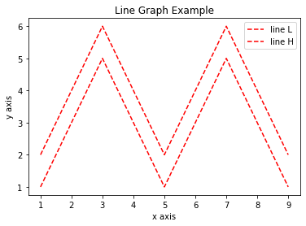

Slide 18
柱狀圖(Bar Chart):matplotlib.pyplot.bar
import matplotlib.pyplot as plt
names = ['var_a', 'var_b', 'var_c']
values = [5, 15, 20]
plt.bar(names, values)
plt.show()

Slide 20
直方圖(histogram):matplotlib.pyplot.hist
import numpy as np
import matplotlib.mlab as mlab
import matplotlib.pyplot as plt
x = [21,22,23,4,5,6,77,8,9,10,31,32,33,34,35,36,37,18,49,50,100]
num_bins = 5
n, bins, patches = plt.hist(x, num_bins, facecolor='blue', alpha=0.5)
plt.show()

Slide 21
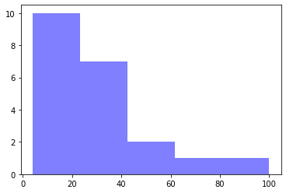
hint: 直方圖和長條圖不同在於直方圖的組距之間有順序性

Slide 22
箱形圖 (Box plot):matplotlib.pyplot.boxplot
import numpy as np
import matplotlib.pyplot as plt
# Fixing random state for reproducibility
np.random.seed(19680801)
# fake up some data
spread = np.random.rand(50) * 100
center = np.ones(25) * 50
flier_high = np.random.rand(10) * 100 + 100
flier_low = np.random.rand(10) * -100
data = np.concatenate((spread, center, flier_high, flier_low))
fig1, ax1 = plt.subplots()
ax1.set_title('Basic Plot')
ax1.boxplot(data)

Slide 23
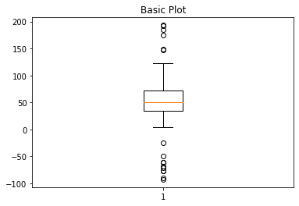

Slide 24
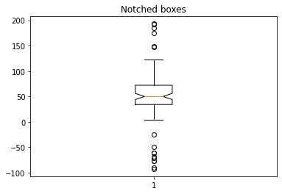
fig2, ax2 = plt.subplots()
ax2.set_title('Notched boxes')
ax2.boxplot(data, notch=True)

Slide 25
green_diamond = dict(markerfacecolor='g', marker='D')
fig3, ax3 = plt.subplots()
ax3.set_title('Changed Outlier Symbols')
ax3.boxplot(data, flierprops=green_diamond)

Slide 26
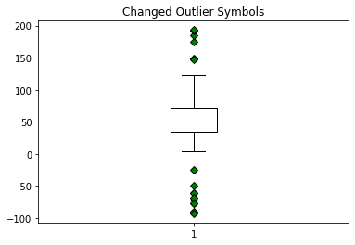

Slide 27
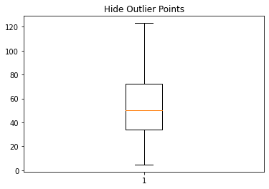
fig4, ax4 = plt.subplots()
ax4.set_title('Hide Outlier Points')
ax4.boxplot(data, showfliers=False)

Slide 28
red_square = dict(markerfacecolor='r', marker='s')
fig5, ax5 = plt.subplots()
ax5.set_title('Horizontal Boxes')
ax5.boxplot(data, vert=False, flierprops=red_square)

Slide 29
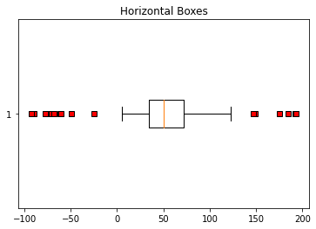

Slide 30
spread = np.random.rand(50) * 100
center = np.ones(25) * 40
flier_high = np.random.rand(10) * 100 + 100
flier_low = np.random.rand(10) * -100
d2 = np.concatenate((spread, center, flier_high, flier_low))
data = [data, d2, d2[::2]]
fig7, ax7 = plt.subplots()
ax7.set_title('Multiple Samples with Different sizes')
ax7.boxplot(data)
plt.show()

Slide 32
散佈圖 (Scatter plot):matplotlib.pyplot.scatter
%matplotlib inline
import matplotlib.pyplot as plt
plt.style.use('seaborn-whitegrid')
import numpy as np
#產生弦波
x = np.linspace(0, 10, 30)
y = np.sin(x)
#畫圖
plt.scatter(x, y, marker='o')

Slide 33
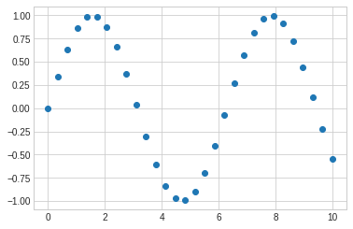

Slide 34
rng = np.random.RandomState(0)
x = rng.randn(100)
y = rng.randn(100)
colors = rng.rand(100)
sizes = 1000 * rng.rand(100)
plt.scatter(x, y, c=colors, s=sizes, alpha=0.3,
cmap='viridis')
plt.colorbar(); # show color scale

Slide 36
from sklearn.datasets import load_iris
iris = load_iris()
features = iris.data.T
plt.scatter(features[0], features[1], alpha=0.2,
s=100*features[3], c=iris.target, cmap='viridis')
plt.xlabel(iris.feature_names[0])
plt.ylabel(iris.feature_names[1]);

Slide 37
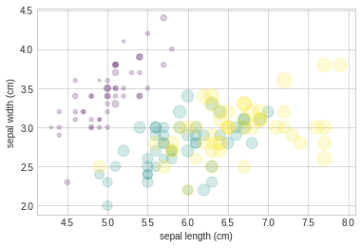

Slide 38
謝謝聆聽

