Slide 1
Pandas資料分析練習與心得
人工智慧與資訊安全
學生: 鄭勝峰
指導教授: 曾龍

Slide 2
Agenda
Data science and Pandas
Pandas資料分析技術:(1)
Pandas資料分析技術:(2)
Pandas專案分析:
https://github.com/wesm/pydata-book

Slide 3
Data science and Pandas

Slide 4
資料科學
資料科學（英語：data science）是一門利用應用數學、統計、圖型識別、機器學習、資料視覺化、資料倉儲以及高效能計算的學科，其目標是通過從資料中提取出有價值的部分來生產資料產品。

Slide 5
Pandas
Pandas 是一個專門供Python使用的資料處理和分析函式庫，特別的是它提供表格和時間序列的操作。

Slide 6
Pandas資料分析技術:(1)

Slide 7
首先必須要引入涵式
import pandas as pd # import pandas 並改名成 pd
import numpy as np # import numpy 對陣列操作很有用

Slide 8
Series
obj = pd.Series([4, 7, -5, 3]) # 產生一個序列並付值
print(obj)
>>
0 4
1 7
2 -5
3 3
dtype: int64

Slide 9
print(obj.values) # 取得obj內的值
>> [ 4 7 -5 3]
print(obj.index) # 類似 range(4) 產生0~3的流水號
>> RangeIndex(start=0, stop=4, step=1)
obj2 = pd.Series([4, 7, -5, 3], index=['d', 'b', 'a', 'c'])
print(obj2.index)
>> Index(['d', 'b', 'a', 'c'], dtype='object')

Slide 10
Pandas資料分析技術:(2)

Slide 11
產生日期流水號的表格
In [64]:
dates = pd.date_range('20201021', periods=6)
dates
Out[64]:
DatetimeIndex(['2020-10-21', '2020-10-22', '2020-10-23', '2020-10-24', '2020-10-25', '2020-10-26'], dtype='datetime64[ns]', freq='D')

Slide 12
Pandas專案分析 美國政府資料分析

Slide 13
在colab中取得範例資料
!wget https://raw.githubusercontent.com/wesm/pydata-book/2nd-edition/datasets/bitly_usagov/example.txt
--2020-11-11 02:25:55-- https://raw.githubusercontent.com/wesm/pydata-book/2nd-edition/datasets/bitly_usagov/example.txt Resolving raw.githubusercontent.com (raw.githubusercontent.com)... 151.101.0.133, 151.101.64.133, 151.101.128.133, ... Connecting to raw.githubusercontent.com (raw.githubusercontent.com)|151.101.0.133|:443... connected. HTTP request sent, awaiting response... 200 OK Length: 1598282 (1.5M) [text/plain] Saving to: ‘example.txt’ example.txt 100%[===================>] 1.52M 8.68MB/s in 0.2s 2020-11-11 02:25:55 (8.68 MB/s) - ‘example.txt’ saved [1598282/1598282]

Slide 14
讀取資料
import json
path = 'example.txt'
records = [json.loads(line) for line in open(path)]
# 從example.txt一行一行讀取並存成json格式

Slide 15
從中取得時區資料
time_zones = [rec['tz'] for rec in records if 'tz' in rec]
time_zones[:10] #最後十筆
['America/New_York', 'America/Denver', 'America/New_York', 'America/Sao_Paulo', 'America/New_York', 'America/New_York', 'Europe/Warsaw', '', '', '']

Slide 16
計算該指定時區共有幾筆資料
def get_counts(sequence):
#計算每一筆時區的總數
counts = {}
for x in sequence:
if x in counts:
counts[x] += 1
else:
counts[x] = 1
return counts
counts = get_counts(time_zones)
print(counts[‘America/New_York’]) #紐約的總數
print(len(time_zones)) #所有時區的總和
1251
3440

Slide 17
時區總數排名
def top_counts(count_dict, n=10):
#根據count_dict計算前十多的時區
value_key_pairs = [(count, tz) for tz, count in count_dict.items()]
value_key_pairs.sort()
return value_key_pairs[-n:]
top_counts(counts)
[(33, 'America/Sao_Paulo'), (35, 'Europe/Madrid'), (36, 'Pacific/Honolulu'), (37, 'Asia/Tokyo'), (74, 'Europe/London'), (191, 'America/Denver'), (382, 'America/Los_Angeles'), (400, 'America/Chicago'), (521, ''), (1251, 'America/New_York')]

Slide 18
#計算總合和排名相當於
# 使用 collections
from collections import Counter
counts = Counter(time_zones) #計算總數
counts.most_common(10) #排前十名

Slide 19
# 使用Pandas
import pandas as pd
frame = pd.DataFrame(records) # Pandas 讀取python 字典
frame[‘tz’][:10] #根據時區取得最多資料的前十名
tz_counts = frame[‘tz’].value_counts() #計算每個時區的資料總數
tz_counts[:10] #取最後10筆

Slide 20
取代空值
clean_tz = frame['tz'].fillna('Missing')
clean_tz[clean_tz == ''] = 'Unknown'
# 將時區資料中的空值取代成'Unknown'

Slide 21
視覺化
import seaborn as sns
subset = tz_counts[:10] #最後十筆
sns.barplot(y=subset.index, x=subset.values)
# 根據tz_counts的index 和 values繪製棒狀圖

Slide 22
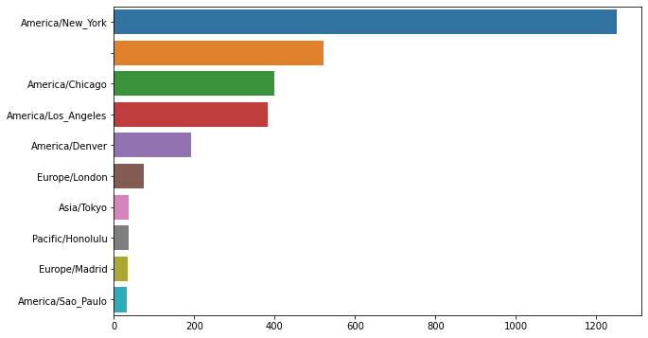

Slide 23
最多人使用的瀏覽器
results = pd.Series([x.split()[0] for x in frame.a.dropna()])
# pandas.DataFrame.dropna() 忽略有pd.NaT的項目
results[:8] #最後8筆
results.value_counts()[:8]
#計算每一種瀏覽器的總和並回傳最多的8筆

Slide 24
判斷作業系統是不是Windows
frame['os'] = np.where(cframe['a'].str.contains('Windows'), 'Windows', 'Not Windows')
frame['os'][:10]
0 Windows
1 Not Windows
2 Windows
3 Not Windows
4 Windows
5 Windows
6 Windows
7 Windows
8 Not Windows
9 Windows
Name: os, dtype: object

Slide 25
計算各時區使用Windows的數量
by_tz_os = cframe.groupby(['tz', 'os'])
agg_counts = by_tz_os.size().unstack().fillna(0)
print(agg_counts[:10])

Slide 26
# Use to sort in ascending order
indexer = agg_counts.sum(1).argsort()
Print(indexer[:10])
tz 24 Africa/Cairo 20 Africa/Casablanca 21 Africa/Ceuta 92 Africa/Johannesburg 87 Africa/Lusaka 53 America/Anchorage 54 America/Argentina/Buenos_Aires 57 America/Argentina/Cordoba 26 America/Argentina/Mendoza 55 dtype: int64

Slide 27
各時區Windows數量圖表
plt.figure()
# Rearrange the data for plotting
count_subset = count_subset.stack()
count_subset.name = 'total'
count_subset = count_subset.reset_index()
count_subset[:10]
sns.barplot(x='total', y='tz', hue='os', data=count_subset)

Slide 28
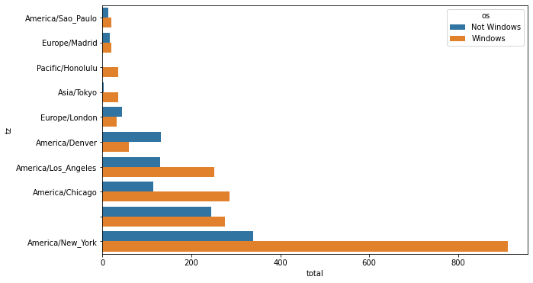

Slide 29
def norm_total(group):
group['normed_total'] = group.total / group.total.sum()
return group
results = count_subset.groupby('tz').apply(norm_total)
sns.barplot(x='normed_total', y='tz', hue='os', data=results)

Slide 30
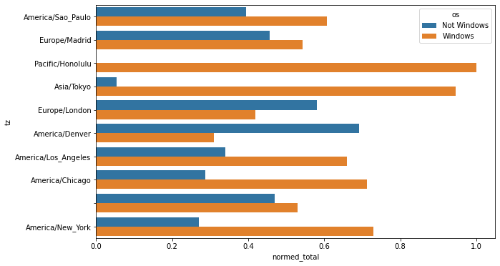

Slide 31
Pandas專案分析 美國政府資料分析2: 美國1880–2010嬰兒姓名

Slide 32
讀取檔案
import pandas as pd
names1880 = pd.read_csv('pydata-book/datasets/babynames/yob1880.txt',
names=['name', 'sex', 'births'])
print(names1880)

Slide 33
依照性別算總數
names1880.groupby('sex').births.sum()
sex
F 90993
M 110493
Name: births,
dtype: int64

Slide 34
讀成 DataFrame
#依照姓名 性別 出生年分轉成 DataFrame
years = range(1880, 2011)
pieces = []
columns = ['name', 'sex', 'births']
for year in years:
path = 'pydata-book/datasets/babynames/yob%d.txt' % year
frame = pd.read_csv(path, names=columns)
frame['year'] = year
pieces.append(frame)
# Concatenate everything into a single DataFrame
names = pd.concat(pieces, ignore_index=True)

Slide 35
畫成圖
total_births = names.pivot_table('births', index='year',
columns='sex', aggfunc=sum)
total_births.tail()
total_births.plot(title='Total births by sex and year')

Slide 36
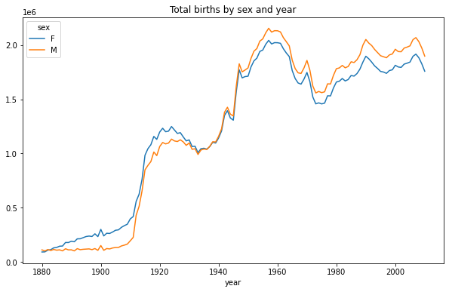
男女出生數比較

Slide 37
Analyzing Naming Trends
# 計算John, Harry, Mary, Marilyn名子的熱門程度
boys = top1000[top1000.sex == 'M']
girls = top1000[top1000.sex == 'F']
total_births = top1000.pivot_table('births', index='year',
columns='name',
aggfunc=sum)
total_births.info()
subset = total_births[['John', 'Harry', 'Mary', 'Marilyn']]
subset.plot(subplots=True, figsize=(12, 10), grid=False,
title="Number of births per year")

Slide 38
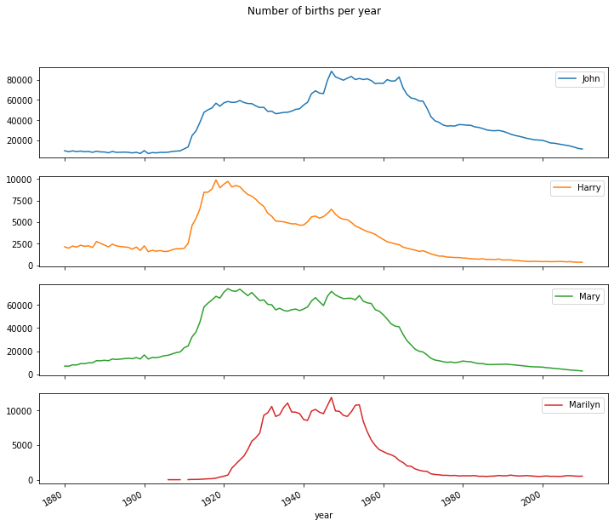
姓名熱門程度

Slide 39
參考資料
https://github.com/wesm/pydata-book

