Slide 1
R Basic Workshop
Yuqing | yhe050@uottawa.ca
Notes:
links, follow up
story
bring USB

Slide 2
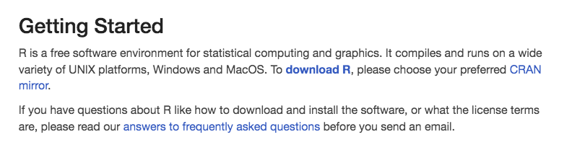
Instructions for downloading R
1. Go to https://www.r-project.org/ and click “To download R” (as shown below);
2. Choose one of the shown locations you like and click;
3. Download the version that works for your computer. It has versions for MAC, Windows and Linux
4. Install it and you finish this step!

Slide 3
Instructions for downloading R studio
1. Go to https://rstudio.com/products/rstudio/download/#download
2. In ‘Installers for Supported Platforms’ section, choose and click the R Studio installer based on your operating system. The download should begin as soon as you click
3. Install it. (just click next and you can do it! ☺)

Slide 4
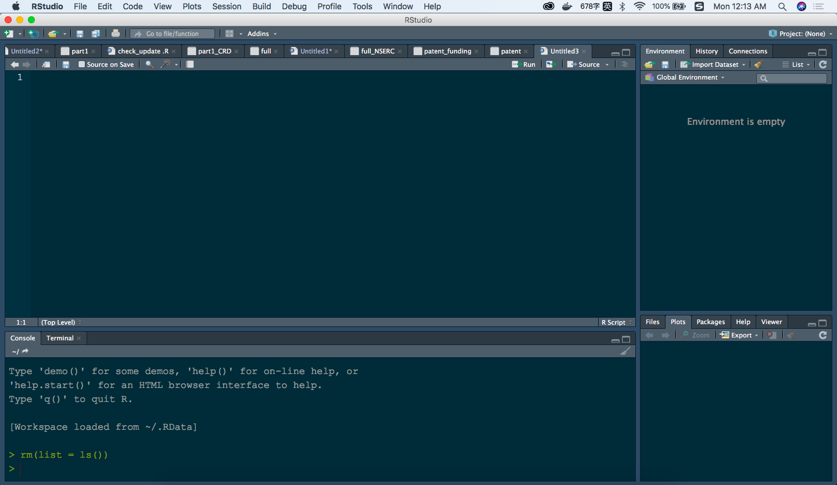
R basic: the interface of R
Notes:
R Console: This area shows the output of code you run. Also, you can directly write codes in console. Code entered directly in R console cannot be traced later. This is where R script comes to use.
R Script: As the name suggest, here you get space to write codes. To run those codes, simply select the line(s) of code and press Ctrl + Enter. Alternatively, you can click on little ‘Run’ button location at top right corner of R Script.
R environment: This space displays the set of external elements added. This includes data set, variables, vectors, functions etc. To check if data has been loaded properly in R, always look at this area.
Graphical Output: This space display the graphs created during exploratory data analysis. Not just graphs, you could select packages, seek help with embedded R’s official documentation.

Slide 5
R basic: data types
1. Character, e.g. “hello world”
2. Numeric, e.g. “123.45” / integer, e.g. “999”
3. Logical, e.g. “TRUE” or “FALSE”
> as.numeric(x) # change to another type
> as.integer(x)
> as.character(x)
class(x) # have a look at what type the object is
is.integer(x) # whether the object is integer

Slide 6
R basic: data types
we could store data by
creating a vector, e.g. x <- c (1,2,3)
creating a list, e.g. x <- list(22, “ab”, TRUE, 1+2i)
creating a data frame, e.g. x <- data.frame(x = data1, y=data2, header = TRUE, sep=“,”)
Notes:
在选择该用哪种数据结构的时候，应该遵循这样的原则： 1. 如果只关心随机存取，不在乎插入和删除 ，那么就要考虑vector 2. 如果只关心插入删除，不在意随机存取， 那么就要考虑list

Slide 7
R basic: computations
x <- 2 + 3
y <- 6 / 3
z <- log(12)
sqrt(), log()...
c <- (a + sqrt(a))/(exp(2)+1)
Basic Numerical Descriptions: mean, min, SD, etc... (see scripts)
round() / ceiling() / floor()

Slide 8
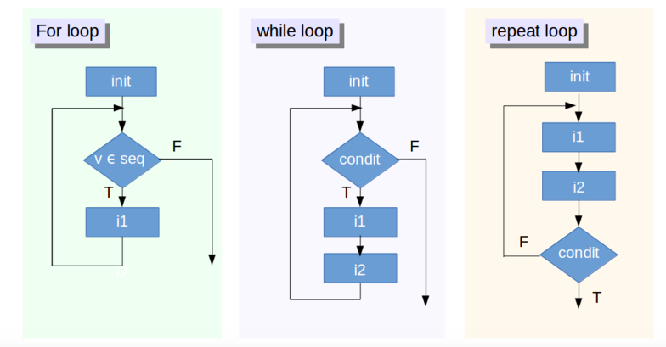
R basic: control structures
1. If... else...
if (<condition>){
# do something
} else {
# do something
}
2. for...
for (<search condition>){
# do something
}
3. while...
while (<search condition>){
# do something
}
other control structures:
repeat – executes an infinite loop
break – breaks the execution of a loop
next - skips an iteration in a loop
return – exit a function
Notes:
we always use both together
more tutorials: https://www.datacamp.com/community/tutorials/tutorial-on-loops-in-r?utm_source=adwords_ppc&utm_campaignid=1655852085&utm_adgroupid=61045433942&utm_device=c&utm_keyword=%2Bloops%20%2Br&utm_matchtype=b&utm_network=g&utm_adpostion=1t1&utm_creative=318880582254&utm_targetid=aud-299261629574:kwd-589281898934&utm_loc_interest_ms=&utm_loc_physical_ms=9000662&gclid=CjwKCAiAx_DwBRAfEiwA3vwZYhbC68Gbnow4LcdEVXupqf8CbraddqNgrsonJCN17mPRStPefI_NARoCKYEQAvD_BwE
exclamation

Slide 9
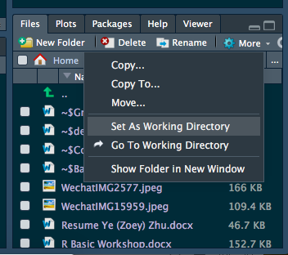
Data Preparation: Importing Data and Installing R packages
Importing Data: two methods for csv file
1. set a working directory
e.g. patent <- read.csv(‘part2_info_update.csv’)
2. set an absolute path
e.g. patent <- read.csv(file = /Users/mayhe/Dropbox/R basic workshop/data processing.csv", header = T, as.is = T, encoding = "UTF=8")
For importing other formats, check packages: data.tables, readr, RMySQL, jsonlite, etc.
Notes:
/Users/mayhe/Dropbox/dataset for R basic workshop

Slide 10
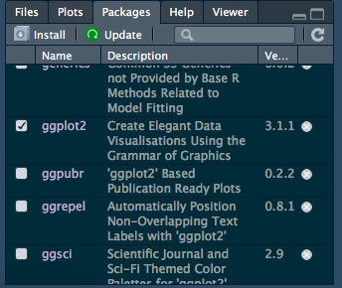
Data Preparation: Importing Data and Installing R packages
Installing R Packages: two ways
1. 2. install.packages('stringr')
library(stringr)

Slide 11
Data Preparation: Some basic functions that are frequently used
summary()
sort()/order()/rank()
unique()
length()
attribute()
dim()
class()
nrow()/ncol(), colnames()/row.names()
is.na()
table()
na.omit()
complete.cases()
Notes:
brackets [ˈbrækət]

Slide 12
Data Preparation: Basic Steps for Data Pre-Processing
import data
check missing data
transfer categorical data
splitting the dataset into the training set and test set
feature scaling
Notes:
Feature Scaling or Standardization: It is a step of Data Pre Processing which is applied to independent variables or features of data. It basically helps to normalise the data within a particular range.
Feature Scaling is a technique to standardize the independent features present in the data in a fixed range. It is performed during the data pre-processing to handle highly varying magnitudes or values or units
decimal points、
continuous

Slide 13
Data Preparation: Packages for Data Processing
ggplot2, for data visualization.
dplyr, for data manipulation.
tidyr, for data tidying.
readr, for data import.
stringr, for strings.
(see cheatsheet provided! )
Notes:
https://cedricscherer.netlify.com/2019/08/05/a-ggplot2-tutorial-for-beautiful-plotting-in-r/
https://tutorials.iq.harvard.edu/R/Rgraphics/Rgraphics.html

Slide 14
Data Preparation: Some suggestions for practicing R
1. Find the packages you want from the website:
https://www.rdocumentation.org/
2. Bonus! you can find some useful cheat sheets here:
https://github.com/rstudio/cheatsheets
3. Google is a good teacher!
4. It is a good forum to ask questions and search for answers:
https://stackoverflow.com/
5. Online courses are good options to learn R, no matter you are a beginner or advanced user!

Slide 15
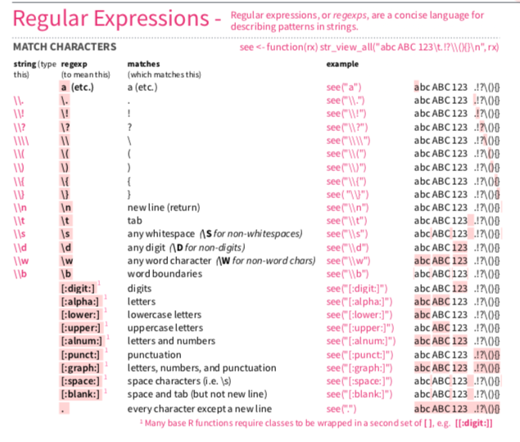
Appendix from cheat sheet produced by R studio...

