Slide 1
Chapter 5
The LC-3

Slide 2
Instruction Set Architecture
ISA = All of the programmer-visible components
and operations of the computer
  memory organization
    address space -- how may locations can be addressed?
    addressibility -- how many bits per location?
  register set
    how many? what size? how are they used?
  instruction set
    opcodes
    data types
    addressing modes
ISA provides all information needed for someone that wants to
write a program in machine language
(or translate from a high-level language to machine language).

Slide 3
LC-3 Overview: Memory and Registers
Memory
  address space: 2¹⁶ locations (16-bit addresses)
  addressability: 16 bits
Registers
  temporary storage, accessed in a single machine cycle
    accessing memory generally takes longer than a single cycle
  eight general-purpose registers: R0 - R7
    each 16 bits wide
    how many bits to uniquely identify a register?
  other registers
    not directly addressable, but used by (and affected by) instructions
    PC (program counter), condition codes

Slide 4
LC-3 Overview: Instruction Set
Opcodes
  15 opcodes
  Operate instructions: ADD, AND, NOT
  Data movement instructions: LD, LDI, LDR, LEA, ST, STR, STI
  Control instructions: BR, JSR/JSRR, JMP, RTI, TRAP
  some opcodes set/clear condition codes, based on result:
    N = negative, Z = zero, P = positive (> 0)
Data Types
  16-bit 2’s complement integer
Addressing Modes
  How is the location of an operand specified?
  non-memory addresses: immediate, register
  memory addresses: PC-relative, indirect, base+offset

Slide 5
Operate Instructions
Only three operations: ADD, AND, NOT
Source and destination operands are registers
  These instructions do not reference memory.
  ADD and AND can use “immediate” mode,
  where one operand is hard-wired into the instruction.
Will show dataflow diagram with each instruction.
  illustrates when and where data moves
  to accomplish the desired operation

Slide 6
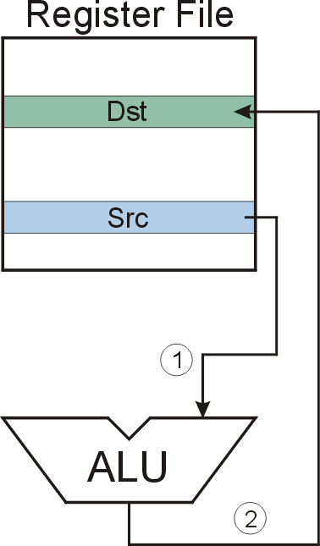
NOT (Register)
Note: Src and Dst
could be the same register.

Slide 7
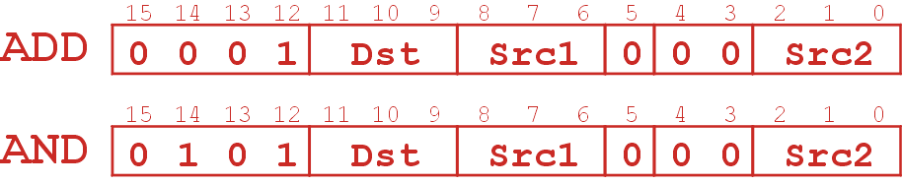
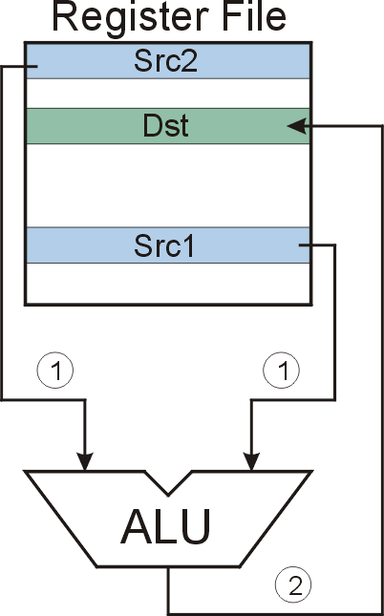
ADD/AND (Register)
this zero means “register mode”

Slide 8
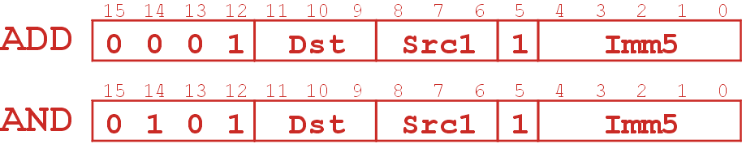
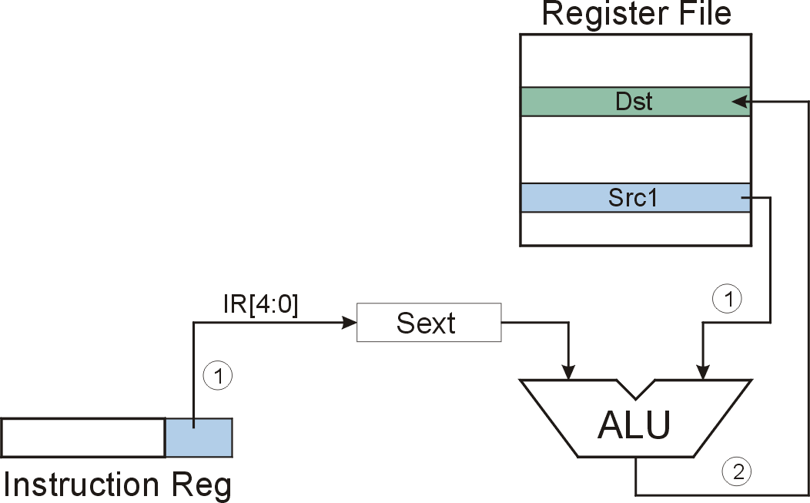
ADD/AND (Immediate)
this one means “immediate mode”
Note: Immediate field is
sign-extended.
Notes:
.

Slide 9
Using Operate Instructions
With only ADD, AND, NOT…
  How do we subtract?
  How do we OR?
  How do we copy from one register to another?
  How do we initialize a register to zero?
Notes:
Subtract: R3 = R1 - R2
Take 2’s complement of R2, then add to R1.
(1) R2 = NOT(R2)
(2) R2 = R2 + 1
(3) R3 = R1 + R2
OR: R3 = R1 OR R2
Use DeMorgan’s Law -- invert R1 and R2, AND, then invert result.
(1) R1 = NOT(R1)
(2) R2 = NOT(R2)
(3) R3 = R1 AND R2
(4) R3 = NOT(R3)
Register-to-register copy: R3 = R2
R3 = R2 + 0 (Add-immediate)
Initialize to zero: R1 = 0
R1 = R1 AND 0 (And-immediate)

Slide 10
Data Movement Instructions
Load -- read data from memory to register
  LD: PC-relative mode
  LDR: base+offset mode
  LDI: indirect mode
Store -- write data from register to memory
  ST: PC-relative mode
  STR: base+offset mode
  STI: indirect mode
Load effective address -- compute address,
save in register
  LEA: immediate mode
  does not access memory

Slide 11


PC-Relative Addressing Mode
Want to specify address directly in the instruction
  But an address is 16 bits, and so is an instruction!
  After subtracting 4 bits for opcode
  and 3 bits for register, we have 9 bits available for address.
Solution:
  Use the 9 bits as a signed offset from the current PC.
9 bits:
Can form any address X, such that:
Remember that PC is incremented as part of the FETCH phase;
This is done before the EVALUATE ADDRESS stage.

Slide 12
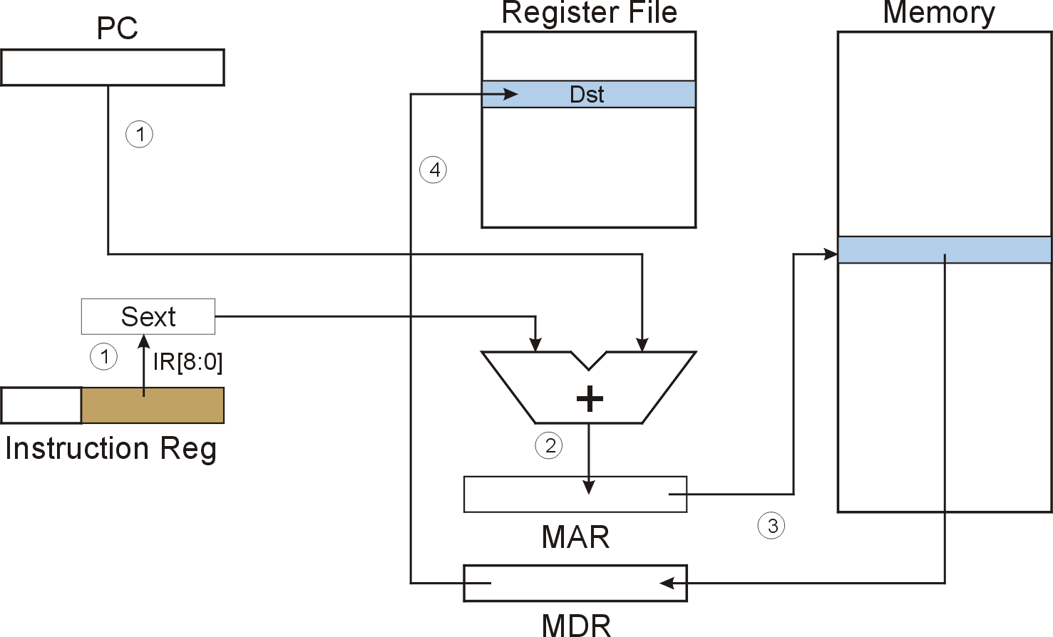
LD (PC-Relative)

Slide 13
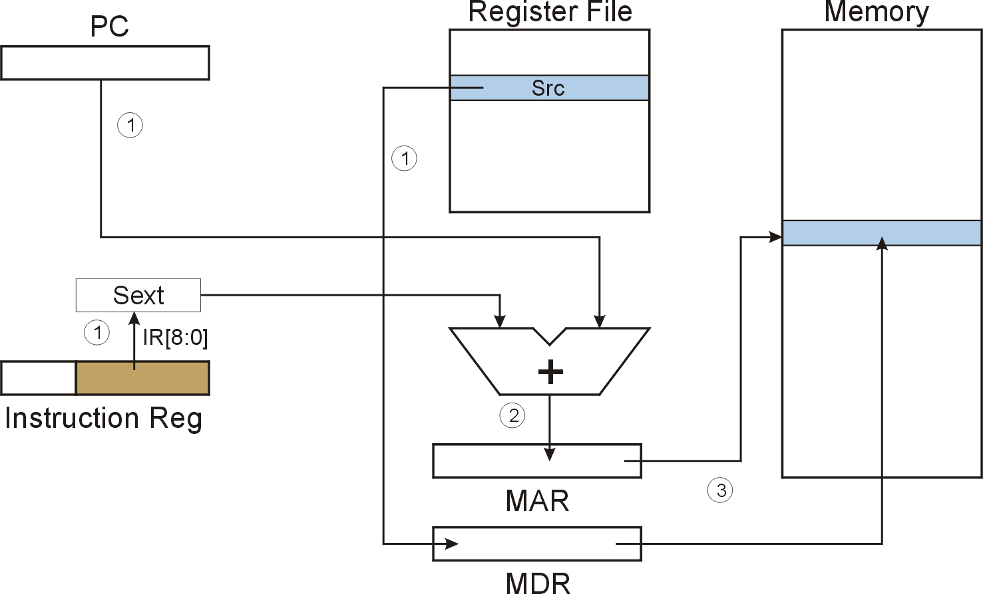
ST (PC-Relative)

Slide 14
Indirect Addressing Mode
With PC-relative mode, can only address data
within 256 words of the instruction.
  What about the rest of memory?
Solution #1:
  Read address from memory location,
  then load/store to that address.
First address is generated from PC and IR
(just like PC-relative addressing), then
content of that address is used as target for load/store.

Slide 15
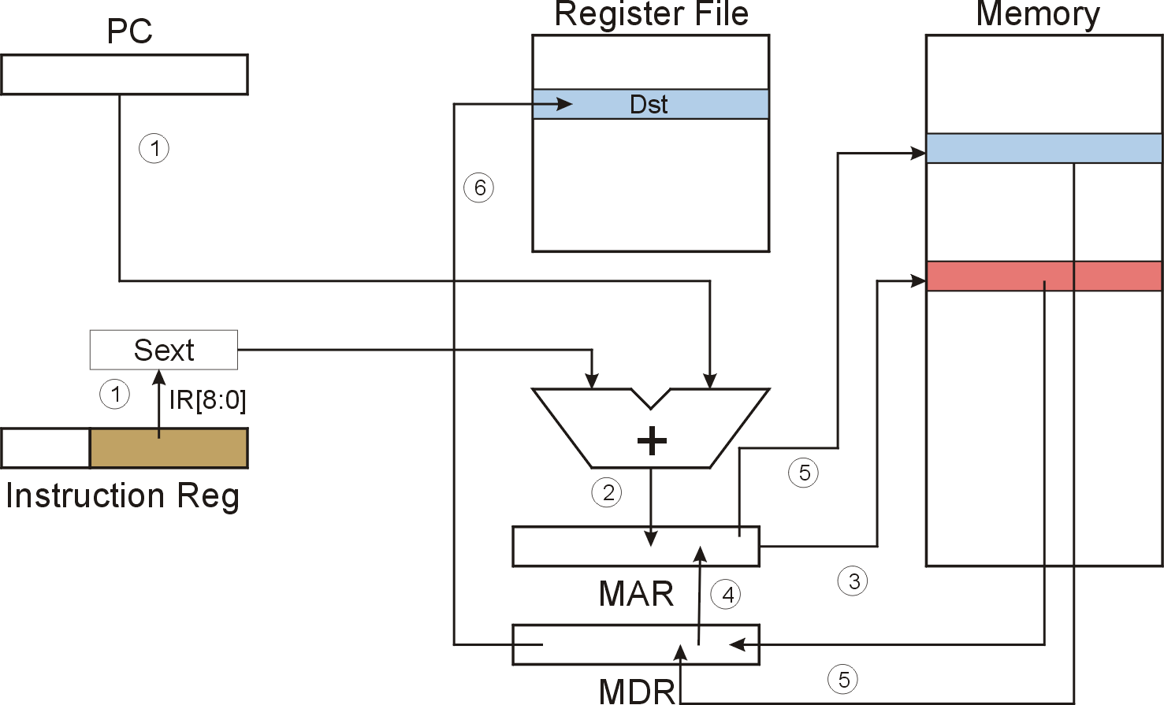
LDI (Indirect)

Slide 16
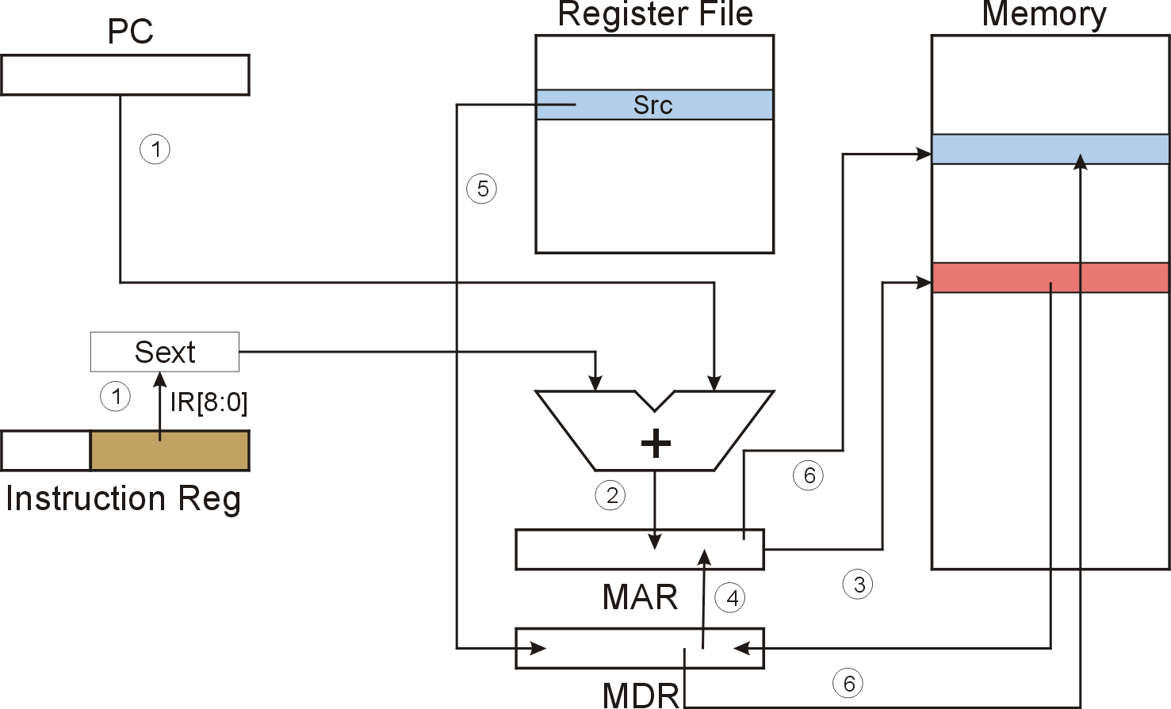
STI (Indirect)

Slide 17
Base + Offset Addressing Mode
With PC-relative mode, can only address data
within 256 words of the instruction.
  What about the rest of memory?
Solution #2:
  Use a register to generate a full 16-bit address.
4 bits for opcode, 3 for src/dest register,
3 bits for base register -- remaining 6 bits are used
as a signed offset.
  Offset is sign-extended before adding to base register.

Slide 18
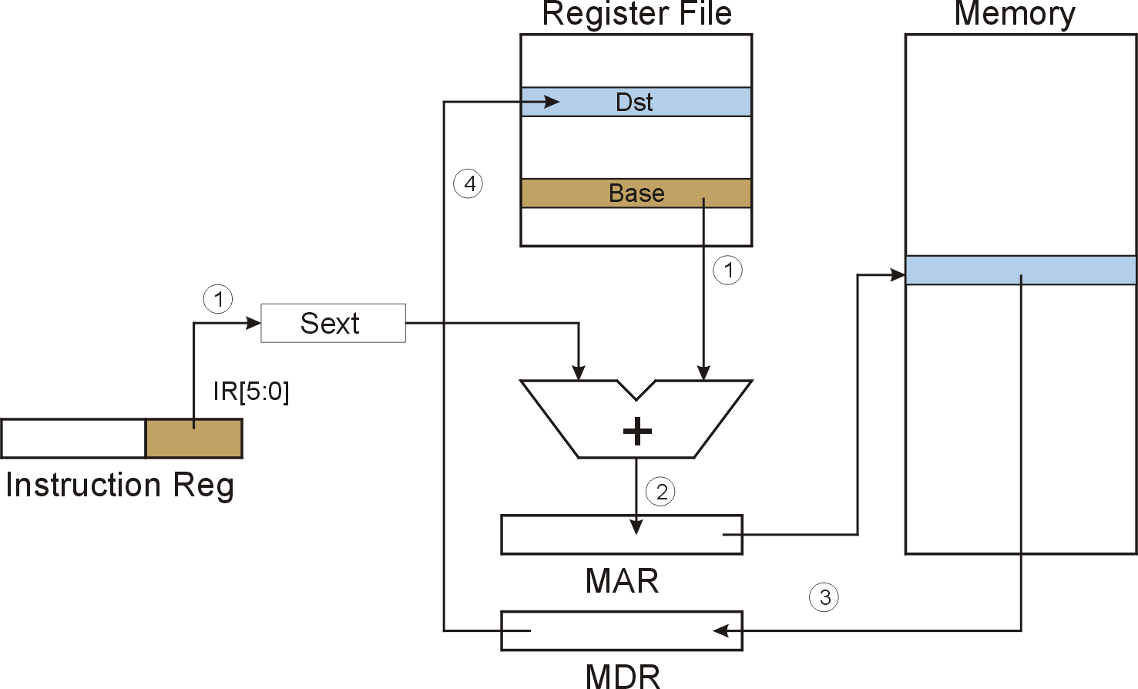
LDR (Base+Offset)

Slide 19

STR (Base+Offset)

Slide 20
Load Effective Address
Computes address like PC-relative (PC plus signed offset) and stores the result into a register.
Note: The address is stored in the register,
not the contents of the memory location.

Slide 21
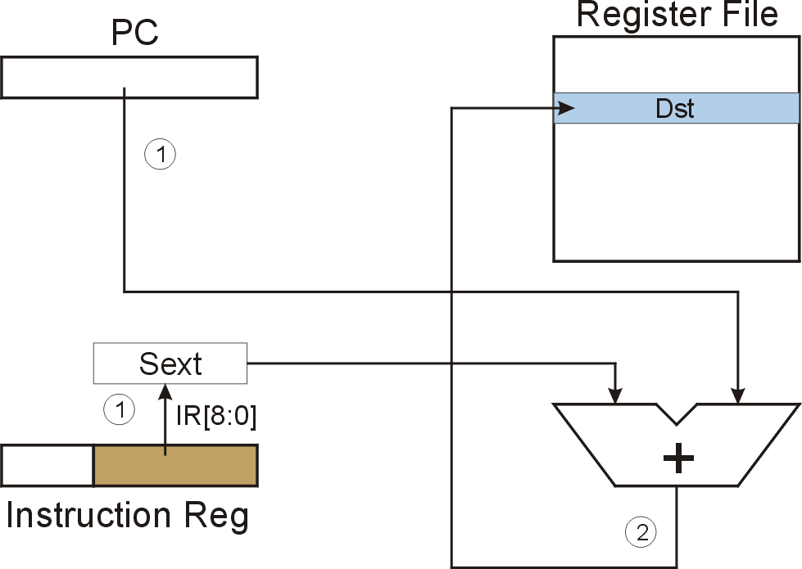
LEA (Immediate)

Slide 22
Example
Address | Instruction | Comments
x30F6 | 1 1 1 0 0 0 1 1 1 1 1 1 1 1 0 1 | R1 ← PC – 3 = x30F4
x30F7 | 0 0 0 1 0 1 0 0 0 1 1 0 1 1 1 0 | R2 ← R1 + 14 = x3102
x30F8 | 0 0 1 1 0 1 0 1 1 1 1 1 1 0 1 1 | M[PC - 5] ← R2 M[x30F4] ← x3102
x30F9 | 0 1 0 1 0 1 0 0 1 0 1 0 0 0 0 0 | R2 ← 0
x30FA | 0 0 0 1 0 1 0 0 1 0 1 0 0 1 0 1 | R2 ← R2 + 5 = 5
x30FB | 0 1 1 1 0 1 0 0 0 1 0 0 1 1 1 0 | M[R1+14] ← R2 M[x3102] ← 5
x30FC | 1 0 1 0 0 1 1 1 1 1 1 1 0 1 1 1 | R3 ← M[M[x30F4]] R3 ← M[x3102] R3 ← 5
opcode

Slide 23
Control Instructions
Used to alter the sequence of instructions
(by changing the Program Counter)
Conditional Branch
  branch is taken if a specified condition is true
    signed offset is added to PC to yield new PC
  else, the branch is not taken
    PC is not changed, points to the next sequential instruction
Unconditional Branch (or Jump)
  always changes the PC
TRAP
  changes PC to the address of an OS “service routine”
  routine will return control to the next instruction (after TRAP)

Slide 24
Condition Codes
LC-3 has three condition code registers:
N -- negative
Z -- zero
P -- positive (greater than zero)
Set by any instruction that writes a value to a register
(ADD, AND, NOT, LD, LDR, LDI, LEA)
Exactly one will be set at all times
  Based on the last instruction that altered a register

Slide 25
Branch Instruction
Branch specifies one or more condition codes.
If the set bit is specified, the branch is taken.
  PC-relative addressing:
  target address is made by adding signed offset (IR[8:0])
  to current PC.
  Note: PC has already been incremented by FETCH stage.
  Note: Target must be within 256 words of BR instruction.
If the branch is not taken,
the next sequential instruction is executed.

Slide 26
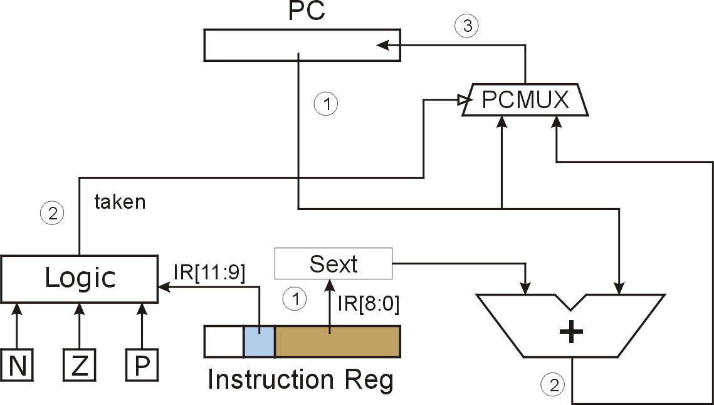
BR (PC-Relative)
What happens if bits [11:9] are all zero? All one?
Notes:
If all zero, no CC is tested, so branch is never taken. (See Appendix B.)
If all one, then all are tested. Since at least one of the CC bits is set to one after each operate/load instruction, then branch is always taken. (Assumes some instruction has set CC before branch instruction, otherwise undefined.)

Slide 27
Using Branch Instructions
Compute sum of 12 integers.
Numbers start at location x3100. Program starts at location x3000.
R1 ← x3100
R3 ← 0
R2 ← 12
R2=0?
R4 ← M[R1]
R3 ← R3+R4
R1 ← R1+1
R2 ← R2-1
NO
YES

Slide 28
Sample Program
Address | Instruction | Comments
x3000 | 1 1 1 0 0 0 1 0 1 1 1 1 1 1 1 1 | R1 ← x3100 (PC+0xFF)
x3001 | 0 1 0 1 0 1 1 0 1 1 1 0 0 0 0 0 | R3 ← 0
x3002 | 0 1 0 1 0 1 0 0 1 0 1 0 0 0 0 0 | R2 ← 0
x3003 | 0 0 0 1 0 1 0 0 1 0 1 0 1 1 0 0 | R2 ← 12
x3004 | 0 0 0 0 0 1 0 0 0 0 0 0 0 1 0 1 | If Z, goto x300A (PC+5)
x3005 | 0 1 1 0 1 0 0 0 0 1 0 0 0 0 0 0 | Load next value to R4
x3006 | 0 0 0 1 0 1 1 0 1 1 0 0 0 0 0 1 | Add to R3
x3007 | 0 0 0 1 0 0 1 0 0 1 1 0 0 0 0 1 | Increment R1 (pointer)
X3008 | 0 0 0 1 0 1 0 0 1 0 1 1 1 1 1 1 | Decrement R2 (counter)
x3009 | 0 0 0 0 1 1 1 1 1 1 1 1 1 0 1 0 | Goto x3004 (PC-6)

Slide 29
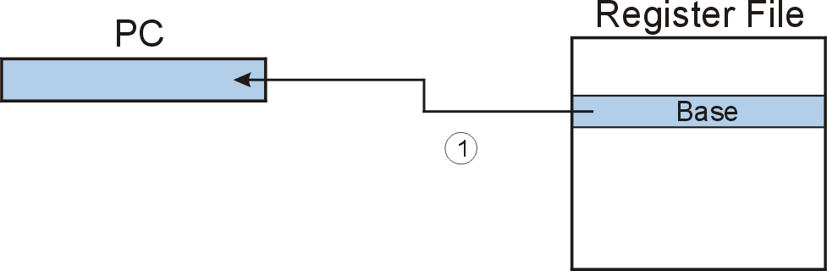
JMP (Register)
Jump is an unconditional branch -- always taken.
  Target address is the contents of a register.
  Allows any target address.

Slide 30
TRAP
Calls a service routine, identified by 8-bit “trap vector.”
When routine is done,
PC is set to the instruction following TRAP.
(We’ll talk about how this works later.)
vector | routine
x23 | input a character from the keyboard
x21 | output a character to the monitor
x25 | halt the program

Slide 31
Another Example
Count the occurrences of a character in a file
  Program begins at location x3000
  Read character from keyboard
  Load each character from a “file”
    File is a sequence of memory locations
    Starting address of file is stored in the memory location
    immediately after the program
  If file character equals input character, increment counter
  End of file is indicated by a special ASCII value: EOT (x04)
  At the end, print the number of characters and halt
  (assume there will be less than 10 occurrences of the character)
A special character used to indicate the end of a sequence
is often called a sentinel.
  Useful when you don’t know ahead of time how many times
  to execute a loop.

Slide 32
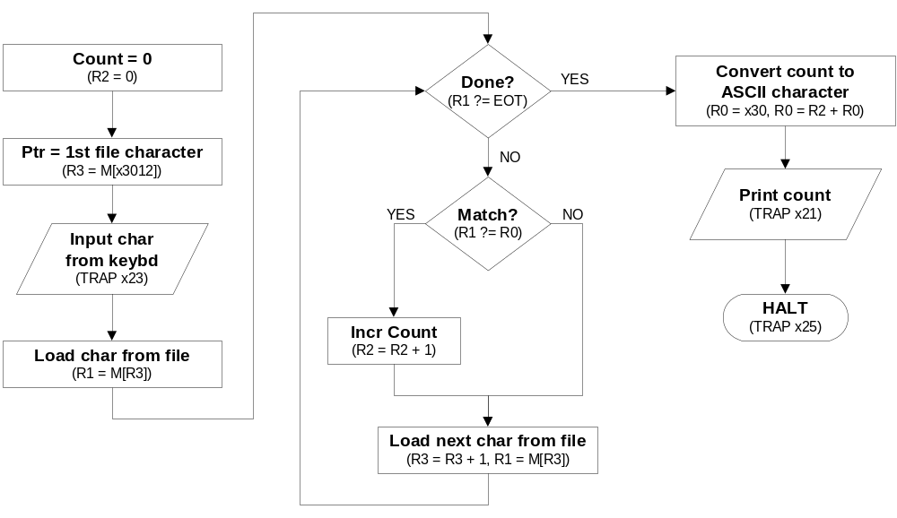
Flow Chart

Slide 33
Program (1 of 2)
Address | Instruction | Comments
x3000 | 0 1 0 1 0 1 0 0 1 0 1 0 0 0 0 0 | R2 ← 0 (counter)
x3001 | 0 0 1 0 0 1 1 0 0 0 0 1 0 0 0 0 | R3 ← M[x3102] (ptr)
x3002 | 1 1 1 1 0 0 0 0 0 0 1 0 0 0 1 1 | Input to R0 (TRAP x23)
x3003 | 0 1 1 0 0 0 1 0 1 1 0 0 0 0 0 0 | R1 ← M[R3]
x3004 | 0 0 0 1 1 0 0 0 0 1 1 1 1 1 0 0 | R4 ← R1 – 4 (EOT)
x3005 | 0 0 0 0 0 1 0 0 0 0 0 0 1 0 0 0 | If Z, goto x300E
x3006 | 1 0 0 1 0 0 1 0 0 1 1 1 1 1 1 1 | R1 ← NOT R1
x3007 | 0 0 0 1 0 0 1 0 0 1 1 0 0 0 0 1 | R1 ← R1 + 1
X3008 | 0 0 0 1 0 0 1 0 0 1 0 0 0 0 0 0 | R1 ← R1 + R0
x3009 | 0 0 0 0 1 0 1 0 0 0 0 0 0 0 0 1 | If N or P, goto x300B

Slide 34
Program (2 of 2)
Address | Instruction | Comments
x300A | 0 0 0 1 0 1 0 0 1 0 1 0 0 0 0 1 | R2 ← R2 + 1
x300B | 0 0 0 1 0 1 1 0 1 1 1 0 0 0 0 1 | R3 ← R3 + 1
x300C | 0 1 1 0 0 0 1 0 1 1 0 0 0 0 0 0 | R1 ← M[R3]
x300D | 0 0 0 0 1 1 1 1 1 1 1 1 0 1 1 0 | Goto x3004
x300E | 0 0 1 0 0 0 0 0 0 0 0 0 0 1 0 0 | R0 ← M[x3013]
x300F | 0 0 0 1 0 0 0 0 0 0 0 0 0 0 1 0 | R0 ← R0 + R2
x3010 | 1 1 1 1 0 0 0 0 0 0 1 0 0 0 0 1 | Print R0 (TRAP x21)
x3011 | 1 1 1 1 0 0 0 0 0 0 1 0 0 1 0 1 | HALT (TRAP x25)
X3012 | Starting Address of File
x3013 | 0 0 0 0 0 0 0 0 0 0 1 1 0 0 0 0 | ASCII x30 (‘0’)

Slide 35
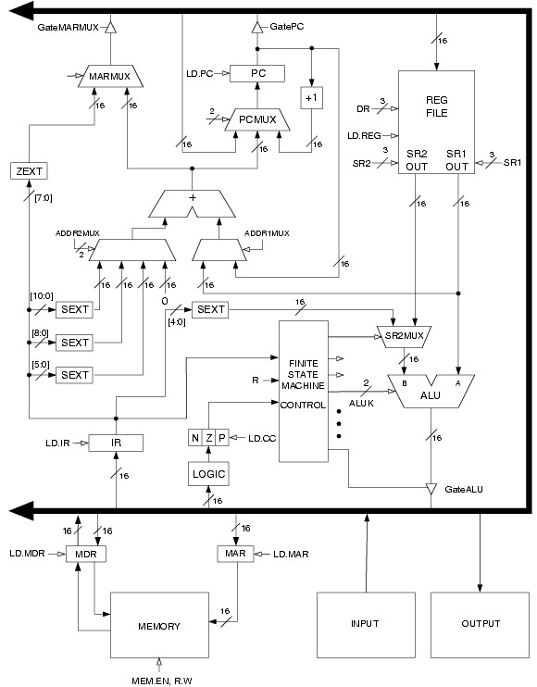
LC-3
Data Path
Revisited
Filled arrow
= info to be processed.
Unfilled arrow
= control signal.

Slide 36
Data Path Components
Global bus
  special set of wires that carry a 16-bit signal
  to many components
  inputs to the bus are “tri-state devices,”
  that only place a signal on the bus when they are enabled
  only one (16-bit) signal should be enabled at any time
    control unit decides which signal “drives” the bus
  any number of components can read the bus
    register only captures bus data if it is write-enabled by the control unit
Memory
  Control and data registers for memory and I/O devices
  memory: MAR, MDR (also control signal for read/write)

Slide 37
Data Path Components
ALU
  Accepts inputs from register file
  and from sign-extended bits from IR (immediate field).
  Output goes to bus.
    used by condition code logic, register file, memory
Register File
  Two read addresses (SR1, SR2), one write address (DR)
  Input from bus
    result of ALU operation or memory read
  Two 16-bit outputs
    used by ALU, PC, memory address
    data for store instructions passes through ALU

Slide 38
Data Path Components
PC and PCMUX
  Three inputs to PC, controlled by PCMUX
    PC+1 – FETCH stage
    Address adder – BR, JMP
    bus – TRAP (discussed later)
MAR and MARMUX
  Two inputs to MAR, controlled by MARMUX
    Address adder – LD/ST, LDR/STR
    Zero-extended IR[7:0] -- TRAP (discussed later)

Slide 39
Data Path Components
Condition Code Logic
  Looks at value on bus and generates N, Z, P signals
  Registers set only when control unit enables them (LD.CC)
    only certain instructions set the codes
    (ADD, AND, NOT, LD, LDI, LDR, LEA)
Control Unit – Finite State Machine
  On each machine cycle, changes control signals for next phase
  of instruction processing
    who drives the bus? (GatePC, GateALU, …)
    which registers are write enabled? (LD.IR, LD.REG, …)
    which operation should ALU perform? (ALUK)
    …
  Logic includes decoder for opcode, etc.

