Slide 1
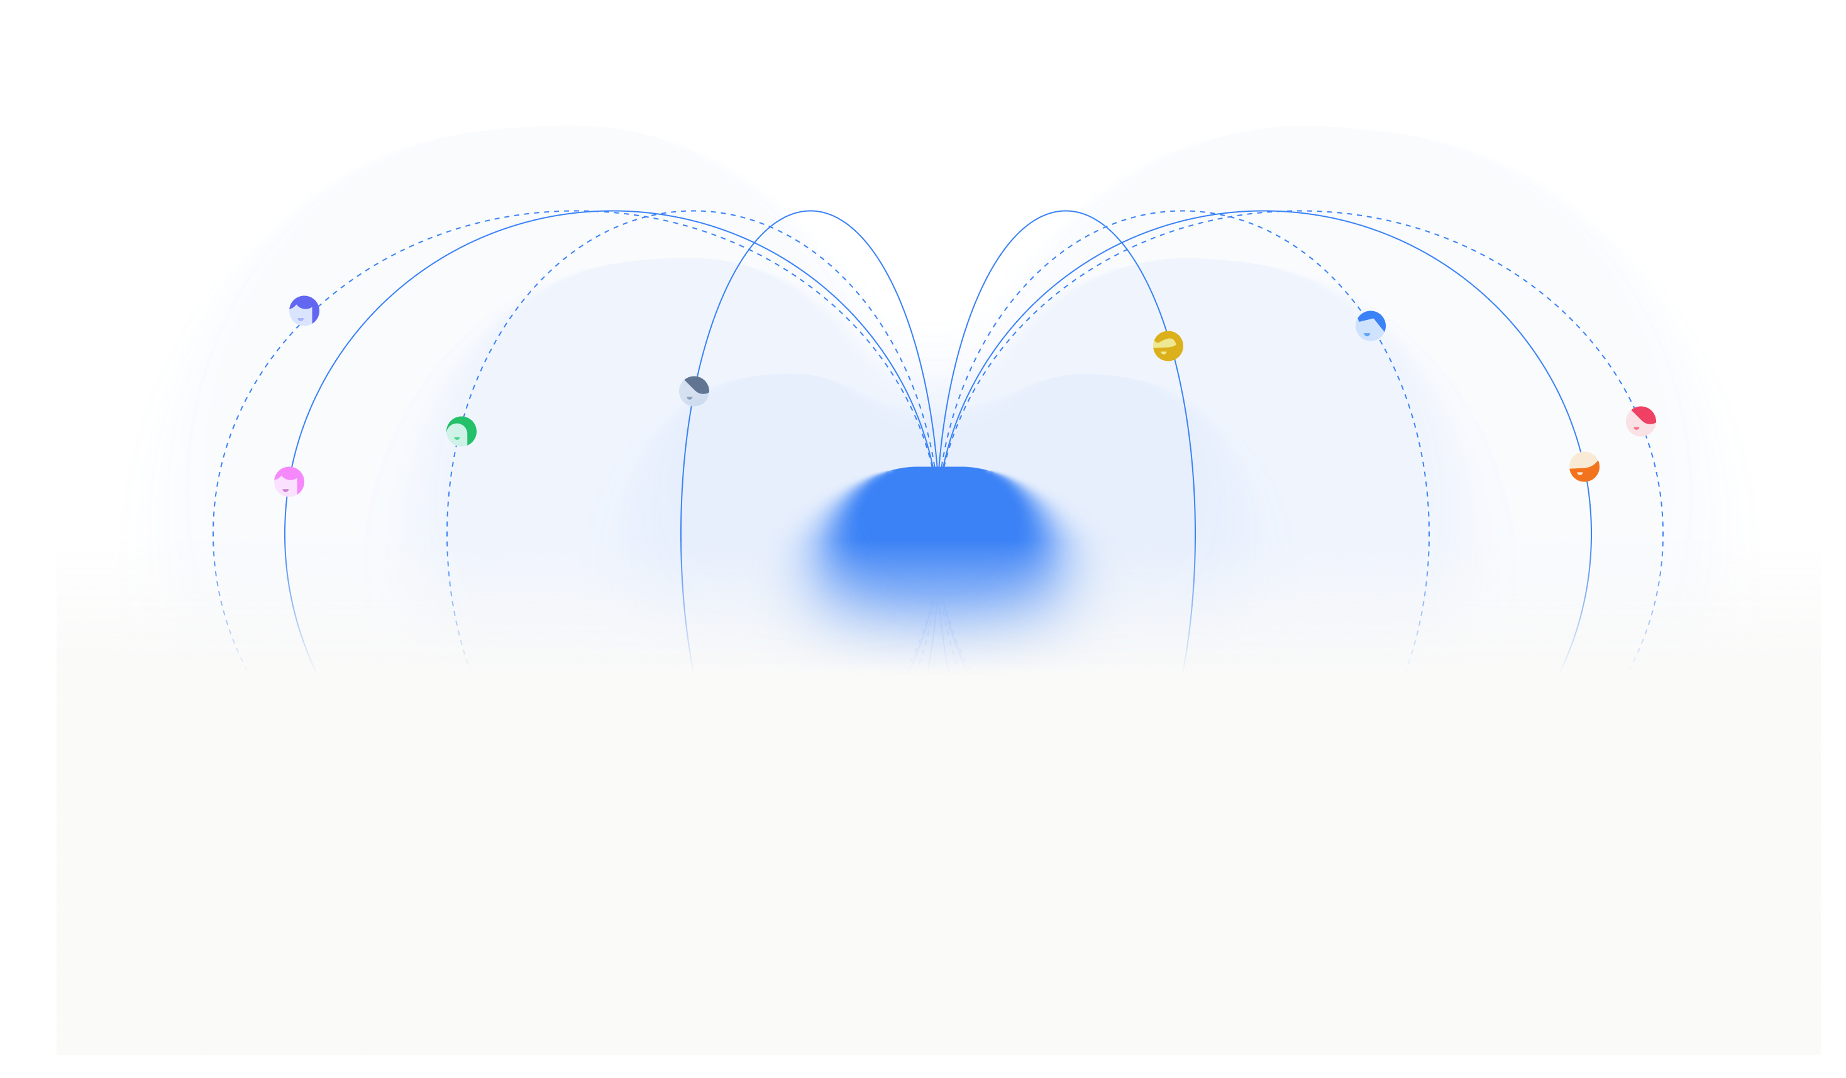
FLYWHEEL
A proactive AI marketing operator for small teams.
Flywheel understands each business, spots growth opportunities, turns them into campaigns, and keeps execution moving.
AI CMO
Content
Social
Growth
Built for SMBs and one-person companies that need marketing motion before they can hire a full team.
mktflywheel.ai
Flywheel go deck v0.2
01

Slide 2
WHO FEELS THE PAIN
Small businesses need full-team marketing before they can hire one.
A solo founder still needs strategy, content, SEO, social, analytics, campaigns, and decisions every week.
Founder owns
Founder owns
Founder owns
Founder owns
CEO
Strategy
Content
Channels
Reporting
CEO / Founder
The bottleneck is judgment
The work is continuous
The hard part is deciding the next move and turning that decision into execution.
Search, GEO, social, content, and reporting keep moving even when there is no dedicated marketing team.
Flywheel go deck v0.2
02

Slide 3
WHY EXISTING OPTIONS BREAK
The founder is still left acting as the CMO.
Current tools cover pieces of marketing. The owner still connects context, chooses priorities, and pushes work forward.
GENERIC AI
MARKETING SAAS
AGENCY
Prompt-level drafting
Workflow layer
External service
Chat tools can write posts and brainstorm ideas. Ownership stays with the founder.
Dashboards, CRMs, and calendars organize activity. The founder still chooses the next move for this business.
Agencies add capacity, with higher cost, slower iteration, and less weekly control for early teams.
Flywheel is built to be the missing marketing operator: business memory + marketing judgment + execution loop.
Flywheel go deck v0.2
03

Slide 4
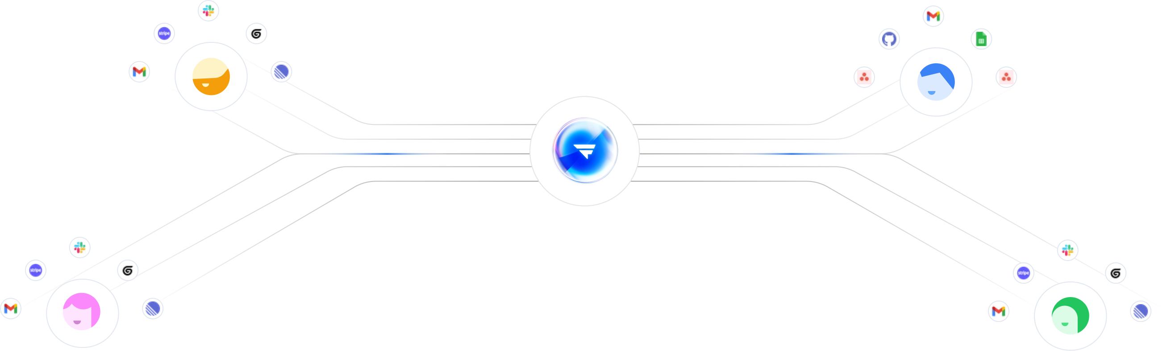
WHAT FLYWHEEL DOES
It turns business context into marketing work.
The CMO makes the call. Specialist agents produce the assets. The founder reviews the moments that matter.
AI CMO
Content Specialist
Social Media Specialist
Owns strategy, prioritization, coordination, and reporting.
Creates and improves SEO / GEO-ready content assets.
Prepares, schedules, publishes, and listens across channels.
A marketing team loop.
Growth Analyst
Tracks market signals, competitors, and growth opportunities.
Flywheel go deck v0.2
04

Slide 5
HOW IT WORKS
From business memory to campaign execution.
The scan is only the entry point. The product is the loop that keeps marketing moving.
SCAN
MEM
OPP
PLAN
WORK
OK
LOOP
Scan
Learn
Plan
Build
Execute
Review
Improve
Company URL
Brand knowledge
Growth strategy
Campaign plan
Specialists
Founder control
Learning loop
Website scan -> Business memory -> Growth opportunity -> Campaign plan -> Specialist execution -> Founder review -> Learning loop
Flywheel go deck v0.2
05

Slide 6
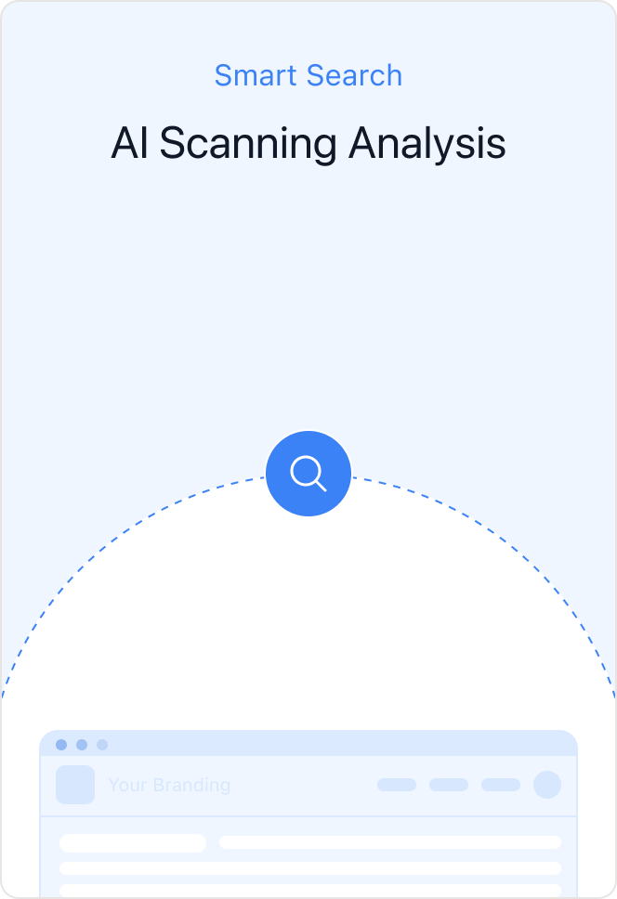
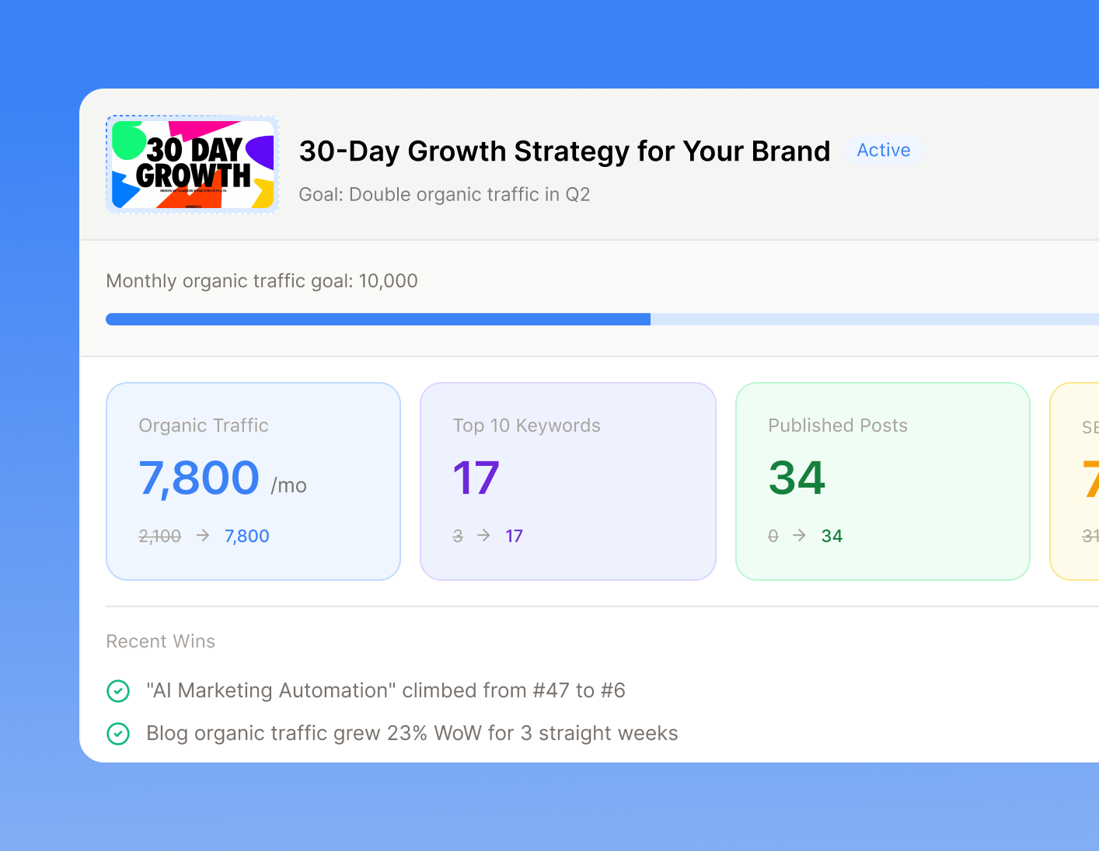
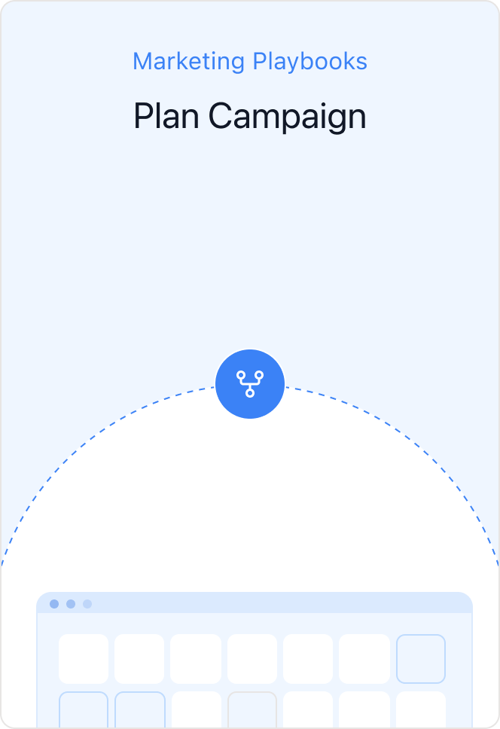
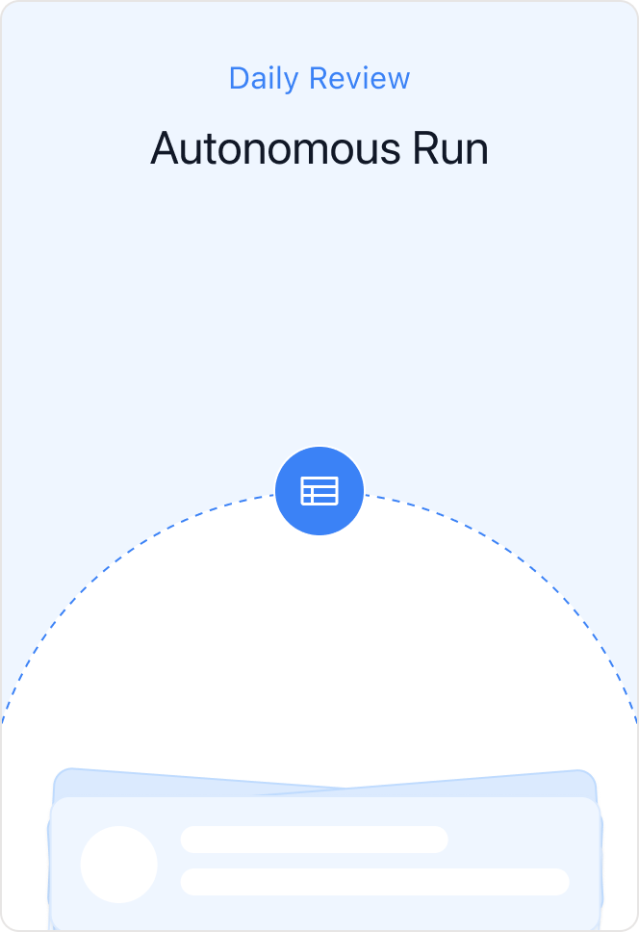
WHAT THE DEMO SHOULD SHOW
The demo starts with a scan and lands on work in motion.
The audience should see Flywheel move from a company URL to CMO judgment and review-ready marketing output.
01
Enter URL
02
Learn business
03
CMO plans
04
Review work
Landing input starts the scan.
Initial brand and market read.
Strategy becomes a campaign.
Founder approves the key outputs.
Viewer takeaway: the URL scan becomes the onboarding moment for an always-on AI marketing team.
Flywheel go deck v0.2
06

Slide 7
EXECUTION AREAS
Built for the marketing work small teams actually need.
Flywheel focuses on the high-leverage channels where founders feel execution pressure every week.
SEO
GEO
Improve search visibility, landing page quality, and content discoverability.
Prepare content for AI search, answer engines, citations, and structured visibility.
Social media
Ad management · upcoming
Prepare, schedule, publish, and listen across key channels with founder review.
Extend the same CMO-led workflow into campaign budget and paid acquisition.
Flywheel go deck v0.2
07

Slide 8
FOUNDER CONTROL
Proactive execution with founder control.
Flywheel moves work forward and asks for review at the moments that matter.
1
2
3
4
CMO proposes direction
Founder confirms plan
Specialists prepare work
CMO reports back
Campaign direction and strategy are recommended before execution.
The founder stays in control of the campaign and high-risk actions.
Content, social posts, and insights are generated as review-ready outputs.
Results and learnings return to the next campaign loop.
Default mode: proactive execution with lightweight founder review.
Flywheel go deck v0.2
08

Slide 9
WHY WE WIN
Vertical know-how plus proactive execution.
Generic AI can draft content. Flywheel is built around the marketing workflow small teams need to run every week.
Business memory
Flywheel operating loop
Learns brand, competitors, market signals, and user preferences.
A repeatable system for deciding, producing, reviewing, and learning.
01
Understand the business
Website, brand context, market signals
Marketing judgment
02
Prioritize the opportunity
CMO chooses the highest-leverage move
The CMO decides what matters and what should happen next.
03
Create review-ready work
Specialists prepare content, social, SEO, insights
04
Review and publish
Founder keeps control at key moments
Execution loop
05
Update the memory
Results feed the next campaign decision
Every campaign and review improves the next recommendation.
Flywheel go deck v0.2
09

Slide 10
WHO IT IS FOR
Founder-led businesses that need marketing motion now.
Flywheel starts with the teams that feel marketing pressure before they can justify hiring a full marketing team.
ONE-PERSON COMPANIES
SMBS
EARLY TEAMS
No marketing hire yet
Need repeatable growth work
Too early for a full team
The founder owns the product, sales, support, and marketing decisions at the same time.
They need steady SEO, GEO, content, social, and campaign execution while keeping tool management low.
They need a marketing operating rhythm before building a dedicated content, social, SEO, and analytics function.
The first wedge: businesses with weekly marketing urgency and limited team capacity.
Flywheel go deck v0.2
10

Slide 11
WHAT WE WANT FROM THE ROOM
A focused live demo and the right follow-up conversations.
The goal: make the new category easy to understand and worth exploring.
DEMO
PARTNERS
INVESTORS
Show the operator loop
Find pilot paths
Earn the second meeting
Start from a company URL, then move quickly to business memory, CMO planning, and one review-ready output.
Look for SMB, founder, and ecosystem partners where Flywheel can prove weekly marketing execution value.
Make the thesis clear: small teams need a marketing operator ahead of more prompt boxes or dashboards.
Desired takeaway: Flywheel can become the always-on marketing team for small businesses.
Flywheel go deck v0.2
11

Slide 12
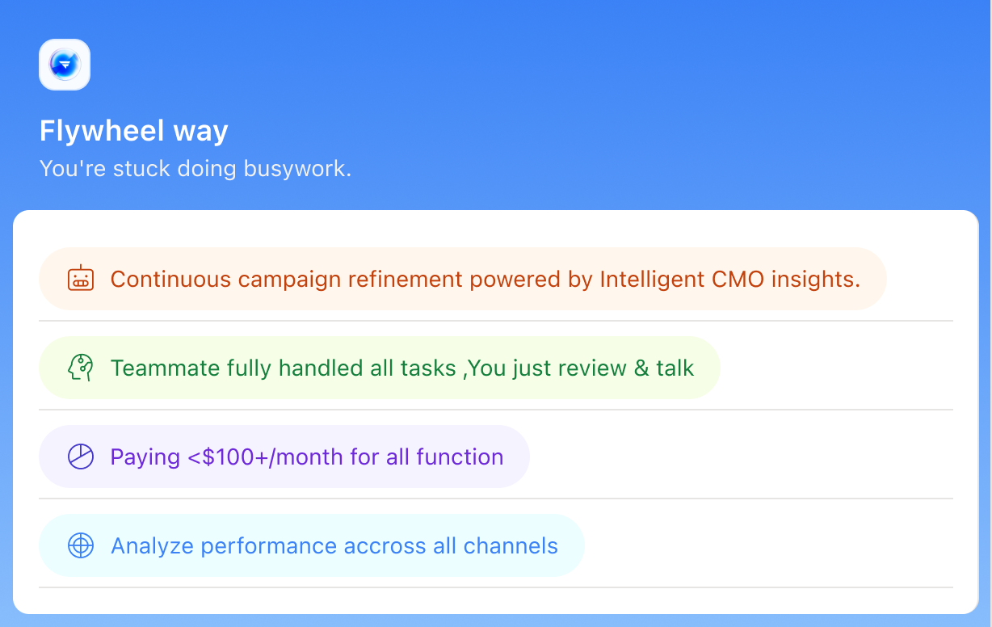
CLOSING
Every small business will need an AI marketing operator.
Flywheel helps founders and small teams keep marketing moving before they hire a full marketing team.
Live demo ready.
Looking for pilot users, strategic partners, and follow-up conversations.
Website: https://mktflywheel.ai
Proactive AI CMO · Vertical marketing know-how · Campaign execution loop
Flywheel go deck v0.2
12

