Slide 1
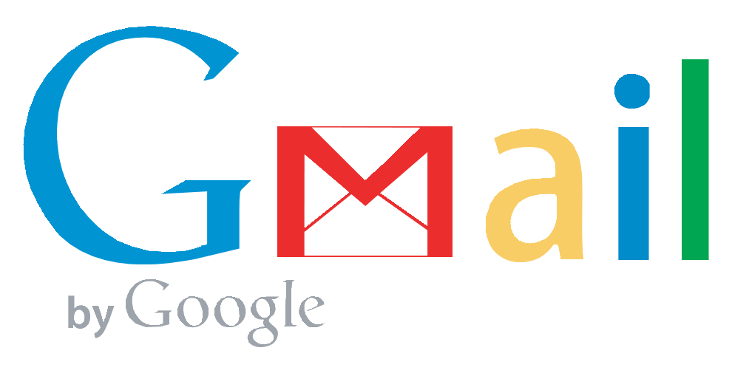



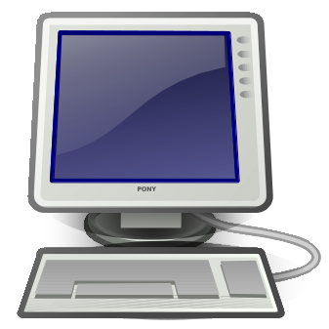
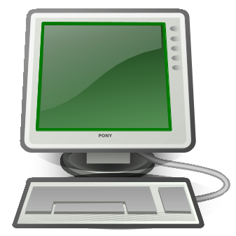
e.g.
e.g.
How email works
1. You write an email on your own computer
2. It is sent to a mail server
3. The mail is possibly sent via several other servers until it reaches its destination

Slide 2
What's in an email?
This is what your email application sees. It translates and formats it for you so it's easier to read.
Where replies should go
Return-Path: <john@gmail.com>
Received: from 127.0.0.1 (EHLO mail-lb0-f169.google.com) (209.85.217.169)
by mta1080.mail.bf1.yahoo.com with SMTP; Tue, 09 Jul 2013 01:09:19 -0700
Received: by mail-lb0-f169.google.com with SMTP id d10so4522578lbj.0
for <jane@yahoo.com>; Tue, 09 Jul 2013 01:09:18 -0700 (PDT)
Received: by 10.112.11.68 with HTTP; Tue, 9 Jul 2013 01:09:18 -0700 (PDT)
Date: Tue, 9 Jul 2013 11:09:18 +0300
Message-ID: <CANHbHq5fQVAXM3BptAhkC+tb9o75ye2Y6V6UgSUyrkaGu8rrvA@mail.gmail.com>
Subject: Lunch
From: John Doe <john@gmail.com>
To: Jane Doe <jane@yahoo.com>
MIME-Version: 1.0
Content-Type: text/plain; charset=UTF-8; format=flowed
Hi,
Let's meet up for lunch!
John
How the mail got here
When the message was sent
Email subject
Who sent the email
Unique ID for the messge
Recipient of email
Tells what type of content the email has
Simple, right?
The actual message

Slide 3
What's in an email?
Return-Path: <potus@whitehouse.gov>
Received: from 127.0.0.1 (EHLO mail-lb0-f169.whitehouse.gov) (72.246.220.110)
by mta1080.mail.bf1.yahoo.com with SMTP; Tue, 09 Jul 2013 01:09:19 -0700
Received: by mail-lb0-f169.whitehouse.gov with SMTP id d10so4522578lbj.0
for <jane@yahoo.com>; Tue, 09 Jul 2013 01:09:18 -0700 (PDT)
Received: by 10.112.11.68 with HTTP; Tue, 9 Jul 2013 01:09:18 -0700 (PDT)
Date: Tue, 9 Jul 2013 11:09:18 +0300
Message-ID: <CANHbHq5fQVAXM3BptAhkC+tb9o75ye2Y6V6UgSUyrkaGu8rrvA@whitehouse.gov>
Subject: Lunch
From: The President <potus@whitehouse.gov>
To: Jane Doe <jane@yahoo.com>
MIME-Version: 1.0
Content-Type: text/plain; charset=UTF-8; format=flowed
Hi,
Let's meet up for lunch!
Barack Obama
Return-Path: <john@gmail.com>
Received: from 127.0.0.1 (EHLO mail-lb0-f169.google.com) (209.85.217.169)
by mta1080.mail.bf1.yahoo.com with SMTP; Tue, 09 Jul 2013 01:09:19 -0700
Received: by mail-lb0-f169.google.com with SMTP id d10so4522578lbj.0
for <jane@yahoo.com>; Tue, 09 Jul 2013 01:09:18 -0700 (PDT)
Received: by 10.112.11.68 with HTTP; Tue, 9 Jul 2013 01:09:18 -0700 (PDT)
Date: Tue, 9 Jul 2013 11:09:18 +0300
Message-ID: <CANHbHq5fQVAXM3BptAhkC+tb9o75ye2Y6V6UgSUyrkaGu8rrvA@mail.gmail.com>
Subject: Lunch
From: John Doe <john@gmail.com>
To: Jane Doe <jane@yahoo.com>
MIME-Version: 1.0
Content-Type: text/plain; charset=UTF-8; format=flowed
Hi,
Let's meet up for lunch!
John
Beware, all of the information can be easily faked!

Slide 4


Eavesdropping
If a connection is unencrypted it is possible for anyone to see the contents of your messages without your knowledge.

Slide 5
Secure connection
By encrypting messages as they are sent from server to server eavesdropping becomes much harder. This is known as TLS/SSL and is also used for secure websites (like your bank).

Slide 6
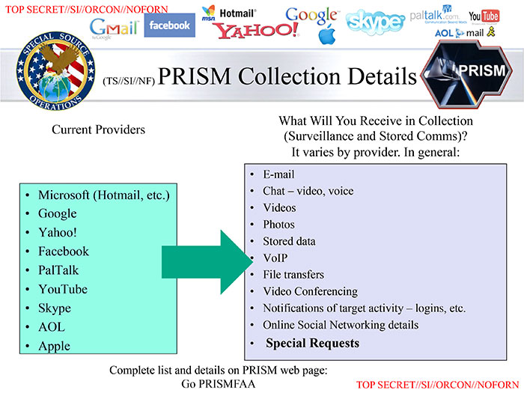
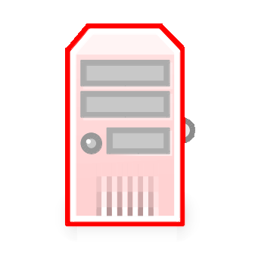






e.g. government agencies can compel server owners to give them access to all messges that pass through
With TLS the message is re-encrypted each time it reaches a server. An organization with sufficient authority can take advantage of this.

Slide 7
Cut out the middle men?
By connecting directly to the recipient the problem with a compromised server can be worked around. But now the recipient has to have her computer on all the time!
Additionally, most internet providers prevent sending mail directly in fear of spam.

Slide 8
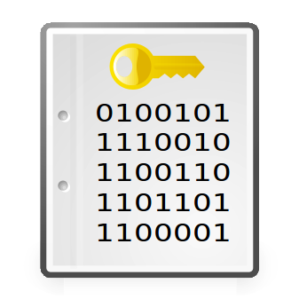
End-to-end encryption
Using a cipher only the recipient can decrypt it becomes practically impossible to intercept your communication.
Pretty Good Privacy (PGP) is an example of such a cipher.

Slide 9
How PGP works
The user generates two ”keys”
(One is actually more like a lock)
Public ”key”
Private key
Anyone can close the lock (encrypt data), but only the owner of the private, secret, key can unlock it (decrypt data)

Slide 10
The public key is sent to a keyserver, from where anyone can get a copy

Slide 11
Only the recipient has the private key needed to decrypt the message. To anyone else the message will appear as gibberish.
The message is encrypted using the public key of the recipient, obtained from the key server

Slide 12
”No one shall be subjected to arbitrary interference with his privacy, family, home or correspondence, nor to attacks upon his honour and reputation. Everyone has the right to the protection of the law against such interference or attacks.”
UN General Assembly, Universal Declaration of Human Rights, 10 December 1948, 217 A (III)

Slide 13
Protecting your (and others') privacy is easy!
PGP is compatible with:
Windows, OS X, Linux, Android, iPhone, ...
Gmail, Yahoo, Mail.app, Thunderbird, ...
See whyencryptemail.net for instructions
To the extent possible under law, the person who associated CC0 with this work has waived all copyright and related or neighboring rights to this work.

