Slide 1
Probabilistic Robot Localization
Kalman Filter · Extended Kalman Filter · Particle Filter
TurtleBot3 Waffle — ROS 2 Jazzy — Gazebo
·
Particle Degeneration Analysis
SPECIAL TASK 2510331009
Rainhard Wipp
M.Sc. Robotics Engineering
FH Technikum Wien
Probabilistic Robotics (PRO)

Slide 2
AGENDA
01
System & Filter Overview
02
Experimental Setup & Landmark Correction
03
Q / R Sensitivity Study
04
Special Task 2510331009 — Particle Degeneration
05
Discussion, Status & Takeaways

Slide 3
Problem Statement
Mobile robots must estimate their pose under uncertain motion and noisy sensing
Three classical probabilistic state estimators: KF, EKF, Particle Filter — all implemented on one platform with identical inputs
Special Task 2510331009: disable PF resampling and analyze particle degeneration
Platform
Framework
Language
State vector
TurtleBot3 Waffle
ROS 2 Jazzy · Nav2 · Gazebo
C++ (rclcpp, Eigen3) + Python 3
μ = [x, y, θ]ᵀ (odom frame)
PROLB_R — Special Task 2510331009
Rainhard Wipp · FH Technikum Wien

Slide 4
System Architecture — ROS 2 Nodes
Single ros2 launch starts the full pipeline: Gazebo + Nav2 (0 s) → Filters + RViz + Logger (5 s) → AutoNav (10 s)
Node
Executable
Subscribes
Publishes
Kalman Filter
kf_node
/cmd_vel, /odom, /scan
/pose_kf
Extended KF
ekf_node
/cmd_vel, /odom, /scan
/pose_ekf
Particle Filter
pf_node
/cmd_vel, /odom, /scan
/pose_pf, /pf_particles, /n_eff
Data Logger
data_logger
/odom, /pose_kf, /pose_ekf, /pose_pf, /n_eff
CSV file
AutoNav
auto_nav
—
/initialpose, Nav2 goals
State vector (all filters): μ = [x, y, θ]ᵀ — reference frame: odom
Launch args: pf:=true resampling:=false sigma_process:=.. sigma_meas:=..
PROLB_R — Special Task 2510331009
Rainhard Wipp · FH Technikum Wien

Slide 5
Filters at a Glance
Kalman Filter
Extended KF
Particle Filter
Belief
Gaussian (μ, Σ)
Gaussian (μ, Σ)
N = 500 weighted particles
Prediction
Linearized B matrix cos/sin of θ — accepted approx.
Exact nonlinear g(u, μ) + Jacobian G — no linearization error
Sample x_t^m ~ p(x_t | u_t, x_{t-1}^m) Gaussian noise on v, ω
Correction
C = I₃ vs /odom + linearized landmark Jacobian
H = I₃ vs /odom + landmark Jacobian Hⱼ
Importance weights w p(z | x^m); odom + landmark
Reference
Thrun Table 3.1
Thrun Table 3.3 / 7.2
Thrun Table 4.3 / 4.4
All three filters share the same landmark-based correction → differences come purely from prediction & belief representation
PROLB_R — Special Task 2510331009
Rainhard Wipp · FH Technikum Wien

Slide 6
Shared Landmark-Based Correction
One shared landmark map (landmark_map.hpp) for all three filters — identical correction input, fair comparison
Measurement model
h(μ, mⱼ) = ‖mⱼ − [x, y]‖
Range-only measurement model — expected bearing from pose estimate indexes into /scan for measured range
Gating: |r_meas − r_exp| ≤ 0.30 m accepted as valid; σ_r = 0.12 m
Gate & noise
Two-stage correction: (1) full-state update vs /odom, then (2) sequential 1D range update per visible landmark
LM_GATE_M = 0.30 m LM_SIGMA_R = 0.12 m
PROLB_R — Special Task 2510331009
Rainhard Wipp · FH Technikum Wien

Slide 7
Experimental Setup
Spawn pose: (−1.96, −0.5, 0°) in map frame = odom origin
WAYPOINTS
AutoNav drives a fixed 8-waypoint loop across 4 unique positions — ~3.6 m diameter
WP1/6 N ( 0.0, 1.8)
WP2/5/8 W (−1.8, 0.0)
Ground truth proxy: /odom (Gazebo) — same caveat applies equally to all filters
WP3/7 S ( 0.0, −1.8)
WP4 E ( 1.8, 0.0)
Identical route, timing, and sensor stream fed to KF, EKF, and PF on every run
DEFAULT PARAMETERS
σ_process
0.01
σ_meas
0.10
num_particles
500
PROLB_R — Special Task 2510331009
Rainhard Wipp · FH Technikum Wien

Slide 8
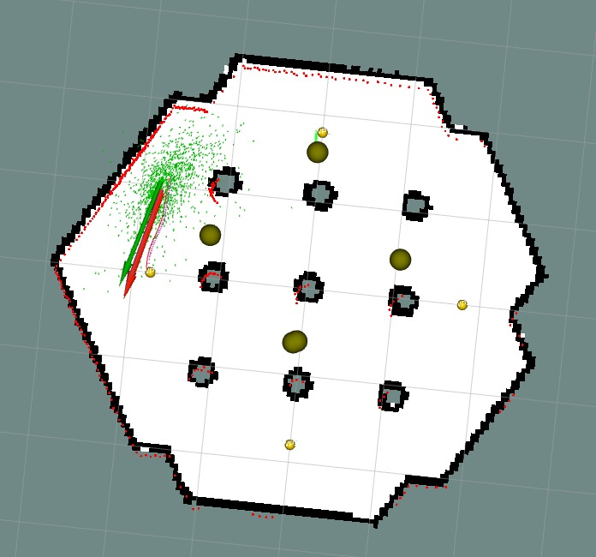
RViz2 Visualization
Particle cloud — PF belief distribution
Laser scan returns
Landmark markers (yellow spheres)
Pose estimate arrow + costmap boundary
Captured during exploratory run — included to satisfy the RViz2 visualization requirement
PROLB_R — Special Task 2510331009
Rainhard Wipp · FH Technikum Wien

Slide 9
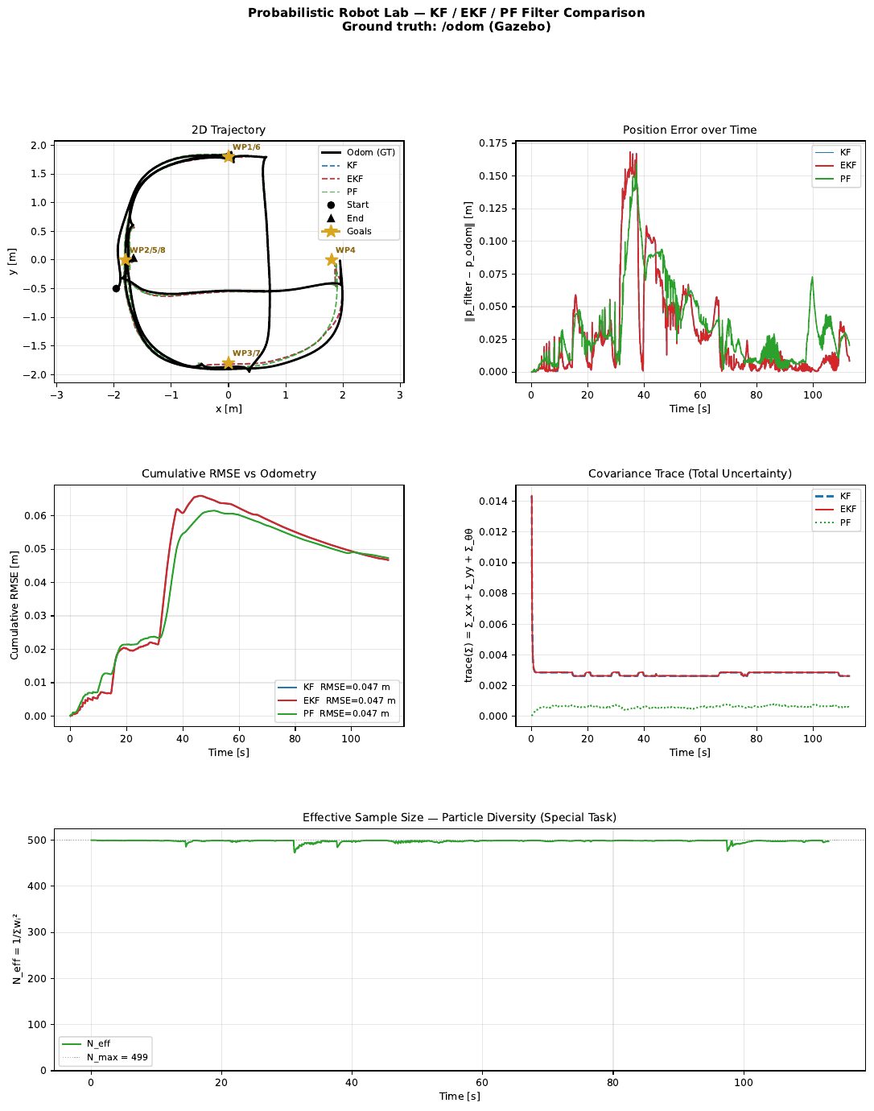
Baseline Filter Comparison (Resampling ON)
RMSE vs /odom
KF = 0.047 m
EKF = 0.047 m
PF = 0.047 m
All three trajectories closely overlap with /odom ground truth across the full 8-waypoint loop
PF covariance trace visibly lower — particle-based estimate tends to underestimate once particles cluster
N_eff/N ≈ 1.0 throughout — healthy particle diversity maintained
PROLB_R — Special Task 2510331009
Rainhard Wipp · FH Technikum Wien

Slide 10
Q / R Sensitivity Study
Vary process noise (Q, model confidence) and measurement noise (R, sensor trust) independently
5 runs total: Baseline + low/high σ_process + low/high σ_meas — same route and landmark map throughout
Run
σ_process
σ_meas
Baseline
0.01
0.10
Low proc. noise
0.001
0.10
High proc. noise
0.10
0.10
Low meas. noise
0.01
0.01
High meas. noise
0.01
0.50
PROLB_R — Special Task 2510331009
Rainhard Wipp · FH Technikum Wien

Slide 11
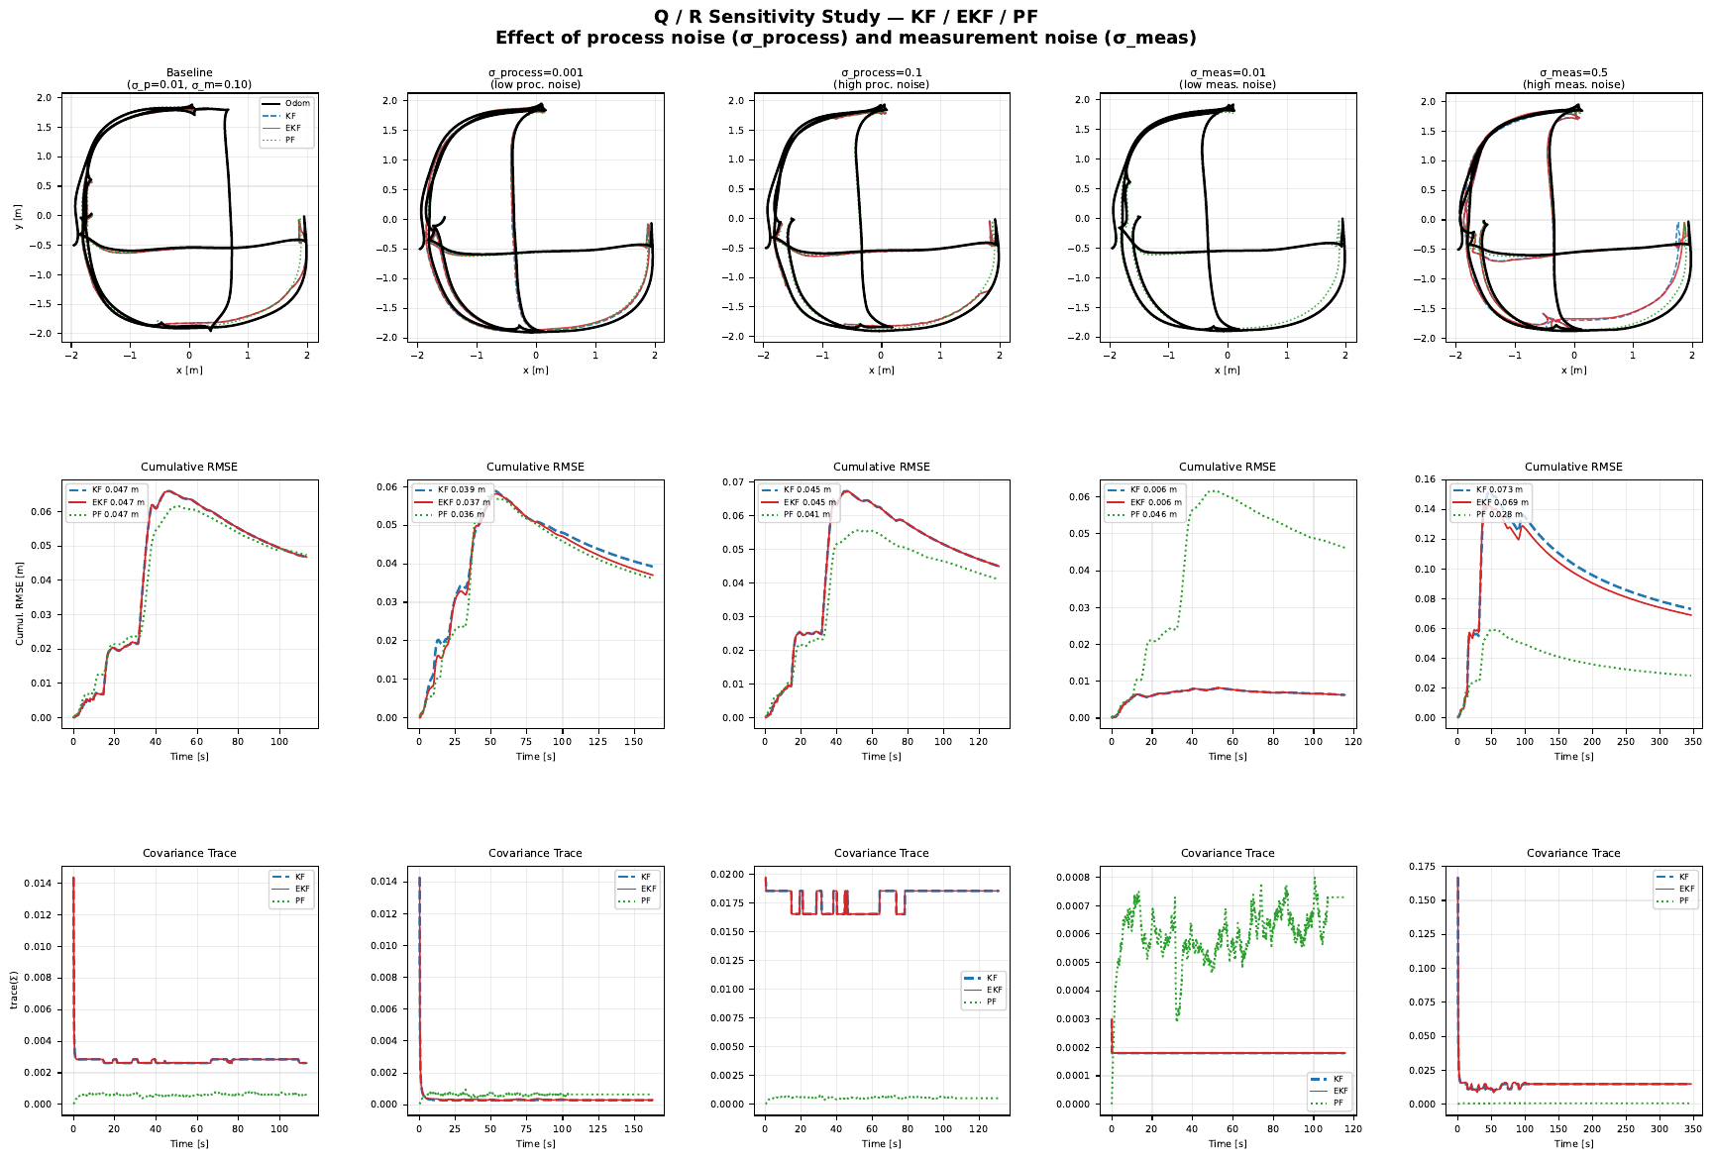
Q / R Results — Trajectories · RMSE · Covariance
PROLB_R — Special Task 2510331009
Rainhard Wipp · FH Technikum Wien

Slide 12
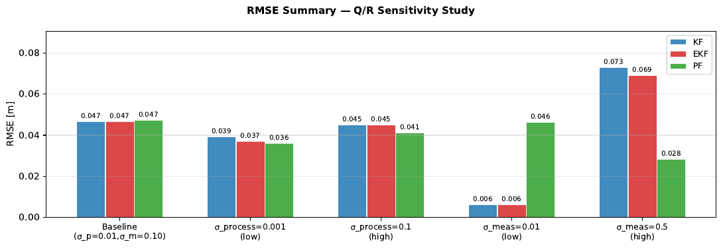
Q / R Sensitivity — Summary
Run
σ_proc
σ_meas
KF
EKF
PF
Baseline
0.01
0.10
0.047
0.047
0.047
Low σ_process
0.001
0.10
0.039
0.037
0.036
High σ_process
0.10
0.10
0.045
0.045
0.041
Low σ_meas
0.01
0.01
0.006
0.006
0.046
High σ_meas
0.01
0.50
0.073
0.069
0.028
σ_meas=0.01: KF/EKF RMSE collapses to 0.006 m — circularity artifact (filter trusts /odom almost unconditionally)
σ_meas=0.5: KF/EKF rise to ~0.07 m; PF stays at 0.028 m — non-parametric PF is more robust to high measurement uncertainty
PROLB_R — Special Task 2510331009
Rainhard Wipp · FH Technikum Wien

Slide 13
SPECIAL TASK 2510331009
Disabling PF Resampling & Analyzing Particle Degeneration
What happens to particle diversity and filter robustness when low-weight particles are never replaced?

Slide 14
Special Task: Definition
Task 2510331009: "Run the PF with reduced or no resampling" — implemented as a full on/off toggle via ROS 2 parameter ( resampling:=false)
Research question
"What happens to particle diversity and filter robustness when low-weight particles are never replaced?"
Resampling is the textbook mechanism that prevents the degeneracy problem in Sequential Importance Sampling (SIR) filters
Without it, all probability mass is expected to concentrate on a single particle — weight collapse
PROLB_R — Special Task 2510331009
Rainhard Wipp · FH Technikum Wien

Slide 15
Systematic Resampling (Thrun Table 4.4)
1
Build the cumulative weight sum over all N particles
# Thrun (2006) Table 4.4
2
Draw a single random offset r ~ U[0, 1/N)
c[1] = w[1]
for i = 2..N:
3
For i = 0..N−1: pick the particle at cumulative position r + i/N
c[i] = c[i-1] + w[i]
r ~ U[0, 1/N)
Result: high-weight particles duplicated; low-weight dropped; all weights reset to 1/N — O(N), low-variance
for i = 1..N:
u = r + (i-1)/N
pick j: c[j] ≥ u
Triggered every correction step when resampling = true
PROLB_R — Special Task 2510331009
Rainhard Wipp · FH Technikum Wien

Slide 16
Particle Degeneration & N_eff
Without resampling, particle weights are only multiplied — never reset → diverge monotonically over time
N_eff = 1 / Σ wᵢ²
Particles with even slightly lower likelihood are exponentially suppressed and never replaced
∈ [1, N]
N_eff computed before the resampling decision → reflects true particle health regardless of whether resampling runs
N_eff → N
Uniform weights (ideal)
N_eff → 1
Single particle dominates (full degeneration)
PROLB_R — Special Task 2510331009
Rainhard Wipp · FH Technikum Wien

Slide 17
Special Task — Experiment Design
Two full runs on the identical 8-waypoint route: Resampling ON (baseline) vs. OFF (Special Task)
Resampling ON (baseline)
./run_experiments.sh --with-resampling
Identical Q/R defaults, landmark map, and N = 500 particles for both runs
/n_eff and /pose_pf logged throughout by data_logger — timestamped CSV per run
Resampling OFF (Special Task)
Compared via plot_n_eff.py : N_eff/N over time + cumulative RMSE, both runs overlaid on the same axes
./run_experiments.sh --without-resampling
PROLB_R — Special Task 2510331009
Rainhard Wipp · FH Technikum Wien

Slide 18
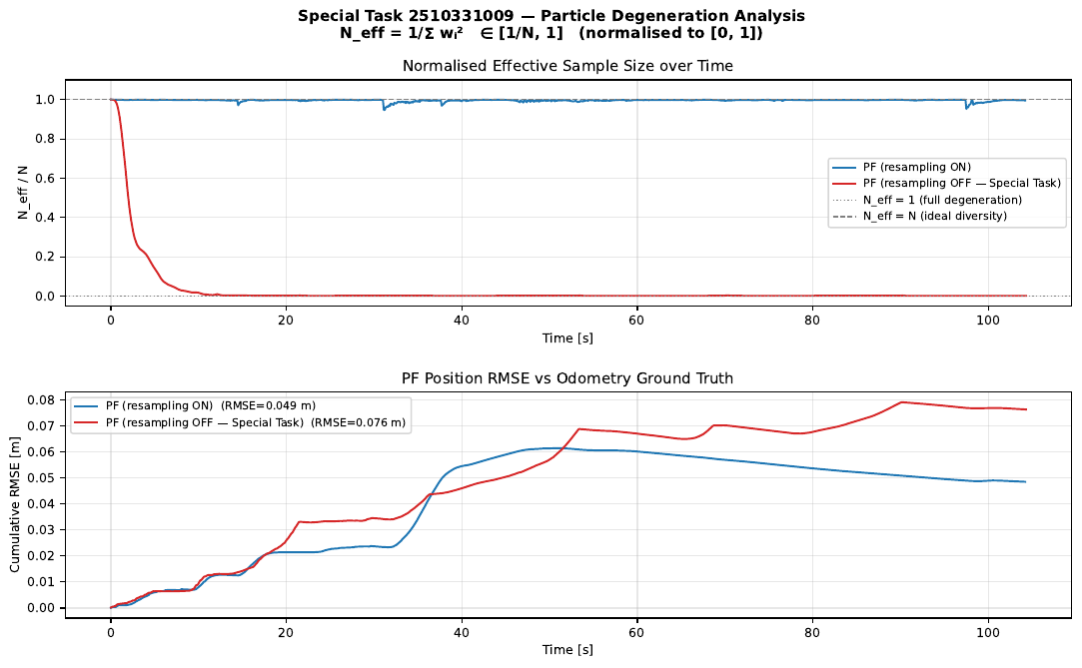
Results — N_eff Collapse
Resampling ON
N_eff/N ≈ 1.0 throughout the entire ~110 s run, with brief dips at landmark corrections
Resampling OFF
N_eff/N collapses from ≈ 1.0 to ≈ 0.0 within ~20 seconds — numerical zero for the rest of the run
Matches the theoretical prediction: without resampling, degeneration is fast and irreversible
PROLB_R — Special Task 2510331009
Rainhard Wipp · FH Technikum Wien

Slide 19
Results — RMSE & Key Insight
Resampling ON
Resampling OFF
KEY INSIGHT
0.049 m
0.076 m
RMSE is an insufficient diagnostic on its own.
cumulative RMSE
cumulative RMSE (+55%)
N_eff is required to detect degeneration — a collapsed PF still reports a confident-looking pose and covariance.
The single surviving particle keeps integrating odometry — RMSE alone still looks "reasonable" after full degeneration
The filter has lost its uncertainty representation — cannot express ambiguity or recover from drift
PROLB_R — Special Task 2510331009
Rainhard Wipp · FH Technikum Wien

Slide 20
Discussion & Interpretation
Resampling trades short-term particle diversity for long-term robustness — classic bias/variance tradeoff in SIR filters
Without resampling, the PF degrades into a de-facto single-hypothesis filter , losing multi-modality and recovery from ambiguous data association
Practical risk: a degenerated filter still reports a confident-looking pose and covariance — failure goes undetected without explicitly monitoring N_eff
Connects to Thrun (2006), Ch. 4.3: the degeneracy problem is the textbook motivation for resampling in SIR filters
PROLB_R — Special Task 2510331009
Rainhard Wipp · FH Technikum Wien

Slide 21
Limitations
Single run per condition — exact degeneration timing depends on the specific random noise realization
Binary on/off only — no intermediate strategy tested (e.g. threshold-based resampling at N_eff/N < 0.5)
Ground truth is /odom — the same circularity caveat applies as in the Q/R study
Short route (~110 s) — degeneration effects over much longer missions remain untested
Possible extension: threshold-based resampling (resample only when N_eff/N < 0.5) to study an intermediate strategy
PROLB_R — Special Task 2510331009
Rainhard Wipp · FH Technikum Wien

Slide 22
Implementation & Experiment Status
KF
EKF
PF
EXPERIMENTS COMPLETED
Prediction step
✓
✓
✓
✓
Ground truth RMSE vs /odom
✓
Covariance trace visualization
Correction (odom)
✓
✓
✓
Landmark detection (shared map)
✓
Correction (landmarks)
✓
✓
✓
✓
Special Task: N_eff with vs. without resampling
Full 3×3 covariance
✓
✓
✓
RViz visualization
✓
✓
✓
✓
σ_process variation (4 runs)
✓
σ_meas variation (4 runs)
Timestamp check (stale odom)
✓
✓
—
Tunable Q/R
✓
✓
✓
PROLB_R — Special Task 2510331009
Rainhard Wipp · FH Technikum Wien

Slide 23
KEY TAKEAWAYS
KF, EKF, and PF perform near-identically under benign noise on this shared, landmark-augmented setup — differences emerge mainly under high measurement uncertainty, where PF is most robust
Resampling prevents particle degeneration — disabling it causes near-total weight collapse (N_eff/N: 1.0 → ~0.0) within ~20 seconds
RMSE alone does not reveal degeneration — the surviving particle can still track odometry well short-term; N_eff is an essential complementary diagnostic

Slide 24
References
Thrun, S., Burgard, W., Fox, D. (2006). Probabilistic Robotics. MIT Press.
Table 3.1 — Kalman Filter
Table 3.3 / 7.2 — EKF / EKF Localization
Table 4.3 — Particle Filter (MCL)
Table 4.4 — Systematic Resampling
Nav2 Documentation
docs.nav2.org
ROS 2 Jazzy Documentation
docs.ros.org/en/jazzy
Source code
github.com/Raini20/PROLB_R
PROLB_R — Special Task 2510331009
Rainhard Wipp · FH Technikum Wien

Slide 25
Thank You
Questions?
Rainhard Wipp · M.Sc. Robotics Engineering · FH Technikum Wien
github.com/Raini20/PROLB_R

