Slide 1
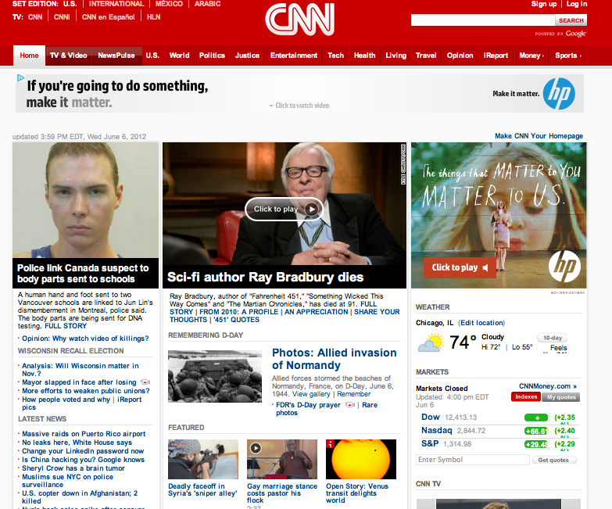

June 6, 2012
Notes:
Alex Since you’re the first person to introduce themselves in slide 2, just briefly introduce the project, e.g. Our project is Refine and we tackled commenting on news websites.

Slide 2

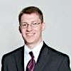
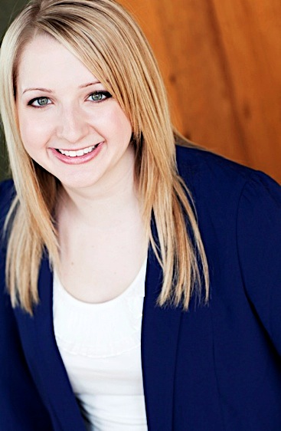
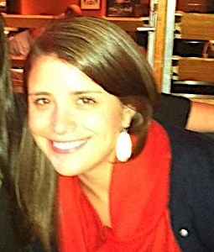
The Refine Team
Alex Madjar (McCormick): Tech Developer: Back End
Josiah Matlack (McCormick): Tech Developer: Front End
Marisa Paulson (Medill): Content Creation, Journalistic Insight, Website
Ali Pisano (Medill): Content Creation, Journalistic Insight, Graphics
Notes:
Everyone introduce themselves in this order.

Slide 3

Why Comments Matter
Online news allows the audience to participate
People expect to have their voice heard and want to engage in dialogue
Participation drives return engagement
Notes:
Ali

Slide 4

Commenting Problems
High volume
Off topic
Profane
Prone to spam and trolls
Difficult to find comments that interest you because they aren’t organized for browsing
Usually has only two sort options: chronological or most popular
Notes:
Ali Highlight last point especially!

Slide 5
Introducing Refine
Refine is tool that categorizes comments visually based on key terms.
Users can find what’s relevant and interesting to them.
Linear lists of comments → topically organized browsing and drill-down
News organizations can offer a more personalized experience
Notes:
Marisa

Slide 6

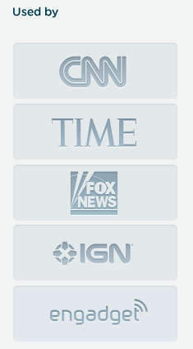
Disqus
Disqus is an online discussion and commenting service for websites.
Has full API for developers
Used by many major publications
Notes:
Marisa

Slide 7
DEMO
refinecomments.herokuapp.com
Notes:
Alex and Josiah: Find around three excellent story examples that show what Refine can reveal about what people are saying that may not be mentioned in the story. Examples are key!

Slide 8
How Refine Works
News URL
Disqus
Article Comments
Term Selection and Ranking
Visualization
Notes:
Josiah

Slide 9

Why Refine Works
Both editorial staff and news consumers benefit:
CNN.com readers discover interesting reactions.
CNN sets itself apart—no other news website is doing this right now.
CNN will not have to dedicate as much manpower, money, and time to monitor.
Notes:
Alex

Slide 10
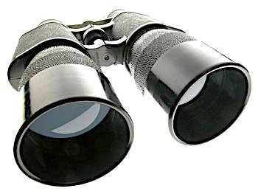
Looking Ahead
Integrate into Disqus Labs
Improve word cloud specs
Show topical relationships
Further drill-down
Notes:
Alex

Slide 11
Thank you.
Alex Madjar (McCormick): madjara13@gmail.com
Josiah Matlack (McCormick): jmatlack@u.northwestern.edu
Marisa Paulson (Medill): marisapaulson@u.northwestern.edu
Ali Pisano (Medill): apisano@u.northwestern.edu
→ Cue questions and feedback.

