Slide 1
Tutorial 2
Lexical Analysis

Slide 2
Q1
Convert the streams following into tokens.
(1) 2*r
(2) While (1) {x=0;}
(3)“This is a test program.”
(4) A[j]+j

Slide 3
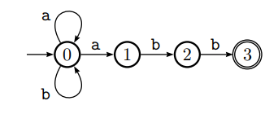
Q2
Is the state conversion diagram following NFA or DFA? Why?

Slide 4
Q3
Given an regular expression as follows:
(1 | 0)*1.
(1) Constrict NFA for the RE.
(2) Convert the NFA to DFA.

Slide 5
Q3
Convert the NFA to a DFA.

