Slide 1
Tutorial 3
Lexical Analysis(Cont)

Slide 2
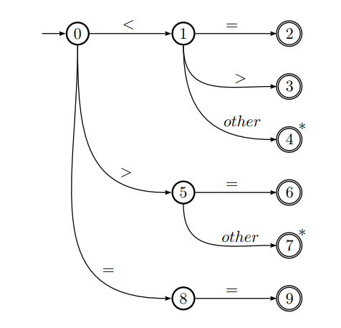
Q1
Consider the following NFA，how does it recognize the string: (1) <=; (2) <>; (3)<; (4) ==; (5) <3; (6)=3;

Slide 3
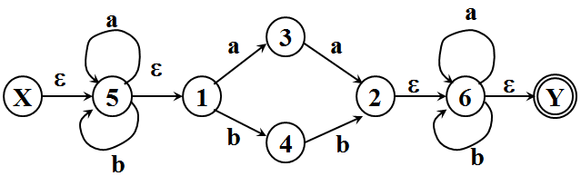
Q2
Convert the following from NFA to DFA.
(1)

Slide 4
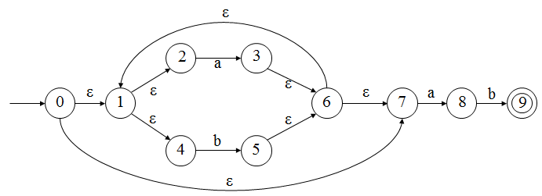
Q2
(2)

