Slide 1
Tutorial 4
Syntax Analysis

Slide 2
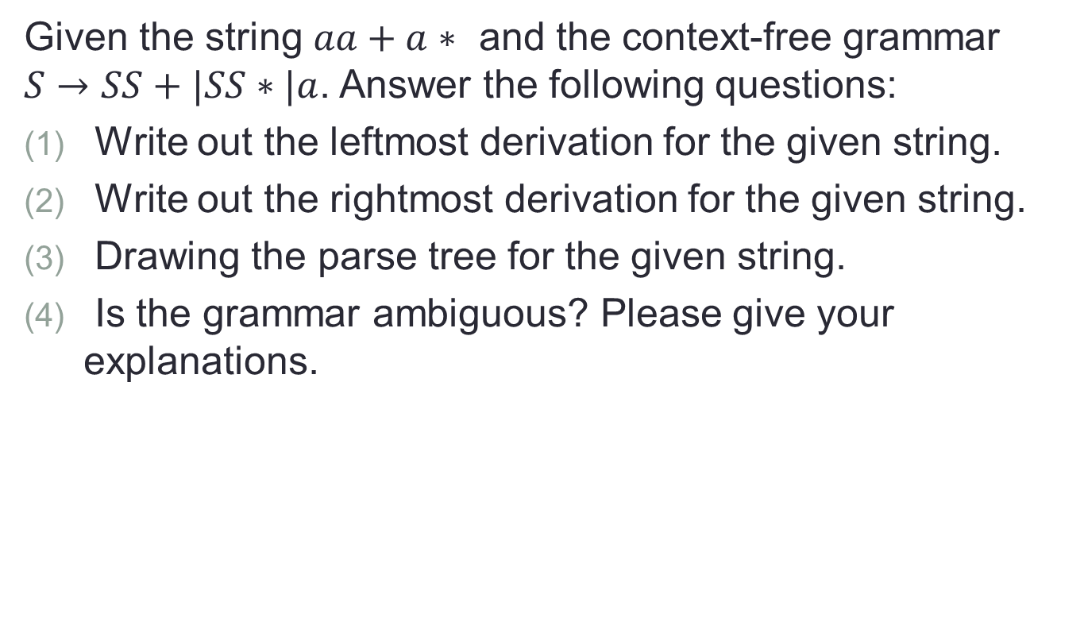
Q1
Given the string $aa+a∗$ and the context-free grammar $S→SS+|SS∗|a$. Answer the following questions:
Write out the leftmost derivation for the given string.
Write out the rightmost derivation for the given string.
Drawing the parse tree for the given string.
Is the grammar ambiguous? Please give your explanations.

Slide 3

Q2
Consider the following grammar $S→aSbS|bSaS|ε$
Build two left-most parsing trees for string $abab$ to show that this is an ambiguous grammar.
Do the right-most derivation for string $abab$.

Slide 4

Q3 (Optional)
Convert the regular expression ${(a|b) }^{∗}abb$ into a context-free grammar.

