Slide 1
Tutorial 5
Syntax Analysis(cont1)

Slide 2

Q1
Given a grammar as follows:
$$S→\left(L\right)\left|aS\right|a$$
$L→L,S|S$
Do left-factoring.
Eliminate the left recursion.

Slide 3
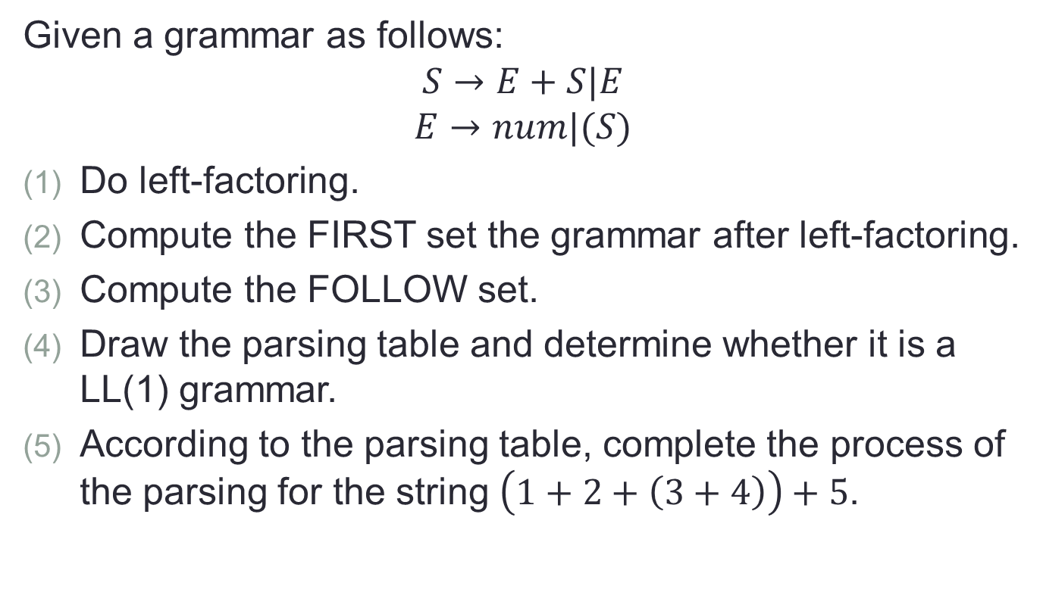
Q2
Given a grammar as follows:
$$S→E+S|E$$
$$E→num|(S)$$
Do left-factoring.
Compute the FIRST set the grammar after left-factoring.
Compute the FOLLOW set.
Draw the parsing table and determine whether it is a LL(1) grammar.
According to the parsing table, complete the process of the parsing for the string $\left(1+2+\left(3+4\right)\right)+5$.

