Slide 1
Tutorial 6
Syntax Analysis(cont2)

Slide 2
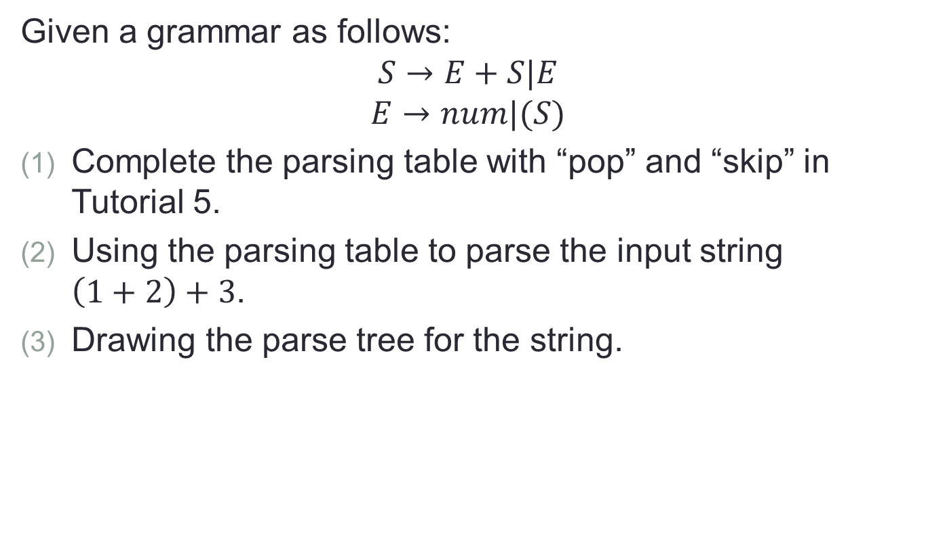
Q1
Given a grammar as follows:
$$S→E+S|E$$
$$E→num|(S)$$
Complete the parsing table with “pop” and “skip” in Tutorial 5.
Using the parsing table to parse the input string $\left(1+2\right)+3$.
Drawing the parse tree for the string.

Slide 3
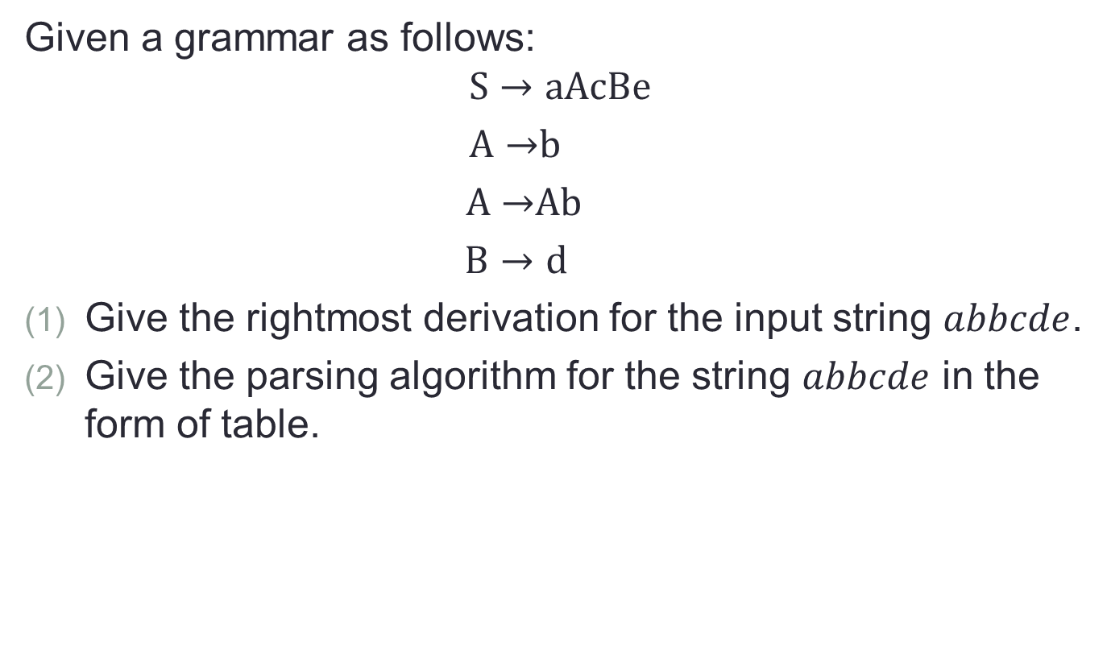
Q2
Given a grammar as follows:
$$S→aAcBe$$
$A→$b
$A→$Ab
$B→d$
Give the rightmost derivation for the input string $abbcde$.
Give the parsing algorithm for the string $abbcde$ in the form of table.

Slide 4
Answering Questions
Understanding Lecture notes: Syntax Analysis (continued) Page 1 to 42.

