Slide 1






Brew Day !
Group: Cerf
Group Member: ZHANG Zhiyi
LUO Zichen
WANG Yuan
LU Guangxing

Slide 2

CONTENT
CONTENT
PART 1 Introduction
PART 2 Software Engineering
PART 3 Software Workshop
PART 4 Q&A

Slide 3
PART 1 Introduction
For our project, we were writing a desktop-based software called “Brew Day!”.
record recipes
keep track of ingredients
etc.

Slide 4
PART 2 Soft Engineering
A. Software Development Process
B. Specification (Requirement analysis)
C. Design
D. Implementation

Slide 5
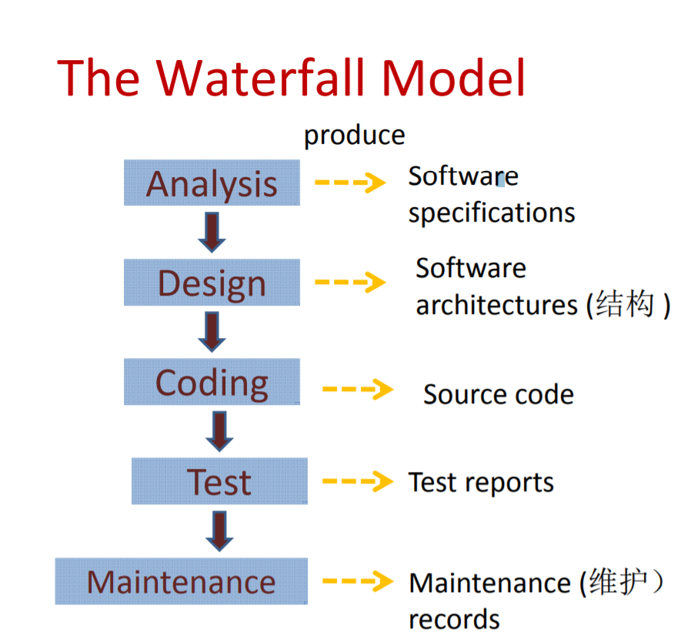
2.A Software Process and Process Model
Process is a set of activities whose goal is the development or evolution of software.
Simplify the problem, separate the implementation of the function from the design, and facilitate the division of labor and cooperation.

Slide 6
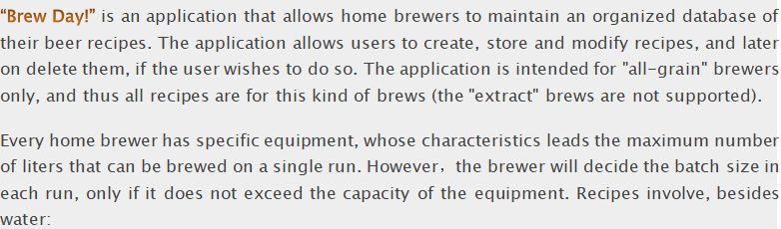
2.B Specification
• Maintain recipes
• Maintain Ingredients
• Maintain equipment

Slide 7
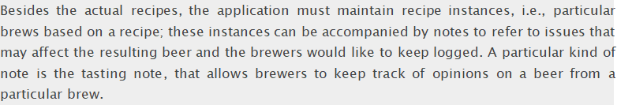
2.B Specification
• Write notes

Slide 8
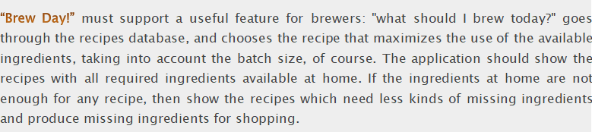
2.B Specification
• Recommend a Recipe
• Shopping List

Slide 9
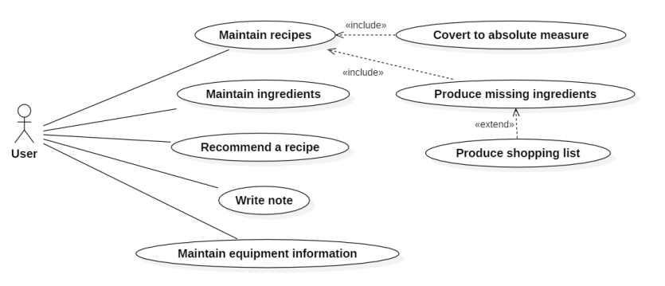
2.C Design
1) Use case design:

Slide 10
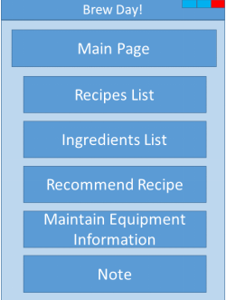
2.C Design
2) User interface design

Slide 11
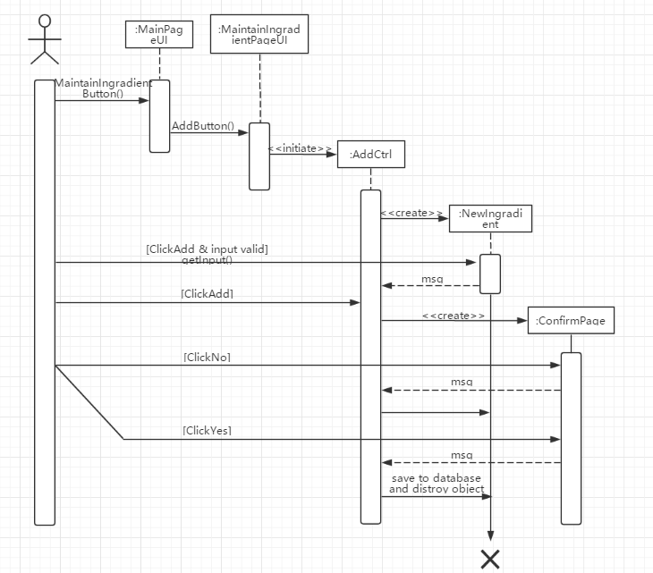
2.C Design
3) Sequence design

Slide 12
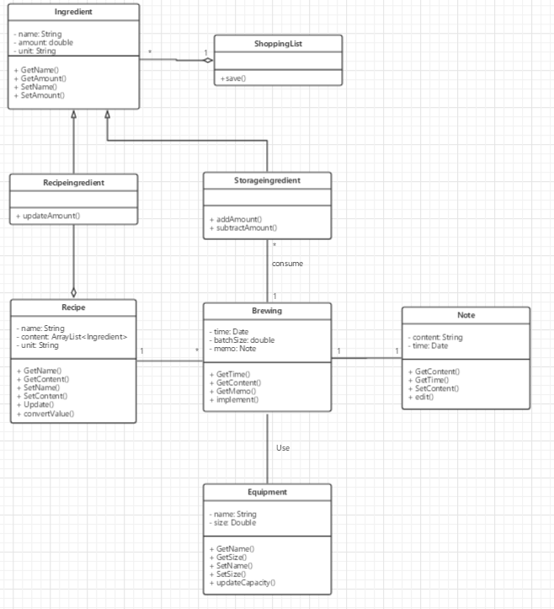
2.C Design
4) Class design

Slide 13
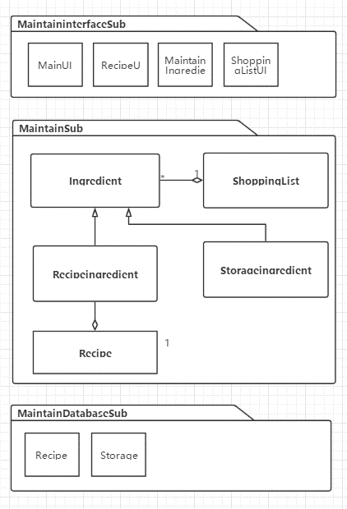
2.C Design
5) Architecture design

Slide 14
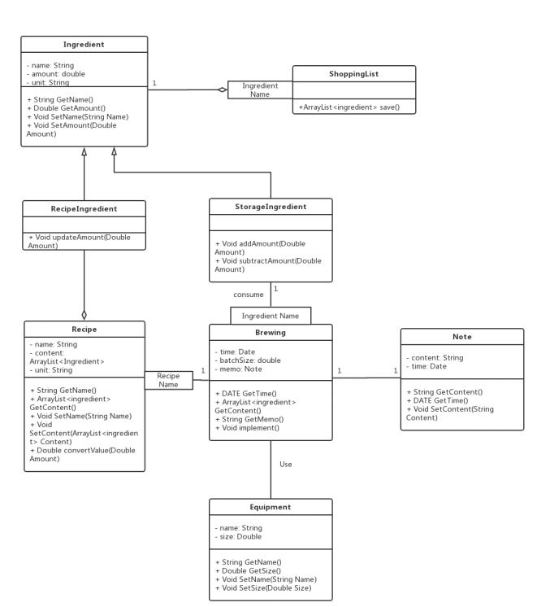
2.C Design
6）Detail design

Slide 15
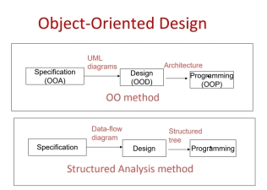
2.D Implementation
1) OOD models

Slide 16
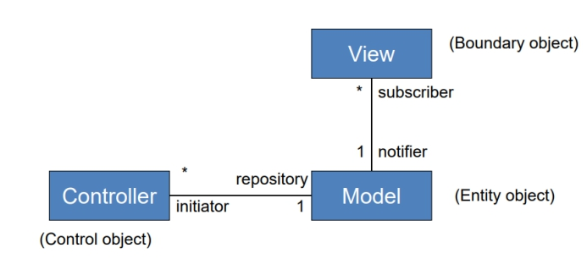
2.D Implementation
2) MVC models

Slide 17
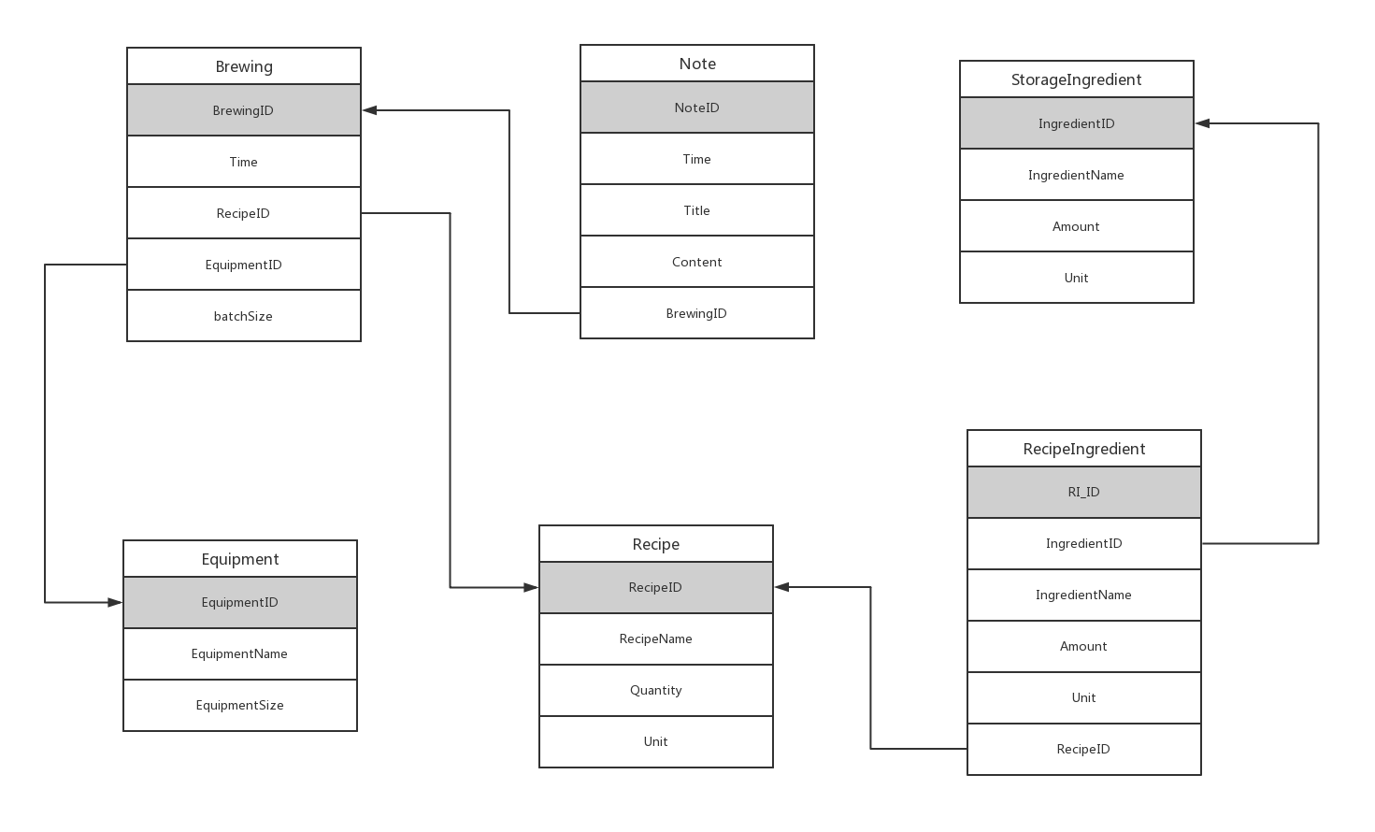
2.D Implementation
3) Repository models

Slide 18
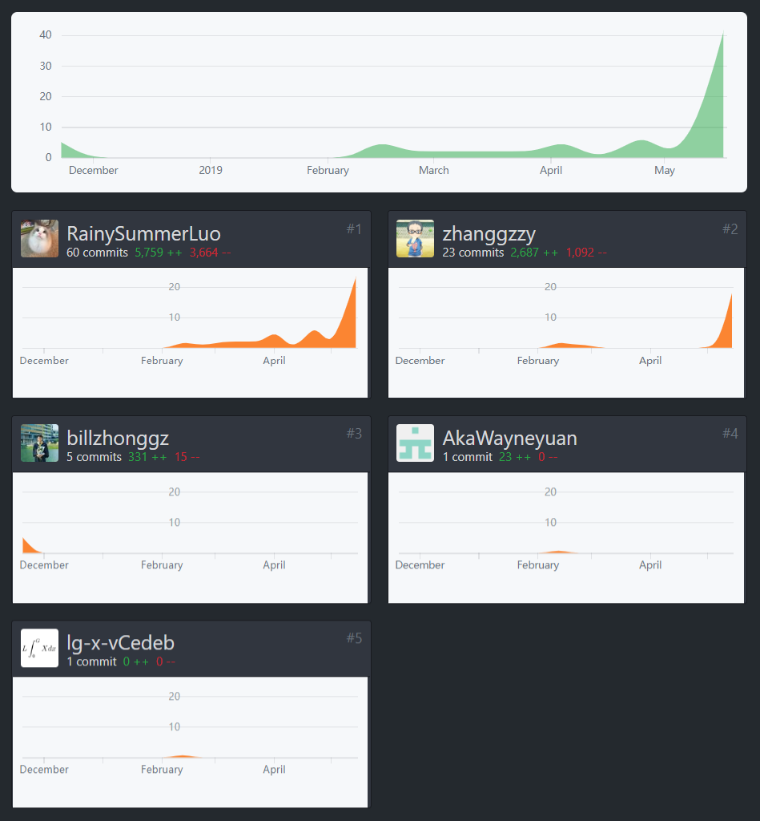
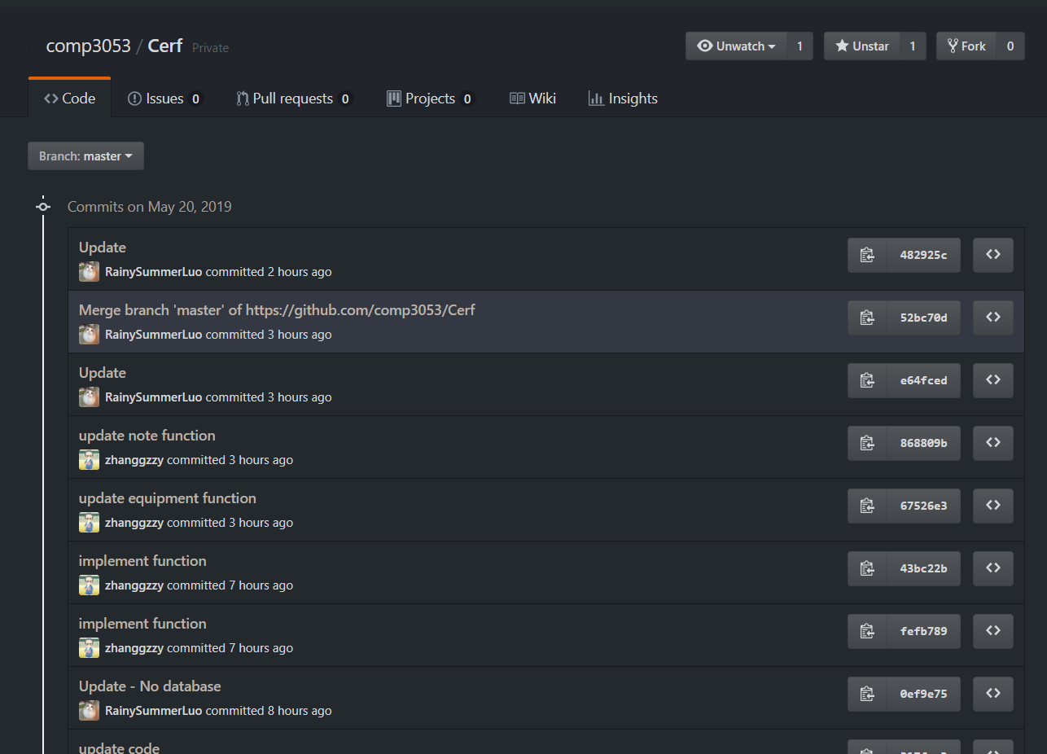
2.D VCS - GitHub

Slide 19
Part 3 Software Workshop
A. Method
B. Feature
C. Product Advantage
D. Demo

Slide 20



3.A Method
Github
Java
SQLite

Slide 21

3.B Feature
1) Maintain recipes
– Add
– Delete
– Update
3) Recommend a recipe
– Convert to absolute measure
– Produce missing ingredients
4) Write note
2) Maintain ingredients
– Add
– Update
5) Maintain equipment information
– Add
– Update

Slide 22
3.C Product Advantage
Cross-Platform
Running Speed
Graphic User Interface
Local database
No need for Internet Connection

Slide 23
3.D Demo

Slide 24
Part 4 Q&A

Slide 25
Thank you!

