Slide 1
Cube SDK
Building an Application for the MS Cube

Slide 2
Stimulant (why are we here?)
We specialize in building interactive installations
Worked with MS on the Surface
Have developed many Kinect 1.0 applications
Created the first app for the Cube (dBcube)

Slide 3
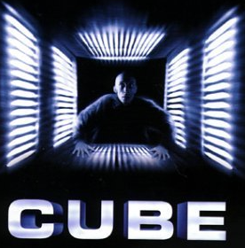
A little about the Cube

Slide 4
The CUBE
5 Intel NUC PCs
4 Kinect V2.0
5 Benq Projectors (1024x768 clipped to 768x768)
4 Acrylic rear projection screens (each 4’x4’)

Slide 5
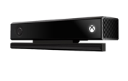
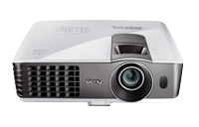
Cube Sensor and Projector Layout (top of Cube not included)
Video
Kinect

Slide 6
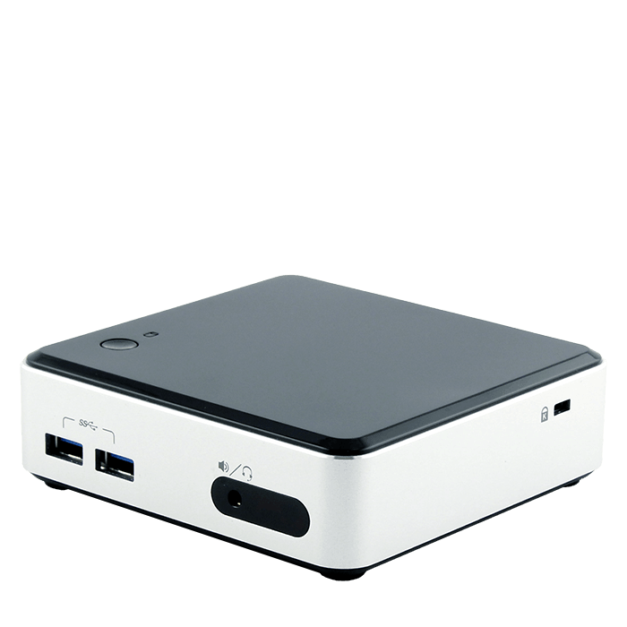
Cube PC Layout
Network Connection
NUC1
NUC4
NUC5
NUC2
NUC3

Slide 7
Building an application for the Cube
Challenge is sending data and creating a shared experience
Many different topologies for Client/Server configuration depending on needs of application
Need to decide early on what shared experience you are trying to create and what data you will need in order to create it
Network bandwidth has it’s limits

Slide 8
SDK Philosophy
Allow you to send data anywhere you want with Kinect Transport application
Provide samples and source code for consuming that data and visualizing it
Some data can exist on one client and some data will probably need to be sent to a server to create a shared experience

Slide 9
Possible Cube Application Topologies
No server, each side is a distinct experience (Cinder, Unity)
Dumb client, server provides all state and visuals (NodeJS)
Distributed system, server sends shared experience to each client to generate visuals (Cinder, Unity)

Slide 10
No Server
Kinect Transport sends data to localhost (127.0.0.1)
Data is visualized locally by Cinder or Unity app
No shared state between sides
NUC5 (unused)
KT
KT
KT
KT
NUC1
NUC2
NUC3
NUC4

Slide 11
Dumb Client
Kinect Transport sends data server (NUC5)
Data is visualized on server as web page
Browser on clients (NUC1-4) display web page
NUC5
KT
KT
KT
KT
NUC1
NUC2
NUC3
NUC4

Slide 12
Distributed System
Kinect Transport sends data server (NUC5)
Shared state created on server
State is sent back to clients to visualize
NUC5
KT
KT
KT
KT
NUC1
NUC2
NUC3
NUC4

Slide 13
Kinect Transport
Sends multiple streams of data (Bodies, Depth) to up to 4 destination hosts (can be localhost)
Uses TCP/IP for networking and sends data as raw binary for speed and reliability
Source code is provided and is easy to use/refactor
C++ code for parsing, sending and receiving binary streams of data is re-used for Cinder (and eventually oF) sample apps

Slide 14
API Specification
Description of binary data
Helper source code for sending/receiving it
General documentation

Slide 15
SDK Samples
Samples in NodeJS, Cinder and Unity that demonstrate receiving and visualizing binary streams of data
NodeJS sample could be used as either client or server (or both)
Samples can be in any framework that supports receiving TCP/IP data (does not need to support Kinect 2.0 SDK

Slide 16
Conclusion
Github repo lives here: https://github.com/stimulant/MS-Cube-SDK
Please try out the samples and give suggestions!
SDK is a work in progress

Slide 17
Thanks!
Joel Pryde
@joelpryde joel@stimulant.com
Stimulant:
@stimulant http://stimulant.com

