Slide 1
RETAIL INTELLIGENCE PLATFORM
Turning Transactions into
Retail Decisions
Seven dashboards. Three ML modules. One source of truth.
PREPARED FOR PORTFOLIO REVIEW
Sample Superstore Dataset | 2014–2017 | 9,994 Orders

Slide 2
AGENDA
What we'll cover
01
The Problem & Our Approach
02
The Platform
03
Key Findings: Sales, Profit & Discounting
04
Three ML Modules
05
Recommendations & Roadmap
1

Slide 3
01 · THE PROBLEM
Data everywhere. Decisions nowhere.
Retail businesses generate large volumes of transactional data, but that data rarely reaches the people making day-to-day calls on inventory, marketing, and pricing.
THE ANSWER
A single platform:
7 dashboards + 3 ML modules
Where is the business performing well or poorly today?
✓ Descriptive analytics (4 pages)
Where is it likely headed next?
✓ Sales forecasting
Who deserves the most retention attention?
✓ Customer segmentation
✓ Product recommendations
What should get priority on the shelf?
2

Slide 4
01 · OUR APPROACH
From raw CSV to interactive dashboard
Raw Data
Clean + Engineer
SQLite Database
Streamlit App
→
→
→
SampleSuperstore.csv
Notebooks 01–03
retail.db
7 dashboard pages
Three ML modules run on top of the same database:
Forecasting
Segmentation
Recommendation
Moving-average time series
K-Means clustering
Rule-based scoring
3

Slide 5
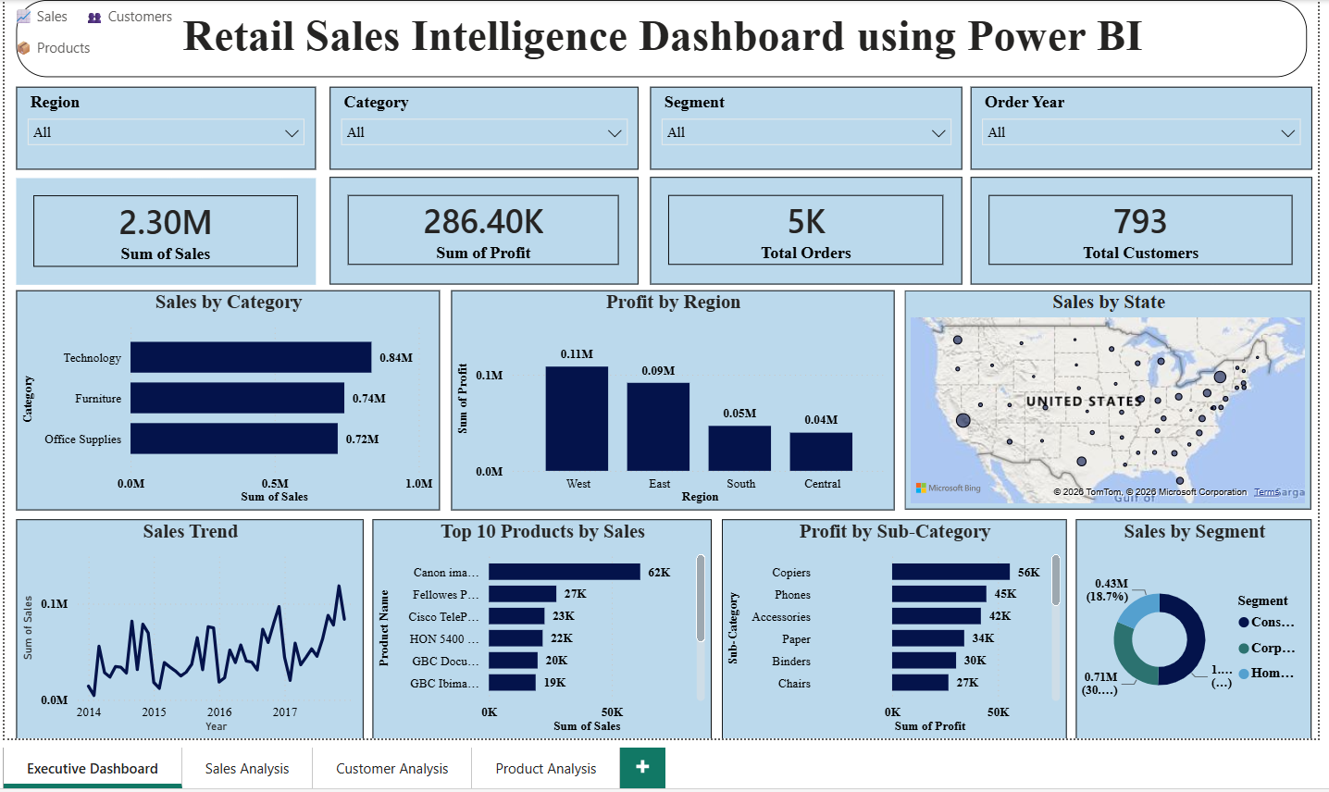
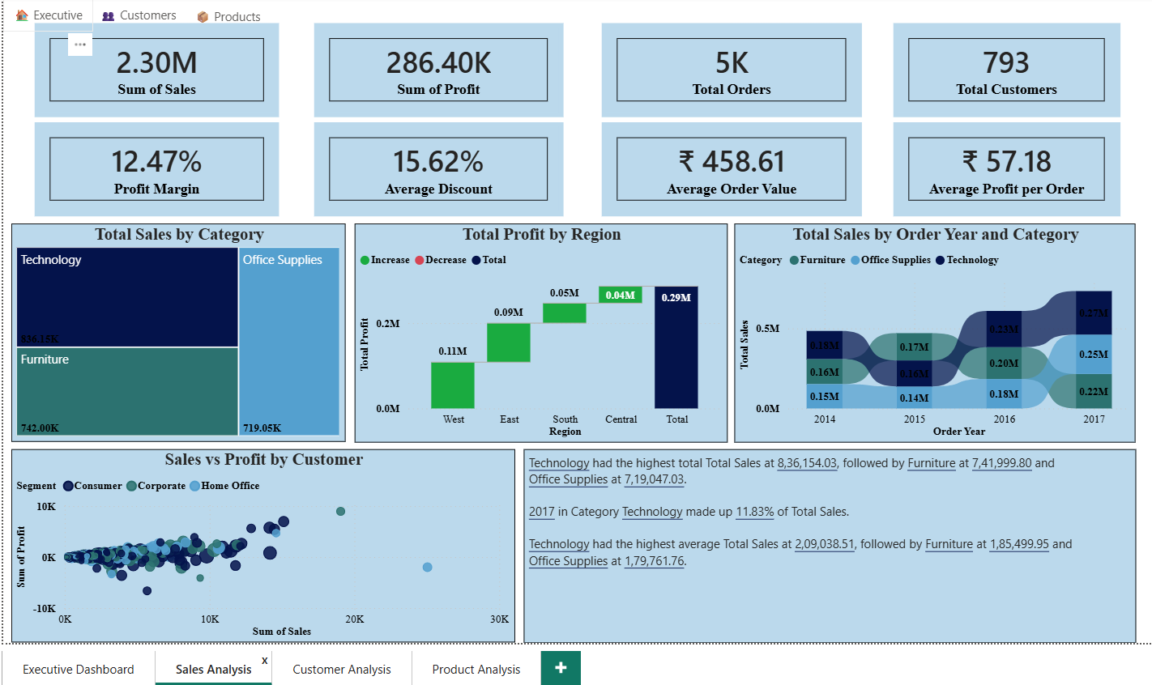
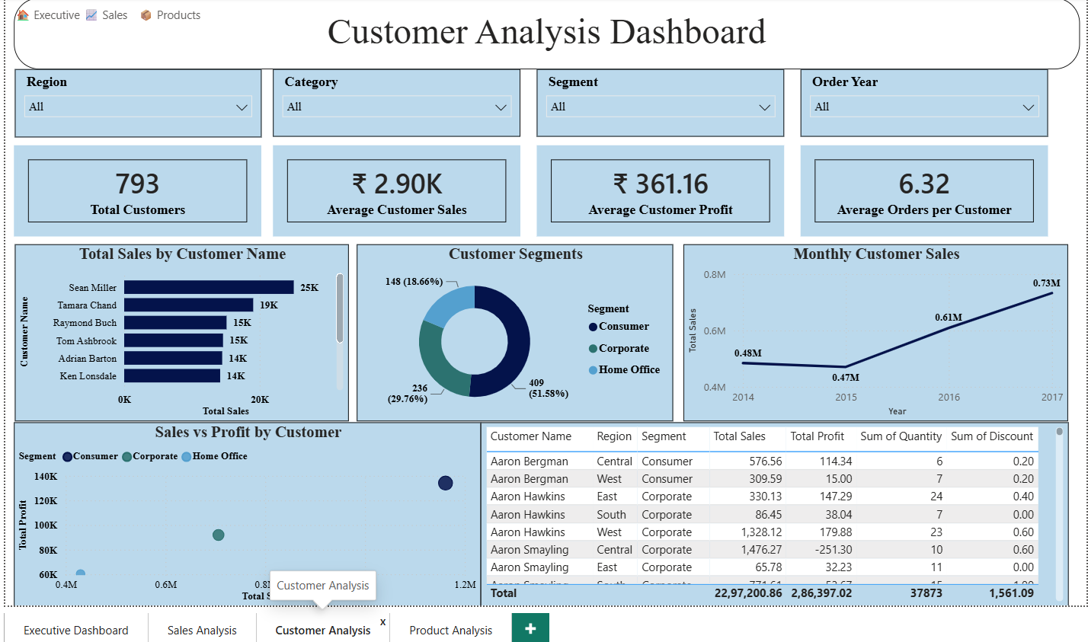
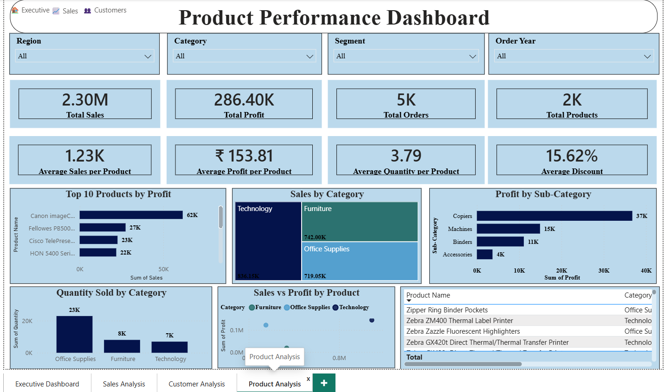
02 · THE PLATFORM
Four descriptive dashboards, one database
Executive
Sales Analysis
Customer Analysis
Product Analysis
4

Slide 6
03 · KEY FINDINGS
Growth is real — but uneven across regions
5

Slide 7
03 · KEY FINDINGS
One cell explains most of the gap
Profit by Region × Category ($)
Region | Furniture | Office Supplies | Technology
Central | −$2,871 | $8,880 | $33,697
East | $3,046 | $41,015 | $47,462
South | $6,771 | $19,986 | $19,992
West | $11,505 | $52,610 | $44,304
THE ONLY NEGATIVE CELL
Central + Furniture
$163.8K in sales generated −$2,871 in profit — the only loss-making region/category combination in the entire dataset.
Why? See next slide →
6

Slide 8
03 · KEY FINDINGS
Discounting above 20% loses money
−$135.4K
COMBINED LOSS ACROSS 1,176 ORDERS DISCOUNTED ABOVE 20%
Central discounts at 24.0% on average — more than double West's 10.9%. This is the root cause behind Central's weak profit performance, and it's fixable through policy.
7

Slide 9
03 · KEY FINDINGS
Value is concentrated — in products more than customers
48%
77%
OF SALES FROM TOP 20% OF CUSTOMERS
OF SALES FROM TOP 20% OF PRODUCTS
Products are far more concentrated than customers. This is exactly why the Product Recommendation module (Module 03) uses a percentile-based cutoff instead of a fixed score threshold — a small set of products dominates the sales distribution.
WHAT THIS MEANS FOR STRATEGY
Customer strategy should focus on retention of a broad-ish top tier (segmentation, Module 02). Product strategy can be narrower and more aggressive — a small assortment change moves the needle disproportionately (recommendation, Module 03).
8

Slide 10
04 · ML MODULE 01
Sales Forecasting
Method
A trailing 3-month moving average projects the next 12 months of sales, feeding each forecast value back into the window. Chosen for transparency over a full seasonal model, given only four years of history.
$1.13M
FORECAST (NEXT 12 MO)
Read it as directional
+54.6%
The projection is anchored to recent, strong months — treat it as an optimistic trend estimate, not a committed number for inventory or staffing.
EXPECTED GROWTH
$733.2K
TRAILING 12-MONTH ACTUAL
9

Slide 11
04 · ML MODULE 02
Customer Segmentation
K-Means clustering (k=3) on Sales, Profit, and Orders per customer — standardized, then re-ranked by mean sales into readable tiers.
Segment | Count | Avg Sales | Avg Profit
High Value | 59 | $9,370.80 | $2,213.02
Regular | 324 | $3,461.22 | $368.91
Low Value | 410 | $1,519.24 | $88.54
The takeaway
Just 7.4% of customers (High Value) generate $552.9K in sales and $130.6K in profit — a small group carrying outsized weight, and a clear target for retention investment.
10

Slide 12
04 · ML MODULE 03
Product Recommendation
A transparent, rule-based score — not a black box — so every recommendation can be explained.
Score = 0.35×Sales + 0.35×Profit + 0.20×Orders − 0.10×Discount
Normalized 0–100 across all products. Top 30% by score are flagged Recommended — a percentile cutoff, chosen because a fixed threshold recommended almost nothing on this heavily skewed sales data.
1,894
568
82.0%
PRODUCTS SCORED
RECOMMENDED (TOP 30%)
RECOMMENDATION ACCURACY
Recommendation Accuracy measures how many Recommended products are independently also High Demand (top quartile by orders) — a sanity check that the score tracks real customer behavior.
11

Slide 13
04 · BRINGING IT TOGETHER
Three independent models, one story
High Value customers skew toward Recommended products
The two independently-built scoring systems point at the same underlying value — not a coincidence.
Discounting hits Furniture hardest
The category with the most loss-making sub-categories is also most exposed to Central's high discount rate.
The forecast assumes the customer mix holds
+54.6% growth assumes today's balance of High Value, Regular, and Low Value customers persists.
12

Slide 14
05 · RECOMMENDATIONS
What to do with this, starting Monday
1
Cap discounts above 20%
Every band above 20% is net loss-making — an immediate, policy-only fix.
2
Audit Central's discount approvals
24.0% average vs. West's 10.9% is the single largest lever identified.
3
Re-price chronic loss-makers
Tables, Bookcases, and Supplies are net-negative on profit across all 4 years.
4
Protect the High Value segment
59 customers drive $552.9K in sales — build a dedicated retention program.
5
Prioritize the 568 recommended products
Especially in Technology, where the scoring model is strongest.
13

Slide 15
05 · ROADMAP
A phased rollout
WEEKS 1–2
WEEKS 3–8
MONTHS 2–4
ONGOING
Phase 1
Phase 2
Phase 3
Phase 4
Stop the Bleeding
Stabilize Margins
Grow with Focus
Institutionalize
Cap discounts above 20%; audit Central's approval workflow.
Re-price Tables/Bookcases/Supplies; formalize regional discount policy.
Launch High Value retention program; align merchandising with Recommended products.
Quarterly forecast refresh and re-clustering as behavior shifts.
14

Slide 16
LOOKING AHEAD
Limitations & Future Work
Forecasting
Segmentation
Recommendation
Discount Analysis
No seasonality component yet. A Prophet or SARIMA model would likely capture yearly patterns more accurately.
Only 3 features used today. Adding recency and category affinity (RFM-style) could sharpen the tiers.
Rule-based by design, for transparency. A learned ranking model could complement it as interaction data grows.
Correlational, not causal. A controlled pilot (e.g. a discount cap in Central) would confirm the causal link.
15

Slide 17
APPENDIX
Tech Stack & Data
Language
Python 3.12
Dashboard
Streamlit + Plotly
Machine Learning
scikit-learn (K-Means, StandardScaler)
Database
SQLite
BI Tool
Power BI (companion dashboard)
Dataset: Sample Superstore · 9,994 orders · 793 customers · 1,862 products · 2014–2017
16

Slide 18
Thank You
Retail Intelligence Platform — Questions & Discussion
Built with Python · Streamlit · scikit-learn · SQLite · Power BI

