Slide 1
Sub Distribution Board (SDB) & Emergency Sub Distribution Board (ESDB)
Prepared by,
Raisa Bentay Hossain (1606151)
Partho Ghosh (1606161)

Slide 2
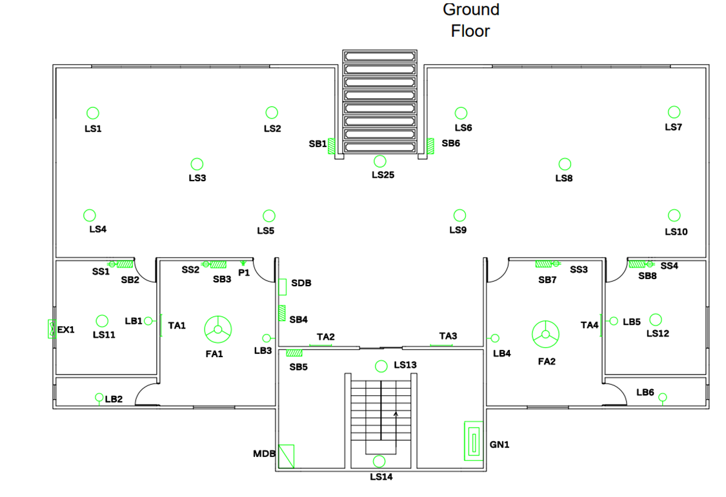
Ground Floor

Slide 3

Ground Floor
Ampere Rating, I= $\frac{P}{V∗pf}(A)$
pf = 0.75 & V = 220 V
CKT No | Switch Board Under The CKT | Ampere Rating Calculated | Wire Used
CKT1 Rating | SB 1 | 0.7 A | 2 x 1.5 rm BYM + 1.5 BYA ECC are used
CKT2 Rating | SB 2,3 | 2.69 A
CKT3 Rating | SB 4,5 | 0.76 A
CKT4 Rating | SB 6 | 0.84 A
CKT5 Rating | SB 7,8 | 2.75 A

Slide 4
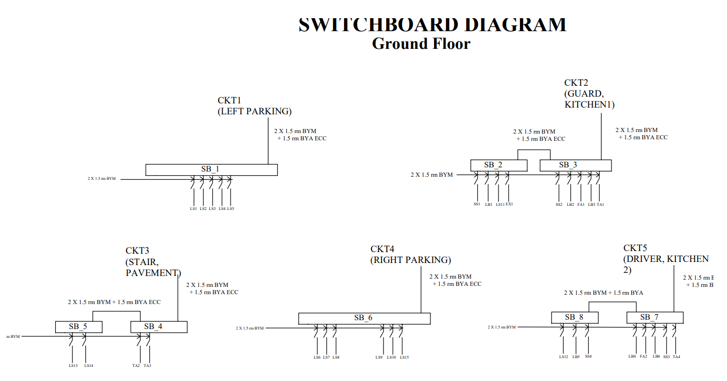
Ground Floor

Slide 5
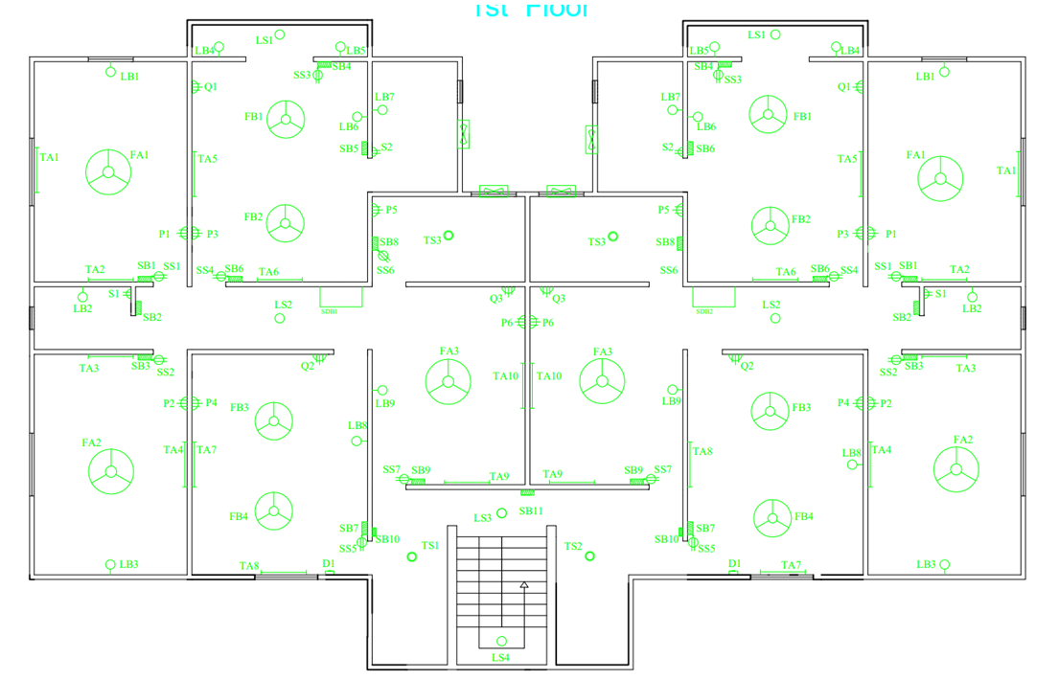
1st and 2nd Floor

Slide 6
1st and 2nd Floor

Slide 7
1st and 2nd Floor
Ampere Rating, I= $\frac{P}{V∗pf}(A)$
pf = 0.75 & V = 220 V
CKT No | Switch Board Under The CKT | Ampere Rating Calculated | Wire Used
CKT1 Rating | SB 1,2,6 | 4.81 A | 2 x 1.5 rm BYM + 1.5 BYA ECC
CKT2 Rating | SB 4,5,8 | 5.11 A | 2 x 2.5 rm BYM + 2.5 BYA ECC
CKT3 Rating | SB 3 | 1.88 A | 2 x 1.5 rm BYM + 1.5 BYA ECC
CKT4 Rating | SB 7,9,10 | 4.73 A
CKT5 Rating | SB 11 | 0.28 A

Slide 8
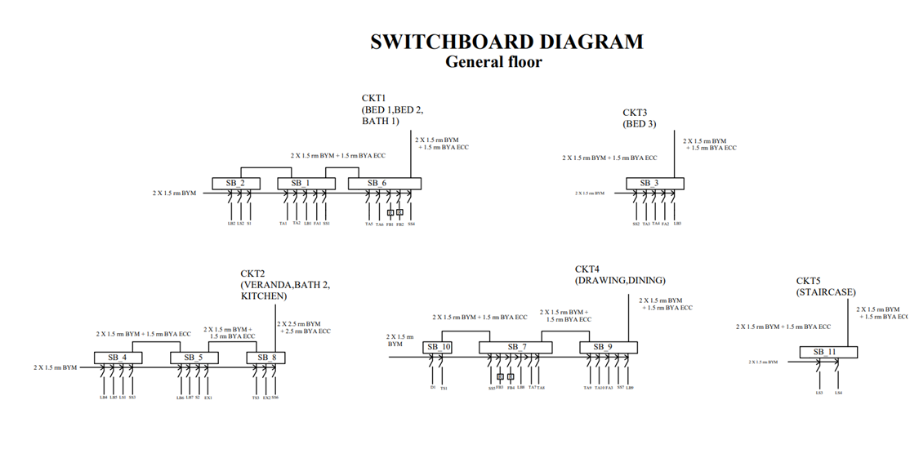
1st and 2nd Floor

Slide 9
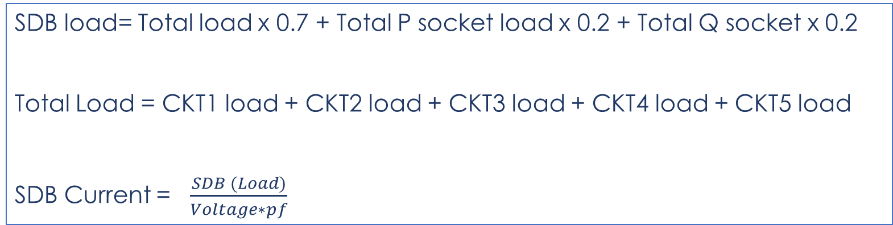
Calculations for SDB
SDB load= Total load x 0.7 + Total P socket load x 0.2 + Total Q socket x 0.2
Total Load = CKT1 load + CKT2 load + CKT3 load + CKT4 load + CKT5 load
SDB Current = $\frac{SDB (Load)}{Voltage∗pf}$
P Load = 2500 W
Q Load = 4000W
Voltage = 220 V
Power Factor, pf = 0.75

Slide 10
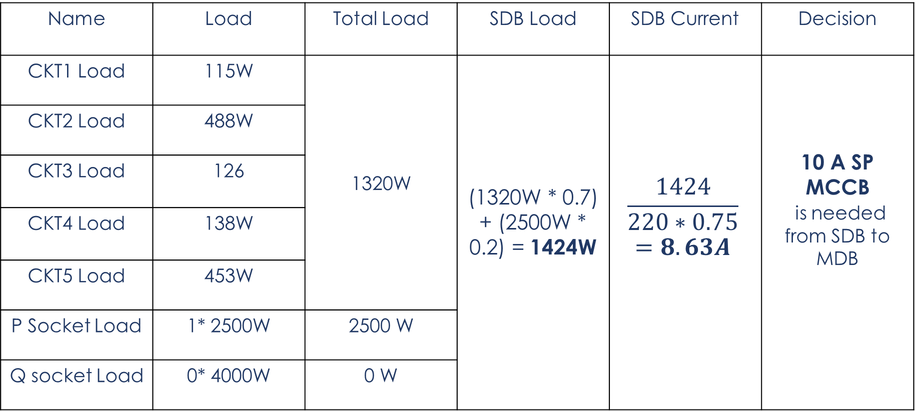
SDB for Ground Floor
Name | Load | Total Load | SDB Load | SDB Current | Decision
CKT1 Load | 115W | 1320W | (1320W * 0.7) + (2500W * 0.2) = 1424W | $$\frac{1424}{220∗0.75}$$ $$=8.63A$$ | 10 A SP MCCB is needed from SDB to MDB
CKT2 Load | 488W
CKT3 Load | 126
CKT4 Load | 138W
CKT5 Load | 453W
P Socket Load | 1* 2500W | 2500 W
Q socket Load | 0* 4000W | 0 W

Slide 11
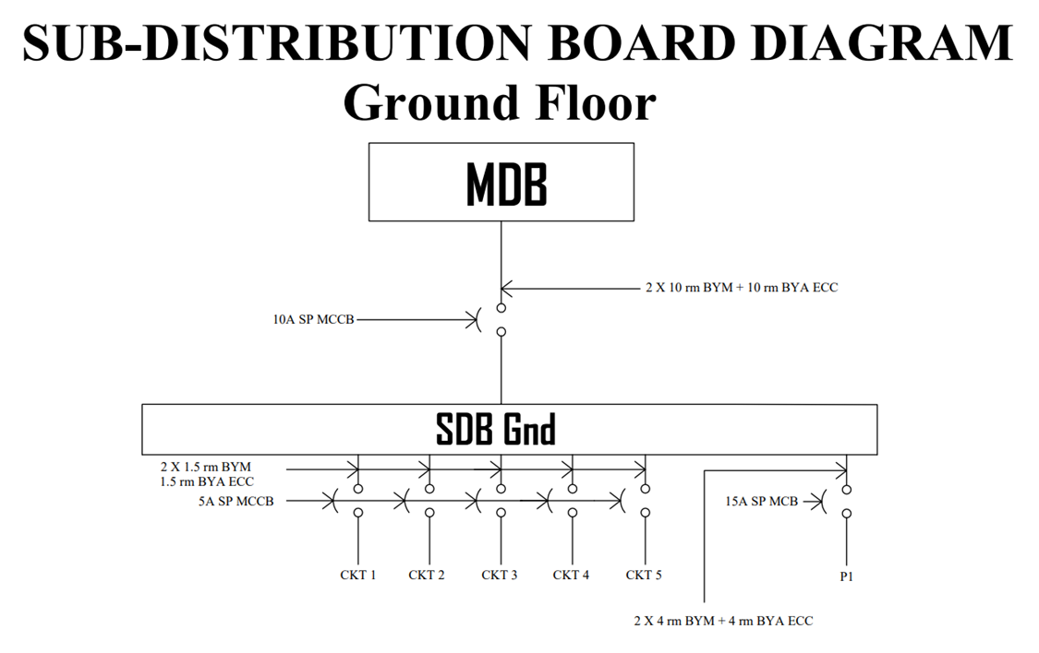

Slide 12
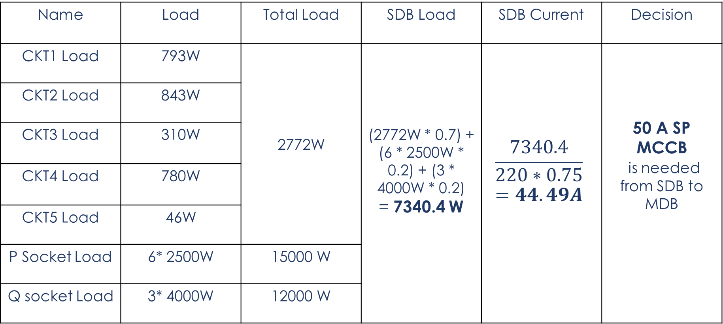
SDB for 1st & 2nd Floor
Name | Load | Total Load | SDB Load | SDB Current | Decision
CKT1 Load | 793W | 2772W | (2772W * 0.7) + (6 * 2500W * 0.2) + (3 * 4000W * 0.2) = 7340.4 W | $$\frac{7340.4}{220∗0.75}$$ $$=44.49A$$ | 50 A SP MCCB is needed from SDB to MDB
CKT2 Load | 843W
CKT3 Load | 310W
CKT4 Load | 780W
CKT5 Load | 46W
P Socket Load | 6* 2500W | 15000 W
Q socket Load | 3* 4000W | 12000 W

Slide 13
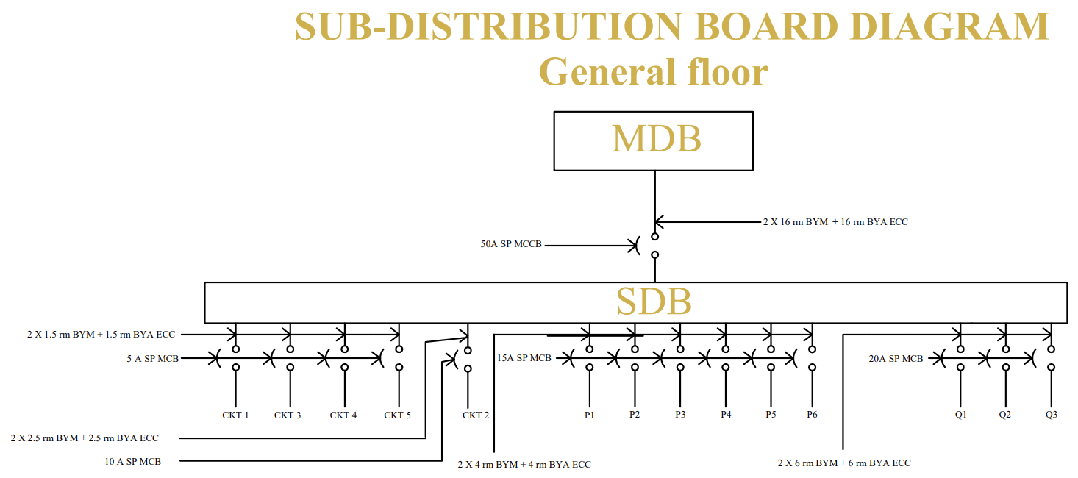
1st and 2nd Floor

Slide 14
Emergency Sub Distribution Board (ESDB)

Slide 15
Ground Floor
CKT No | Ampere Rating Calculated | Wire Used
CKT1’ Rating | 0.36 A | 2 x 1.5 rm BYM + 1.5 BYA ECC are used
CKT2’ Rating | 0.36 A
CKT3’ Rating | 0.139 A
CKT4’ Rating | 0.139 A
CKT5’ Rating | 0.36 A

Slide 16
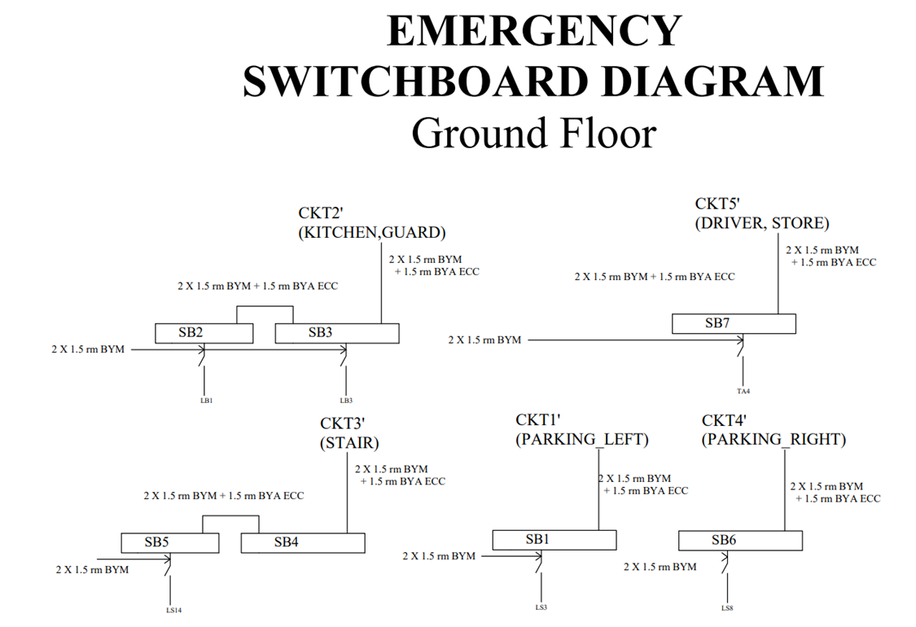

Slide 17
1st and 2nd Floor
CKT No | Ampere Rating Calculated | Wire Used
CKT1’ Rating | 1.68 A | 2 x 1.5 rm BYM + 1.5 BYA ECC are used
CKT2’ Rating | 0.24 A
CKT3’ Rating | 0.745 A
CKT4’ Rating | 0.7 A
CKT5’ Rating | 0.424 A
CKT6’ Rating | 0.14 A

Slide 18
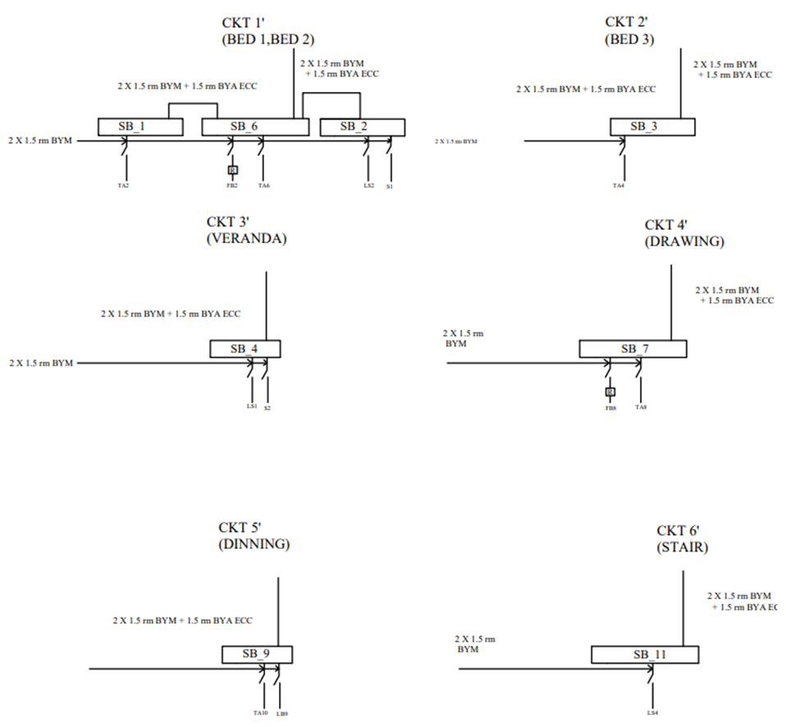
1st and 2nd Floor

Slide 19
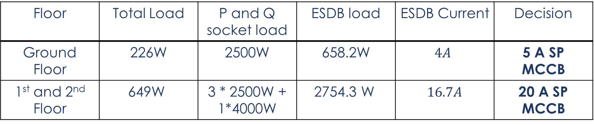
Calculations for ESDB
Floor | Total Load | P and Q socket load | ESDB load | ESDB Current | Decision
Ground Floor | 226W | 2500W | 658.2W | $$4A$$ | 5 A SP MCCB
1st and 2nd Floor | 649W | 3 * 2500W + 1*4000W | 2754.3 W | $16.7A$ | 20 A SP MCCB

Slide 20
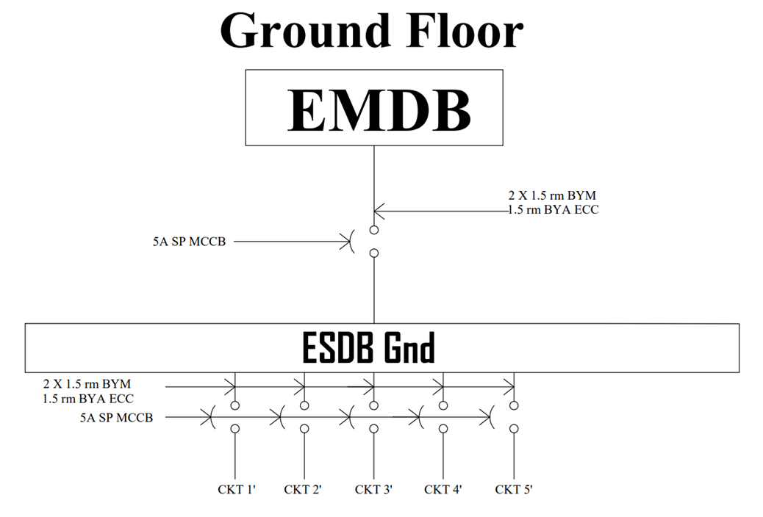

Slide 21
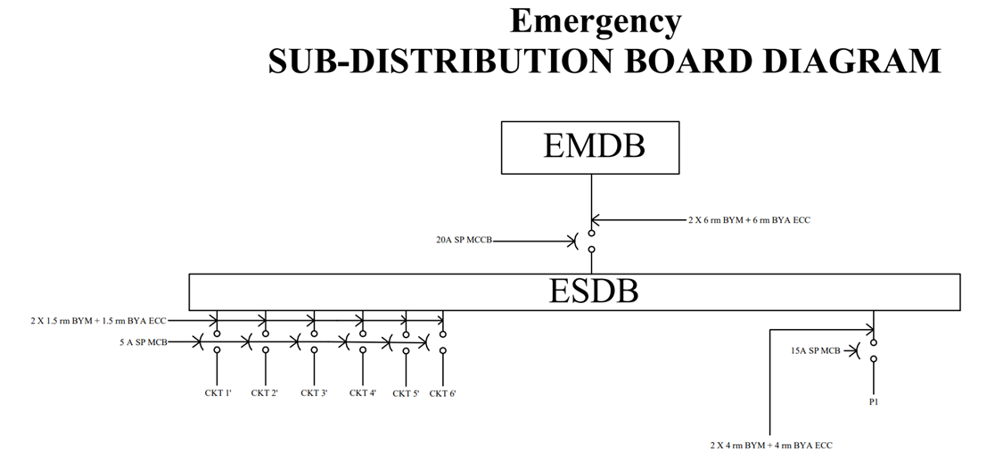
1st and 2nd Floor

