Slide 1

Title: FastCare Team ID: CTO-6B60
Team Member Details
MD. RAISUL ISLAM NILOY(19-39982-1@student.aiub.edu)
SAZIA RAHMAN(19-39976-1@student.aiub.edu)
SITHI SHIKDER(19-40003-1@student.aiub.edu)

Slide 2

Finding Problems
A need for an ambulance can occur anytime from anywhere, and there might be times were one might not know about the closest hospital and ambulance service
Which may lead to many unexpected critical health conditions.
This kind of event happens every day in our country

Slide 3
Concept
So our purpose is to create a system to easily get proper information and service for those who are in need.
In this the system will give the user information about nearby hospitals and ambulance services.
In a time of emergency, the user can request a particular type of ambulance as the patient need, and also this will also notify the hospital the user has selected to take proper steps before the ambulance arrives
Also the service will give some fist aid tips to help the patient at the moment

Slide 4
Beneficiary
This proposed system will help every person who is need of medical attention.
A person can gather information about medical center there services all in one place
This system will be able to help patient and doctor communicate with each other easily
Give information about popular illness and spread awareness to the people and give suggestion how to take proper measurement to be safe from it

Slide 5
Solution Statement
In this system the main functionality is ambulance service request system.
As this system will provide a list of ambulance service near the user and select the type of ambulance is needed with the coordinate of hospital with required needs.
Also give the user Realtime location of the ambulance and time needed to arrive to the patient.
The system will also spread aware to people about current Epidemic and give suggestion to preventing from happening.

Slide 6
User Scenario
Admin
Doctor
Client

Slide 7
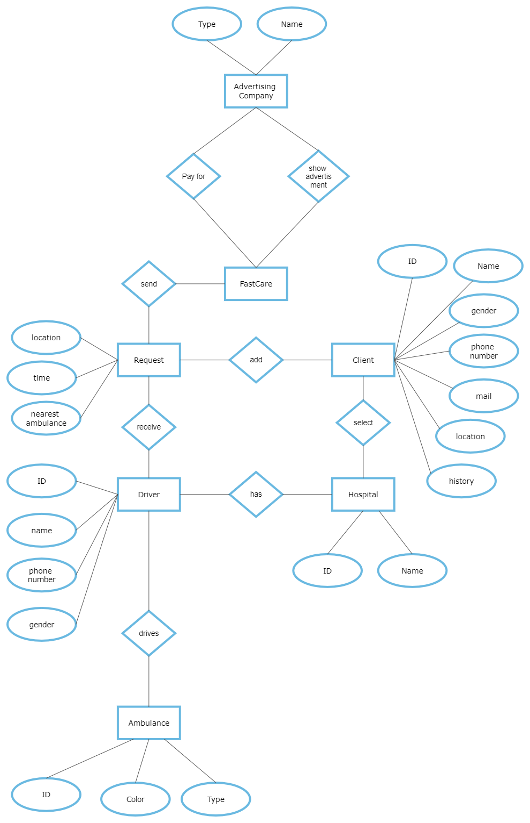
ER Diagram

Slide 8
Future Expansion
In the future we can marge this system with the Traffic system with out country.
By this traffic system can take proper steps like creating a safe way for the ambulance and helping the patient.

Slide 9
Challenges & Conclusion
1.Small scale project, not applicable on an international level as of yet
2.Lack of manpower , cost, recourses, custom software, requirement analysis, modelling, coding, testing simulation
3.Missuse of the system
This project may help and save lives by giving helping hand in need.

Slide 10
Thank you for your time!
Feel free to ask any relevant questions.

