Slide 1


SUPERVISED LEARNING MODEL TO PREDICT URBAN TEMPERATURE
PROJECT 2
Name, ID
April 2024
Raisina Chowdhury
11362115
Notes:
Hi everybody. Today I'm going to focus on supervised learning models and their results

Slide 2

TABLE OF CONTENT
04
01
About The Dataset
Research Questions
02
05
Spearman Correlation Matrix
Results and Discussion
03
Feature Engineering
Notes:
I will first touch upon the preprocessing step, then move to the feature engineering, and then go over the results

Slide 3
ABOUT THE DATASET
COLUMNS
PRE-PROCESSING STEPS
ADDITIONAL INFO ON THE DATASET
TREFMXAV_U = Urban daily maximum of average 2-m temperature
FLNS = Net longwave flux at the surface
FSNS = Net solar flux at the surface
PRECT = Total (convective and large-scale) precipitation rate (liq + ice)
PRSN = Snow precipitation rate
QBOT = Lowest model level water vapor mixing ratio
TREFHT = Reference height temperature
UBOT = Lowest model level zonal wind (m/s)
VBOT = Lowest model level meridional wind (m/s)
lat = latitude
lon = longitude
time
No missing data and duplicates
Time-series data, from 2006 to 2080
No components for hours, mins, seconds
Futuristic Meteorological Dataset
Merged the 6 files
Replaced negative values of PRSN and PRECT with 0
Filtered the data for Manchester using latitude and longitude
Added a Seasonality feature
Notes:
As you can see there are 12 columns and covers information on [read through them]

Slide 4
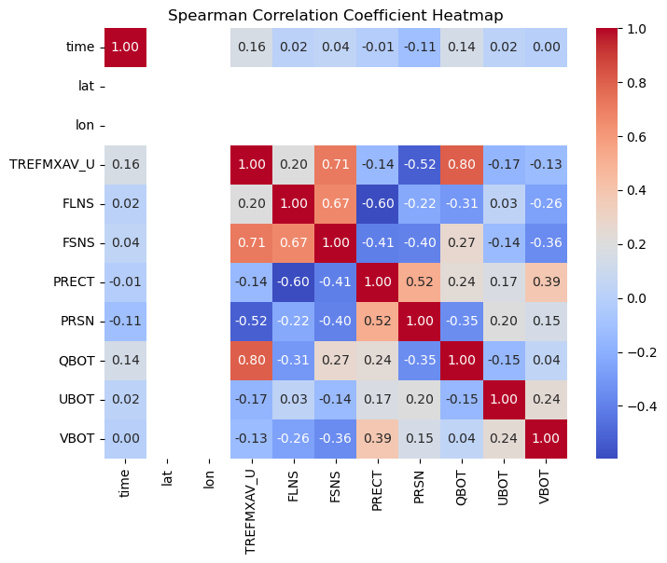
SPEARMAN CORRELATION MATRIX
1 | Non-linear relationships exhibited by the scatterplots and Distributions are not normal
2 | FSNS – 0.71 (strong positive correlation) QBOT – 0.80 (strong positive correlation) PRSN - -0.52 (moderate negative correlation)
Notes:
I have used spearman correlation for my analysis as almost all of the relationships exhibit non-linearity and the distributions are also not normal

Slide 5
RESEARCH QUESTIONS
Sensitivity of the Inputs to the Model
Comparative Analysis of Learning Models: Random Forest and XGBoost

Slide 6
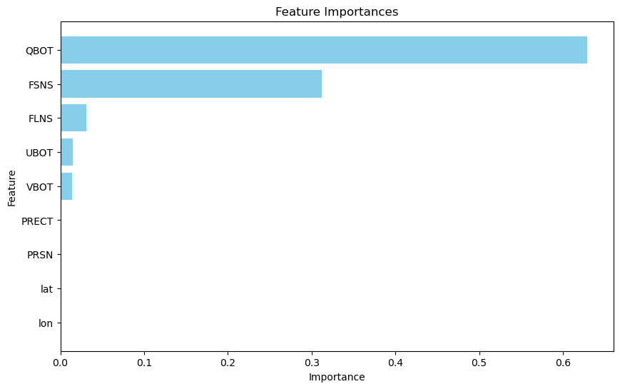
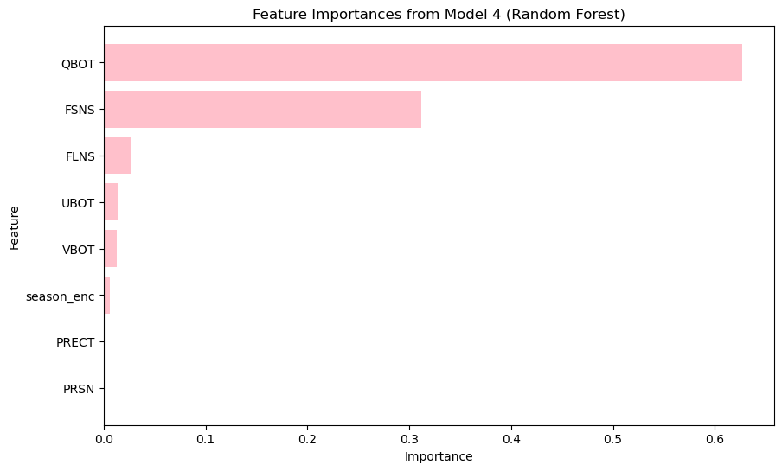
Feature Selection
01
EDA from Project 1
Got leads from Project 1 on how QBOT and FSNS are important features
Avoided reference height temp as this has direct influence on the target variable
02
Feature Importance Graph
Feature Importance from the base model (including all variables) and model 4 (including all variables + seasonality feature)
We can see how PRECT and PRSN do not have significant influence on urban temperature
However, removing PRECT and PRSN did not put any effect on the model results but adding seasonality did improve the metrics
03
Finalized Features
QBOT FSNS FLNS UBOT VBOT season_enc PRECT and PRSN
Notes:
For my first research question I exploredthe different set of input features, and the one that yielded the best result.
EDA from project 1 was aligned with project 2, hence, it helped me to select features
temperature as a feature could inadvertently provide the model with direct information about the target variable it's trying to predict, leading to inflated model performance during training
So for my base model I have used all the features (not the season_enc) and then I ran a code to give me the feature importance graph, which is the first graph. It shows that PRECT and PRSN do not have significant influence, however removing them from the feature set did not improve the metrics but slightly lowered them.

Slide 7
Random Forest Benefits It significantly reduces the risk of overfitting. While decision trees can overfit by closely fitting all samples within the training data, Random Forests avoid overfitting thanks to their robust number of decision trees. This is achieved by averaging uncorrelated trees, which lowers the overall variance and prediction error. Random Forest simplifies the process of determining feature importance. It offers several methods to evaluate a decrease in model accuracy in scenarios where a given variable is excluded | XGBoost Benefits XGBoost is renowned for its efficiency, speed, and accuracy. Here are some of its key benefits:1. Regularization: XGBoost incorporates both L1 (Lasso Regression) and L2 (Ridge Regression) regularization. This in-built regularization helps prevent overfitting; while L1 regularization encourages sparsity, L2 penalizes complex models. Parallel processing: XGBoost leverages the power of parallel processing, making it significantly faster
Notes:
A unique aspect of random forest model is that each decision tree is trained on a random subset of the available features rather than the entire feature set. This process introduces randomness into the tree-building process and helps to reduce the correlation between trees, making the ensemble more robust and less prone to overfitting.
One of the main advantages of XGBoost is its ability to find the best balance between making accurate predictions and keeping things simple. It does this by using regularized objective functions.

Slide 8
Results

Slide 9
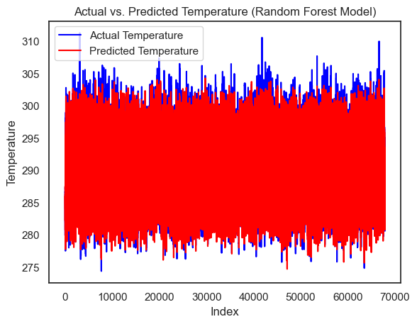
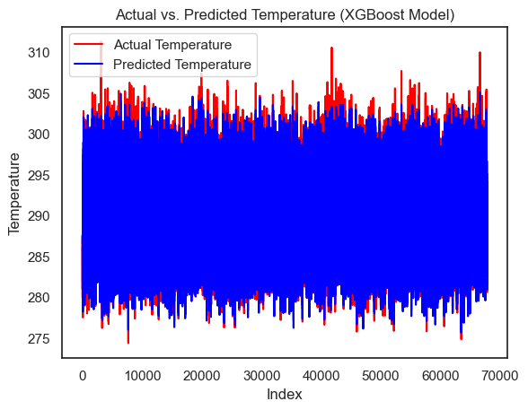
Results of the Random Forest Model
Results from the XGBoost Model
Training | R-square on the training data of the test set = 0.9550 MSE = 1.1309
Testing | R-square on the testing data = 0.9471 MSE = 1.543
Training | R-square on the training data of the test set = 0.9648 MSE = 0.8846
Testing | R-square on the testing data = 0.9568 MSE = 1.260
Notes:
MSE measures the average of the squares of the errors (the difference between actual and predicted values)
R² score, also known as the coefficient of determination, measures the proportion of the variance in the dependent variable that is predictable from the independent variables
You can see how higher temperatures are being under-predicted in the model

Slide 10
Way Forward
01
Using the whole dataset except data from Manchester for '2050-01-01’ to ‘2080-12-31’ to train the model and test on the testing data.
02
Using domain knowledge to pre-process the dataset accurately. Check for values that are considered outliers
03
Hyperparameter tuning using grid search/randomized search

Slide 11
THANK YOU

