Slide 1
◰
Shift Operations
Analytics
Turning messy shift logs into operational decisions
React 19 · Django 6 + DRF · pandas · PostgreSQL · Groq (optional AI)
Md Raisul Islam Rahad — Full-stack technical assignment · Round 3
Live: shift-operations-analytics.vercel.app API: shift-analytics-api.onrender.com
Notes:
I built a web app that takes raw, deliberately messy shift records, cleans them, and turns them into operational insight a plant manager can act on: efficiency, downtime patterns, reliability. All analysis runs server-side in Python; the frontend only renders. I'll walk through the problem, the architecture, and the key engineering decisions.

Slide 2
PART I
The brief,
delivered live
I
— Seven requirements, each shown in the running app
— Live and public — scan the QR to follow along
— The 4-day finding hiding inside the labels
Notes:
Part one. I'll take the seven requirements from the brief and show each one running in the live app - not slides describing features, the features themselves. Scan the QR code and you can follow along in your own browser. And keep an eye out for the four-day finding hiding inside the labels - that's the thread that ties the whole talk together.

Slide 3
01 · THE PROBLEM
THE BRIEF, DELIVERED LIVE
It's not a charting task — it's a trust-the-data task
Given shift records with deliberate operational inconsistencies, clean the data, visualize shift patterns, score efficiency, detect recurring breakdown periods, and surface actionable insights — and stay useful when new categories appear or are grouped.
Dirty data
Invalid dates, bad/missing timestamps, negative & mismatched hours, duplicates, overnight shifts — silently dropping rows hides the truth.
Meaningful analysis
Efficiency, multi-day streaks, reliability — each needs a defensible definition, not just a number.
Extensibility
No reason list can be hardcoded; grouping must re-flow every chart, streak and score.
Shift Operations Analytics · Md Raisul Islam Rahad
01 / 21
Notes:
The assignment isn't about drawing charts — it's about handling data you can't trust and building believable analysis on top of it. Those three challenges drove every design decision.

Slide 4
02 · THE BRIEF → DELIVERED
THE BRIEF, DELIVERED LIVE
Every requirement delivered — each shown live in the next slides
From the brief | Delivered as | Where to see it
Detect, document & handle inconsistencies | 10-issue cleaning pipeline — recover or exclude, nothing silently dropped | Data Quality report
Filter & analyse by attribute combinations | Shared apply_filters(): date range, reasons, validity — on every endpoint | Filter bar, all panels
Shift analysis chart with all reasons | Custom 36-hour chart, one coloured bar per shift, every reason included | Shift Analysis panel
Identify meaningful breakdown streaks | Configurable consecutive-day detection with severity; assumptions documented | Streaks panel + README
Efficiency = (Productive ÷ Total) × 100 | Implemented literally — 86.8% overall + daily trend; reason set configurable | KPI row + trend chart
At least 3 actionable insights | 5+ insights computed live from the data, never hardcoded | Insights panel
Stays useful as categories appear / group | Reasons derived from data; grouping re-flows every chart, streak & score | Edit groups / upload
React frontend · Django backend · no hardcoding | React 19 + Vite SPA over Django 6 + DRF; all policy lives in config / env | GitHub repo + live app
Shift Operations Analytics · Md Raisul Islam Rahad
02 / 21
Notes:
This is the scorecard: every line of the brief on the left, how I delivered it in the middle, and where you can see it in the running app on the right. I won't read the table - I'll spend the next few slides walking each row live. The point is that nothing here is aspirational; every requirement is already shipped and testable.

Slide 5
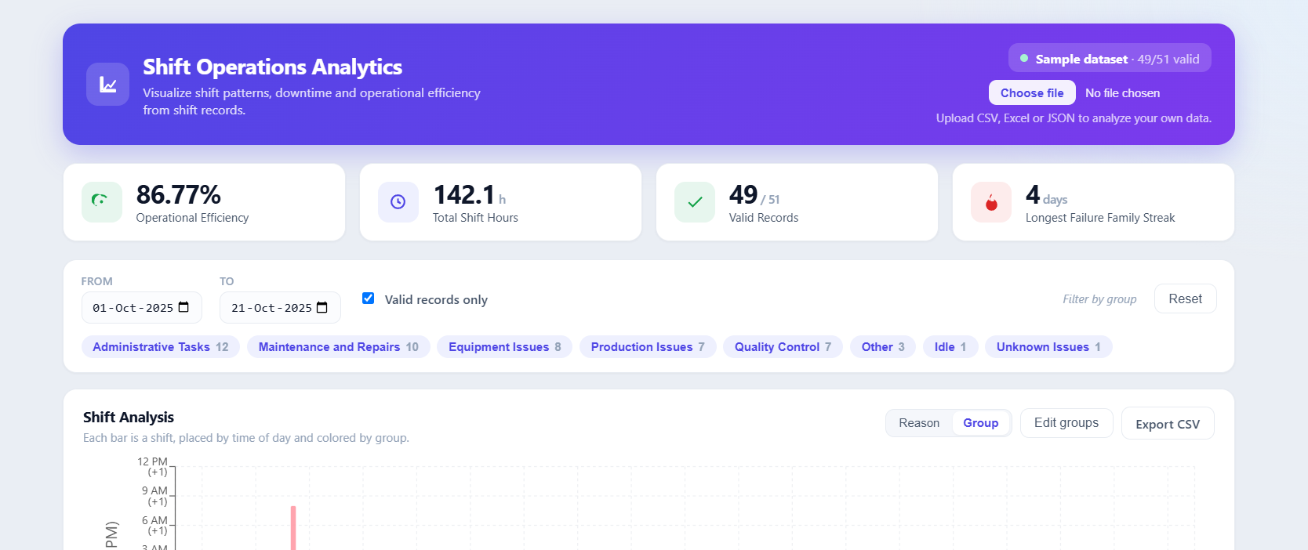

03 · LIVE IN PRODUCTION
THE BRIEF, DELIVERED LIVE
Deployed and public — the panel can open it during this talk
Live app shift-operations-analytics.vercel.app · API shift-analytics-api.onrender.com · Code github.com/Raisulll/Shift-Operations-Analytics
Scan to open the live app
Shift Operations Analytics · Md Raisul Islam Rahad
03 / 21
Notes:
Before the feature tour - this is real and public, deployed right now. Frontend on Vercel, API on Render, code on GitHub. Scan the QR to open the live app on your phone, so as I describe each requirement you can try it yourself. Everything from here on is running against that deployment, not a local demo.

Slide 6
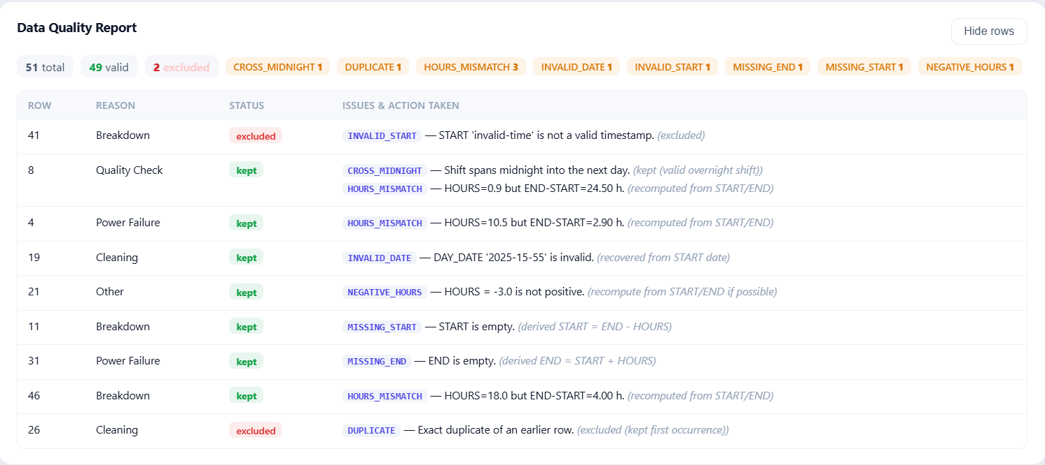
04 · REQUIREMENT 1 · DATA QUALITY
THE BRIEF, DELIVERED LIVE
Detect, document and handle inconsistencies — nothing dropped in silence
The Data Quality report lists every flagged row with its issue and the action taken: recovered rows keep their derived values, excluded rows stay visible with the reason. Ten issue types are detected, and the full catalogue is documented in the README.
Shift Operations Analytics · Md Raisul Islam Rahad
04 / 21
Notes:
Requirement one: detect, document and handle the inconsistencies. My rule was that nothing gets silently dropped. The Data Quality report lists every flagged row with its exact issue and the action I took - a recovered row keeps its derived values, an excluded row stays visible with its reason. Ten issue types in total, all catalogued in the README.

Slide 7
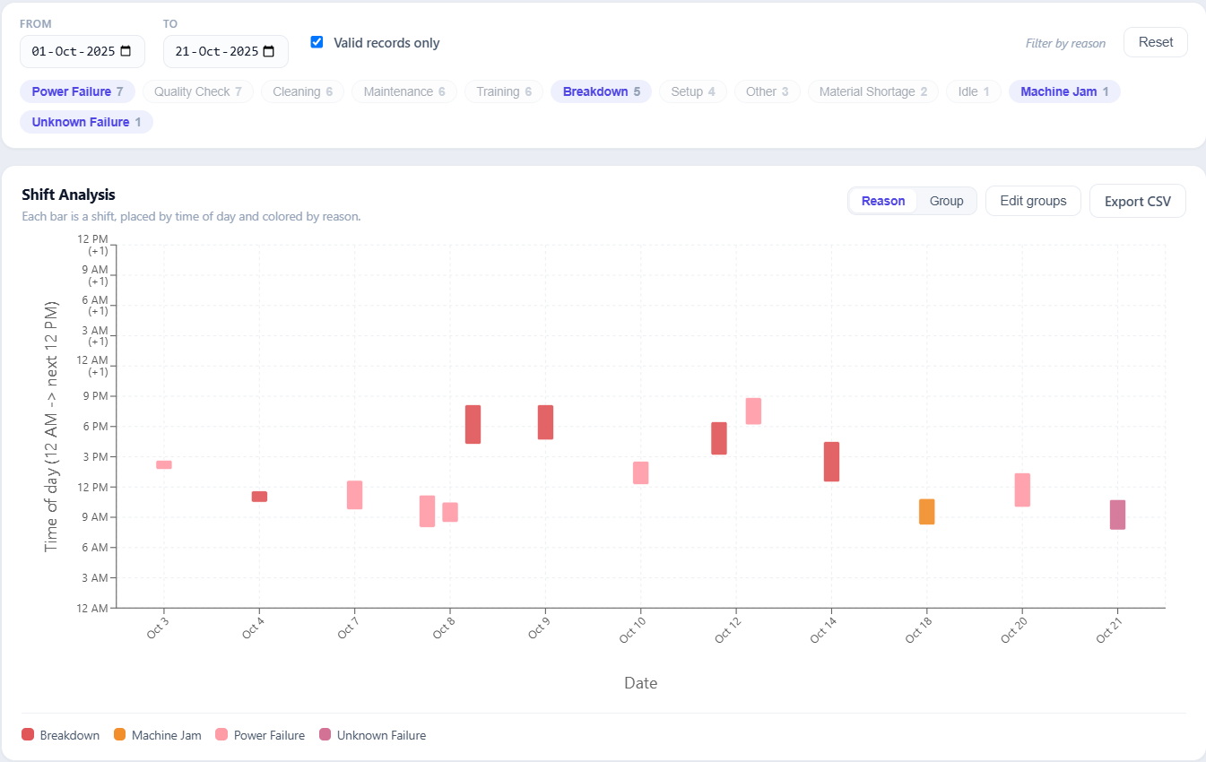
05 · REQUIREMENT 2 · FILTER & ANALYSE
THE BRIEF, DELIVERED LIVE
Filter and analyse by any combination of attributes
One shared filter — date range, reasons, validity — drives every panel and the CSV export, so a filtered view and its download always agree. Combinations apply everywhere at once: charts, streaks, score and insights.
Shift Operations Analytics · Md Raisul Islam Rahad
05 / 21
Notes:
Requirement two: filter and analyse by any combination of attributes. The key choice is that there's a single shared filter - date range, reasons, validity - and it drives every panel and the CSV export from the same code path. So a filtered view and its download can never disagree, and combinations apply everywhere at once: charts, streaks, score, insights.

Slide 8
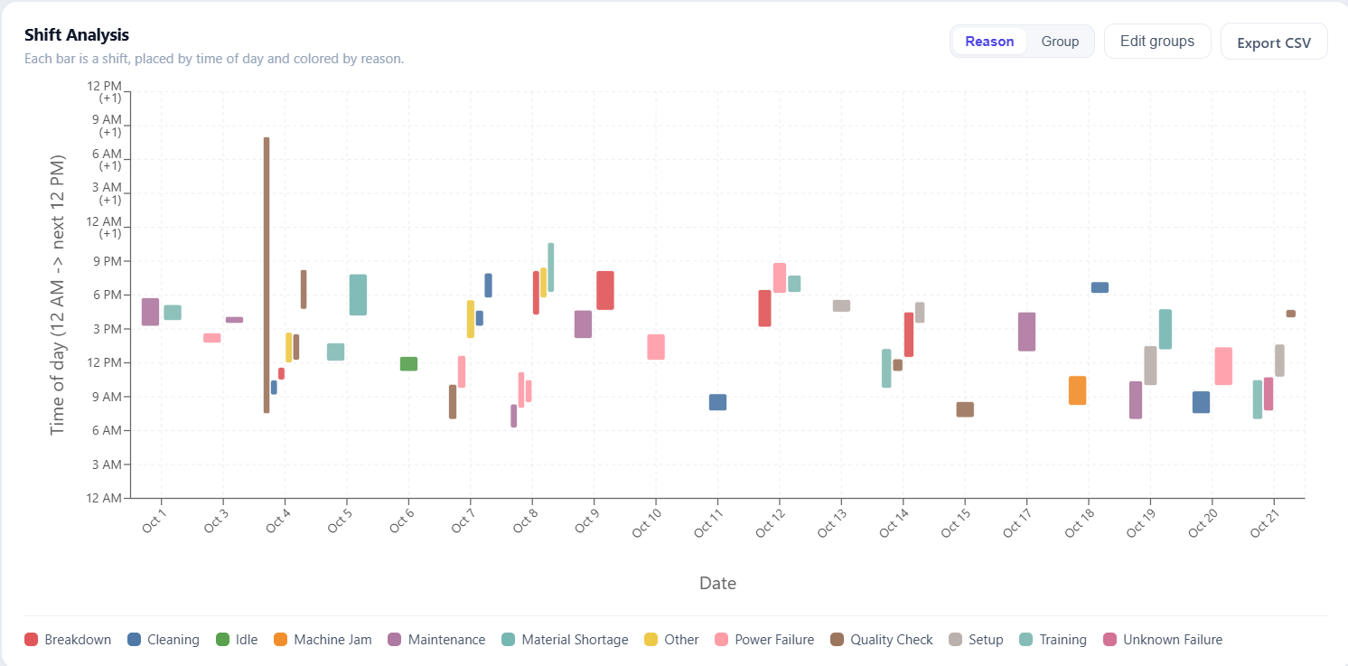
06 · REQUIREMENT 3 · SHIFT CHART
THE BRIEF, DELIVERED LIVE
A 36-hour axis keeps overnight shifts as one continuous bar
Date on X, time of day on Y, one coloured bar per shift. A 22:00 → 06:00 shift crosses midnight, so the axis runs 12 AM → next 12 PM (36 h): an overnight bar simply passes the 24-hour line — see Oct 4 — instead of wrapping or breaking.
Shift Operations Analytics · Md Raisul Islam Rahad
06 / 21
Notes:
A subtle correctness issue that's easy to get wrong. Real plants run night shifts, so I extended the axis to 36 hours. A bar's start and end are just minutes from midnight, so a cross-midnight shift naturally draws as one continuous bar past the 24-hour mark instead of wrapping around.

Slide 9
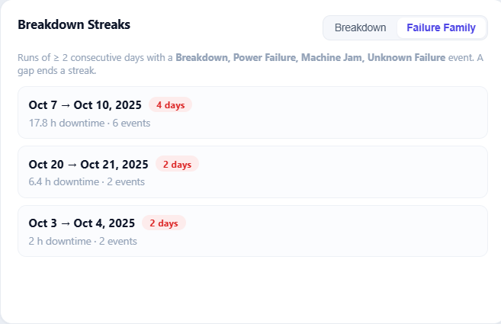
07 · REQUIREMENT 4 · BREAKDOWN STREAKS
THE BRIEF, DELIVERED LIVE
Identify meaningful breakdown streaks — configurable and documented
A streak is N or more consecutive calendar days, each containing at least one record from a configurable target set — reported with span, length and severity in downtime hours. Presets switch the definition live; the assumptions are written down, not implied.
Shift Operations Analytics · Md Raisul Islam Rahad
07 / 21
Notes:
Requirement four: identify meaningful breakdown streaks. I defined a streak precisely - N or more consecutive calendar days, each with at least one record from a configurable target set - and report each one's span, length and severity in downtime hours. The definition is a preset you can switch live, and every assumption is written down rather than implied. This sets up the finding on the next slide.

Slide 10
08 · THE KEY FINDING
THE BRIEF, DELIVERED LIVE
Grouping the labels reveals a 4-day run the raw label hides
Literal “Breakdown”
2-day blip
Failure family
2d
4-DAY RUN (Oct 7–10)
2d
Oct 3
Oct 6
Oct 9
Oct 12
Oct 15
Oct 18
Oct 21
Literal Breakdown label → one 2-day blip. Widen to the failure family (Breakdown + Power Failure + Machine Jam + Unknown Failure) → a 4-day downtime run emerges.
➡ Concrete, data-driven evidence for why categories must be groupable.
Shift Operations Analytics · Md Raisul Islam Rahad
08 / 21
Notes:
My favourite result. If you only look at the literal 'Breakdown' reason, you see a minor two-day blip. But those failures are logged under several labels. Group them into a failure family and a four-day continuous downtime run emerges — the kind of thing a manager must treat as one incident. That's the argument for the whole extensibility requirement, made with the data itself.

Slide 11
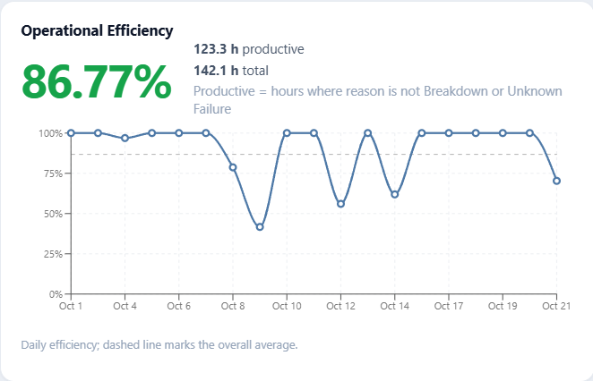
09 · REQUIREMENT 5 · EFFICIENCY SCORE
THE BRIEF, DELIVERED LIVE
(Productive ÷ Total) × 100 — implemented exactly as specified
86.8% overall on the bundled data, plus a daily trend. I followed the formula literally — only Breakdown and Unknown Failure count as non-productive — then made the set configurable, and gave streaks a broader failure family so downtime analysis is not limited by the formula.
Shift Operations Analytics · Md Raisul Islam Rahad
09 / 21
Notes:
Requirement five: the efficiency score. I implemented the formula exactly as specified - productive over total, times a hundred - which gives 86.8% on the bundled data, plus a daily trend. Two deliberate choices: only Breakdown and Unknown Failure count as non-productive, per the brief, but I made that set configurable; and I gave streak detection its own broader failure family so downtime analysis isn't boxed in by the efficiency formula.

Slide 12
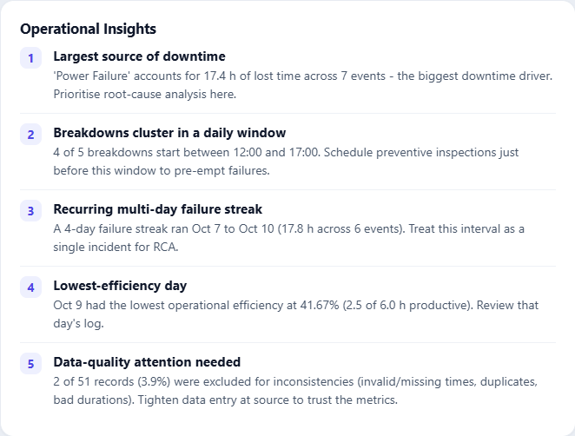
10 · REQUIREMENT 6 · ACTIONABLE INSIGHTS
THE BRIEF, DELIVERED LIVE
Five-plus insights a plant manager can act on — computed, never hardcoded
Biggest downtime driver, peak failure window, worst day, data-quality signal and more — each generated live from the current filtered dataset, so the insights update the moment the data, the filters or the grouping change.
Shift Operations Analytics · Md Raisul Islam Rahad
10 / 21
Notes:
Requirement six asked for at least three actionable insights - I compute five-plus. Biggest downtime driver, peak failure window, worst day, a data-quality signal, and more, all generated live from the current filtered dataset. Nothing is hardcoded, so the moment the data, the filters or the grouping change, the insights re-compute.

Slide 13
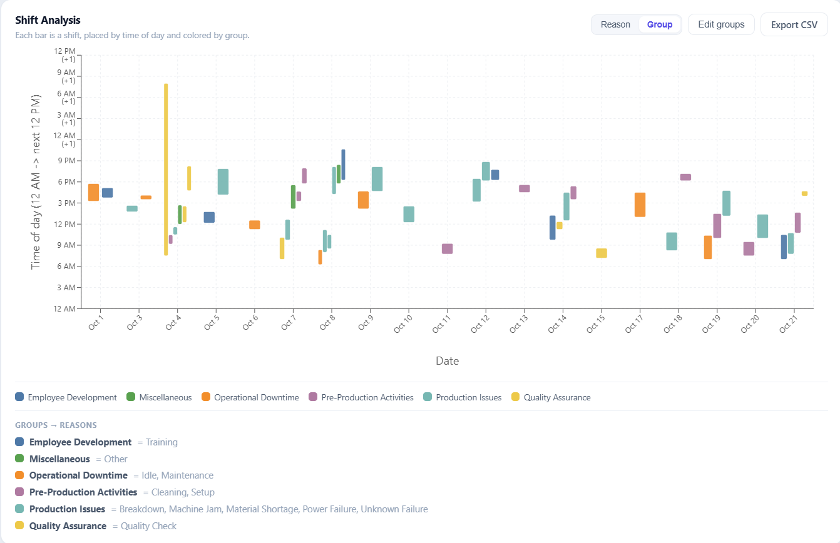
11 · REQUIREMENT 7 · BUILT FOR CHANGE
THE BRIEF, DELIVERED LIVE
New categories appear, related ones group — every view re-flows
Reasons are derived from the data, never hardcoded, and colours are assigned deterministically. Merge related reasons in the group editor and every chart, streak and score re-aggregates instantly — proven live by uploading sample_new_categories.
Shift Operations Analytics · Md Raisul Islam Rahad
11 / 21
Notes:
Requirement seven: stay useful as categories appear or get grouped. Reasons are derived from the data, never hardcoded, and colours are assigned deterministically so a new reason just takes the next colour. Merge related reasons in the group editor and every chart, streak and score re-aggregates instantly - I prove it live by uploading a dataset of brand-new reasons. This is the requirement the key finding a few slides back was really about.

Slide 14
PART II
Beyond
the brief
II
— Reliability KPIs — MTBF, MTTR, Availability
— Optional AI that structurally cannot fabricate
— Upload any format, export a filtered CSV
Notes:
Part two: what I built beyond the brief. Three things - reliability KPIs in the language a maintenance team actually uses, optional AI that's structurally prevented from fabricating data, and upload-any-format in with a filtered CSV out. This is where I went past the minimum to make it feel like a real product rather than an assignment.

Slide 15
12 · RELIABILITY KPIS
BEYOND THE BRIEF
Speak the maintenance team's language — no black boxes
MTTR = downtime hours ÷ failure count (mean time to repair)
MTBF = uptime hours ÷ failure count (mean time between failures)
Availability = uptime ÷ total × 100 = MTBF ÷ (MTBF + MTTR) × 100
Reliability
Standard maintenance KPIs computed over unplanned failures
7.38 h
MTBF
Mean Time Between Failures
2.77 h
MTTR
Mean Time To Repair
72.7%
Availability
Uptime Share
14
Failures
38.8 h Downtime
Shift Operations Analytics · Md Raisul Islam Rahad
12 / 21
Notes:
These weren't required — I added them because reliability is the language maintenance teams actually speak. The three tie together algebraically, and every tile explains its own formula on hover so nothing feels like a magic number.

Slide 16
13 · AI FEATURES
BEYOND THE BRIEF
Useful — and boxed in so they can't fabricate data
Suggest grouping
Executive summary
An LLM proposes reason groups, merging synonyms, typos and casing variants.
A plain-language briefing of the current filtered view for leadership.
Output is validated against the real reason list — hallucinated reasons are dropped; nothing persists until you approve.
The model only sees numbers computed server-side — never raw rows — so it cannot invent figures.
Shift Operations Analytics · Md Raisul Islam Rahad
13 / 21
Notes:
AI is a genuine risk if it can invent data, so I boxed it in. The grouping suggestion is checked against the actual reasons — it physically can't introduce a category that isn't in your data. And the summary model never sees a raw row; it only rephrases numbers I already computed. Both degrade cleanly without a key.

Slide 17
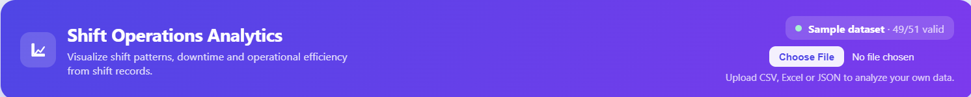
14 · UPLOAD & EXPORT
BEYOND THE BRIEF
Any dataset in — CSV, TSV, Excel or JSON — filtered CSV out
The loader is format-agnostic and re-runs the full cleaning pipeline on every upload, so a brand-new dataset gets the same treatment as the bundled one. The export honours the active filters: what you see is exactly what you download.
Upload
CSV · TSV · Excel · JSON
Clean
Full pipeline re-runs on every upload
Export
Filtered CSV — exactly what you see
Shift Operations Analytics · Md Raisul Islam Rahad
14 / 21
Notes:
Upload and export close the loop. The loader is format-agnostic - CSV, TSV, Excel or JSON - and it re-runs the full cleaning pipeline on every upload, so your data gets exactly the same treatment as the bundled set. And the export honours the active filters, so what you see on screen is precisely what you download.

Slide 18
PART III
How
it’s built
III
— One rule: all logic server-side, the UI renders
— Recover-or-exclude cleaning with an audit trail
— Tested, deployed, extensible by construction
Notes:
Part three: how it's actually built. One rule governs everything - all logic lives on the backend and the UI only renders. I'll cover the architecture, the recover-or-exclude cleaning pipeline with its audit trail, the one key data decision, and how it's tested and deployed. This is the engineering section.

Slide 19
15 · ARCHITECTURE
HOW IT’S BUILT
One rule: all logic on the backend, the UI only renders
BACKEND · RENDER
FRONTEND · VERCEL
Django 6 + DRF
REST API
🗄 PostgreSQL
Supabase
React 19 + Vite SPA
useDashboardData hook
Recharts / SVG panels
Pure renderer —
no business logic
👤 User
Plant manager
/api HTTPS
pandas pipeline
cleaning + analysis
(single source of truth)
Groq LLM
optional
Shift Operations Analytics · Md Raisul Islam Rahad
15 / 21
Notes:
Clean separation. The React app never computes a metric — it asks the API. That guarantees the numbers on screen and in a CSV export always agree, and I can test all logic in Python. The Groq box is dashed because it's fully optional — without a key the app behaves identically minus two buttons.

Slide 20
16 · CLEANING PIPELINE
HOW IT’S BUILT
Detect → recover-or-exclude → gate, with a full audit trail
is_valid = true
charts · streaks · score
START / END valid?
HOURS = END−START?
Date ok? / duplicate?
Raw row
5 fields
Parse
multi-format
tz-aware
Validity
gate
RECOVER lane
row is fixed, then continues
derive START
= END − HOURS
recompute HOURS
from timestamps
recover date
from START
is_valid = false
quality report only
EXCLUDE → report
invalid ts · END<START · bad date · duplicate
Every row emits {code, detail, action}:
INVALID_DATE · INVALID_START/END · MISSING_START/END · NEGATIVE_HOURS · HOURS_MISMATCH · END_BEFORE_START · CROSS_MIDNIGHT · DUPLICATE
Shift Operations Analytics · Md Raisul Islam Rahad
16 / 21
Notes:
This is the heart of the project. Walk the happy path left to right, then point at one recovery branch — a missing START derived from END minus HOURS — and one exclusion branch. The output is a validity flag plus a list of issues, so a row survives into the report even when excluded from analysis.

Slide 21
17 · KEY DECISION
HOW IT’S BUILT
When HOURS and timestamps disagree, I trust the timestamps
HOURS = 18 but END − START = 4.0 h → which is right?
17 / 21
rows already agree
within rounding
✓ Timestamps are internally consistent — and they drive the timeline / chart axis anyway.
✓ HOURS is a single scalar — — the easy field to fumble on manual data entry.
✓ Documented, defensible assumption — written in the README and the code, not a silent choice.
📌 A decision I'd flag to a stakeholder, not bury in code — if HOURS were authoritative it's a one-function change. And the data model keeps the audit trail: every row stores its raw values, recomputed fields, is_valid flag and issue list.
Shift Operations Analytics · Md Raisul Islam Rahad
17 / 21
Notes:
This is a judgement call and I made it deliberately. I measured it — 44 of 51 rows already agree with the timestamps — so treating timestamps as authoritative recovers the mismatched rows instead of trusting an easily mistyped number. And I documented it.

Slide 22
18 · EXTENSIBILITY, BY CONSTRUCTION
HOW IT’S BUILT
No reason is hardcoded — new categories flow everywhere for free
Filters
Chart legend
+ colours
Grouping
editor
Dataset
any reasons
Reasons derived
at runtime
SELECT DISTINCT
Re-aggregate charts · streaks · score · filters
Proof: upload sample_new_categories → brand-new reasons (Sensor Fault, Tool Change, Calibration, Shift Handover) appear in filters, colours, legend and grouping with zero code changes.
Colours are assigned deterministically from the sorted reason list — a new reason just takes the next colour. Policy (non-productive set, groups, streak targets) is env-driven.
Shift Operations Analytics · Md Raisul Islam Rahad
18 / 21
Notes:
I treated this as a hard constraint. There is no list of reasons anywhere in the code. To prove it, I ship a dataset with reasons that don't exist in the original — you upload it and they flow through filters, colours, legend and grouping with no code change. That's the demo I'd run live.

Slide 23
19 · TESTING & VERIFICATION
HOW IT’S BUILT
The risky parts — cleaning and analysis — carry the tests
Backend — 25 tests (unit + DRF integration)
Every cleaning issue code (recover vs exclude)
Efficiency exclusion + configurable non-productive set
Consecutive-day streak logic + configurable targets
Overnight-axis handling · insight generation
Reason grouping · reliability math
API integration: exact numbers, filters, grouping round-trip, CSV download
Frontend — Vitest + RTL
Filter chips render per reason
Group mode collapses reasons into group chips
Toggling a group selects its member reasons
Reliability tiles + empty state
Every headline number is reproducible from the bundled data: 51 → 49 valid · 86.8% efficiency · the streaks above — I re-ran the real pipeline to confirm.
Shift Operations Analytics · Md Raisul Islam Rahad
19 / 21
Notes:
The cleaning rules and analysis are the risky parts, so the tests concentrate there — including API integration tests that assert exact numbers. Every figure I've shown is reproducible from the bundled data.

Slide 24
20 · DEPLOYMENT
HOW IT’S BUILT
It's live — same code on SQLite locally and Postgres in prod
Vercel
static SPA
(React build)
Render
gunicorn + Django
WhiteNoise static
Supabase
PostgreSQL
🌐 Browser
/api HTTPS
pooler :5432
Same code, two databases — engine chosen from DATABASE_URL via dj-database-url. No schema changes.
Config via env vars (render.yaml); secrets never in code.
RENDER_EXTERNAL_HOSTNAME auto-trusted; CORS locked to the Vercel origin.
Shift Operations Analytics · Md Raisul Islam Rahad
20 / 21
Notes:
It's live, not just local. Frontend on Vercel, API on Render, data on Supabase Postgres. The same Django code runs on SQLite locally and Postgres in production — I flip one environment variable.

Slide 25
21 · DEMO FLOW & LIMITS
HOW IT’S BUILT
What I'd show live — and where I know it would strain
Live demo (≈ 3 min)
1. Dashboard + KPI row (efficiency, valid/total).
2. Quality report: a recovered row and an excluded duplicate.
3. Streak preset toggle → the 4-day run appears. (the money moment)
4. Upload sample_new_categories → new reasons everywhere, no code change.
5. Edit groups / ✨ Suggest with AI → charts re-aggregate.
6. AI summary + export CSV.
Honest limitations / next steps
Scale: move heavy aggregation into SQL + paginate large uploads (pipeline is in-memory today).
Auth & multi-user: active dataset is a singleton → add per-user workspaces.
Streaming AI summary + caching for identical views.
Drill-down from a Pareto bar to its records.
I'd rather show I know the edges of my solution than pretend it has none.
Shift Operations Analytics · Md Raisul Islam Rahad
21 / 21
Notes:
If I get to demo, this is my order — step 3 is the one to land; it makes the extensibility argument visually in two clicks. And I name the limits honestly: the biggest is scale — the pipeline is in-memory today, fine for shift logs, but I'd push aggregation into the database for millions of rows.

Slide 26
IN SUMMARY
Summary
Messy data, handled honestly — 10 issue types, recover-or-exclude, full audit trail. Nothing silently dropped.
Defensible analytics — Efficiency, streaks, reliability — written assumptions, reproducible numbers.
Genuinely extensible — No hardcoded categories; grouping re-flows everything, proven with new-category data.
Engineered like production — Server-side logic, live deploy, optional AI that can't fabricate.
Thank you — happy to dive into any layer.
Md Raisul Islam Rahad · github.com/raisulll · shift-operations-analytics.vercel.app
Notes:
To wrap: the project is really about trusting the data and the analysis on top of it. I handled dirty data transparently, built metrics I can defend, made it extensible by construction, and shipped it like production code. Happy to go deeper anywhere you'd like.

Slide 27
APPENDIX
Anticipated
questions
?
— Prepared answers to the questions a technical panel is most likely to ask.
Notes:
That's the main talk. The remaining slides are an appendix - prepared answers to the questions I'd expect a technical panel to ask, on architecture, data, scale, testing and the AI. I'm happy to jump to any of them, or just take questions live.

Slide 28
Q&A · ARCHITECTURE & DATA
APPENDIX · Q&A PREP
Anticipated questions — architecture & data
Q Why put all analysis on the backend, not the client?
A One source of truth, testable in isolation, reusable by any client, and heavy pandas work stays off the browser. Trade-off: a round-trip per interaction — negligible at this scale.
Q Why SQLite locally but Postgres in production?
A Zero-setup dev vs durable, concurrent prod. dj-database-url picks the engine from DATABASE_URL — identical models and migrations, no code change.
Q What happens when HOURS and the timestamps disagree?
A Timestamps win — HOURS is recomputed. One explicit rule resolves a whole class of conflicts consistently, and it’s configurable if the opposite were wanted.
Q How do you handle a brand-new failure reason?
A It flows through automatically — reasons are derived from data, colours are deterministic, grouping and policy live in config. Demoed by sample_new_categories.
Shift Operations Analytics · Md Raisul Islam Rahad
A1
Notes:
These are my prepared answers on architecture and data: why all analysis sits on the backend, why SQLite locally but Postgres in production, what happens when HOURS and the timestamps disagree, and how a brand-new reason flows through. I'll let you drive - point me at whichever one you want to dig into.

Slide 29
Q&A · SCALE, TESTING & AI
APPENDIX · Q&A PREP
Anticipated questions — scale, testing & AI
Q How would this scale to millions of rows?
A Move cleaning to a batch / streaming job, store aggregates, and paginate. The clean separation — pipeline → stored records → analysis — means the API and UI wouldn’t change.
Q What stops the AI features from fabricating numbers?
A The model only sees pre-computed metrics, never raw rows; grouping output is validated against the real reason list. Without a key the features disable cleanly.
Q How is the cross-midnight shift handled correctly?
A The backend emits minutes-from-midnight (end can exceed 1440) and a crosses_midnight flag; the chart uses a 36-hour axis so an overnight shift is one continuous bar.
Q What would you improve with more time?
A Auth & per-user datasets, background jobs for large uploads, caching of analysis responses, and end-to-end (Playwright) tests over the existing coverage.
Shift Operations Analytics · Md Raisul Islam Rahad
A2
Notes:
And the second set: how this scales to millions of rows, what structurally stops the AI from fabricating numbers, how the cross-midnight shift is handled correctly, and what I'd improve with more time. Same as before - ask, and I'll go as deep as you like.

