Slide 1
◰
Shift Operations
Analytics
Turning messy shift logs into operational decisions
React 19 · Django 6 + DRF · pandas · PostgreSQL · Groq (optional AI)
Md Raisul Islam Rahad — Full-stack technical assignment · Round 3
Live: shift-operations-analytics.vercel.app API: shift-analytics-api.onrender.com
Notes:
I built a web app that takes raw, deliberately messy shift records, cleans them, and turns them into operational insight a plant manager can act on: efficiency, downtime patterns, reliability. All analysis runs server-side in Python; the frontend only renders. I'll walk through the problem, the architecture, and the key engineering decisions.

Slide 2
PART I
The brief,
delivered live
I
— Seven requirements, each shown in the running app
— Live and public — scan the QR to follow along
— The 4-day finding hiding inside the labels
Notes:
Section I: The problem
& the approach.

Slide 3
01 · THE PROBLEM
THE BRIEF, DELIVERED LIVE
It's not a charting task — it's a trust-the-data task
Given shift records with deliberate operational inconsistencies, clean the data, visualize shift patterns, score efficiency, detect recurring breakdown periods, and surface actionable insights — and stay useful when new categories appear or are grouped.
Dirty data
Invalid dates, bad/missing timestamps, negative & mismatched hours, duplicates, overnight shifts — silently dropping rows hides the truth.
Meaningful analysis
Efficiency, multi-day streaks, reliability — each needs a defensible definition, not just a number.
Extensibility
No reason list can be hardcoded; grouping must re-flow every chart, streak and score.
Shift Operations Analytics · Md Raisul Islam Rahad
01 / 21
Notes:
The assignment isn't about drawing charts — it's about handling data you can't trust and building believable analysis on top of it. Those three challenges drove every design decision.

Slide 4
02 · THE BRIEF → DELIVERED
THE BRIEF, DELIVERED LIVE
Every requirement delivered — each shown live in the next slides
From the brief | Delivered as | Where to see it
Detect, document & handle inconsistencies | 10-issue cleaning pipeline — recover or exclude, nothing silently dropped | Data Quality report
Filter & analyse by attribute combinations | Shared apply_filters(): date range, reasons, validity — on every endpoint | Filter bar, all panels
Shift analysis chart with all reasons | Custom 36-hour chart, one coloured bar per shift, every reason included | Shift Analysis panel
Identify meaningful breakdown streaks | Configurable consecutive-day detection with severity; assumptions documented | Streaks panel + README
Efficiency = (Productive ÷ Total) × 100 | Implemented literally — 86.8% overall + daily trend; reason set configurable | KPI row + trend chart
At least 3 actionable insights | 5+ insights computed live from the data, never hardcoded | Insights panel
Stays useful as categories appear / group | Reasons derived from data; grouping re-flows every chart, streak & score | Edit groups / upload
React frontend · Django backend · no hardcoding | React 19 + Vite SPA over Django 6 + DRF; all policy lives in config / env | GitHub repo + live app
Shift Operations Analytics · Md Raisul Islam Rahad
02 / 21

Slide 5
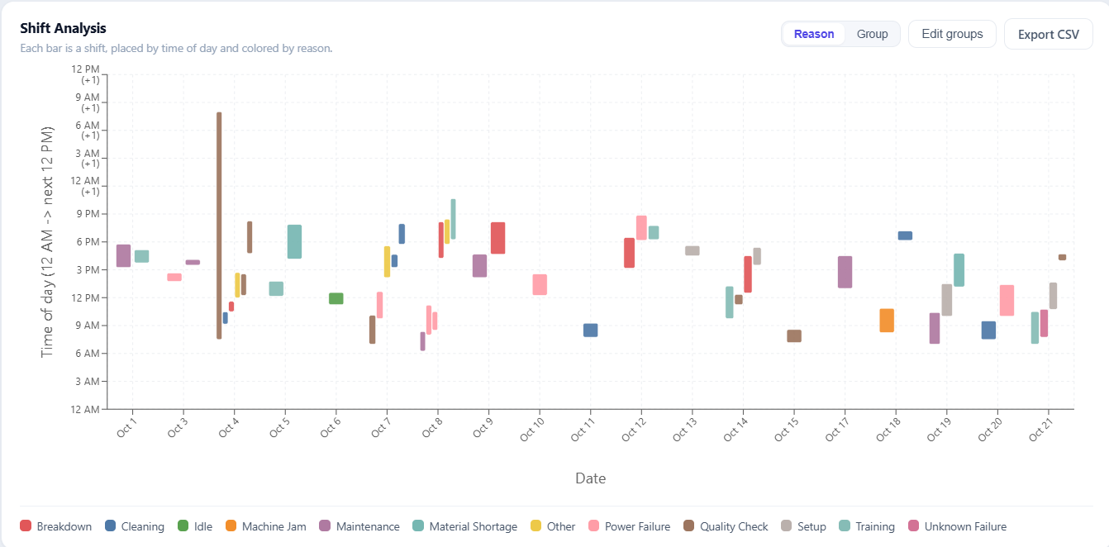

03 · LIVE IN PRODUCTION
THE BRIEF, DELIVERED LIVE
Deployed and public — the panel can open it during this talk
Live app shift-operations-analytics.vercel.app · API shift-analytics-api.onrender.com · Code github.com/Raisulll/Shift-Operations-Analytics
Scan to open the live app
Shift Operations Analytics · Md Raisul Islam Rahad
03 / 21

Slide 6
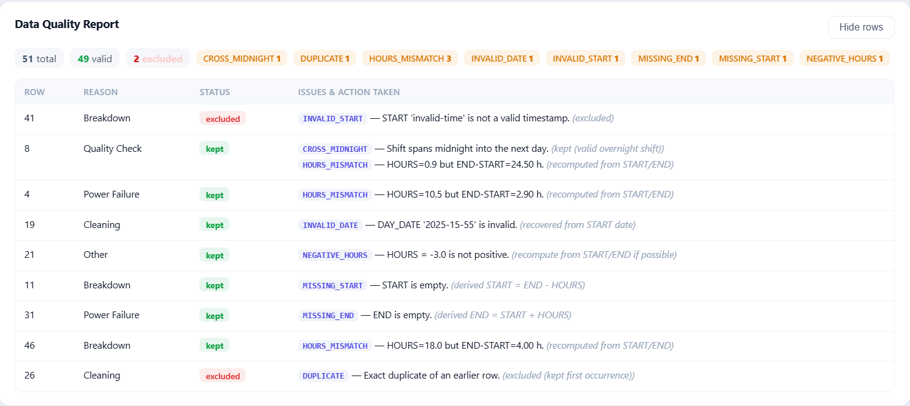
04 · REQUIREMENT 1 · DATA QUALITY
THE BRIEF, DELIVERED LIVE
Detect, document and handle inconsistencies — nothing dropped in silence
The Data Quality report lists every flagged row with its issue and the action taken: recovered rows keep their derived values, excluded rows stay visible with the reason. Ten issue types are detected, and the full catalogue is documented in the README.
Shift Operations Analytics · Md Raisul Islam Rahad
04 / 21

Slide 7
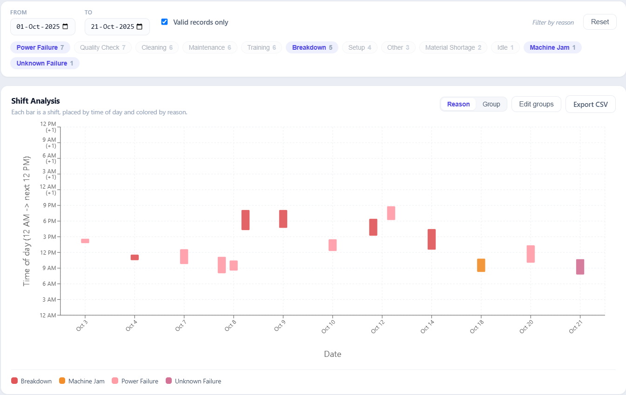
05 · REQUIREMENT 2 · FILTER & ANALYSE
THE BRIEF, DELIVERED LIVE
Filter and analyse by any combination of attributes
One shared filter — date range, reasons, validity — drives every panel and the CSV export, so a filtered view and its download always agree. Combinations apply everywhere at once: charts, streaks, score and insights.
Shift Operations Analytics · Md Raisul Islam Rahad
05 / 21

Slide 8
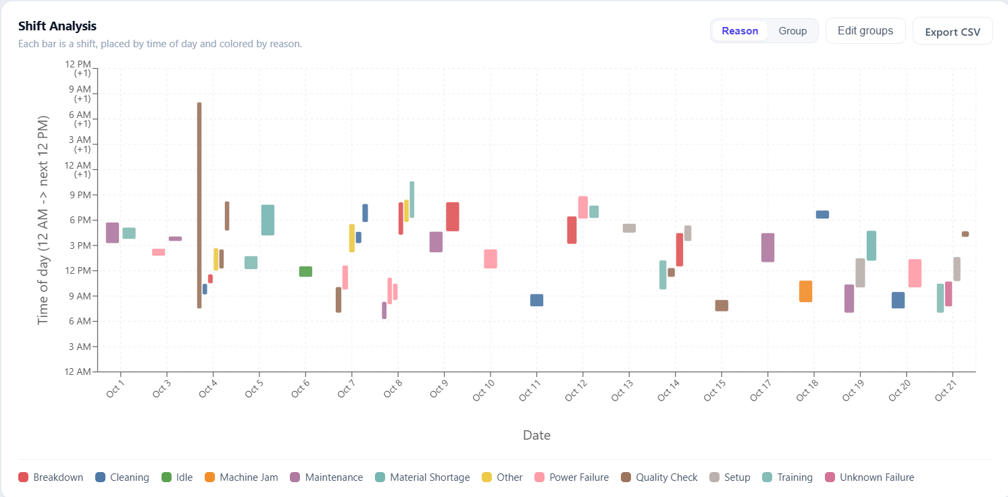
06 · REQUIREMENT 3 · SHIFT CHART
THE BRIEF, DELIVERED LIVE
A 36-hour axis keeps overnight shifts as one continuous bar
Date on X, time of day on Y, one coloured bar per shift. A 22:00 → 06:00 shift crosses midnight, so the axis runs 12 AM → next 12 PM (36 h): an overnight bar simply passes the 24-hour line — see Oct 4 — instead of wrapping or breaking.
Shift Operations Analytics · Md Raisul Islam Rahad
06 / 21
Notes:
A subtle correctness issue that's easy to get wrong. Real plants run night shifts, so I extended the axis to 36 hours. A bar's start and end are just minutes from midnight, so a cross-midnight shift naturally draws as one continuous bar past the 24-hour mark instead of wrapping around.

Slide 9
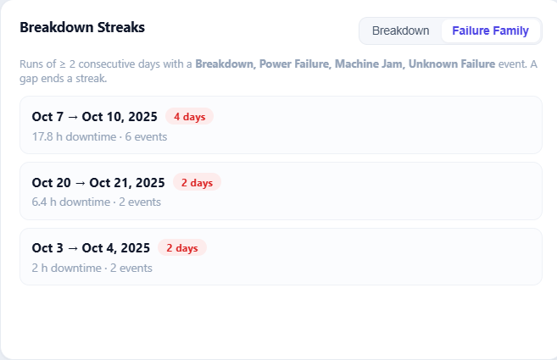
07 · REQUIREMENT 4 · BREAKDOWN STREAKS
THE BRIEF, DELIVERED LIVE
Identify meaningful breakdown streaks — configurable and documented
A streak is N or more consecutive calendar days, each containing at least one record from a configurable target set — reported with span, length and severity in downtime hours. Presets switch the definition live; the assumptions are written down, not implied.
Shift Operations Analytics · Md Raisul Islam Rahad
07 / 21

Slide 10
08 · THE KEY FINDING
THE BRIEF, DELIVERED LIVE
Grouping the labels reveals a 4-day run the raw label hides
Literal “Breakdown”
2-day blip
Failure family
2d
4-DAY RUN (Oct 7–10)
2d
Oct 3
Oct 6
Oct 9
Oct 12
Oct 15
Oct 18
Oct 21
Literal Breakdown label → one 2-day blip. Widen to the failure family (Breakdown + Power Failure + Machine Jam + Unknown Failure) → a 4-day downtime run emerges.
➡ Concrete, data-driven evidence for why categories must be groupable.
Shift Operations Analytics · Md Raisul Islam Rahad
08 / 21
Notes:
My favourite result. If you only look at the literal 'Breakdown' reason, you see a minor two-day blip. But those failures are logged under several labels. Group them into a failure family and a four-day continuous downtime run emerges — the kind of thing a manager must treat as one incident. That's the argument for the whole extensibility requirement, made with the data itself.

Slide 11
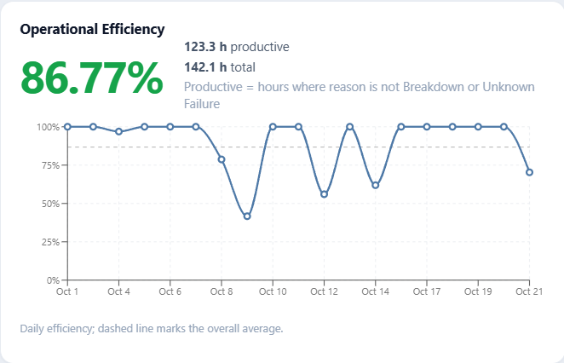
09 · REQUIREMENT 5 · EFFICIENCY SCORE
THE BRIEF, DELIVERED LIVE
(Productive ÷ Total) × 100 — implemented exactly as specified
86.8% overall on the bundled data, plus a daily trend. I followed the formula literally — only Breakdown and Unknown Failure count as non-productive — then made the set configurable, and gave streaks a broader failure family so downtime analysis is not limited by the formula.
Shift Operations Analytics · Md Raisul Islam Rahad
09 / 21

Slide 12
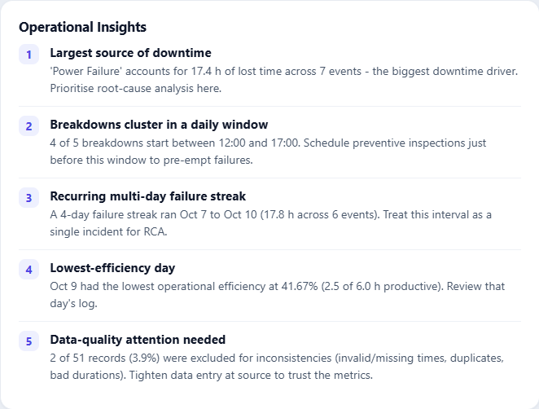
10 · REQUIREMENT 6 · ACTIONABLE INSIGHTS
THE BRIEF, DELIVERED LIVE
Five-plus insights a plant manager can act on — computed, never hardcoded
Biggest downtime driver, peak failure window, worst day, data-quality signal and more — each generated live from the current filtered dataset, so the insights update the moment the data, the filters or the grouping change.
Shift Operations Analytics · Md Raisul Islam Rahad
10 / 21

Slide 13
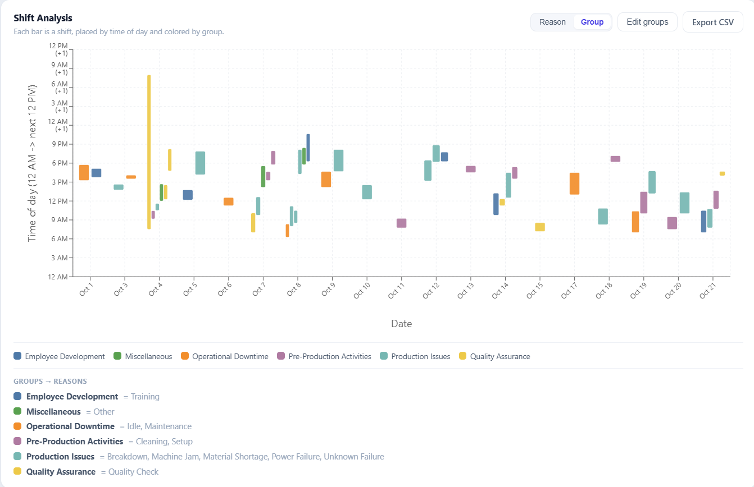
11 · REQUIREMENT 7 · BUILT FOR CHANGE
THE BRIEF, DELIVERED LIVE
New categories appear, related ones group — every view re-flows
Reasons are derived from the data, never hardcoded, and colours are assigned deterministically. Merge related reasons in the group editor and every chart, streak and score re-aggregates instantly — proven live by uploading sample_new_categories.
Shift Operations Analytics · Md Raisul Islam Rahad
11 / 21

Slide 14
PART II
Beyond
the brief
II
— Reliability KPIs — MTBF, MTTR, Availability
— Optional AI that structurally cannot fabricate
— Upload any format, export a filtered CSV
Notes:
Section II: Cleaning
messy data.

Slide 15
12 · RELIABILITY KPIS
BEYOND THE BRIEF
Speak the maintenance team's language — no black boxes
MTTR = downtime hours ÷ failure count (mean time to repair)
MTBF = uptime hours ÷ failure count (mean time between failures)
Availability = uptime ÷ total × 100 = MTBF ÷ (MTBF + MTTR) × 100
Reliability
Standard maintenance KPIs computed over unplanned failures
7.38 h
MTBF
Mean Time Between Failures
2.77 h
MTTR
Mean Time To Repair
72.7%
Availability
Uptime Share
14
Failures
38.8 h Downtime
Shift Operations Analytics · Md Raisul Islam Rahad
12 / 21
Notes:
These weren't required — I added them because reliability is the language maintenance teams actually speak. The three tie together algebraically, and every tile explains its own formula on hover so nothing feels like a magic number.

Slide 16
13 · AI FEATURES
BEYOND THE BRIEF
Useful — and boxed in so they can't fabricate data
Suggest grouping
Executive summary
An LLM proposes reason groups, merging synonyms, typos and casing variants.
A plain-language briefing of the current filtered view for leadership.
Output is validated against the real reason list — hallucinated reasons are dropped; nothing persists until you approve.
The model only sees numbers computed server-side — never raw rows — so it cannot invent figures.
Shift Operations Analytics · Md Raisul Islam Rahad
13 / 21
Notes:
AI is a genuine risk if it can invent data, so I boxed it in. The grouping suggestion is checked against the actual reasons — it physically can't introduce a category that isn't in your data. And the summary model never sees a raw row; it only rephrases numbers I already computed. Both degrade cleanly without a key.

Slide 17
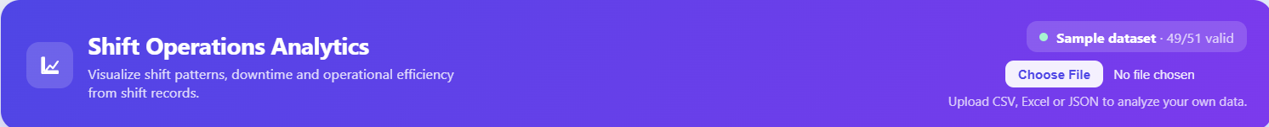
14 · UPLOAD & EXPORT
BEYOND THE BRIEF
Any dataset in — CSV, TSV, Excel or JSON — filtered CSV out
The loader is format-agnostic and re-runs the full cleaning pipeline on every upload, so a brand-new dataset gets the same treatment as the bundled one. The export honours the active filters: what you see is exactly what you download.
Upload
CSV · TSV · Excel · JSON
Clean
Full pipeline re-runs on every upload
Export
Filtered CSV — exactly what you see
Shift Operations Analytics · Md Raisul Islam Rahad
14 / 21

Slide 18
PART III
How
it’s built
III
— One rule: all logic server-side, the UI renders
— Recover-or-exclude cleaning with an audit trail
— Tested, deployed, extensible by construction
Notes:
Section III: Analysis
& the key finding.

Slide 19
15 · ARCHITECTURE
HOW IT’S BUILT
One rule: all logic on the backend, the UI only renders
BACKEND · RENDER
FRONTEND · VERCEL
Django 6 + DRF
REST API
🗄 PostgreSQL
Supabase
React 19 + Vite SPA
useDashboardData hook
Recharts / SVG panels
Pure renderer —
no business logic
👤 User
Plant manager
/api HTTPS
pandas pipeline
cleaning + analysis
(single source of truth)
Groq LLM
optional
Shift Operations Analytics · Md Raisul Islam Rahad
15 / 21
Notes:
Clean separation. The React app never computes a metric — it asks the API. That guarantees the numbers on screen and in a CSV export always agree, and I can test all logic in Python. The Groq box is dashed because it's fully optional — without a key the app behaves identically minus two buttons.

Slide 20
16 · CLEANING PIPELINE
HOW IT’S BUILT
Detect → recover-or-exclude → gate, with a full audit trail
is_valid = true
charts · streaks · score
START / END valid?
HOURS = END−START?
Date ok? / duplicate?
Raw row
5 fields
Parse
multi-format
tz-aware
Validity
gate
RECOVER lane
row is fixed, then continues
derive START
= END − HOURS
recompute HOURS
from timestamps
recover date
from START
is_valid = false
quality report only
EXCLUDE → report
invalid ts · END<START · bad date · duplicate
Every row emits {code, detail, action}:
INVALID_DATE · INVALID_START/END · MISSING_START/END · NEGATIVE_HOURS · HOURS_MISMATCH · END_BEFORE_START · CROSS_MIDNIGHT · DUPLICATE
Shift Operations Analytics · Md Raisul Islam Rahad
16 / 21
Notes:
This is the heart of the project. Walk the happy path left to right, then point at one recovery branch — a missing START derived from END minus HOURS — and one exclusion branch. The output is a validity flag plus a list of issues, so a row survives into the report even when excluded from analysis.

Slide 21
17 · KEY DECISION
HOW IT’S BUILT
When HOURS and timestamps disagree, I trust the timestamps
HOURS = 18 but END − START = 4.0 h → which is right?
17 / 21
rows already agree
within rounding
✓ Timestamps are internally consistent — and they drive the timeline / chart axis anyway.
✓ HOURS is a single scalar — — the easy field to fumble on manual data entry.
✓ Documented, defensible assumption — written in the README and the code, not a silent choice.
📌 A decision I'd flag to a stakeholder, not bury in code — if HOURS were authoritative it's a one-function change. And the data model keeps the audit trail: every row stores its raw values, recomputed fields, is_valid flag and issue list.
Shift Operations Analytics · Md Raisul Islam Rahad
17 / 21
Notes:
This is a judgement call and I made it deliberately. I measured it — 44 of 51 rows already agree with the timestamps — so treating timestamps as authoritative recovers the mismatched rows instead of trusting an easily mistyped number. And I documented it.

Slide 22
18 · EXTENSIBILITY, BY CONSTRUCTION
HOW IT’S BUILT
No reason is hardcoded — new categories flow everywhere for free
Filters
Chart legend
+ colours
Grouping
editor
Dataset
any reasons
Reasons derived
at runtime
SELECT DISTINCT
Re-aggregate charts · streaks · score · filters
Proof: upload sample_new_categories → brand-new reasons (Sensor Fault, Tool Change, Calibration, Shift Handover) appear in filters, colours, legend and grouping with zero code changes.
Colours are assigned deterministically from the sorted reason list — a new reason just takes the next colour. Policy (non-productive set, groups, streak targets) is env-driven.
Shift Operations Analytics · Md Raisul Islam Rahad
18 / 21
Notes:
I treated this as a hard constraint. There is no list of reasons anywhere in the code. To prove it, I ship a dataset with reasons that don't exist in the original — you upload it and they flow through filters, colours, legend and grouping with no code change. That's the demo I'd run live.

Slide 23
19 · TESTING & VERIFICATION
HOW IT’S BUILT
The risky parts — cleaning and analysis — carry the tests
Backend — 25 tests (unit + DRF integration)
Every cleaning issue code (recover vs exclude)
Efficiency exclusion + configurable non-productive set
Consecutive-day streak logic + configurable targets
Overnight-axis handling · insight generation
Reason grouping · reliability math
API integration: exact numbers, filters, grouping round-trip, CSV download
Frontend — Vitest + RTL
Filter chips render per reason
Group mode collapses reasons into group chips
Toggling a group selects its member reasons
Reliability tiles + empty state
Every headline number is reproducible from the bundled data: 51 → 49 valid · 86.8% efficiency · the streaks above — I re-ran the real pipeline to confirm.
Shift Operations Analytics · Md Raisul Islam Rahad
19 / 21
Notes:
The cleaning rules and analysis are the risky parts, so the tests concentrate there — including API integration tests that assert exact numbers. Every figure I've shown is reproducible from the bundled data.

Slide 24
20 · DEPLOYMENT
HOW IT’S BUILT
It's live — same code on SQLite locally and Postgres in prod
Vercel
static SPA
(React build)
Render
gunicorn + Django
WhiteNoise static
Supabase
PostgreSQL
🌐 Browser
/api HTTPS
pooler :5432
Same code, two databases — engine chosen from DATABASE_URL via dj-database-url. No schema changes.
Config via env vars (render.yaml); secrets never in code.
RENDER_EXTERNAL_HOSTNAME auto-trusted; CORS locked to the Vercel origin.
Shift Operations Analytics · Md Raisul Islam Rahad
20 / 21
Notes:
It's live, not just local. Frontend on Vercel, API on Render, data on Supabase Postgres. The same Django code runs on SQLite locally and Postgres in production — I flip one environment variable.

Slide 25
21 · DEMO FLOW & LIMITS
HOW IT’S BUILT
What I'd show live — and where I know it would strain
Live demo (≈ 3 min)
1. Dashboard + KPI row (efficiency, valid/total).
2. Quality report: a recovered row and an excluded duplicate.
3. Streak preset toggle → the 4-day run appears. (the money moment)
4. Upload sample_new_categories → new reasons everywhere, no code change.
5. Edit groups / ✨ Suggest with AI → charts re-aggregate.
6. AI summary + export CSV.
Honest limitations / next steps
Scale: move heavy aggregation into SQL + paginate large uploads (pipeline is in-memory today).
Auth & multi-user: active dataset is a singleton → add per-user workspaces.
Streaming AI summary + caching for identical views.
Drill-down from a Pareto bar to its records.
I'd rather show I know the edges of my solution than pretend it has none.
Shift Operations Analytics · Md Raisul Islam Rahad
21 / 21
Notes:
If I get to demo, this is my order — step 3 is the one to land; it makes the extensibility argument visually in two clicks. And I name the limits honestly: the biggest is scale — the pipeline is in-memory today, fine for shift logs, but I'd push aggregation into the database for millions of rows.

Slide 26
IN SUMMARY
Summary
Messy data, handled honestly — 10 issue types, recover-or-exclude, full audit trail. Nothing silently dropped.
Defensible analytics — Efficiency, streaks, reliability — written assumptions, reproducible numbers.
Genuinely extensible — No hardcoded categories; grouping re-flows everything, proven with new-category data.
Engineered like production — Server-side logic, live deploy, optional AI that can't fabricate.
Thank you — happy to dive into any layer.
Md Raisul Islam Rahad · github.com/raisulll · shift-operations-analytics.vercel.app
Notes:
To wrap: the project is really about trusting the data and the analysis on top of it. I handled dirty data transparently, built metrics I can defend, made it extensible by construction, and shipped it like production code. Happy to go deeper anywhere you'd like.

Slide 27
APPENDIX
Anticipated
questions
?
— Prepared answers to the questions a technical panel is most likely to ask.

Slide 28
Q&A · ARCHITECTURE & DATA
APPENDIX · Q&A PREP
Anticipated questions — architecture & data
Q Why put all analysis on the backend, not the client?
A One source of truth, testable in isolation, reusable by any client, and heavy pandas work stays off the browser. Trade-off: a round-trip per interaction — negligible at this scale.
Q Why SQLite locally but Postgres in production?
A Zero-setup dev vs durable, concurrent prod. dj-database-url picks the engine from DATABASE_URL — identical models and migrations, no code change.
Q What happens when HOURS and the timestamps disagree?
A Timestamps win — HOURS is recomputed. One explicit rule resolves a whole class of conflicts consistently, and it’s configurable if the opposite were wanted.
Q How do you handle a brand-new failure reason?
A It flows through automatically — reasons are derived from data, colours are deterministic, grouping and policy live in config. Demoed by sample_new_categories.
Shift Operations Analytics · Md Raisul Islam Rahad
A1

Slide 29
Q&A · SCALE, TESTING & AI
APPENDIX · Q&A PREP
Anticipated questions — scale, testing & AI
Q How would this scale to millions of rows?
A Move cleaning to a batch / streaming job, store aggregates, and paginate. The clean separation — pipeline → stored records → analysis — means the API and UI wouldn’t change.
Q What stops the AI features from fabricating numbers?
A The model only sees pre-computed metrics, never raw rows; grouping output is validated against the real reason list. Without a key the features disable cleanly.
Q How is the cross-midnight shift handled correctly?
A The backend emits minutes-from-midnight (end can exceed 1440) and a crosses_midnight flag; the chart uses a 36-hour axis so an overnight shift is one continuous bar.
Q What would you improve with more time?
A Auth & per-user datasets, background jobs for large uploads, caching of analysis responses, and end-to-end (Playwright) tests over the existing coverage.
Shift Operations Analytics · Md Raisul Islam Rahad
A2

