Slide 1
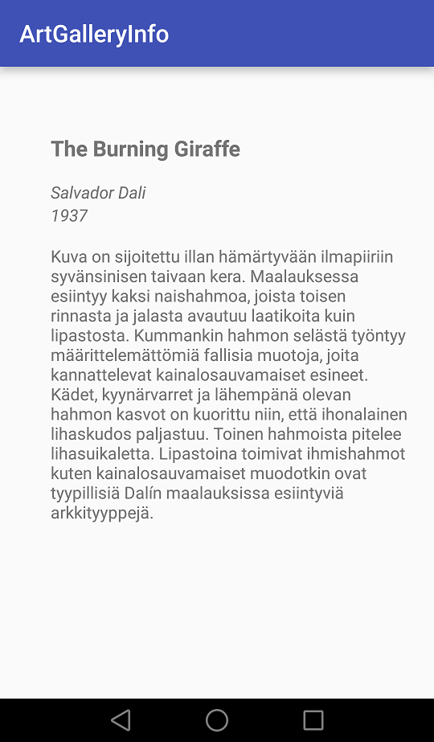
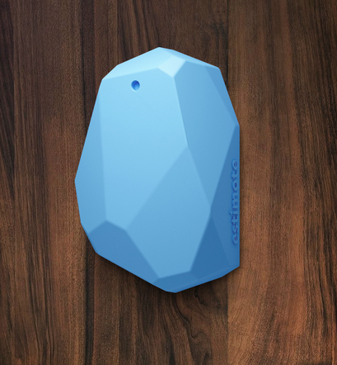
Art Gallery application implemented with Beacons
Atte Visuri, Eetu Lehmus, Jani Kärkkäinen, Anni Toivanen
School of Engineering and Natural Recources, Information Technology, Software Engineering
Introduction
The goal of our project was to design a real-world application for beacon technology. We chose to create a solution for art galleries for displaying info on gallery pieces on visitors’ phones. We were granted use of three Estimote beacons. Our goal was to create both a management tool for the gallery to manage their database and a user-end mobile app for displaying the data from that database.
FIGURE 1. Estimote beacon
Estimote beacon
The beacon is a Bluetooth low energy (BLE) transmitter that transmits location info on top of other info such as movement or temperature. Estimote’s beacons are easily customizable in terms of transmit power and frequency.
Methods
Our main goal was to create the connection from the database to the Android app. The app was designed to check its parameter for beacons and when a new one enters the range, data is fetched from the database according to the beacon’s unique id.
The management web app was created in HTML5 and JSAngular and the database connection is handled with PHP. The database and the app is hosted by the school.
FIGURE 2. Management web app
Results
The management app allows the user to add, edit and delete database entries with ease. Two separate databases were created to handle login and management.
The development of our mobile app was easy to start with the Android –based templates Estimote provided in their website.
FIGURE 3 Mobiiliapp
Conclusions
This solution is just a base for a system that would be of benefitial use to both art galleries and gallery visitors. This solution could easily be expanded to take in customer feedback through the mobile app and place it to the database for the management to read.
References
http://estimote.com/
Project
Date of publication: 2016, Fall
Supervisor Pertti Heikkilä

