Slide 1
BABEŞ-BOLYAI UNIVERSITY CLUJ- NAPOCA FACULTY OF MATHEMATICS AND COMPUTER SCIENCE SPECIALIZATION COMPUTER SCIENCE
MiniMax Algorithm for Gomoku Game: A Multi-Language Analysis and Performance Evaluation
Supervisor,
Arthur-Jozsef Molnar
Author,
Raiu Mădălin-Augustin

Slide 2
Motivation and Description
I
Efficiency & Flexibility
Language Selection
Gomoku
MiniMax

Slide 3
Literature Overview
II

Slide 4

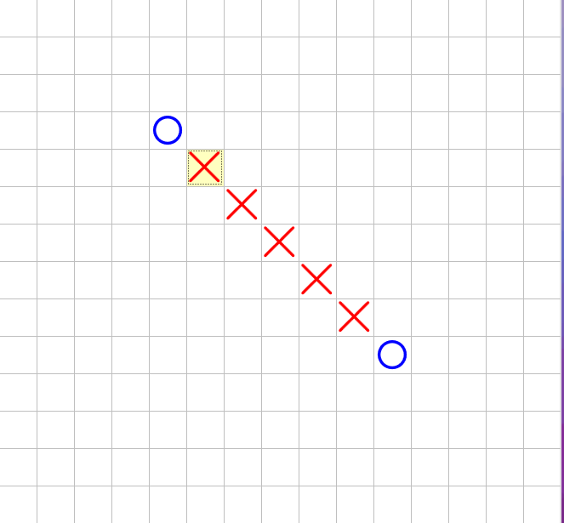
Gomoku
Apeared around 270 BC
Simple rules, complex strategies
Simplicity in design
Popular in algorithm testing
Rules adaptability

Slide 5
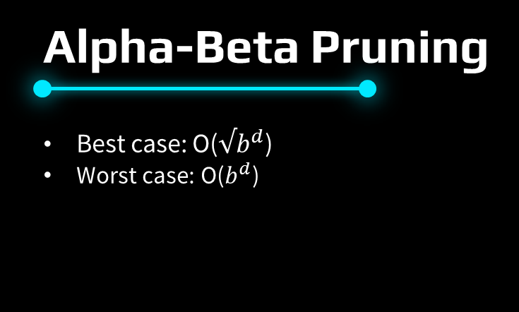
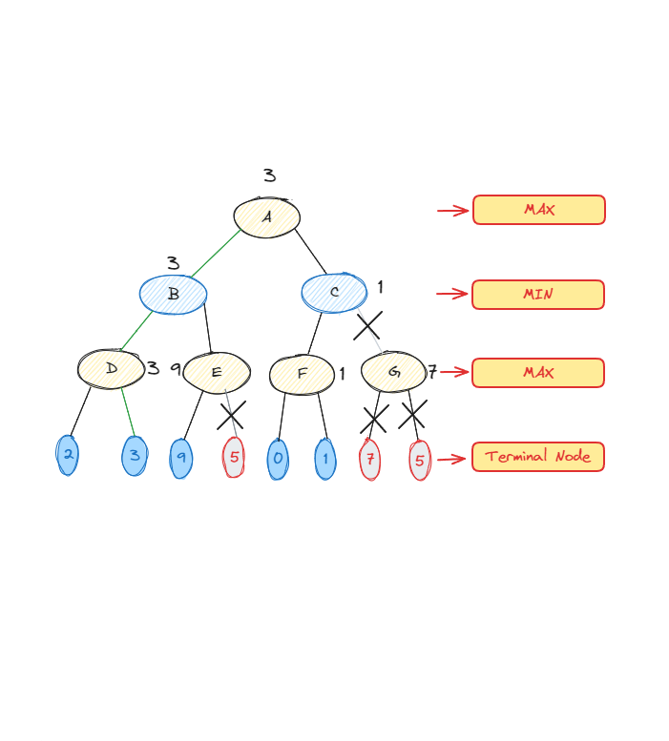

Slide 6
METHODOLOGY & RESULTS
III

Slide 7
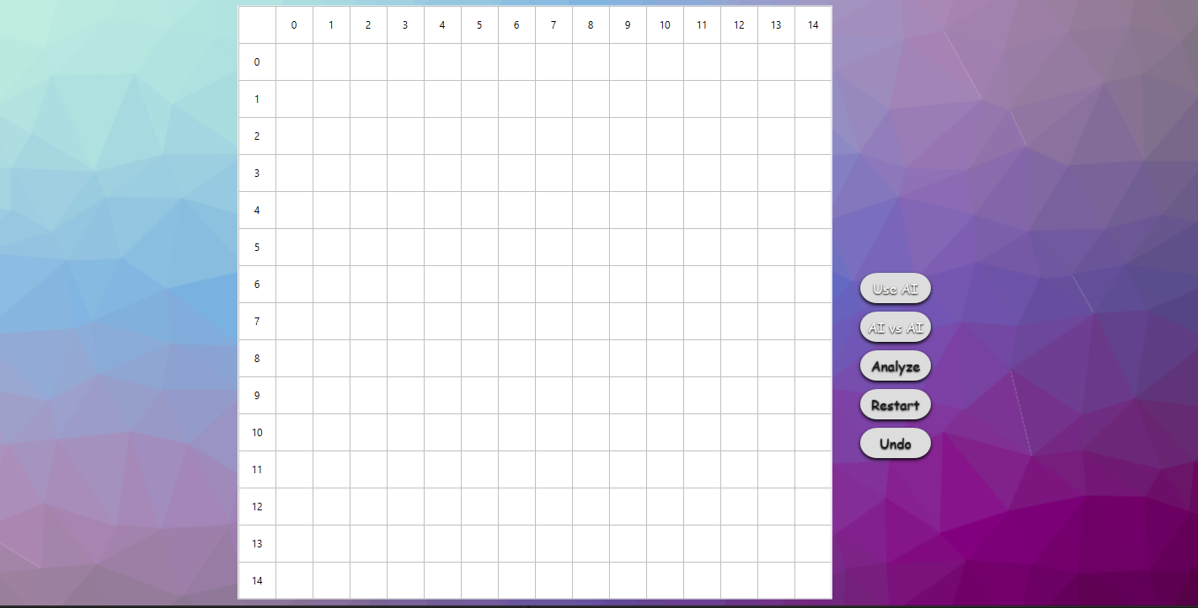
Implementation
Gomoku and MiniMax research
GUI using WPF
Implementing MiniMax in C# and Python
Performance evaluation
Result analysis

Slide 8
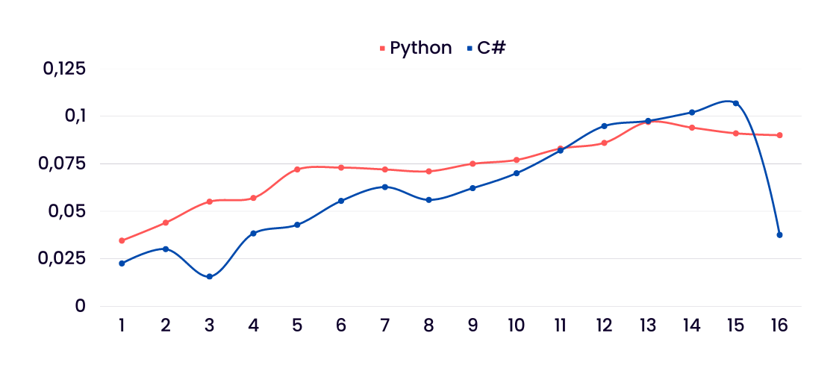
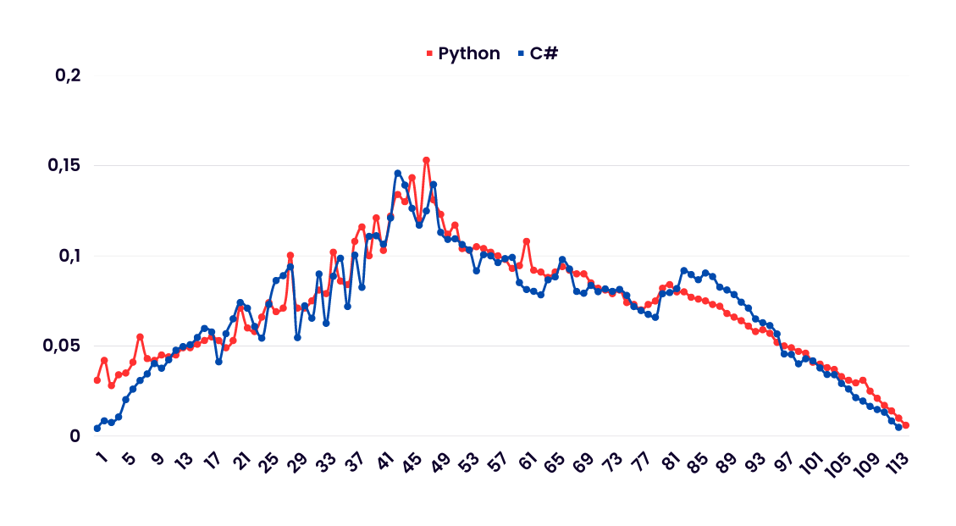
Performance

Slide 9
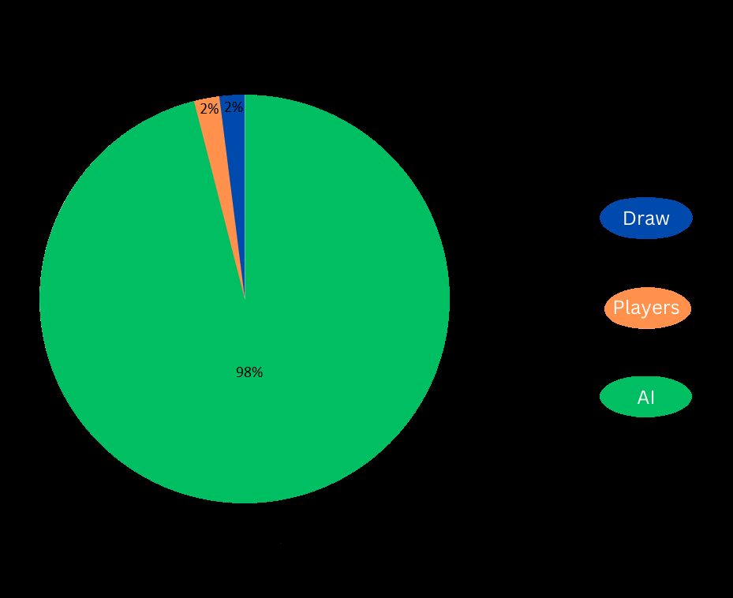
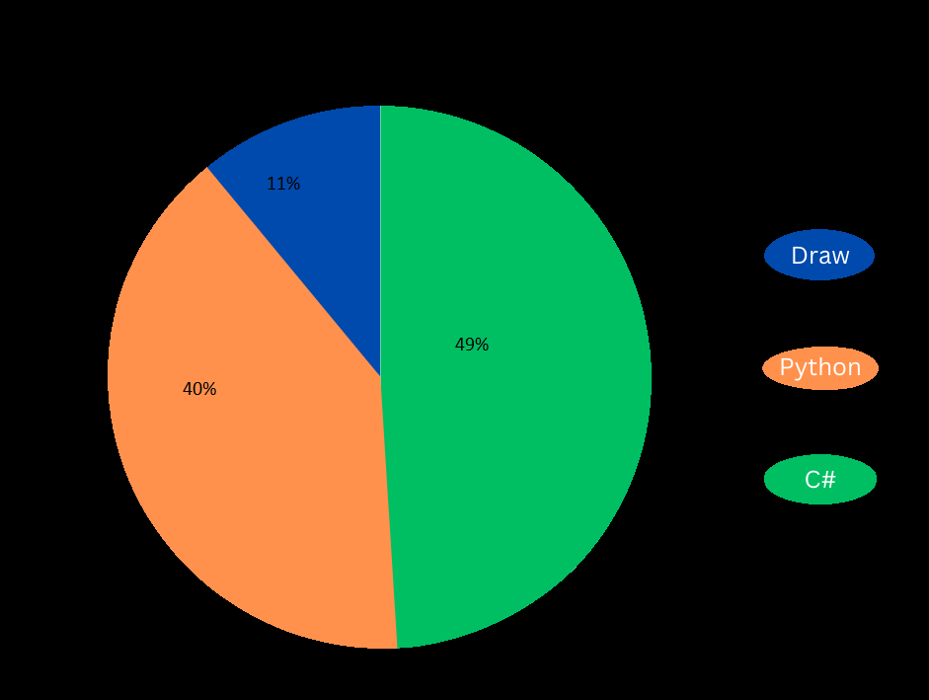
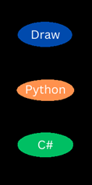
Experiments

Slide 10
Results and Analysis
Execution speed
Performance and ease of implementation
Readability and maintainability
Development considerations

Slide 11
Conclusions

Slide 12
THANK YOU!

