Slide 1



Introduction to Mathematical Modelling of Infectious Diseases
Dr. Oscar Cortés & Dr. Jair Andrade

Slide 2
Outline
Why do we care?
What is a mathematical model?
How can these models be useful?
A brief introduction to the SIR model

Slide 3
Why do we care?

Slide 4
The burden of infectious diseases
249 million malaria cases and 608,000 deaths in 2022¹
2.8 billion people live at risk of arboviral infection (dengue, chikungunya, Zika, …)³
59 million dengue cases and 29,000 deaths in 2021²
Shigellosis (leading cause of diarrhoeal disease) causes 200,000 deaths annually⁴
Editorial, Lancet. Infect. Dis., 2024
Zhang et al., PLOS Negl Trop Dis, 2025
Ribeiro dos Santos et al., Nat. Med., 2025
Khalil et al., Lancet. Infect. Dis., 2018

Slide 5
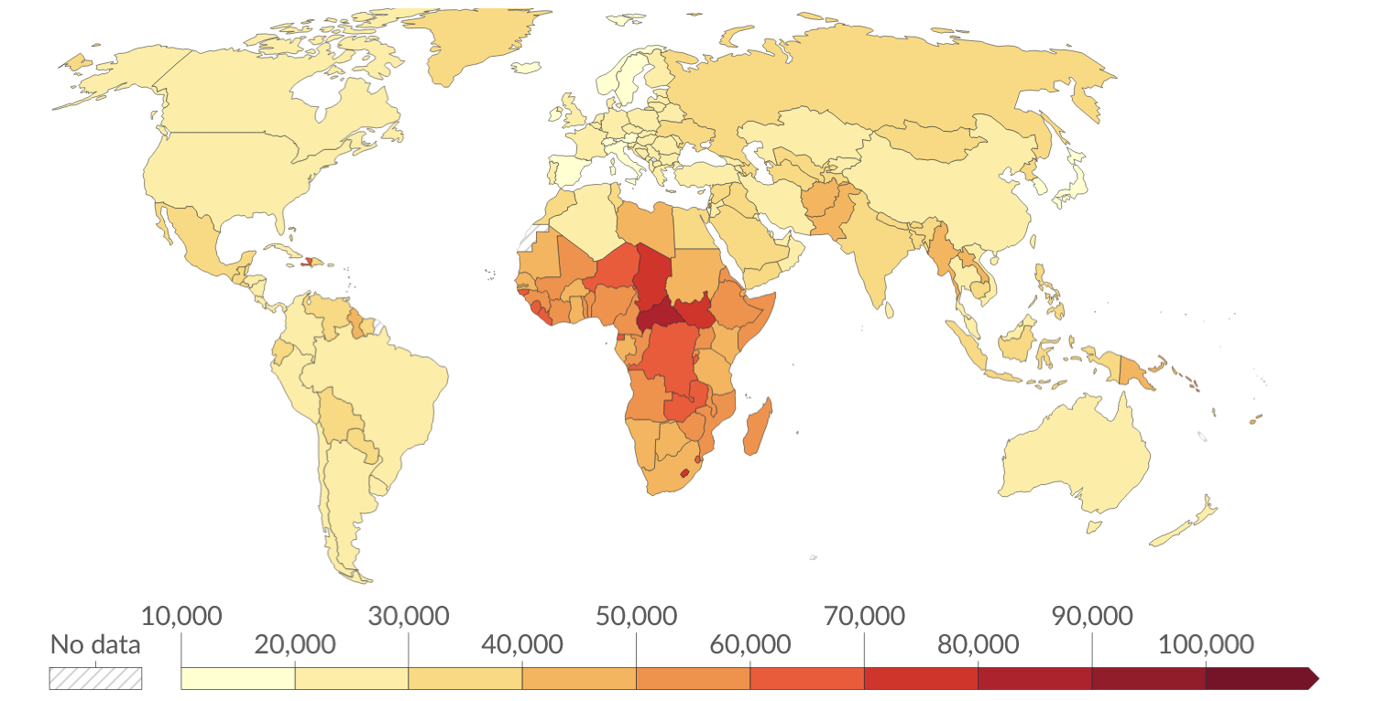
An unequal issue
DALYs (Disability-Adjusted Life Years)
Number of years of full health lost to infectious disease in 2023
Roser, Ritchie & Spooner, Our World in Data, 2024

Slide 6
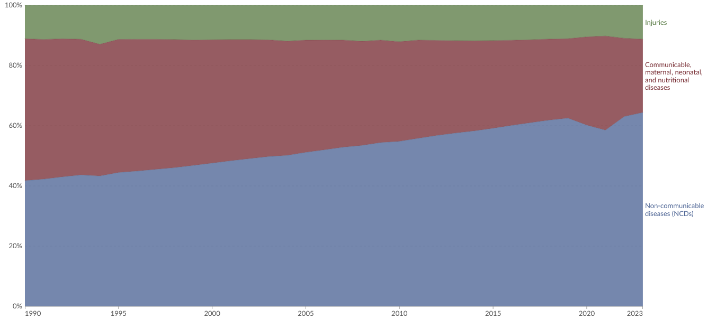
Is it getting any better?
Total disease burden by cause worldwide
~30% in 2023
~50% in 1990
YES!
Roser, Ritchie & Spooner, Our World in Data, 2024

Slide 7
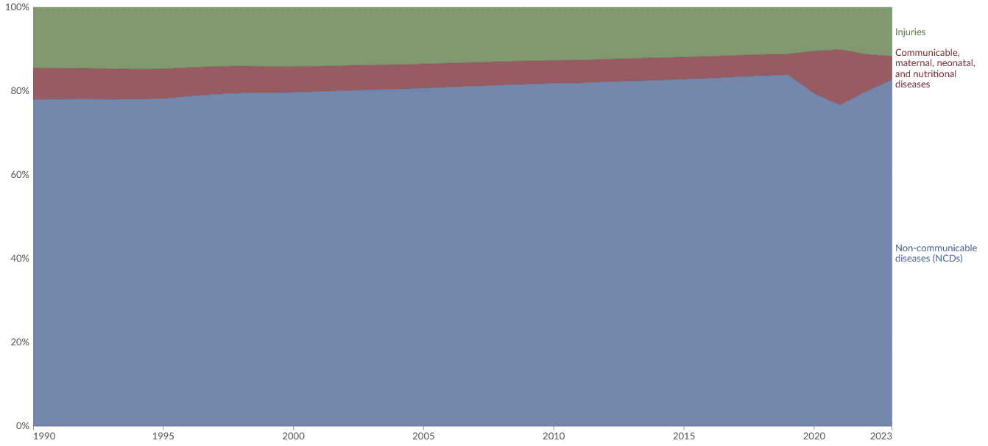
Is it getting any better?
Total disease burden by cause in high-income countries
Roser, Ritchie & Spooner, Our World in Data, 2024

Slide 8
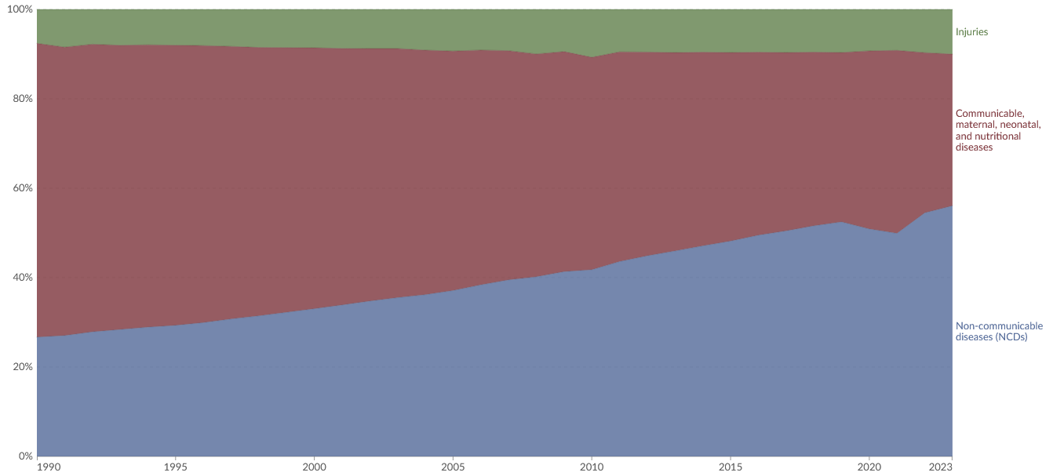
Is it getting any better?
Total disease burden by cause in low- and middle-income countries (LMICs)
YES!
Roser, Ritchie & Spooner, Our World in Data, 2024

Slide 9
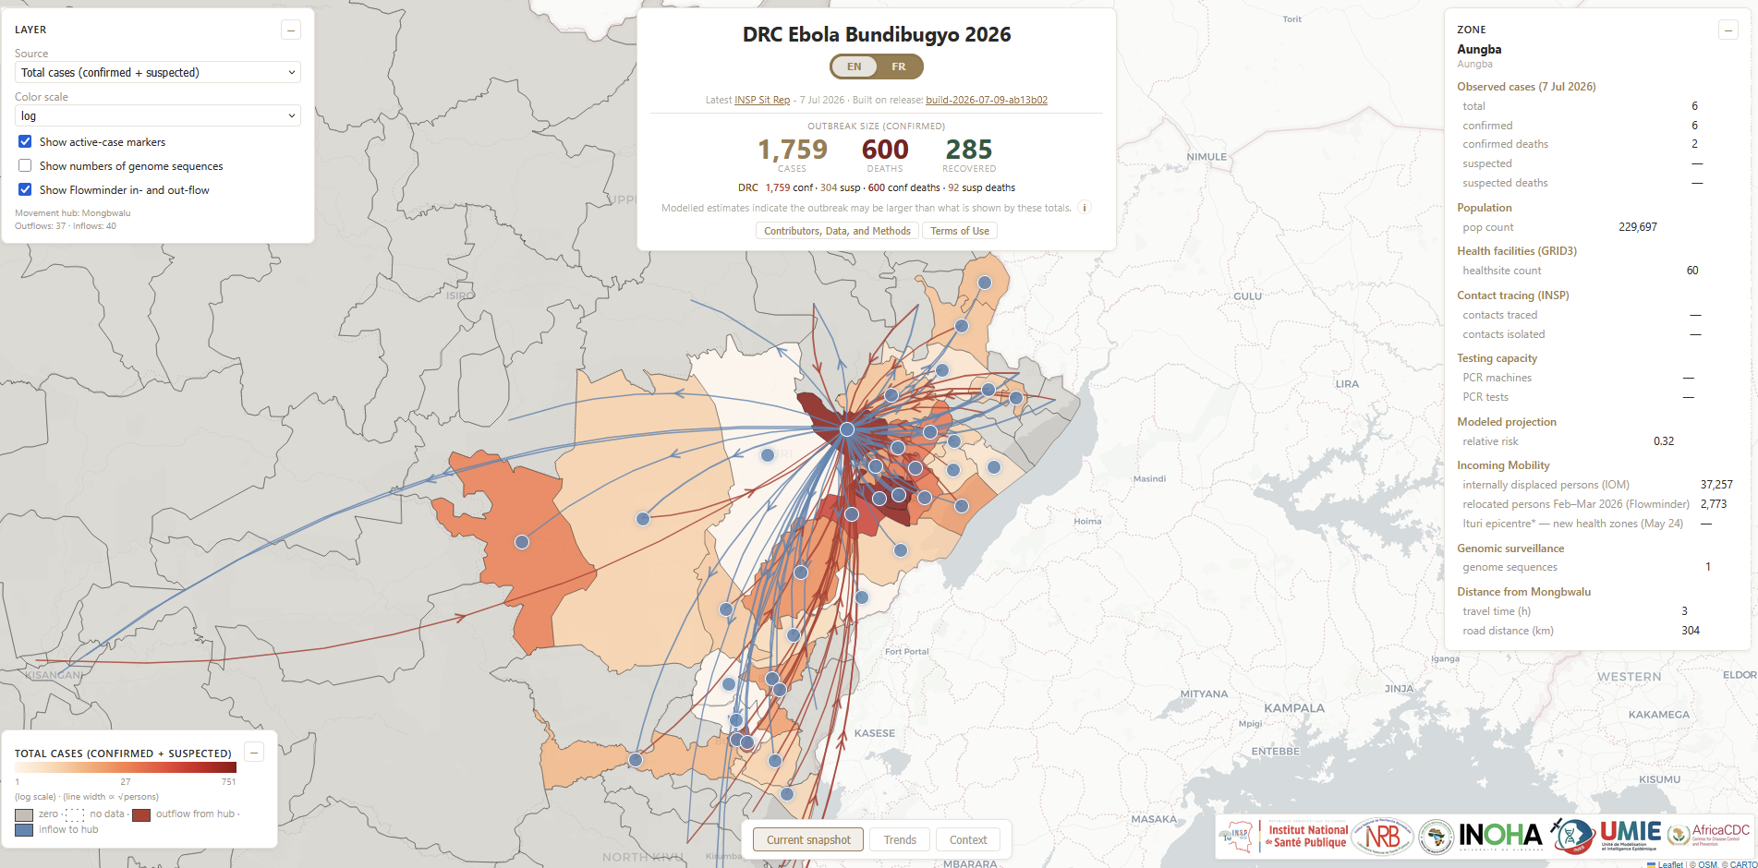
New challenges arise!
New outbreaks occur
INRB Ebola Bundibugyo dashboard, https://inrb-umie.github.io/BDBV2026-Epidemic_Dashboard/

Slide 10
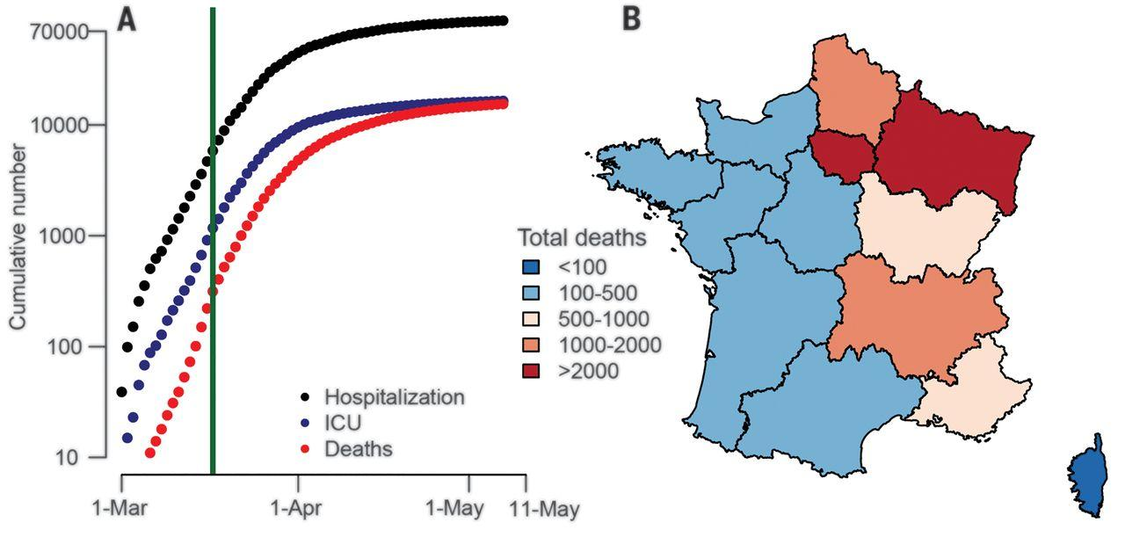
New pathogens emerge
SARS-CoV-2 cases and deaths in France, Mar-May 2020
Salje et al., Science, 2020

Slide 11
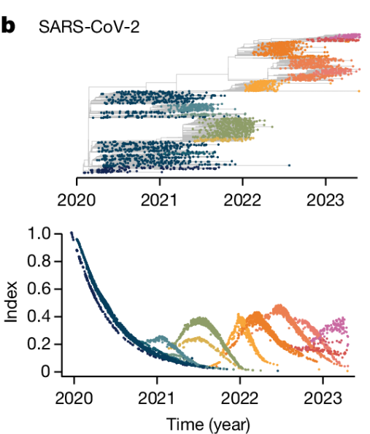
Pathogens evolve
and become more transmissible,
evade vaccines
Lefrancq et al., Nature, 2025

Slide 12
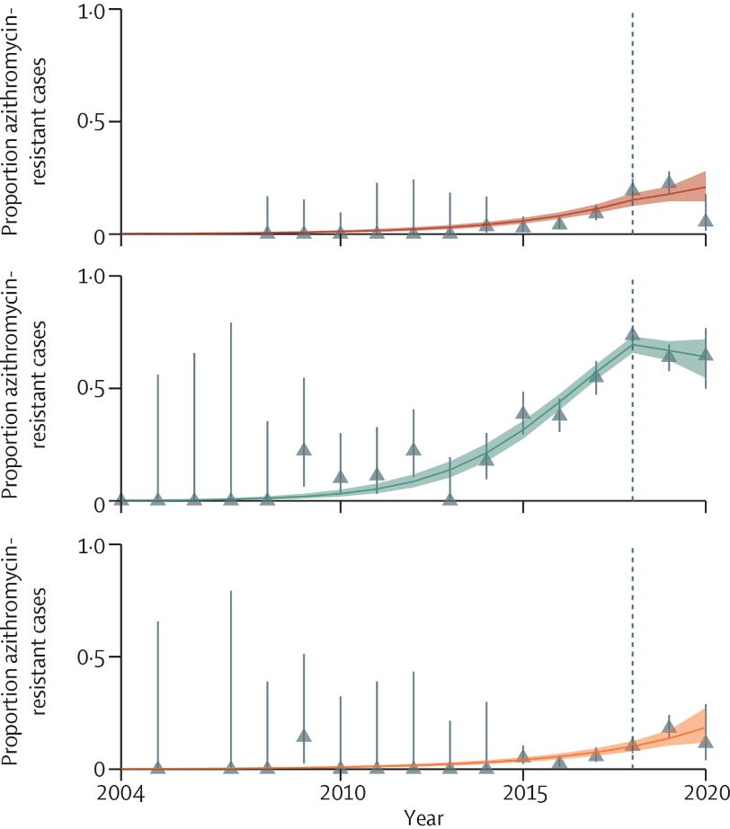
Pathogens evolve
and become resistant to treatments
Antimicrobial resistant (AMR) is on the rise in Shigella in the UK across all demographic groups
Marshall et al., Lancet Infect. Dis., 2026

Slide 13
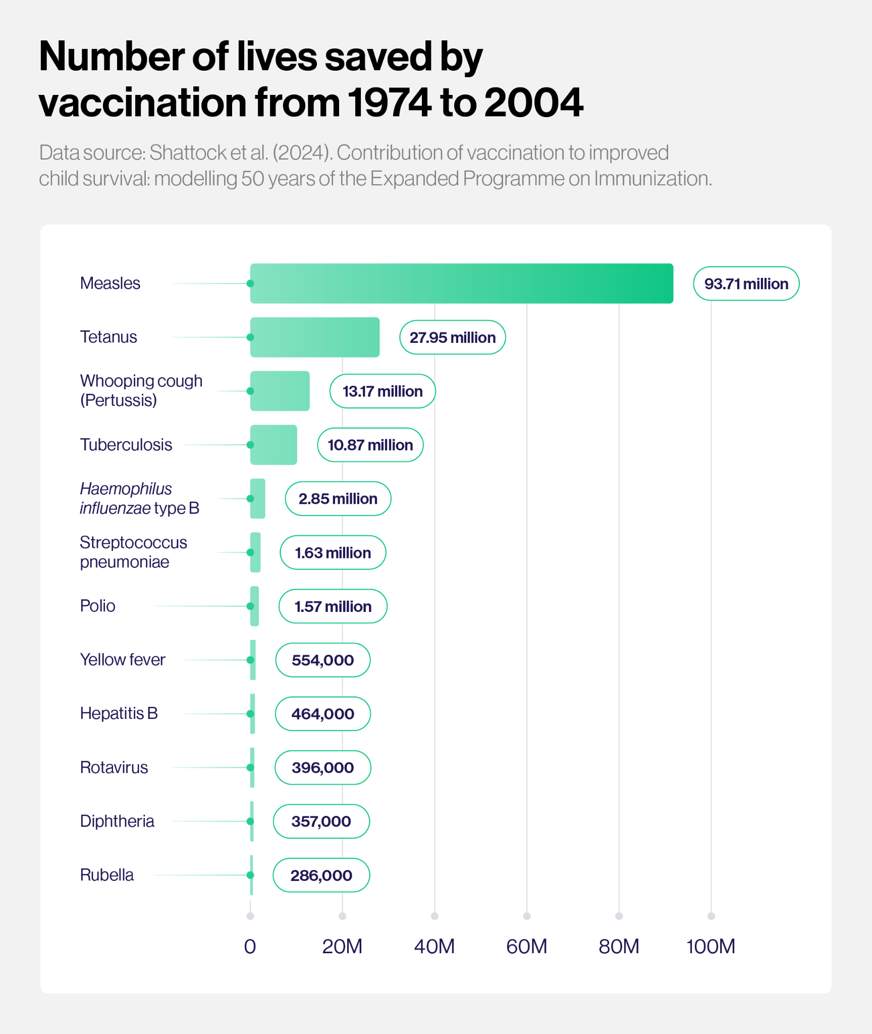
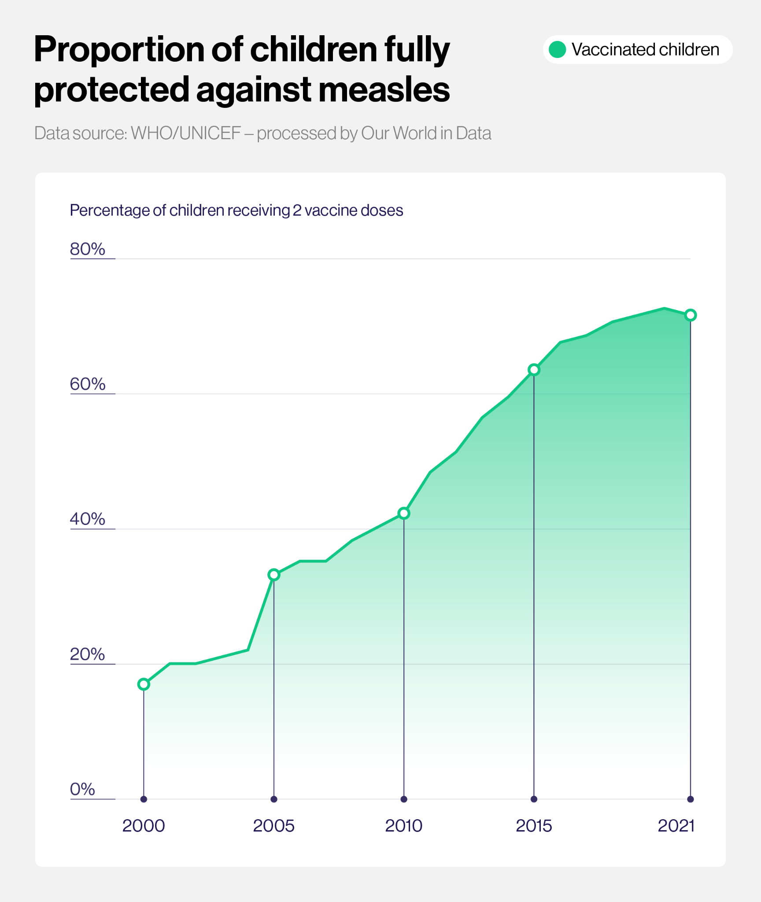
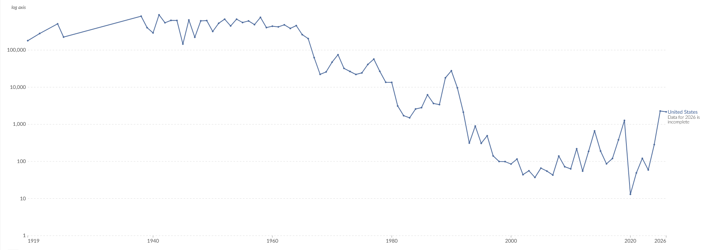
Vaccine hesitancy is on the rise
Measles cases in the US Our World in Data, 2026
Gavi, the Vaccine Alliance, 2024

Slide 14
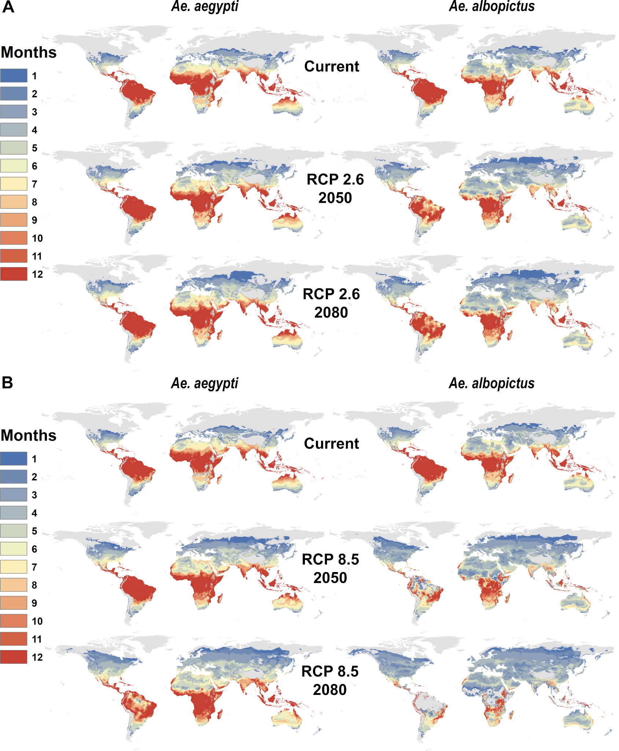
Anthropogenic climate change is a thing
Mathematical models can help us be better prepared to tackle these threats
Number of months of the year during which Aedes mosquitoes can transmit dengue virus
Ryan et al., PLOS Negl. Trop. Dis., 2019

Slide 15
What is a mathematical model?

Slide 16
What is a mathematical model?
An abstract description of a concrete system using mathematical concepts and language
Putting lines through dots
Finding ways in which mathematical functions can help us represent, and thus understand complex ecological systems

Slide 17


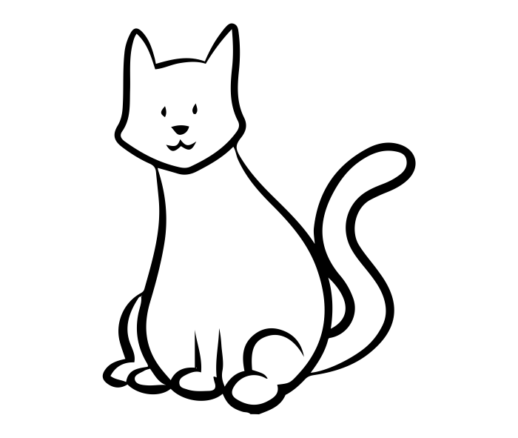

Mathematical models of infectious diseases
A model is a mathematical representation of a system
Simplified representation of reality, constructed based on various assumptions
Good models allow us to gain insight into the system or the processes that we are modelling that go beyond the assumptions we used to create it
Can range from very simple to very realistic

Slide 18
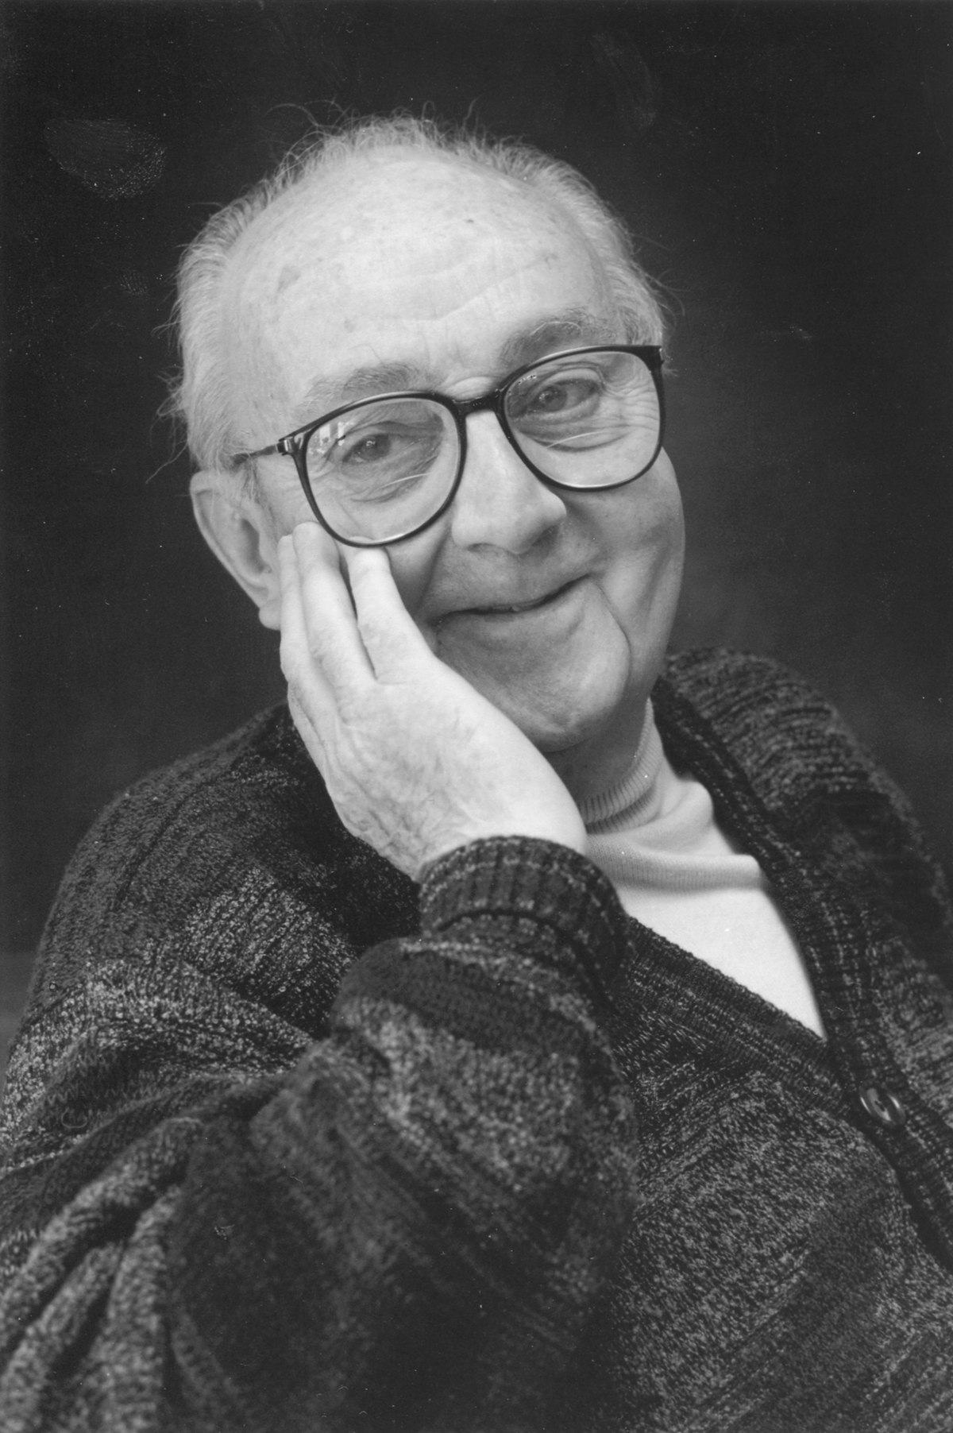
“All models are wrong but some are useful”
- George Box

Slide 19
How can mathematical models be useful in infectious diseases?

Slide 20
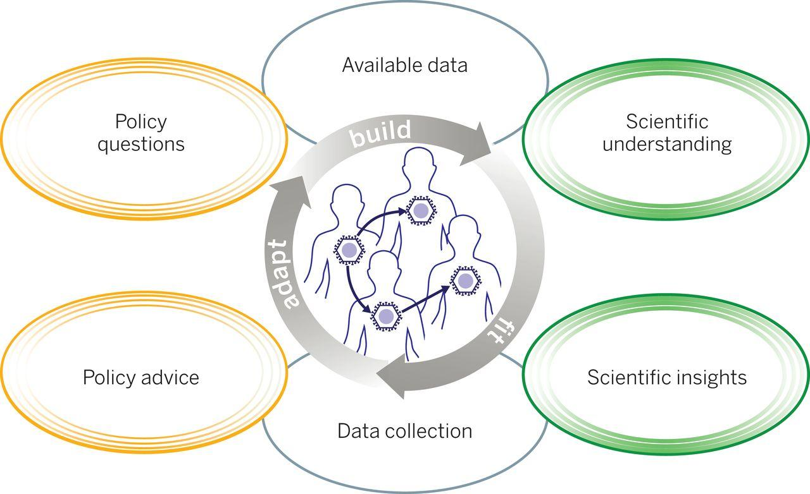
How can mathematical models be useful? (for infectious diseases)
Heesterbeek et al., Science, 2015

Slide 21
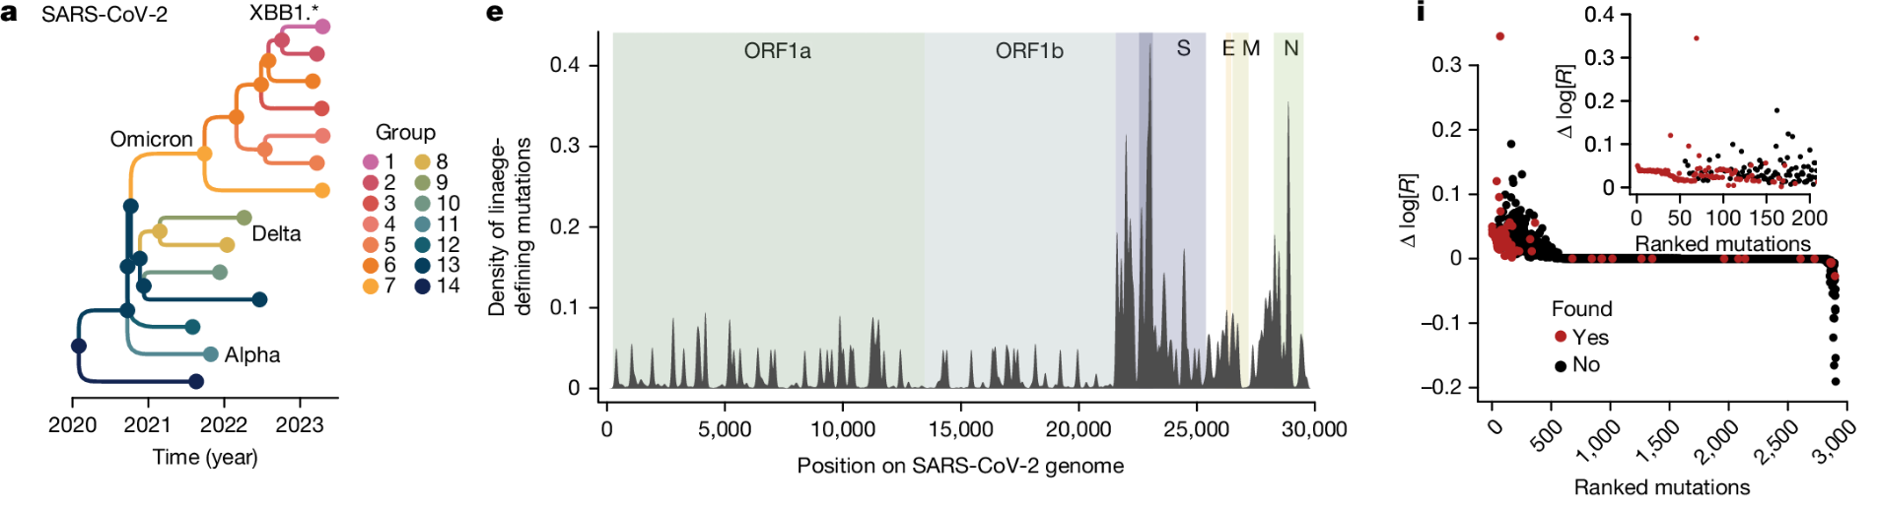
From fundamental science…
Identification of key mutations that increase the fitness of SARS-CoV-2 and define new lineages
Lefrancq et al., Nature, 2025

Slide 22
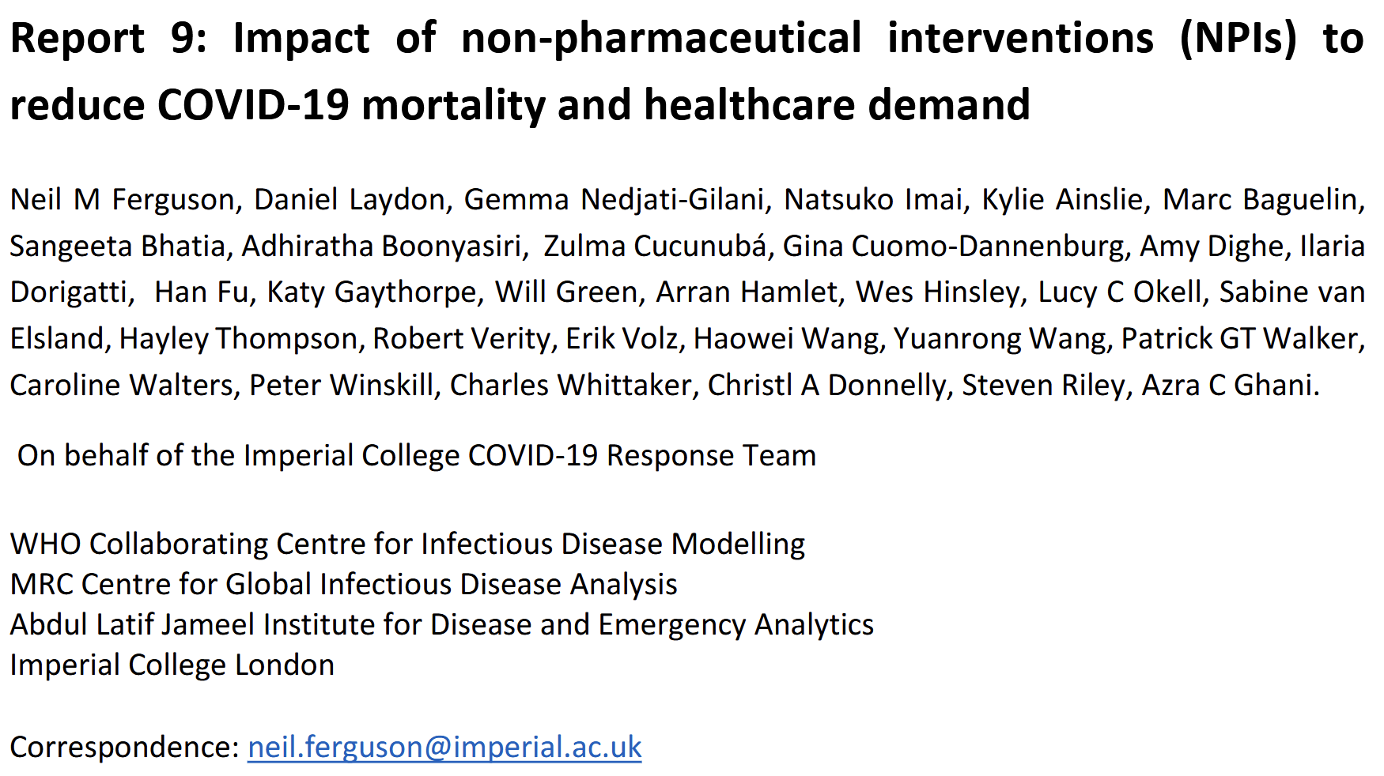
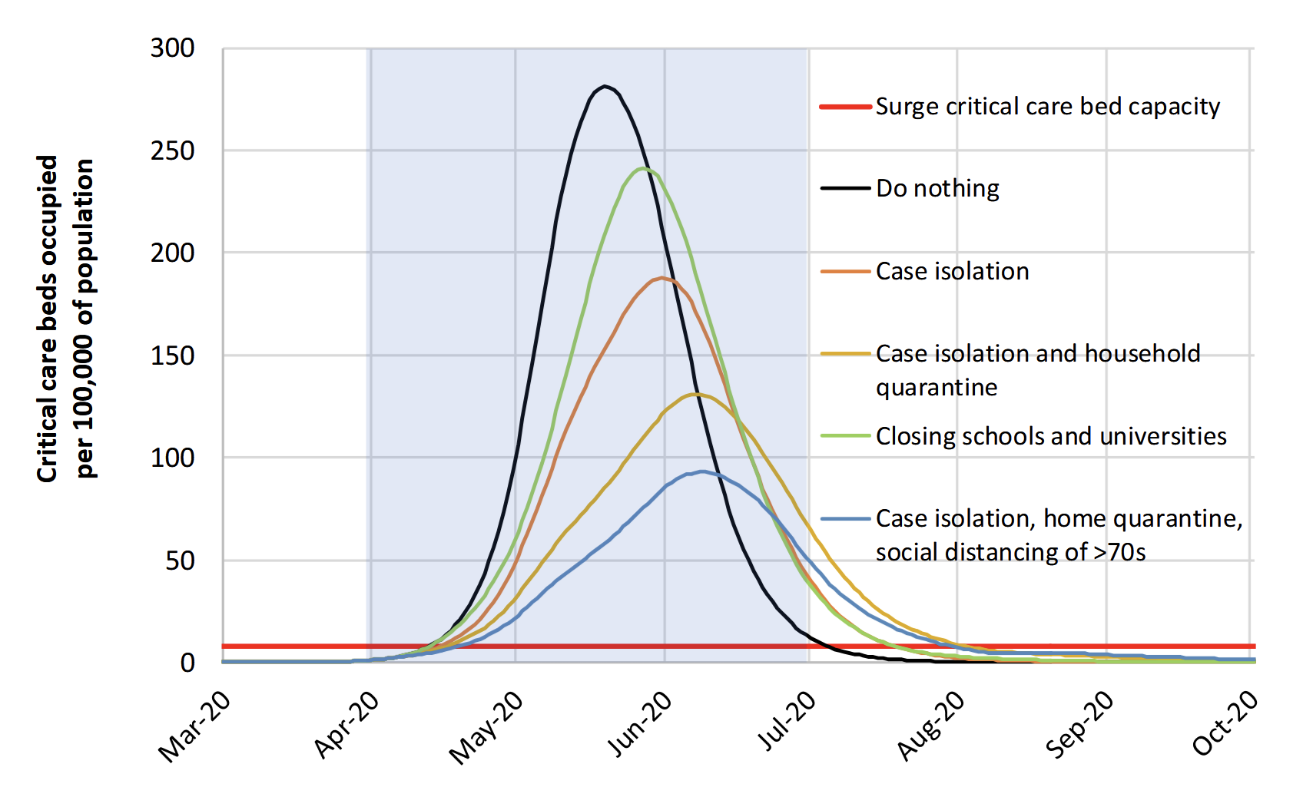
… to directly informing policy

Slide 23
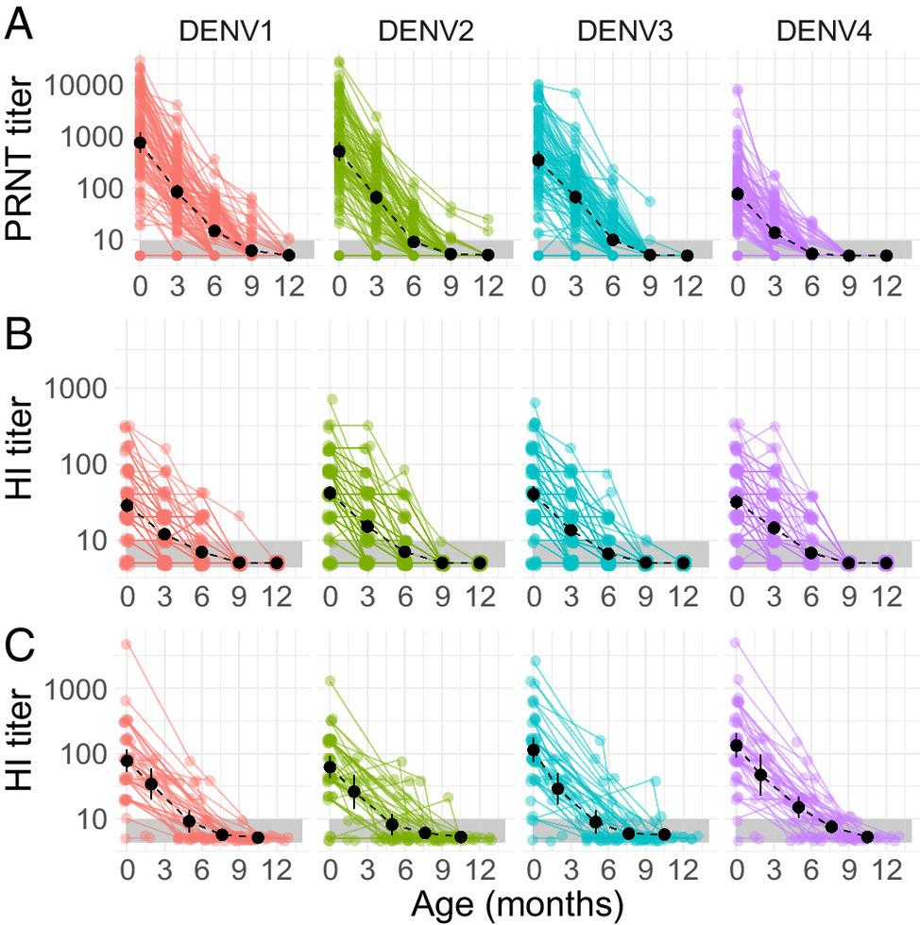
Models can help to…
…understand how pathogens affect individuals
Evolution of maternally-derived antibodies against the four dengue viruses throughout the first year of life
O’Driscoll et al., PNAS, 2023

Slide 24
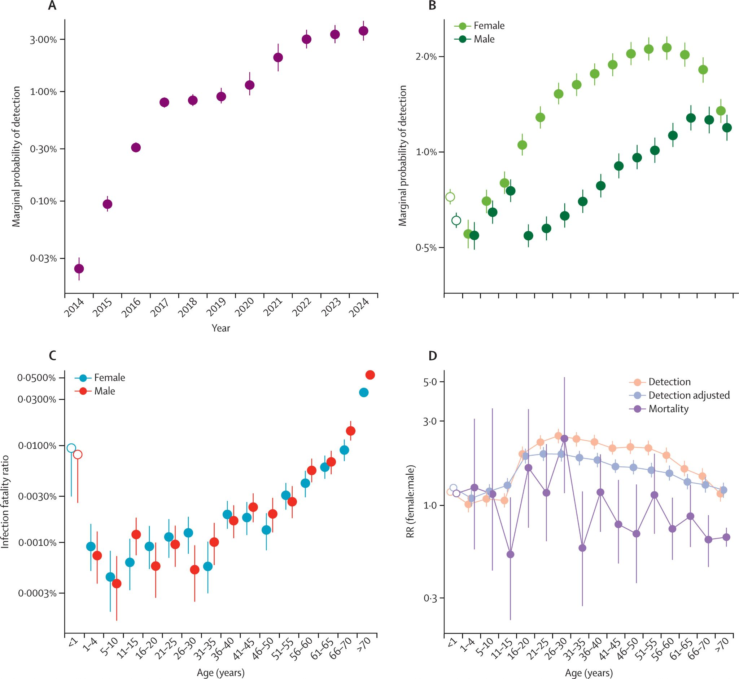
Models can help to…
…evaluate risk at demographic levels
Risk of severe disease and death following chikungunya virus infection according to sex and age
Cortes-Azuero et al., Lancet Infec. Dis., 2025

Slide 25
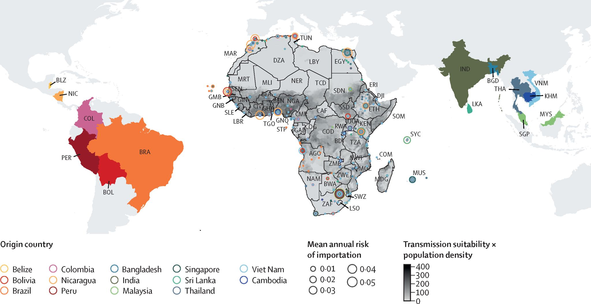
Models can help to…
…evaluate risk at large population scales
Risk of importation of dengue virus to Africa and ecological suitability using flight and environmental data
Poonganavan et al., Lancet Planet. Health, 2024

Slide 26
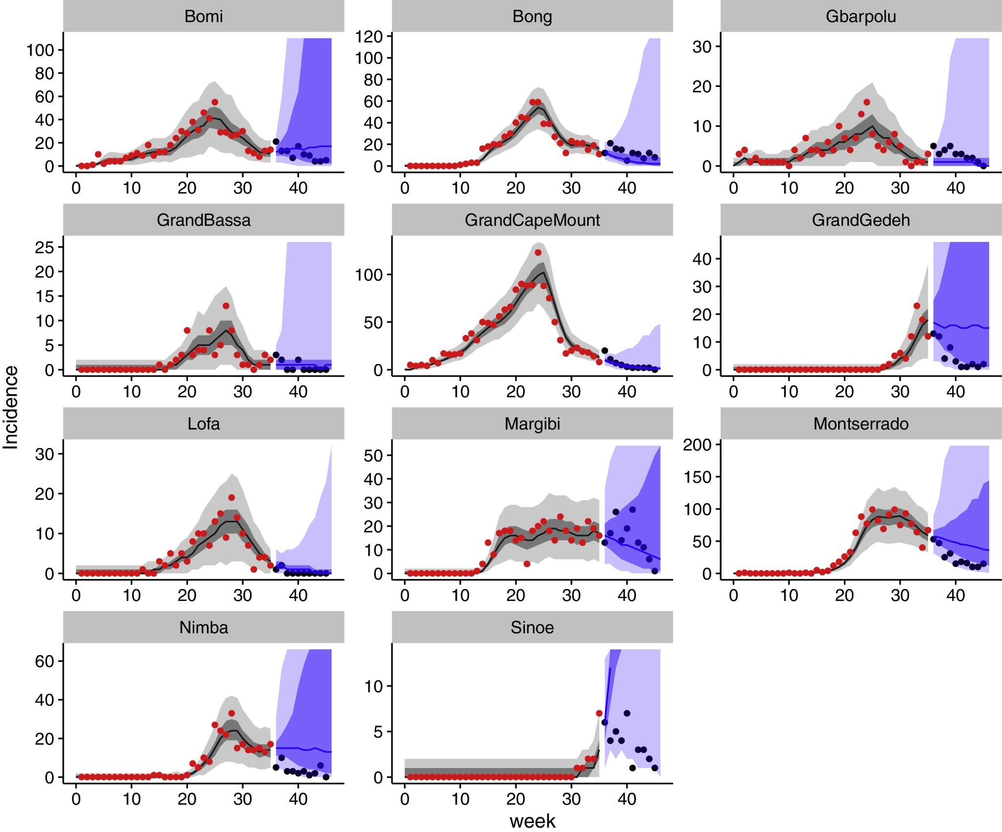
Models can help to…
…inform resource allocation
Forecasts of weekly incidence in Liberia during the Ebola virus outbreak in West Africa 2013-2016
Funk et al., Epidemics, 2018

Slide 27
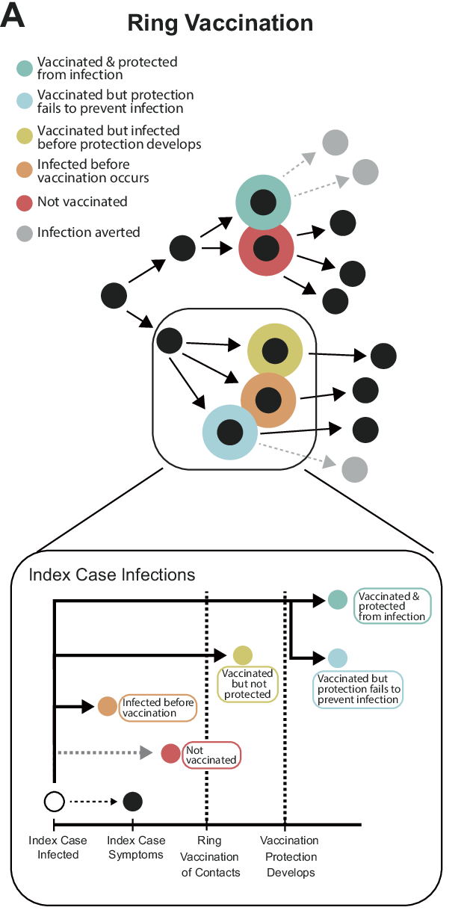
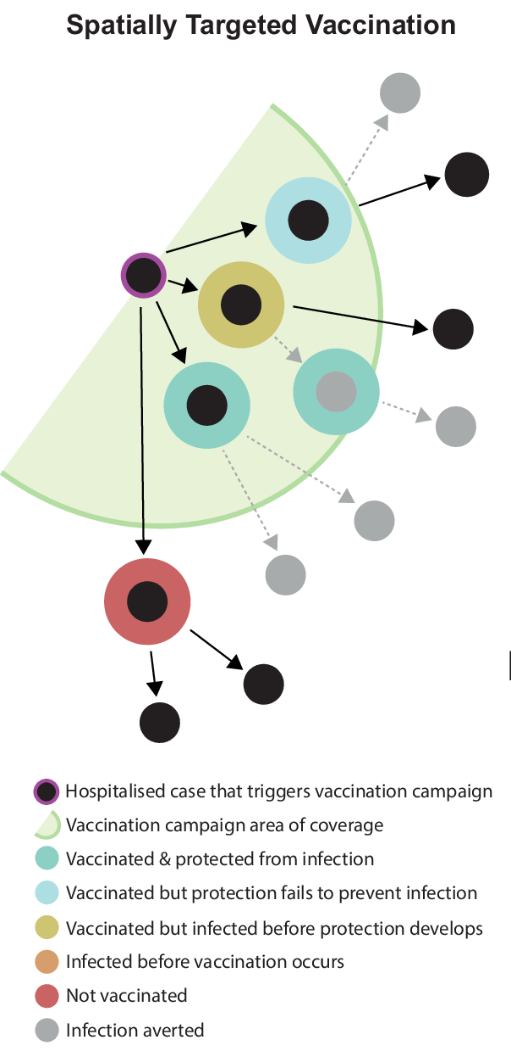
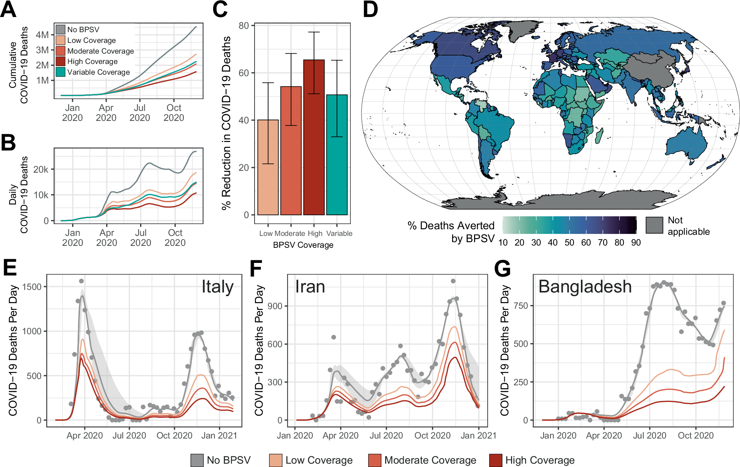
Models can help to…
…design intervention strategies
Potential impact of broadly protective sarbecovirus vaccines
Whittaker et al., Nat. Comms., 2025

Slide 28
How can I start?

Slide 29
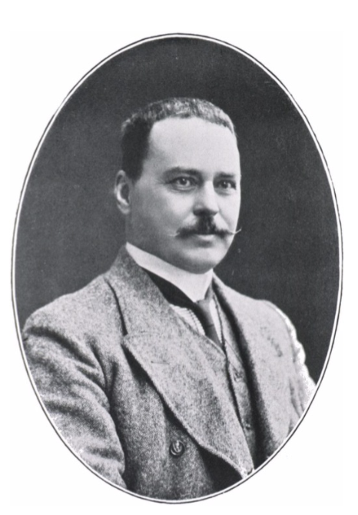
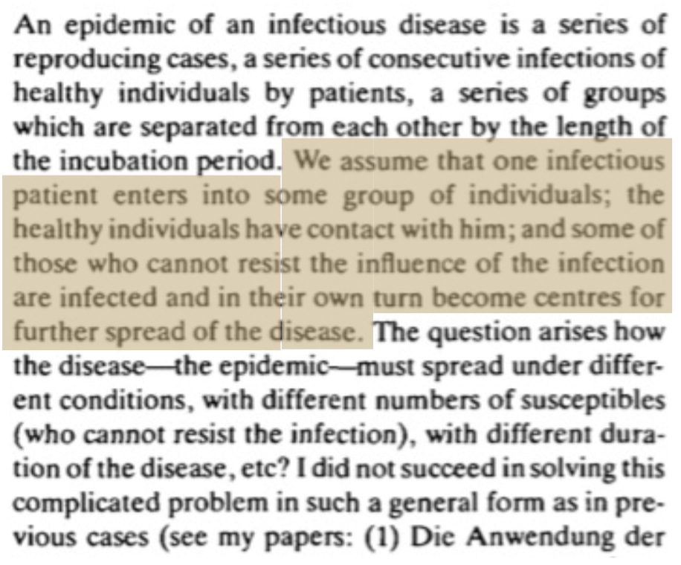
The SIR model, where it all began
Ross, 1911
Evaluated the impact of vector control on malaria elimination
En’ko, 1898

Slide 30
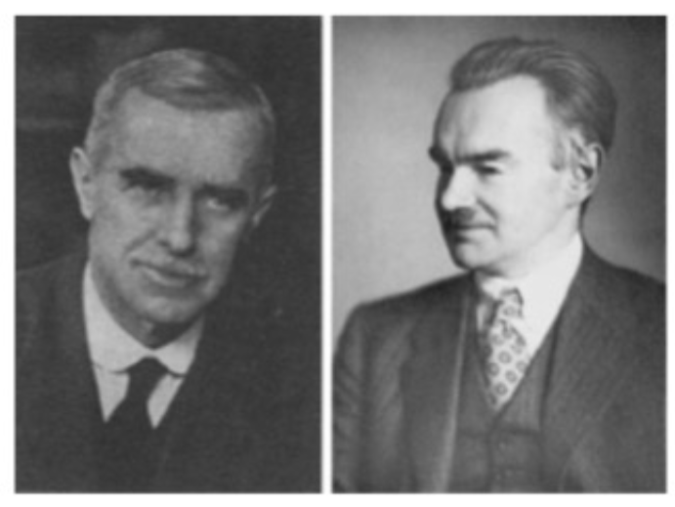
The SIR model, where it all began
McKendrick and Kermack, 1926

Slide 31

From population to compartments

Slide 32



From population to compartments

Slide 33
From population to compartments
Susceptible
Infected
Recovered

Slide 34
Compartmental model
S
I
R

Slide 35
Compartmental model
β
Ɣ
S
I
R

Slide 36
β
The transmission coefficient (i.e. the probability of an infectious contact between two members of the population)
Ɣ
Recovery rate (1/γ is the duration of infectiousness)

Slide 37
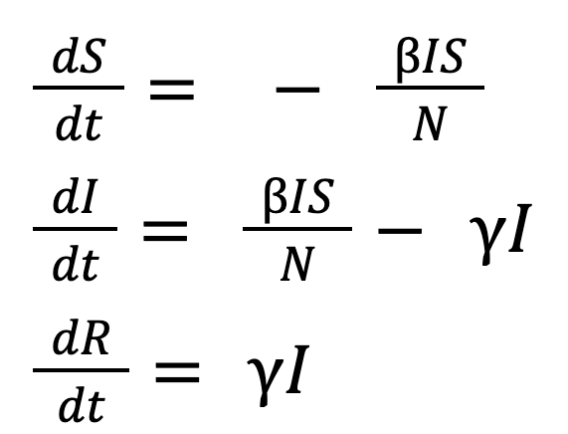
From compartments to equations
Susceptible
Infected
Recovered

Slide 38
From compartments to equations
Key assumptions:
Constant population size (no birth or death)
Recovery is permanent (fully immunising)
People mix uniformly (mass action)
Infectious when infected
Susceptible
Infected
Recovered

Slide 39
The basic reproduction number
R0
The number of people a single infected person will go on to infect in a completely susceptible population
R0 = 2

Slide 40
The basic reproduction number
R0
The number of people a single infected person will go on to infect in a completely susceptible population
R0 = 3

Slide 41
The basic reproduction number
R0
The number of people a single infected person will go on to infect in a completely susceptible population
This is pathogen & setting specific
R0 = 3

Slide 42
R0 for multiple pathogens
Pathogen | R0
Cholera
Dengue
Influenza
Measles
SARS
SARS-COV-2
?

Slide 43
R0 for multiple pathogens
Pathogen | R0
Cholera | 2.6, 4 - 15
Dengue | 1.3 - 6.3
Influenza | 1.5 - 2
Measles | 16-18, 11-12, 5-6, 14-15
SARS | 2.7, 1.2, 2.2-3.6
SARS-COV-2 | ~ 1.5 - 4 (ancestral variant)

Slide 44
The basic reproduction number
R0
The number of people a single infected person will go on to infect in a completely susceptible population
We can calculate R0 as:
R0 = β/ɣ

Slide 45
The time-varying reproduction number
Rt
The number of people a single infected person will infect at time t

Slide 46
The time-varying reproduction number
Rt
The number of people a single infected person will infect at time t
Rt = 1

Slide 47
The time-varying reproduction number
Rt
The number of people a single infected person will infect at time t
We can calculate Rt by:
Rt = R0 x s
Where S is the proportion of the population who are still susceptible

Slide 48
The time-varying reproduction number
Rt
The number of people a single infected person will infect at time t
At the beginning of an novel epidemic Rt = R0 as everyone is susceptible
Then, for immunising infections, infections will decrease the susceptible population and Rt will decrease
When Rt > 1, the epidemic will continue to grow
When Rt < 1, the epidemic will begin to decline

Slide 49
Definitions
Generation time: Time between the time of infection in subsequent generations of infection
Serial interval: Time between symptom onset in subsequent generations of cases (often used as a proxy for generation time)
Incubation period: Time between infection and symptom onset
Latent period: Time between infection and becoming infectious

Slide 50
Herd immunity threshold
Herd immunity threshold: the level of immunity in a population above which a pathogen cannot invade and persist in the population

Slide 51
Herd immunity threshold
Herd immunity threshold: the level of immunity in a population above which a pathogen cannot invade and persist in the population
We need s (population susceptible) to be small enough that cases would decline rather than increase…

Slide 52
Extensions to the SIR framework
Many diseases have a latent period (time between being infected and becoming infectious)
β
𝜎
Ɣ
S
E
I
R

Slide 53
Extensions to the SIR framework
For some pathogens individuals can become reinfected.
β
𝜎
Ɣ
S
E
I
R

Slide 54

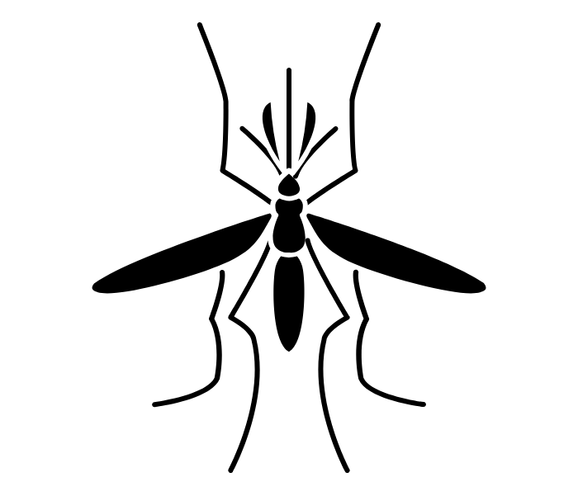
Extensions to the SIR framework
S
I
R
Alternative modes of transmission
S
I

