Slide 1



Simulating ODEs in R
Dr. Oscar Cortés & Dr. Jair Andrade

Slide 2
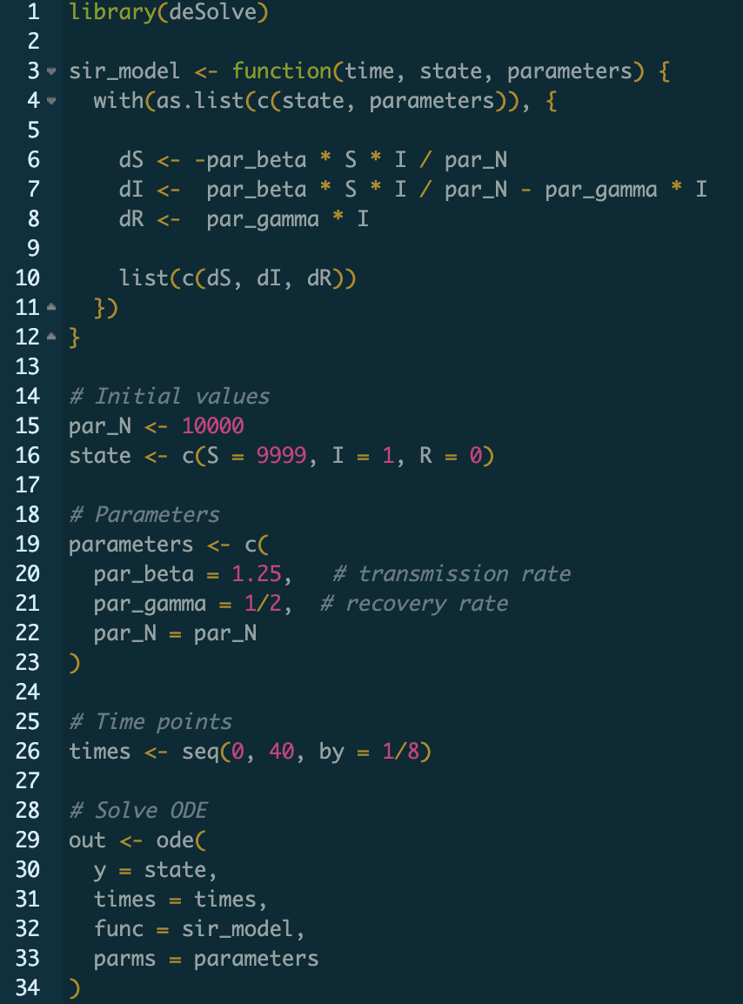
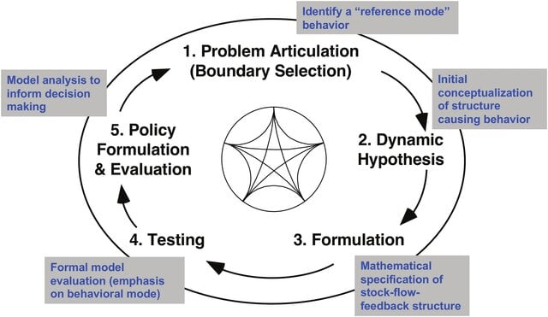
Goal
Learn how to simulate ordinary differential equation (ODE) models in R using deSolve
Formulation
Implementation
Simulation
Sterman, J. D. (1994)

Slide 3
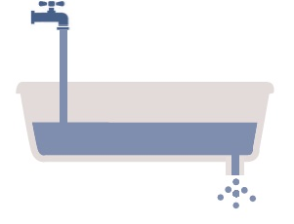
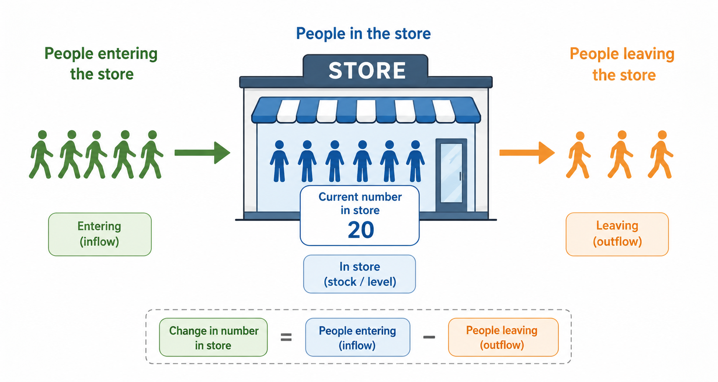

Model formulation
Examples?
Tap = inflow
Bathtub = Compartment, state or stock
Units
Memory, delays
Drain = outflow
How much water is in any particular bathtub at a given time?
How many people are in the store at a given time?

Slide 4
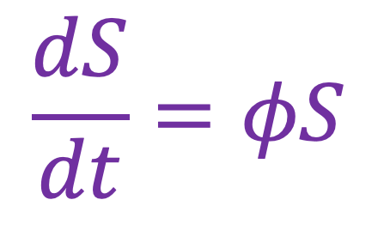



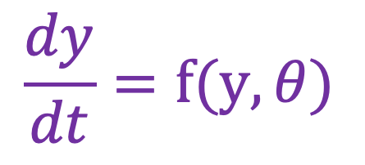
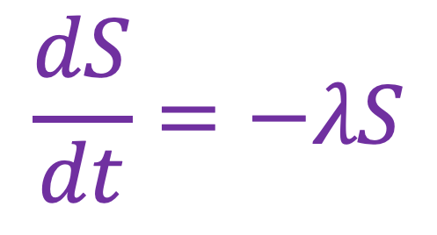


Differential equations
Describe how a system changes over time.
I spend a fixed percentage of my savings over time
$$S_{0}exp⁡(−λt)$$
$$\frac{dS}{dt}=−λS$$
$$\frac{dy}{dt}=f(y, θ)$$
Savings
$$y:Compartments$$
I get interest payments at a fixed rate of my savings over time
t$:$ Time
$θ:$ Parameters
$$\frac{dS}{dt}=φS$$
Savings
In essence, a differential equation describes flows, and our task is to accumulate (integrate) them over time.
$$S_{0}exp⁡(φt)$$
Notice the languages.

Slide 5

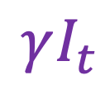
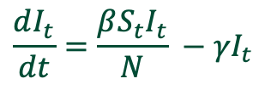
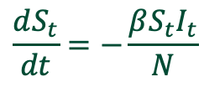
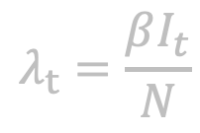

SIR
$$λ_{t}=\frac{βI_{t}}{N}$$
$$\frac{dS_{t}}{dt}=−\frac{βS_{t}I_{t}}{N}$$
$$λ_{t}S_{t}$$
$$γI_{t}$$
$$\frac{dI_{t}}{dt}=\frac{βS_{t}I_{t}}{N} −{γI}_{t}$$
Infections
Recoveries
$$\frac{dR_{t}}{dt}={γI}_{t}$$
In most cases, ODEs cannot be solved analytically, and we must resort to numerical approximations.
Instead of solving an ODE with an exact formula, we approximate the solution by computing how it changes over small time steps.
Common numerical methods for solving ODEs include Euler’s method, Runge-Kutta methods, adaptive step-size algorithms, and multistep methods, each balancing simplicity, accuracy, and computational cost.

Slide 6
deSolve
deSolve is an R package that provides functions for numerically solving ordinary differential equations (ODEs), delay differential equations (DDEs), and partial differential equations (PDEs) using efficient and flexible integration methods.
A user-defined function that returns a list of derivatives. Essentially, the model. The list of derivates must be in the same order as y.
Named vector of parameters used in the model
ode(y, times, func, parms)
Numeric vector of time points to solve over. The more points, the more accurate the solution will be.
Named vector with the initial values of the compartments.

Slide 7
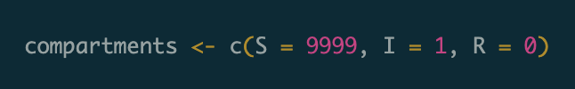

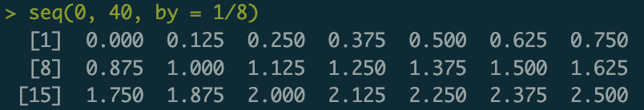
Initial conditions & simulation interval
ode(y = compartments,
times = times,
func = SIR,
parms = parameters)
Compartments and their initial values
Simulate from time 0 to time 40

Slide 8
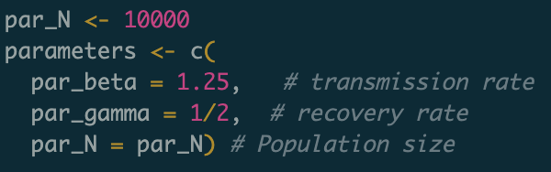
Model specification
ode(y = compartments,
times = times,
func = sir_model,
parms = parameters)
sir_model <- function(time, compartments, parameters) {
with(as.list(c(compartments, parameters)), {
dS <- par_beta * S * I / par_N
dI <- par_beta * S * I / par_N - par_gamma * I
dR <- par_gamma * I
list(c(dS, dI, dR)))
})
}
Allows refer to states and parameters by name directly inside the function
Otherwise, it would be dR <- parameters[“par_gamma”] * compartments[“I”]

Slide 9
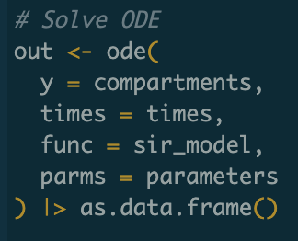
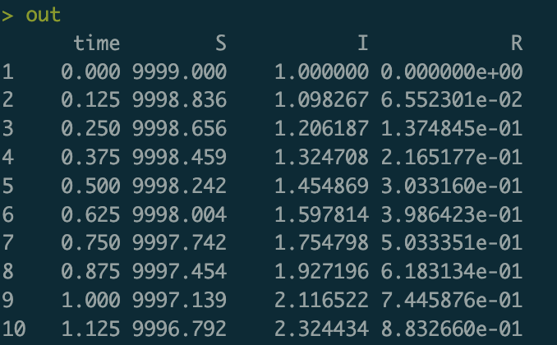
Our first simulation with deSolve

Slide 10
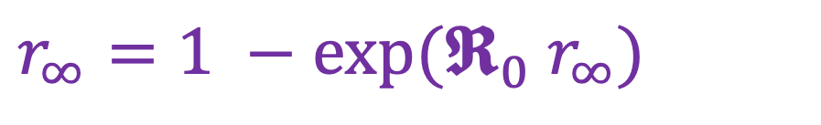
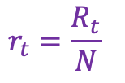


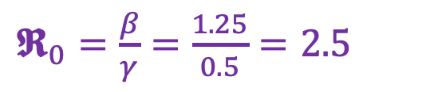
Final size
Why are these simulations useful?
$$s_{t}=\frac{S_{t}}{N}$$
0.8926222
$$i_{t}=\frac{I_{t}}{N}$$
Prevalence
$$r_{t}=\frac{R_{t}}{N}$$
Final epidemic size
$r_{∞}=1 −exp⁡(𝕽_{0} r_{∞})$
0.8926482
No changes in assumptions
Transcendental equation
Basic reproduction number
$𝕽_{0}=\frac{β}{γ}=\frac{1.25}{0.5}=2.5$
Kermack & McKendrick (1927)

Slide 11
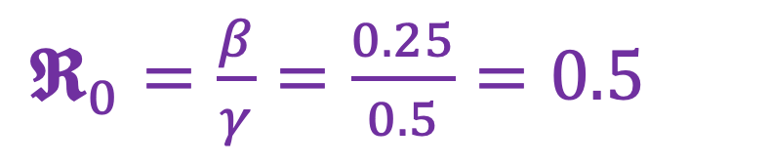
The basic reproduction as a threshold
What if, just before the introduction of the first case, the transmission rate ($β$) is reduced from 1.25 to 0.25?
$𝕽_{0}=\frac{β}{γ}=\frac{0.25}{0.5}=0.5$
How can that be achieved?

Slide 12
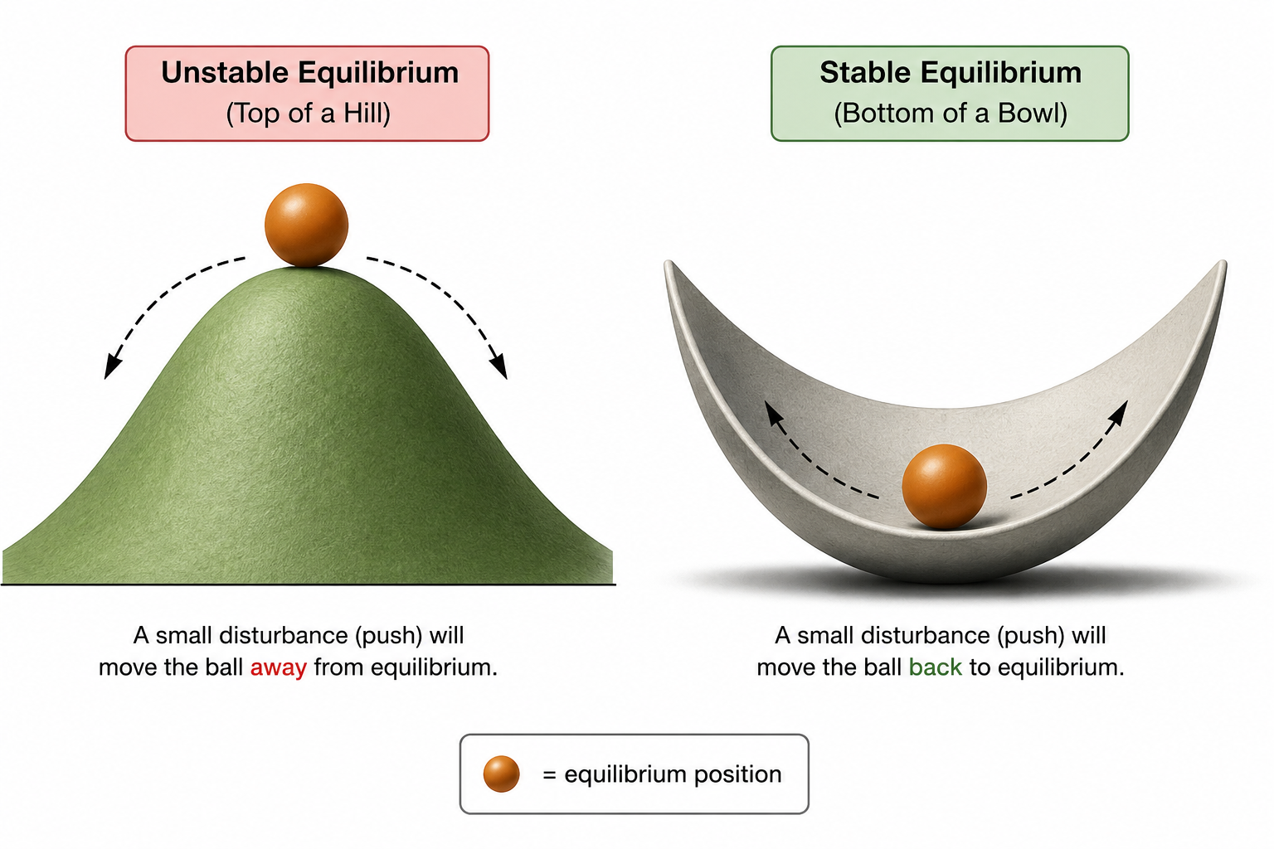


Stability
$$𝕽_{0}≤1$$
$$𝕽_{0}>1$$
Bifurcation

Slide 13


The effective reproduction number
$${𝕽_{t}=𝕽}_{0}s_{t}$$

Slide 14
References
Sterman, J. D. (1994). Learning in and about complex systems. System Dynamics Review, 10(2–3), 291–330. https://doi.org/10.1002/sdr.4260100214
Kermack, William Ogilvy, & McKendrick, A. G. (1927). A contribution to the mathematical theory of epidemics. Proceedings of the Royal Society A: Mathematical, Physical and Engineering Sciences, 115(772), 700–721. https://doi.org/10.1098/rspa.1927.0118

