Slide 1



Extensions to the SIR framework
Dr. Oscar Cortés & Dr. Jair Andrade

Slide 2
Goal
Learn how to add more realism to SIR models to make them useful in practice.
Content
Incidence
Latent compartment (SEIR)
Demography
Vaccination

Slide 3
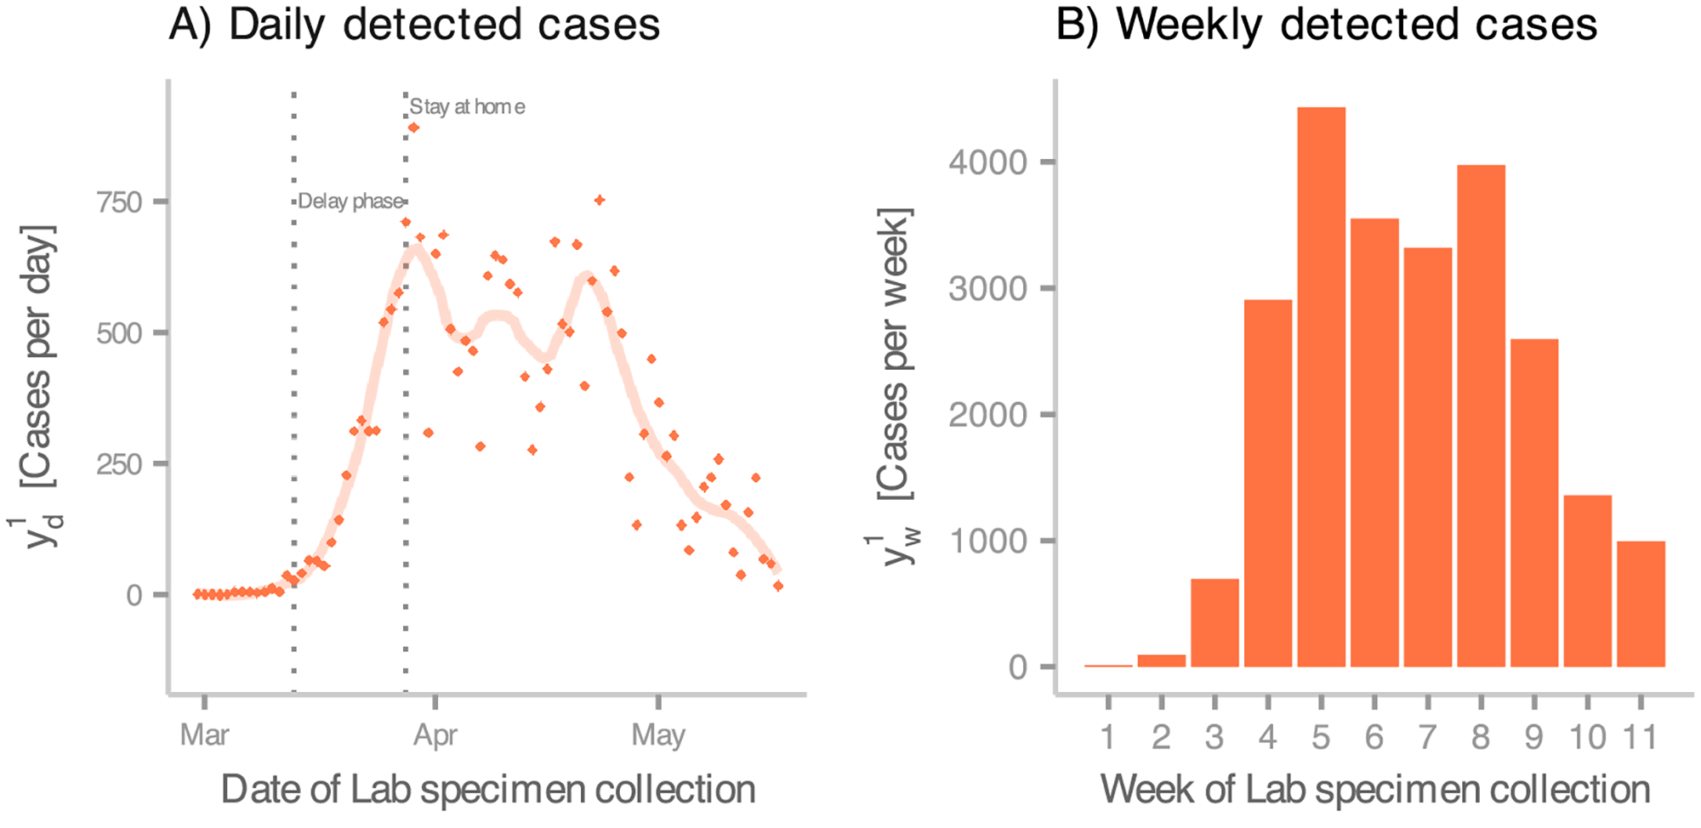
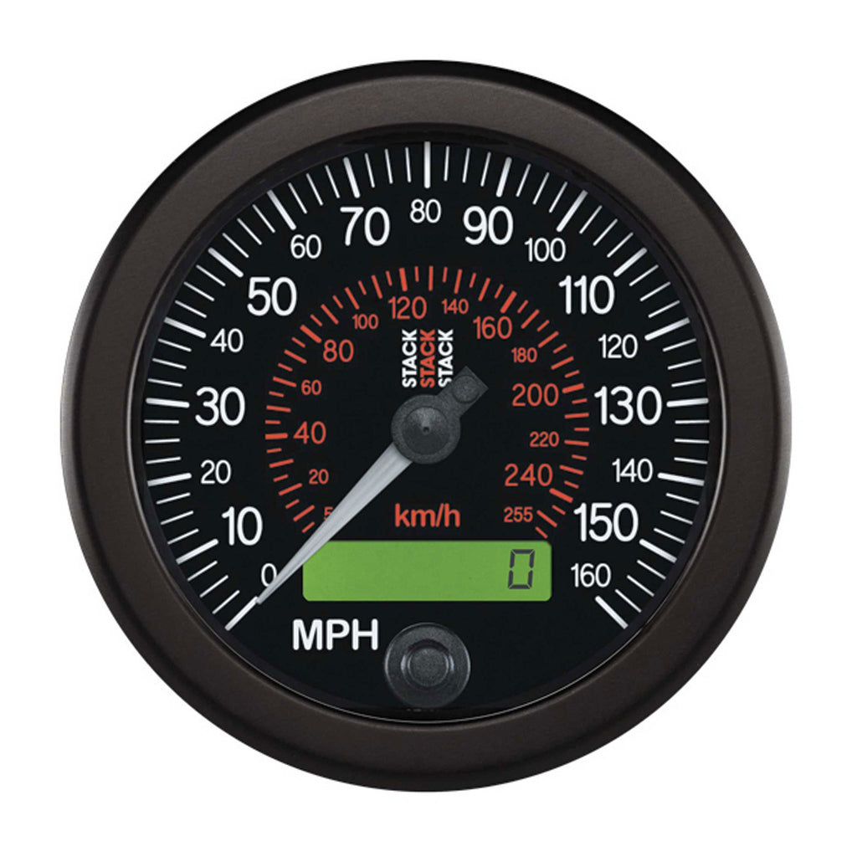
Incidence
Often, the most readily available data are case counts (incidence).
Gathering information about other states of the system can be prohibitively expensive.
Incidence
Andrade & Duggan (2022)

Slide 4

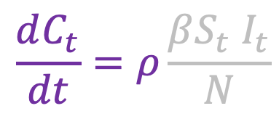

Incidence (modelling)
New reported cases over an interval
Reported cases
Reporting fraction
$$ΔC_{τ}=C_{τ} −C_{τ−1}$$
$$τ∈0, 1, 2…$$
$$\frac{dC_{t}}{dt}=ρ\frac{{βS_{t} I}_{t}}{N}$$

Slide 5
SEIR
Individuals do not usually become infectious immediately after infection; there is typically a latent period before they can transmit the disease.
This delay is represented by adding an Exposed (E) compartment between the Susceptible and Infectious compartments.
Exposed is a somewhat misleading name. Latent would have been more accurate. (Burke, 2024)

Slide 6

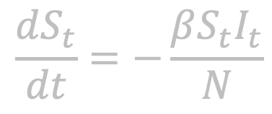
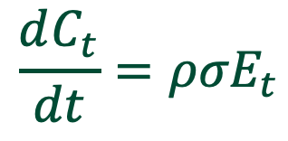
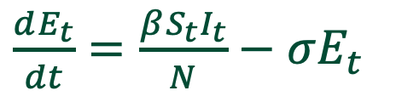
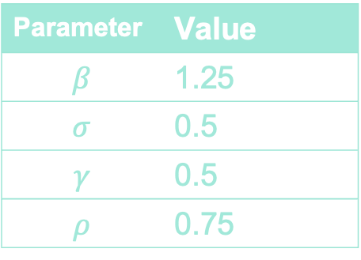
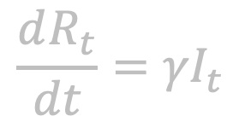
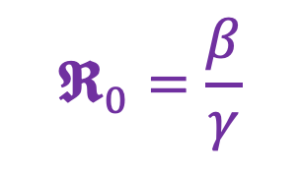
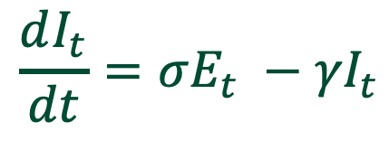
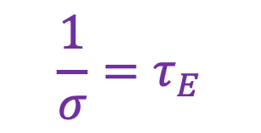
SEIR (modelling)
$$\frac{dS_{t}}{dt}=−\frac{βS_{t}I_{t}}{N}$$
$$σE_{t}$$
$$\frac{1}{σ}=τ_{E}$$
$\frac{dE_{t}}{dt}=\frac{βS_{t}I_{t}}{N}−σE_{t}$
Latent period
$$\frac{dI_{t}}{dt}=σE_{t} −{γI}_{t}$$
$$𝕽_{0}=\frac{β}{γ}$$
Parameter | Value
$$β$$ | 1.25
$$σ$$ | 0.5
$$γ$$ | 0.5
$$ρ$$ | 0.75
$$\frac{dR_{t}}{dt}={γI}_{t}$$
Same as the SIR
$$\frac{dC_{t}}{dt}={ρσE}_{t}$$
Modelling decision

Slide 7
SEIR (modelling)
delay

Slide 8

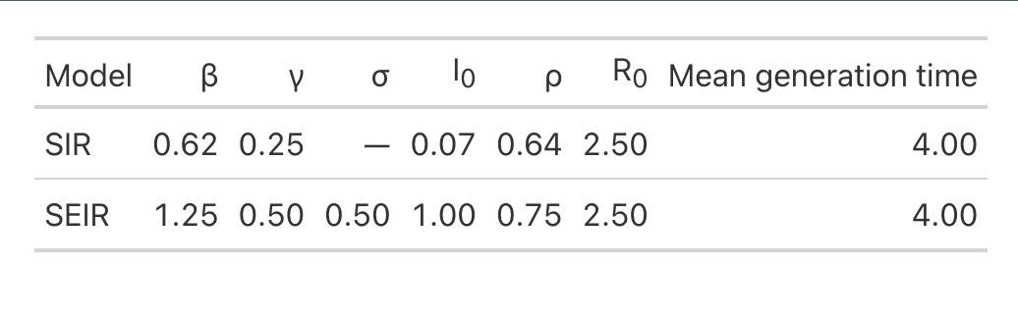


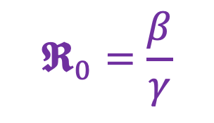
Can we infer the model from the trajectory?
$$𝕽_{0}=\frac{β}{γ}$$
$$τ_{G}=τ_{I}$$
SIR
$$τ_{G}=τ_{E}+τ_{I}$$
SEIR
Andrade & Duggan (2023)

Slide 9
Demography
So far, we have have ignored demographics (births\deaths). What happens if we relax that assumption?
If we are interested in exploring the longer-term persistence and endemic dynamics of an infectious disease, then clearly demographic processes will be important.
Deaths = natural mortality
Keeling & Rohani (2008)

Slide 10


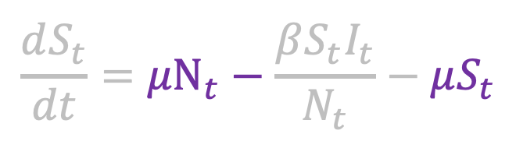
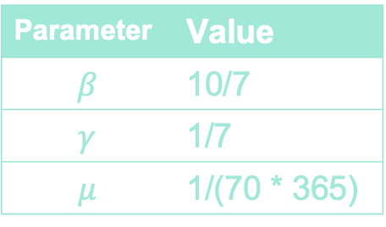

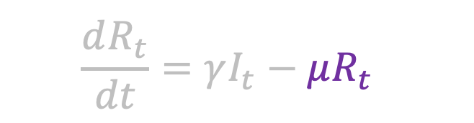

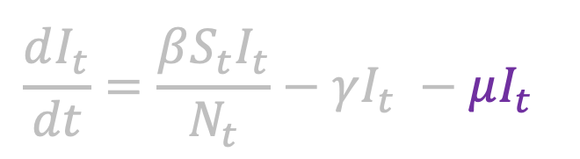

SIR with demography
Birth rate = death rate
$$\frac{dS_{t}}{dt}={μN}_{t}−\frac{βS_{t}I_{t}}{N_{t}}−μS_{t}$$
$$μS_{t}$$
$$μI_{t}$$
$$μR_{t}$$
$${μN}_{t}$$
$$\frac{dI_{t}}{dt}=\frac{βS_{t}I_{t}}{N_{t}}−γI_{t} −μI_{t}$$
Parameter | Value
$$β$$ | 10/7
$$γ$$ | 1/7
$$μ$$ | 1/(70 * 365)
$$\frac{dR_{t}}{dt}=γI_{t}−μR_{t}$$
Dynamic equilibrium
$$𝕽_{0}=\frac{β}{γ+μ}∼10$$
$$N_{t}=S_{t}+I_{t}+R_{t}$$

Slide 11
SIR with demography (simulation)

Slide 12
SIR with demography (simulation)
This is really cool

Slide 13
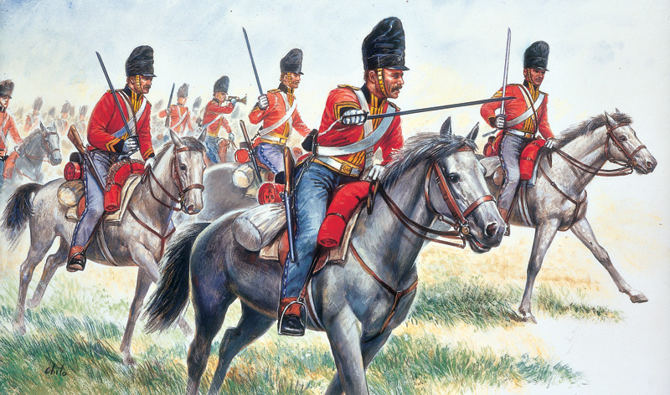

Bringing the cavalry
$${𝕽_{t}=𝕽}_{0}s_{t}$$
The public health system can reach safely high immunity levels by employing one of the most important inventions in the history of science: vaccines

Slide 14
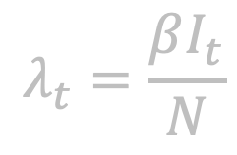
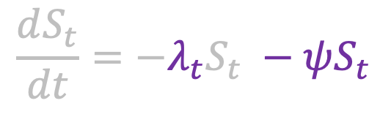
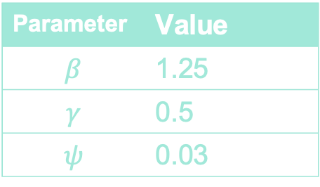


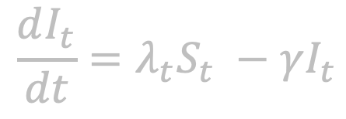
Vaccination (modelling)
$$ψS_{t}$$
$$\frac{dS_{t}}{dt}=−λ_{t}S_{t} −ψS_{t}$$
$$\frac{dI_{t}}{dt}=λ_{t}S_{t} −γI_{t}$$
$$\frac{dR_{t}}{dt}=γI_{t}+ψS_{t}$$
Parameter | Value
$$β$$ | 1.25
$$γ$$ | 0.5
$$ψ$$ | 0.03
$$λ_{t}=\frac{βI_{t}}{N}$$

Slide 15



Herd immunity threshold (via vaccination)
If we could vaccinate the population before the introduction of the first infectious case, what is the minimum fraction of the population that would need to be vaccinated?
0.4
0.0
0.6
$$s_{t}≤\frac{1}{𝕽_{0}}=0.4$$
$${𝕽_{t}=𝕽}_{0}s_{t}$$
$$𝕽_{0}s_{t}≤1$$

Slide 16


Competition
Final epidemic size
$$ψS_{t}$$
$$γI_{t}$$

Slide 17
Resource constraints
There are upper limits to produce and deliver vaccines
How much time is required to build this capacity, and how long does the pathogen take to infect the population?
Therefore, the success of an outbreak or pandemic response is most likely determined by the resources accumulated before the first case occurs.
Additionally, models help in understanding these issues, but they are not the reason outbreak responses fail. Rather, it is the lack of resources and the knowledge of how to use them effectively.
Andrade et al (2024)

Slide 18
References
Andrade, J., & Duggan, J. (2022). Inferring the effective reproductive number from deterministic and semi-deterministic compartmental models using incidence and mobility data. PLOS Computational Biology, 18(6), e1010206. https://doi.org/10.1371/journal.pcbi.1010206
Andrade, J., & Duggan, J. (2023). Anchoring the mean generation time in the SEIR to mitigate biases in ℜ ₀ estimates due to uncertainty in the distribution of the epidemiological delays. Royal Society Open Science, 10(8), 230515. https://doi.org/10.1098/rsos.230515
Andrade, J., Beishuizen, B., Stein, M., Connolly, M., & Duggan, J. (2024). Preparing for pandemic response in the context of limited resources. System Dynamics Review, 40(3), e1775. https://doi.org/10.1002/sdr.1775
Burke, D. S. (2024). Origins of the problematic E in SEIR epidemic models. Infectious Disease Modelling, 9(3), 673–679. https://doi.org/10.1016/j.idm.2024.03.003
Keeling, M. J., & Rohani, P. (2008). Modeling infectious diseases in humans and animals. Princeton University Press.

