Slide 1



Comparing models to data
Dr. Oscar Cortés & Dr. Jair Andrade

Slide 2
Outline
Real-world data is often messy
How to link types of data with mathematical functions?
Measuring how good a model is at representing real data
Finding the best parameter values for a model

Slide 3
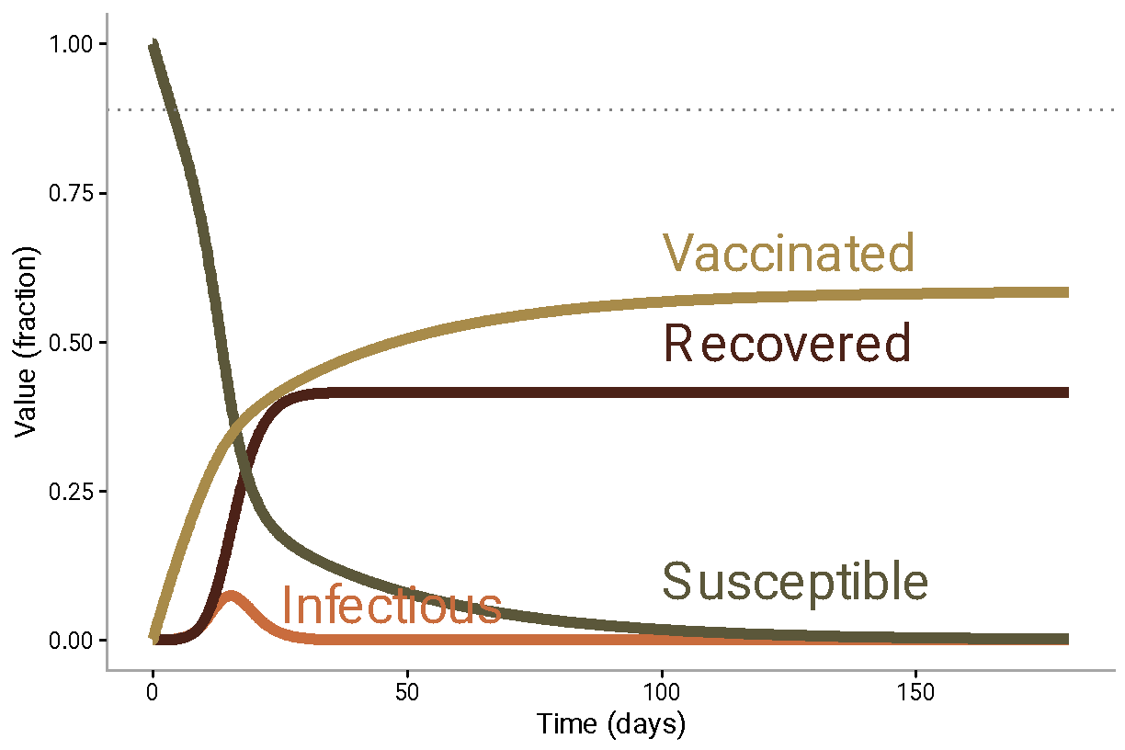
So far we’ve simulated outbreaks that look like this:

Slide 4
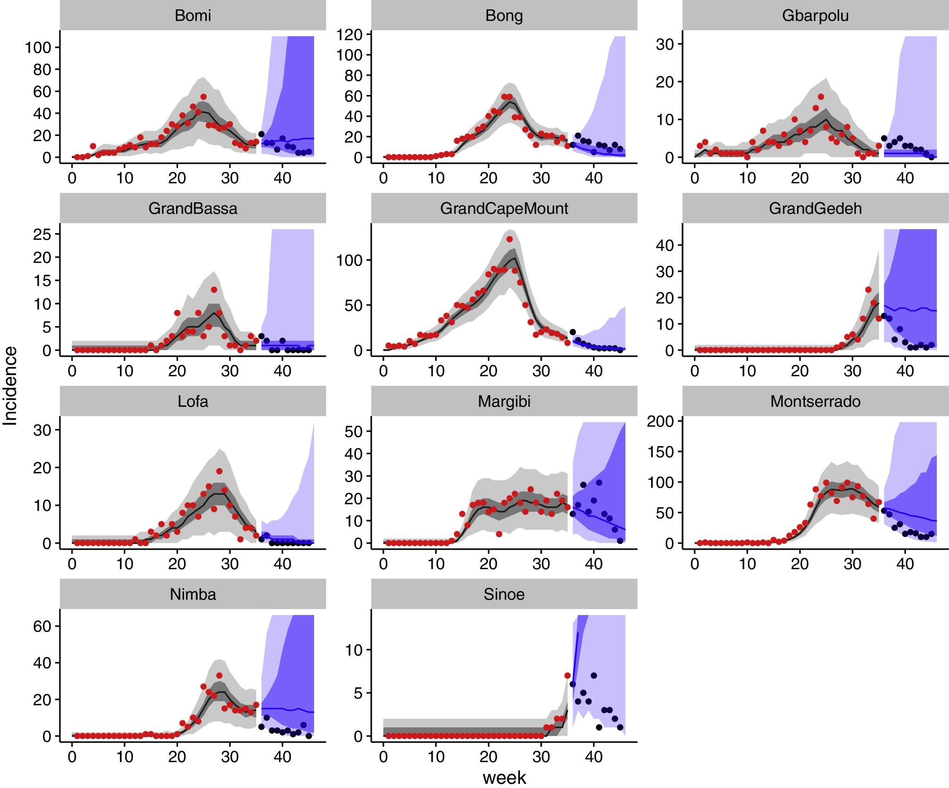
But epidemic data is usually messier than this
Funk et al., Epidemics, 2018

Slide 5
Why?

Slide 6
Real life is not perfectly predictable
Model validity is determined by its assumptions
Individuals behave differently: demographic stochasticity
The environment is not uniform: environmental stochasticity
Observation processes are imperfect

Slide 7
Model assumptions are key
Fundamental assumption: well-mixed population
Reality: populations are structured in many different ways

Slide 8
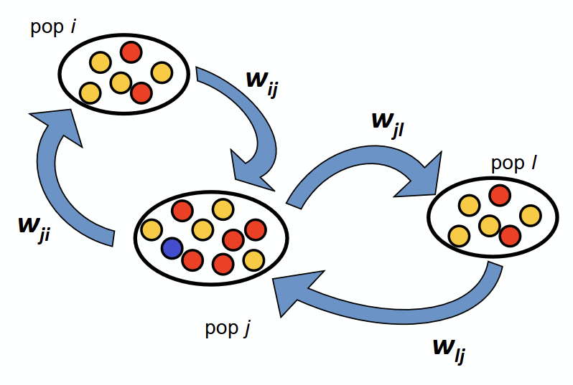
Structures introduce more assumptions…
Colizza et al., PNAS, 2006

Slide 9
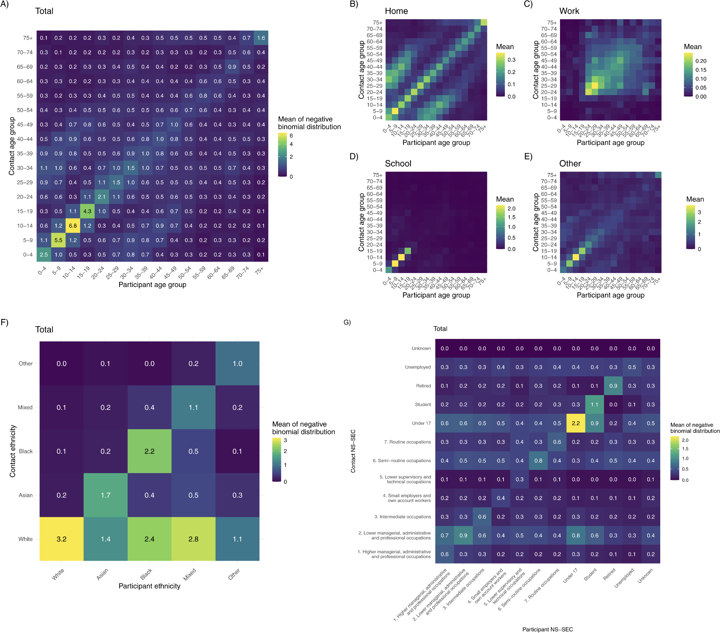
Some structures…
Age-based contacts
Goodfellow et al., PLOS Med., 2026

Slide 10
Some structures…
Ethnicity-based contacts
Goodfellow et al., PLOS Med., 2026

Slide 11
Some structures…
Age and place
Goodfellow et al., PLOS Med., 2026

Slide 12
Noise is ever-present
Process noise:
Demographic stochasticity - stochasticity in the infection process
Environmental stochasticity - e.g. weather variation, public health policy changes, school holidays

Slide 13
Observation processes are imperfect
Individual gets infected with chikungunya virus
Individual develops symptoms
Individual seeks care
Case gets reported
Individual gets correctly diagnosed
At each step, we lose some individuals

Slide 14
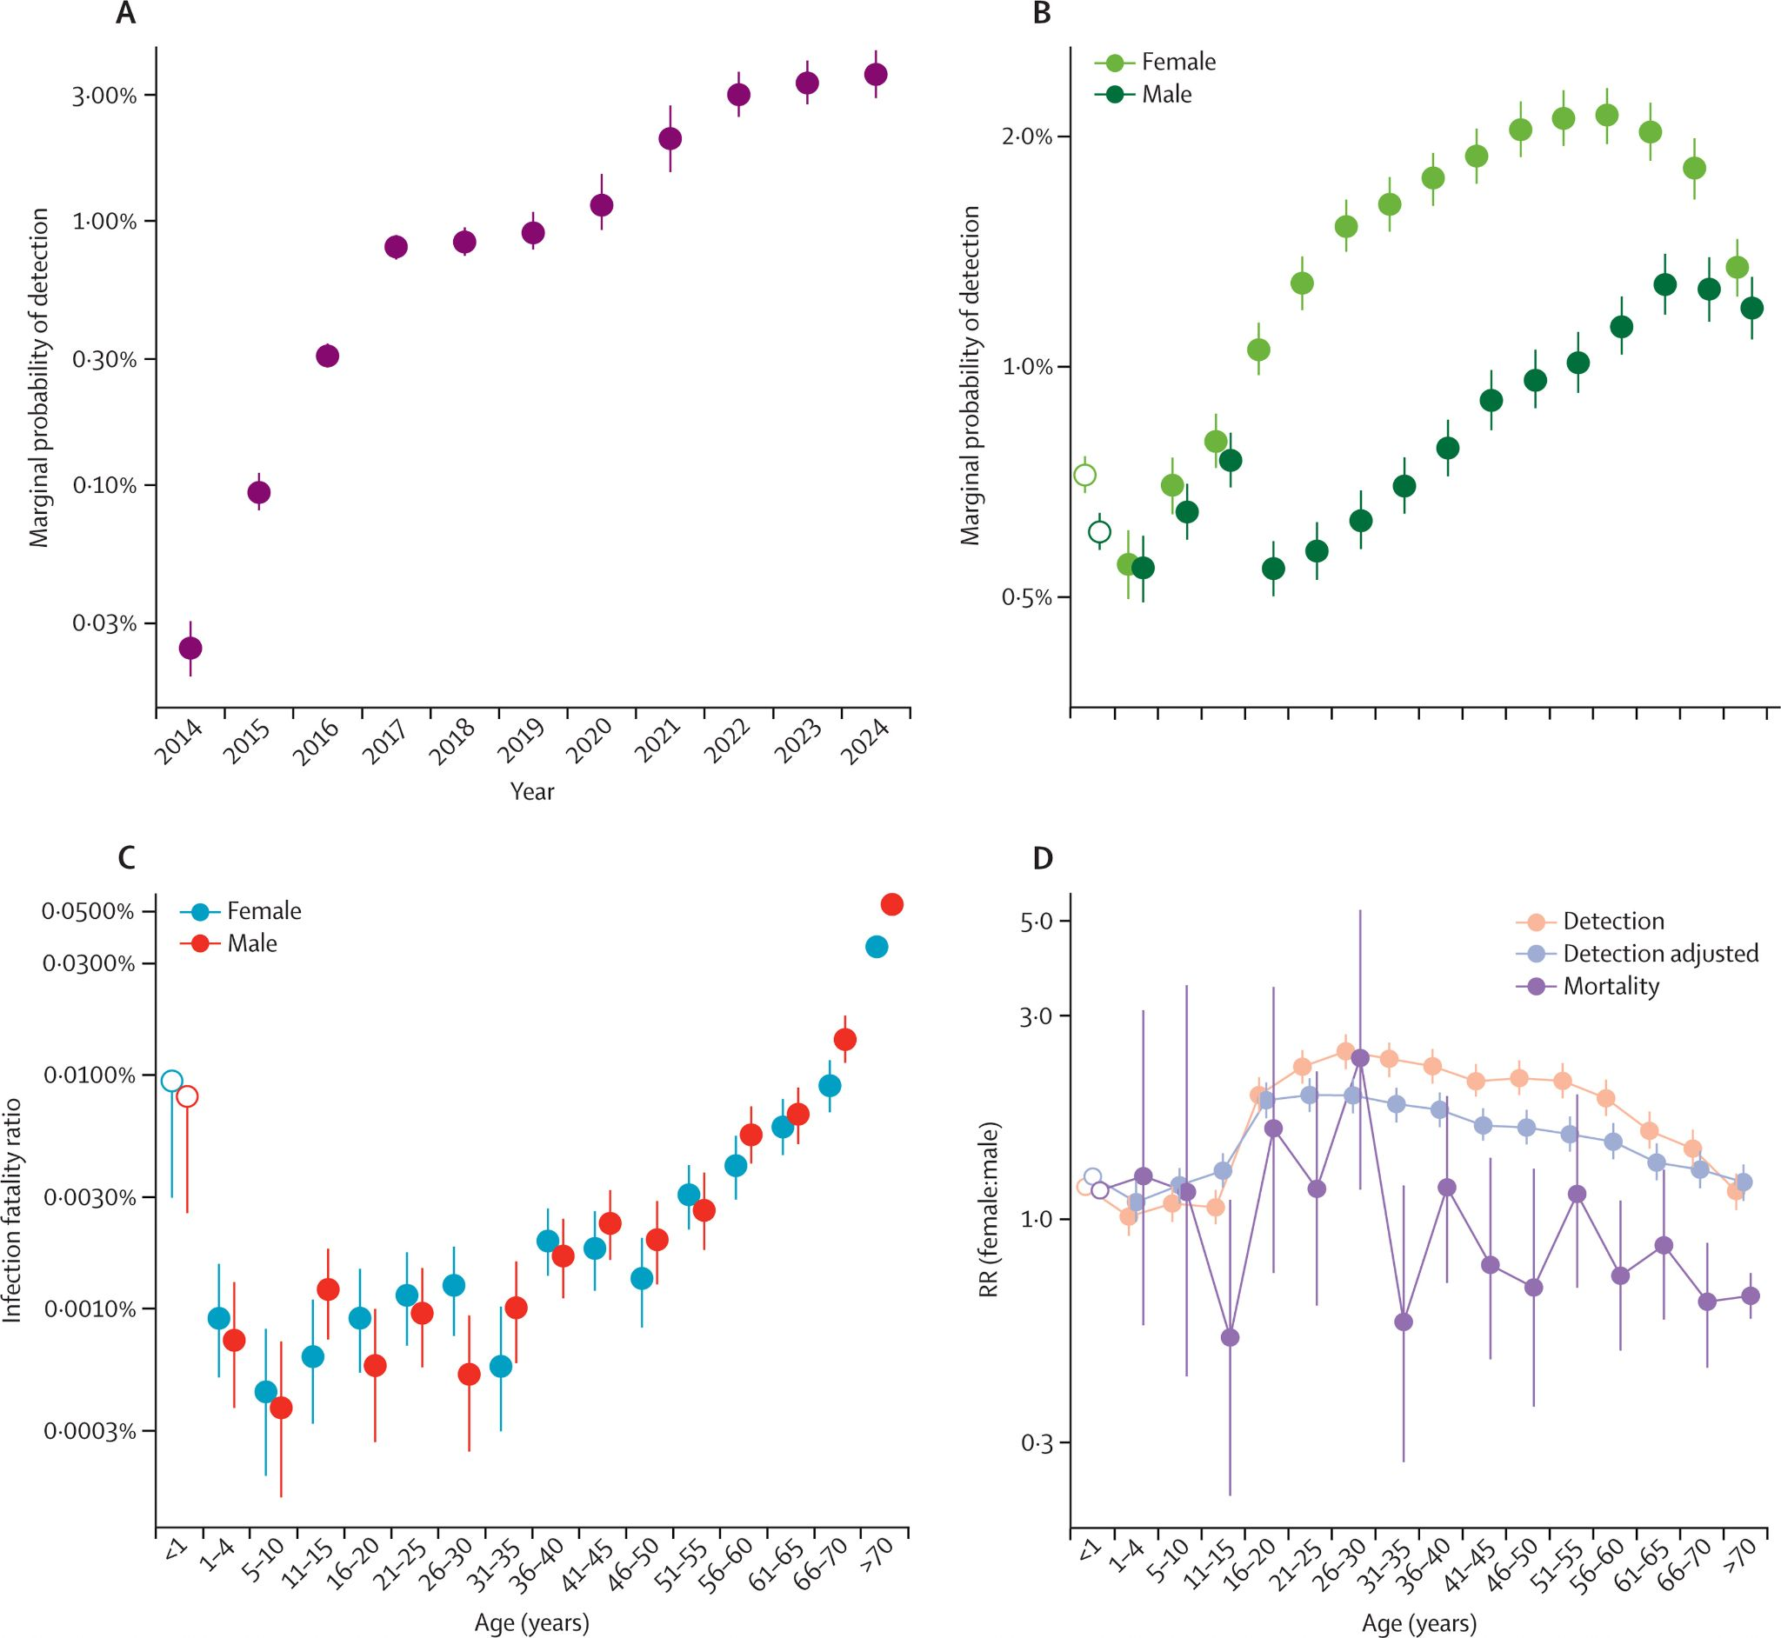
Observation processes are imperfect
Cortes-Azuero et al., Lancet Infec. Dis., 2025

Slide 15
Ok, now how do I actually link functions to data?

Slide 16
Refresher
Random variables can be sampled from a distribution of the right type.
Random variable: a quantity that can be modelled as a random process (e.g. number of cases detected in a week, number of mm of rainfall in Cambridge, waiting time at the bank. Can be discrete or continuous
Distribution: sets of functions that link all possible outcomes of the experiment to a certain probability. They have different use cases and properties.

Slide 17
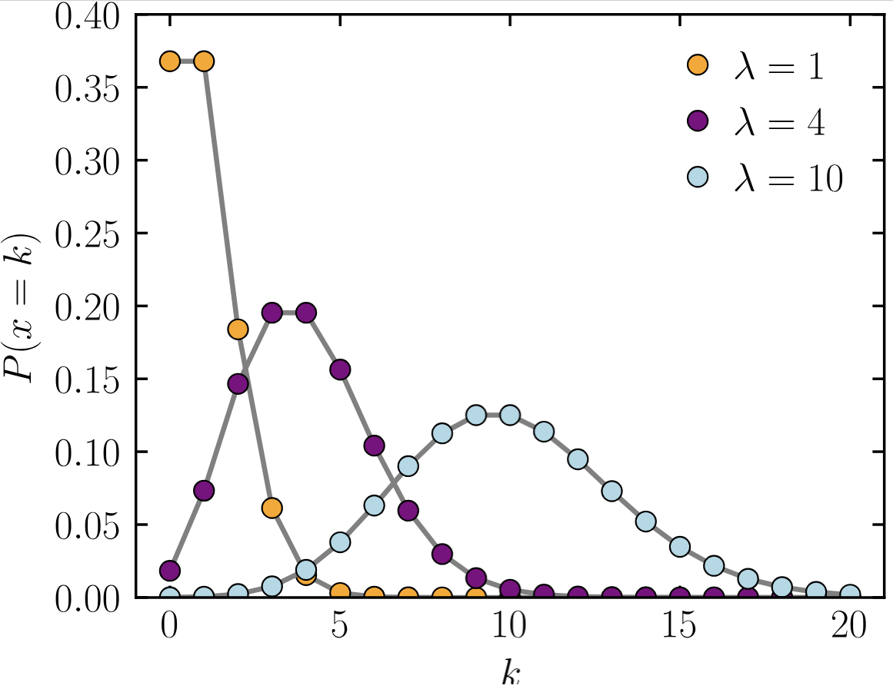
Example: count data
For count data (e.g. how many chikungunya cases are detected per day in Brazil), we can use a Poisson distribution.
It gives the probability of a given number of events occurring in a fixed interval of time, given a known constant mean rate (the single parameter, λ).
Probability mass function
Wikipedia

Slide 18
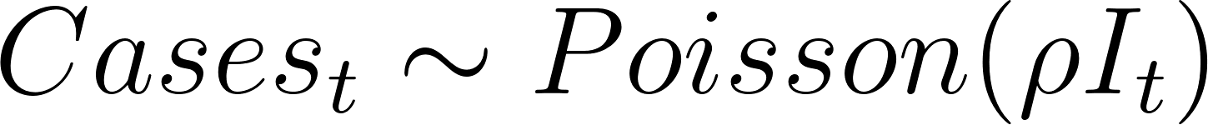
Example: count data
From our SIR model, we can obtain the daily incidence I_{t} of chikungunya virus infections during an outbreak in a city in Brazil.
If we want to model daily cases detected by the public health system, we have to model the observation process
Reporting rate

Slide 19
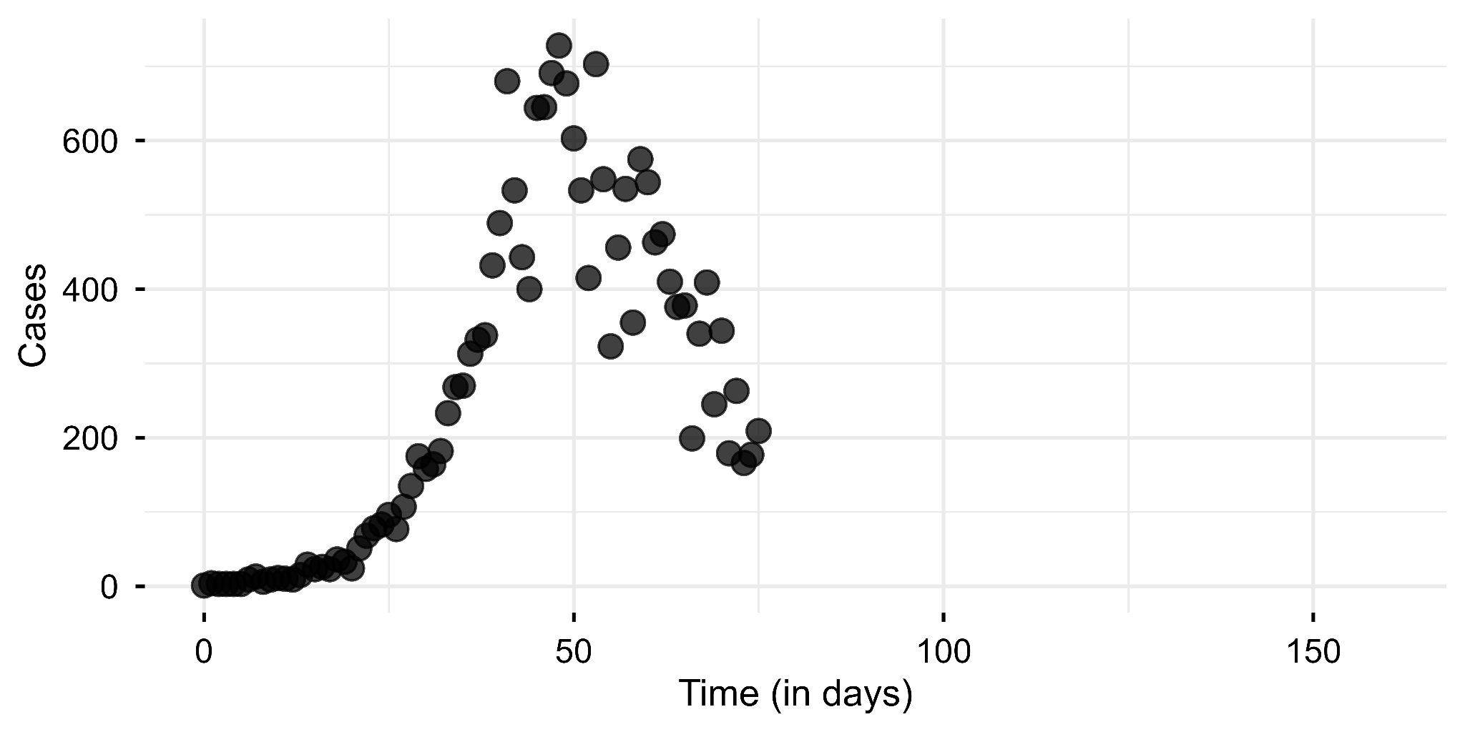
Comparing expected cases to data
Data
𝛽 = 0.3, 𝛾=0.1, 𝜌 = 0.25

Slide 20
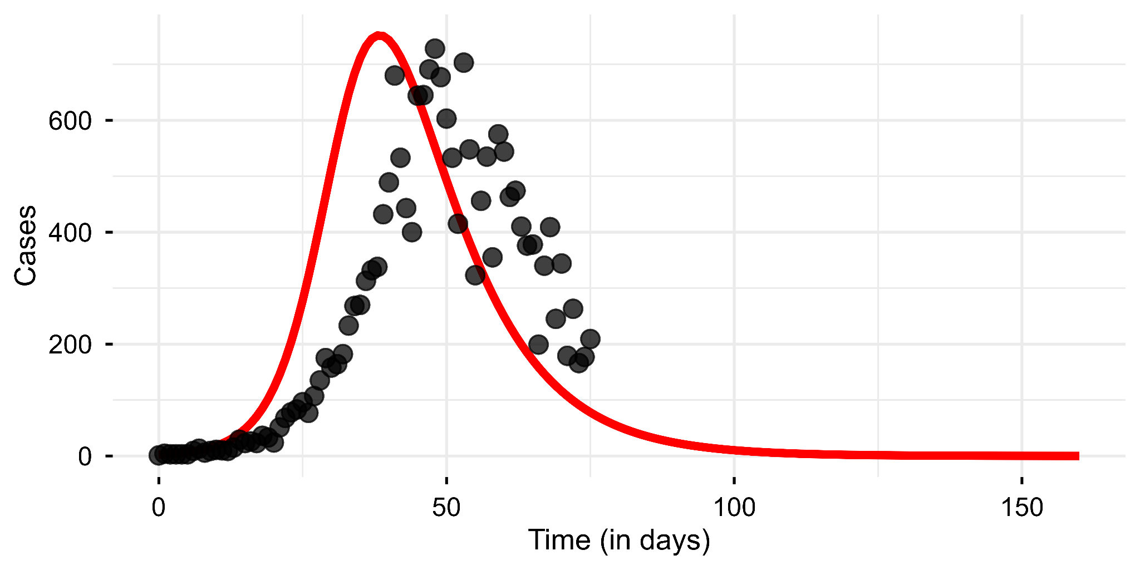
Comparing expected cases to data
Data
𝜌I_{t}
𝛽 = 0.3, 𝛾=0.1, 𝜌 = 0.25

Slide 21
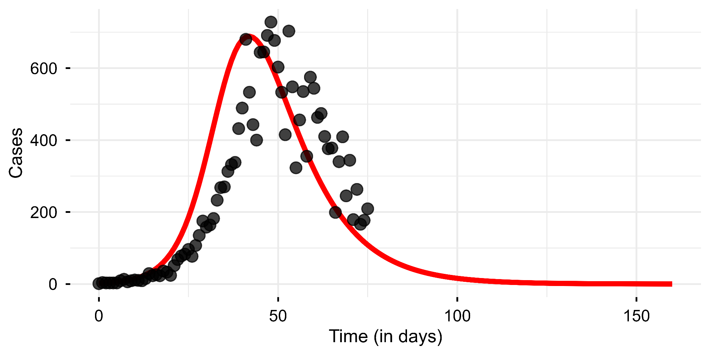
Comparing expected cases to data
Data
𝜌I_{t}
𝛽 = 0.28, 𝛾=0.1, 𝜌 = 0.25

Slide 22
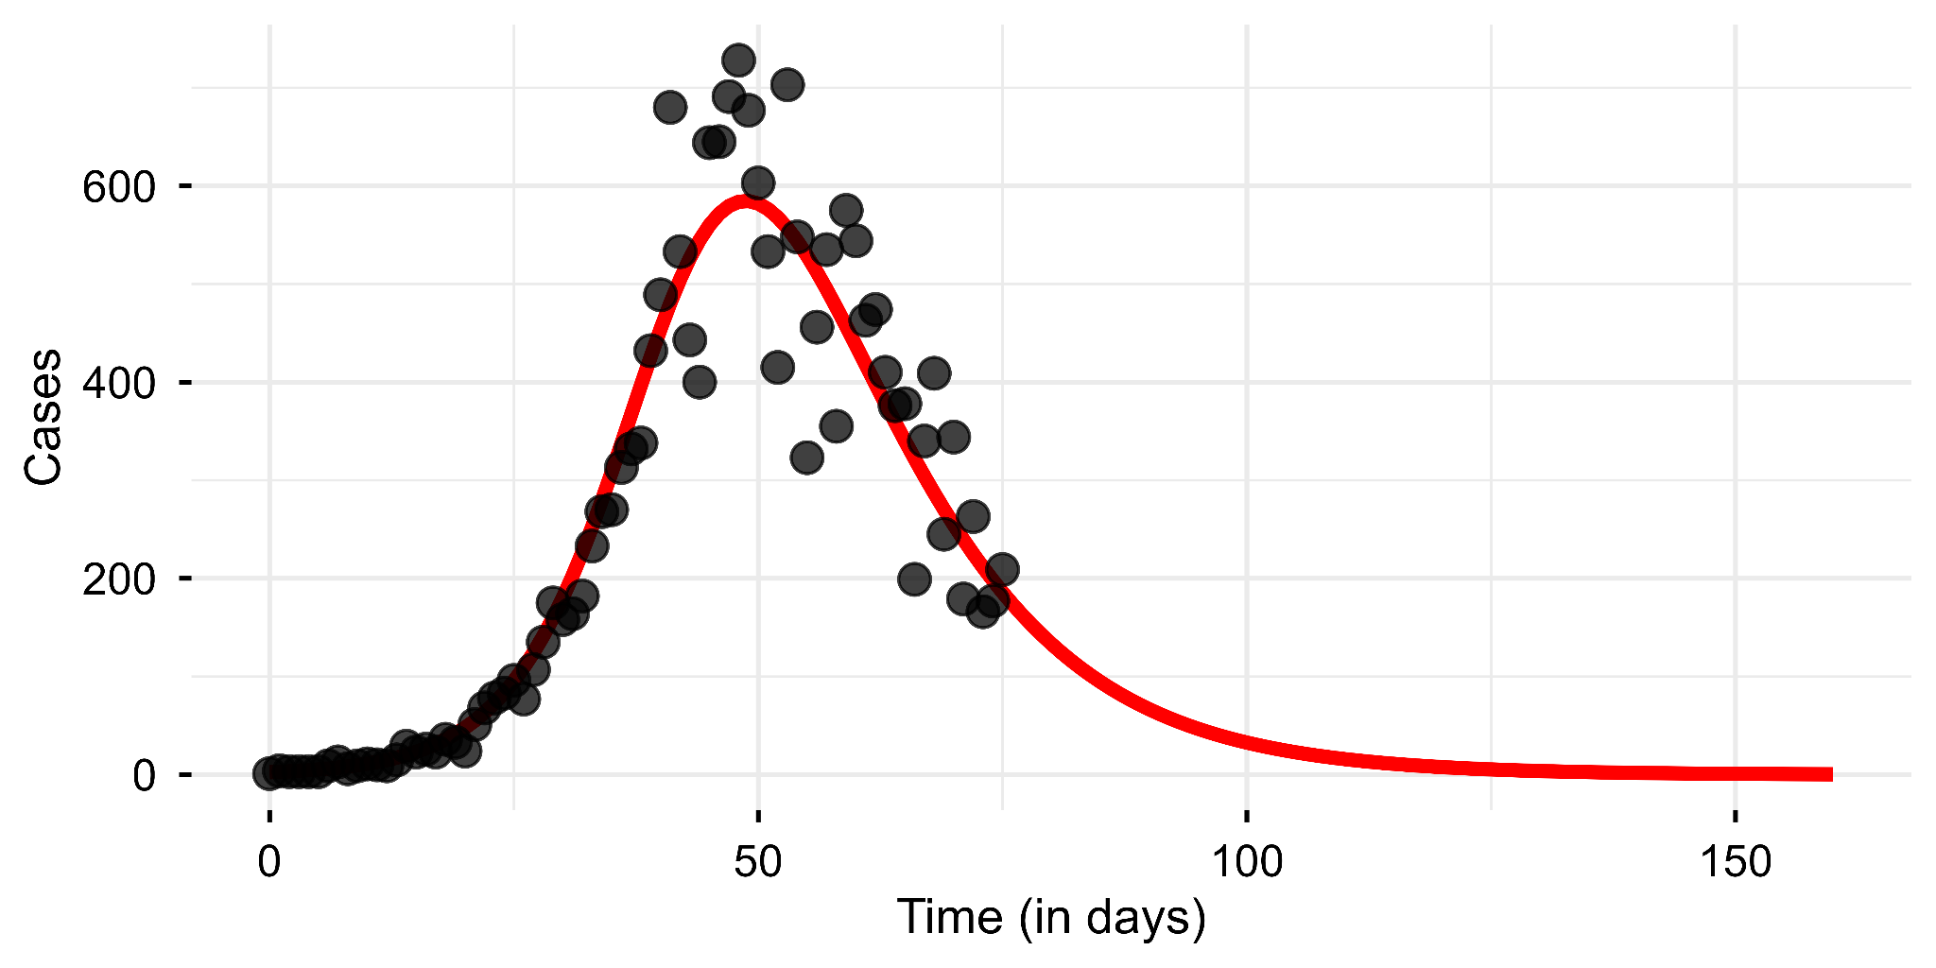
Comparing expected cases to data
Data
𝜌I_{t}
𝛽 = 0.25, 𝛾=0.1, 𝜌 = 0.25

Slide 23
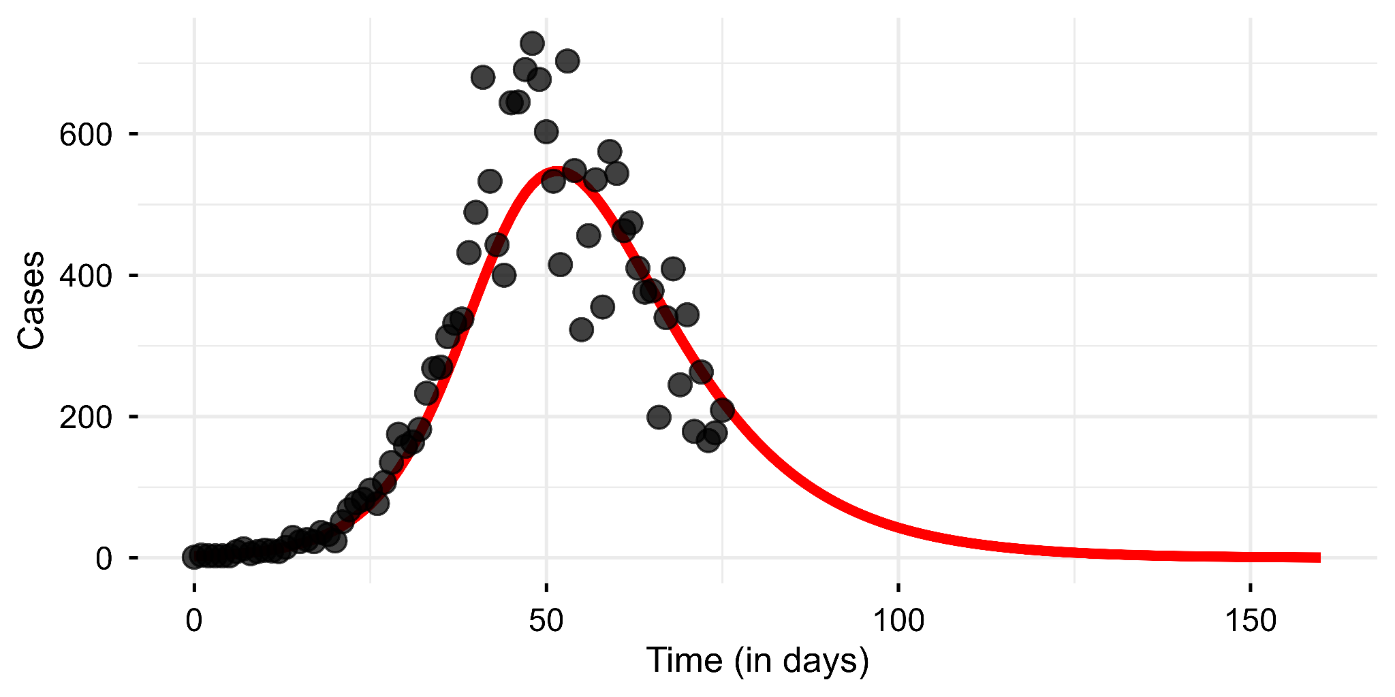
Comparing expected cases to data
Data
𝜌I_{t}
𝛽 = 0.24, 𝛾=0.1, 𝜌 = 0.25

Slide 24
How to find the parameter values that best fit the data?

Slide 25
Likelihood
The likelihood is the probability of observing the data given the model parameters
Notation:
If we consider a data set D, that we’re trying to model with parameters 𝜃, the likelihood 𝓛 is the probability of observing the data as a function of 𝜃
𝓛(𝜃|D) = P(D|𝜃)
The likelihood is a function of 𝜃!

Slide 26
Likelihood
If we consider data point D that we model with a Poisson distribution, for each possible value of the mean 𝜆 of the distribution,
𝓛(𝜆|D) = P(D|𝜆) = 𝜆^{D}exp(-𝜆)/D!
D
Probability mass function

Slide 27
Likelihood
If we consider independent data points D₁ and D₂ that we model with parameters 𝜃, then for D = D₁⋃ D₂
𝓛(𝜃|D) = 𝓛(𝜃|D₁) x 𝓛(𝜃|D₂)
If we use the log,
log(𝓛(𝜃|D)) = log(𝓛(𝜃|D₁)) + log(𝓛(𝜃|D₂))

Slide 28
Likelihood
For many independent data points D₁, …, D_{n} that we model with parameters 𝜃, we have
𝓛(𝜃|D) = ∏𝓛(𝜃|D_{i})
If we use the log,
log(𝓛(𝜃|D)) = ∑log(𝓛(𝜃|D_{i}))

Slide 29
So how do we formally compare our model to data?
We are usually interested in parameter inference (rather than the likelihood of any one set of parameters). We can do this through:
Maximum likelihood estimation
Here, we find the parameter value 𝛉 that maximimises the likelihood
The log likelihood reaches its maximum at the same value
It is a frequentist method that gives you the most likely value of theta (without uncertainty around it, although methods exist to construct confidence intervals)

Slide 30
So how do we formally compare our model to data?
We are usually interested in parameter inference (rather than the likelihood of any one set of parameters). We can do this through:
Maximum likelihood estimation
Here, we find the parameter value 𝛉 that maximimises the (log) likelihood
The log likelihood reaches its maximum at the same value
It is a frequentist method that gives you the most likely value of theta (without uncertainty around it, although methods exist to construct confidence intervals)
Bayesian inference
Here, we focus on estimating the posterior distribution (the probability of the random variable 𝛉)

Slide 31
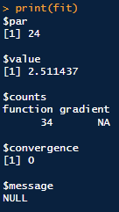
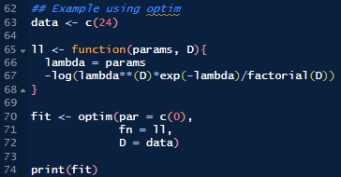
And how do we find the maximum?

Slide 32
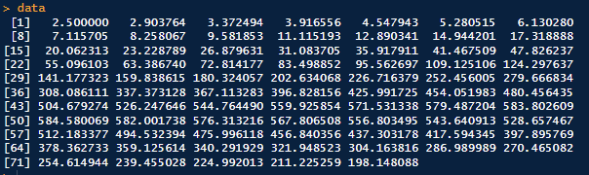
How about for many points?

Slide 33
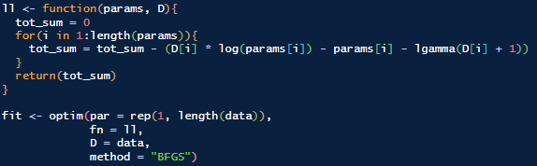
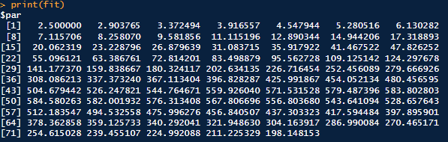
How about for many points?

Slide 34
What if our data didn’t look like this…
Data
𝜌I_{t}
𝛽 = 0.25, 𝛾=0.1, 𝜌 = 0.25

Slide 35
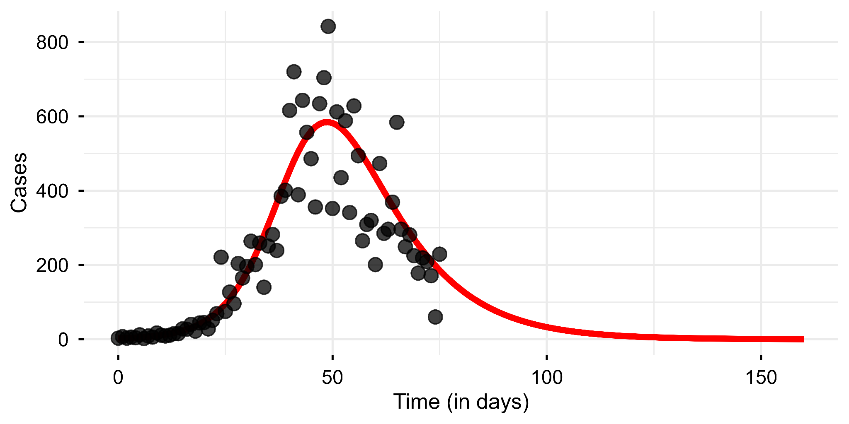
… and looked like this instead?
Data
Are we using the best model?
𝜌I_{t}
𝛽 = 0.25, 𝛾=0.1, 𝜌 = 0.25

Slide 36
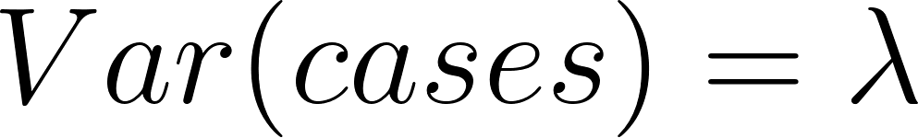
Modelling is an iterative process…
The Poisson distribution assumes that the variance in our data is equal to the mean.
E.g. if you expect to see 10 cases on average, the variability around that will be 10 as well.

Slide 37
However, the Poisson distribution assumes that the variance in our data is equal to the mean.
Epidemic surveillance data is often overdispersed, meaning it’s variance is greater than the mean expected number of cases (e.g. we see much smaller and larger case numbers than we’d expect given the average number of cases).

Slide 38
If we think our data is overdispersed (more variable than the Poisson assumes) we can use a Negative Binomial distribution.

Slide 39
If we think our data is overdispersed (more variable than the Poisson assumes) we can use a Negative Binomial distribution.
This has an additional parameter k which controls the over-dispersion of the distribution
If k is small then over-dispersion is high, if k is high then the Negative Binomial converges on the Poisson
We’re adding another parameter to describe the spread of our data around the mean

