Slide 1


Serocatalytic models
Dr. Oscar Cortés & Dr. Jair Andrade
Adapted from slides from
Professor Henrik Salje

Slide 2
Why conduct serological analyses?

Slide 3
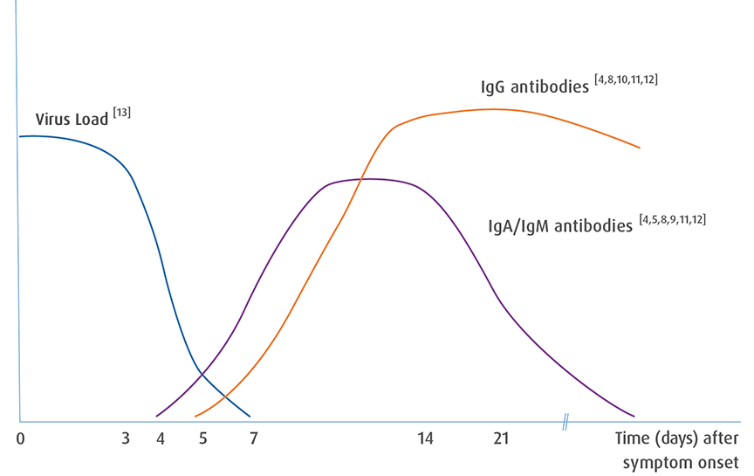

Slide 4
The level of pathogen-specific antibodies in the blood is measured in antibody titres

Slide 5
Different types of serological studies

Slide 6
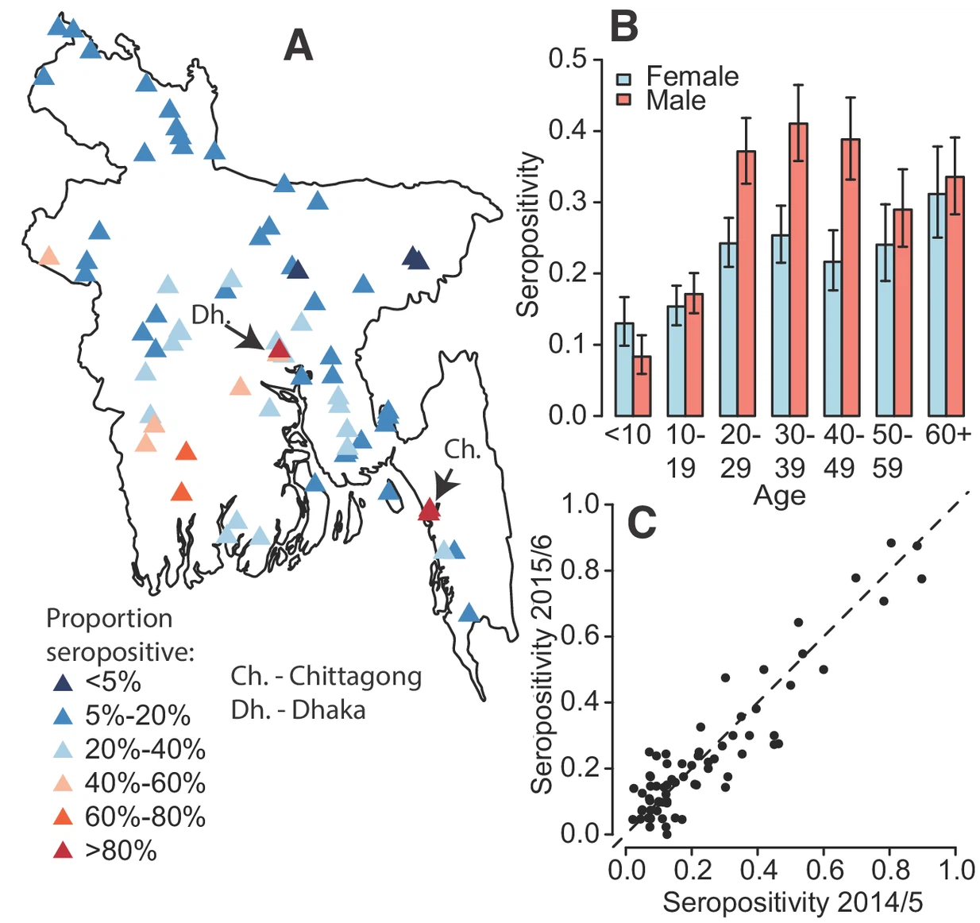
Different types of serological studies
Cross-sectional seroprevalence studies
Community-based studies
Blood bank studies
Salje H, Paul KK, Paul R, Rodriguez-Barraquer I, Rahman Z, Alam MS, et al. Nationally-representative serostudy of dengue in Bangladesh allows generalizable disease burden estimates. Elife. 2019 Apr 8;8:e42869.

Slide 7
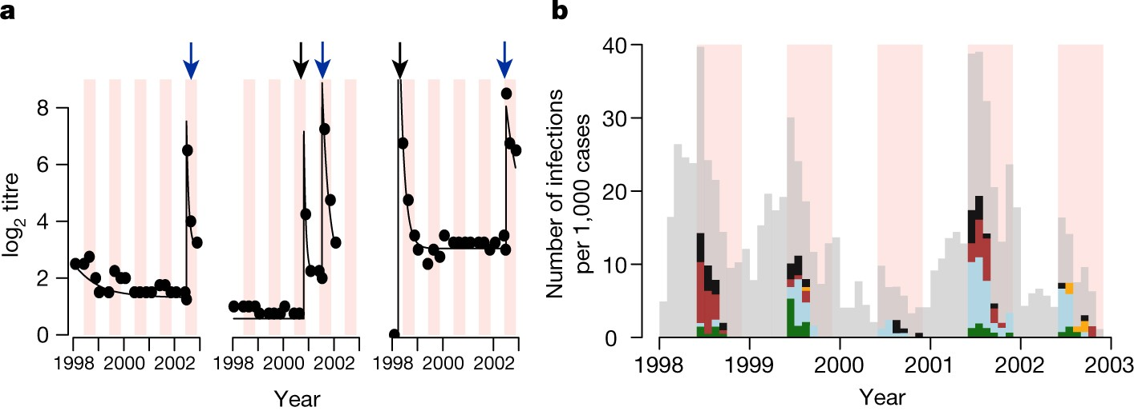
Different types of serological studies
Cross-sectional seroprevalence studies
Community-based studies
Blood bank studies
Longitudinal studies
Cohort studies
Salje H, Cummings DAT, Rodriguez-Barraquer I, Katzelnick LC, Lessler J, Klungthong C, et al. Reconstruction of antibody dynamics and infection histories to evaluate dengue risk. Nature. 2018 May;557(7707):719–23.

Slide 8
Examples of different types of serological assays?
ELISAs
Neutralisation tests
Multiplex assays
IFA
Hemagglutination inhibition assay
Depletion assays
ADCC
CDC
Blockade of binding
Enhancement assays
Many more

Slide 9
What complicates analysing the results of serological testing?

Slide 10
Why are mathematical approaches useful in analysis of serological datasets?
Help provide interpretation between observed reading and infection history
Individual scale
Population scale
Identification of risk factors for infection
Identify correlates of protection

Slide 11
Disease surveillance
In many settings, infectious disease diagnosis is based on clinical judgement only.
Why does that complicate our understanding of disease trends?

Slide 13

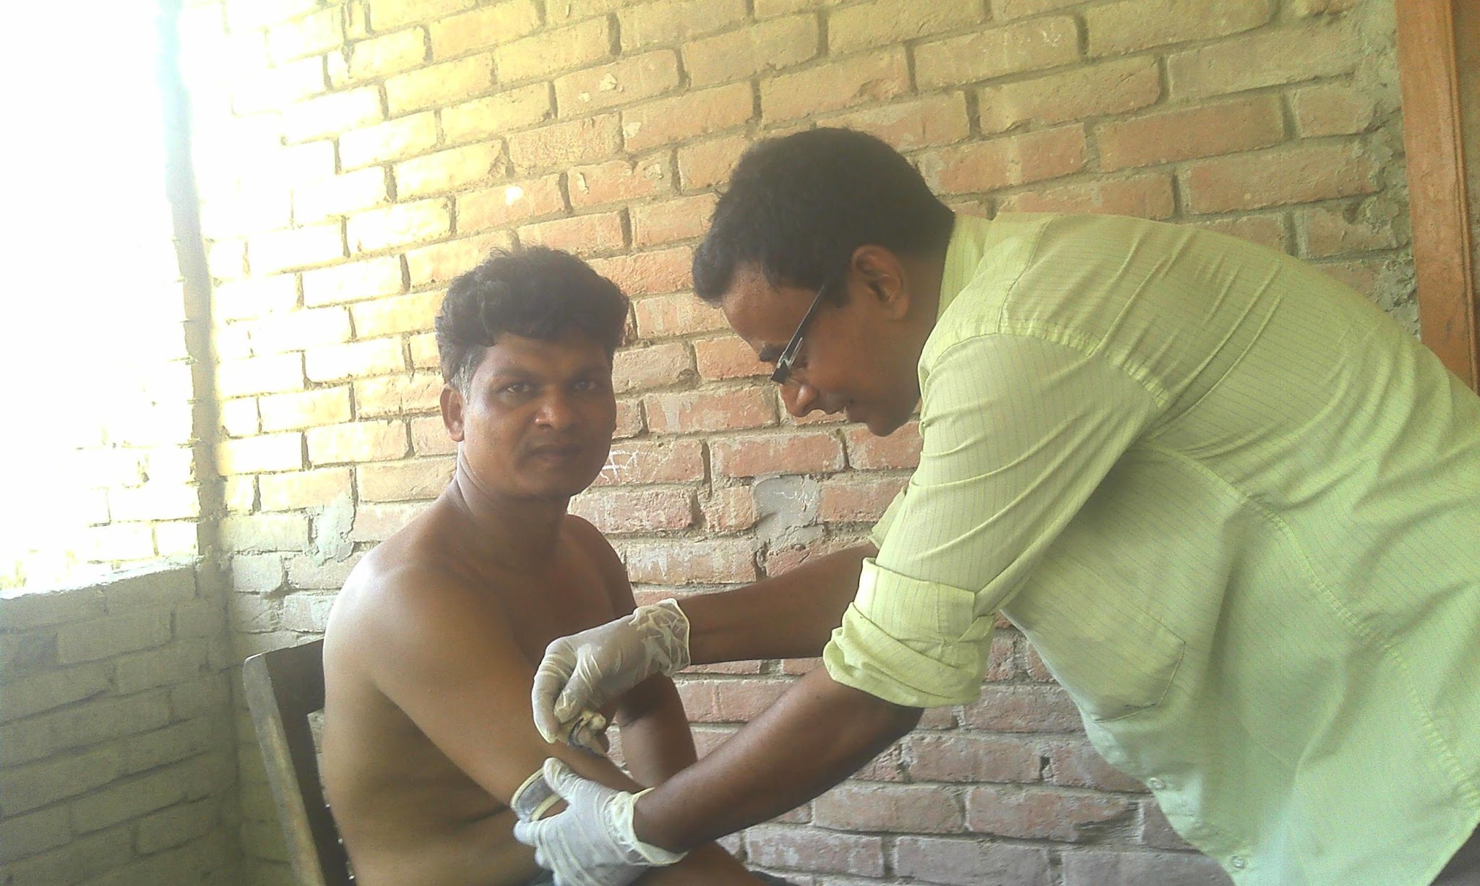
Cross-sectional seroprevalence studies
Collect blood from random people in community
Test the blood for IgG antibodies to your pathogen

Slide 14
Cross-sectional seroprevalence studies
Let’s say there was a study in 2020 that tested for chikungunya IgG antibodies
What would this seropositivity by age indicate?
0.6
Proportion seropositive
0
0
40
80
Age

Slide 15
Cross-sectional seroprevalence studies
What about this?
0.6
Proportion seropositive
0.2
0
0
40
80
Age

Slide 16
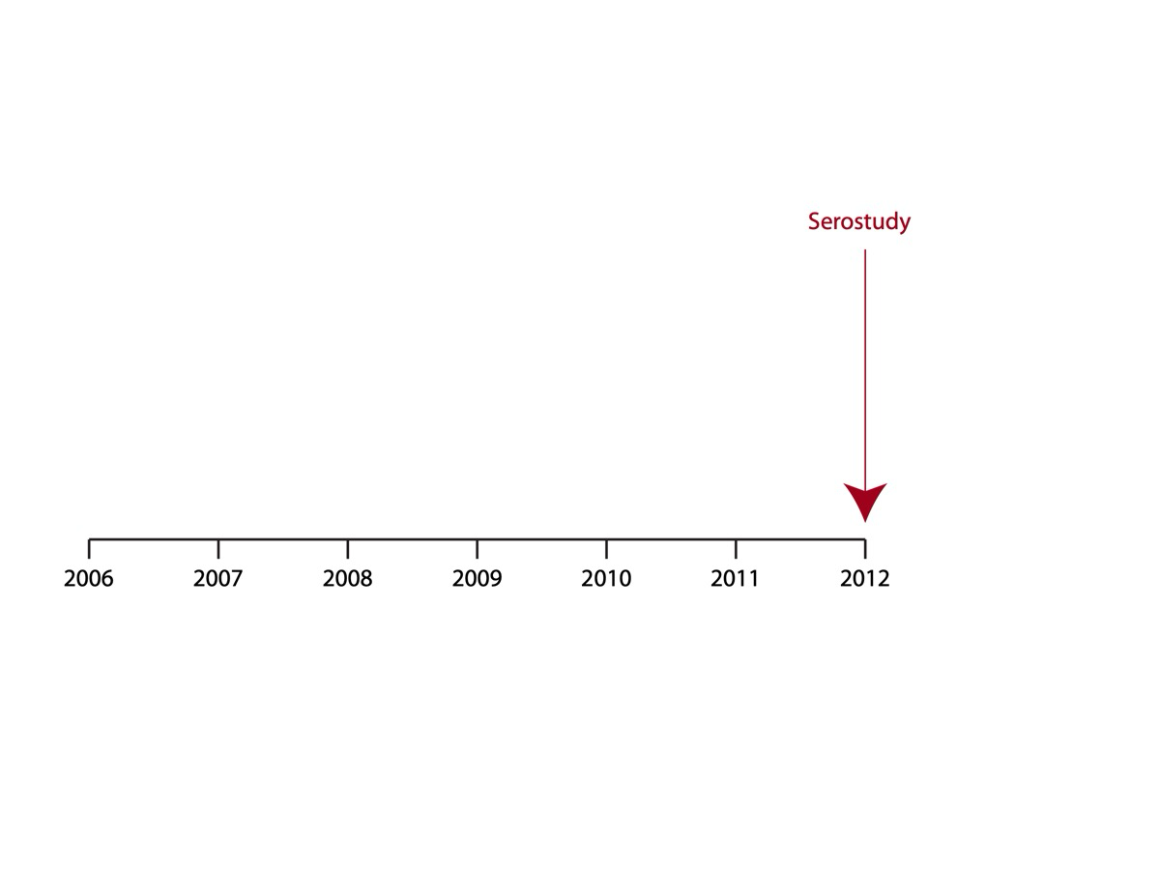
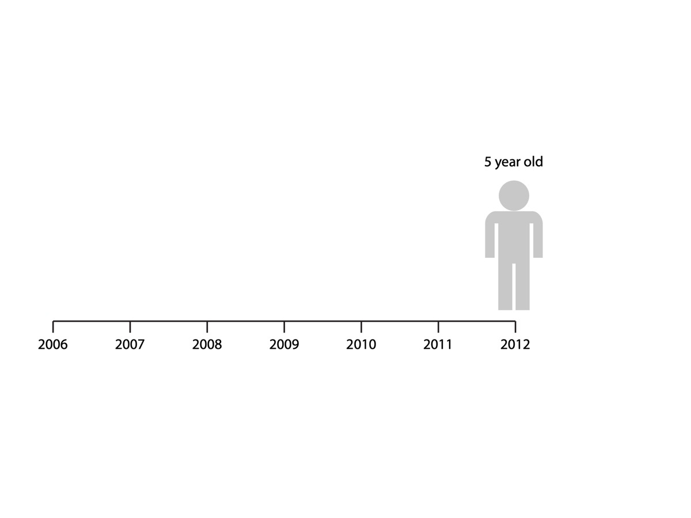
Cross-sectional seroprevalence studies
What about this?
0.6
Proportion seropositive
0.2
0
0
40
80
Age

Slide 17
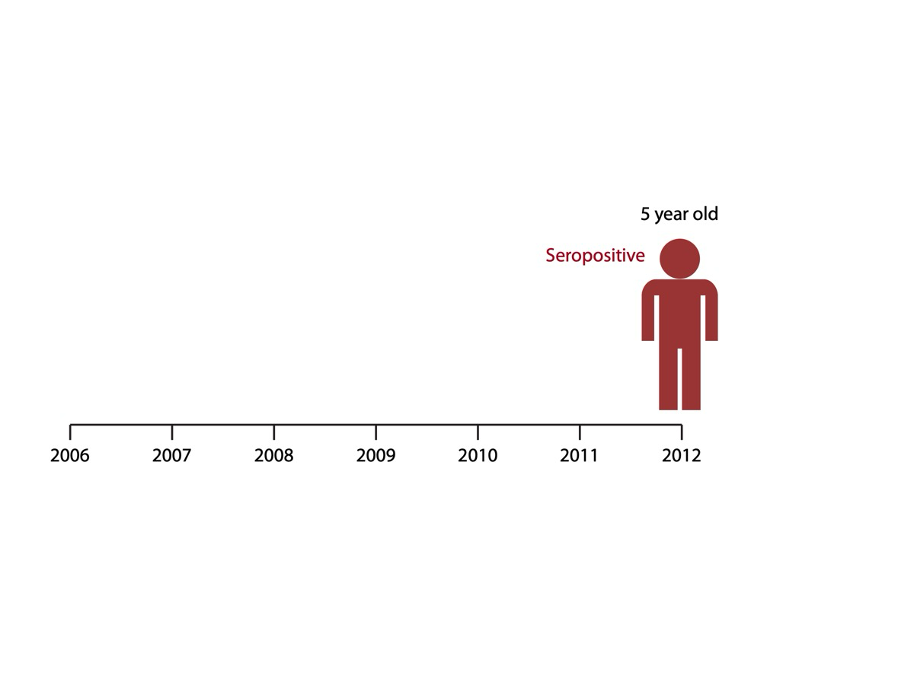

Slide 18
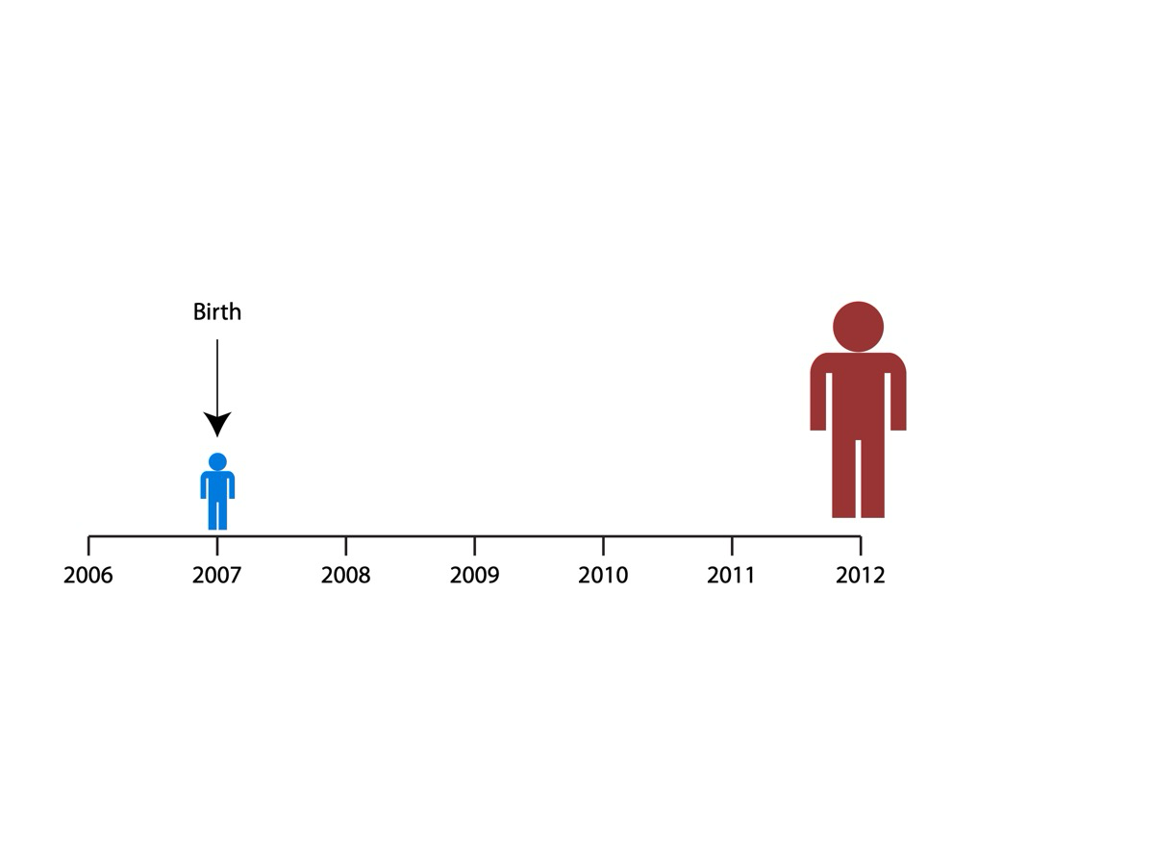

Slide 19
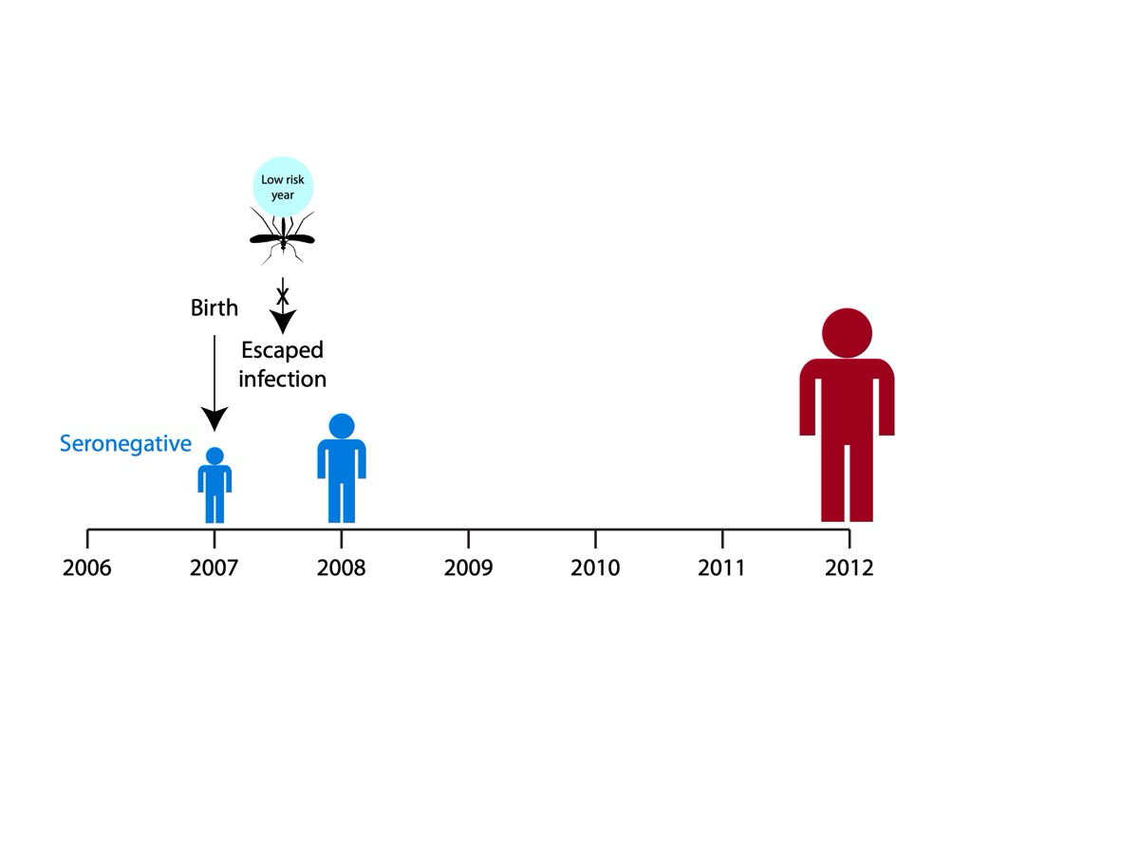

Slide 20
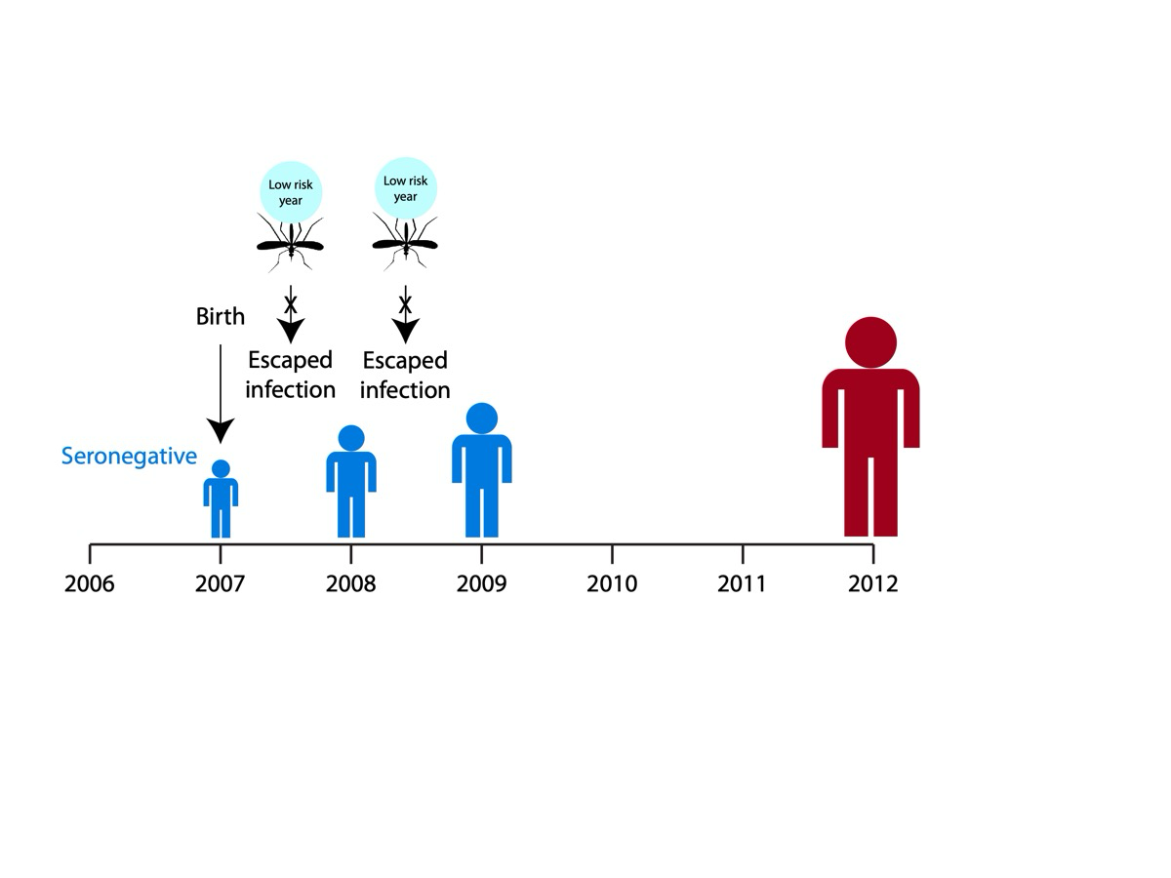

Slide 21
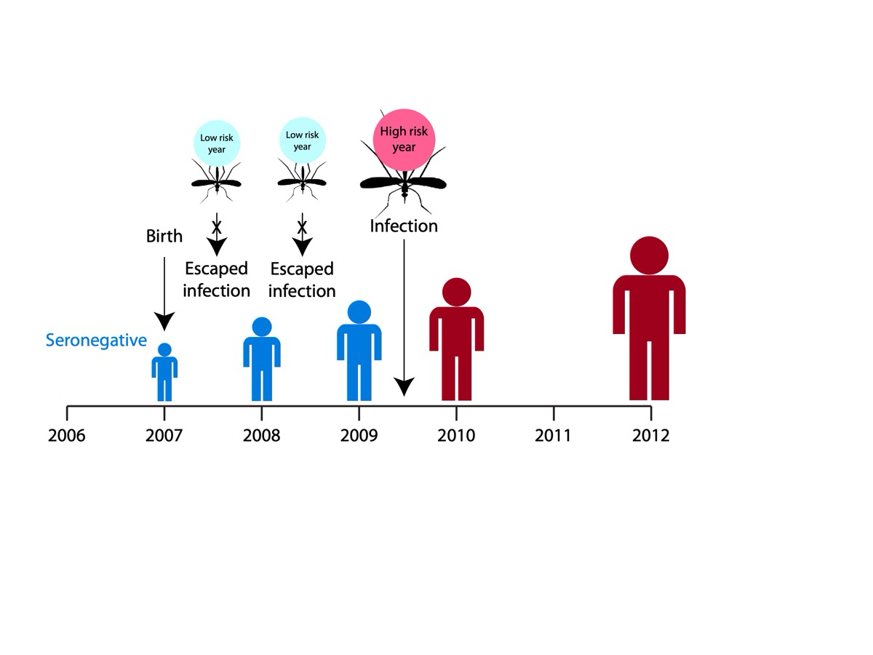

Slide 22
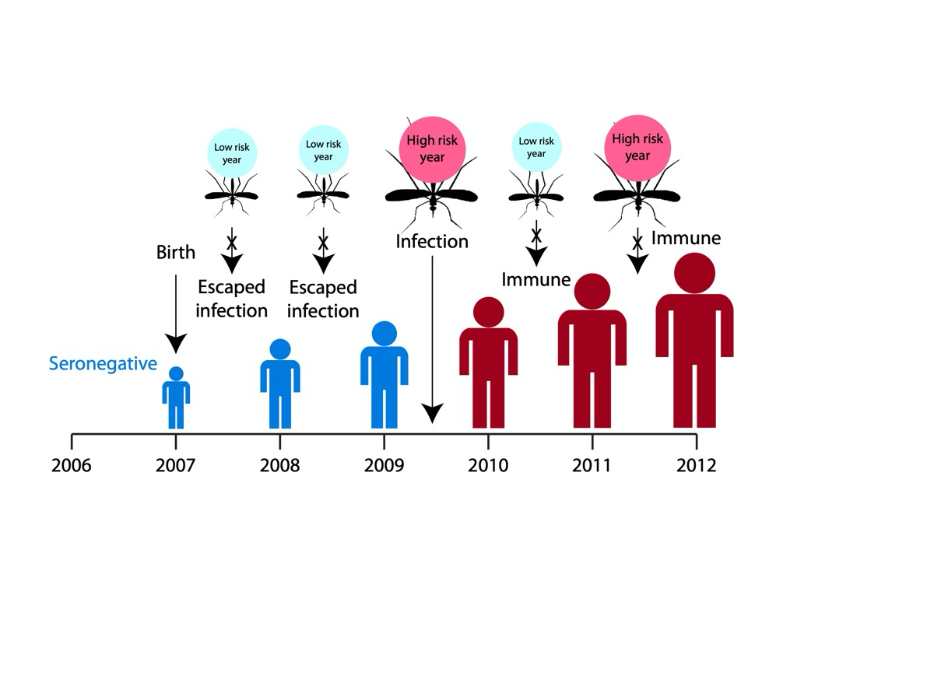

Slide 23
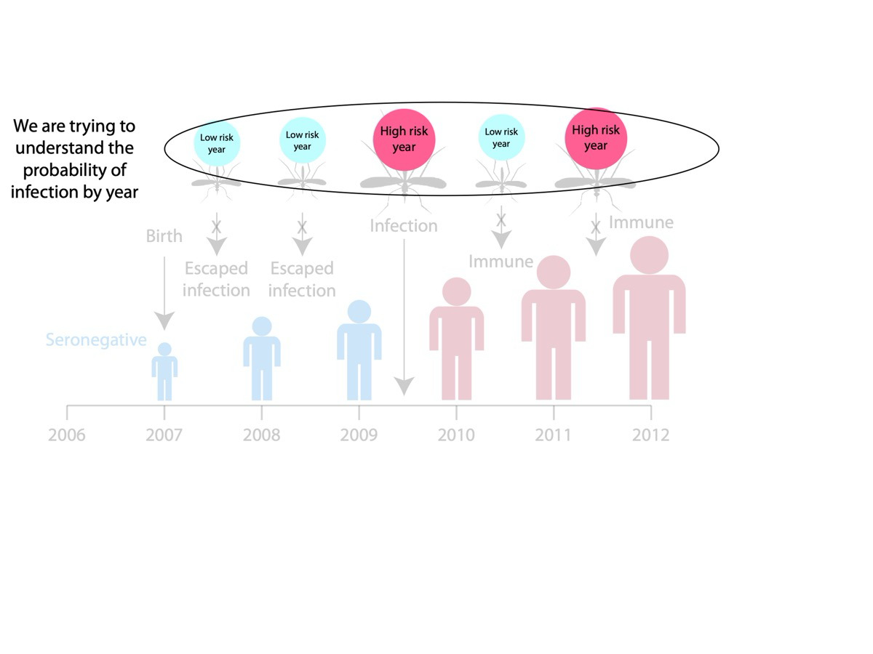

Slide 24
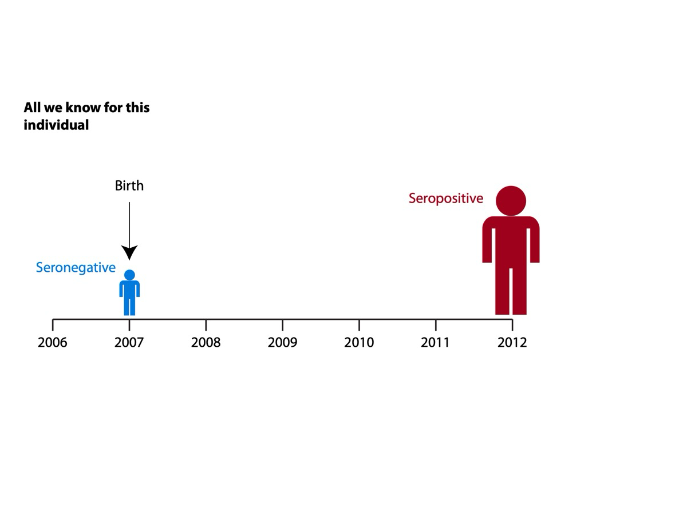

Slide 25
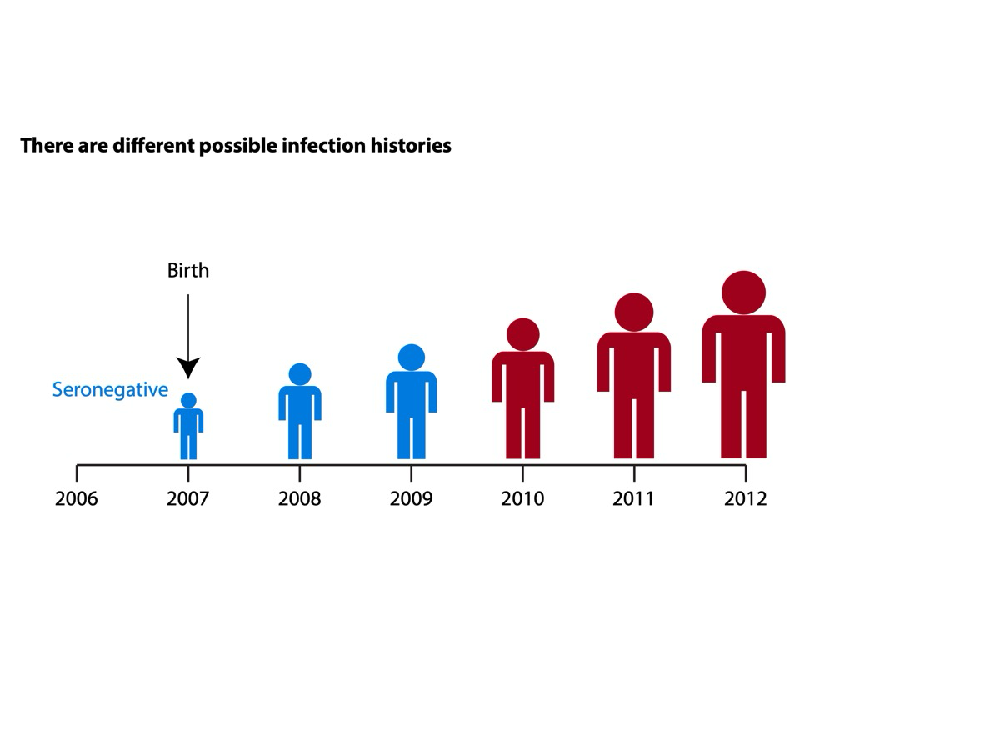

Slide 26
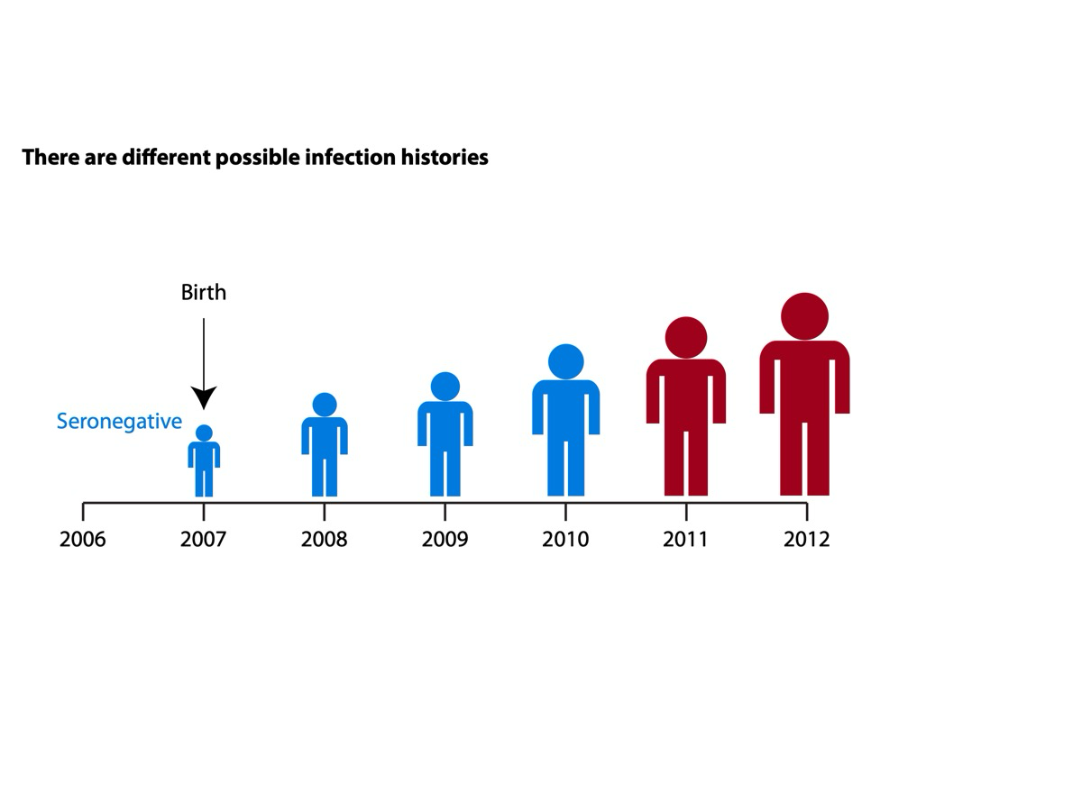

Slide 27
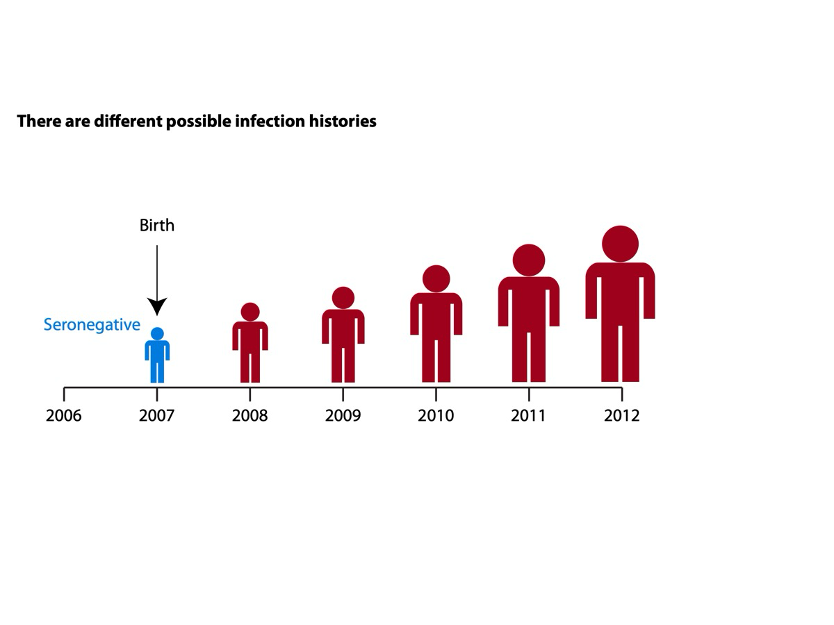

Slide 28
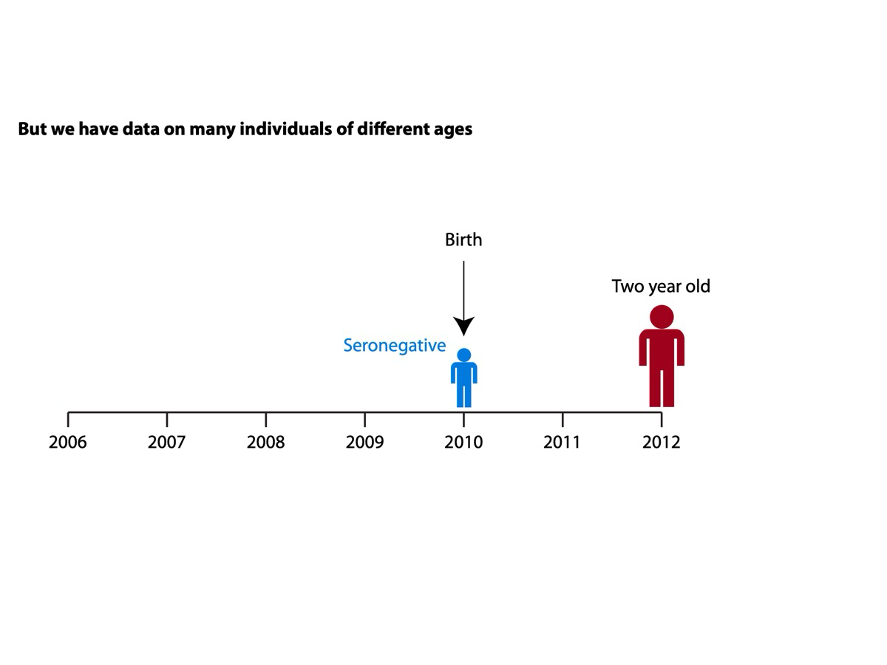

Slide 29
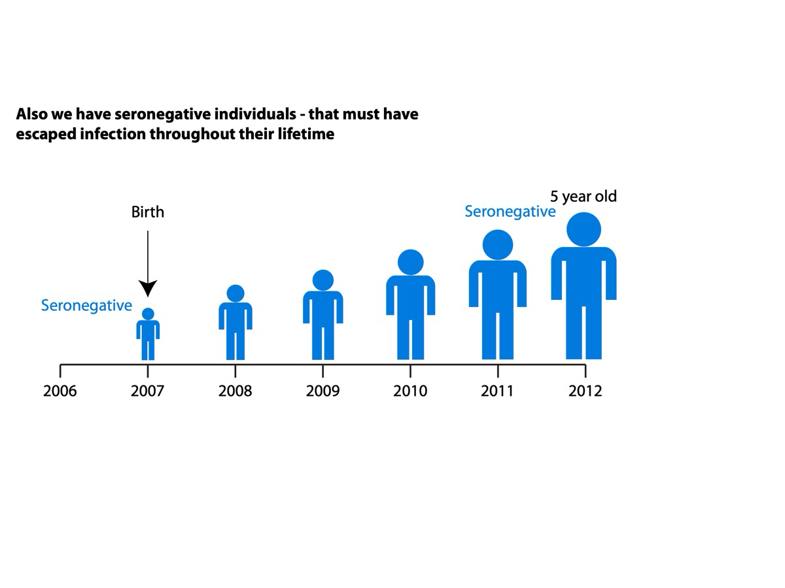

Slide 30
Catalytic models
Catalytic models are a way of describing mathematically your annual probability of infection.
Let’s assume we have an endemic pathogen with sterilizing immunity which has an annual probability of infection of p.
The probability that a one year old is seropositive is:
p
The probability of them being seronegative (having escaped infection) is:
1-p
The probability that a two year old has escaped infection is:
(1-p)²
The probability that a two year old is seropositive is therefore:
1-(1-p)²

Slide 31
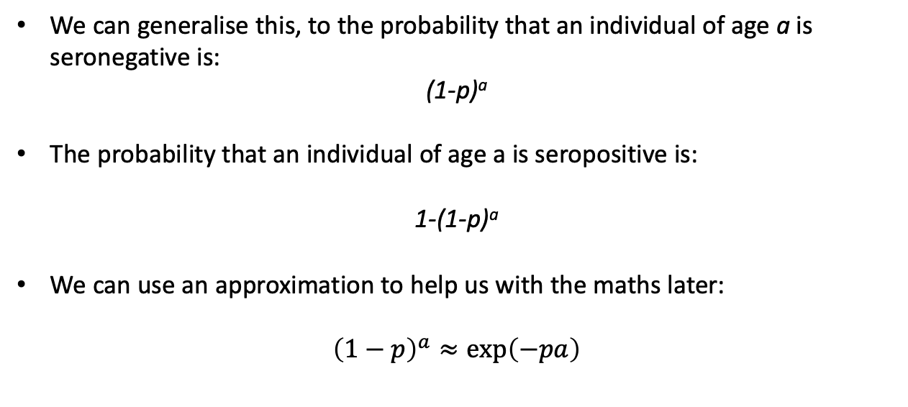
Catalytic models

Slide 32
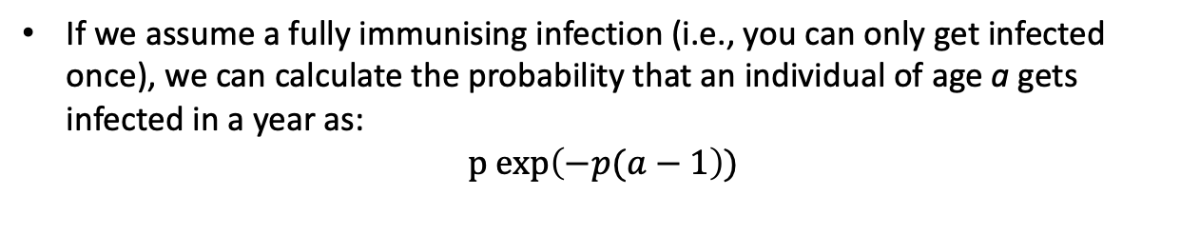
Estimating number of infected individuals
Didn’t get infected in previous years
Gets infected this year

Slide 33
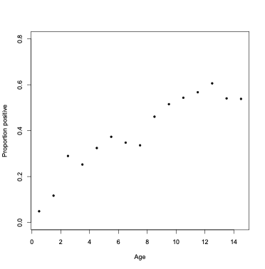
Catalytic models
Data
1995 individuals between 1 and 15 with serostatus to dengue virus
ID | Age | Serostatus
1 | 4 | 1
2 | 10 | 0
3 | 13 | 1
4 | 3 | 0
We want to estimate the annual probability of infection p

Slide 34
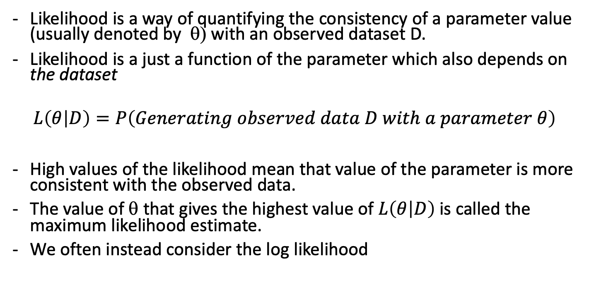

Likelihood

Slide 35
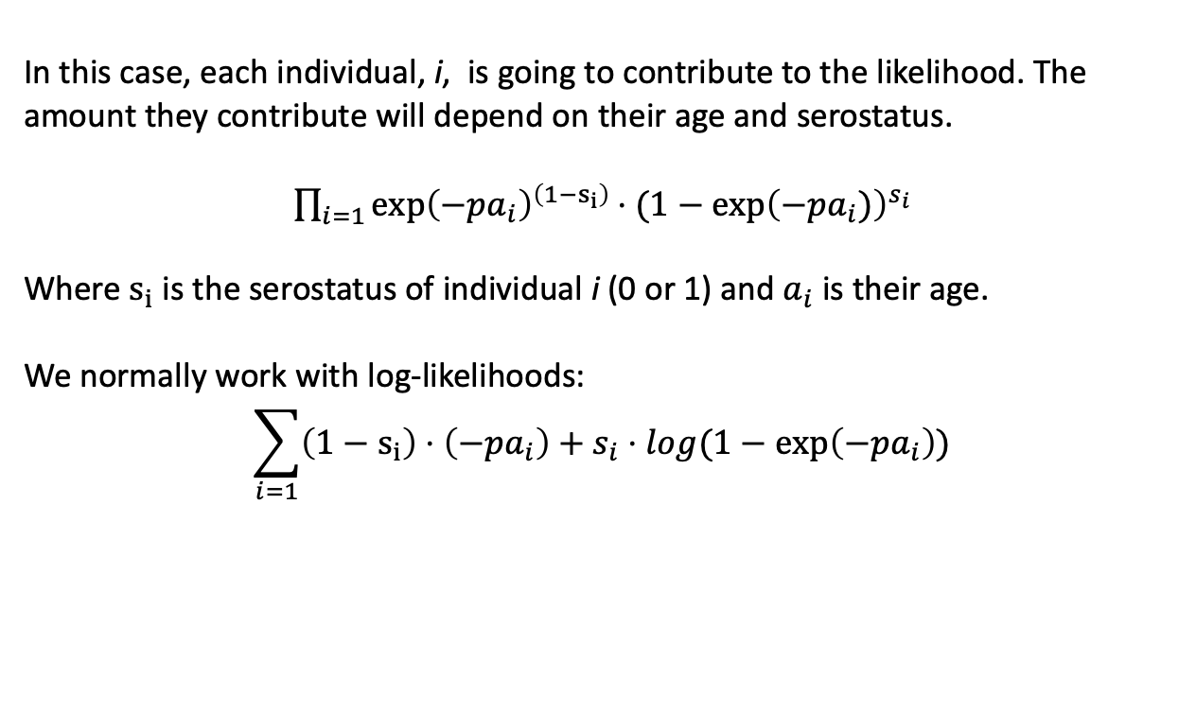
Likelihood

Slide 36
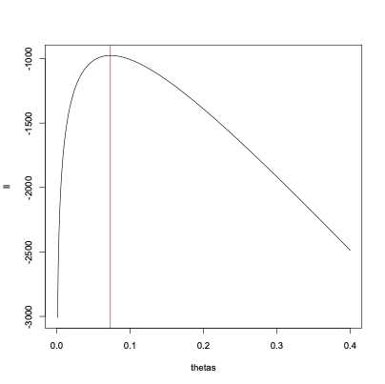
Likelihood
One approach is to identify the value of p that maximizes the log-likelihood.
Log-likelihood max at 0.073

Slide 37

Likelihood interval
We can create ~95% confidence intervals
Find values > l(θ)-1.921 = -975.615-1.821 = -977.936
Wilk’s confidence interval of 0.068 - 0.079

Slide 38
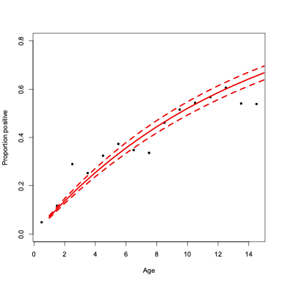
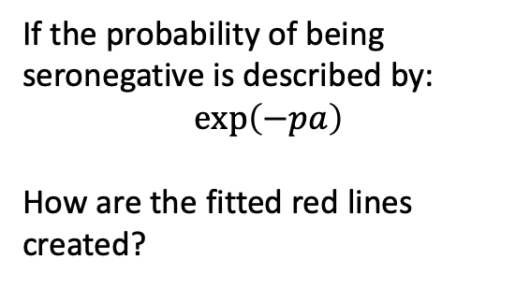
Model fit

Slide 39
Model fit
How could we improve fit?
What are the major assumptions currently?

Slide 40
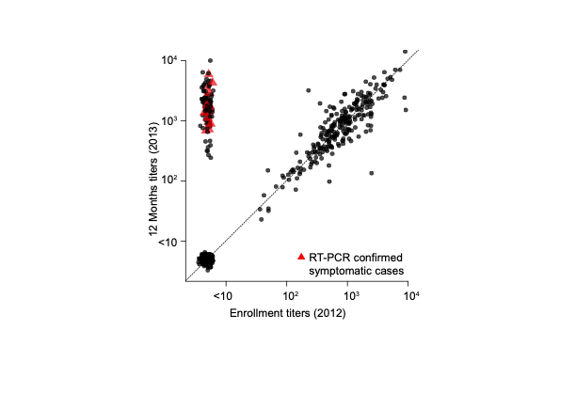
Chikungunya example
Results from one year follow up of individuals from Cebu, Philippines (N=847), who were bled in 2012 and then in 2013.
They were also followed up for illness events in between. Any instances of illness resulted in additional sample collection and testing with PCR.

Slide 41
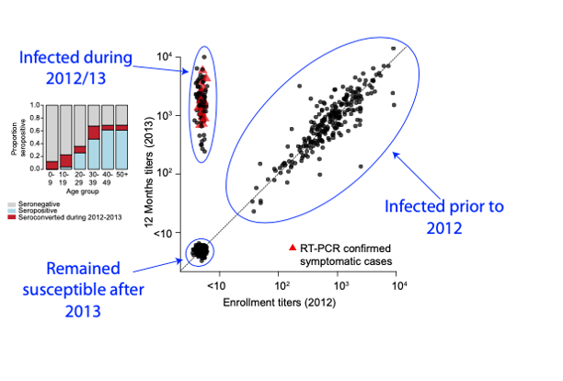
Chikungunya example

Slide 42
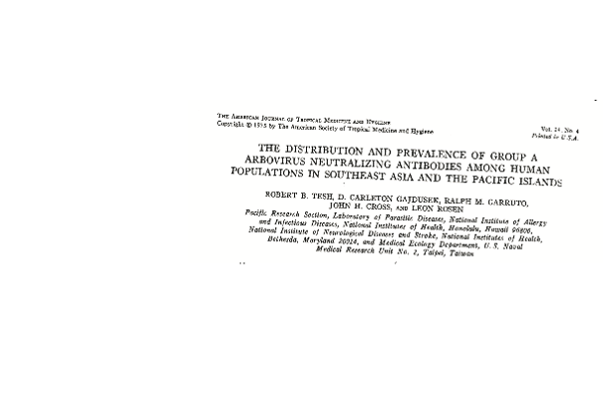
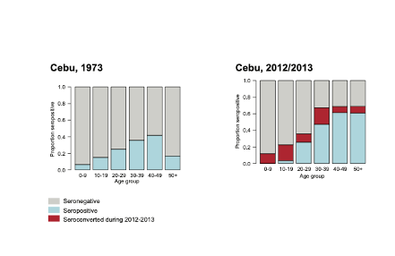
Chikungunya example

Slide 43
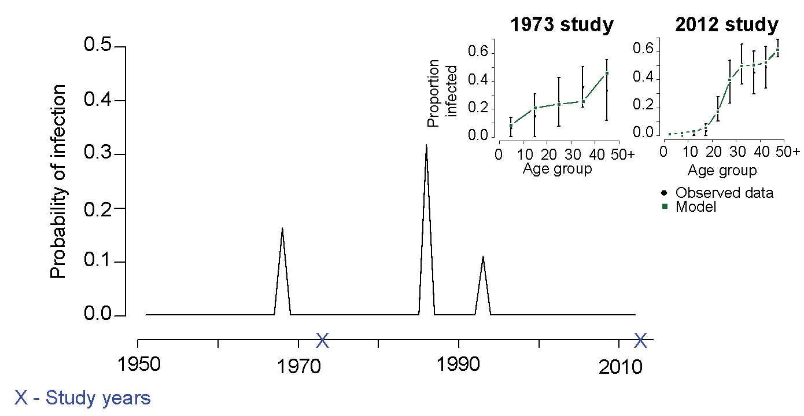
Model fitting

Slide 44
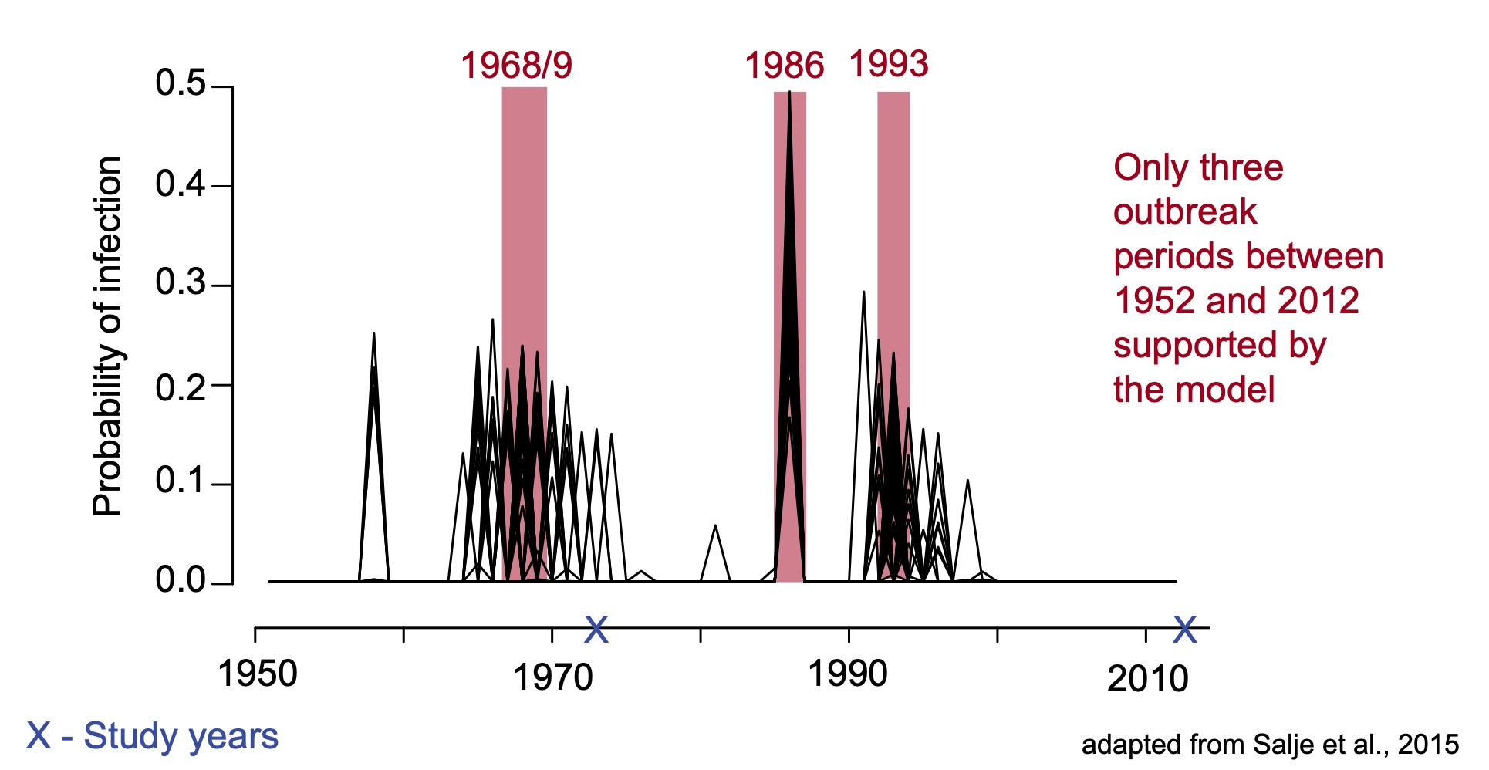
Using MCMC we can estimate the annual probability of infection

Slide 45
Size of the population infected
We now know have estimates of the annual probability of becoming infected among those susceptible (and alive) in each year.
We would like to also estimate the number of people infected in each year and the proportion that remain susceptible.
What determines this?

Slide 46
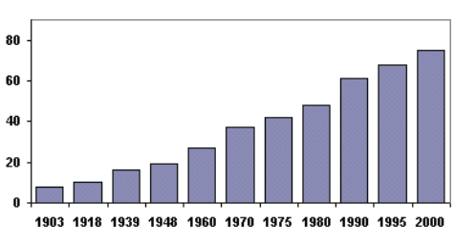
Size of the population infected
Population size (m)

Slide 47
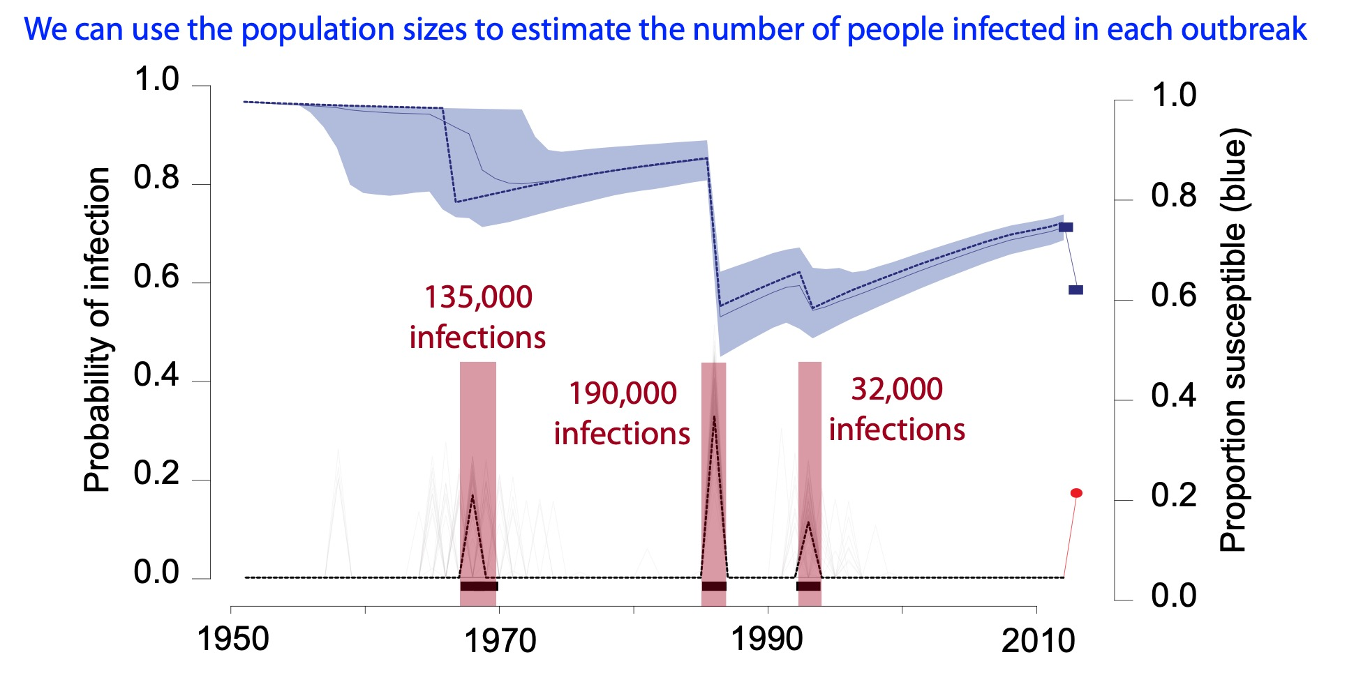
Size of the population infected

Slide 48

Size of the population infected
Number of chikungunya cases reported in Cebu over this period: 1 !!!

Slide 49
Size of the population infected
What inferences can we make about chikungunya transmission?
Why might this be?

Slide 50
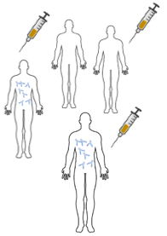
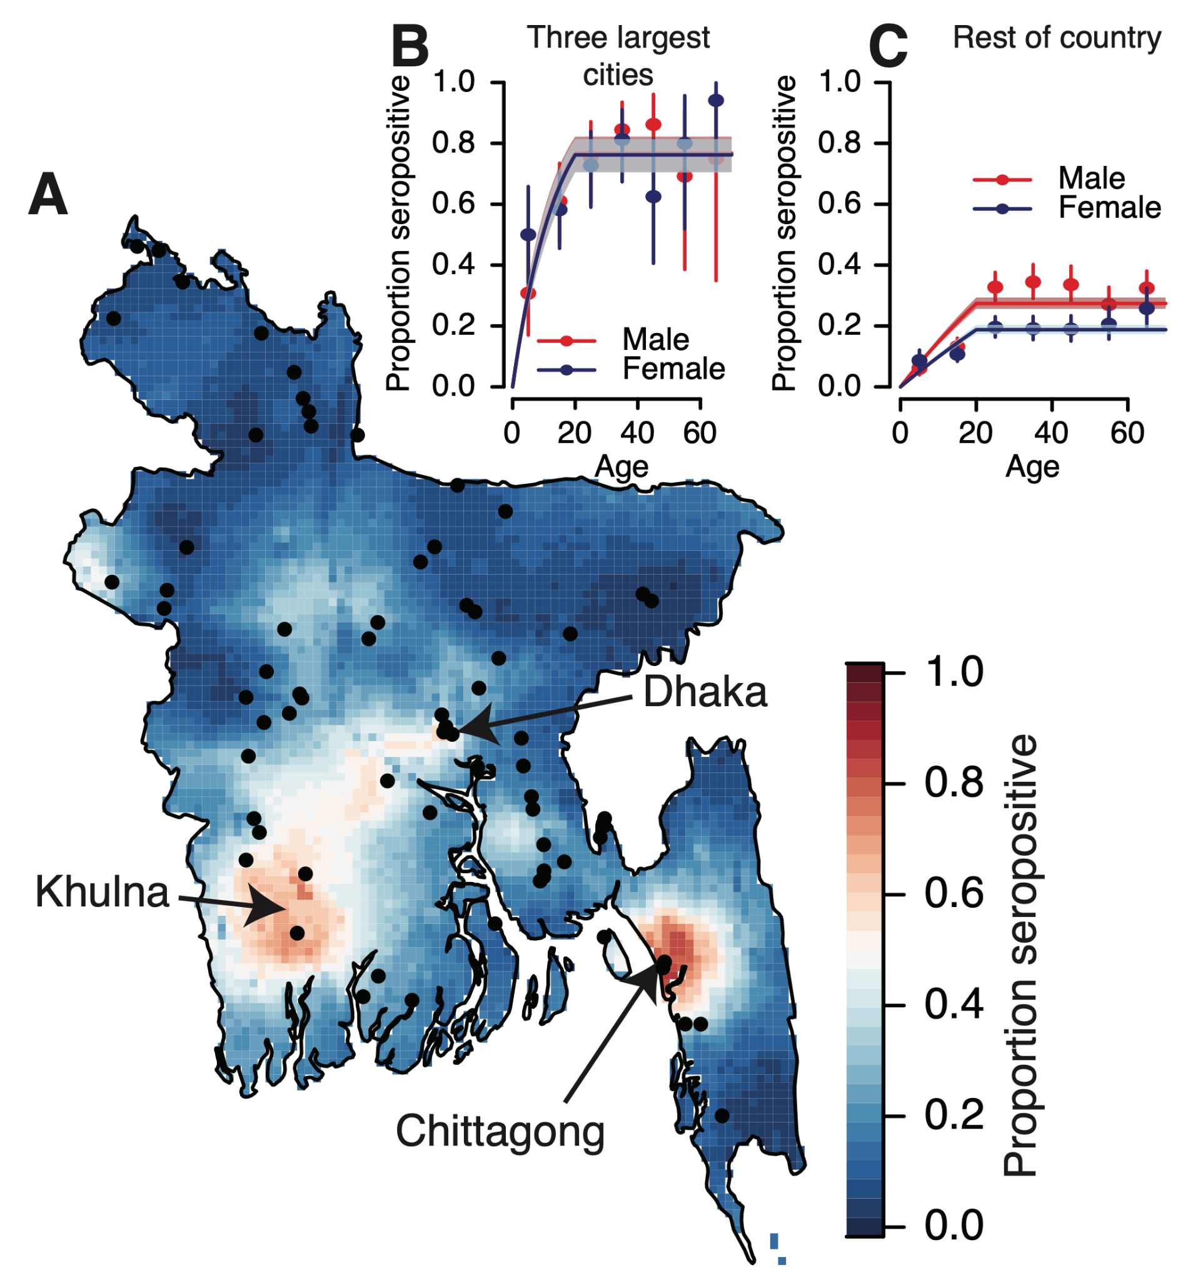
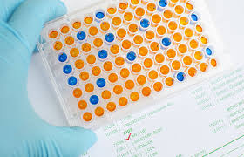
Expanding to multiple locations
Age, location
Location A
Population data
Environment
Behaviour
Location C
Location B
2.4 million infections/yr
Salje et al., eLife 2020

Slide 51


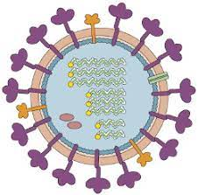
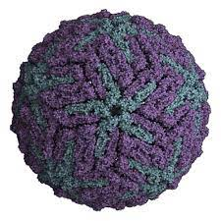
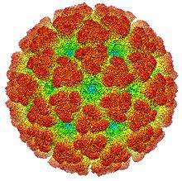



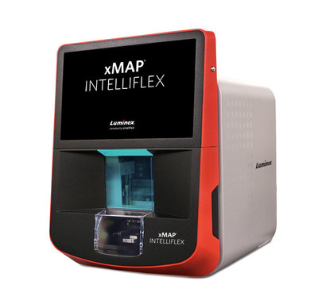
Time

Slide 52
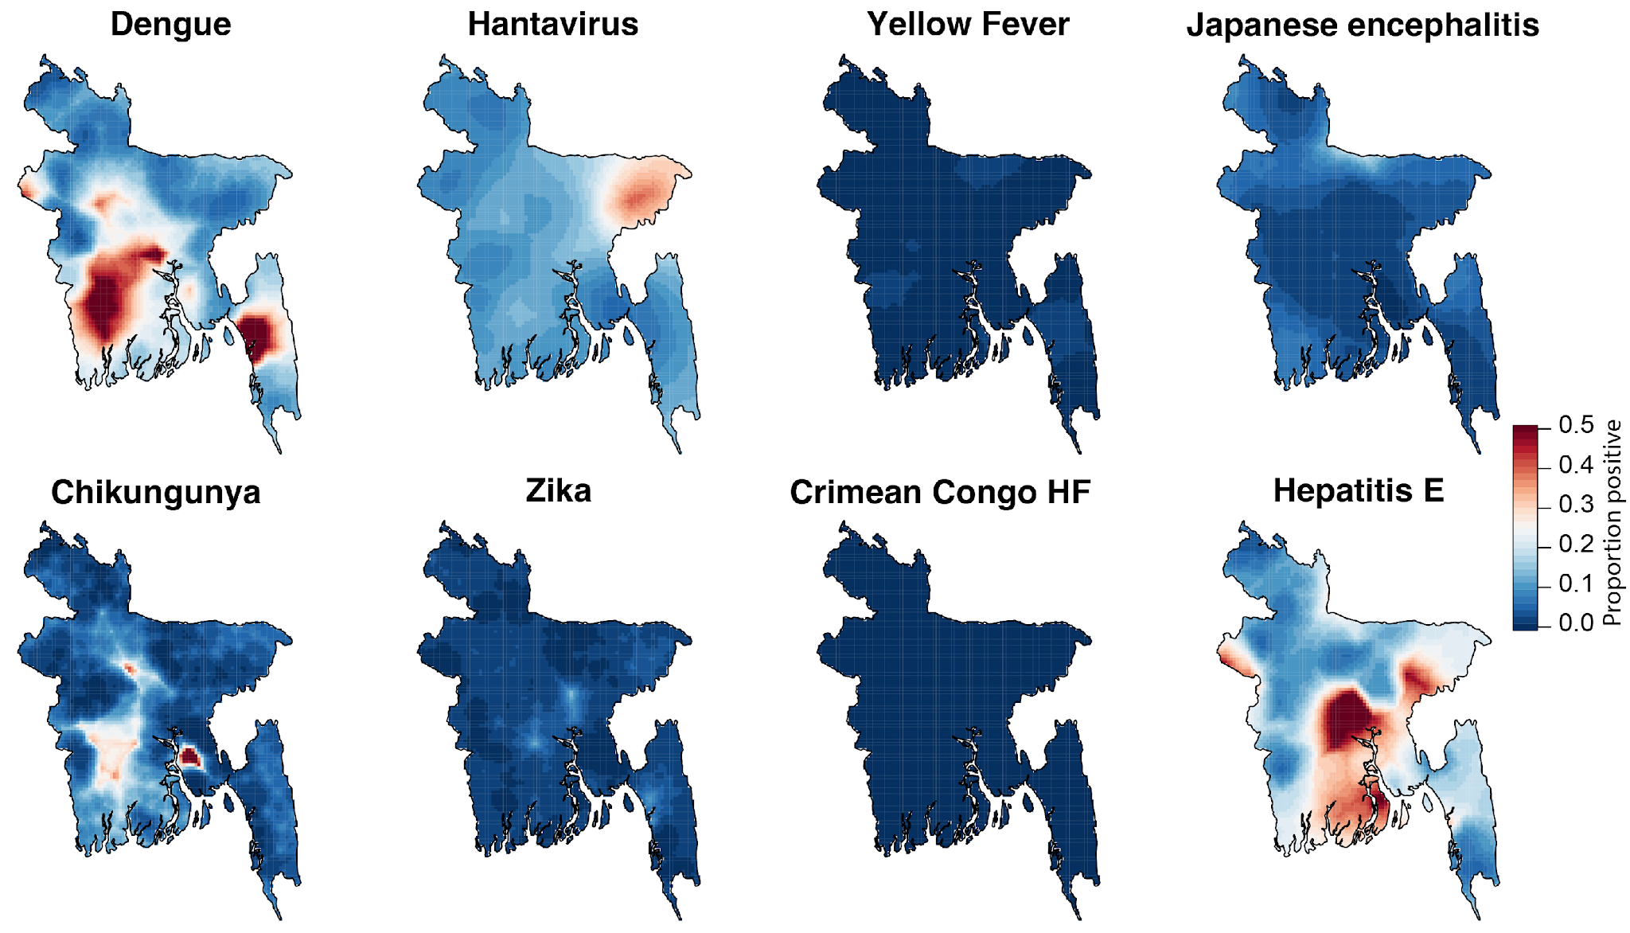
Nationwide data from Bangladesh
Salje et al., eLife 2020, Azman et al., Lancet Microbe 2021, Azman et al., JID 2021

Slide 53

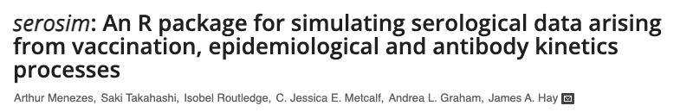

Rsero R package

Slide 54
Summary
Catalytic models are a way to estimate the underlying probability of infection using age-specific seroprevalence data.
Very useful in a context where biases in disease surveillance can limit the interpretability of cases reported in healthcare settings.
We can fit the annual probability of infection using difference approaches – likelihood and Bayesian approaches require us to write down a Likelihood.
Reliant on working with good quality data - need close collaboration with field and laboratory teams.

