Slide 1
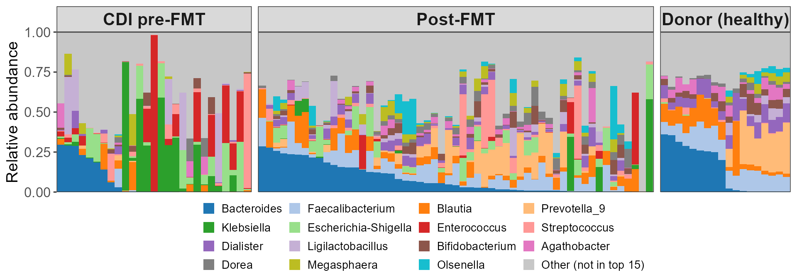
Every patient's gut is broken differently; every donor's looks the same
RESULT: Patients share no common disrupted state - each is dominated by a different organism
Data: Duvallet et al. 2017, Nat Commun (s41467-017-01973-8) - cdi_youngster study, Youngster et al. 2014, Clin Infect Dis 58:1515. 100 stool samples from 23 people: 19 patients sampled before and after FMT, plus 4 healthy donors. 16S rRNA V4, 100%-identity OTUs named against SILVA v138.1 (92% to genus), pooled into 286 genera holding 95.1% of reads. Top 15 genera shown; grey = all others.
Raiyan: CDI & FMT
Notes:
Slide 1 — Every patient's gut is broken differently; every donor's looks the same
"286 genera; 169 appeared in at least 10% of people so were worth testing; a Wilcoxon test on each, then Benjamini-Hochberg to correct for 169 tests, left 53 — 51 depleted in patients, 2 enriched.“
Dataset
Youngster et al. (2014)
19 patients + 4 healthy donors
100 stool samples
Repeated patient samples averaged → 23 individuals for statistics
Explain the figure
Each bar = one stool sample
Colours = 15 most abundant bacteria
Grey = all remaining bacteria
Left (Patients before FMT)
Every patient sample looks different
Different bacteria dominate each sample
No common specific "disease microbiome“
Right (Donors)
Donors look remarkably similar
Stable, healthy microbial community
Only 4 Donors
Middle (Patients after FMT)
Patients shift toward donor composition
Gut becomes more similar to healthy donors
Main takeaway
Many ways for a gut to become unhealthy, but common stable healthy state.

Slide 2
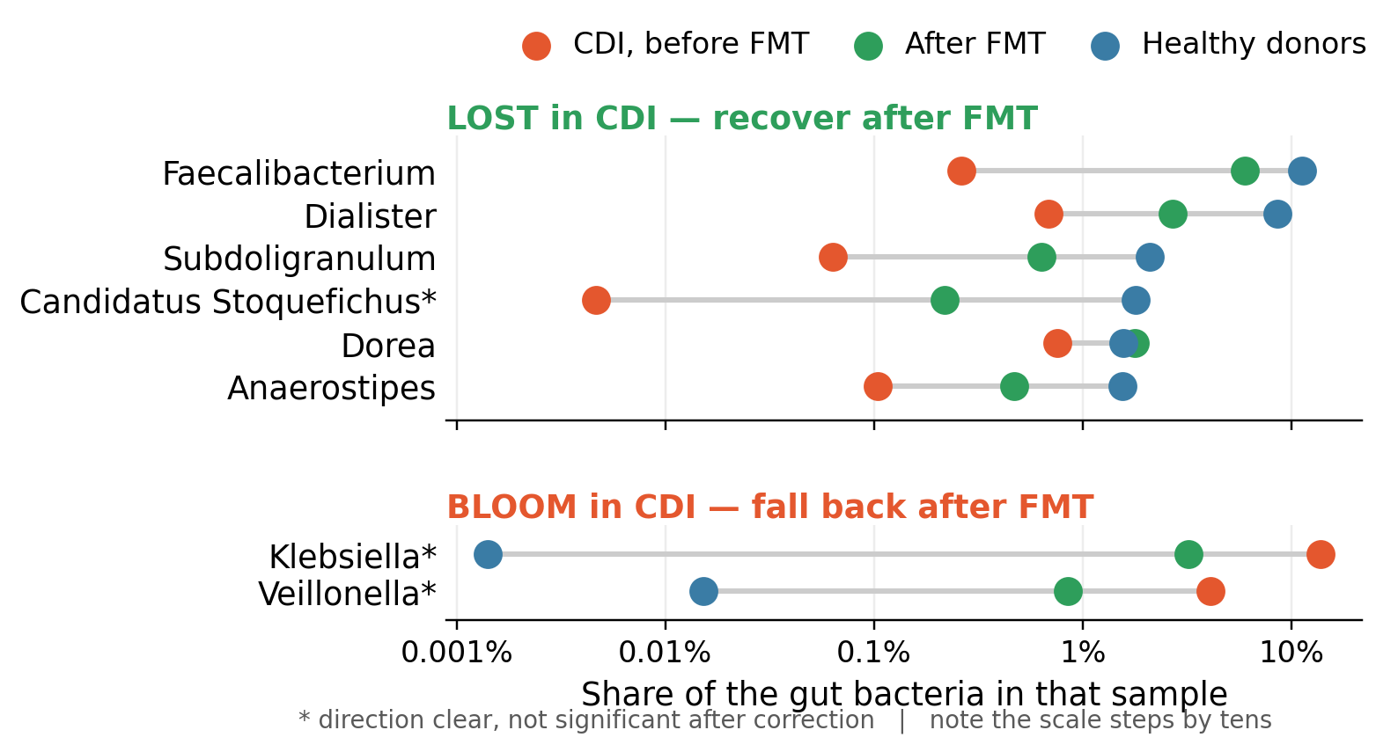
The fibre-fermenters come back; the invaders fall away
RESULT: The bacteria wiped out by infection come back after the FMT transplant; the ones that took over fades
53 genera differ: Between patients and donors. 51 depleted, only 2 enriched
What is lost: Fibre-fermenting anaerobes. They make butyrate, which fuels the colon lining and keeps the gut oxygen-free
What moves in: Klebsiella and Veillonella; Opportunists that grow once that oxygen-free state is gone
After FMT: The anaerobes return, but not fully.
Genera selected by Wilcoxon test, CDI patients vs donors, Benjamini-Hochberg q < 0.05. Shown: the 6 depleted genera most abundant in donors, plus both enriched genera. * = movement after FMT not significant after correction (Klebsiella q = 0.054, Veillonella q = 0.096).
Raiyan: CDI & FMT
Notes:
Slide 2 — Fibre fermenters return, opportunists disappear
Differential abundance
Compared 169 genera
53 significantly different
51 enriched in healthy donors
Only 2 enriched in patients
Top panel
Six most depleted beneficial genuses
Red = before
Green = after
Blue = donors
Key point
Faecalibacterium nearly absent before FMT
Returns toward donor levels after treatment
Most beneficial bacteria recover substantially
Bottom panel
Two bacteria enriched in patients
Klebsiella especially abundant before treatment
Drops slighty after FMT compared to the healthy
Biological explanation (Most important)
Beneficial bacteria ferment fibre
Produce butyrate
Butyrate fuels colon cells
Colon cells consume oxygen
Low oxygen prevents pathogens like Klebsiella to grow
FMT restores this healthy environment
The microbiome only got about halfway back, but people felt completely better even if it was still only partly restored.
Main takeaway
FMT restores beneficial bacteria rather than directly killing pathogens and restores the healthy gut environment.
Important numbers
Item
Value
Patients 19
Donors 4
Total samples 100
Individuals analysed 23
Genera tested 169
Significant genera 53
Depleted genera 51
Enriched genera 2
Faecalibacterium 0.26% → 5.98% (donors 11.29%)
Klebsiella 13.8% → 3.2% (donors ~0%)
Limitations
Only 4 donors.
Single clinical study.
Repeated sampling handled by averaging.
Genus-level resolution only.
Function inferred, not directly measured.

