Slide 1
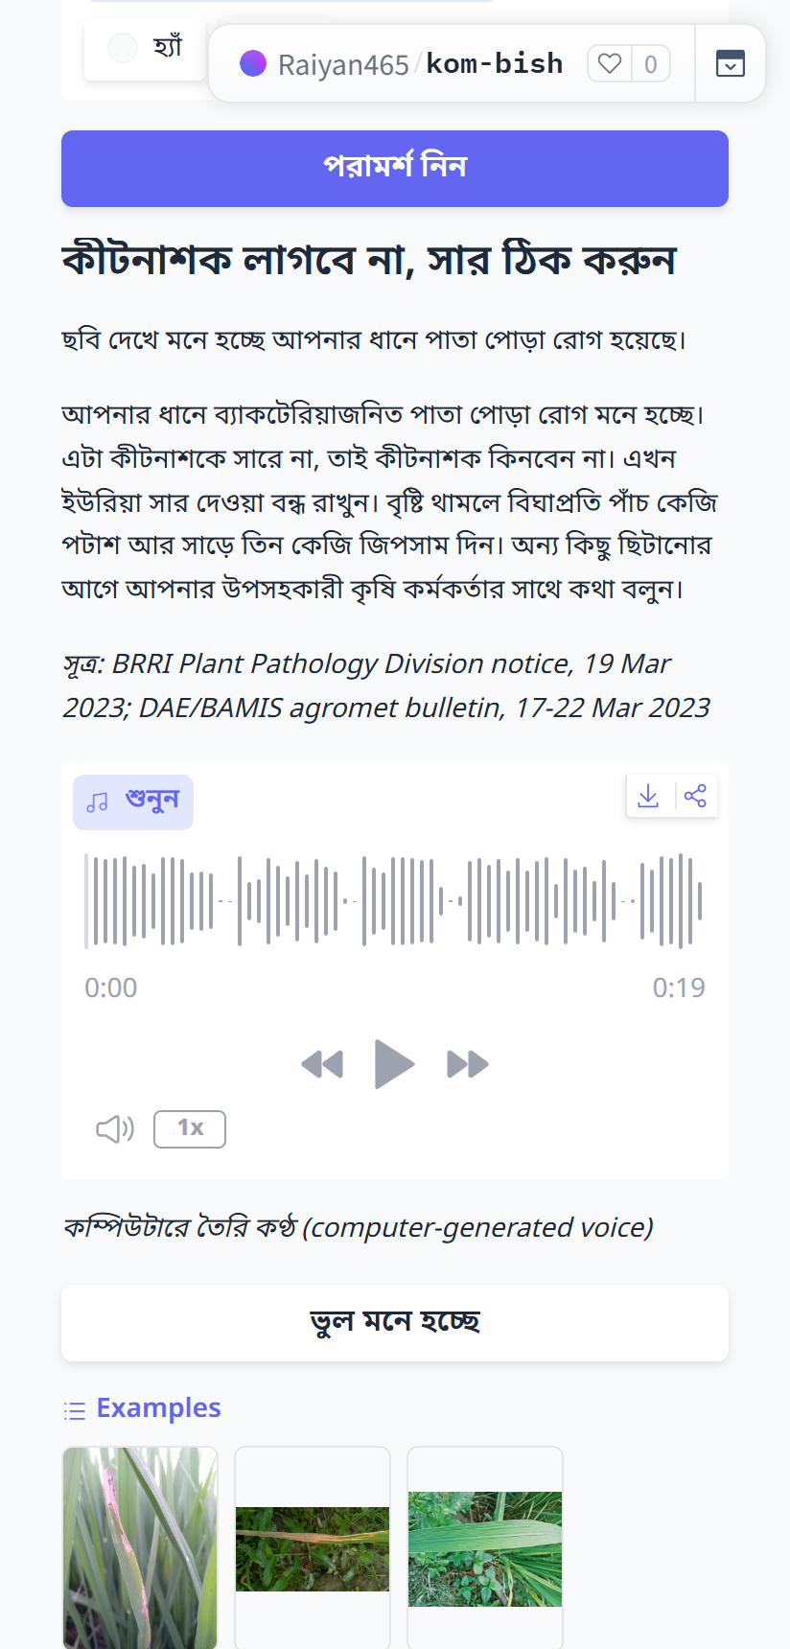
Kom Bish (কম বিষ)
A Bangla rice adviser that says whether to spray at all.
Safe by design: it refers what it doesn't know.
Team Unsick · Hack for Humanity BD 2026, Round 2
Track: Inclusive Rural Development & Agriculture
Live app: https://raiyan465-kom-bish.hf.space
Code: https://github.com/Raiyan465-F1/kom-bish
Model: https://huggingface.co/Raiyan465/kom-bish-rice-leaf
Video: https://youtu.be/UUdfN2WERf4
The live app, as a farmer sees it: “No insecticide needed, fix the fertiliser”, as text and audio.
1 / 8
Notes:
Kom Bish is a Bangla rice adviser. A farmer sends a photo of one rice leaf and gets a pre-written, reviewed Bangla answer, as text and as an audio clip, that says whether a spray is needed at all. When it is not sure it sends the farmer to the Krishi Call Centre 16123 or the local agriculture officer. The app is live; the links are on this slide and on the last one.

Slide 2
The shop that sells the spray often gives the advice too.
73.23%
about 21%
92,094
of brinjal farmers followed dealer advice on pesticides.
of pooled vegetable samples were over residue limits.
calls reached the Krishi Call Centre 16123 in one year (July 2025 to June 2026): farmers do ask for help.
Kom Bish answers one question first: is a spray needed at all?
Mannan et al. 2021, BJAR (brinjal farmers, survey of 2014–15); Toxicology Reports systematic review (via DOAJ); BSS, 2 Jul 2026
2 / 8
Notes:
The person who profits from a sale is often the farmer's main adviser. The dealer figure is from a 2014-15 survey of brinjal farmers, not rice farmers. The call-centre figure shows that farmers already ask for independent advice. Kom Bish takes no money from input sellers and never names a brand or a dose.

Slide 3
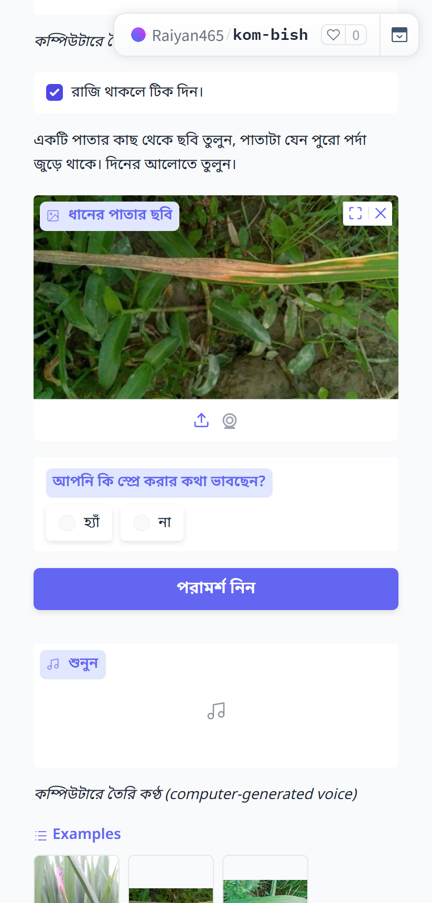
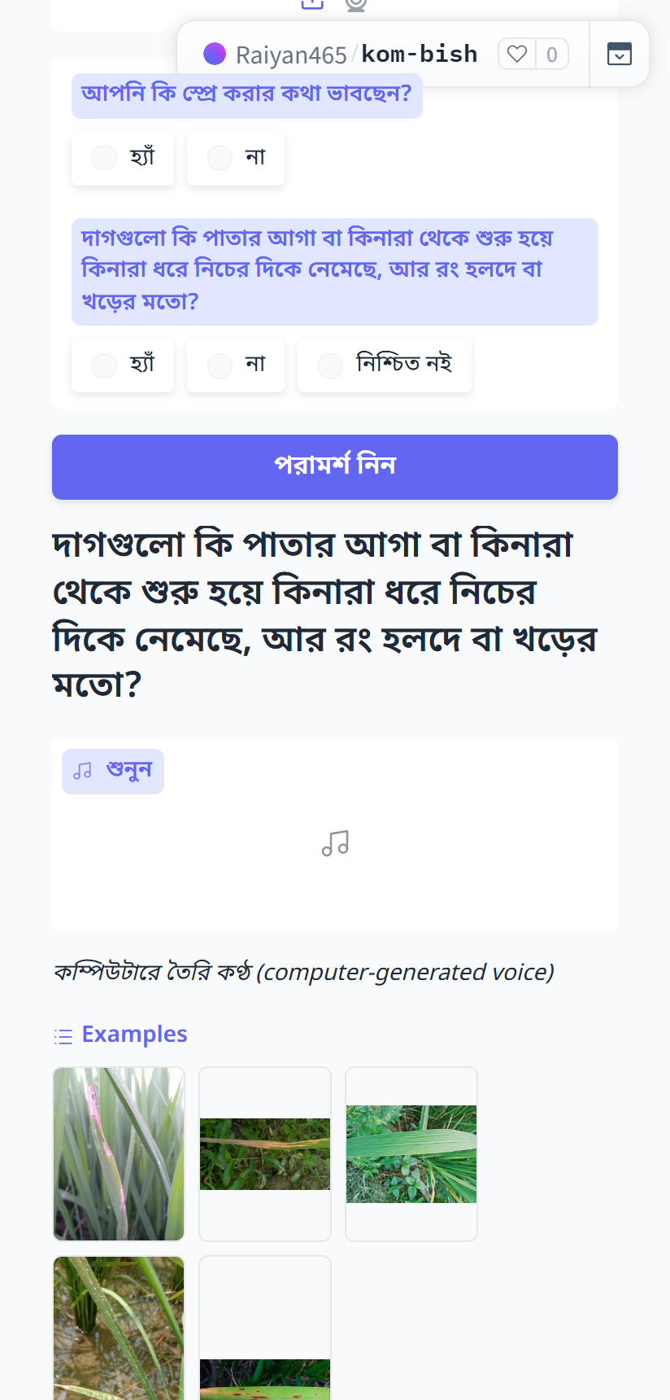
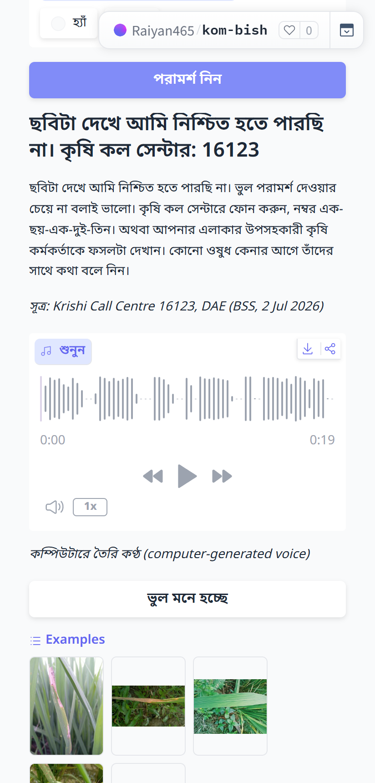
One photo in, one honest answer out.
1. The farmer agrees to the consent text and gives a close-up photo of one leaf.
2. Before a disease answer the app asks: “Do the yellow or straw-coloured patches start at the leaf tip or edge and run down along the edge?”
3. On “yes”: “No insecticide needed, fix the fertiliser”, as reviewed text and an audio clip (computer-generated voice).
4. When it is not sure: “I can't be sure from this photo. Krishi Call Centre: 16123.”
Screens from the live app in Bangla, 12 Oct 2026. Sample leaf images: RiceLeafBD test split and Dhan-Shomadhan held-out set (CC BY 4.0).
3 / 8
Notes:
These are screenshots of the live app, in Bangla, as a farmer sees it on a phone. The farmer ticks the consent box and uploads a photo of one leaf. If the photo looks like bacterial leaf blight the app first asks where the patches start. Only on a yes does it give the answer: no insecticide is needed, fix the fertiliser. The same reviewed text is played as a Bangla audio clip; the voice is computer-generated and the app says so. When the model is not confident the app says so and gives the call-centre number. The app has a Show English switch for reviewers.

Slide 4
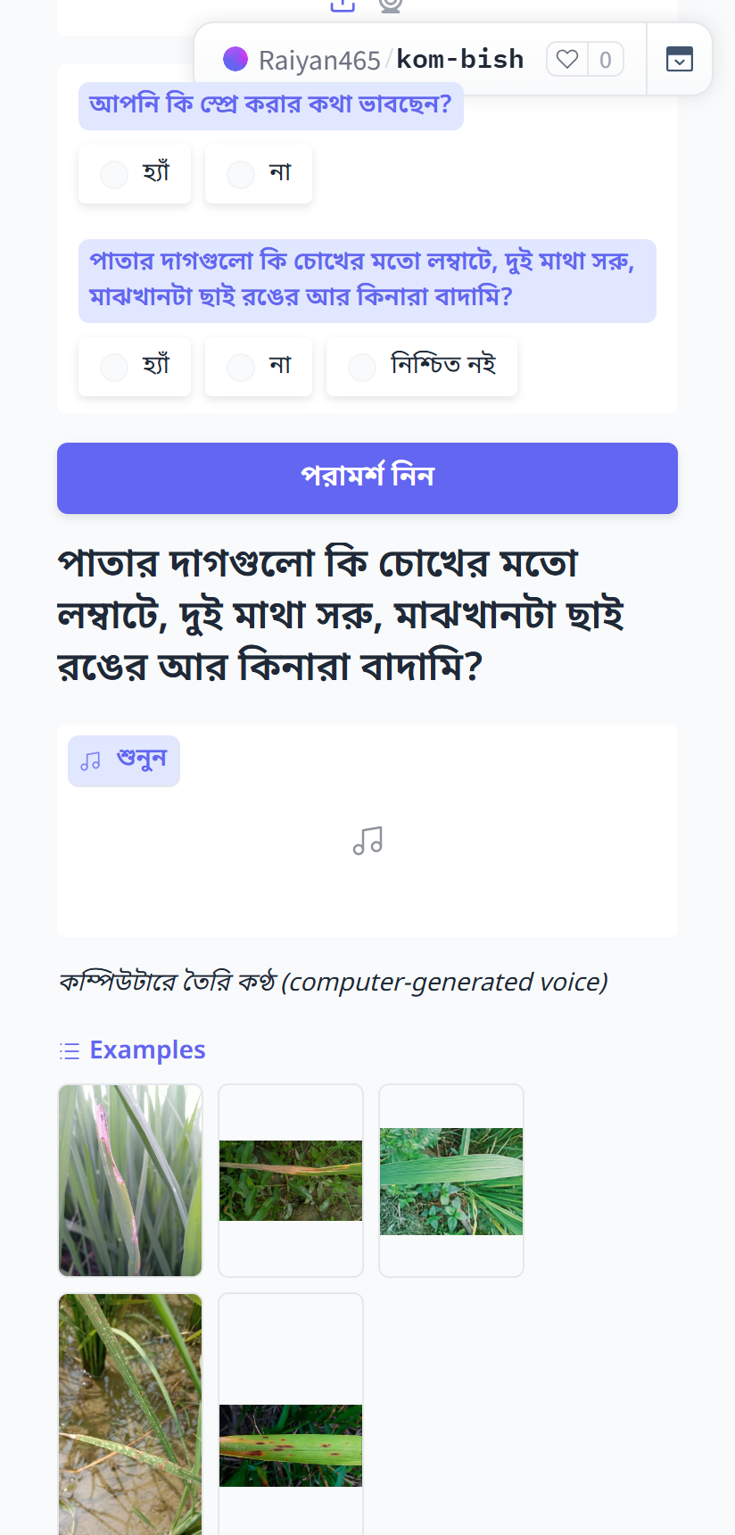
Safe by design: it refers what it doesn't know.
1. Confidence gate
Below 0.91, or with a close second guess, the app refers the farmer.
2. Stricter gate per disease
Bacterial leaf blight needs 0.955, blast 0.999. Chosen on validation data only.
3. The farmer's own “yes”
Before the BLB answer and before the blast (spray) answer, the app asks one question about what is on the leaf. “No” or “not sure” gives a referral.
4. Closed rule table
Code picks the answer. Every sentence is pre-written and reviewed. No brands, no doses.
The two questions (shown in Bangla):
BLB: “Do the yellow or straw-coloured patches start at the leaf tip or edge and run down along the edge?”
Blast: “Are the spots on the leaf long like an eye, narrow at both ends, ash-grey in the middle and brown at the edge?”
The lesion-shape question, asked before any spray answer (live app).
Wrong “spray correctly” advice in all our tests: 0, even if the farmer says “yes” to every question.
Thresholds: labels.json in the model repo, revision v2.1. Rules and tests: kombish/rules.py, data/rules.csv, tests/test_rules.py
4 / 8
Notes:
Kom Bish is built to avoid wrong spray advice, not to diagnose everything. An answer has to pass four gates. First the general confidence gate. Second a stricter threshold for each disease, chosen on validation data only. Third the farmer's own yes to one question about what is on the leaf: one question for bacterial leaf blight and one for blast. No or not sure sends the farmer to the call centre or the officer. Fourth, the answer itself comes from a closed table of reviewed sentences. Each question has its own answer box, so a yes to one can never confirm the other.

Slide 5
How it works: what is real today and what is planned.
Consent
Photo of one leaf
ONNX classifier
MobileNetV3, 4 classes, CPU
Confidence gates
Rule engine
pure Python
Farmer's “yes”
BLB or blast question
Reviewed Bangla text
+ audio clip
Anonymous log (private dataset)
no photo, audio, name or number
Public
counters
Low confidence, “no” or “not sure”:
referral to the Krishi Call Centre 16123 or an agriculture officer
Planned, not built or not switched on
Voice note → fixed symptom list
NEXT STEP: code written, switched off until tested
Officer-verified referrals
→ local training data (pilot plan)
Telegram, WhatsApp,
phone call
Human-recorded audio
(today: computer-generated voice)
Real and live
Planned
Voice can only make an answer more cautious: it can turn an answer into a referral, never into a spray.
Code: kombish/classifier.py, kombish/rules.py, kombish/logging_store.py, data/rules.csv, data/clips.csv
5 / 8
Notes:
Everything in green runs in the live app today. The photo goes through an ONNX classifier on the CPU; the model only names one of four classes. Plain Python code applies the confidence gates and picks a row in the rule table; for a disease answer the app first asks the farmer one question. The farmer sees and hears only pre-written, reviewed text. The log is anonymous: no photo, audio, name or phone number is stored. Orange is planned. Voice input is the next step: the code is written and tested, but it is switched off until we have tested it with real voice notes, and it can only add caution.

Slide 6
Tested on photos from three countries: 0 wrong spray advice.
Test set | Photos | Classifier confident | Advice given (“no spray now”) | BLB question asked | Blast question asked | Wrong spray advice
Bangladesh our test split | 828 | 515 (62.2%) | 150 139 right, 11 wrong | 32 31 true BLB, 1 other | 0 | 0
India* Paddy Doctor held-out | 500 | 327 (65.4%) | 113 112 right, 1 wrong | 103 103 true BLB, 0 other | 6 6 true blast, 0 other | 0
Philippines external, never seen | 200 | 69 (34.5%) | 28 27 right, 1 wrong | 0 | 0 | 0
*Same source as some training data, so it is not an external test. Only the Philippine set was never seen in training.
Advice given: the healthy answer, the only answer given from the photo alone. A wrong one is a diseased leaf told “no spray now”.
BLB / blast question asked: the model is confident, and the app asks the farmer before it answers. “Other” would become a wrong answer only if the farmer said “yes”.
Wrong spray advice counts the worst case: the farmer answers “yes” to every blast question.
Model v2.1: weights frozen on 11 Oct 2026; every threshold chosen on validation data only. 0 off-script answers in 20 scripted consultations.
training/eval_report.md and training/eval_summary.json. Data: RiceLeafBD, BD5, Dhan-Shomadhan, Paddy Doctor (CC BY 4.0); Zambali Rice Dataset (Apache-2.0)
6 / 8
Notes:
These are the final numbers for the published model, version 2.1. The same definitions are used everywhere. Classifier confident means the prediction passed the gates. Advice given is the healthy answer, no spray now: the only answer the farmer gets from the photo alone. For bacterial leaf blight and for blast the app asks the farmer a question first, so those are counted separately. The Indian set is held out from Paddy Doctor, which is also part of the training data, so only the Philippine set is truly external. There the model recognised about half of the healthy leaves and referred almost every diseased one. Wrong spray advice is zero on all three sets.

Slide 7
What it cannot do yet.
• It does not recognise diseases from a new source. In the Philippine test the BLB question was asked 0 times and the blast question 0 times on 200 photos: almost every diseased leaf was referred, not recognised.
• Four close-up web photos of blast: none was recognised as blast. All four are referred.
• Blast is rarely answered: the blast question was asked 0 times on our 828 test photos and 6 times on the 500 Indian photos.
• Wrong “no spray now”: 11 narrow brown spot leaves on a white sheet (Bangladesh), 1 blast leaf (India), 1 blast leaf (Philippines). The healthy answer therefore ends: if spots appear or spread, take a new photo or call 16123.
• The two confirmation questions rely on the farmer's judgement and have not been tested with farmers.
• No field trial. The rules are not yet signed off by an agronomist. The audio is a computer-generated voice.
• Voice input is written but switched off. Telegram, WhatsApp and phone calls are not built.
README, section “Limitations”; docs/gates.md; training/eval_report.md
7 / 8
Notes:
We measured where it fails and we show it. Outside the sources it was trained on, the model refers diseased leaves instead of recognising them. Four textbook photos of blast from the web were not recognised; after we raised one threshold on validation data and added a question, all four are referred. A few diseased leaves were told no spray now, which is why the healthy answer ends with what to do if spots appear. Nobody has checked what a farmer did after an answer.

Slide 8
Next: local data through a pilot.
Pilot plan (a plan, not a built feature)
Team Unsick
1. Review first: a Sub-Assistant Agriculture Officer reads the rule table and the answer scripts.
2. A small pilot: about 30 farmers in one block, photo only.
3. Officer-verified referrals become local training data, with a separate, explicit consent. Today the app stores no photos.
4. Retrain only against a held-out local test: more right answers, no more wrong spray advice.
5. Then the next step in the app: voice input, which can only add caution.
6. Measure: how often it refers, how often the officer agrees, any wrong advice, whether the farmer sprayed.
Raiyan Rahman
Hack for Humanity BD 2026, Round 2
Track: Inclusive Rural Development & Agriculture
Links
Live app
https://raiyan465-kom-bish.hf.space
Code
https://github.com/Raiyan465-F1/kom-bish
Model
https://huggingface.co/Raiyan465/kom-bish-rice-leaf
Video
https://youtu.be/UUdfN2WERf4
README, section “Pilot plan”. Nothing in the plan is built yet.
8 / 8
Notes:
Recognising diseases in a new place needs local data with trustworthy labels, and the referral already sends the farmer to the person who can give that label. The plan, which is not built: when the app refers a farmer and an officer then sees the crop, the officer's diagnosis and the photo, with a separate explicit consent, become local training data. A new model replaces the old one only if it gives more right answers on a held-out local test and no more wrong spray advice. The live app, the code and the model are public at the links on this slide.

