Slide 1
ACADEMIC PROJECT • OBJECT ORIENTED PROGRAMMING SESSIONAL
Food Order & Delivery
Management System
NAME
Raiyan Al Rakib
ID
0182410012101118
COURSE TITLE
Object Oriented Programming: Sessional
COURSE CODE
CSE-3112

Slide 2
PROJECT OVERVIEW
A CRUD-Focused Console Application
This project is centered on Create, Read, Update, and Delete (CRUD) operations, implemented in Java and backed by a MySQL database through JDBC connectivity. It models a simplified online food ordering workflow — managing customers, food items, and orders from a single console-based interface.
BUILT WITH
Java
JDBC
MySQL
Scanner I/O
C
Create
R
Read
U
Update
D
Delete
Add new customers, food items, and orders
View customers, food items, and order records
Change the status of an existing order
Remove customers, food items, or orders

Slide 3
MENU-DRIVEN FUNCTIONALITY
Project Features
1
Add Customer
7
Update Order Status
2
View Customers
8
Delete Customer
3
Add Food Item
9
Delete Food Item
4
View Food Items
10
Delete Order
5
Place Order
11
Exit
6
View Orders

Slide 4
DATABASE SCHEMA
SQL Table Creation
CREATE TABLE Customers (
customer_id INT AUTO_INCREMENT PRIMARY KEY,
name VARCHAR(100) NOT NULL,
phone VARCHAR(15),
address VARCHAR(255)
);
CREATE TABLE Food_Items (
food_id INT AUTO_INCREMENT PRIMARY KEY,
name VARCHAR(100) NOT NULL,
price DECIMAL(8,2) NOT NULL,
category VARCHAR(50)
);
CREATE TABLE Orders (
order_id INT AUTO_INCREMENT PRIMARY KEY,
customer_id INT NOT NULL,
order_date DATETIME DEFAULT CURRENT_TIMESTAMP,
total_amount DECIMAL(10,2),
status VARCHAR(20) DEFAULT 'Pending'
);

Slide 5
PART 1 OF 8 • LINES 1–23
Main.java — Source Code
import java.sql.*;
import java.lang.*;
import java.util.Scanner;
public class Main {
public static void main(String[] args) {
String url = "jdbc:mysql://localhost:3306/food_order_and_delivery_management_system";
String user = "root";
String db_pass = "";
Scanner sc = new Scanner(System.in);
try {
Class.forName("com.mysql.cj.jdbc.Driver");
Connection con = DriverManager.getConnection(url, user, db_pass);
while (true) {
System.out.println("\n1. Add Customer");
System.out.println("2. View Customers");
System.out.println("3. Add Food Item");
System.out.println("4. View Food Items");
System.out.println("5. Place Order");
System.out.println("6. View Orders");
System.out.println("7. Update Order Status");
System.out.println("8. Delete Customer");
System.out.println("9. Delete Food Item");
Part 1/8

Slide 6
PART 2 OF 8 • LINES 24–46
Main.java — Source Code (continued)
System.out.println("10. Delete Order"); System.out.println("11. Exit"); System.out.print("Enter choice: "); int choice = sc.nextInt(); sc.nextLine(); switch (choice) { case 1: System.out.print("Enter Name: "); String name = sc.nextLine(); System.out.print("Enter Phone: "); String phone = sc.nextLine(); System.out.print("Enter Address: "); String address = sc.nextLine(); String sql = "INSERT INTO Customers(name, phone, address) VALUES (?, ?, ?)"; PreparedStatement ps = con.prepareStatement(sql); ps.setString(1, name); ps.setString(2, phone); ps.setString(3, address); ps.executeUpdate(); System.out.println("Customer added!"); break;
Part 2/8

Slide 7
PART 3 OF 8 • LINES 47–69
Main.java — Source Code (continued)
case 2:
String showCustSql = "SELECT * FROM Customers";
PreparedStatement ps2 = con.prepareStatement(showCustSql);
ResultSet rs = ps2.executeQuery();
System.out.println("\n--- Customer List ---");
while (rs.next()) {
System.out.println(rs.getInt("customer_id") + " | " + rs.getString("name") + " | "
+ rs.getString("phone") + " | " + rs.getString("address"));
}
break;
case 3:
System.out.print("Enter Food Name: ");
String foodName = sc.nextLine();
System.out.print("Enter Price: ");
double price = sc.nextDouble();
sc.nextLine();
System.out.print("Enter Category: ");
String category = sc.nextLine();
String foodSql = "INSERT INTO Food_Items(name, price, category) VALUES (?, ?, ?)";
PreparedStatement ps3 = con.prepareStatement(foodSql);
ps3.setString(1, foodName);
Part 3/8

Slide 8
PART 4 OF 8 • LINES 70–92
Main.java — Source Code (continued)
ps3.setDouble(2, price);
ps3.setString(3, category);
ps3.executeUpdate();
System.out.println("Food item added!");
break;
case 4:
String showFoodSql = "SELECT * FROM Food_Items";
PreparedStatement ps4 = con.prepareStatement(showFoodSql);
ResultSet rs2 = ps4.executeQuery();
System.out.println("\n--- Food Item List ---");
while (rs2.next()) {
System.out.println(rs2.getInt("food_id") + " | " + rs2.getString("name") + " | "
+ rs2.getDouble("price") + " | " + rs2.getString("category"));
}
break;
case 5:
System.out.print("Enter Customer ID: ");
int custId = sc.nextInt();
sc.nextLine();
System.out.print("Enter Total Amount: ");
double totalAmount = sc.nextDouble();
Part 4/8

Slide 9
PART 5 OF 8 • LINES 93–115
Main.java — Source Code (continued)
sc.nextLine();
String orderSql = "INSERT INTO Orders(customer_id, total_amount) VALUES (?, ?)";
PreparedStatement ps5 = con.prepareStatement(orderSql);
ps5.setInt(1, custId);
ps5.setDouble(2, totalAmount);
ps5.executeUpdate();
System.out.println("Order placed!");
break;
case 6:
String showOrderSql = "SELECT * FROM Orders";
PreparedStatement ps6 = con.prepareStatement(showOrderSql);
ResultSet rs3 = ps6.executeQuery();
System.out.println("\n--- Order List ---");
while (rs3.next()) {
System.out.println(rs3.getInt("order_id") + " | " + rs3.getInt("customer_id") + " | "
+ rs3.getTimestamp("order_date") + " | " + rs3.getDouble("total_amount") + " | "
+ rs3.getString("status"));
}
break;
case 7:
Part 5/8

Slide 10
PART 6 OF 8 • LINES 116–138
Main.java — Source Code (continued)
System.out.print("Enter Order ID: ");
int orderId = sc.nextInt();
sc.nextLine();
System.out.print("Enter New Status: ");
String status = sc.nextLine();
String updateSql = "UPDATE Orders SET status = ? WHERE order_id = ?";
PreparedStatement ps7 = con.prepareStatement(updateSql);
ps7.setString(1, status);
ps7.setInt(2, orderId);
ps7.executeUpdate();
System.out.println("Order status updated!");
break;
case 8:
System.out.print("Enter Customer ID to delete: ");
int delCustId = sc.nextInt();
sc.nextLine();
String delCustSql = "DELETE FROM Customers WHERE customer_id = ?";
PreparedStatement ps8 = con.prepareStatement(delCustSql);
ps8.setInt(1, delCustId);
ps8.executeUpdate();
Part 6/8

Slide 11
PART 7 OF 8 • LINES 139–161
Main.java — Source Code (continued)
System.out.println("Customer deleted!");
break;
case 9:
System.out.print("Enter Food ID to delete: ");
int delFoodId = sc.nextInt();
sc.nextLine();
String delFoodSql = "DELETE FROM Food_Items WHERE food_id = ?";
PreparedStatement ps9 = con.prepareStatement(delFoodSql);
ps9.setInt(1, delFoodId);
ps9.executeUpdate();
System.out.println("Food item deleted!");
break;
case 10:
System.out.print("Enter Order ID to delete: ");
int delOrderId = sc.nextInt();
sc.nextLine();
String delOrderSql = "DELETE FROM Orders WHERE order_id = ?";
PreparedStatement ps10 = con.prepareStatement(delOrderSql);
ps10.setInt(1, delOrderId);
Part 7/8

Slide 12
PART 8 OF 8 • LINES 162–180
Main.java — Source Code (continued)
ps10.executeUpdate();
System.out.println("Order deleted!");
break;
case 11:
System.out.println("Program exited.");
con.close();
sc.close();
System.exit(0);
default:
System.out.println("Invalid choice, try again.");
}
}
} catch (Exception e) {
e.printStackTrace();
}
}
}
Part 8/8

Slide 13
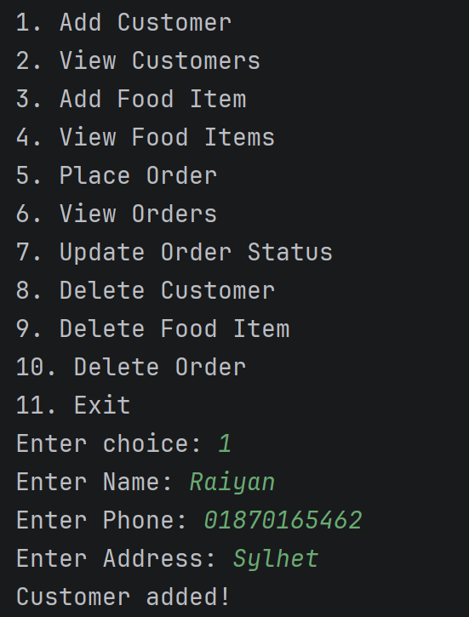
APPLICATION WALKTHROUGH
Step 1 of 18

Slide 14
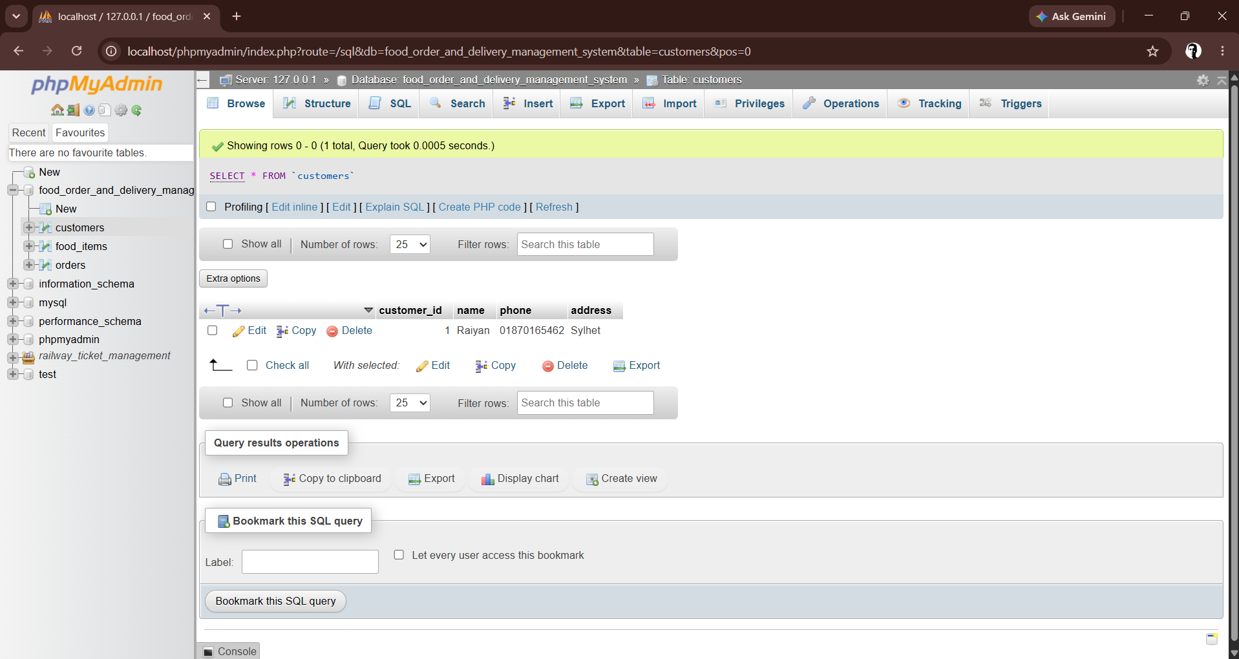
APPLICATION WALKTHROUGH
Step 2 of 18

Slide 15
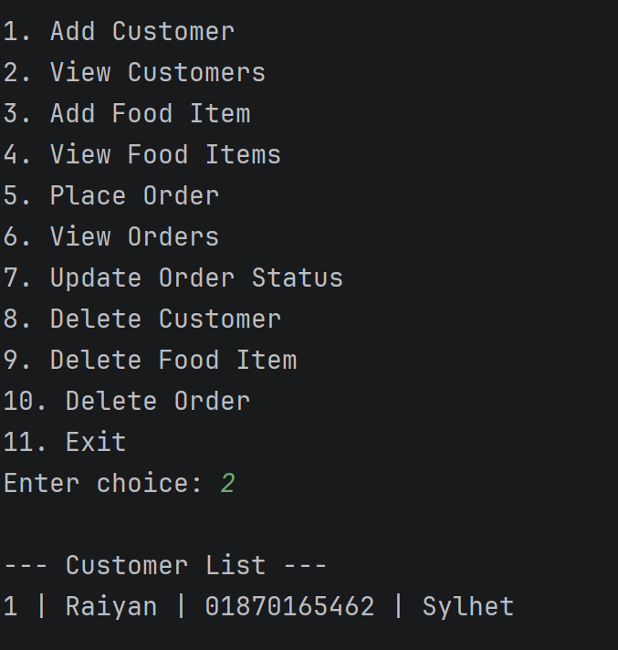
APPLICATION WALKTHROUGH
Step 3 of 18

Slide 16
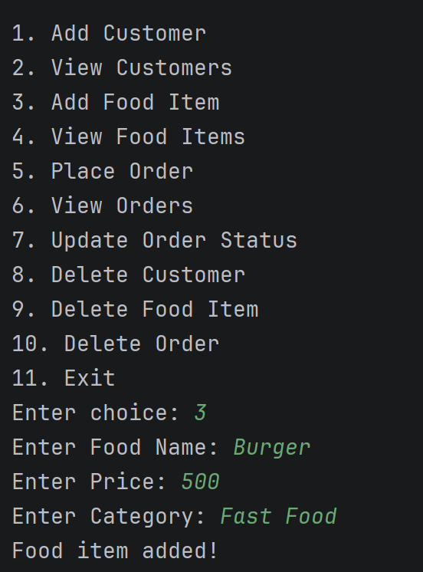
APPLICATION WALKTHROUGH
Step 4 of 18

Slide 17
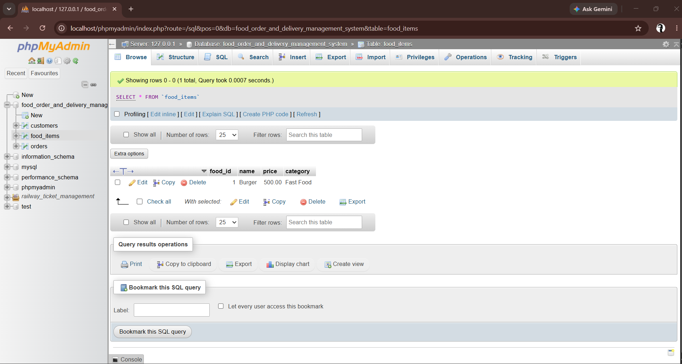
APPLICATION WALKTHROUGH
Step 5 of 18

Slide 18
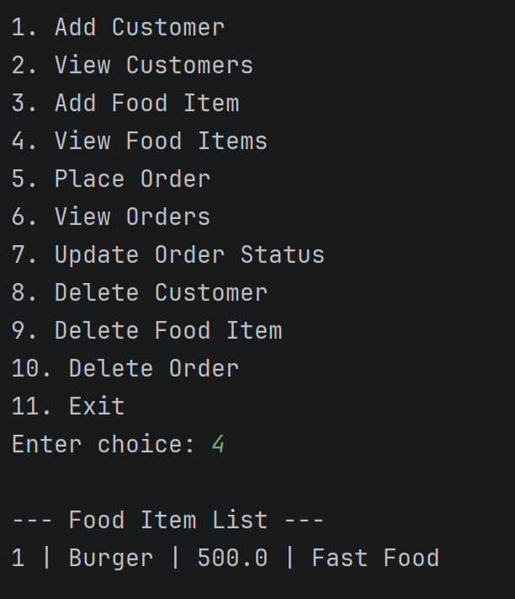
APPLICATION WALKTHROUGH
Step 6 of 18

Slide 19
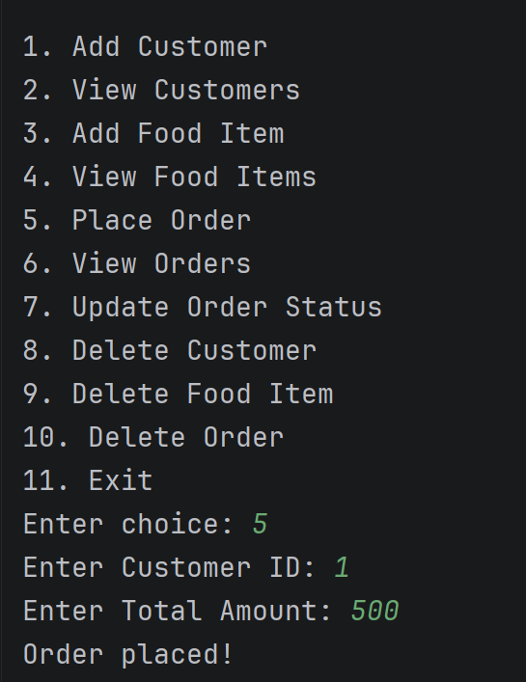
APPLICATION WALKTHROUGH
Step 7 of 18

Slide 20
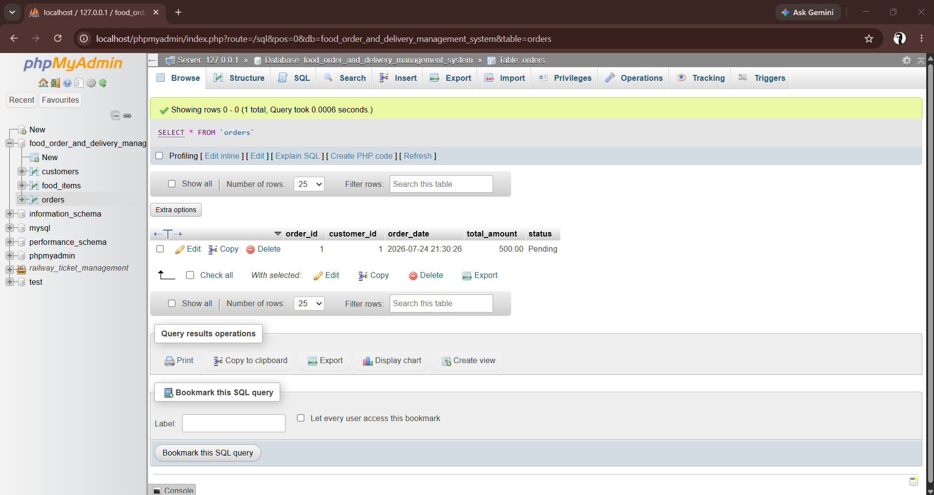
APPLICATION WALKTHROUGH
Step 8 of 18

Slide 21
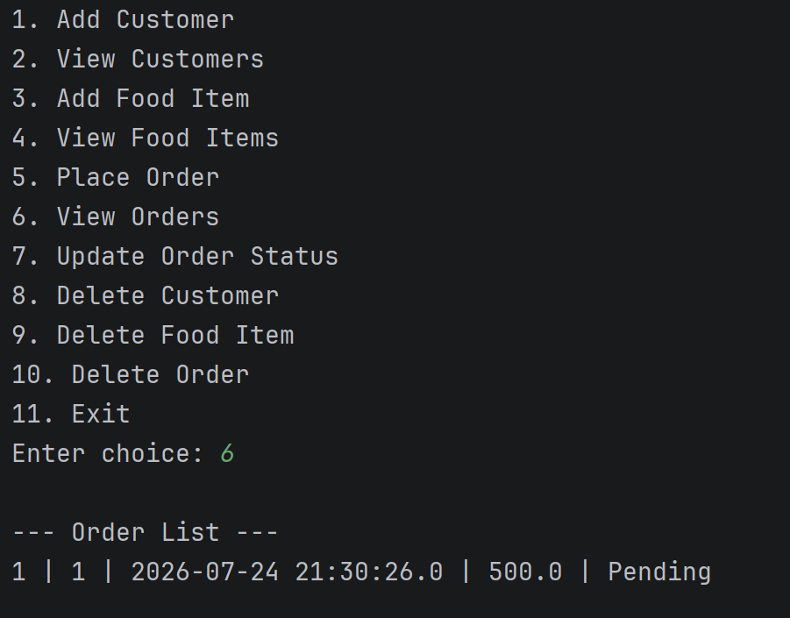
APPLICATION WALKTHROUGH
Step 9 of 18

Slide 22
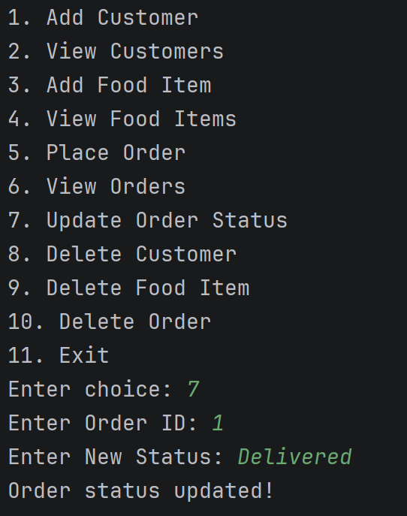
APPLICATION WALKTHROUGH
Step 10 of 18

Slide 23
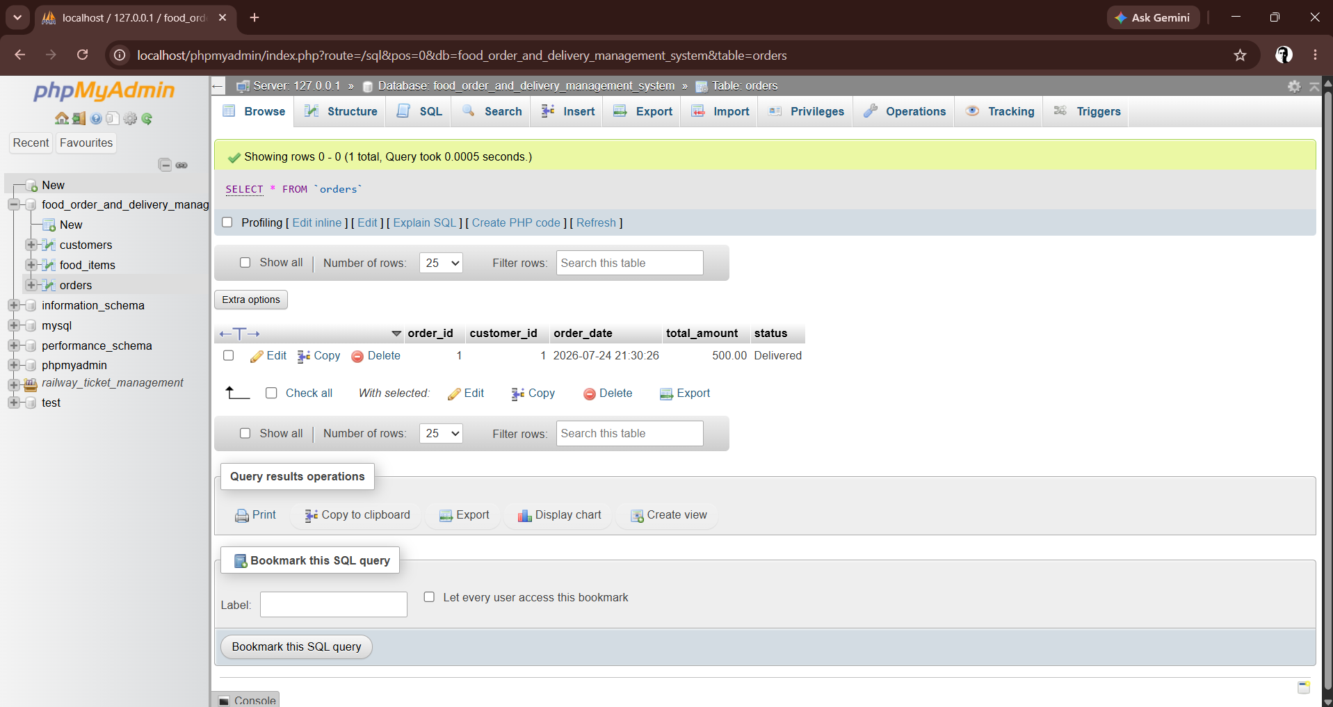
APPLICATION WALKTHROUGH
Step 11 of 18

Slide 24
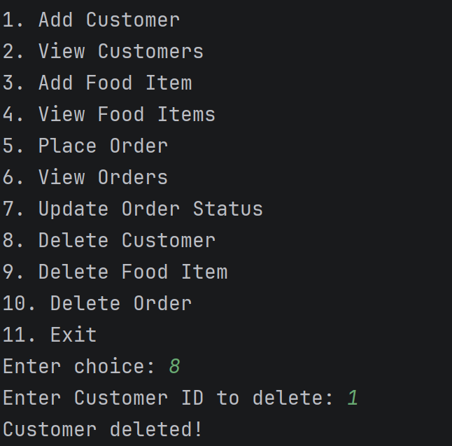
APPLICATION WALKTHROUGH
Step 12 of 18

Slide 25
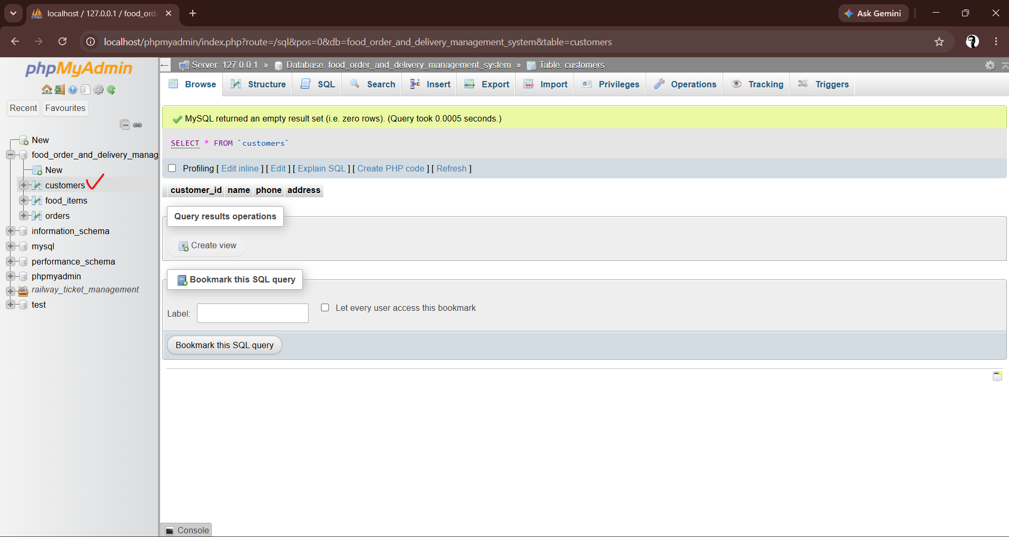
APPLICATION WALKTHROUGH
Step 13 of 18

Slide 26
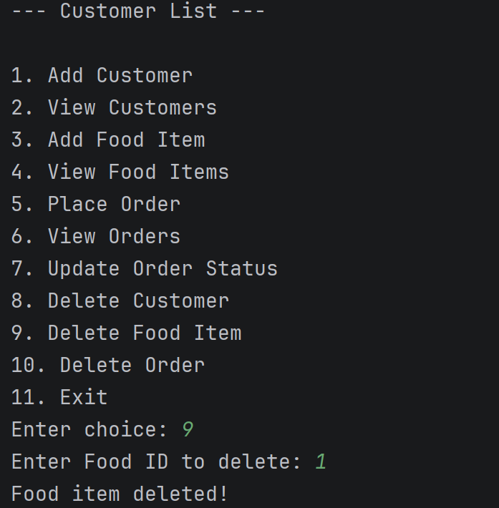
APPLICATION WALKTHROUGH
Step 14 of 18

Slide 27
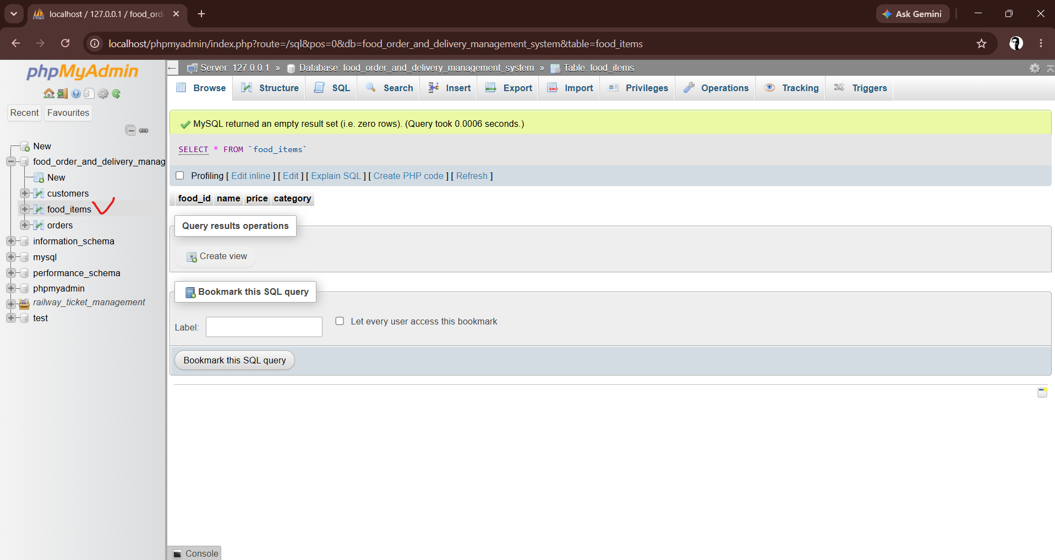
APPLICATION WALKTHROUGH
Step 15 of 18

Slide 28
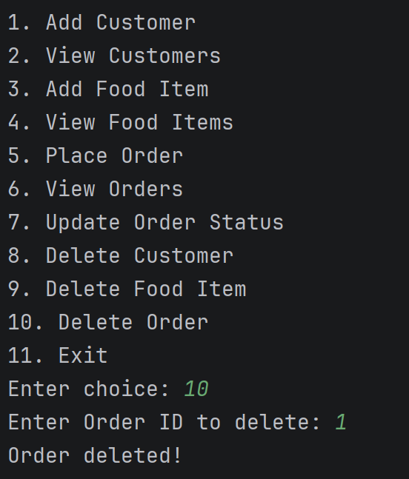
APPLICATION WALKTHROUGH
Step 16 of 18

Slide 29
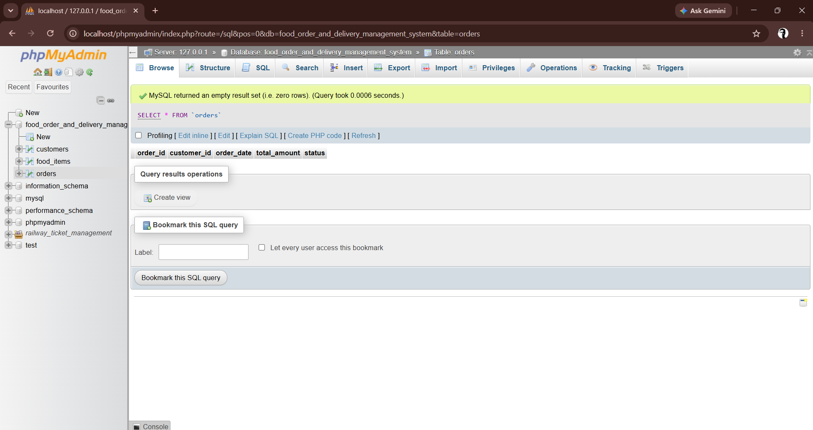
APPLICATION WALKTHROUGH
Step 17 of 18

Slide 30
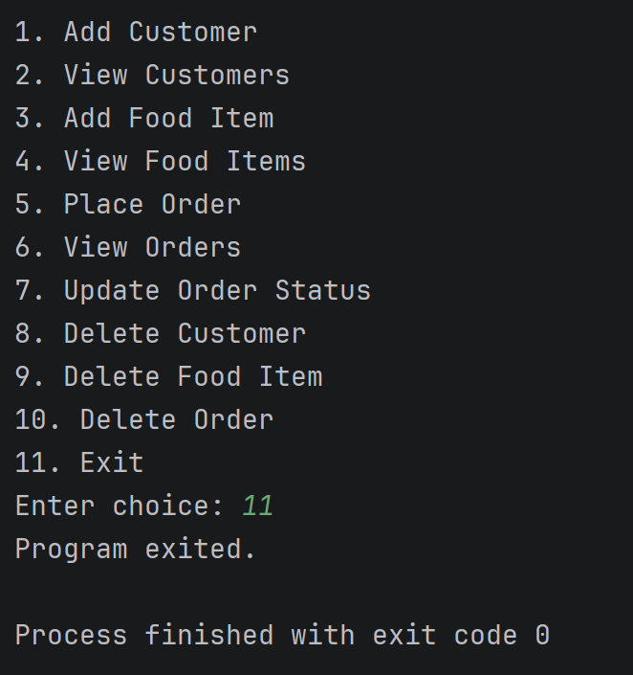
APPLICATION WALKTHROUGH
Step 18 of 18

