Slide 1
CPS109: Computer Science
Tutorial 05

Slide 2
Recap of Last Tutorial
Default values for function params
def greeting(name, msg=‘Hello’): …
Bisection Search
Mentioned the Math library
Factorial implementation with loops

Slide 3
Default Arguments
Functions take in arguments but what if none or only some are provided?
Can set default values for these parameters
Syntax:
def greet(name, msg=‘Good morning!’): return ‘Hello ’ + name + ‘, ‘ + msg
greet(‘Bob’)
greet(‘Bob’, ‘How are you?’)

Slide 4
Variable Space
The scope of a variable is where this variable exists/is present, and can be used.
Global scope is the scope of the whole Python file. Variables in the global scope are accessible anywhere. These are called global variables and are defined in the main body of the code.
Local scope is the scope that is inside a specific location such as a specific function, but not outside of it. Variables in this scope are called local variables and are only usable in the scope they are defined in.

Slide 5
Variable Scope Example
def func(x, y): z = x ** y print(z) # What will this print? result = z + 1 # Result is (x^y) + 1 return result
x = 2
y = 5
z = func(x, y)
print(z) # What will this print?

Slide 6
Functions as Arguments
We can also send in functions as arguments to other functions!
We would refer to the function that we want to send by its name just like a variable.
Example:
def greet(name): return ’Hi, ’ + name
def print_greeting(f): print(f(‘Bob’))
print_greeting(greet)

Slide 7
Mutability
Mutability is the property of whether or not something can be changed or mutated.
In Python, lists, sets, dictionaries are mutable.
We can change specific elements, add and remove elements, etc.
In Python, numbers, strings, tuples, frozen sets are immutable.
We can’t change specific elements, if we add or remove elements then a new object is created

Slide 8
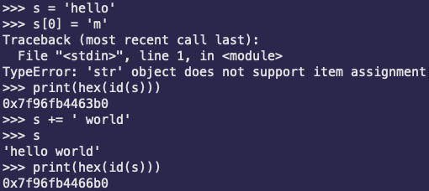
Mutability Example
String Example:

Slide 9
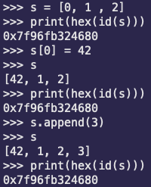
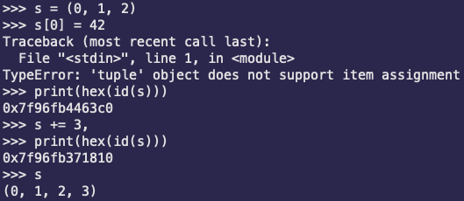
Mutability Example
List Example:
Tuple Example:

Slide 11
Quiz Question
Write a function, flatten, that takes in a list containing ints, floats, strings, and lists of ints, floats, and strings, and returns a list containing the same elements in the same order but “flattened” into one dimension. The nested lists in the provided list will not have further nested lists.
Example:
[0, [1, 2], 3, [], 4, [5, 6, ‘7’], ‘8’, [9]]
flatten will return: [0, 1, 2, 3, 4, 5, 6, ‘7’, ‘8’, 9]

