Slide 1
CPS109: Computer Science 1
Tutorial 06

Slide 2
Recap of Last Tutorial
Variable Scope
Global Scope
Local Scope
Functions as Arguments
Mutability
Mutable Data Types vs Immutable Data Types
Aliasing

Slide 3
Variable Scope Example
def func(x, y): z = x ** y print(z) # What will this print? result = z + 1 # Result is (x^y) + 1 return result
x = 2
y = 5
z = func(x, y)
print(z) # What will this print?

Slide 4
Example of Functions as Arguments
def greet(name): return ’Hi, ’ + name
def print_greeting(f): print(f(‘Bob’))
print_greeting(greet)

Slide 5
Mutability
Mutability is the property of whether or not something can be changed or mutated.
In Python, lists, sets, dictionaries are mutable.
We can change specific elements, add and remove elements, etc.
In Python, numbers, strings, tuples, frozen sets are immutable.
We can’t change specific elements, if we add or remove elements then a new object is created

Slide 6
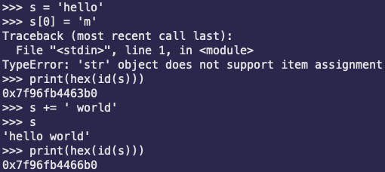
Mutability Example
String Example:

Slide 7
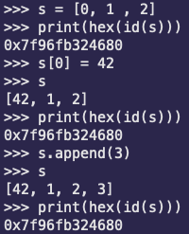
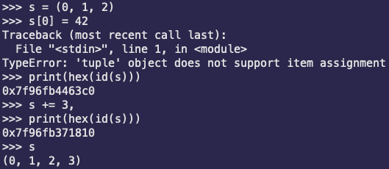
Mutability Example
List Example:
Tuple Example:

Slide 8
List Data Type
Sequential collection of values stored between []
Very similar to strings
Can use indexing to access individual elements and sublists
my_list[2] or my_list[2: 4]
Mutable data type
Can store a mixture of types
Add to list with .append(x) to add x to the end of the list
my_list.append(5)
Can remove first instance of an element x using .remove(x)
my_list.remove(5)
Can remove last element or element at index i using .pop() or .pop(i)
my_list.pop() or my_list.pop(2)

Slide 9
Dictionary Data Type
Strings, Lists and Tuples order elements in them
Elements are usually accessed by moving left to right
Dictionaries map elements
We use keys to access the values they map to
Keys are unique
As of Python 3.6+, they are ordered, but in questions, we consider them unordered

Slide 10
Dictionaries Example
Example:
dictionary = {‘key1’: ‘data1’, ‘key2’: ‘data2’} print(dictionary[‘key2’]) # This will print data2 dictionary[‘key3’] = ‘data3’ # Adds new key-value pair dictionary[‘key1’] = ‘data4’ # Update existing key’s value
del dictionary[‘key2’] # Delete an existing key (key must exit) print(dictionary) # This will print out {‘key1’: ‘data4’, ‘key3’: ‘data3’}

Slide 11

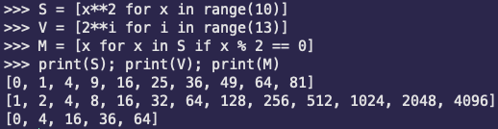
List Comprehension
A very useful way of working with lists
Utilizes the map and lambda functionality in Python and programming languages
Writing code in a more mathematical way, similar to discrete math

Slide 12

List Comprehension Example

