Slide 1
CPS109: Computer Science 1
Tutorial 08

Slide 2
Recap
List Data Type
Append
Remove/Pop
Dictionary Data Type
Adding key, value pairs
Accessing values that keys map to
Removing key, value pairs
List Comprehension

Slide 3
Dictionaries Example
Example:
dictionary = {‘key1’: ‘data1’, ‘key2’: ‘data2’} print(dictionary[‘key2’]) # This will print data2 dictionary[‘key3’] = ‘data3’ # Adds new key-value pair dictionary[‘key1’] = ‘data4’ # Update existing key’s value
del dictionary[‘key2’] # Delete an existing key (key must exit) print(dictionary) # This will print out {‘key1’: ‘data4’, ‘key3’: ‘data3’}

Slide 4

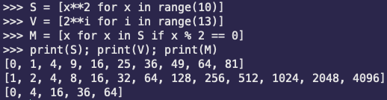
List Comprehension
A very useful way of working with lists
Utilizes the map and lambda functionality in Python and programming languages
Writing code in a more mathematical way, similar to discrete math

Slide 5
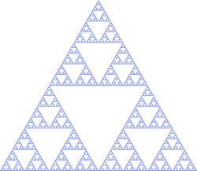
Recursion
The process in which a function calls itself to use solutions of smaller instances of the same problem
All programs that can be solved with iteration (loops) also have an equivalent recursive solution
Approach recursive problems by:
Identifying a base case
Identifying the recursive case
Based on mathematical induction which you will have seen in your discrete math course

Slide 6
Base Case
We do not want to keep recursing forever
This base case is the simplest case that is usually at the bottom of recursion
This case returns the solution without making a recursive call
The solution is usually trivial to compute
There must always be at least one base case for recursive functions, but there can be more than one

Slide 7
Recursive Case
The recursive case (also called the general case) is the case where we utilize recursive calls so that we can use smaller solutions all the way until the base case
We have to write this so that it always approaches the base case, otherwise we will go into infinite recursion
A function can have multiple recursive cases but each case must be going in the general direction of the base case

Slide 8
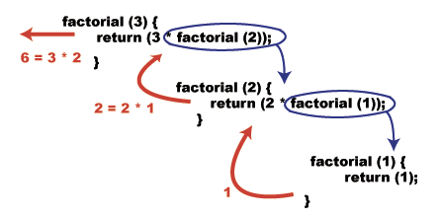
Revisiting our Factorial Example
def factorial(n): product = 1 for i in range(n): product *= (i + 1) return product
def factorial(n):
# Base Case if n == 1:
return 1
# Recursive Case else: return n * factorial(n - 1)

Slide 9
Another Example: Fibonacci
def fibonacci(n): ‘‘‘Return the n-th Fibonacci number’’’
# Base Case if n <= 1: return n
# Recursive Case else: return fibonacci(n - 1) + fibonacci(n - 2)

Slide 10
Another Example: Checking Primes
def isPrime(n, i=2): ‘‘‘Return whether the given number is prime or not, where n is the given number and i is the current divisor to check.’’’
# Base Cases if n <= 2: return True if n == 2 else False elif n % i == 0: return False elif i ** 2 > n: return true
# Recurse and check the next divisor. return isPrime(n, i + 1)

Slide 11
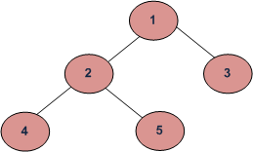
A More Visual Example
def printInOrder(root): ‘‘‘Print the node values in the tree in order. (left child, root, right child).’’’
# If the given root node is not None. if root:
# Recurse on the left subtree/child. printInOrder(root.left)
# Print out the root’s value. print(root.value)
# Recurse on the right subtree/child. printInOrder(root.right)
InOrder (Left, Root, Right): 4 2 5 1 3 PreOrder (Root, Left, Right): 1 2 4 5 3 PostOrder (Left, Right, Root): 4 5 2 3 1

Slide 13
Quiz Question
Write a function called palindrome that takes in a string and returns True if the string is a palindrome, and False if it isn’t. Examples: palindrome(‘civic’) -> True palindrome(‘racecar’) -> True palindrome(‘hello’) -> False

