Slide 1

JAVA GUI APPLICATION • THEORY PROJECT
Subscription Manager
Desktop Subscription Tracking and Budget Management System
Faculty: Dr. Shamim Al Mamum
Professor
Department of Electrical and Computer Engineering
Raiyan Choudhury • Tafsir Hasan • Hassan Shayer Palok
2531141042 | | 2523828642 | 2524003042

Slide 2

OVERVIEW
What We'll Cover
1. Problem & Objectives
2. Architecture & OOP Design
Why the GUI exists and what it set out to do
How the codebase is structured
3. Core Features & Demo Flow
4. Security & Validation
Authentication, subscriptions, budgeting, admin
Access control and exception handling
5. Challenges & Improvements
6. Team & Conclusion
What new features or improvements can be added
Contributions and final takeaways
2

Slide 3
MOTIVATION
The Problem We're Solving
A Java programming language based a GUI with JSwing which allows user to keep track of multiple subscription’s validity to prevent auto renewal issues. It also allows it’s admin to have control over user and their subscriptions, making it viable for both admin and the user.
3

Slide 4
GOALS
Project Objectives
1
2
3
Model subscriptions with reusable OOP classes
Provide active, expired & searchable views
Calculate spend against editable budgets
Monthly and annual plans share a common abstract design.
Users can browse, filter, and search their subscriptions.
Live monthly / annual totals compared to user-set limits.
4
5
6
Persist data between runs
Secure registration, login & recovery
Give admins user & subscription oversight
Credentials and subscriptions saved to local files.
Attempt limits, safe-pass checks, phone-verified recovery.
A dedicated admin view to manage accounts and records.
Subscription Manager — Java Project Presentation
4

Slide 5




SOFTWARES & FILES
Technology Stack
Java
Java Swing
Local Text Files
EncryptionUtils
Core language — JDK 8+
Entire GUI: windows, dialogs, tables
Credentials & per-user subscription data
XOR + Base64 credential transformation
5

Slide 6
DESIGN
Architecture & Startup Flow
Presentation
LoginManager, SubscriptionManager, SubscriptionWindow
Startup Sequence
Application Control
Main, SubscriptionManager
1
Main.main()
2
ensureFilesExist()
Domain Model
Subscription, MonthlySubscription, AnnualSubscription, Cancelable
3
loadSubscriptions()
Persistence
FileManager
4
showLoginWindow()
5
loadUserSubscriptions()
Protection
EncryptionUtils
6
showDashboard()
6

Slide 7
CORE DESIGN
Object-Oriented Concepts in Action
Abstraction
Subscription is abstract; requires getMonthlyCost()
Inheritance
MonthlySubscription & AnnualSubscription extend Subscription
Polymorphism
getMonthlyCost() gives plan-specific results via base references
Interface
Cancelable declares cancelSubscription() for both plan types
Encapsulation
Private fields; controlled via getCost(), isActive(), setAutoRenew()
Overloading / Overriding
Constructor variants; overridden getMonthlyCost() & cancelSubscription()
7

Slide 8





FUNCTIONALITY
Core Features
Authentication
Registration & Recovery
Subscription Records
Login with safe-pass + 3-attempt lockout
Local accounts, phone-verified password reset
Monthly/annual plans, categories, auto-renewal
Live Search
Budgeting
Admin Console
Instant filtering by subscription name
Monthly/annual totals with progress visualization
User table, subscription oversight, deletion
8

Slide 9
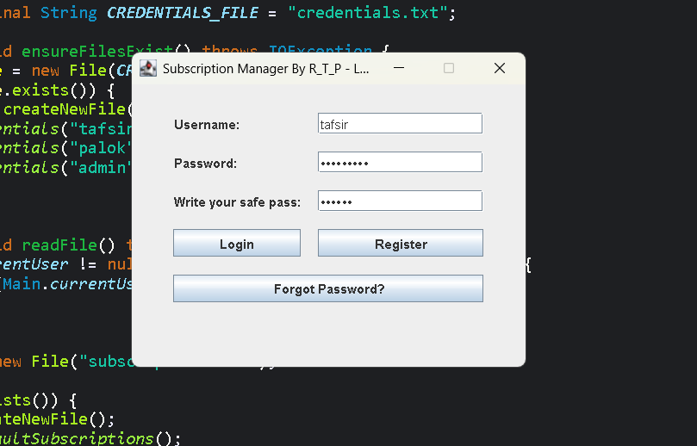
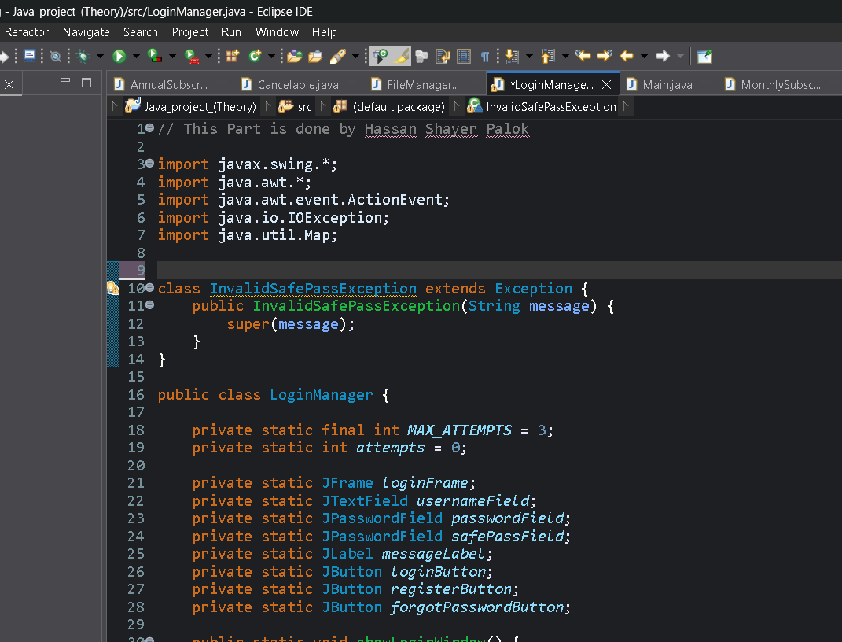
Authentication

Slide 10
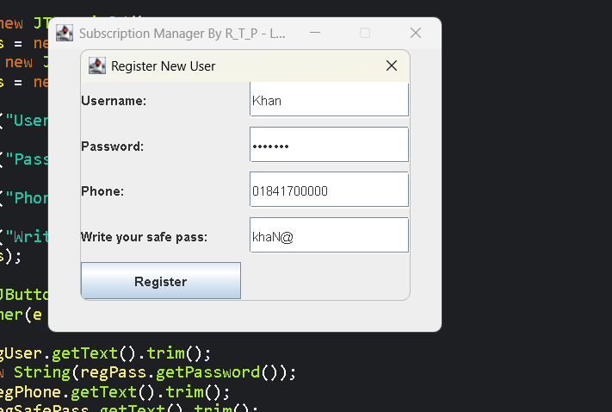
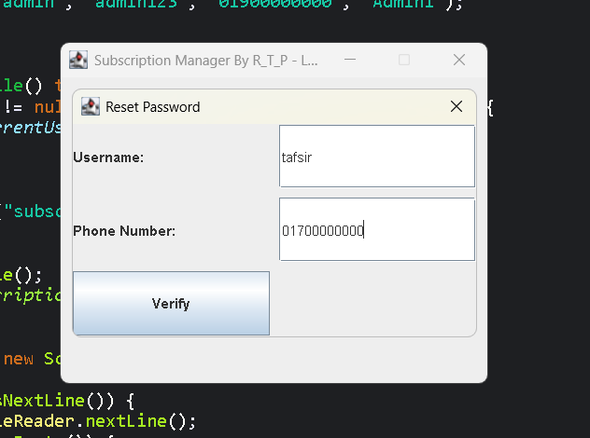
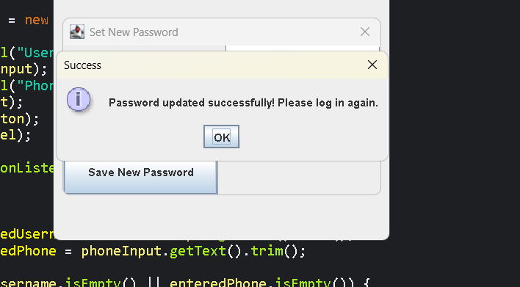
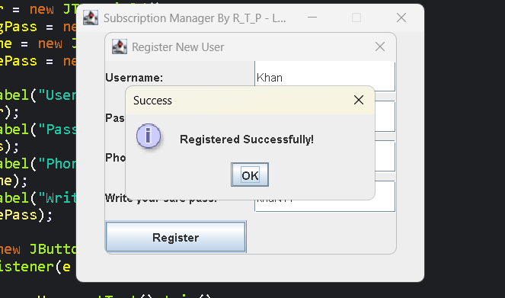
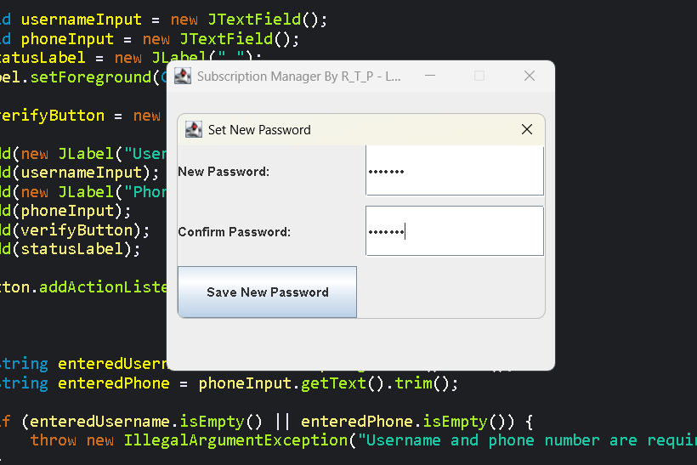
Registration & Recovery

Slide 11
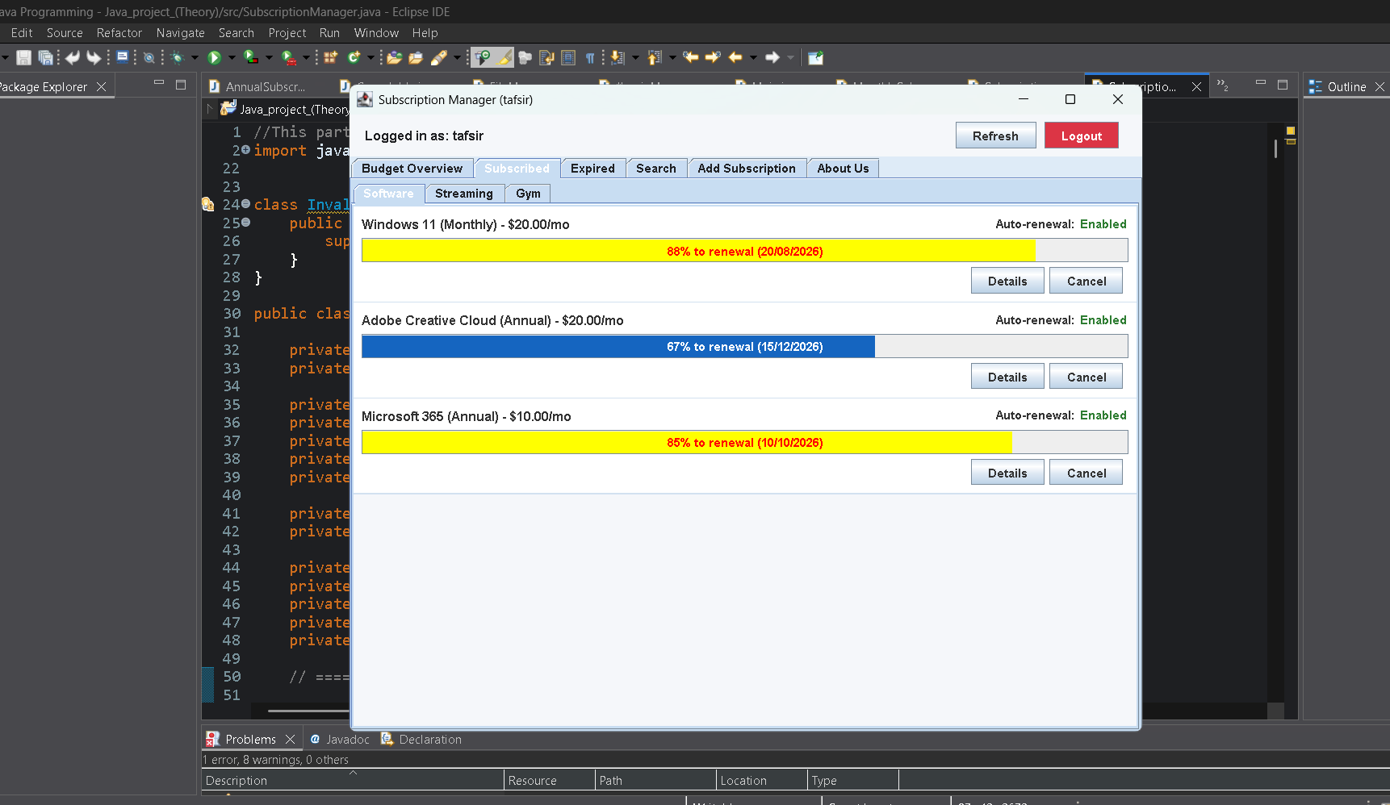
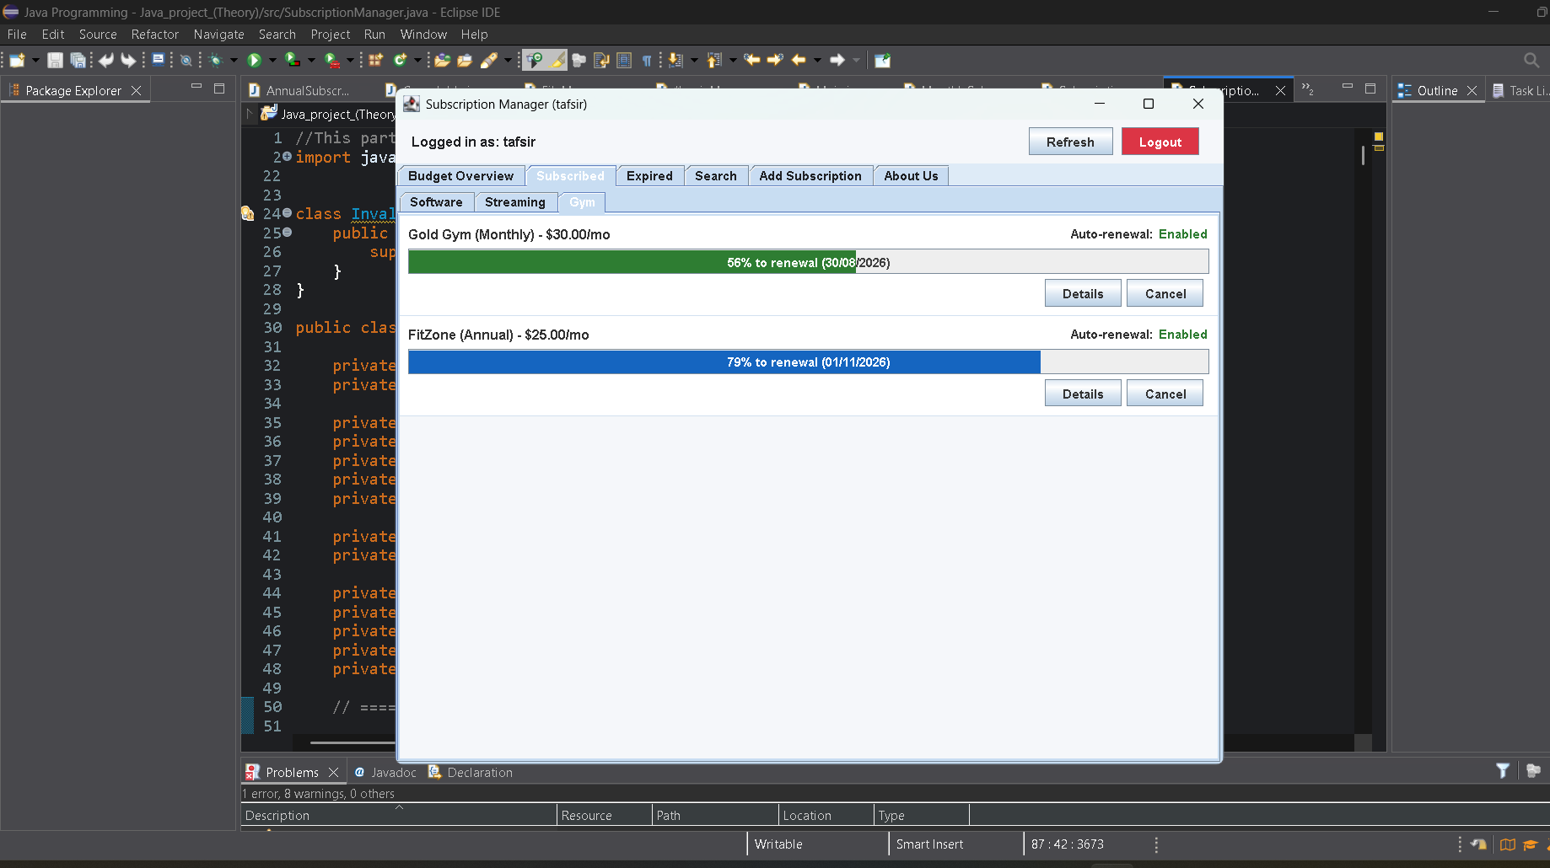
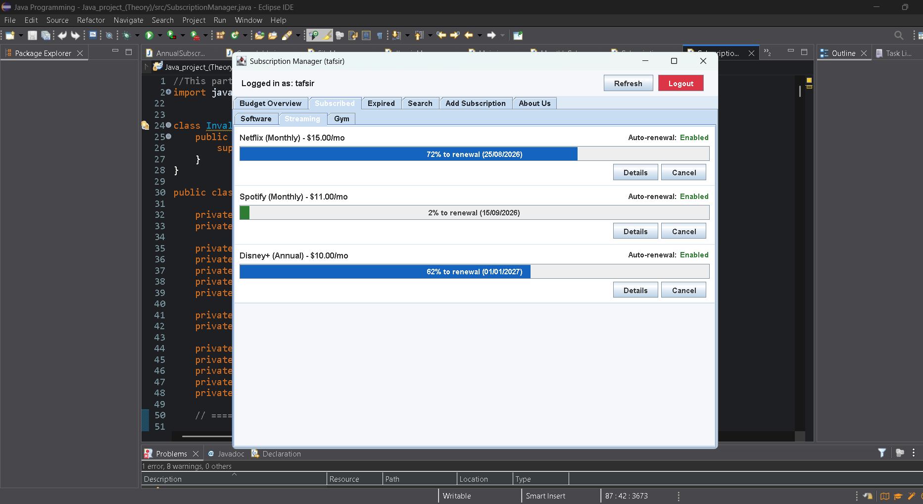
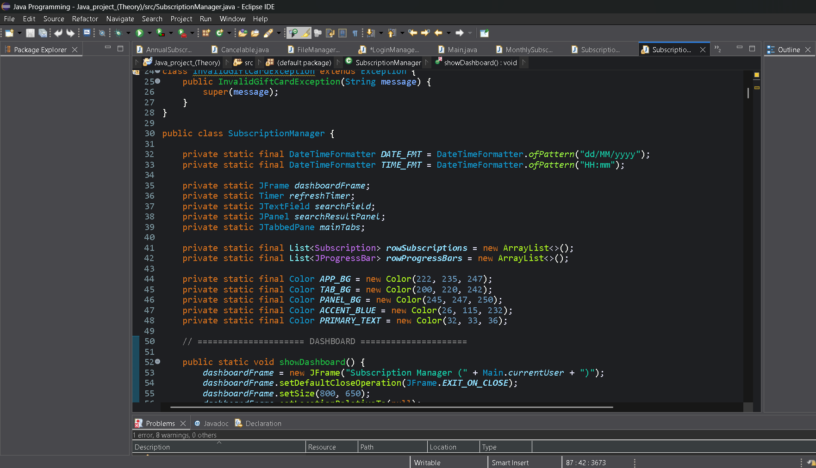
Subscription Records

Slide 12
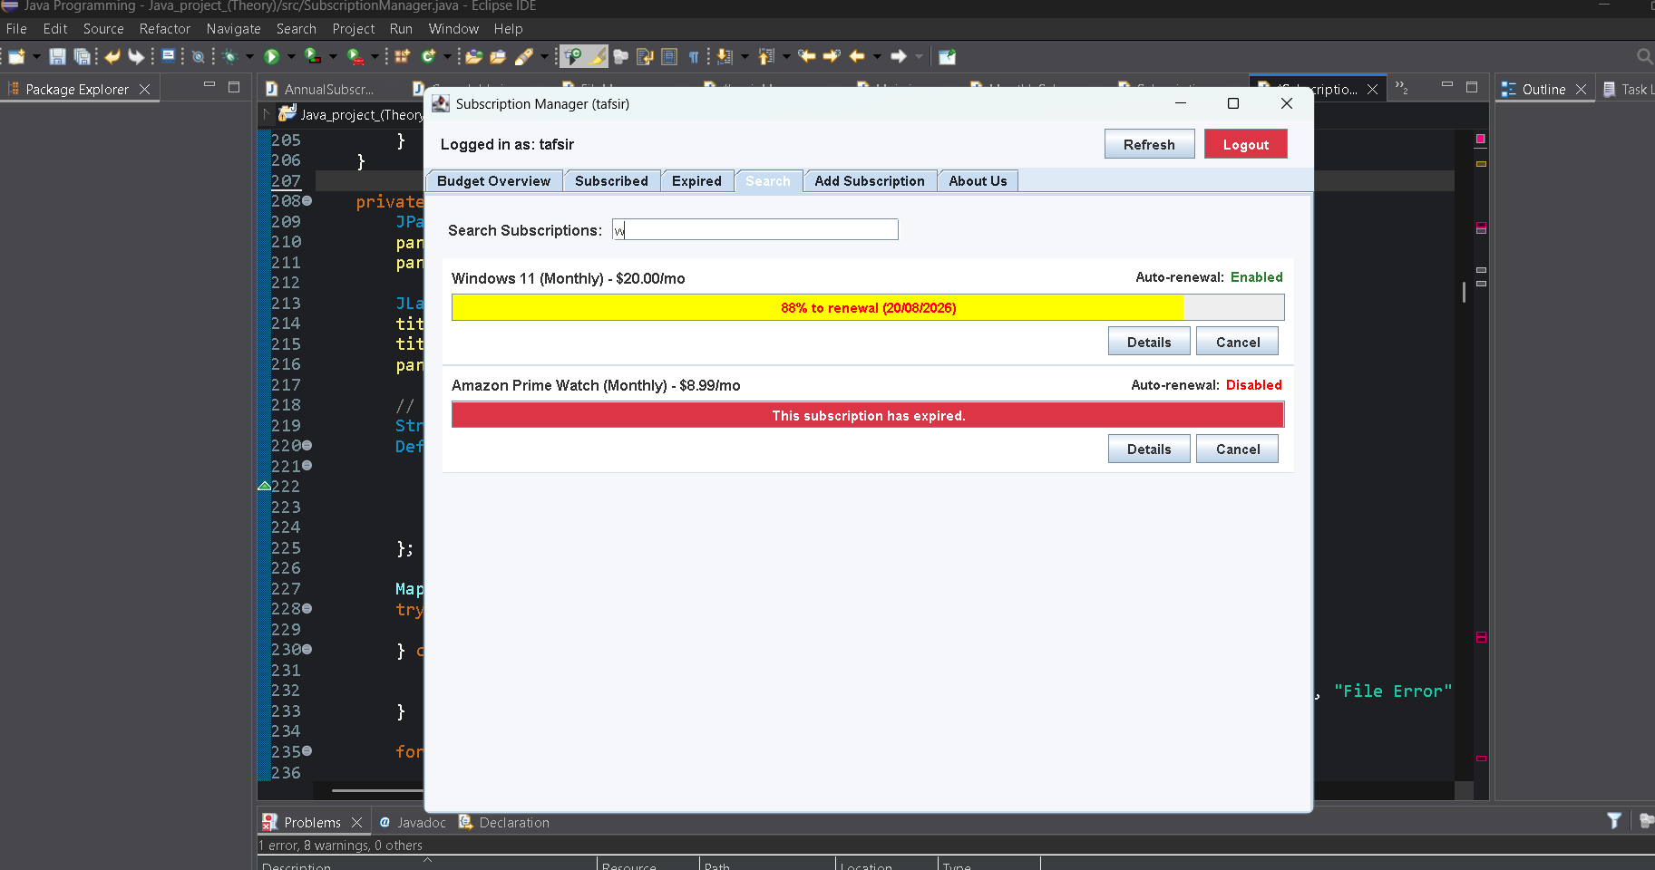
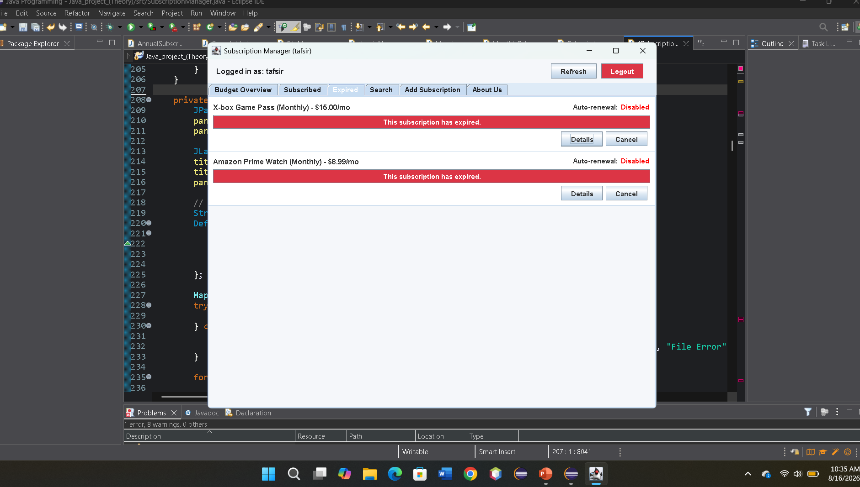
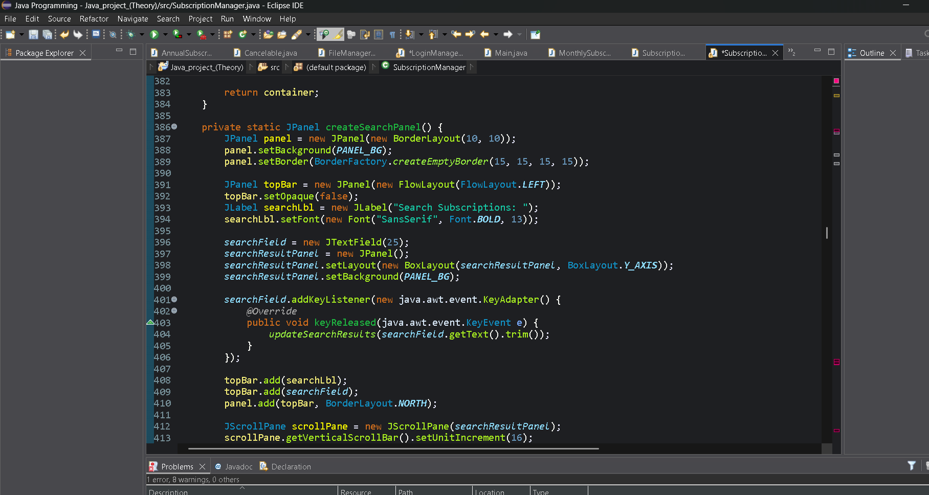
Live Search

Slide 13
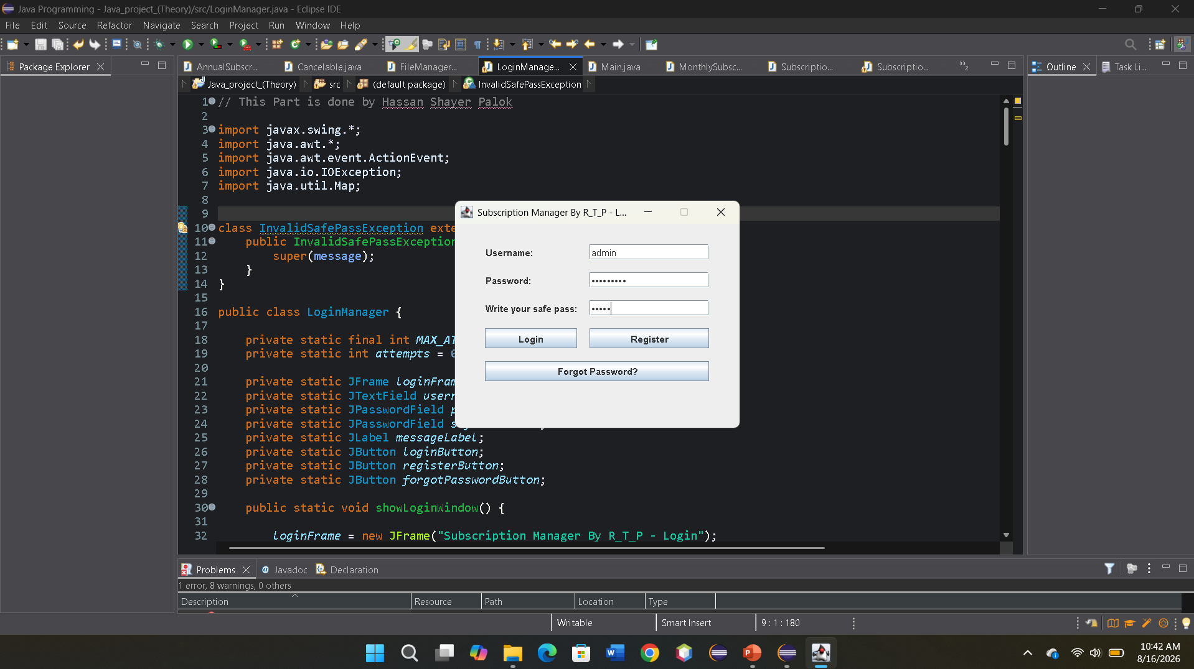
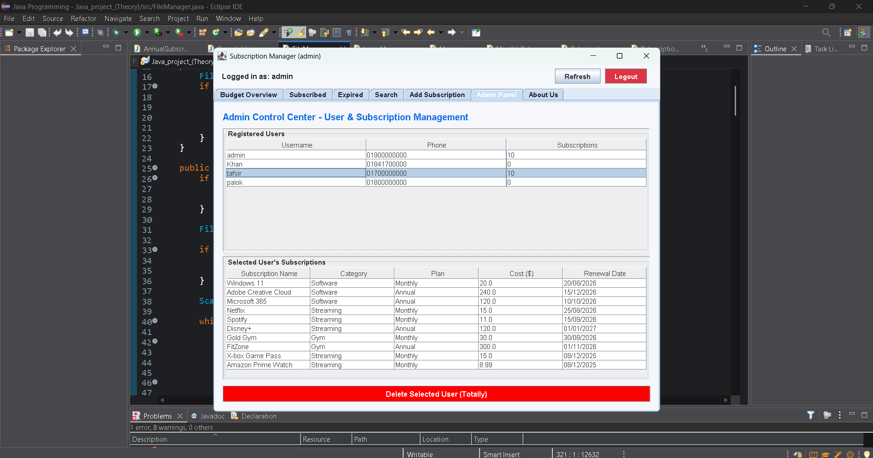
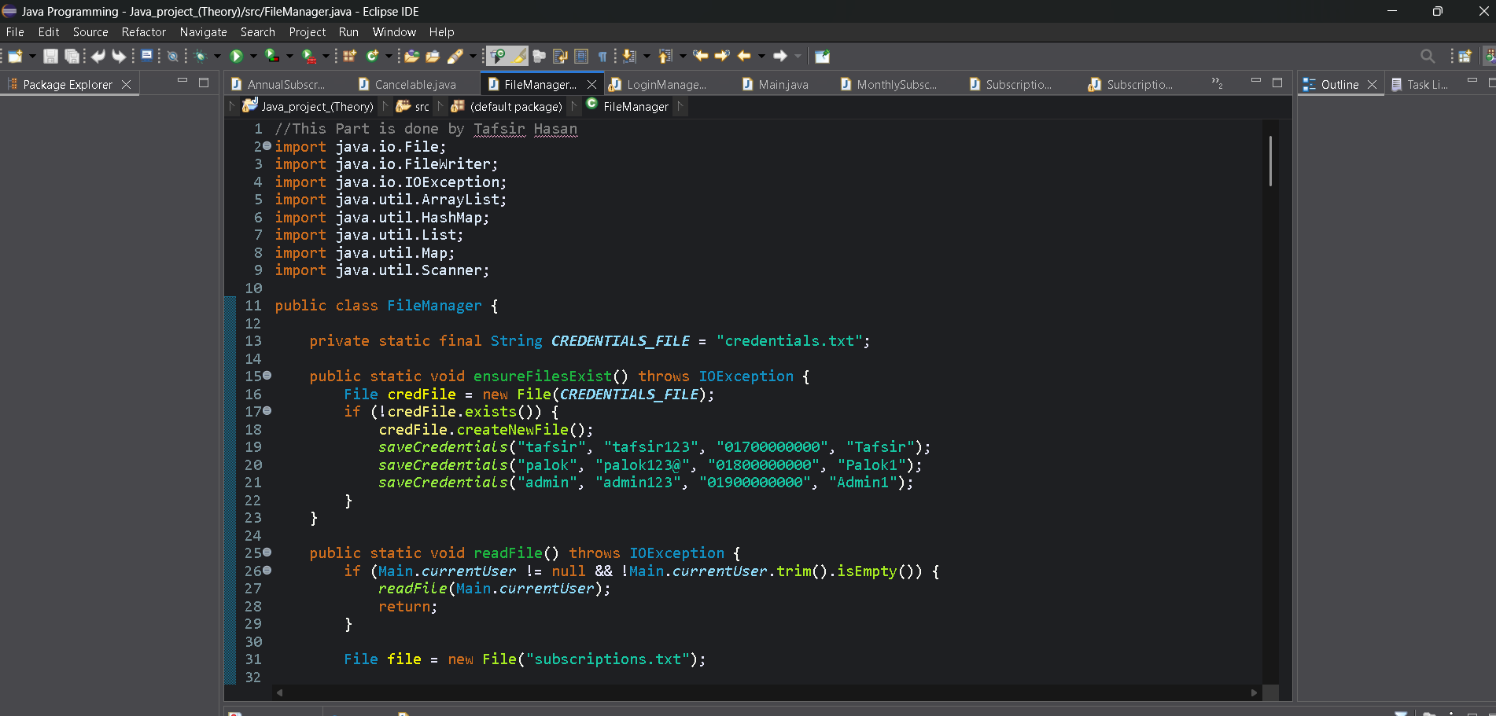
Admin Console

Slide 14
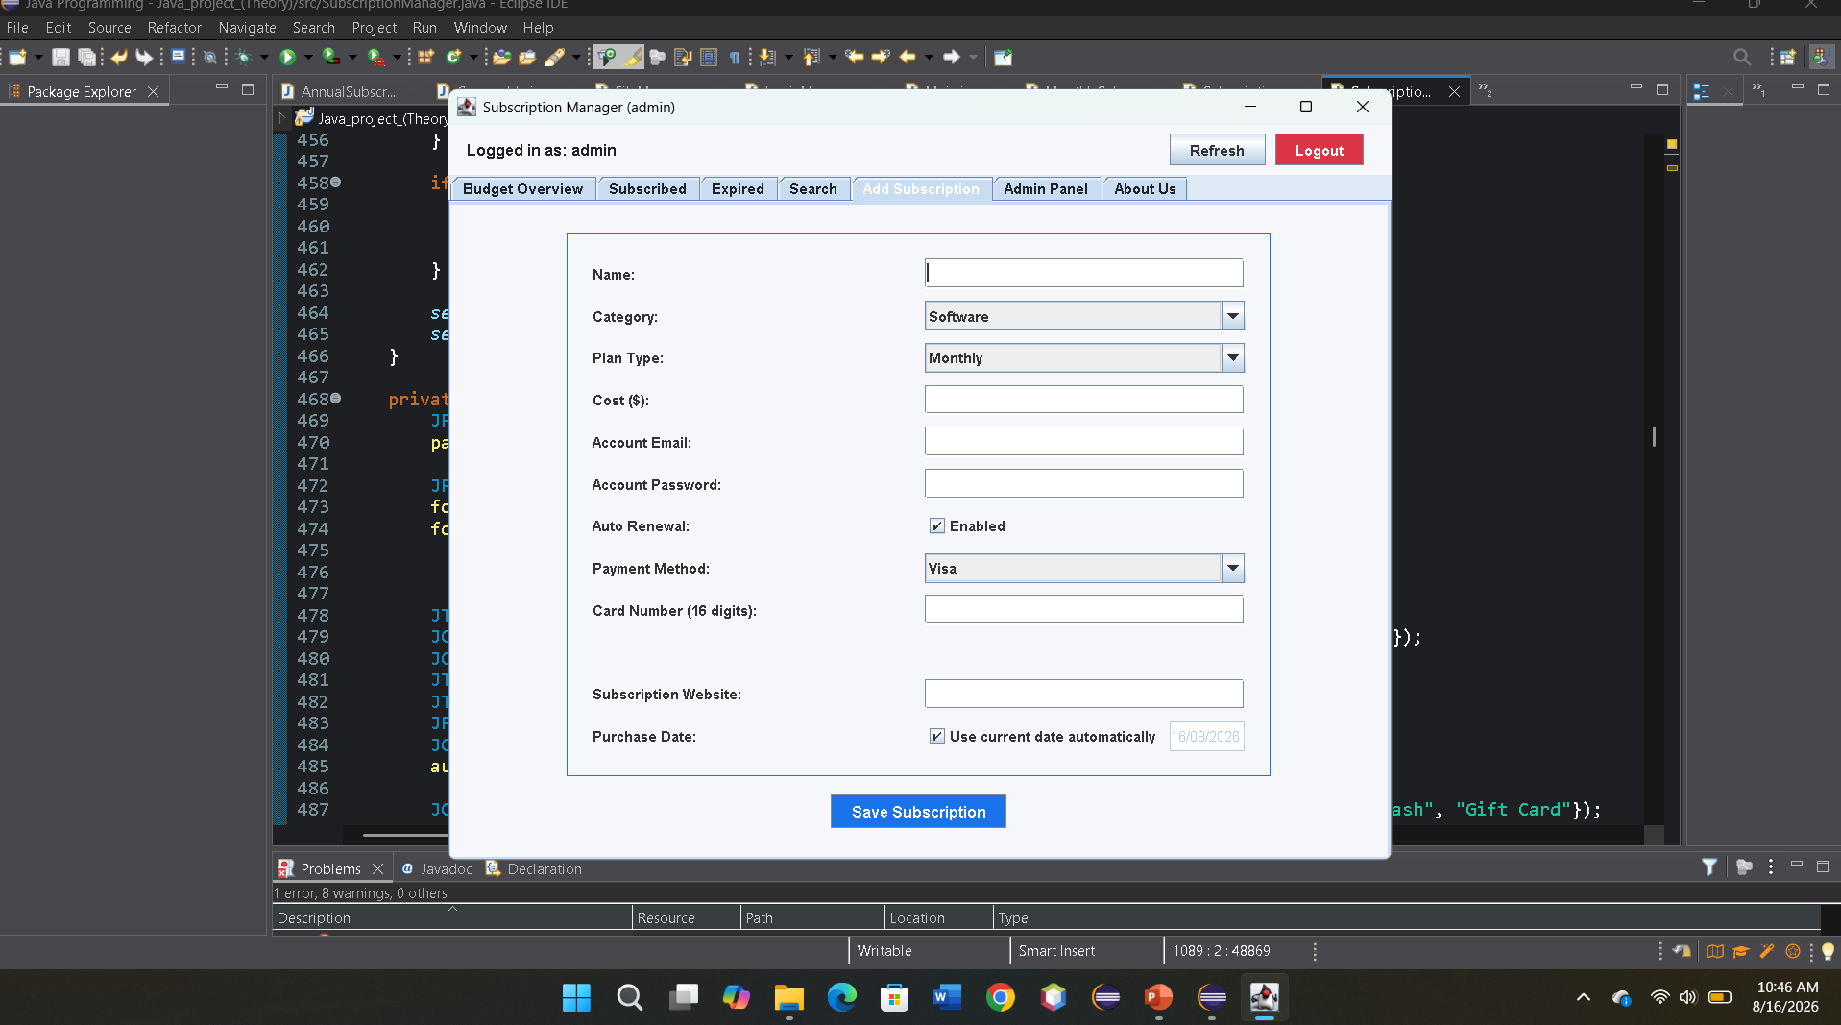
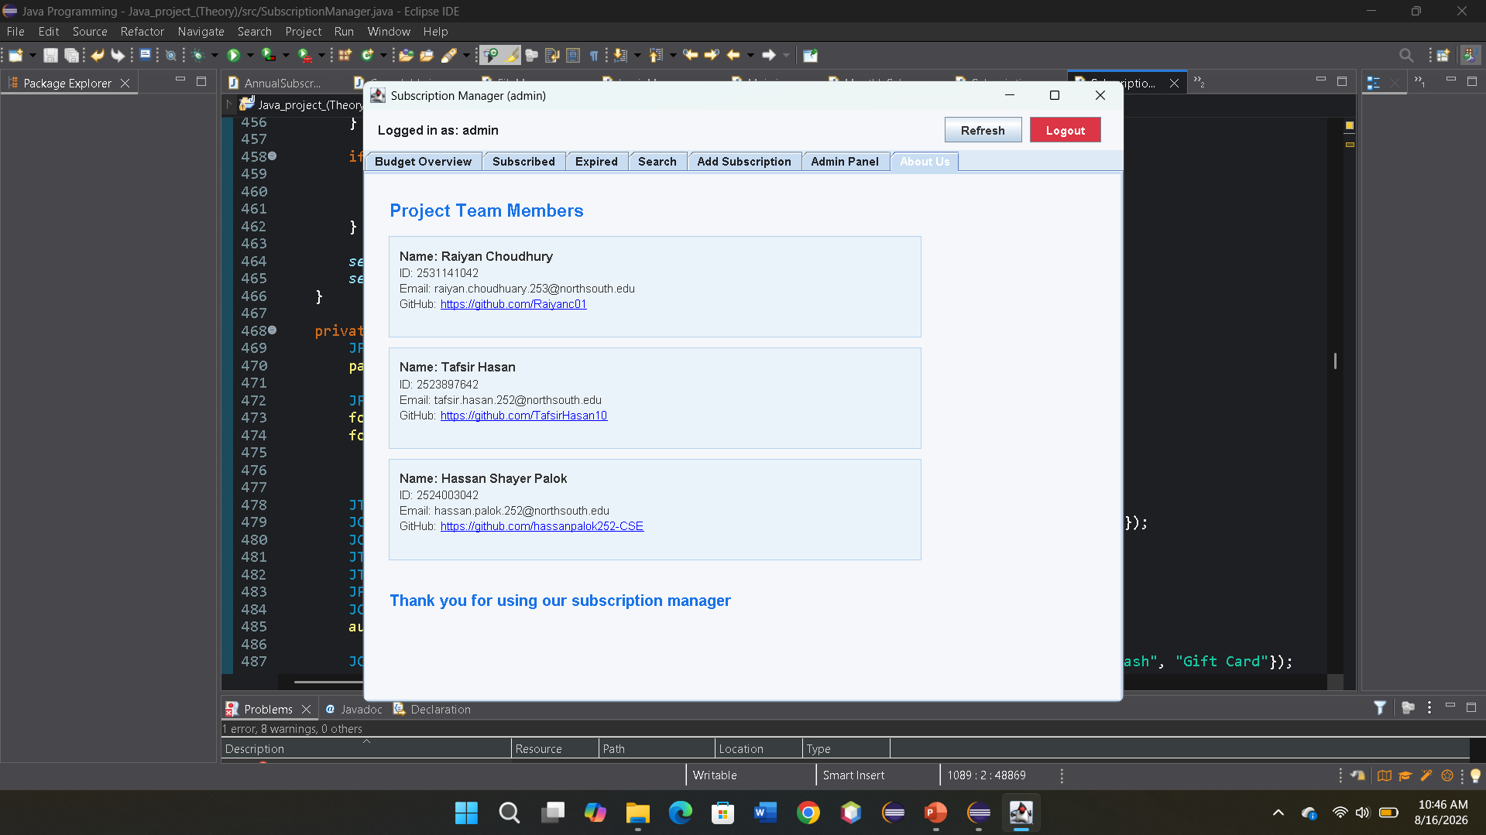
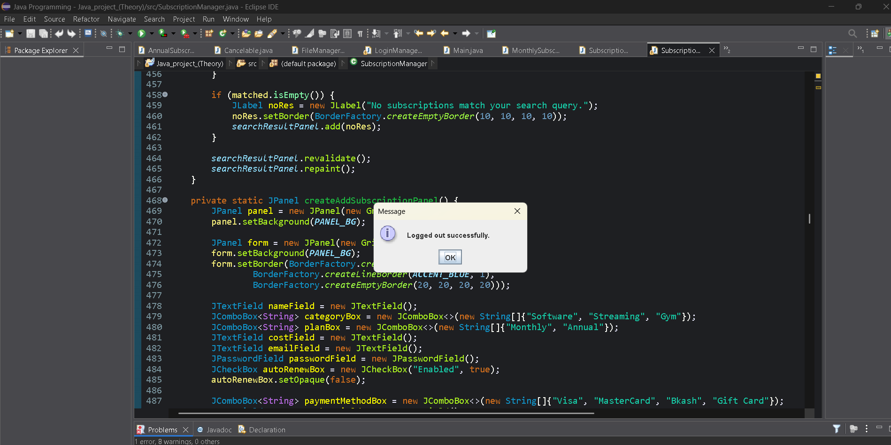
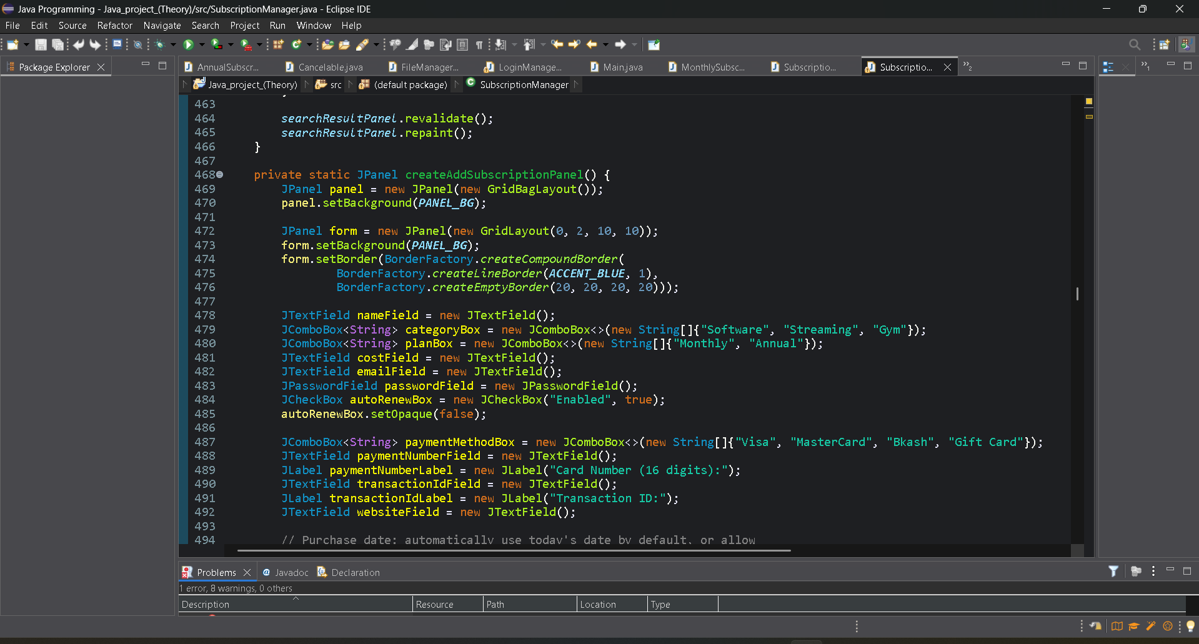
Add Subscription & About us

Slide 15
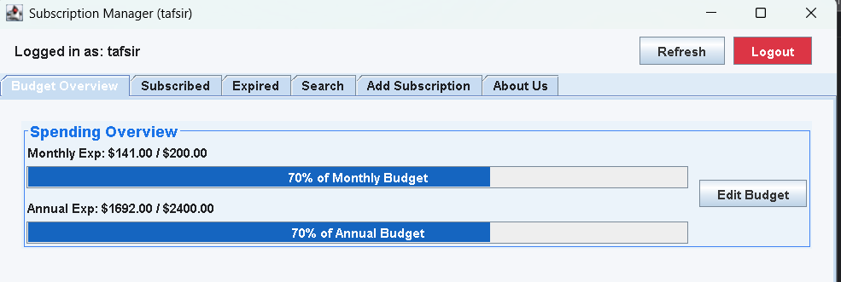
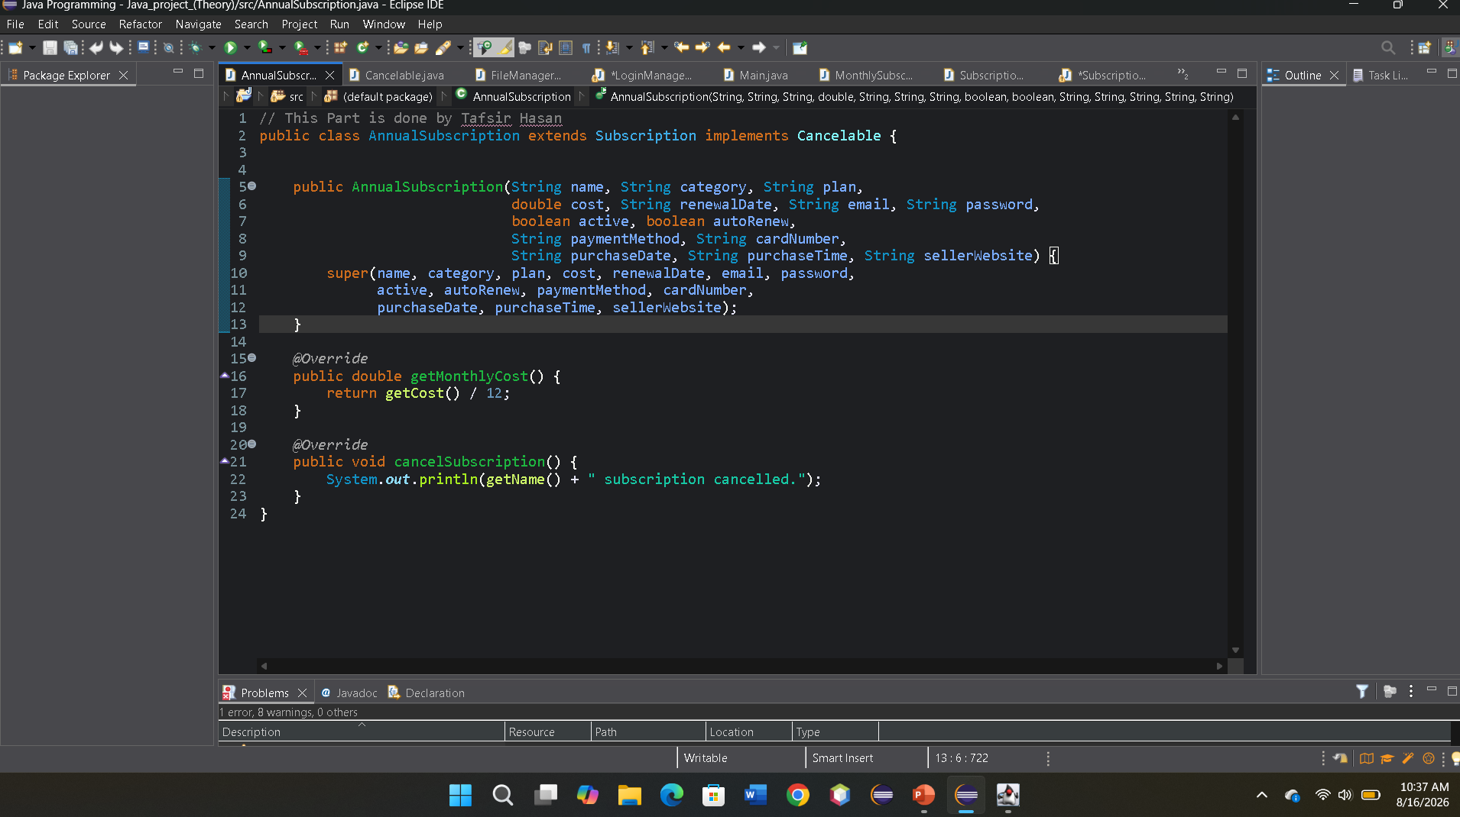
FINANCIAL LOGIC
Budgeting & Real-Time Calculations
All Progress Indicator
Active subscriptions → getMonthlyCost() → Monthly expense → × 12 → Annual expense
Below 60%
60–79%
80%+
10

Slide 16
SECURITY
Authentication & Data Protection
Input
→
Safe-pass validation
→
Read credentials
→
Decrypt + compare
→
Load user file
→
Dashboard
Safe pass
Exactly six alphanumeric characters
Input validation
Attempt limit
Three failed attempts lock the form
Basic brute-force friction
Credential transformation
Fixed XOR key + Base64
Obfuscation, not modern hashing
Payment masking
Only last four digits shown
UI protection only
Admin gate
Admin tab shown only for username 'admin'
Simple role check
9

Slide 17
INTERFACE & RELIABILITY
Swing UI & Exception Handling
UI Components
Custom Exception Handling
JFrame
Login & dashboard windows
InvalidSafePassException
JDialog
Registration, reset, details
InvalidGiftCardException
JTabbedPane
Budget, search, add, admin tabs
InvalidBudgetException
JTable
Admin user & subscription tables
IllegalArgumentException
JProgressBar
Renewal & budget visualization
NumberFormatException
JOptionPane
Confirmation & error messages
IOException
11

Slide 18
REFLECTION
Challenges Faced & Improvements
Cancellation only prints a message
→
Change state, persist, then refresh dashboard
Logout does not reopen login
→
Clear session state and reopen login
Weak credential protection (XOR/Base64)
→
Use modern password hashing with salts
Raw payment data stored in files
→
Proper encryption / key management
Large SubscriptionManager class
→
Refactor into focused view/controller classes
Budgets are not persisted
→
Persist per-user budget settings
12

Slide 19
WHO BUILT WHAT
Team Contributions
Raiyan Choudhury
Tafsir Hasan
Hassan Shayer Palok
EncryptionUtils, SubscriptionManager, Program Designer, Debugging
MonthlySubscription, AnnualSubscription, Cancelable, FileManager
Subscription, LoginManager, Main, SubscriptionWindow
13

Slide 20
WRAP UP
Conclusion
Subscription Manager is a substantial Java Swing desktop application combining subscription tracking, budgeting, authentication, local persistence and administrative functionality — built around an abstract Subscription model with concrete monthly and annual implementations.
Final Assessment
OOP
Strong integration into real workflows
GUI
Broad Swing interface coverage
It demonstrates abstraction, inheritance, polymorphism, encapsulation, interface implementation, constructor overloading and method overriding — all connected to real calculations, file persistence, and an event-driven Swing interface.
Persistence
Functional local file-based storage
Security
Basic controls; hashing needs work
Testing
No automated test suite supplied
14

Slide 21
THANK YOU Everyone

