Slide 1
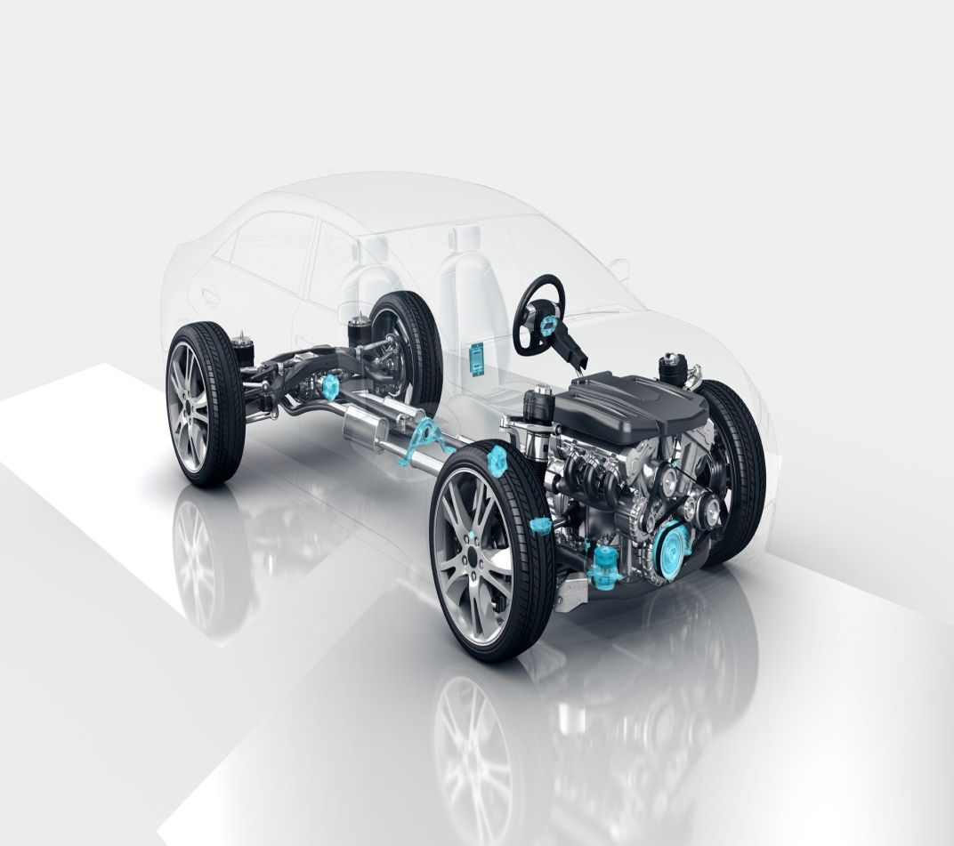

Automotive Electronics Group
School of ECE
Lane Detection with Steer Assist
AV Team 16
Students Details:
1. Rajendra G Kanbargi USN:01FE19BEC246
2. Prajwal Vakkund USN:01FE19BEC250
3. Tejaswini N USN:01FE19BEC256
4. Vishwas Raju Banagar USN:01FE19BEC258
Guide Details:
Prof. RM Shet

Slide 2
Automotive Electronics Group
School of ECE
Contents
1. Introduction
2. Need Statement
3. Problem Statement
Literature survey
Objectives
Lane Detection with real time videos
Block Diagram
Implementation
Results

Slide 3

Automotive Electronics Group
School of ECE
Introduction
ADAS:
Advanced driver-assistance systems (ADAS) are groups of electronic technologies that assist drivers in driving and parking functions. Through a safe human-machine interface, ADAS increase car and road safety. ADAS use automated technology, such as sensors and cameras, to detect nearby obstacles or driver errors, and respond accordingly.

Slide 4
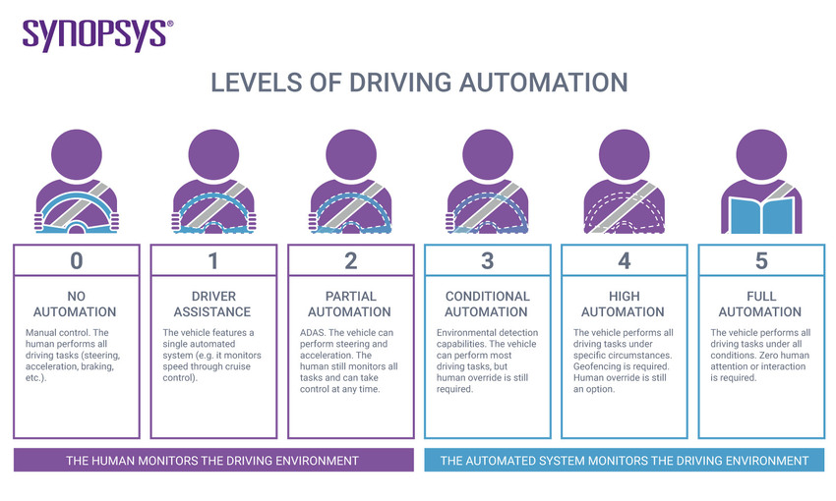
Automotive Electronics Group
School of ECE
Advanced Driver Assistance Systems (ADAS) are systems intended to help the driver in his driving activities. Technological solutions are many, like Adaptive Cruise Control (ACC), Intelligent Speed Adaptation (ISA) or Collision Warning Systems (CWS).
ADAS functions can be split in two groups: comfort functions and safety functions. The aim of the comfort functions is to warn the driver by triggering a warning, like a flashing light, sound, vibration or even a gentle steering suggestion.

Slide 5
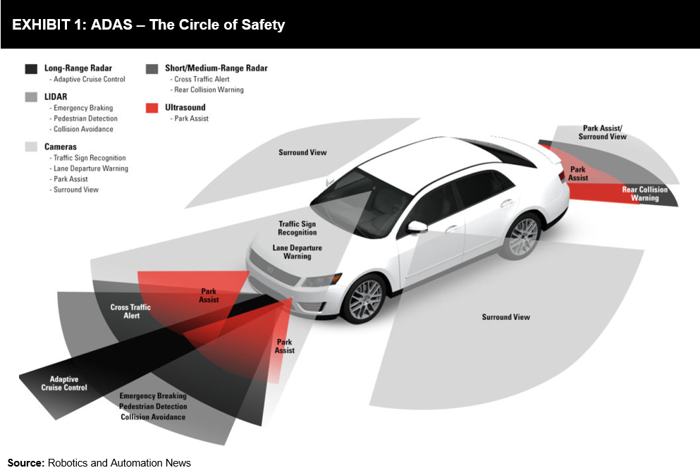
Automotive Electronics Group
School of ECE
Need Statement
To increase the driver road safety by introducing active safety / ADAS in autonomous vehicles.

Slide 6
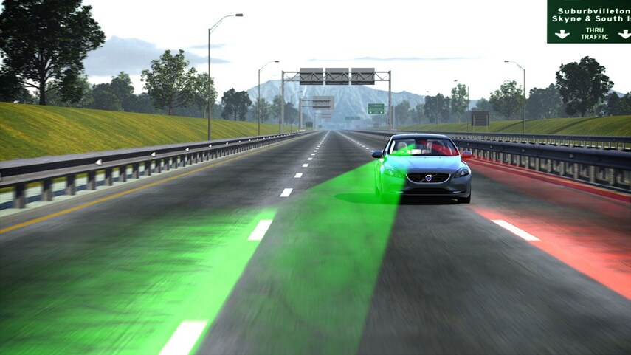
Automotive Electronics Group
School of ECE
Problem Statement
To design and implement lane detection with steer assist for an autonomous vehicle.

Slide 7
Automotive Electronics Group
School of ECE
Literature Survey
Sl.No | Title and Date of publication | Authors | Learning
1. | On the Image Sensor Processing for Lane Detection and Control in Vehicle Lane Keeping Systems | C.Y. Kuo, Y.R. Lu and S.M. Yang * | It presents a cost-effective image sensor with efficient processing algorithm for lane detection and lane control applications to autonomous delivery systems.
2. | Steering Wheel Control in Lane Departure Warning System | Maximiliano Hernández García Rojas1 , Humberto Velasco Arellano1 , David Ubach González2 , Martín Montes Rivera1 , Marving Omar Aguilar Justo3 | It presents a position steering wheel control (SWC) in a lane detection prototype designed for its implementation in cars that do not have installed this system
3. | Real Time Lane Detection for Autonomous Vehicles | Abdulhakam.AM.Assidiq, Othman O. Khalifa, Md. Rafiqul Islam, Sheroz Khan | It is based on lane detection which includes the localization of the road, the determination of the relative position between vehicle and road.

Slide 8
Automotive Electronics Group
School of ECE
Objectives:
To significantly improves safety by making sure the vehicle is centered inside the lane lines.
To control the steering wheel to take gentle curves on highways without any driver input.
Lane Detection involves determining the location of the lane boundaries in a single image without strong prior knowledge regarding the lane position.
To describe the path for self-driving cars and to avoid the risk of getting in another lane.

Slide 9
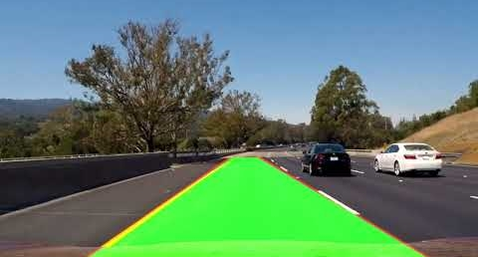
Automotive Electronics Group
School of ECE
Lane Detection with Real Time Videos
The project was made to show how a lane detection system works in cars that have
a front-facing camera.
This feature is responsible for detecting lanes, measuring curve radius (tightness of
a curve) and monitors the offset from center.
With this information, the system significantly improves safety by making sure the
vehicle is centered inside the lane lines, as well as adds comfort if it is also
configured to control the steering wheel to take gentle curves on highways without
any driver input.

Slide 10
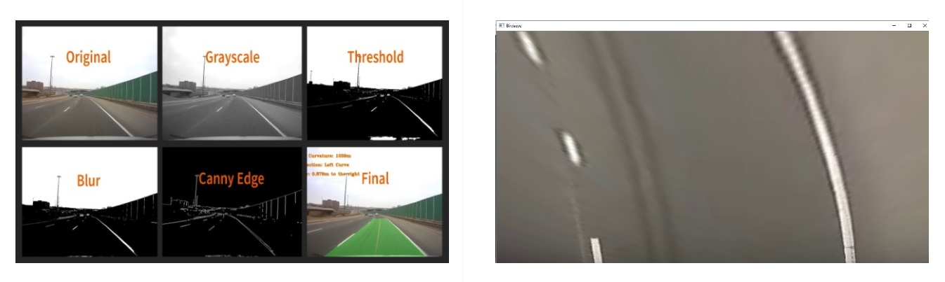
Automotive Electronics Group
School of ECE
Image Processing:
readVideo(): The readVideo() function is used to access the video file, which is placed in the same directory.
processImage(): This function uses some processing techniques to extract white lane lines and prepare them for analysis by subsequent procedures.
perspectiveWarp(): After we get the image we desire, we apply a perspective warp. Four points are set on the frame in such a way that they only surround the area where lanes are present , and the data is then mapped into another matrix to generate a birds eye view of the lanes.

Slide 11
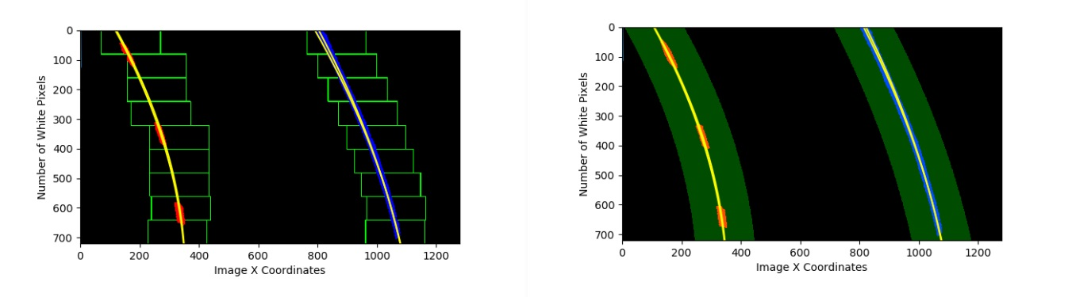
Automotive Electronics Group
School of ECE
Lane Detection, Curve Fitting & Calculations :
slide_window_search(): To recognize lanes and their curvature, a sliding window technique is employed. It takes the data from the preceding histogram function and creates a box with a lane in the middle.
general_search() : Following the slide window search() function, the general search() method may now fill in an area around the detected lanes. This will be used to calculate the radius of curvature, which is necessary for calculating steering angles.
measure_lane_curvature() : With information provided by the previous two functions, np.polyfit() function is used again but with the values multiplied by xm_per_pix and ym_per_pix variables to convert them from pixel space to meter space.

Slide 12
Automotive Electronics Group
School of ECE
Visualization and Main Function :
draw_lane_lines() : Following that, certain approaches are used to visualize the detected lanes as well as other data that will be displayed in the final image. This programme uses recognized lanes to fill the space within them with a green hue. It also depicts the lane's centre by saving the mean of the left_fitx and right_fitx lists in the pts mean variable, which is subsequently represented by a yellowish tint. This variable is also used to determine whether the car is displaced to one side or centered in the lane.
offCenter() : offCenter() function uses pts_mean variable to calculate the offset value and show it in meter space.
addText() : Finally by adding text on the final image would complete the process and the information displayed.
main() : Main function is where all these functions are called in the correct order and contains the loop to play video.

Slide 13
Automotive Electronics Group
School of ECE
Block Diagram:
I
Input Video
Access the video
Extract the white lanes
Perspective Warping
Image processing
Output Steering Angles
Lane Detected with data visualization
Radius of curvature Calculation
Sliding window search

Slide 14
Automotive Electronics Group
School of ECE
Mathematical Modeling:
Based on Brewnog’s idea,
s = wheel base
a = steering wheel angle
n = steering ratio (e.g. for 16:1, n = 16)
r = radius of curvature, in the same units as the wheel base
So:
r = s / (sqrt(2 - 2 * cos(2*a/n))
For one complete turn of steering i.e., 360 degree wheel turn by 24 degree.
a=n/2*cos^-1(1-(s^2/2r^2)

Slide 15
Automotive Electronics Group
School of ECE
Specifications of components:
Raspberry pi 3 B+ model :
Processor : Broadcom BCM2837B0, Cortex-A53
Memory : 1GB LPDDR2 SDRAM
Connectivity : 2.4 GHz and 5 GHz Wireless LAN , Bluetooth 4.2, BLE, and Gigabit Ethernet over USB 2.0
Access : Extended 40-pin GPIO header.
SD Card support : Micro SD format for loading operating system and data storage.
Environment : Operating temperature, 0-50 degree Celsius.
LN298 Motor Driver:
Motor Supply Voltage (Maximum) : 46 V
Motor Supply Current (Maximum) : 2A
Driver Voltage : 5-35V
Driver Current : 2A
Maximum Power : 25W
Heat sink for better performance.
3.Servo Motor : Futaba S3003
Rotational Range : 60 degree
Weight : 37 g
Speed : 4.8 V : 0.23 sec/ 60 degree
Pulse Cycle : 30 ms
Pulse Width : 500-3000 microsecs
Gear type : Plastic

Slide 16
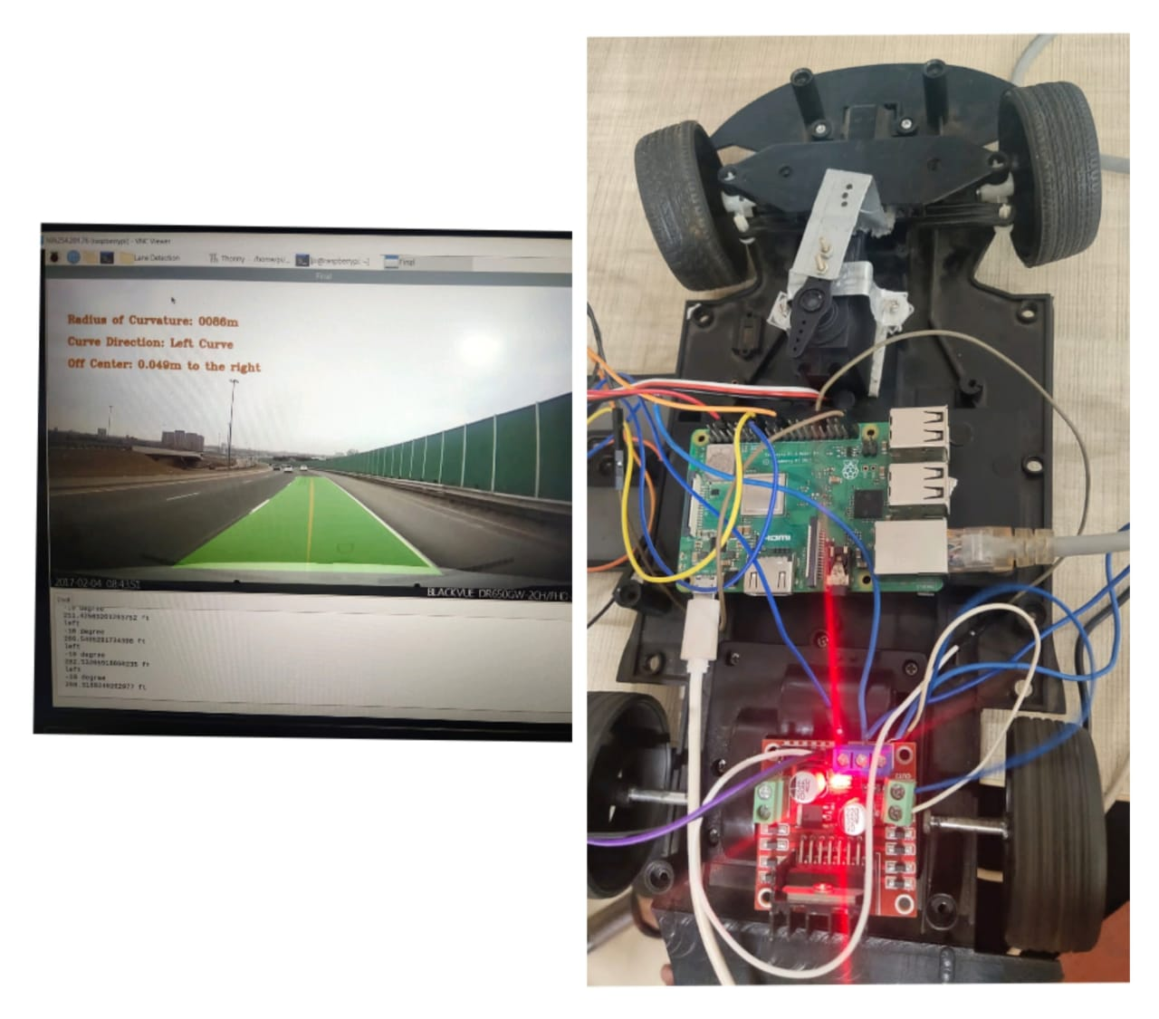
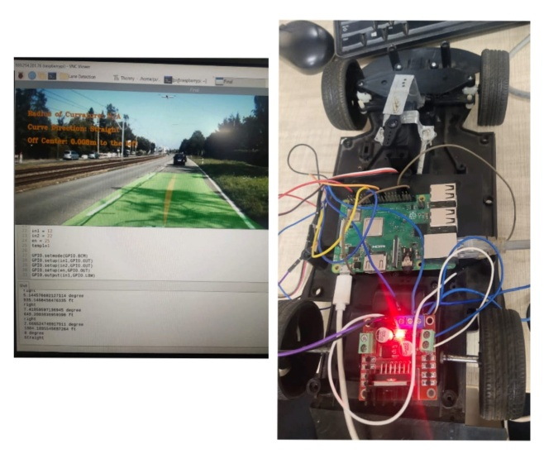
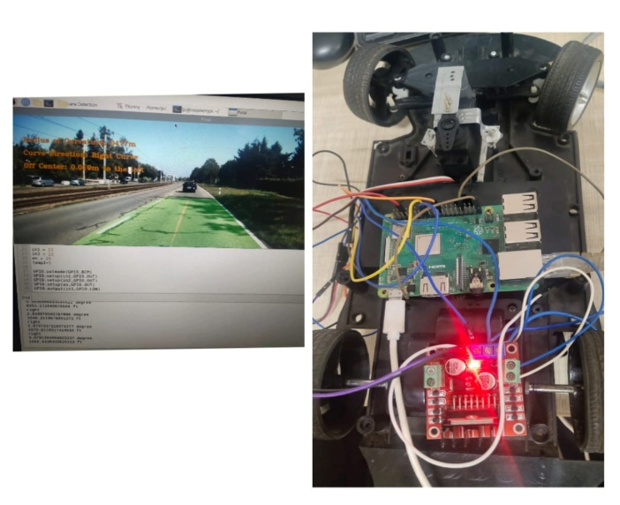
Automotive Electronics Group
School of ECE
Implementation:
Left curve
Straight direction
Right curve
https://drive.google.com/file/d/13xo7oJLFx7SZnQUySeY_vsVwQpbF3OtZ/view?usp=drivesdk

Slide 17
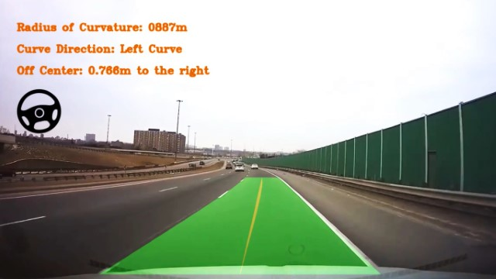
Automotive Electronics Group
School of ECE
Results:

Slide 18
[1] M. T. Kimour and D. Meslati, “Deriving objects from use cases in real-time embedded systems,” Information and Software Technology, vol. 47, p. 533-545, June 2005.
Automotive Electronics Group
School of ECE
References

Slide 19
Automotive Electronics Group
School of ECE
Thank You

