Slide 1

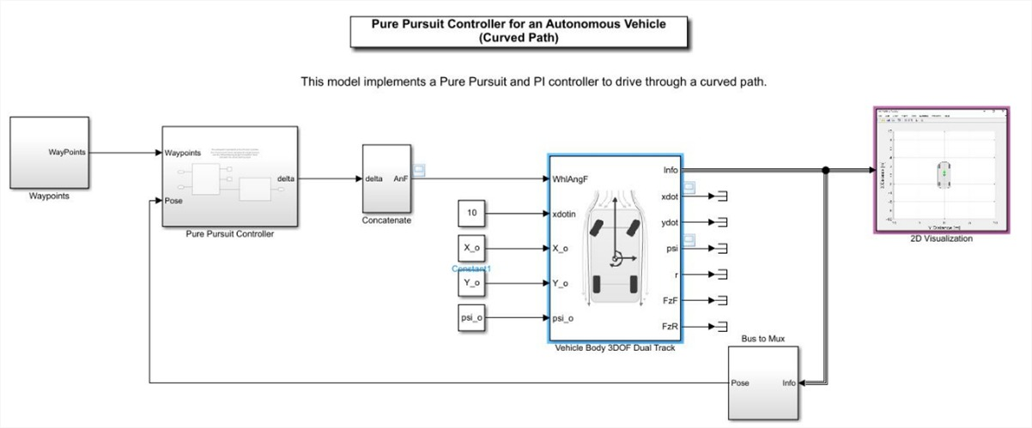
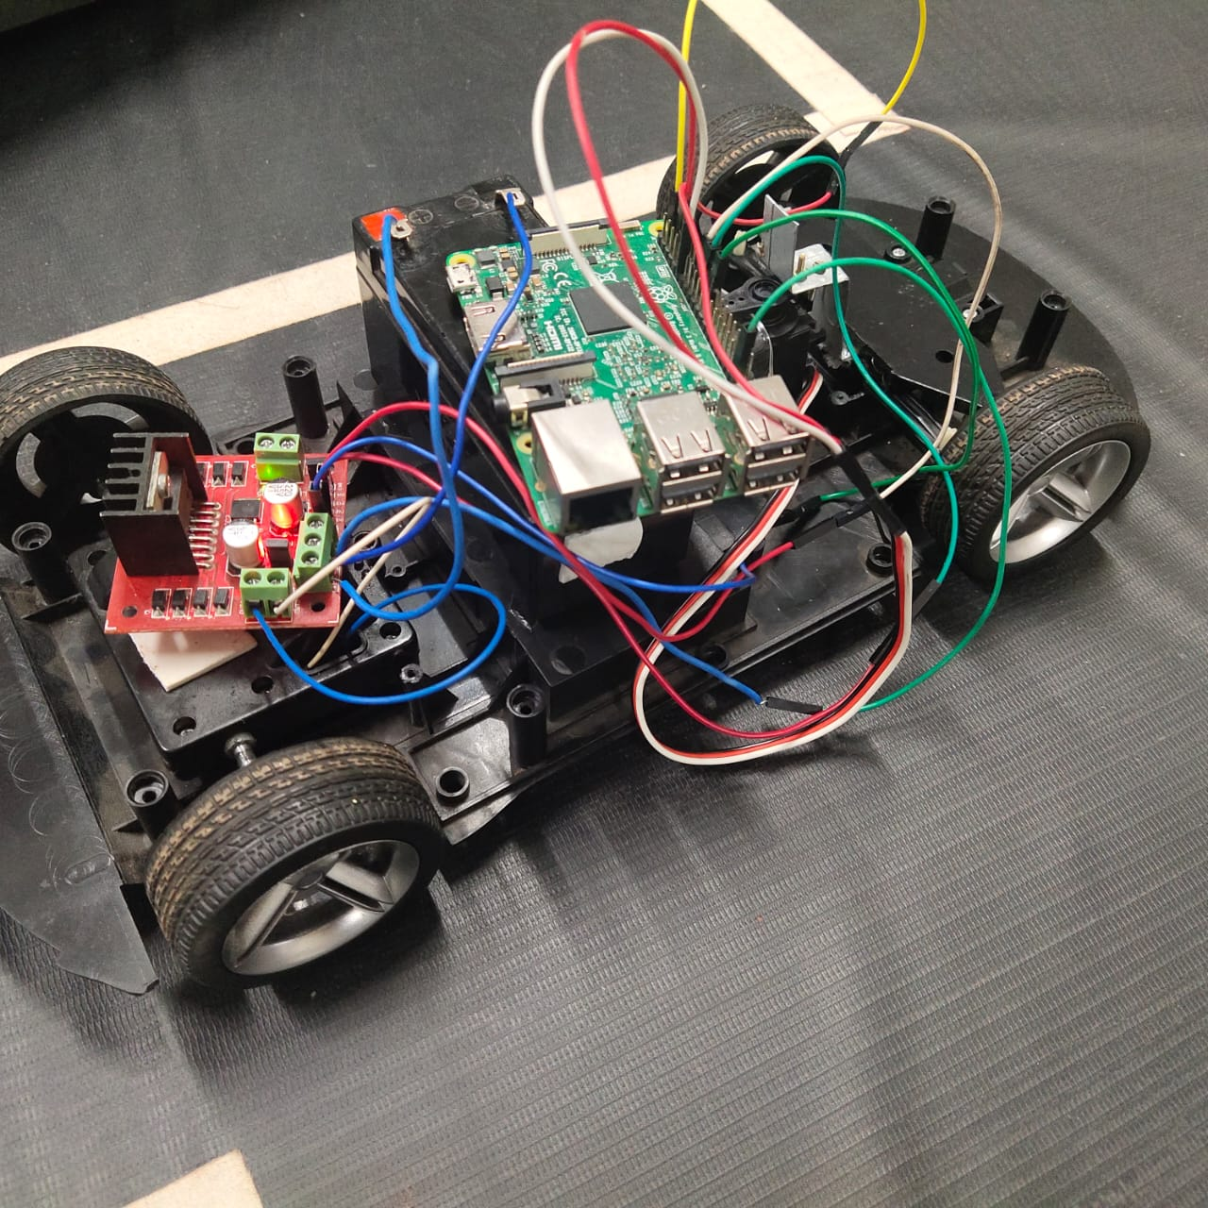
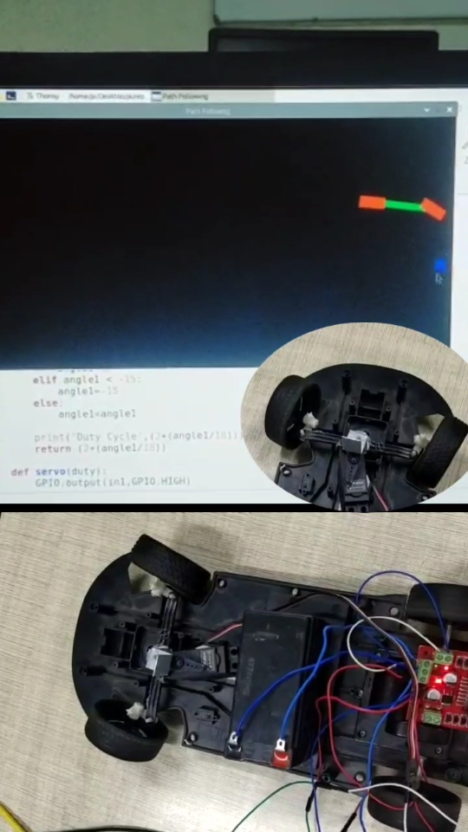
MOTION CONTROL FOR AUTONOMOUS VEHICLES
Rajendra G Kanbargi, Prajwal Vakkund, Tejaswini N, Vishwas Raju Banagar
Under the guidance of Prof. R M Shett.
School of Electronics and Communication Engineering
rajendragkanbargi@gmail.com ,prajwalpravesh@gmail.com
Problem statement
Methodology
Results
To design and implement control algorithm for lateral motion control of an autonomous vehicle
1.Find the vehicle’s approximate position.
2.Select the path point that is closest to the vehicle.
3.Locate the goal point.
4.Convert the goal point’s coordinates to vehicle coordinates.
5.Calculate the curvature and request that the vehicle’s steering be adjusted to that curvature.
6.Refresh the vehicle’s location.
Objectives
● The goal of lateral control is to follow a desired path.
● To move the autonomous vehicle from source point to destination point.
● The lateral control aims to track a planned trajectory using an output-feedback controller for the vehicle lateral motion.
● For increased safety and fewer accidents.
Fig 1: Final assembled prototype
Fig2: A waypoint is marked in pygame window and the prototype steering is also turned to that marked point
Contributions
To ensure road safety and to have better control over an autonomous car, we have designed lateral control system using pure pursuit model.
Optimization details
Optimization techniques:
1.Hardware optimization
2.Software optimization
Literature survey
● “An introduction of autonomous vehicles and a brief survey”
.● A Review of some Pure-Pursuit based Path Tracking Techniques for Control of Autonomous Vehicle.
Conclusions
The project goal is to control steering system of an autonomous vehicle. The best feasible solution is lateral control system using pure pursuit model.
Mini Project-2021-22

