Slide 1
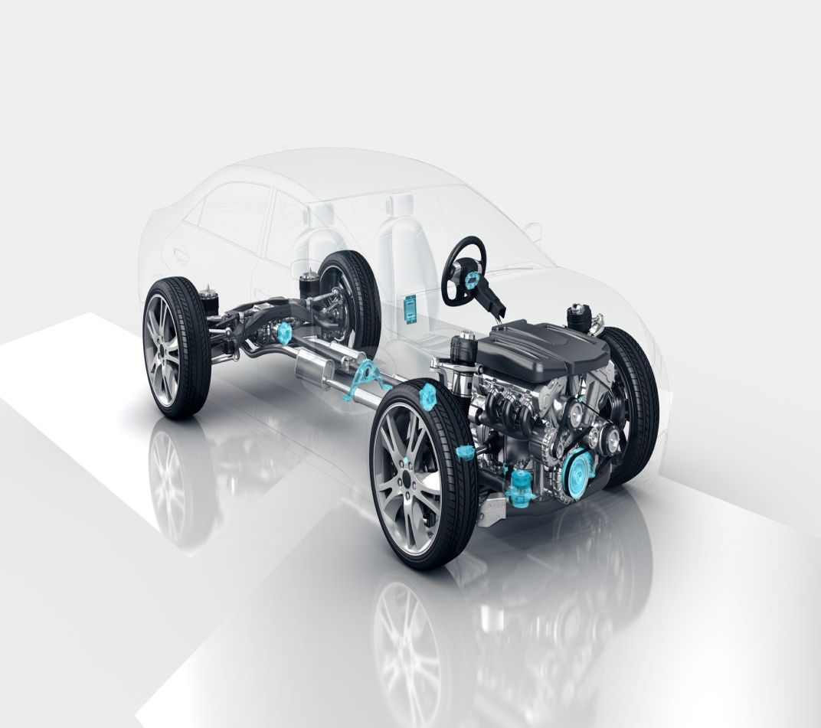

Autonomous Electronics Group
School of ECE
Motion control of autonomous vehicle
AV Team No: 16
Students Details:
Rajendra G Kanbargi USN: 01FE19BEC246
Prajwal Vakkund USN: 01FE19BEC250
Tejaswini N USN: 01FE19BEC256
Vishwas Banagar USN: 01FE19BEC258
Guide Details:
Prof. RM SHET

Slide 2
Autonomous Electronics Group
School of ECE
Contents:
Introduction
Need Statement
Problem Statement
Technical and Non Technical
Literature survey
Multiple solution
Ethics
Bill of materials
Gantt chart
Design Specification
Functional Block Diagram
Pin Diagram
Implementation
Mathematical model
Algorithm
Results

Slide 3
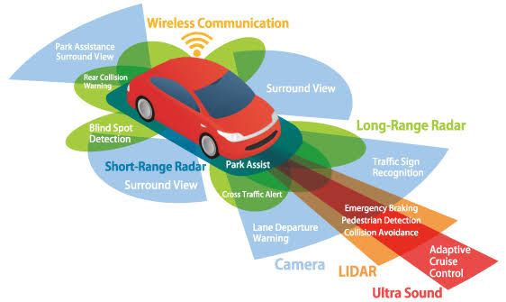
Autonomous Electronics Group
School of ECE
Introduction:
An autonomous vehicle is one that can drive itself.
It is capable of moving from a starting point to a predetermined destination in “autopilot” mode.
It uses various in-vehicle technologies and sensors, including adaptive cruise control, active steering (steer by wire), anti-lock braking systems (brake by wire), GPS navigation technology, lasers and radar.

Slide 4
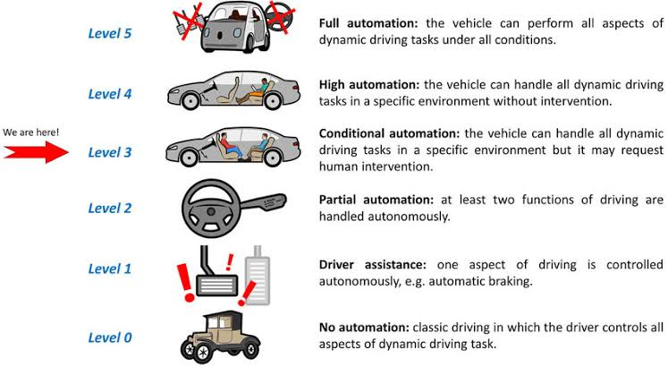
Autonomous Electronics Group
School of ECE
Five Levels of Automation:
The classification of the development stages up to the self-driving
vehicle comes from the Society of Automotive Engineers (SAE)
The development stages up to the autonomous vehicle are divided
into five levels.
It describes the extent to which the vehicle can and may take over
the tasks of the driver.

Slide 5
Autonomous Electronics Group
School of ECE
Need Statement :
For an autonomous vehicle the basic need is to travel from source to destination along the planned reference trajectory.
Challenges in need statement:
Path planning.
Obstacle detection.
Vehicle speed and steering control.
Localization.
Banking of roads.

Slide 6
Autonomous Electronics Group
School of ECE
Technical Information:
Advanced sensor technology
Smart control systems
Intelligent actuators
Accident liability(safety)
Non-Technical Information:
The information which is not having specialized science , but it may directly or indirectly involved in the project .
For example,
1.Condition of track
2.Weather conditions
3.Energy consumption

Slide 7
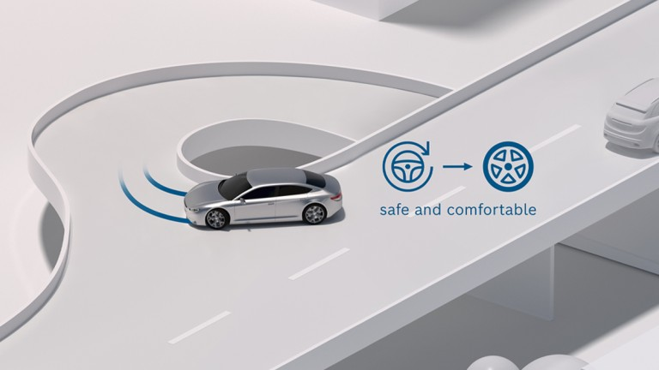
Autonomous Electronics Group
School of ECE
Problem Statement :
To design and implement control algorithm for lateral motion control of an autonomous vehicle.

Slide 8
Autonomous Electronics Group
School of ECE
Literature Survey:
Sl.No | Title and date of publication | Authors | Learning
1. | “An introduction of autonomous vehicles and a brief survey”, Vol 7, Issue 13, 2020 | Tirumalapudi Raviteja, Rajay Vedaraj I.S | *Majority of people in urban are more aware regarding autonomous vehicle as compared to rural in India.
2. | “Longitudinal and Lateral Coordinated Motion Control of Four-Wheel-Independent Drive Electric Vehicles “, , EVS27 Barcelona, Spain, November 17-20, 2013 | Yifan Dai, Yugong Luo, Keqiang Li | *About active front steering (AFS) system *Vehicle state estimation, optimum tire force distribution and tire force control.
3. | Longitudinal and Lateral Control for Autonomous Ground Vehicles June 8-11, 2014. Dearborn, Michigan, USA | Carlos Massera Filho , Denis F. Wolf1 , Valdir Grassi Jr, Fernando S. Osorio | *About the control system developed for AV named CARINA II. *Lateral model is based on simplification of Ackermann’s model.

Slide 9
Autonomous Electronics Group
School of ECE
Gaps in literature survey:
The problems such as accuracy and robustness of the vehicle state estimation is not high enough.
The performance index of tire force distribution is
not optimal, and the accuracy of inverse tire model is limited.
There are some problems in existing researches.

Slide 10
Autonomous Electronics Group
School of ECE
Multiple solutions:
Pure pursuit: Pure pursuit is the geometric path tracking controller. A geometric path tracking controller is any controller that tracks a reference path using only the geometry of the vehicle kinematics and the reference path.
Stanley method: Stanley method use the front axle as its reference point. Meanwhile, it looks at both the heading error and cross-track error. In this method, the cross-track error is defined as the distance between the closest point on the path with the front axle of the vehicle.
PID controller: PID controller is an instrument used in industrial control applications to regulate temperature, flow, pressure, speed and other process variables. PID (proportional integral derivative) controllers use a control loop feedback mechanism to control process variables and are the most accurate and stable controller.
MPC: MPC uses a model of the system to make predictions about the system’s future behavior.MPC can handle multi-input multi-output systems that may have interactions between their inputs and outputs. It can also handle input and output constraints.

Slide 11
Autonomous Electronics Group
School of ECE
Ethics:
Currently in India there is no dedicated legislation to regulate self-driving cars.
If reference is drawn from another statute, the newly enacted Consumer Protection Act, 2019, under section 2(34) defines product liability as “the responsibility of a product manufacturer or product seller, of any product or service, to compensate for any harm caused to a consumer by such defective product manufactured or sold or by deficiency in services relating thereto”.

Slide 12
Autonomous Electronics Group
School of ECE
Bill of materials:
Sl.No | Components | Specification | Cost | Quantity
1. | Raspberry pi kit | Raspberry pi model 3 | 6000/- | 01
2. | Servo Motor | SG 90 | 195/- | 01
3. | DC Motor | 60rpm | 150/- | 02
4. | DC Motor Drivers | Robocraze L298 | 250/- | 01
5. | Battery | 12V , 1200 maH | 600/- | 01
6. | Wires | - | - | -

Slide 13
Autonomous Electronics Group
School of ECE
Gantt Chart:

Slide 14
Autonomous Electronics Group
School of ECE
Design Specification: Pure Pursuit Method
INPUTS:
Goal point is a point on the path that is lookahead distance from current vehicle position.
A path is represented as a set of discrete points. (It has to be stored in memory.) Typically a path point is of some PATH-TYPE that is a it containing the following information:
* x location in global coordinates. *y location in global coordinates. * Heading in global coordinates. * Curvature of the path at this point.
* Distance (along a straight line) of this point from the beginning of path.
OUTPUTS:
Update the vehicles position.
Move the vehicle to updated position point.

Slide 15
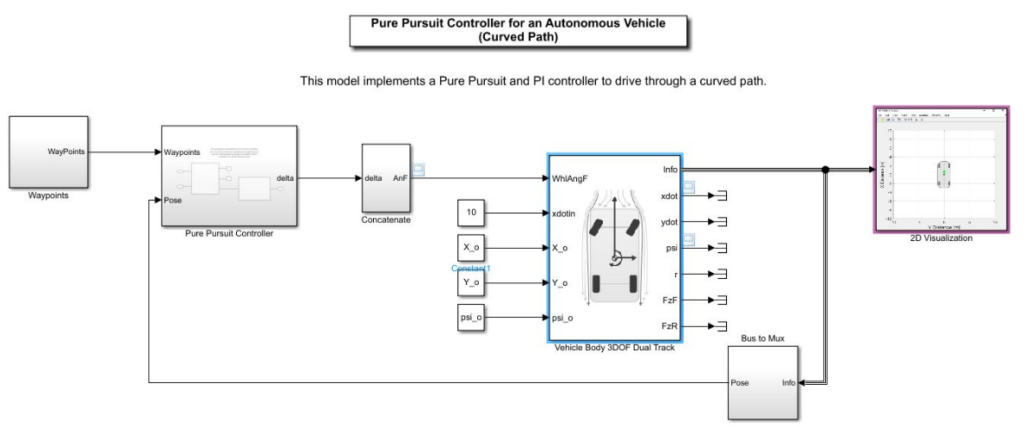
Autonomous Electronics Group
School of ECE
Functional Block Diagram: Pure Pursuit Method

Slide 16
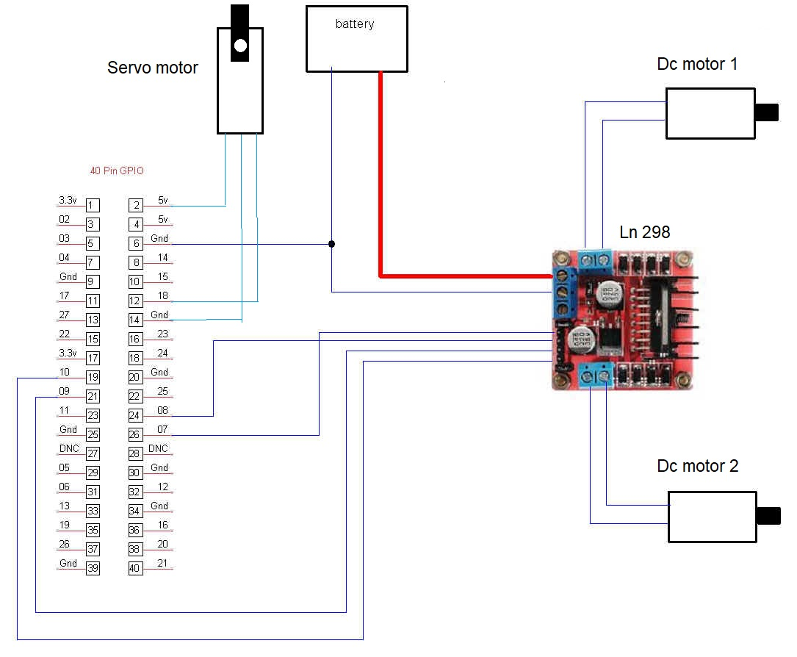
Autonomous Electronics Group
School of ECE
Pin Diagram:

Slide 17
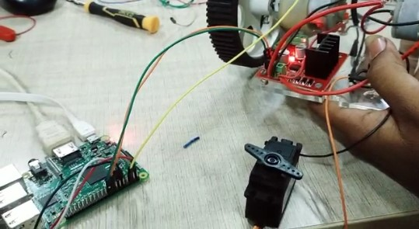
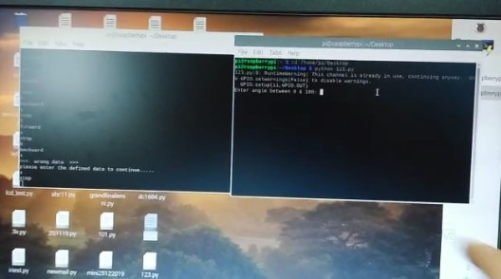
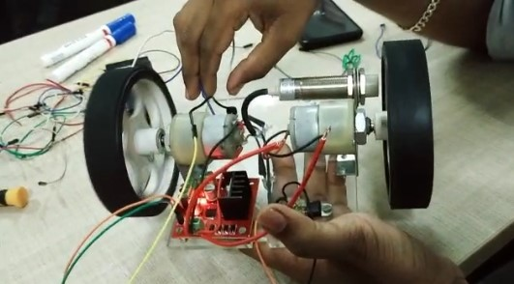
Autonomous Electronics Group
School of ECE
Implementation:
https://drive.google.com/file/d/1j7CtX7uU6QRW7ZYQGzbVFpWLq3kUz4hq/view?usp=drivesdk

Slide 18
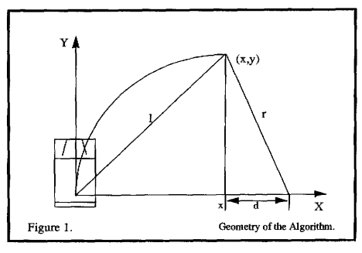
Autonomous Electronics Group
School of ECE
Mathematical Model:
The point (x , y), which is one look ahead distance 1 from the origin, is also shown. The point (x , y) is constrained to be on the path. The objective is to calculate the curvature of the arc that joins the origin to (x , y) and whose chord length is 1.

Slide 19
Autonomous Electronics Group
School of ECE
The following two equations hold. The first is from the geometry of the smaller right triangle in Figure 1. The second from the summing of line segments on the x axis.
x+y =I (2.1)
x+d = r (2.2)
Equation (2.1) describe the circle of radius 1 about the origin. This Is the locus of possible goal points for the vehicle.
Equation (2.2) describes the relationship between the radius of the arc that joins the origin and the goal point, and the x offset of the goal point from the vehicle. This equation simply states that the radius of the arc and the x offset are independent and differ by d.
The next series of equations relate the curvature of the arc to the look ahead distance. The algebra is straightforward and requires no further explanation.

Slide 20
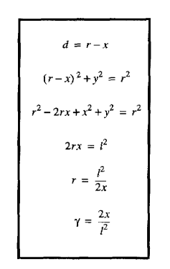
Autonomous Electronics Group
School of ECE
The curvature has been related to the x offset of the goal point from the origin by the inverse square of the look ahead distance 1. There is some similarity in form to a proportional controller where the gain is 2 times the inverse square of 1. However the “error” in this form is the x offset of a point ahead of the vehicle.

Slide 21
Autonomous Electronics Group
School of ECE
Algorithm:
The implementation of the pure pursuit algorithm itself is fairly straightforward. The pure pursuit algorithm can be outlined as follows:
*Determine the anent location of the vehicle.
*Find the path point closest to the vehicle.
* Find the goal point
* Transform the goal point to vehicle coordinates.
* Calculate the curvature and request the vehicle to set the steering to that curvature.
*Update the vehicle’s position.
1) Determine the current location of the vehicle. Both the HMMWV and NavLab have a central vehicle controller that provides functions which report the vehicle’s current position as (x,y,heading). The position is reported with respect to the vehicle’s position at initialization time. This original position is the global reference frame for the run.

Slide 22
Autonomous Electronics Group
School of ECE
2) Find the path point closest to the vehicle. In the geometric derivation it was stated that the goal point would be within one look ahead distance of the vehicle. It is possible that there are multiple points one look ahead distance from the vehicle’s current location. The vehicle should steer toward the closest point one look ahead distance from its current location. Therefore, the path point closest to the vehicle will first be found, and the search for a point 1 look ahead distance away from the vehicle will start at this point and commence up the path.
3) Find the goal point. The goal point is found by moving up the path and calculating the distance between that path point and the vehicle’s current location. Path point locations are recorded in the global frame; this calculation is done in global coordinates.
4) Transform the goal point to vehicle coordinates. Once the goal point has been found, it must be transformed to the vehicle’s local coordinates. The geometric derivation for the curvature was done in vehicle coordinates and curvature commands to the vehicle make sense in vehicle. coordinates.

Slide 23
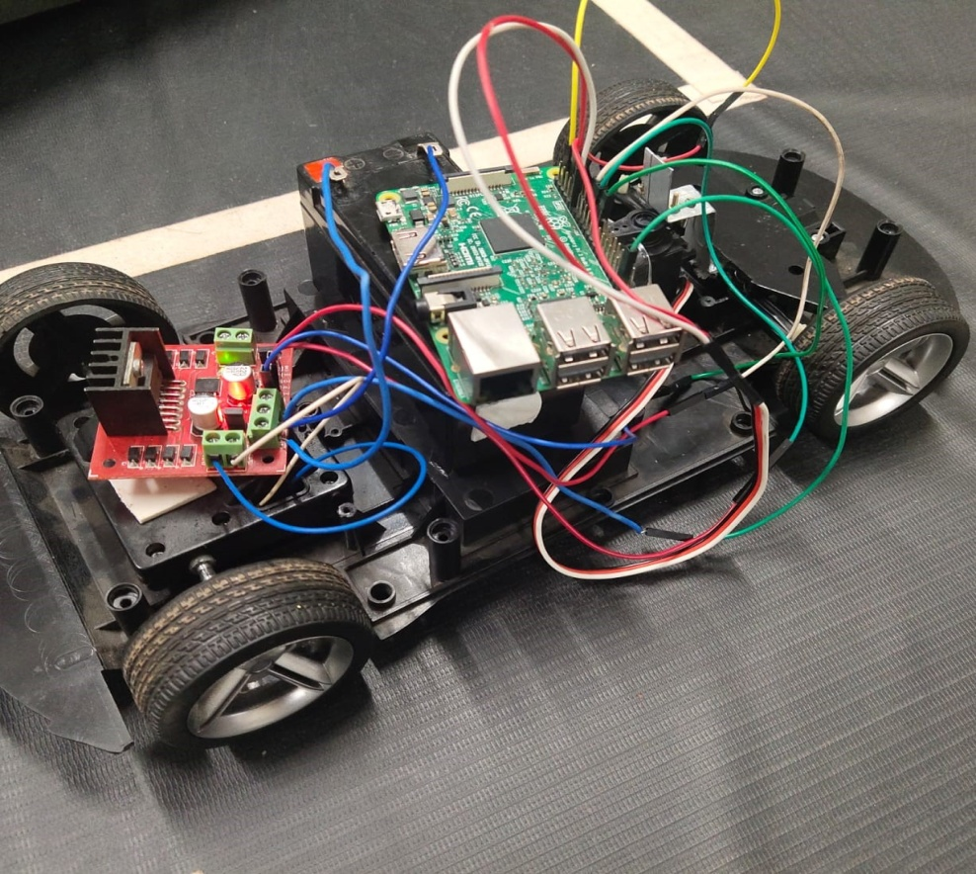
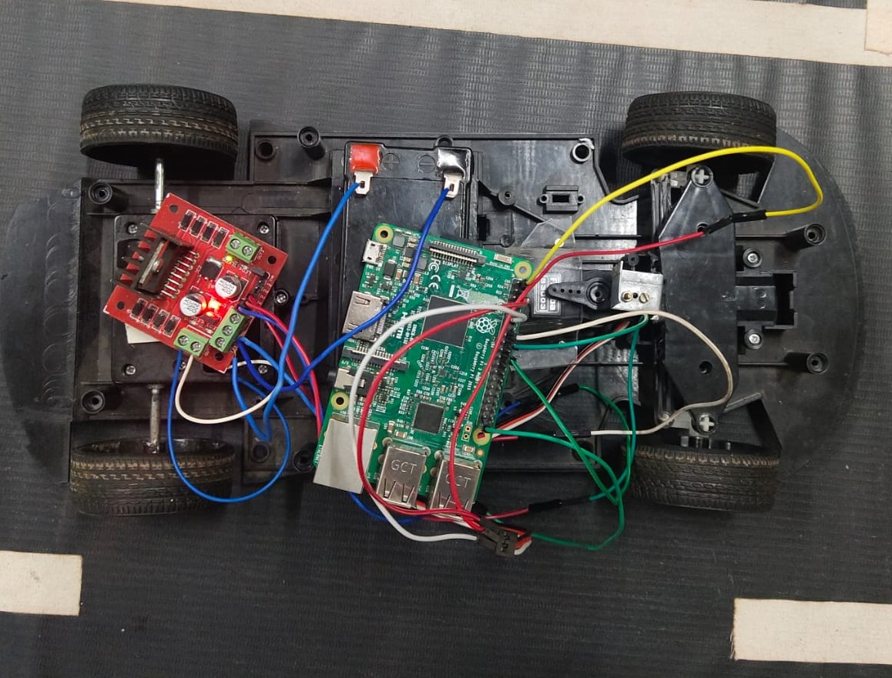
Autonomous Electronics Group
School of ECE
Final assembled prototype:

Slide 24
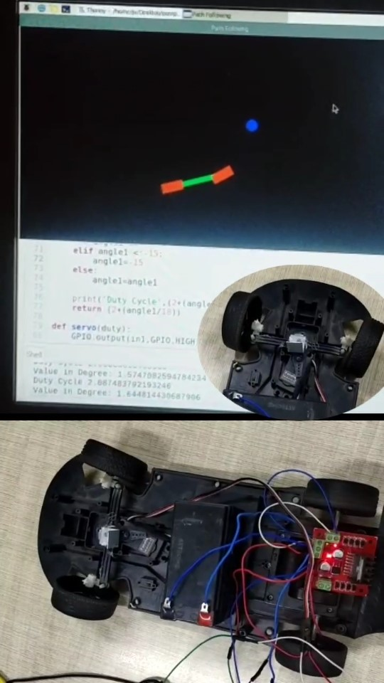
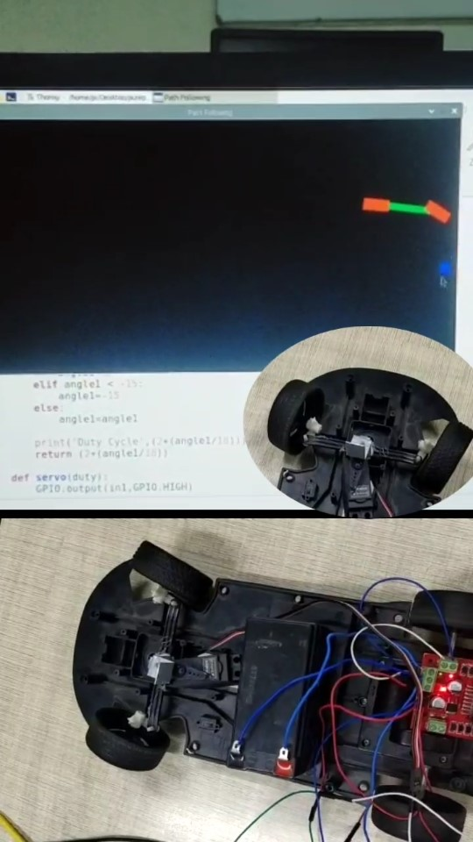
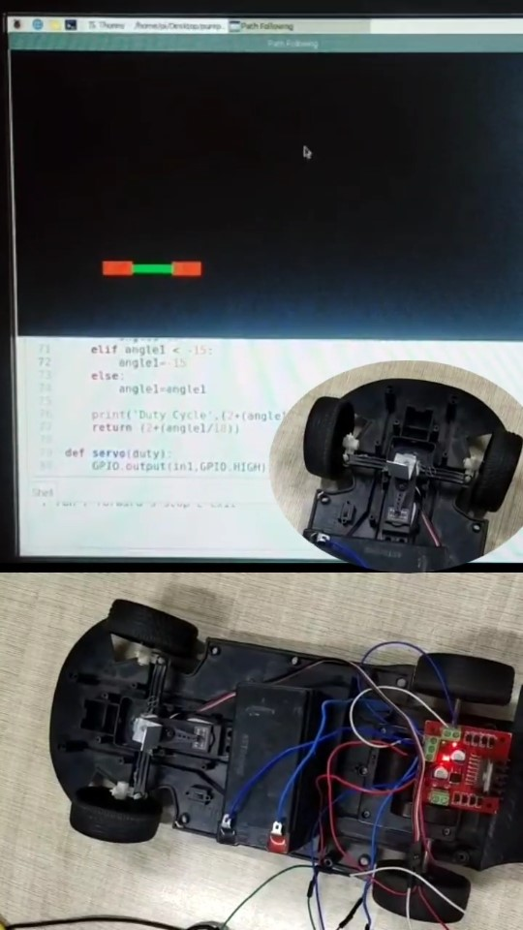
Autonomous Electronics Group
School of ECE
https://drive.google.com/file/d/1j4fE1jEzZJVoSCRygPEpQ63cOGQCgQjr/view?usp=drivesdk
Results:

