Slide 1
Pattern-Based DFA for Memory-Efficient and Scalable Multiple Regular Expression Matching
Minor Project – B.Tech (5th Semester)

Slide 2
Introduction
• Regular Expression Matching is widely used in security systems (e.g., Intrusion Detection, Firewalls).
• DFAs are fast but suffer from state explosion when handling multiple complex regexes.
• The research paper proposes Pattern-Based DFA (PB-DFA) for scalable and memory-efficient regex matching.

Slide 3
Problem Statement
• Need to match hundreds/thousands of regex patterns efficiently.
• Naïve DFA construction leads to exponential memory growth.
• Challenge: How to scale regex matching without huge memory costs?

Slide 4
Proposed Solution
• Assign a complexity score to each regex (based on operators, length, groups).
• Group regexes smartly before DFA construction:
– Naïve Grouping: fixed number of regexes per group.
– Greedy Grouping: keep adding until group score exceeds a threshold.
• Handle heavy regexes separately (overflow groups).

Slide 5
Implementation – Minor Project
• Dataset: 18 real-world regex patterns (Emails, URLs, IPs, SQLi, XSS, etc.).
• Complexity score function assigns weights based on regex structure.
• Grouping algorithms implemented in Python:
– Naïve grouping
– Greedy grouping
• Output: Comparison of groups, memory efficiency, visualization.

Slide 6
Results
• Naïve grouping ignores complexity → uneven memory usage.
• Greedy grouping respects complexity threshold → balanced groups.
• Overflow handled by placing heavy regex in its own group.
• Visualization: Bar chart comparing number of groups.

Slide 7
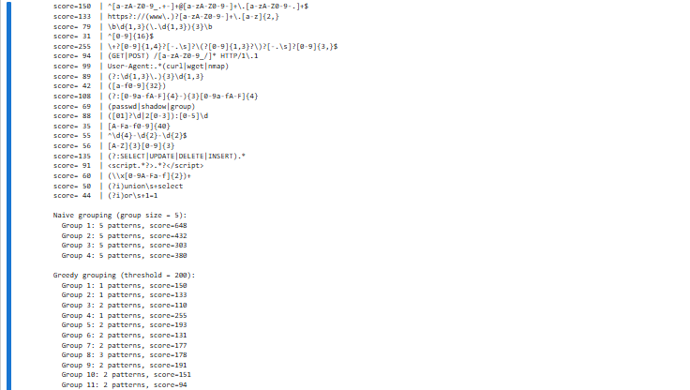

Slide 8
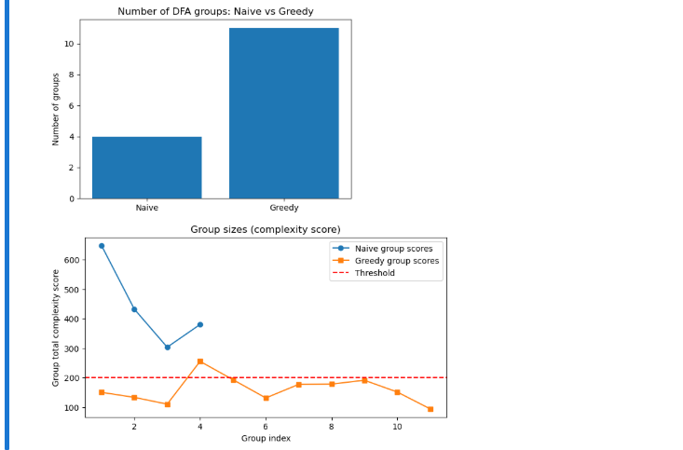

Slide 9
Conclusion
• PB-DFA approach reduces memory overhead while maintaining scalability.
• Greedy grouping is more efficient than naïve grouping.
• Project demonstrates simplified version of research idea.
• Future Work: Use real DFA state counts instead of heuristic scores.

Slide 10
References
1. Research Paper: 'Pattern-Based DFA for Memory-Efficient and Scalable Multiple Regular Expression Matching.'
2. Snort IDS Regex Rules (dataset inspiration).
3. Python Libraries: automata-lib, matplotlib, re.

Slide 11
Applied Concepts
In the Research Paper (PB-DFA)
  The paper proposes:
    Problem → DFA state explosion when combining many regexes.
    Pattern-Based DFA (PB-DFA) idea:
      Estimate regex complexity before DFA construction.
      Group regexes intelligently to balance memory vs speed.
      Handle very heavy regexes separately.
    Algorithms → Different grouping strategies for regexes.
    Evaluation → Compare memory usage and scalability vs traditional DFA/NFA approaches.
In our Project (Applied Concepts)
  We applied a simplified version of the same ideas:
    Dataset of Regexes
      Collected real-world regex patterns (emails, URLs, IPs, SQL injection, XSS, etc.)
      Inspired by Snort IDS rules.
    Complexity Estimation (Score Function)
      Instead of building full DFAs, we used a heuristic scoring function.
      Counts regex length, repetition, alternations, groups, etc. → gives a score (proxy for DFA size).
    Grouping Strategies
      Naïve grouping → fixed number of regexes per DFA.
      Greedy grouping → keep adding regexes until total score exceeds a threshold.
      Overflow handling → if a single regex score > threshold, it forms its own group.
    Visualization & Comparison
      Compared how many groups are formed by each method.
      Used bar chart to show difference in memory efficiency.

