Slide 1
What is Cloud Computing
It is the use of remote servers on the internet to store, manage and process data rather than a local server or personal computer. There are basically 3 categories in cloud computing
1.SAAS
2.PAAS
3.IAAS

Slide 2
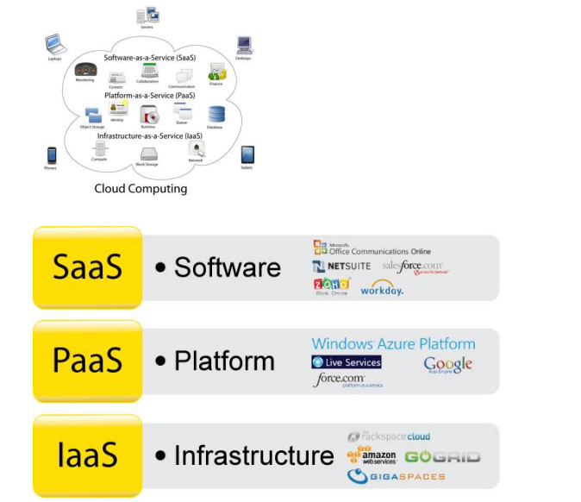

Slide 3
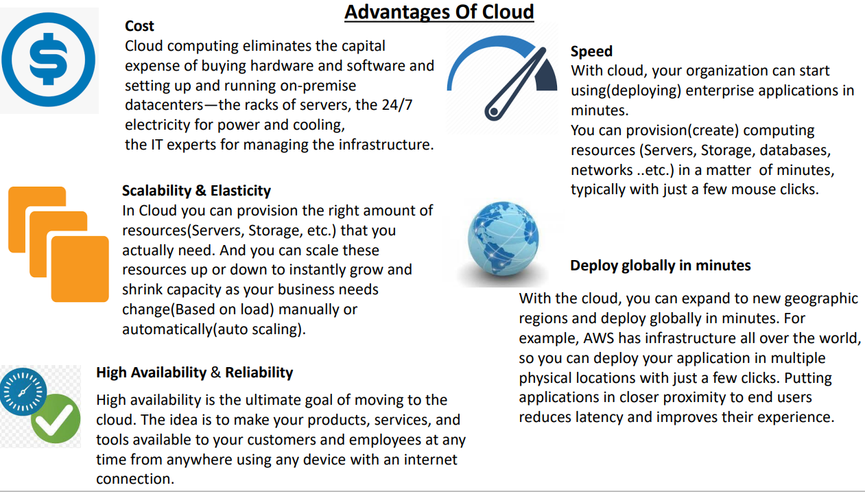

Slide 4
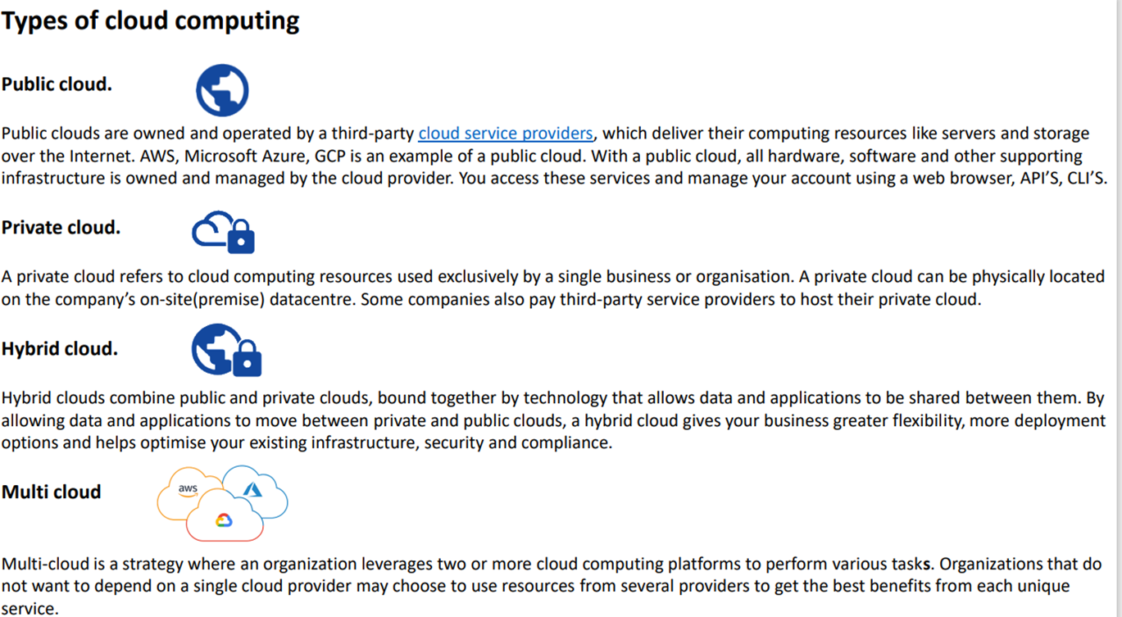

Slide 5
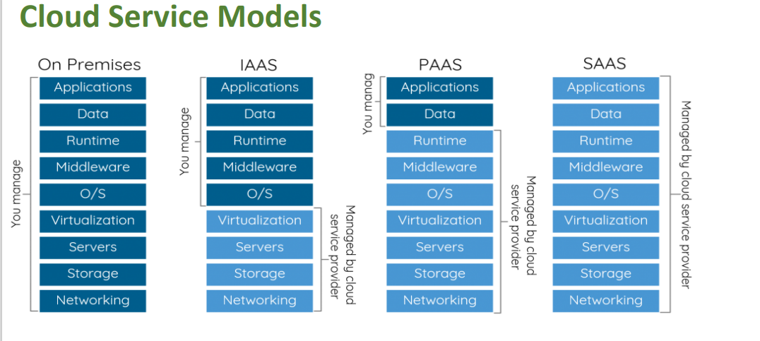

Slide 6
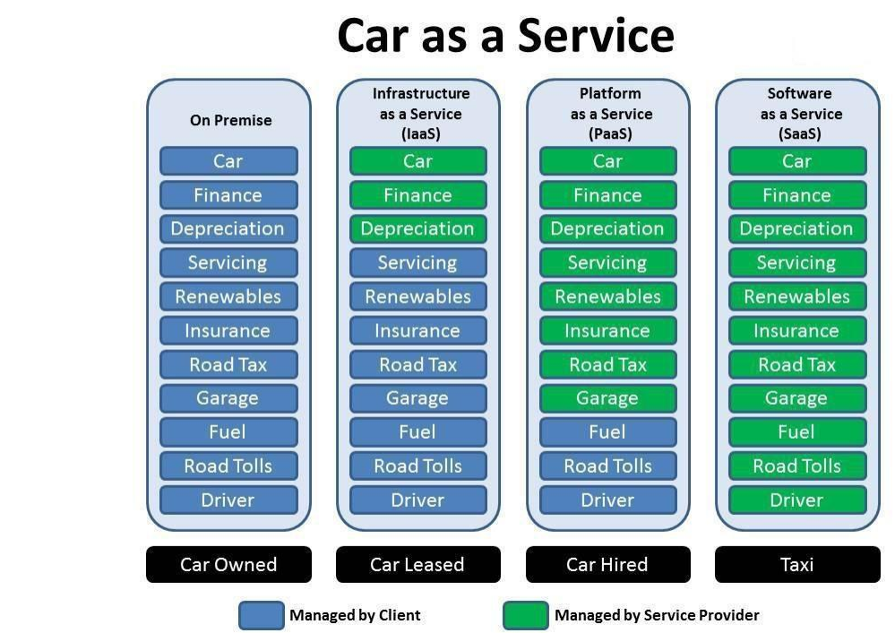

Slide 7
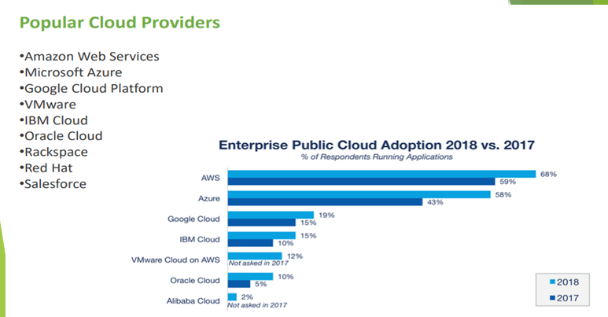

Slide 8
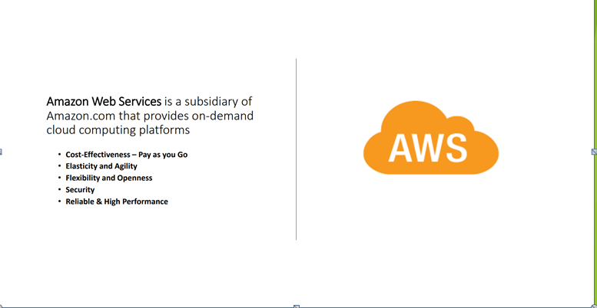

Slide 9
Uses of AWS
A small manufacturing organization uses their expertise to expand their business by leaving their IT management to the AWS.
A large enterprise spread across the globe can utilize the AWS to deliver the training to the distributed workforce.
An architecture consulting company can use AWS to get the high-compute rendering of construction prototype.
A media company can use the AWS to provide different types of content such as ebox or audio files to the worldwide files.

Slide 10
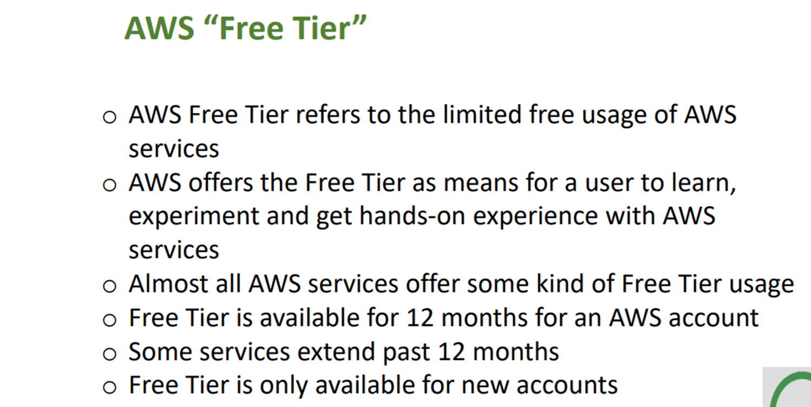

Slide 11
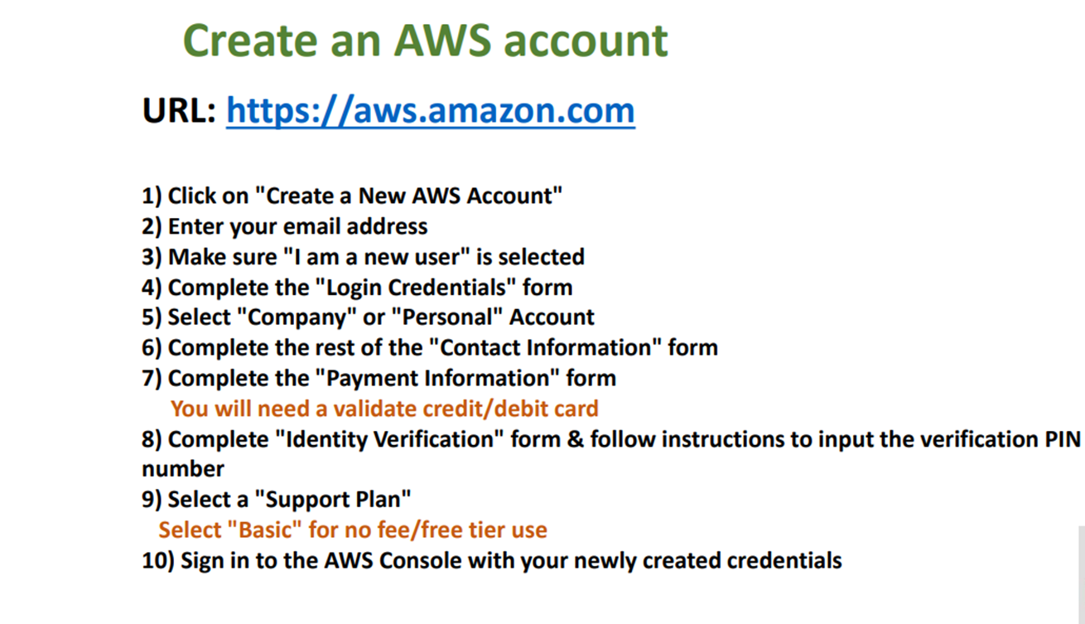

Slide 12
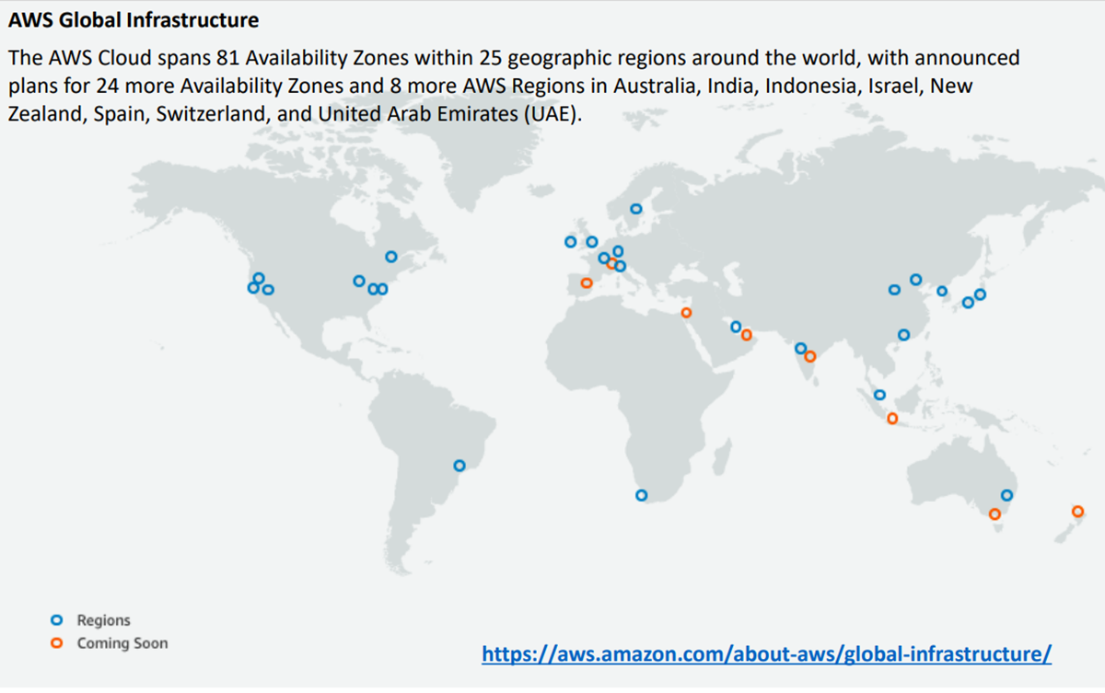

Slide 13
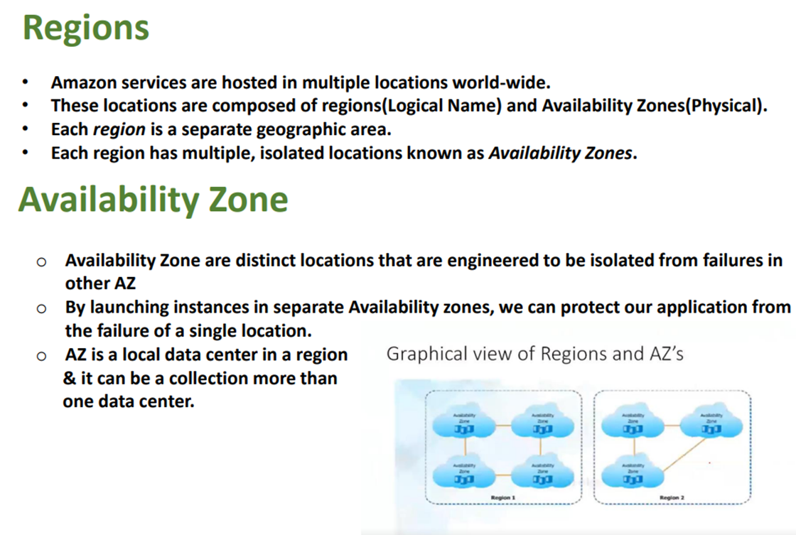

Slide 14
AWS SERVICES
EC2 — Elastic Cloud Computing
IAM — Identity and Access Management
VPC—Virtual Private Cloud
EBS—Elastic Block Storage
Rds — Relational Database Service
S3 — Simple Storage Service
Ecr — Elastic Container Registry
EKS--Elastic Kubernetes Service
CLOUD WATCH etc…

Slide 15
EC2
EC2 stands for Amazon Elastic Compute Cloud.
It is a web service which provides re-sizable compute capacity in the cloud.
It is designed to make the web scale computing easier for developers

Slide 16
AWS EC2 offers 5 types of instances
General Instances
Compute Instances
For applications that require a balance of performance and cost.
▪ E.g email responding systems, where you need a prompt response as well as the it should be cost effective, since it doesn’t require much processing.
t2
m4
m3
For applications that require a lot of processing from the CPU.
▪ E.g analysis of data from a stream of data, like Twitter stream
C4
C3

Slide 17
Memory Instances
Storage Instances
For applications that are heavy in nature, therefore, require a lot of RAM.
▪ E.g when your system needs a lot of applications running in the background i.e
multitasking.
R3
x1
For applications that are huge in size or have a data set that occupies a lot of space.
▪ E.g When your application is of huge size.
I2
d2

Slide 18
GPU Instances
For applications that require some heavy graphics rendering.
E.g 3D modelling etc..
G2

Slide 19
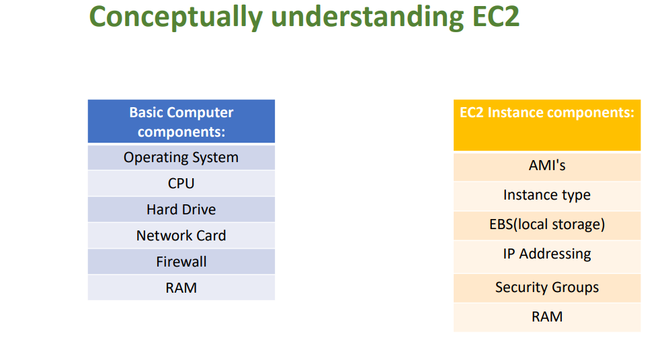

Slide 20
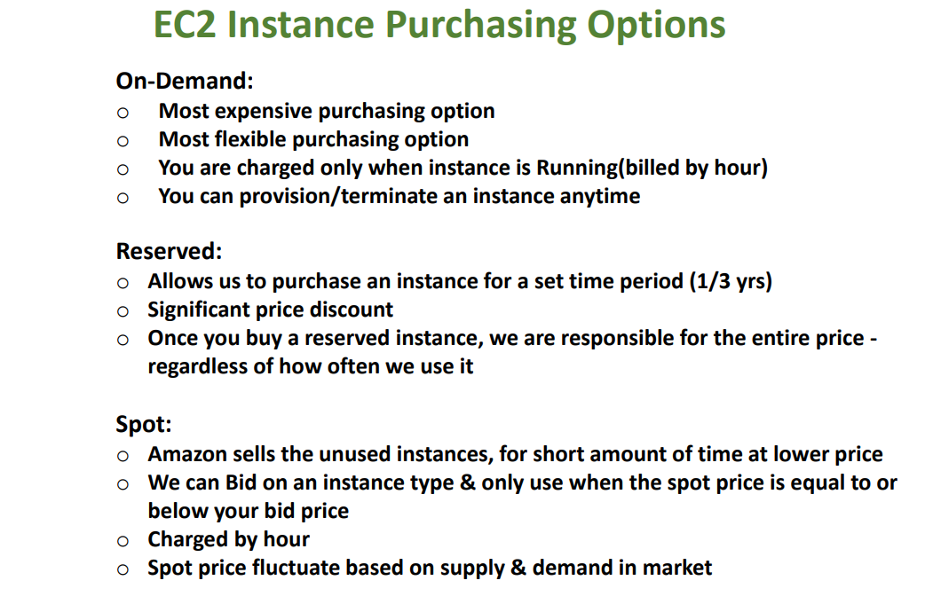

Slide 21
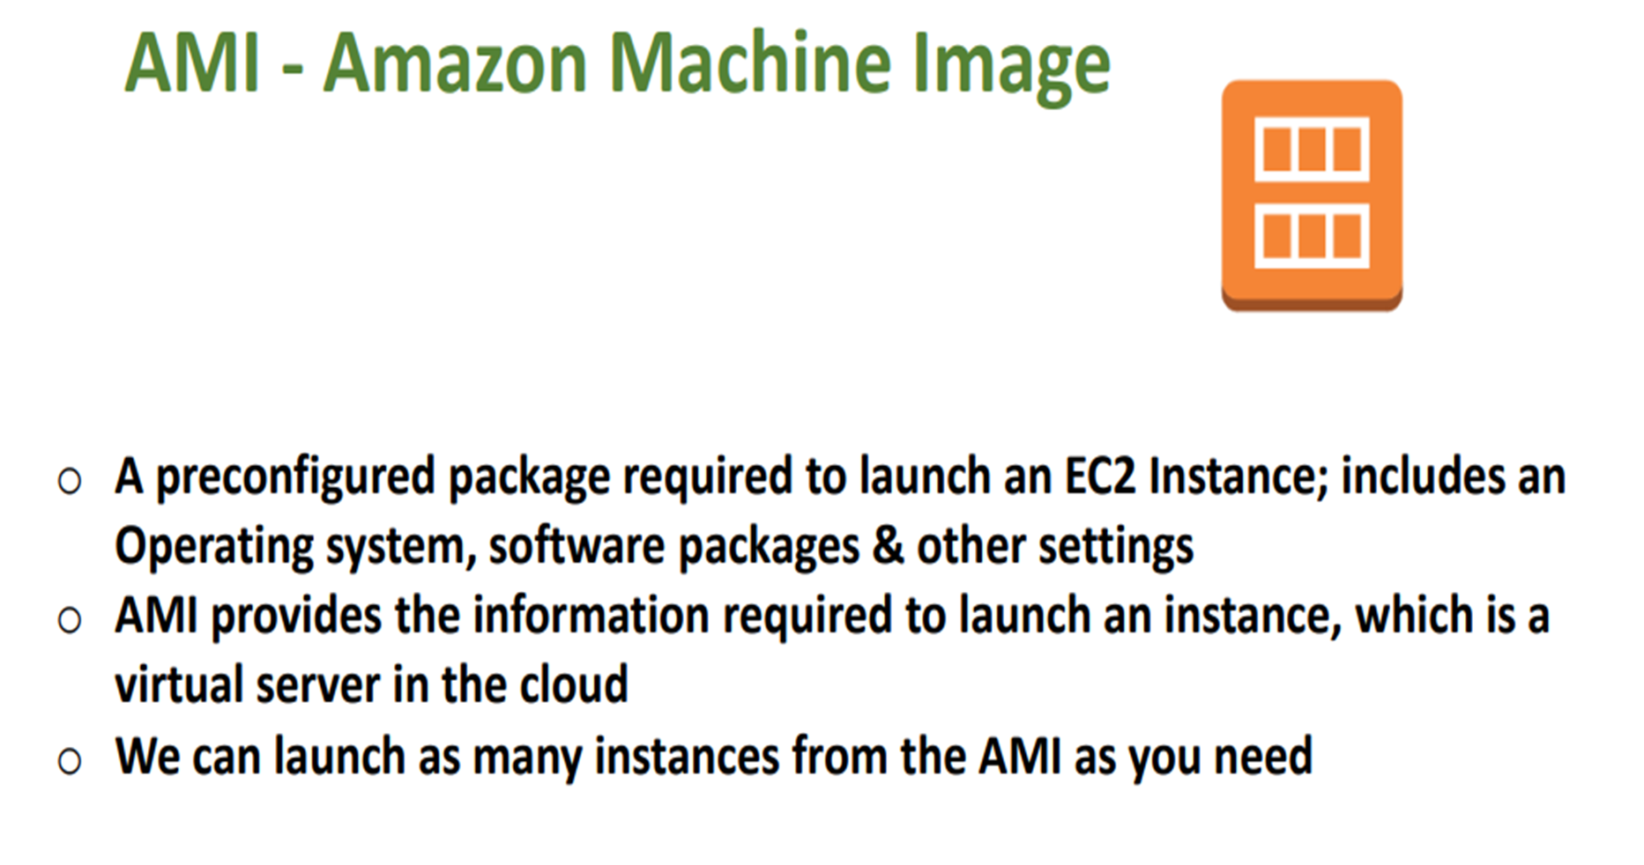

Slide 22
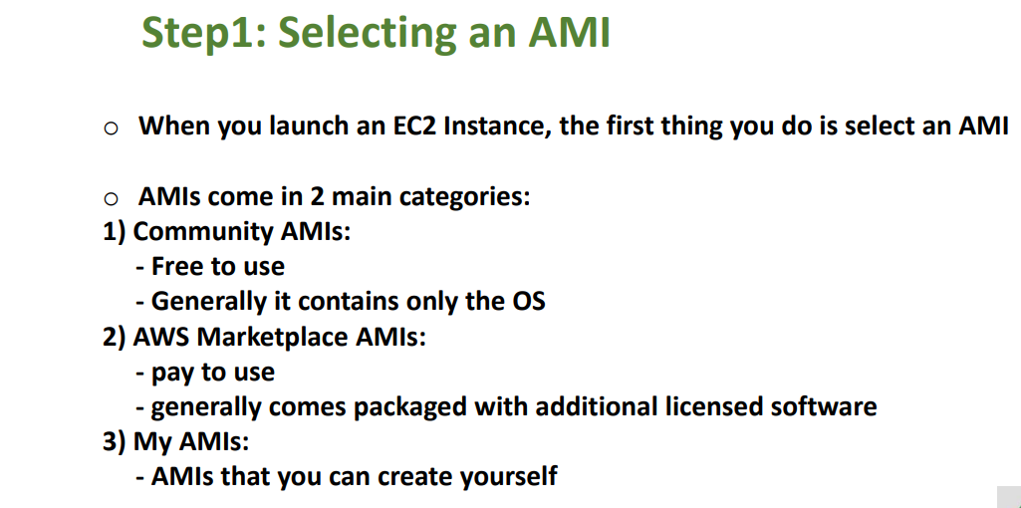

Slide 23
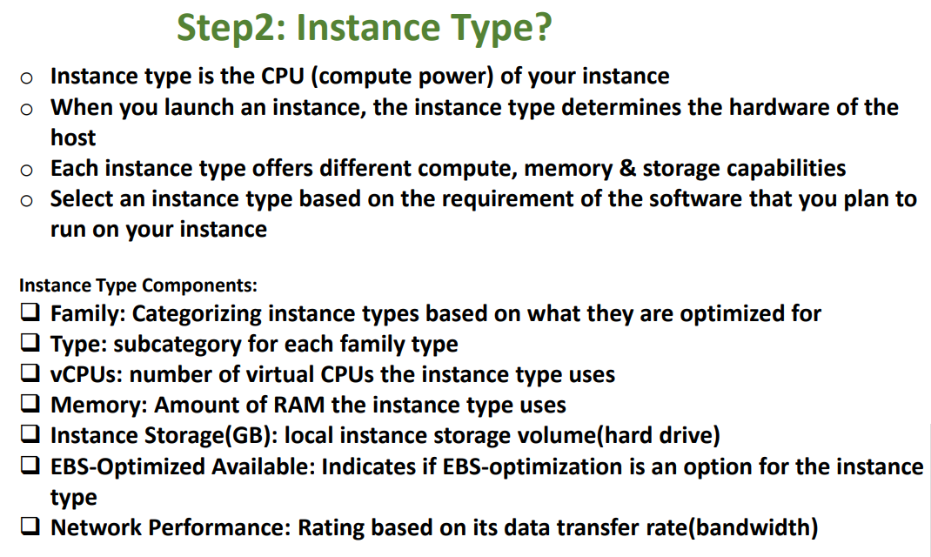

Slide 24
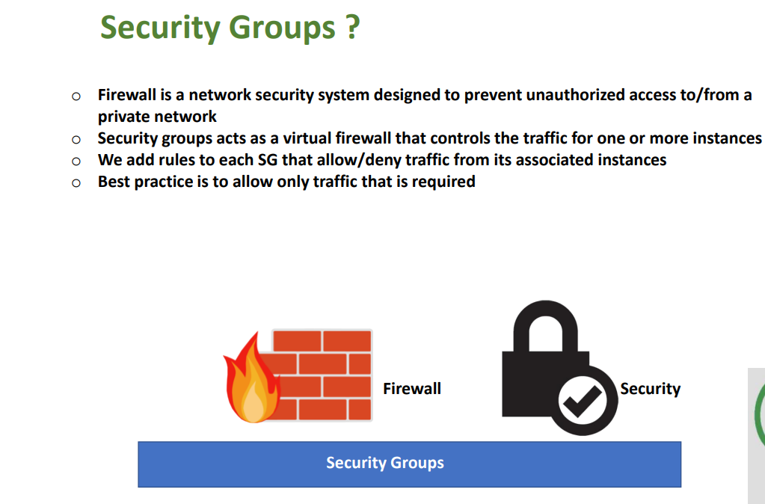

Slide 25
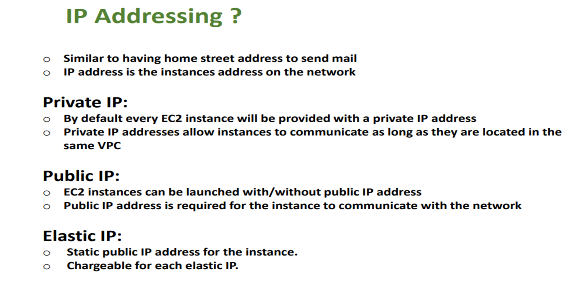

Slide 26
