Slide 1
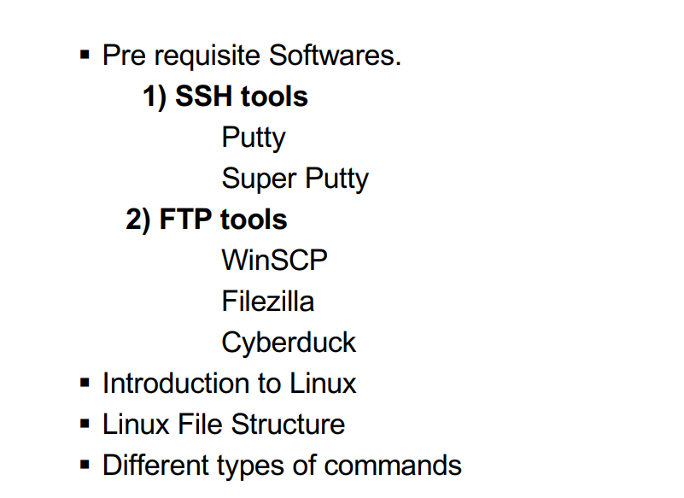
Linux

Slide 2
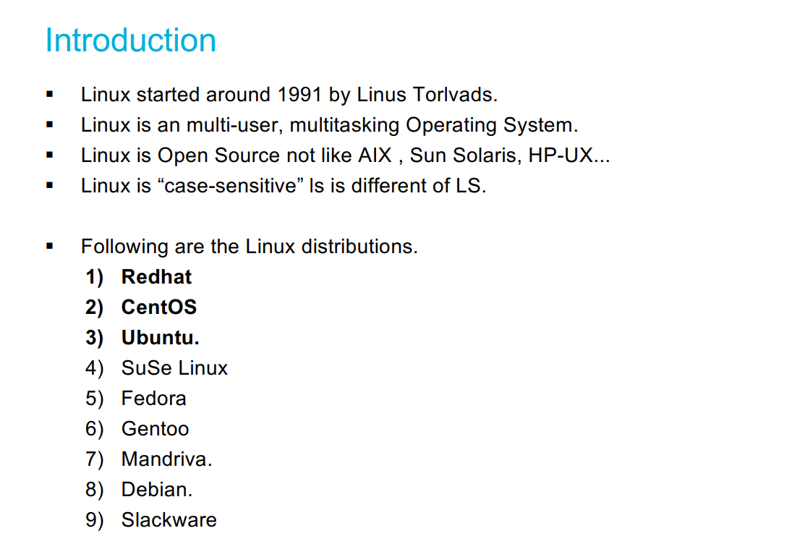
Linux

Slide 3
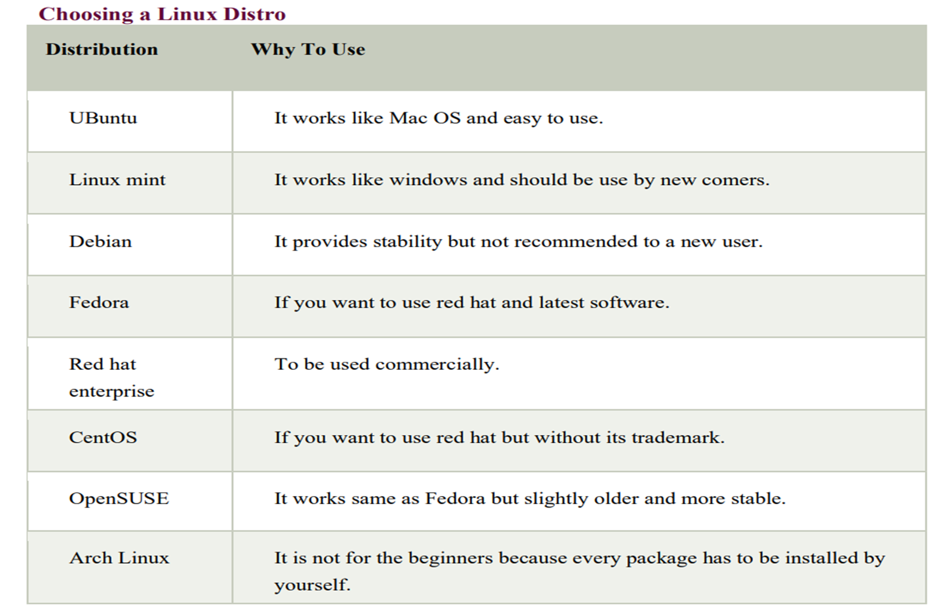

Slide 4
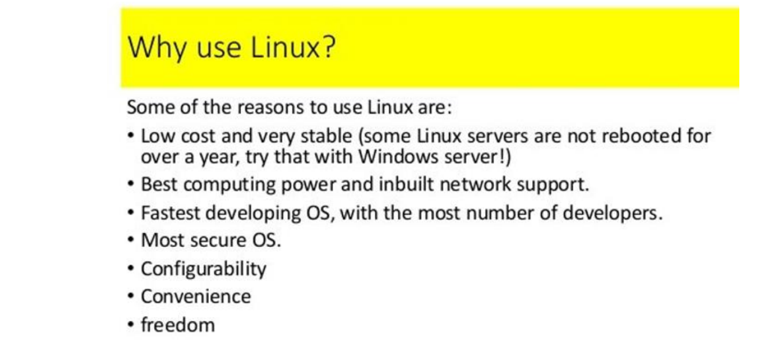

Slide 5
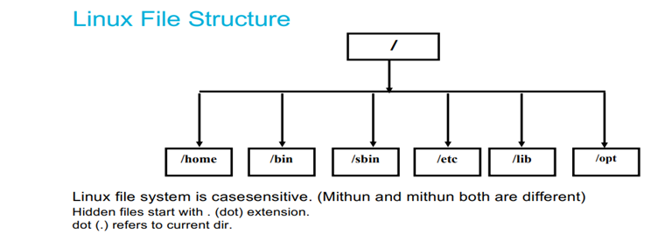

Slide 6
Linux File System
In linux everything is a file
Linux do not contain physical hard drive like windows
Linux has a logical hierarchical file structure
Linux is case sensitive
/ is the Root directory
Hidden files start with (.)dot extension
Dot(.) refers to current directory

Slide 7
1)/bin - In this binaries folder we are having commands
2)/opt - If we download 3rd party s/w in linux that will store in this optional folder
3)/boot - whenever you on the system, booting data present. So that boot code will present in this folder
4)/root - Root user data present
5)/dev - device folder - External devices info stored here
6)/home - Every user data stored here

Slide 8
7)/tmp - we can store the temporary data
8)/usr - In linux kernel info and system binaries info present in user folder
9)/lib - shareable files present in libraries folder
10)/sbin - system binaries -extra commands present when we compared to bin
11)/mnt - mount - If we put pendrive, usb from external that data is coming into this directory
12)/var - In this variable folder, all logs stored.

