Slide 1

Image Feature Extraction and Classification Deep Learning (22AIE304)
Team – 3 G.SRIMAAN - CH.SC.U4AIE23015 N. BHARGAV – CH.SC.U4AIE23037 M. RAJ DHANUSH – CH.SC.U4AIE23064

Slide 2
Objectives
To compare handcrafted (traditional) and deep learning-based feature extraction techniques for plant disease classification.
To analyze the impact of different classifiers (Logistic Regression, KNN, Decision Tree, Random Forest) when combined with extracted features.
To evaluate model performance using both standard metrics (Accuracy, Precision, Recall, F1-score) and advanced metrics (Cohen’s Kappa, Confusion Matrix).
To investigate robustness of models under noisy and augmented image inputs.
To identify the trade-offs between traditional and deep learning features in terms of accuracy, computation time, and generalization ability.

Slide 3
Why Feature Extraction Matters?
Raw pixels are high-dimensional and sensitive to noise, illumination, scale, and orientation.
Feature extraction transforms images into compact and discriminative representations.
Benefits
Reduces computation compared to raw pixels.
Provides invariance to scale, rotation, and lighting.
Enhances classifier performance by focusing on salient patterns.
Offers interpretability (handcrafted features are explainable).
Acts as a bridge between low-level pixel data and high-level decision-making.
raw image → features → classifier → output

Slide 4
Conventional Feature Extraction Methods
Histogram of Oriented Gradients (HOG): HOG is a feature extraction technique that captures the structural shape of objects by computing histograms of gradient orientations. It is widely applied in tasks such as pedestrian and vehicle detection due to its robustness in representing object contours.
Local Binary Patterns (LBP): LBP encodes local texture information by thresholding pixel neighborhoods into binary patterns. This method is particularly effective in face recognition, texture classification, and surface inspection tasks.
Edge Detection: Edge detection techniques identify object boundaries by highlighting regions of rapid intensity change. These methods are extensively used in image segmentation, medical imaging, and object boundary analysis.

Slide 5
Deep Learning Feature Extraction
ResNet50 ResNet50 is a deep convolutional neural network that introduces residual connections to overcome the vanishing gradient problem. It efficiently captures hierarchical features, making it highly effective for large-scale image classification, object detection, and transfer learning tasks.
VGG16 VGG16 is a deep neural network characterized by its uniform use of small 3×33×3 convolution filters across 16 layers. It emphasizes texture and structural representation, and is widely applied in image classification, style transfer, and feature extraction due to its simplicity and effectiveness.
MobileNetV2 MobileNetV2 is a lightweight convolutional architecture designed for efficiency on mobile and edge devices. By employing depthwise separable convolutions and inverted residual blocks, it achieves competitive accuracy while reducing computational cost, making it suitable for real-time applications.

Slide 6
Applications of Feature Extraction
Agriculture and Plant Disease Detection
Traditional features (HOG, LBP, Edge) can be applied for identifying leaf texture patterns, disease spots, and structural deformations in crops.
CNN-based deep features (MobileNetV2, VGG16, ResNet50) provide robust and discriminative representations, enabling highly accurate classification of diseases across diverse plant species.
These techniques support early disease detection and intervention, helping farmers reduce crop losses and improve agricultural productivity.
Autonomous Driving
HOG and CNN features support pedestrian and vehicle detection.
Edge detection techniques assist in accurate lane marking recognition.

Slide 7
Dataset Used
Dataset – Plant Village
Total samples: 54,000 leaf images.
Classes: 38 (healthy + diseased states across 14 crop species).
Diseases covered: Apple Scab, Black Rot, Corn Rust, Tomato Early/Late Blight, Bacterial Spot, Powdery Mildew, Leaf Mold, etc.
Conditions: Captured in controlled lab setups (uniform background, clear visibility).
Justification:
Plant-Village dataset is large-scale (54,000 images) and diverse, covering 38 classes across 14 crops. It provides clear and well-labeled samples of both healthy and diseased leaves. The dataset is widely used and benchmarked, ensuring reliable comparison. Its controlled imaging conditions make it ideal for testing feature extraction and classification methods.

Slide 8
Experimental Setup
1. Preprocessing (Traditional Models)
Image Reading: All images loaded from Plant-Village dataset folders (.png, .jpg, .jpeg).
Resizing: Every image resized to 128 × 128 pixels for uniform input size.
Normalization: Converted to float32 and pixel values scaled to [0,1].
Feature-specific preprocessing (via feature_generator()):
HOG: Gradient orientation histograms extracted from image.
LBP: Local Binary Patterns computed (P=8, R=1, uniform method) → histogram of codes.
Edge: Canny edge detector applied (thresholds 100–200), histogram of edge intensities computed.

Slide 9
Experimental Setup
2. Preprocessing in Deep Learning Models
Image Size: All images resized to 128×128 pixels.
Normalization: Pixel values rescaled to the range [0,1] using ImageDataGenerator(rescale=1./255).
Directory-based loading: Training images from PlantVillage/train/, Validation images from PlantVillage/val/
Batching: Mini-batches of size 32 created for efficient GPU training.
Class Labels: Auto-encoded from folder structure (class_mode='sparse').
Augmentation (optional): ImageDataGenerator can add noise/variations, though here mostly rescaling was used.

Slide 10
Experimental Setup
Classifiers used
Logistic Regression
K-Nearest Neighbors
Decision Tree
Random Forest
Evaluation Metrics
Standard: Accuracy, Precision, Recall, F1-score
Advanced: Cohen’s Kappa, Confusion Matrix analysis
Class-wise evaluation for detailed disease-level performance
Robustness Test
Assessed stability of both traditional features (HOG, LBP, Edge) and deep CNN features (ResNet50, VGG16, MobileNetV2)

Slide 11
Results: Traditonal Model Features
Results: Accuracy and Classifier Trends (Traditional Features)
HOG + Logistic Regression: Achieved the highest accuracy (~64.7%).
HOG + KNN: Moderate (~52%), below Logistic Regression.
HOG + Decision Tree: Weak (~24%).
HOG + SVM: Around ~41.7% accuracy.
Edge-based features: Performed poorly, up to ~27% with SVM.
LBP: Lowest, ~23% with SVM
Classifier ranking: Logistic Regression > SVM > KNN > Decision Tree.

Slide 12
Results: Traditonal Model Features
HOG + Logistic Regression: Moderate baseline (~64.7%), but accuracy dropped sharply under noise, highlighting high sensitivity to pixel distortions.
LBP-based features: Already weak (~23–41%), further degraded under noise; texture information was easily disrupted.
Edge-based features: Performed poorest (<27%), and noise completely distorted edge maps, making features unreliable.
Observation
Traditional handcrafted features are highly noise-sensitive, as they rely on raw pixel intensities and local neighborhood comparisons.
Noisy conditions caused severe performance degradation, with classifiers unable to generalize.
Confirms that handcrafted methods, while interpretable and lightweight, lack robustness compared to deep learning features.

Slide 13
Results: Deep Learning Model Features
MobileNetV2 + Logistic Regression: Achieved the highest accuracy (~94.8%), F1 = 0.95, Kappa = 0.945.
VGG16 + Logistic Regression: Strong performance (~91.5%), F1 = 0.91, Kappa = 0.911.
ResNet50 + Logistic Regression: Moderate (~54–55%), underperformed without fine-tuning.
MobileNetV2 + KNN: Solid (~90.5%) but slightly weaker than Logistic Regression.
VGG16 + KNN / Random Forest: Good (~85–86%), less stable than LR.
Decision Trees (all models): Weakest, ~55–58% accuracy with poor generalization.
Classifier ranking: Logistic Regression > KNN > Random Forest > Decision Tree.

Slide 14
Results: Deep Learning Model Features
MobileNetV2 + Logistic Regression: Most robust; accuracy drop from 94.8% → ~89% under Gaussian noise.
VGG16 + Logistic Regression: Accuracy dropped more significantly (91.5% → ~76%), showing higher sensitivity to noise.
ResNet50 + Logistic Regression: Already lower baseline (~54–55%), further reduced under noise, indicating poor adaptability.
Observation:
Deep CNN features degrade gracefully under noise, unlike handcrafted methods which collapse in performance.
MobileNetV2 shows the best balance of accuracy + robustness, making it suitable for real-world deployment.
VGG16 remains strong but is computationally expensive and less stable under perturbations.

Slide 15
Comparative Analysis of Traditional Models
Feature | Kappa | F1 | Accuracy | Classifier
HOG | 0.628844 | 0.64455 | 0.64681 | LogisticRegression
HOG | 0.493746 | 0.511239 | 0.519381 | KNN
HOG | 0.20114 | 0.238777 | 0.238284 | Decision Tree
HOG | 0.440218 | 0.40538 | 0.479606 | Random Forest
LBP | 0.145584 | 0.121607 | 0.227327 | LogisticRegression
LBP | 0.32258 | 0.347017 | 0.357518 | KNN
LBP | 0.234918 | 0.271308 | 0.270693 | DecisionTree
LBP | 0.376457 | 0.377102 | 0.41405 | Random Forest
Edge | 0.088398 | 0.070067 | 0.17549 | LogisticRegression
Edge | 0.084629 | 0.09707 | 0.142344 | KNN
Edge | 0.088119 | 0.116805 | 0.145659 | Decision Tree
Edge | 0.092425 | 0.121167 | 0.153485 | Random Forest
Table 1. Comparison of Feature Extraction Methods with Classifiers

Slide 16
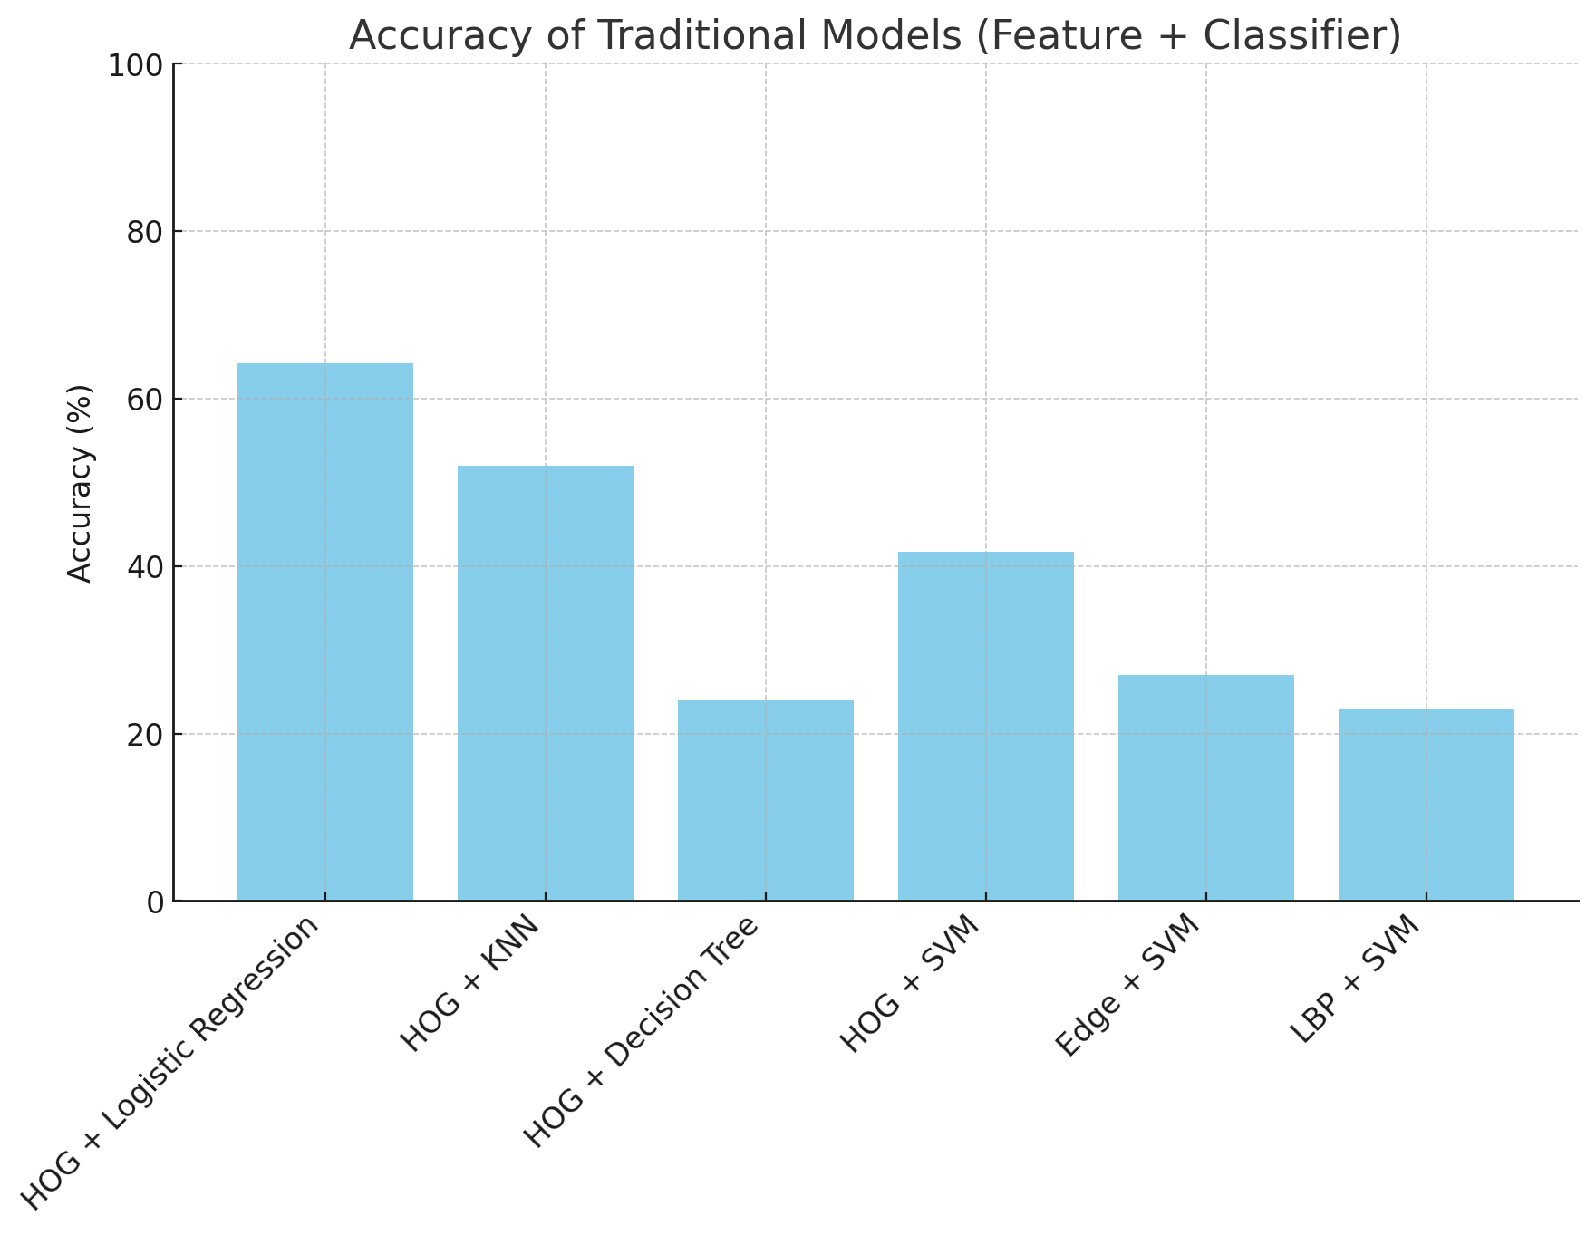
Comparative Analysis of Traditional Models
Fig.1. Comparative Analysis of Traditional Models
Traditional Models
Best performance: HOG + Logistic Regression (~64% accuracy).
Moderate: HOG + KNN (~52%), HOG + SVM (~41%).
Weakest: HOG + Decision Tree (~24%), Edge (~27%), LBP (~23%).

Slide 17
Comparative Analysis of Deep Learning Models
Feature-(CNN Backbone) | Classifier | Accuracy | F1 | Kappa
MobileNetV2 | Logistic Regression | 94.8% | 0.95 | 0.945
VGG16 | Logistic Regression | 91.5% | 0.91 | 0.911
ResNet50 | Logistic Regression | 54-55% | 0.51 | 0.51
Table 2. Comparision of Feature Extraction methods in Deep Learning Models

Slide 18
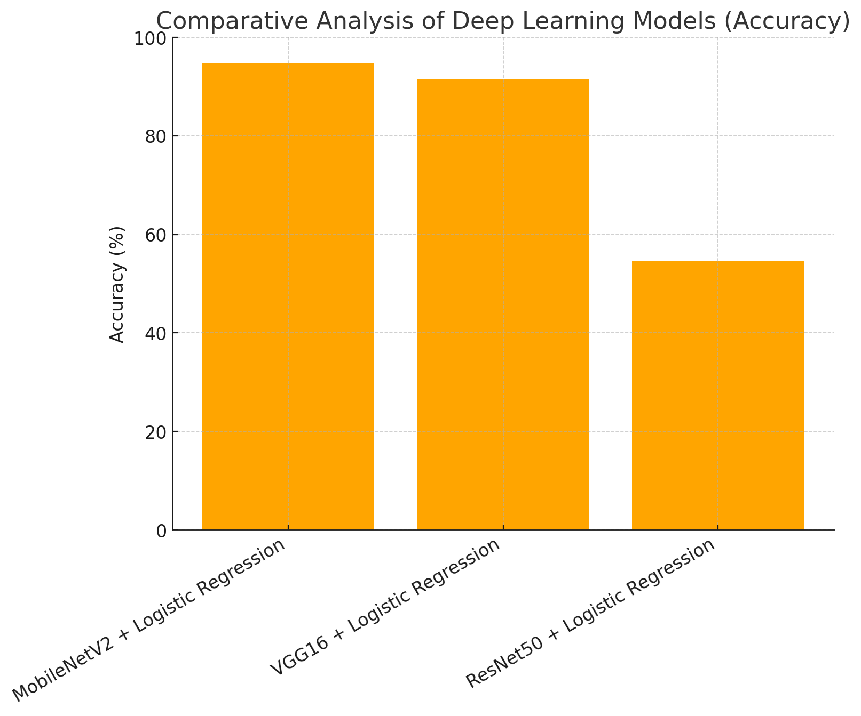
Comparative Analysis of Deep Learning Models
Fig.2. Comparative Analysis of Deep Learning Models
Deep Learning Models
Best performance: MobileNetV2 + Logistic Regression (~94.8% accuracy).
Strong: VGG16 + Logistic Regression (~91.5%).
Moderate: ResNet50 + Logistic Regression (~54–55%)

Slide 19
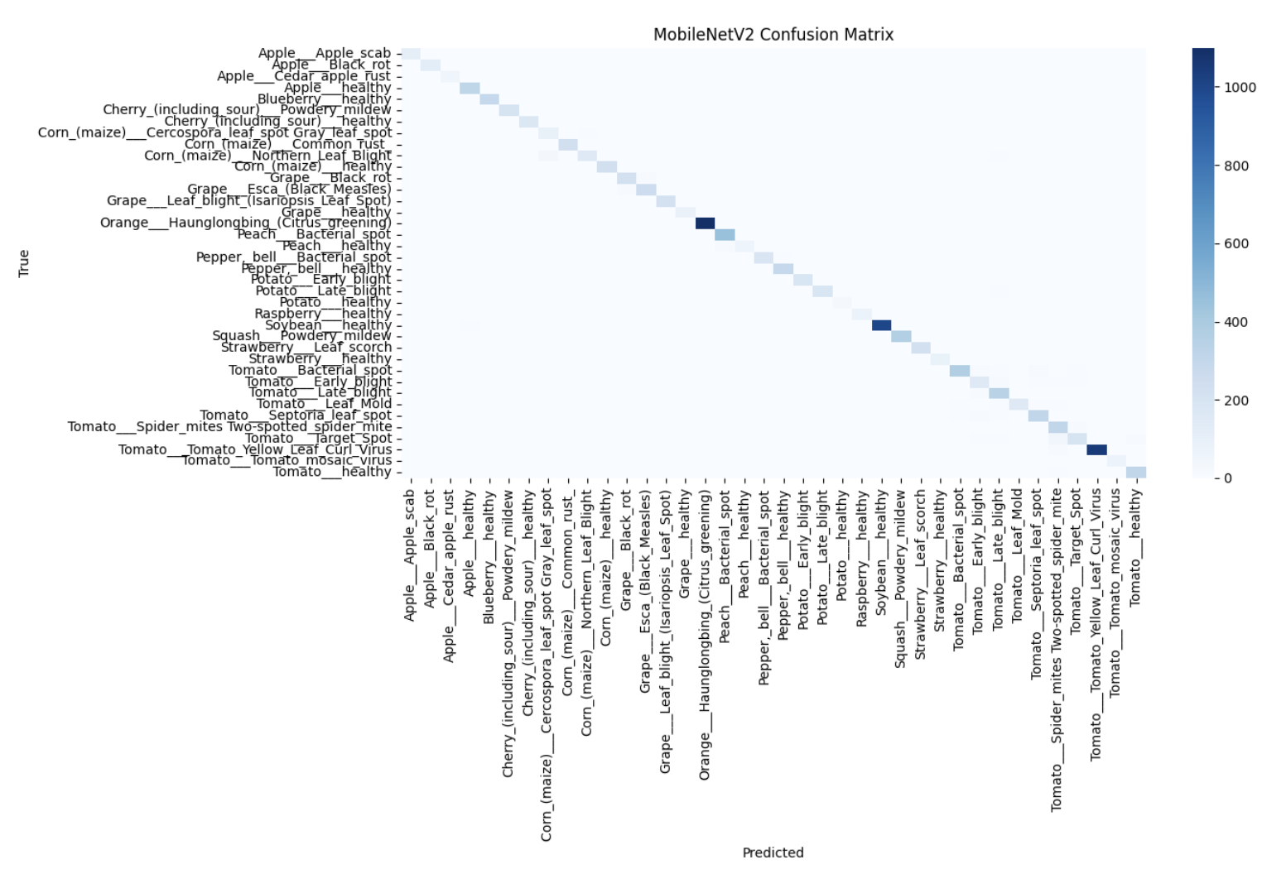
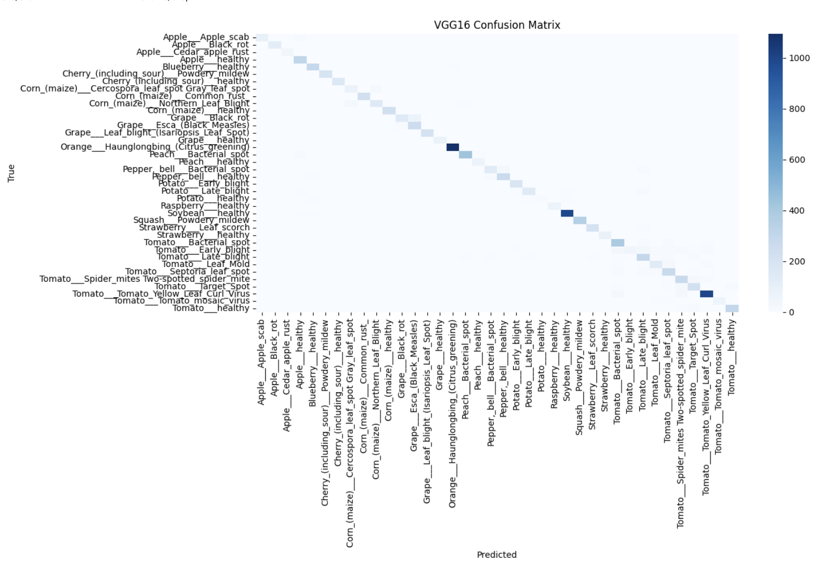
Best performing in Deep Learning Models (Accuracy)
Fig.1.MobileNetV2
Fig.2.VGG16
Best Model – MobileNetV2 + Logistic Regression: Achieved 94.8% accuracy, F1-score 0.95, and Cohen’s Kappa 0.945, with minimal misclassifications, proving highly robust and efficient.
Second Best – VGG16 + Logistic Regression: Achieved 91.5% accuracy, strong generalization, but slightly more misclassifications due to fine-grained similarities.
Key Insight: Deep features (MobileNetV2, VGG16) paired with Logistic Regression significantly outperformed handcrafted features, proving deep representations are critical for plant disease classification.

Slide 20
References:
S. Pal, et al., “Machine Learning Based Pattern Recognition with HOG Features for Detection of Islanding,” in Proc. IEEE ICEPES, 2024.
S. Pal, et al., “Decision Tree Based Method for Detecting Islanding using Pattern Recognition with HOG Features,” in Proc. ICWITE, 2024.
S. Pal, et al., “Detecting Islanding by Ensemble Classifier for Pattern Recognition Using HOG Features,” in Proc. ICPEICES, 2024.
M. Heikkilä, T. Ahonen, T. Pietikäinen, and C. Schmid, “Description of Interest Regions with Local Binary Patterns,” Pattern Recognition, vol. 42, no. 3, pp. 425–436, 2009, doi: 10.1016/j.patcog.2008.08.014.
N. Karis and A. Abdul Razif, “Local Binary Pattern (LBP) with Application to Variant Object Detection: A Survey and Method,” in Proc. CSPA, 2016.
D. Maksimović, et al., “Comparative Analysis of Edge Detection Operators Using a Threshold Estimation Approach on Medical Noisy Images with Different Complexities,” Sensors, vol. 25, no. 1, 2025, doi: 10.3390/s25010087.
M. Batista, et al., “Machine Learning Algorithm Partially Reconfigured on FPGA for Real-Time Image Processing,” Journal of Navigation, Engineering & Space Technologies (JNLest), 2024, doi: 10.1016/j.jnlest.2024.100248.
X. Du, et al., “Methodology for Evaluating the Generalization of ResNet,” Applied Sciences, vol. 14, no. 9, 2024, doi: 10.3390/app14093951.
A. Kumar, et al., “A Comprehensive Analysis on ResNet-Based Techniques for Brain Tumor Detection,” in Proc. TIACOMP, 2024, doi: 10.1109/TIACOMP64125.2024.00082.
Z. Chen, et al., “Multidirectional Enhancement Model Based on SIFT for GPR Underground Pipeline Recognition,” IEEE Transactions on Geoscience and Remote Sensing, 2024, doi: 10.1109/TGRS.2024.3458452.

Slide 21
References:
11. J. Lin and Y. Otoya, “Enhancing the Robustness of SIFT During Pose-Invariant Face Recognition,” IEEE Access, 2024, doi: 10.1109/ACCESS.2024.3406911.
12. H. El-Masry, et al., “Investigating Feature Extraction by SIFT Methods for Prostate Cancer Early Detection,” Egyptian Informatics Journal, vol. 26, no. 1, 2025, doi: 10.1016/j.eij.2024.100607.
13.A. Yogeshwari, et al., “Automatic Feature Extraction and Detection of Plant Leaf Disease using GLCM Features and Convolutional Neural Networks,” Materials Today: Proceedings, vol. 45, pp. 3121–3127, 2021, doi: 10.1016/j.matpr.2021.03.700.
14.J. Benco, “An Advanced Approach to Extraction of Colour Texture Features Based on GLCM,” International Journal of Advanced Robotic Systems, 2014, doi: 10.5772/58692.
15. V. A. Vinay, et al., “ORB-PCA Based Feature Extraction Technique for Face Recognition,” Procedia Computer Science, vol. 58, pp. 302–307, 2015, doi: 10.1016/j.procs.2015.08.080.
16. A. Aráez, P. Real, and M. Araujo, “A New Approach to ORB Acceleration Using a Modern Low-Power Microcontroller,” Sensors, vol. 25, no. 12, 2025, doi: 10.3390/s25123796.
17. Y. S. Kumari, et al., “Comparing Deep Learning (CNN) Features with Hybrid Models (HOG_CNN, LBP_CNN) for Classification of Leafs,” in Proc. ICCCIT, 2025.
18. H. Yzzogh and H. Benaboud, “Evaluating ORB and SIFT With Neural Network as Alternatives to CNN for Traffic Classification in SDN Environments,” IEEE Access, vol. 13, pp. 51484–51499, 2025, doi: 10.1109/ACCESS.2025.3553449.
19. M. Kalaiyarasi, et al., “Performance Analysis of Tomato Leaf Disease Detection using VGG, ResNet and MobileNet,” in Proc. IEEE Conference, 2024.
20. A. Bhargava, A. Shukla, O. P. Goswami, M. H. Alsharif, and P. Uthansakul, “Plant Leaf Disease Detection, Classification, and Diagnosis Using Computer Vision and Artificial Intelligence: A Review,” IEEE Access, vol. 12, pp. 37443–37461, 2024, doi: 10.1109/ACCESS.2024.3373001.

