Slide 1
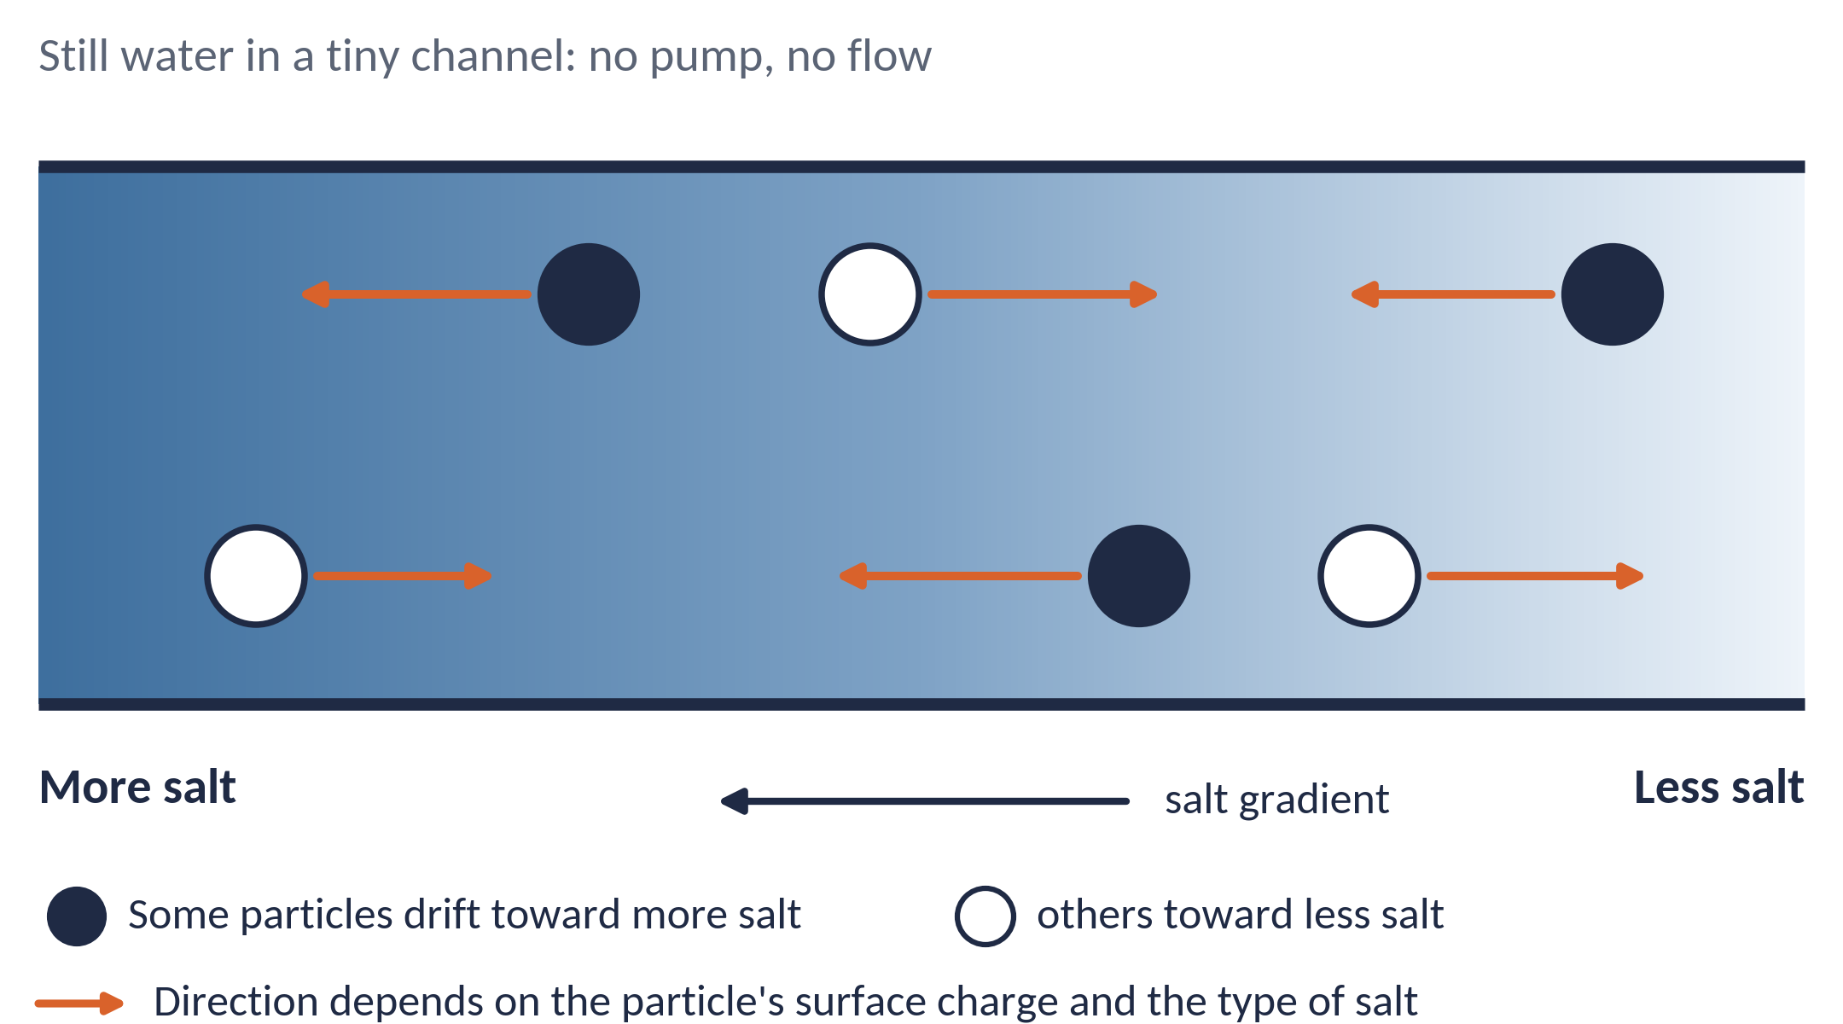

A salt gradient can push particles through still water
1 / 3 · THE CONCEPT
Three ways a tiny particle moves
Diffusion
random jiggling; spreads out, no preferred direction
Advection
carried along by flowing liquid
Diffusiophoresis
steered by a difference in dissolved salt, with no pump and no electrodes
particle speed = mobility × steepness of the salt gradient (on a log scale)
Big idea: where liquid cannot flow, a chemical gradient can still move particles.
Anderson, Annu. Rev. Fluid Mech. 21 (1989); Velegol et al., Soft Matter 12 (2016). Schematic is illustrative; arrow lengths not to scale.
Notes:
Most of us know two ways a tiny particle, like a speck of dust or a colloid, moves in a liquid. Diffusion: it jiggles randomly and slowly spreads out. And advection: it is carried along when the liquid flows.
Diffusiophoresis is a third way. Here the water is completely still. There is no pump and no electrodes. The only thing that changes from left to right is how much salt is dissolved. Yet the particles drift in a definite direction.
Notice the arrows do not all point the same way. Some particles move toward more salt, others toward less. That depends on the particle's surface charge and on the type of salt.
The simple rule used in the field is shown at the bottom right: the particle's speed equals a mobility times how steeply the salt concentration changes, measured on a log scale.
So the big idea is this: in places where liquid simply cannot flow, a chemical gradient can still move particles. (~60 s)

Slide 2
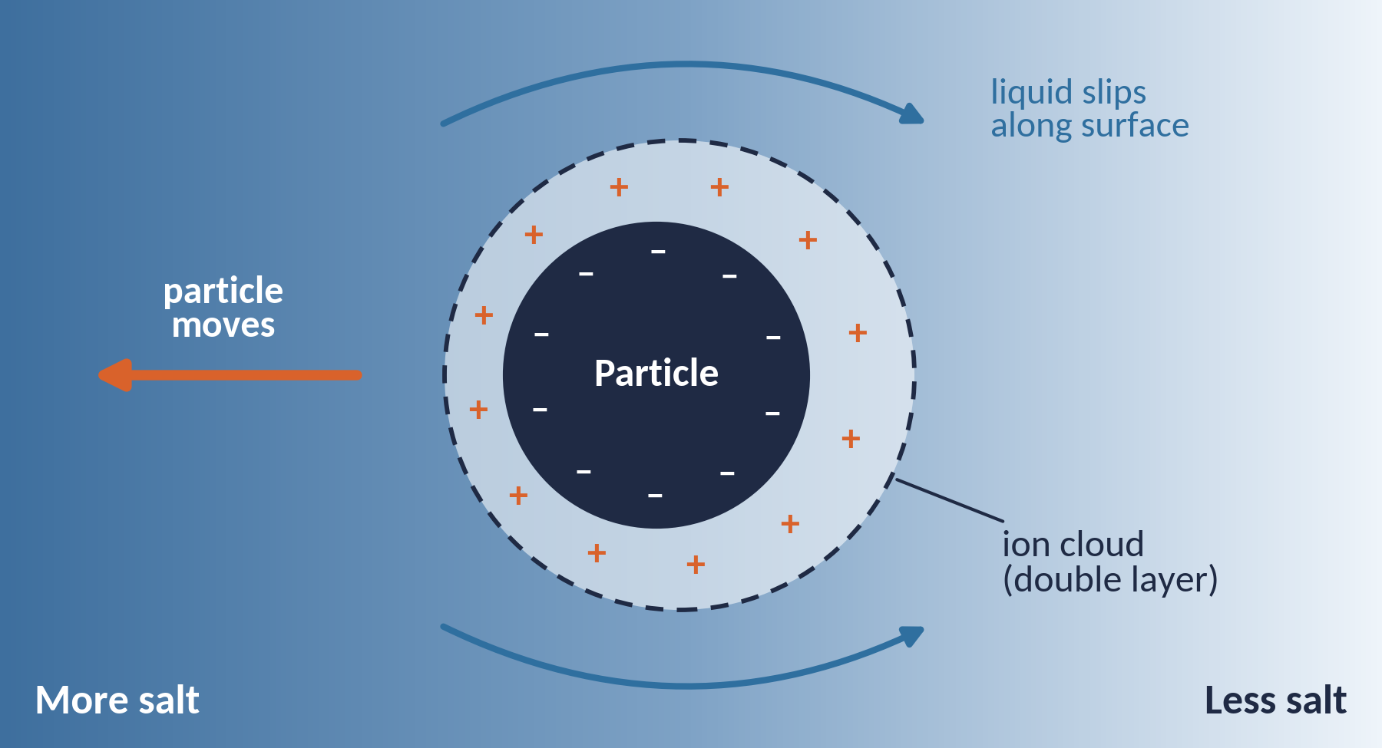
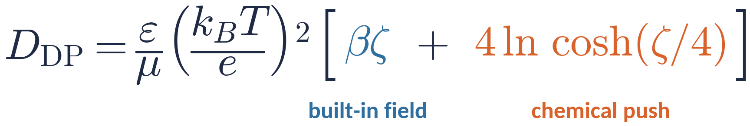
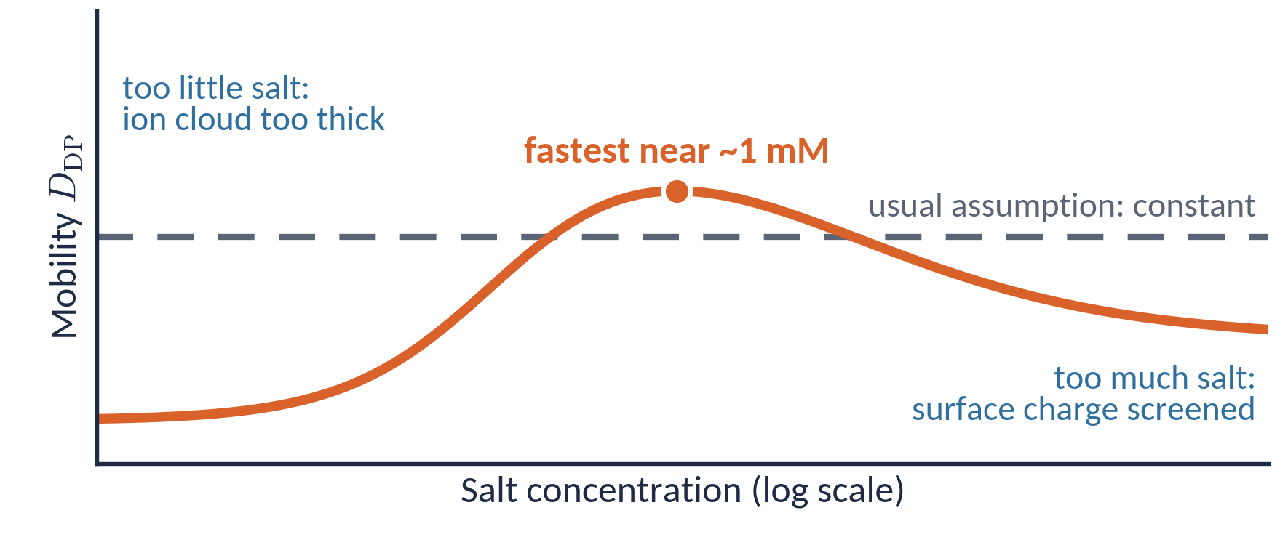
Charged surfaces turn a salt gradient into motion
2 / 3 · HOW IT WORKS
What sets the speed?
ζ: particle surface (zeta) potential, in units of kT/e; β: how unequally Na⁺ and Cl⁻ diffuse
Chemical push
Built-in electric field
Uneven ion cloud makes liquid slip along the surface; the particle moves the other way.
In NaCl, Cl⁻ outruns Na⁺, creating a tiny field that pulls on the charged particle.
Theory and experiment agree: fastest near ~1 mM, so for micron-sized particles work at about 1–10 mM salt.
Prieve et al., J. Fluid Mech. 148 (1984); Gupta, Shim & Stone, Soft Matter 16, 6975 (2020). Curve is a schematic of their qualitative trend, not data.
Notes:
Why does this happen? Most particles in water carry a surface charge, and a thin cloud of opposite ions, the double layer, surrounds them.
When the salt level differs across the particle, two things happen. First, a chemical push: the ion cloud is uneven, so liquid slips along the surface and the particle moves the other way. Second, a built-in electric field: in sodium chloride, chloride diffuses faster than sodium, which creates a tiny field with no electrodes, and it pulls on the charged particle.
The formula on the right simply adds these two effects. The blue term is the electric pull; it depends on the zeta potential and on how unequally the ions diffuse. The orange term is the chemical push; it always points toward more salt.
But the speed is not fixed. The usual assumption is a constant, the dashed line. Gupta, Shim and Stone showed that too little salt thickens the ion cloud and too much salt screens the charge, so mobility peaks near one millimolar. Their experiments confirmed it. So: work at one to ten millimolar. (~60 s)

Slide 3
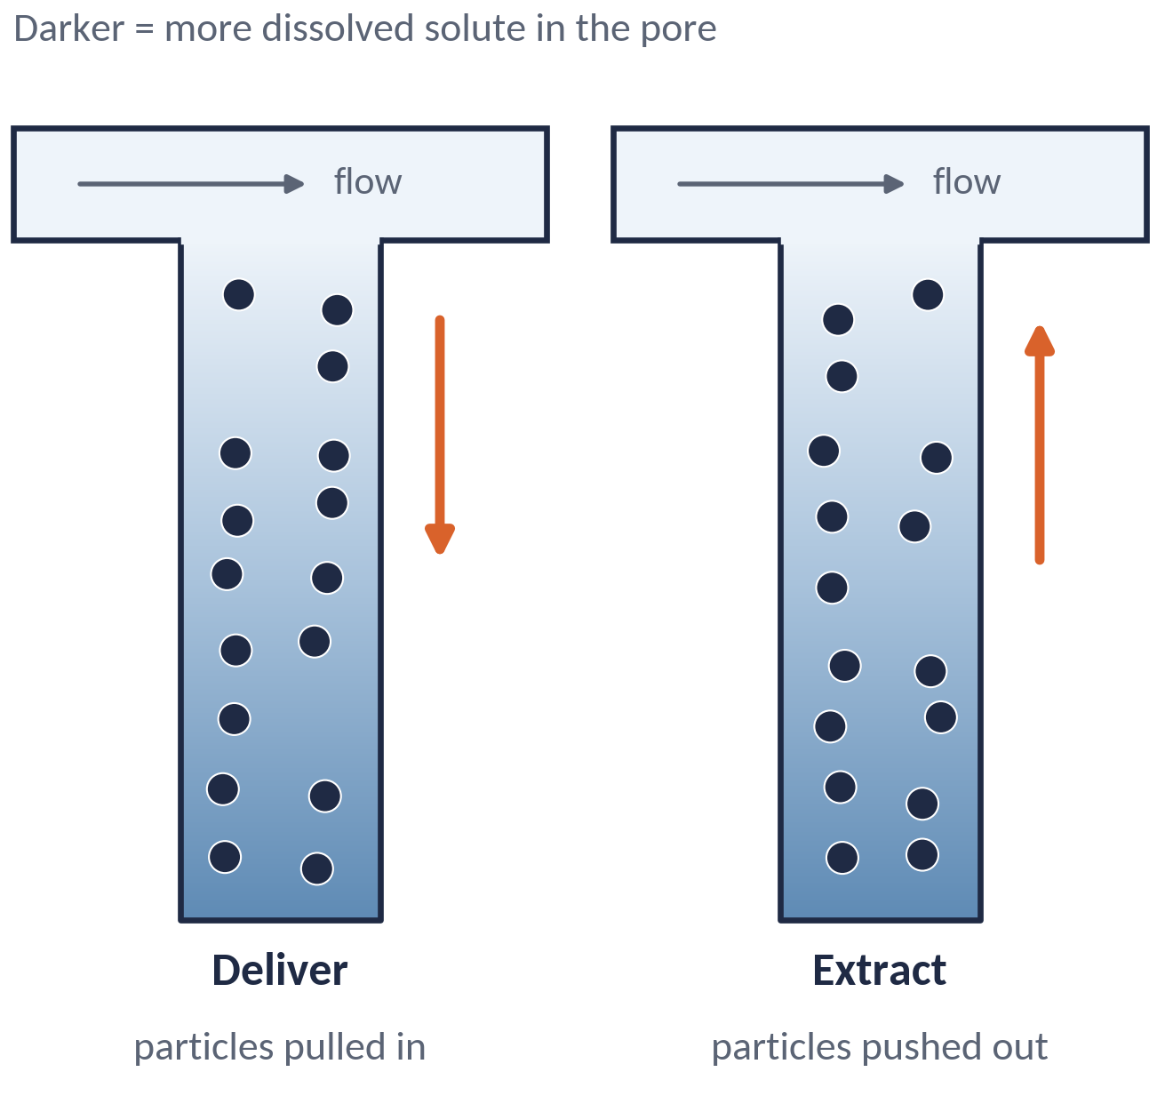




Moving particles where flow cannot reach
3 / 3 · APPLICATIONS
Better laundry rinsing
Delivery into pores
Rinsing leaves detergent trapped deep in fabric pores. The gradient pulls dirt particles out.
Carry particles, such as drugs or disinfectants, into dead-end pores, or extract them, by size.
Shin, Warren & Stone, Phys. Rev. Applied 9, 034012 (2018)
Kar et al., ACS Nano 9, 746 (2015); Shin et al., PNAS 113, 257 (2016)
Membrane-free water filtration
Low-cost surface-charge test
Dissolved CO₂ creates an ion gradient that pushes suspended particles away from the water stream.
How far particles drift in a known salt gradient reveals their zeta potential.
Dead-end pores (in fabrics, filters, soils and rocks) trap particles because flow cannot enter. A solute gradient can still move them in or out.
Shin et al., Nat. Commun. 8, 15181 (2017)
Shin et al., Adv. Mater. 29, 1701516 (2017)
Takeaway: a pump-free, electrode-free way to move particles, tuned by choosing the solute and its concentration.
Applications as reported in the cited studies; pore schematic is illustrative. Direction (in or out) depends on the particle–solute pair.
Notes:
Why does this matter? Many real materials are full of dead-end pores: the gaps between fibres in fabric, filters, soils and rocks. Liquid flowing past cannot get inside, so particles stuck in there barely move by diffusion alone. Diffusiophoresis can pull them in or push them out.
Four examples from the literature. First, laundry: researchers at Princeton and Unilever showed that rinsing works because detergent stays trapped deep in fabric pores, and that gradient draws dirt out. Second, delivery: the same effect can carry particles such as drugs or disinfectants into dead-end pores, or extract them, depending on size. Third, water treatment: dissolving carbon dioxide creates an ion gradient that pushes suspended particles away, giving filtration without a membrane. Fourth, measurement: how far particles drift in a known gradient tells us their surface charge, a cheap alternative to standard instruments.
So the takeaway: diffusiophoresis is a pump-free, electrode-free way to move particles, and we tune it simply by choosing the solute and its concentration. Thank you. (~60 s)
--- Q&A BACKUP (not spoken) ---
Is this the same as electrophoresis? No. There is no applied field or electrodes. The only electric field comes from the salt itself, because cations and anions diffuse at different rates.
Is it the same as diffusioosmosis? No. Diffusioosmosis is the liquid slipping along a fixed wall. Diffusiophoresis is the particle moving relative to the liquid. In experiments, the wall effect can contaminate measurements.
How fast is it? It is typically micrometres per second for micron particles. Gupta et al. show the mobility is usually no larger than the salt's own diffusivity, D_DP/D_s ≲ 1.
Why log of concentration? Velocity depends on the relative change in concentration, not the absolute change. But the mobility itself changes with concentration, which was the main finding.
Why does it peak? At low salt, the ion cloud is thick compared with the particle (finite-Debye-length effect). At high salt, the surface charge is screened, so the zeta potential falls.
Other uses? The laundry authors suggest that removing particles from deep pores could matter for petroleum production and skin-pore cleansing; these are their suggestions, not demonstrated here.

