Slide 1
STAT 654 · Texas A&M University
ISOT Fake News Detection
A Leakage-Aware NLP Study with Multi-Track Feature Engineering
Hareen Sai Vatikuti · Raj Purohith Arjun · Venkateswarlu Nagineni
ISOT Dataset · 44,898 Articles · Phase 1–4 Results

Slide 2
Presentation Outline
Phase 1
Data Loading, Leakage Detection & Temporal Analysis
Phase 2
Feature Engineering: Length, Vocabulary, Readability & Sentiment
Phase 3
Feature Tracks: Leaky Baseline, Decontaminated TF-IDF & Linguistic Style
Phase 4
Model Training: LR, Naïve Bayes, SVM, Random Forest, LightGBM
Up Next
Phase 5 — Ensemble, Error Analysis & Final Evaluation

Slide 3
Phase 1 — Dataset Overview
ISOT Dataset · 44,898 Articles
44,898
23,481
21,417
1.096
6,252
Total Articles
Fake (0)
Real (1)
Imbalance Ratio
Duplicate Texts
Dataset Columns
⚠ Label Leakage Findings
title (object)
Article headline
Subject column:
5-fold CV accuracy = 1.000 — perfect predictor
text (object)
Body content
Reuters byline:
99.8% of Real articles contain 'reuters'
subject (object)
⚠ Leaks label perfectly
Single-word acc.:
has_reuters feature → 99.2% accuracy
date (object)
Only fake articles parseable
Temporal bias:
Only Fake articles have parseable dates
(2015–2017)
label (int64)
0 = Fake, 1 = Real
Verdict:
Models trained on raw data detect SOURCE,
not linguistic deception

Slide 4
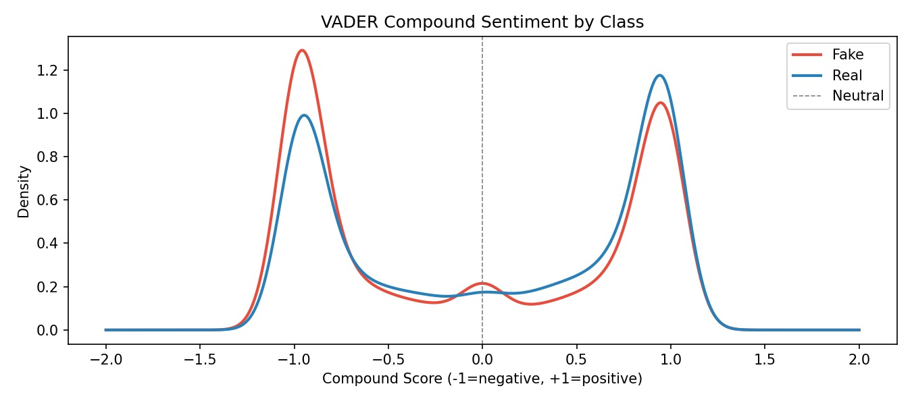
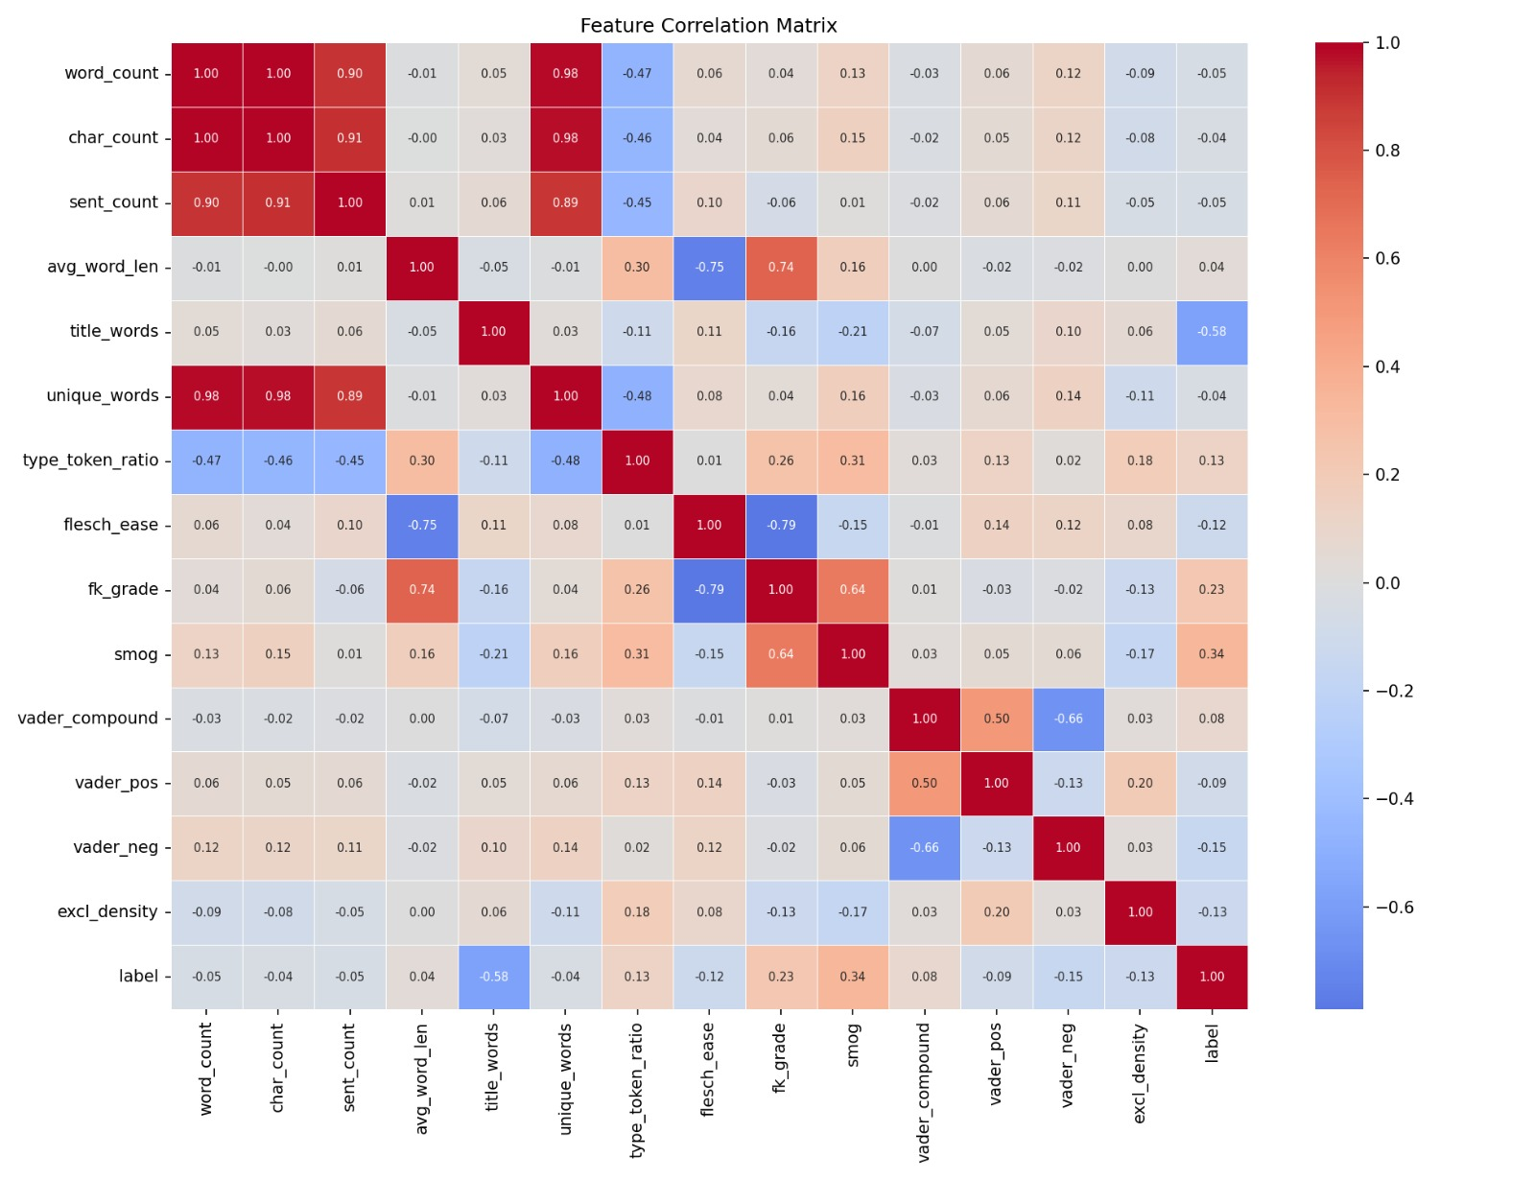
Phase 1 — Subject Column: Perfect Label Leakage
Key Finding: Subject categories perfectly separate Fake vs Real (AUC = 1.00). All fake articles fall under 'Government News', 'politics', 'News', etc.; all real articles under 'politicsNews' or 'worldnews'. → Subject must be excluded from all models. Reuters byline similarly excluded.

Slide 5
Phase 2 — Feature Engineering & Hypothesis Testing
Feature | Fake Median | Real Median | Effect Size (rb) | Significant
word_count | 363 | 359 | −0.040 | ✓
avg_word_len | 4.95 | 5.17 | 0.401 | ✓
type_token_ratio | 0.590 | 0.607 | 0.140 | ✓
title_words | 14 | 10 | −0.747 | ✓ (largest)
char_count | 2166 | 2222 | −0.013 | ✗
unique_words | 216 | 215 | −0.029 | ✓
Flesch Ease
FK Grade
VADER Compound
Excl. Density
51.5 (Fake) vs 42.8 (Real)
10.9 vs 12.7
−0.19 vs +0.26
Both ≈ 0
Fake news is easier to read
Real news uses higher grade level
Fake = more negative sentiment
Sig. difference at p≈0

Slide 6
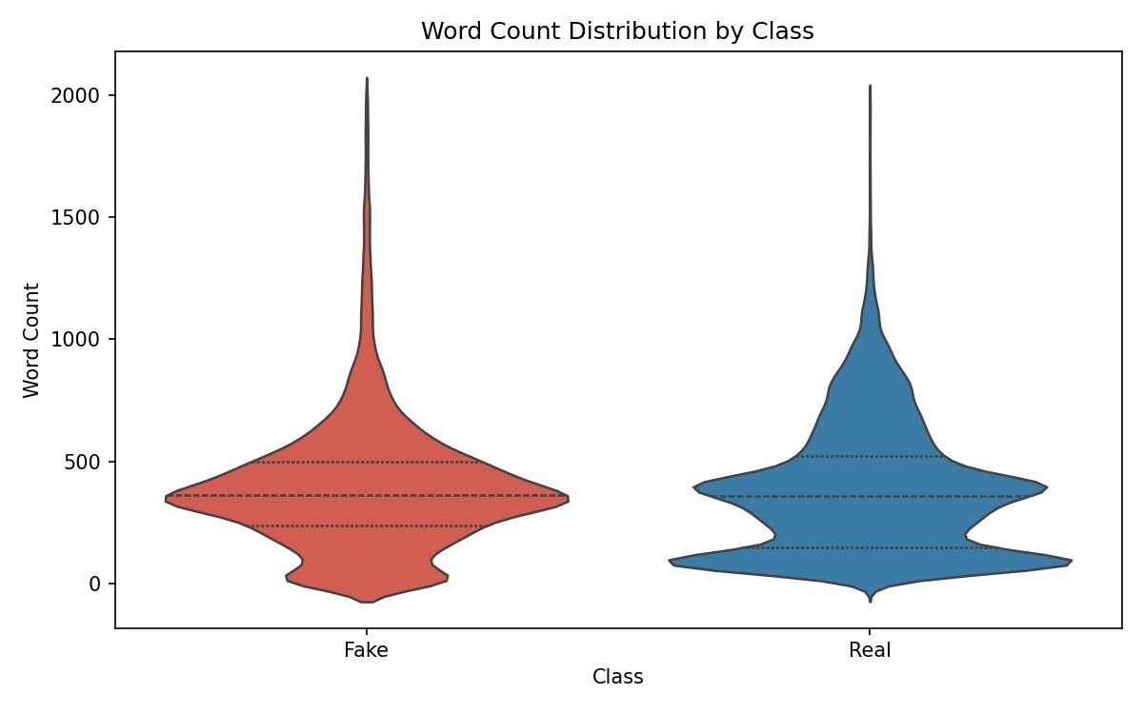
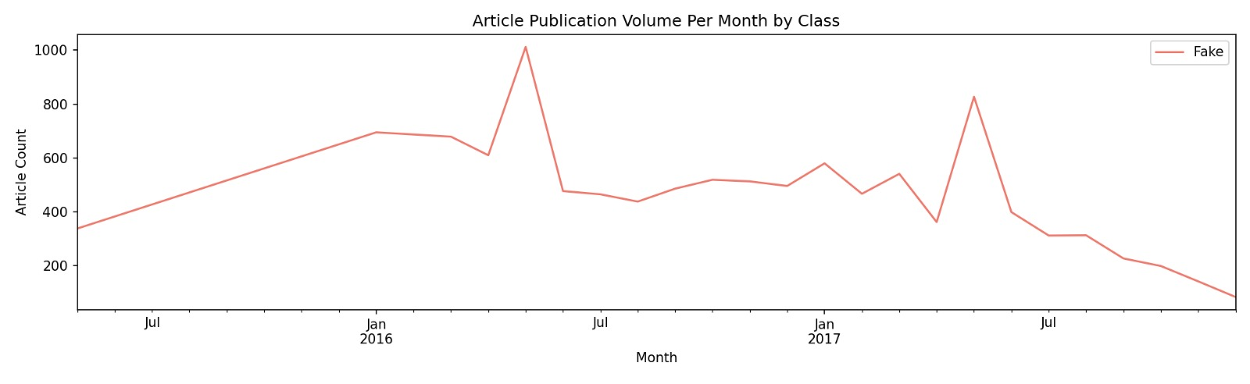
Phase 2 — Sentiment Distribution & Vocabulary Differences
Fake Sentiment
Real Sentiment
Fake Vocabulary
Real Vocabulary
Median VADER compound = −0.19
Stronger negative peak at −1.0
More emotionally charged language
Median VADER compound = +0.26
Dominant positive peak at +0.9
More measured/neutral reporting
Top terms: 'https', 'getty', 'pic', 'screenshot'
Artifacts of web scraping — not natural language
Top terms: 'reuters', 'EU', 'talks', 'minister'
Geopolitical, formal journalistic register

Slide 7
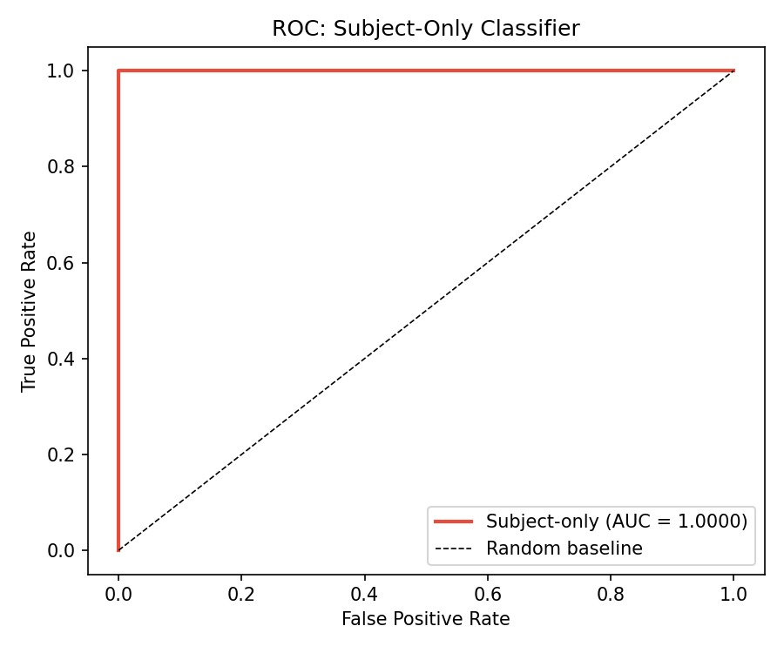
Phase 2 — Feature Correlation Matrix
Key Observations
word_count ↔ char_count
r = 1.00 — perfectly collinear, only one needed
flesch_ease ↔ fk_grade
r = −0.79 — expected inverse; either alone sufficient
title_words → label
r = −0.58 — strongest single predictor in Track C
avg_word_len → label
r = +0.23 — real news uses longer words
vader_compound ↔ vader_neg
r = −0.66 — expected structural correlation
vader_pos → label
r = −0.09 — weak; polarity more complex than positivity

Slide 8
Phase 3 — Three Feature Tracks
A
Track A — Raw TF-IDF (Leaky Baseline)
44,898 × 50,000
Includes 'reuters', source bylines, scraped artifacts.
Any model trained here detects SOURCE identity,
not linguistic deception patterns.
⚠ LEAKY — for comparison only
B
Track B — Decontaminated TF-IDF
44,898 × 50,000
Reuters + source fingerprints removed.
0 articles still contain 'reuters' after cleaning.
LSA reduction → 300 SVD components (15.9% variance).
✓ Clean content-based features
C
Track C — Linguistic Style (14 features)
44,898 × 14
word_count, type_token_ratio, flesch_ease, fk_grade,
smog, vader_compound/pos/neg, excl_density,
avg_word_len, sent_count, title_words, caps_ratio, quest_density
✓ Interpretable, source-agnostic

Slide 9
Phase 4 — Model Results Summary (5-Fold CV)
Model | Track | F1 | AUC | Precision | Recall | Train Gap
LR-L2 | A (Leaky) | 0.9916 | 0.9993 | 0.9903 | 0.9929 | 0.0038
LR-L2 | B (Clean) | 0.9891 | 0.9991 | 0.9878 | 0.9904 | 0.0052
LR-L2 | C (Style) | 0.8778 | 0.9396 | 0.8513 | 0.9059 | 0.0002
Multinomial NB | B (Clean) | 0.9575 | 0.9910 | 0.9571 | 0.9579 | 0.0042
Complement NB | B (Clean) | 0.9572 | 0.9910 | 0.9552 | 0.9592 | 0.0046
SVM (Linear) | B (Clean) | 0.9953 | 0.9997 | 0.9956 | 0.9950 | 0.0047
Random Forest | C (Style) | 0.9198 | 0.9755 | 0.9119 | 0.9279 | 0.0587
Random Forest | B-LSA | 0.9719 | 0.9962 | 0.9730 | 0.9709 | 0.0275
XGBoost | C (Style) | 0.9219 | 0.9774 | 0.9051 | 0.9393 | 0.0202
LightGBM | B-LSA | 0.9868 | 0.9989 | 0.9885 | 0.9851 | 0.0132
LightGBM | C (Style) | 0.9266 | 0.9796 | 0.9121 | 0.9417 | 0.0345
★ Best clean model: SVM on Track B (F1 = 0.9953, AUC = 0.9997) · Track A inflated by source fingerprints · Track C is most interpretable

Slide 10
Phase 4 — F1 Score Comparison Across Models & Tracks

Slide 11
Key Takeaways — Phases 1–4
01
Dataset Has Severe Leakage
02
Title Length Is the Strongest Style Signal
Subject column (AUC = 1.00) and Reuters byline (99.2% accuracy) perfectly predict labels. All models must be evaluated on Track B/C to measure genuine language understanding.
Effect size rb = −0.747 for title_words. Fake headlines average 14 words; real average 10. This single feature carries more discriminative power than readability scores.
03
SVM Dominates on Clean TF-IDF
04
Style Features Alone Reach ~93% F1
Linear SVM on Track B achieves F1 = 0.9953, AUC = 0.9997 — best clean-data performance. Small train-test gap (0.005) indicates low overfitting.
Track C (14 interpretable features) with tree-based models achieves 0.92–0.93 F1 with no vocabulary needed — strong evidence that writing style genuinely differs.
Next: Phase 5 — Ensemble methods, error analysis, cross-dataset generalization

Slide 12
PHASE 5
Evaluation
Hold-out Evaluation · McNemar’s Test · Error Analysis · Interpretability
ISOT Dataset · 44,898 Articles · Final Hold-out: 8,980 Samples

Slide 13
Phase 5.1 & 5.2 — Evaluation Framework & Hold-out Results
Why Accuracy Alone Is Not Enough
Final Hold-out Results (n = 8,980)
LR-L2 (Track B)
Accuracy: 99% · F1: 0.99 · ROC-AUC: 0.9992
PR-AUC: 0.9991 · FP: 39 · FN: 62
Confusion: [[4634, 62], [39, 4245]]
Accuracy counts the fraction of correct predictions. On near-balanced data it is a reasonable starting point but treats all errors as equally bad.
Two errors have very different consequences:
False Positive — flags real news as fake. Potentially suppresses legitimate journalism.
False Negative — lets fake news through. Allows misinformation to spread.
We therefore report Precision, Recall, F1, ROC-AUC, and PR-AUC alongside confusion matrices on the final hold-out set (8,980 samples).
SVM Linear (Track B) ★ Best
Accuracy: 100% · F1: 1.00 · ROC-AUC: 0.9998
PR-AUC: 0.9998 · FP: 25 · FN: 16
Confusion: [[4680, 16], [25, 4259]]
SVM reduces errors by 62% vs LR-L2 (41 total vs 101 total misclassifications)

Slide 14
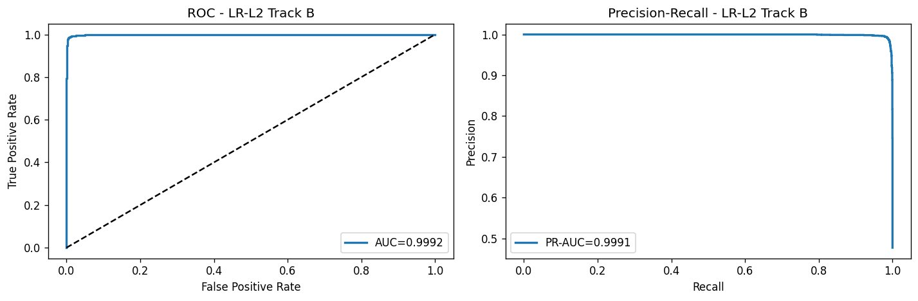
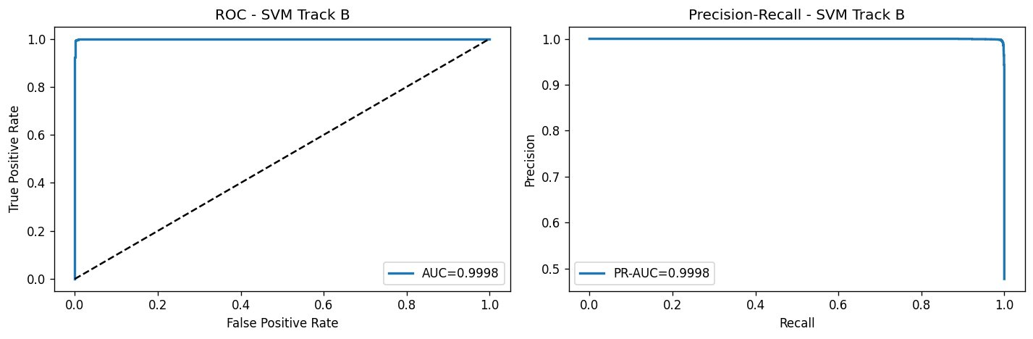
Phase 5.2 — ROC & Precision-Recall Curves
LR-L2 AUC = 0.9992 · PR-AUC = 0.9991
SVM AUC = 0.9998 · PR-AUC = 0.9998
Key Observations
Both models achieve near-perfect discrimination on decontaminated text. The ROC curve hugs the top-left corner with AUC > 0.999, and the PR curve sustains precision ≈ 1.0 across nearly all recall levels — indicating virtually no precision-recall tradeoff.
SVM outperforms LR-L2: AUC 0.9998 vs 0.9992. Both exceed 0.999 AUC — confirming that even without source leakage, content-based TF-IDF carries strong discriminative signal.

Slide 15
Phase 5.3 & 5.4 — McNemar’s Test & Error Analysis
LR-L2 vs SVM · p < 0.001 McNemar’s Test: LR-L2 vs SVM
Both correct: 8,877
LR-L2 right, SVM wrong: 2
LR-L2 wrong, SVM right: 62
Both wrong: 39
p = 2.26e-16 → SIGNIFICANT
SVM’s advantage over LR-L2 is statistically significant. The difference in errors is not due to chance.
False Positives (n=39) — Real flagged as Fake
Avg word count: 378 · Mostly worldnews / politics articles with emotionally charged phrasing that resembles fake news style
False Negatives (n=62) — Fake slipped through
Avg word count: 417 · Fake articles using measured journalistic language (e.g. CalPERS profit sharing, Facebook political influence) that mimics real reporting style
Pattern: Hard cases cluster around style ambiguity
Both FP and FN articles have higher-than-average word counts (377 and 417 vs dataset median ~360), suggesting that longer, more detailed articles blur the decision boundary. Fake articles that mimic journalistic register and real articles with emotional political framing are the primary failure modes — neither a precision nor recall issue alone.

Slide 16
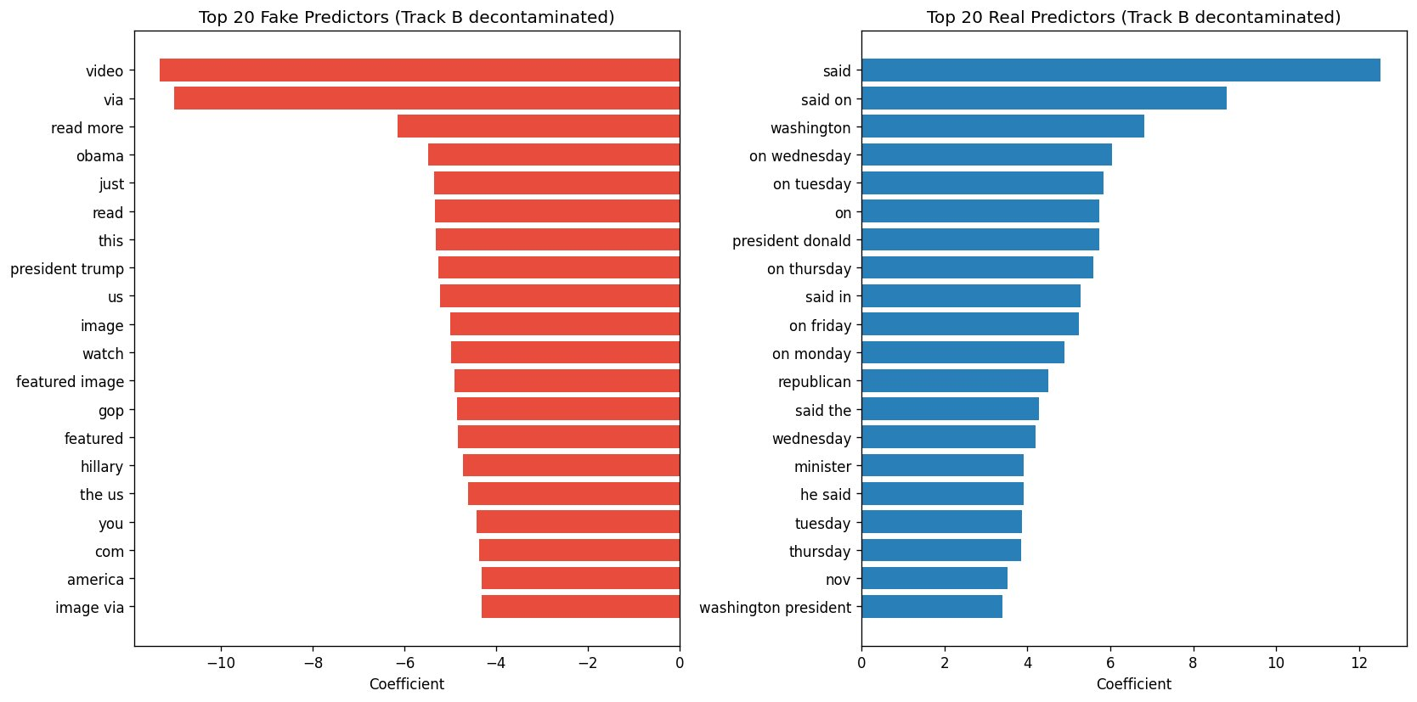
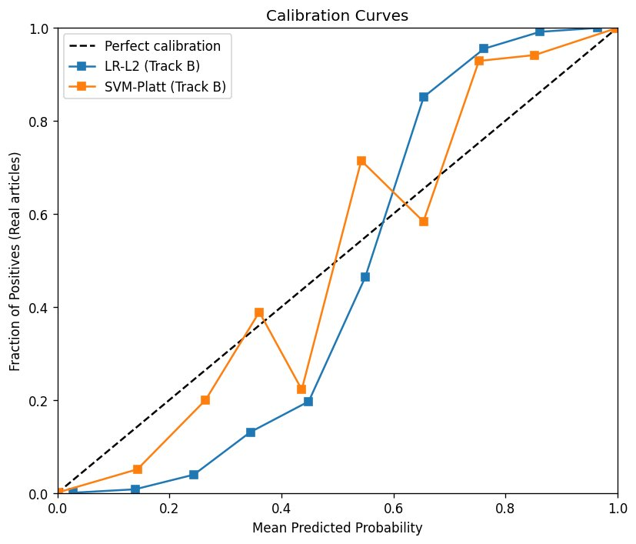
Phase 6 — Interpretability: Top Predictors & Calibration
Interpretation
Fake predictors — “video”, “via”, “read more”, “featured image” reflect web-scraping artifacts; “obama”, “hillary”, “gop” indicate partisan targeting.
Real predictors — “said”, “washington”, day-of-week phrases signal wire-service attribution and dateline conventions of formal journalism.
Calibration — LR-L2 is better calibrated than SVM-Platt; both models are overconfident in the 0.3–0.6 probability range where calibration diverges from the diagonal.

Slide 17
Thank You
Questions & Discussion
Hareen Sai Vatikuti · Raj Purohith Arjun · Venkateswarlu Nagineni STAT 654 · Texas A&M University
ISOT Dataset · Phases 1–5 · 44,898 Articles · 5-Fold Stratified CV

