Slide 1


Slide 2

SmartlyGo
~ Digital Khata System

Slide 3
Submitted By Group 1 :
Jenish Gohel (92300527156) Yuvrajsinh Zala (92300527141) Raj Rathod (92300527179)
Internal Guide :
Prof. Jignesh Kariya
Faculty of Computer Application.
Institution Address :
Marwadi University -,
Rajkot-Morbi Road, At & PO: Gauridad, Rajkot

Slide 4
Introduction
SmartlyGo is a modern digital khata and expense management system designed to simplify financial record-keeping for small businesses, shopkeepers, and individuals. It replaces traditional handwritten ledgers with a secure, digital, and user-friendly platform.
Built with Python (PyQt5) and SQLite, SmartlyGo allows users to manage customers, transactions, and inventory all in one place. The system supports credit/debit tracking, automated balance updates, low-stock alerts, business reports, QR code payments, and visual dashboards.
With features like multi-user login, data backup/restore, report exports (PDF, Excel, CSV), and interactive charts, SmartlyGo ensures that businesses can monitor their financial health efficiently. Its dark/light mode UI and customizable settings make it more accessible and professional.
SmartlyGo serves as a digital companion for businesses, enabling smarter decisions, transparency, and growth.

Slide 5
🎯 Objectives :
To provide a digital alternative to traditional khata (ledger) systems.
To enable easy customer, transaction, and inventory management.
To ensure secure login and data storage with encryption.
To offer real-time reports and visual insights for better decision-making.
To support data backup, restore, and exports in multiple formats (PDF, Excel, CSV).
💻 Technologies Used :
Python (PyQt5) → GUI development.
SQLite → Lightweight, embedded database.
bcrypt → Secure password hashing.
Matplotlib → Data visualization & charts.
ReportLab, OpenPyXL, CSV → Report generation & export.
Qrcode → Product & payment QR code generation.
Twilio (Future Integration) → SMS notifications.
👥 Targeted Audience :
Small shopkeepers & retailers needing easy credit/debit tracking.
Small & medium businesses (SMBs) managing customers and inventory.
Freelancers & service providers keeping client payment records.
Educational projects & students learning digital ledger systems.
Entrepreneurs/startups looking for a low-cost bookkeeping solution.

Slide 6
Key Features
Secure User Login & Registration (with password hashing)
Customer Management → Add, search, view balances, print statements
Transaction Management → Credit/Debit entries with auto-balance updates
Inventory Management → Add, edit, delete products with low-stock alerts
QR Code Integration → Generate product & payment QR codes
Reports Module → Daily sales, customer ledger, transaction summary, balances
Export Options → Save reports as PDF, Excel, CSV, or Print
Data Visualization → Sales trends, customer balances, product categories, transaction types, monthly summary
Customizable Settings → Currency, dark/light mode, SMS notification toggle, business logo upload
Data Safety → Backup & restore database

Slide 7
Modules in SmartlyGo
1. User Module
Login & Registration (bcrypt password security)
User profile & settings (business info, currency, dark mode, logo)
2. Dashboard Module
Business overview (customers, payments, inventory stats)
Recent transactions table
Quick action shortcuts
3. Customer (Khata) Management Module
Add/search customers
View customer details & balances
Record credit/debit transactions
Print customer statements
4. Transaction Module
Manage debit & credit entries
Auto-update balances
Transaction history & reports

Slide 8
Modules in SmartlyGo
5. Inventory Module
Add, edit, delete products
Manage categories & barcodes
Low-stock alerts
Generate product QR codes
6. Reports Module
Daily Sales, Customer Ledger, Transaction Summary, Customer Balances
Export reports (PDF, Excel, CSV)
Print report option
7. Visualization Module
Graphical insights: Sales trends, balances, product categories, monthly summary
Interactive charts with dark mode support
8. Settings Module
Currency & notification preferences
Business logo management
Dark/Light mode toggle
Data backup & restore

Slide 9
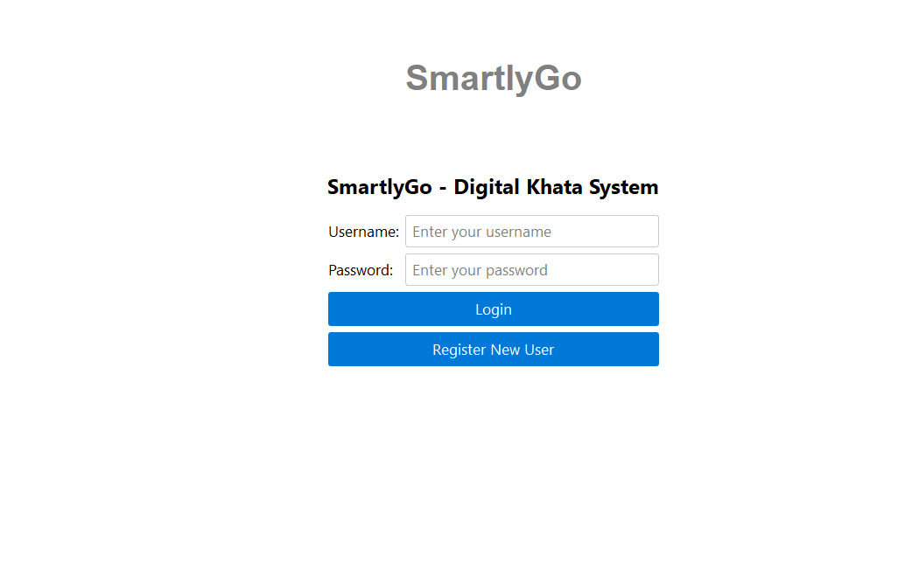
1. User Module
This module manages secure login and registration using bcrypt encryption to protect user credentials. Users can set up their business details including name, phone, address, and logo. It also provides profile settings like currency selection, SMS notification toggle, and theme customization.

Slide 10
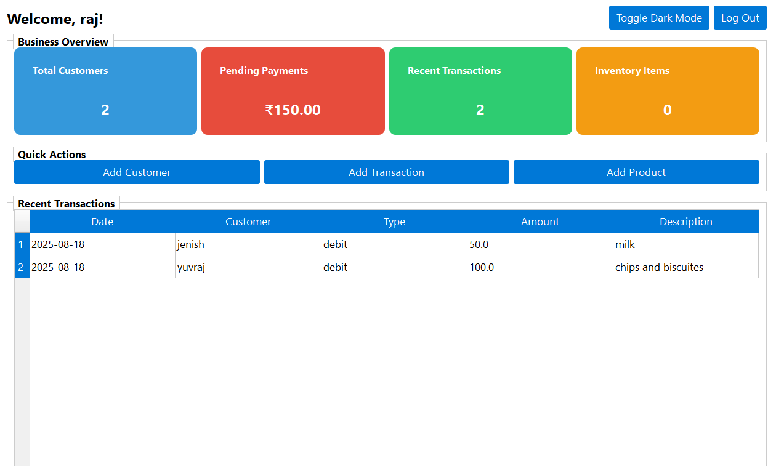
2. Dashboard Module
The dashboard gives a snapshot of business performance in one place. It shows total customers, pending payments, recent transactions, and inventory stats. Quick action buttons allow easy access to add customers, transactions, and products.

Slide 11
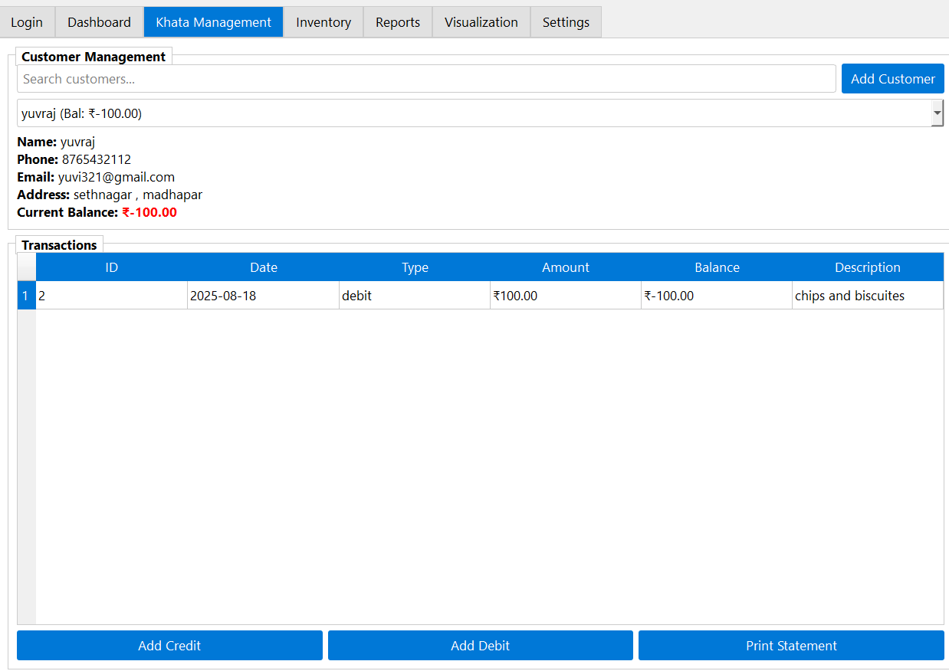
3. Khata Management Module
Handles all customer-related activities such as adding, searching, and managing customer details. It keeps track of customer balances with credit/debit entries and transaction history. The module also supports generating and printing customer account statements.

Slide 12
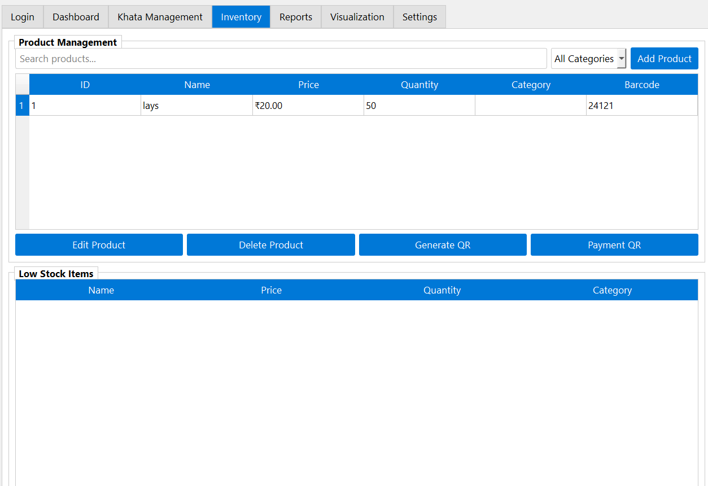
4. Inventory Module
Provides complete product management including adding, editing, deleting, and searching items. Supports product categorization, barcode storage, and QR code generation. Alerts for low-stock items help businesses manage inventory effectively.

Slide 13
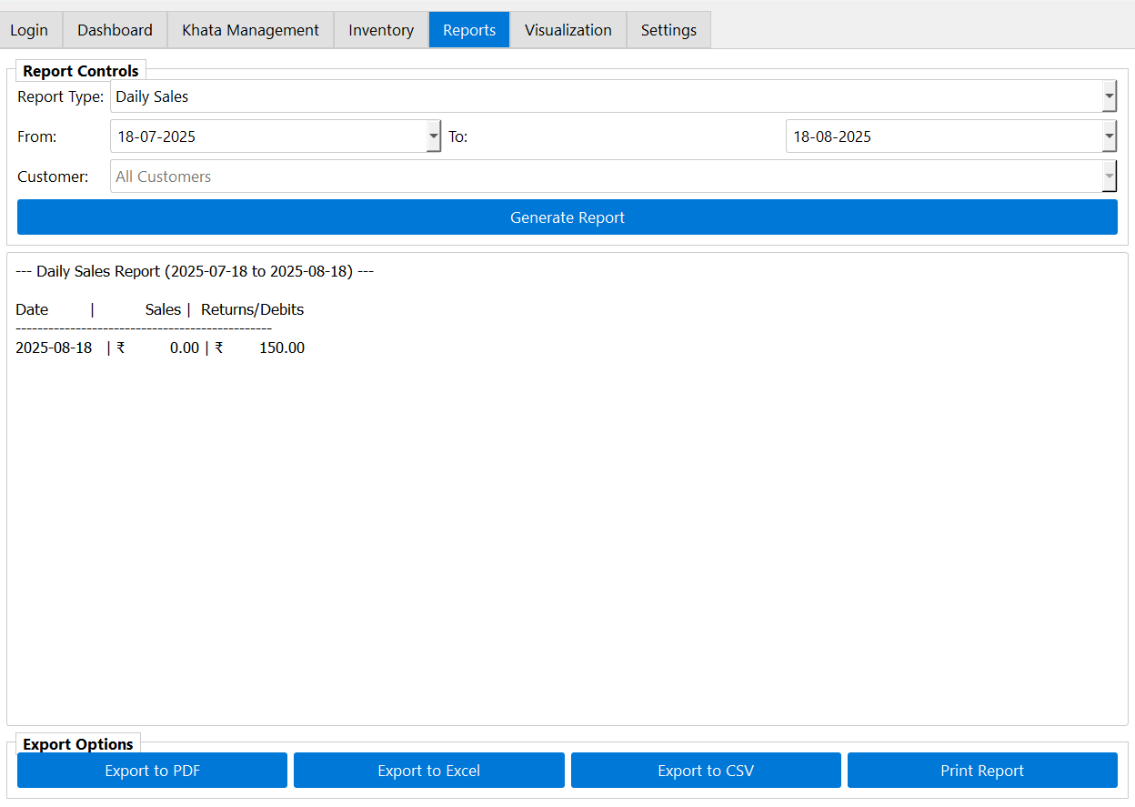
5. Reports Module
Generates detailed reports such as Daily Sales, Customer Ledger, Transaction Summary, and Customer Balances. Users can export these reports in PDF, Excel, or CSV formats for record-keeping. Printing options make it easy to share reports with customers or management.

Slide 14
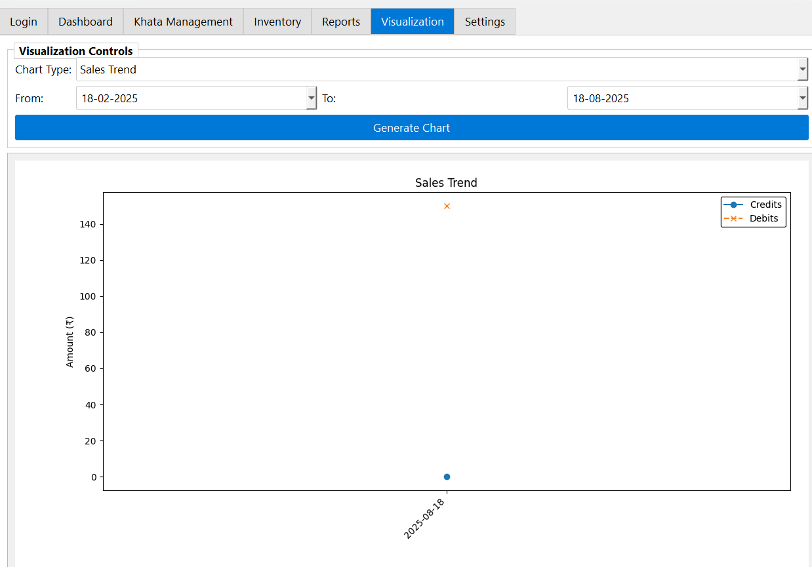
6. Visualization Module
Offers graphical insights for better decision-making through interactive charts. Displays sales trends, customer balances, product categories, transaction types, and monthly summaries. Charts are styled according to dark or light mode for better readability.

Slide 15
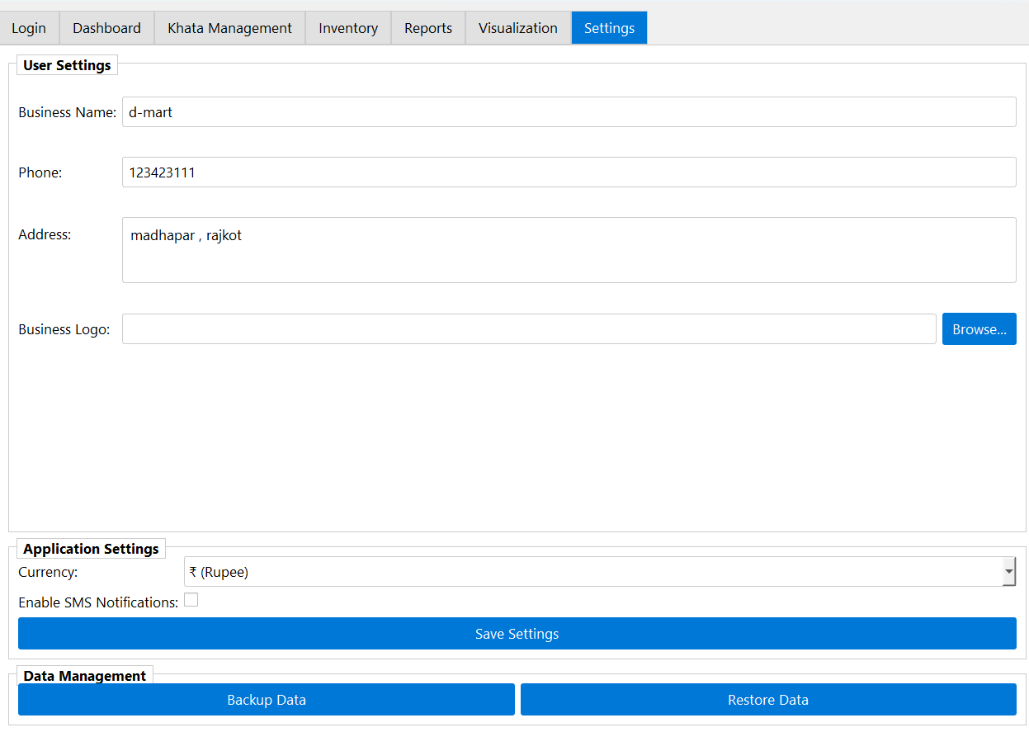
7. Settings Module
Lets users customize application settings like currency, notifications, and theme preferences. Provides options to upload and display a business logo on the interface. Includes data safety features such as database backup and restore.

Slide 16
Technical Requirements
1). Hardware Requirements :
Since the project is developed as a desktop-based application, it does not require very high-end hardware. A standard computer or laptop is enough to run the system smoothly.
Processor: Intel i3 / AMD Ryzen 3 or higher
RAM: Minimum 4 GB (8 GB recommended for better performance)
Storage: At least 500 MB free space for program files and database
Display: Minimum 1366×768 resolution
Optional Devices: Barcode Scanner and Printer (for faster product entry and invoice printing)
2). Software Requirements :
The software stack has been chosen to be open-source and widely used so that the system is cost-effective and easily customizable.
Operating System: Windows 10 / 11 (compatible with Linux & macOS as well)
Programming Language: Python 3.10+
GUI Framework: PyQt5
Database: SQLite3 (lightweight and serverless)
Libraries/Packages:
Matplotlib (for charts and visualization)
ReportLab (for generating PDF invoices)
Pandas (for data handling and CSV export)
IDE/Editor: VS Code / PyCharm (or any Python-supported IDE)

Slide 17
System Design Diagram
This project is supported with multiple design diagrams that represent its structure and workflow:
Flow Chart → Shows the overall working flow of SmartlyGo.
Data Flow Diagram (DFD) → Explains how data moves between modules and database.
Use Case Diagram → Represents interactions between users and the system.
Sequential Diagram → Depicts the step-by-step execution of operations (e.g., adding a transaction).
Class Diagram → Describes system classes, attributes, and their relationships.
Activity Diagram → Shows the workflow of activities like login, transactions, and report generation.

Slide 18
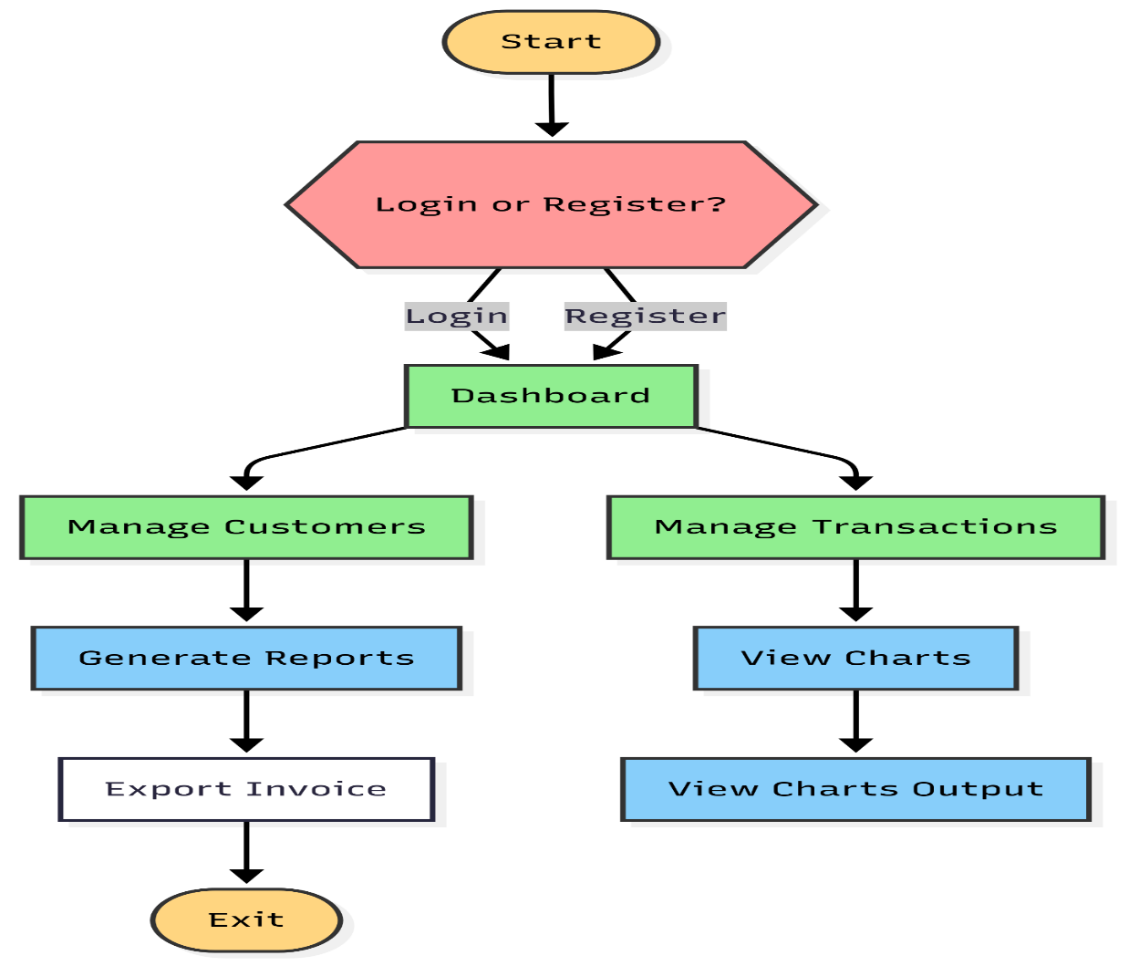
Flow Chart
This Flow Chart Shows the overall working flow of SmartlyGo.

Slide 19
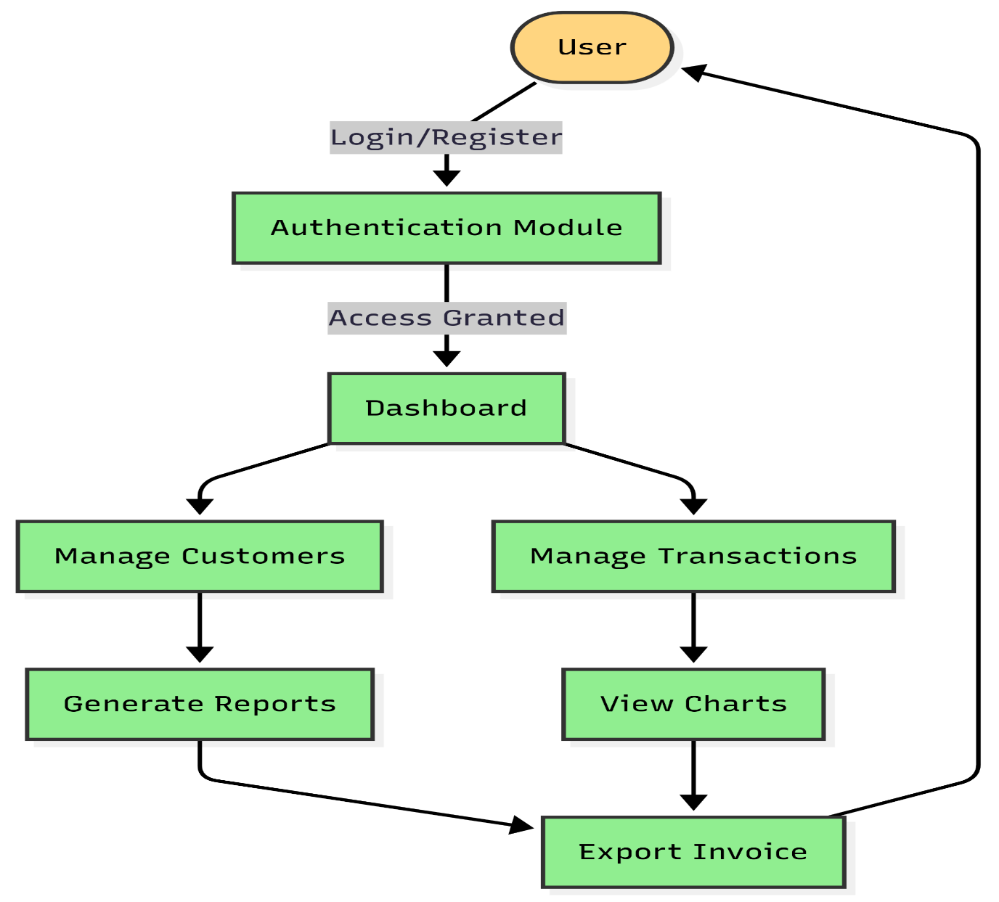
Data Flow Diagram
Data flow Diagram Explains how data moves between modules and database.

Slide 20
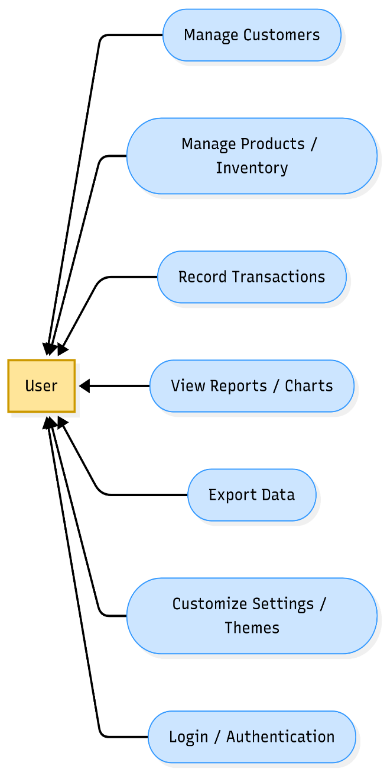

Use Case Diagram
Use Case Diagram Represents interactions between users and the system.
/Actor

Slide 21
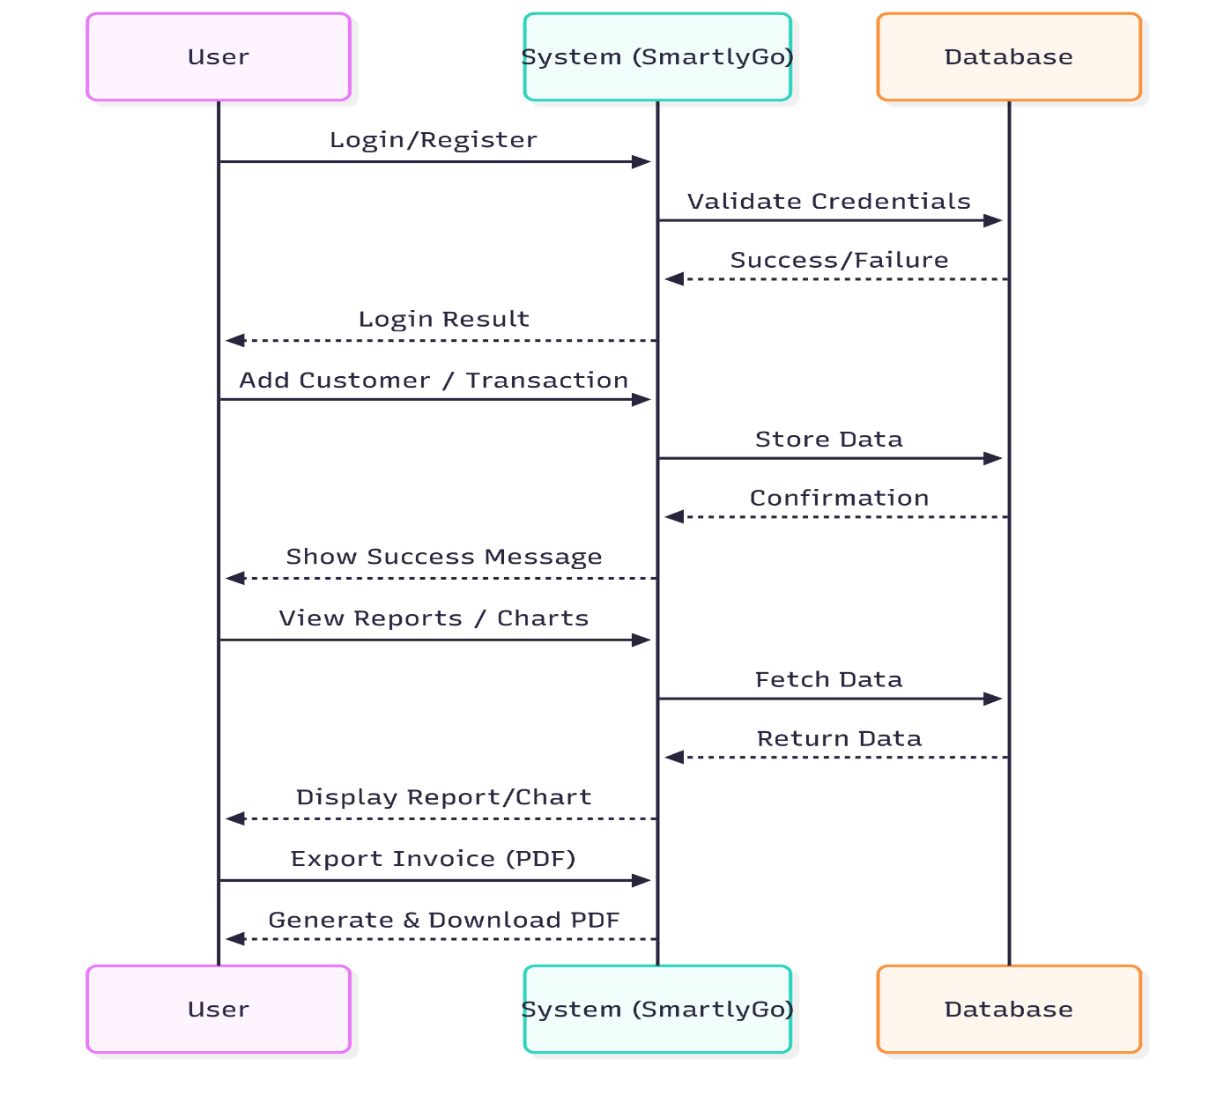
Sequential Diagram
Sequential Diagram Depicts the step-by-step execution of operations (e.g., adding a transaction).

Slide 22
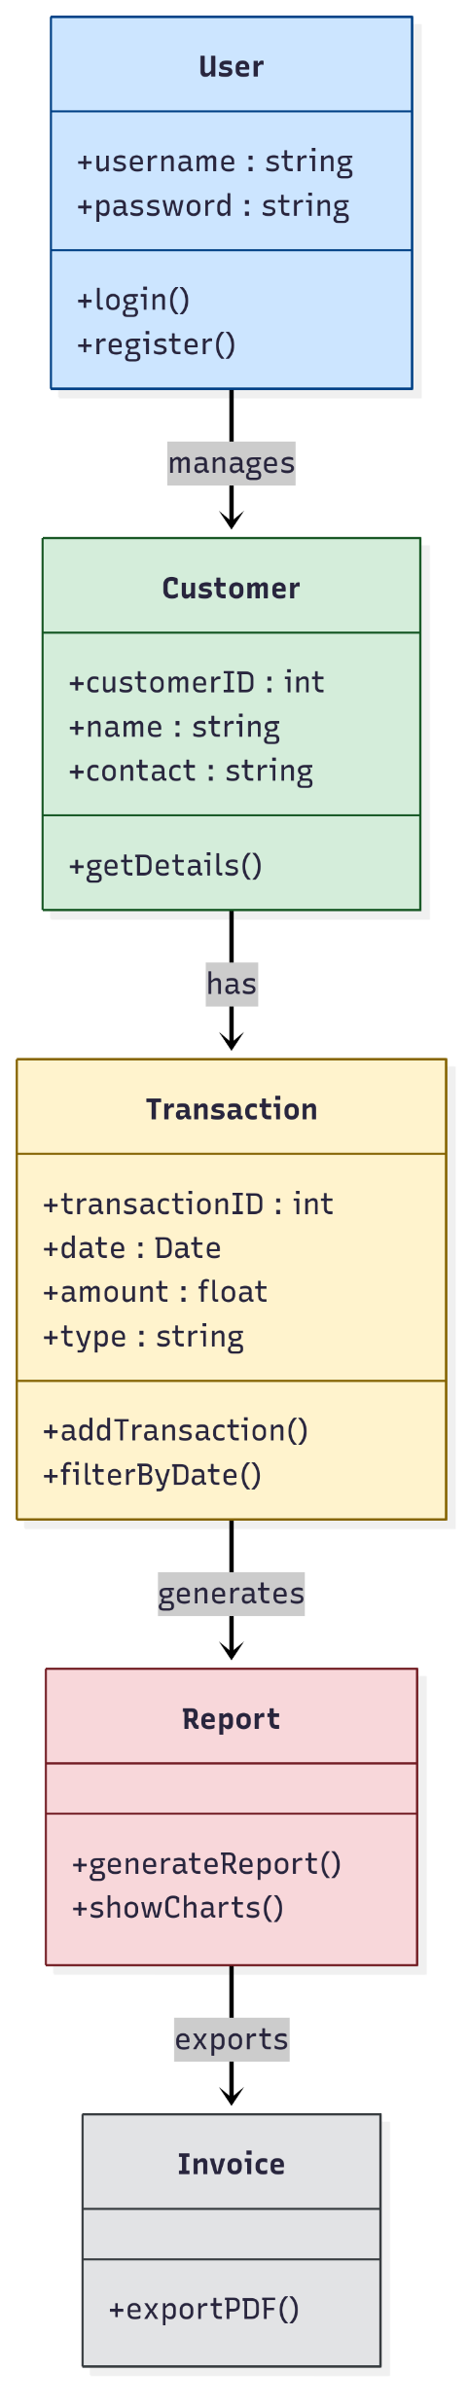
Class Diagram
Class Diagram Describes system classes, attributes, and their relationships.

Slide 23
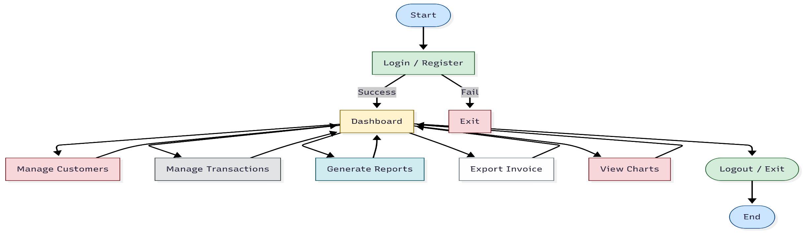
Activity Diagram
Activity Diagram Shows the workflow of activities like login, transactions, and report generation.

Slide 24
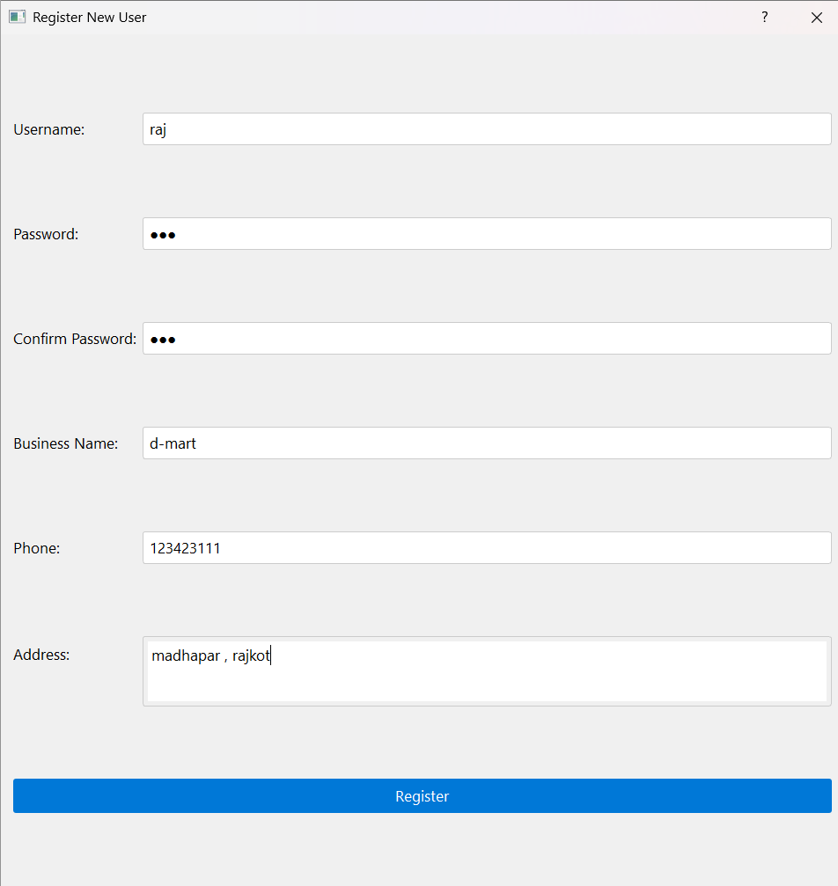

GUI Overview :

Slide 25
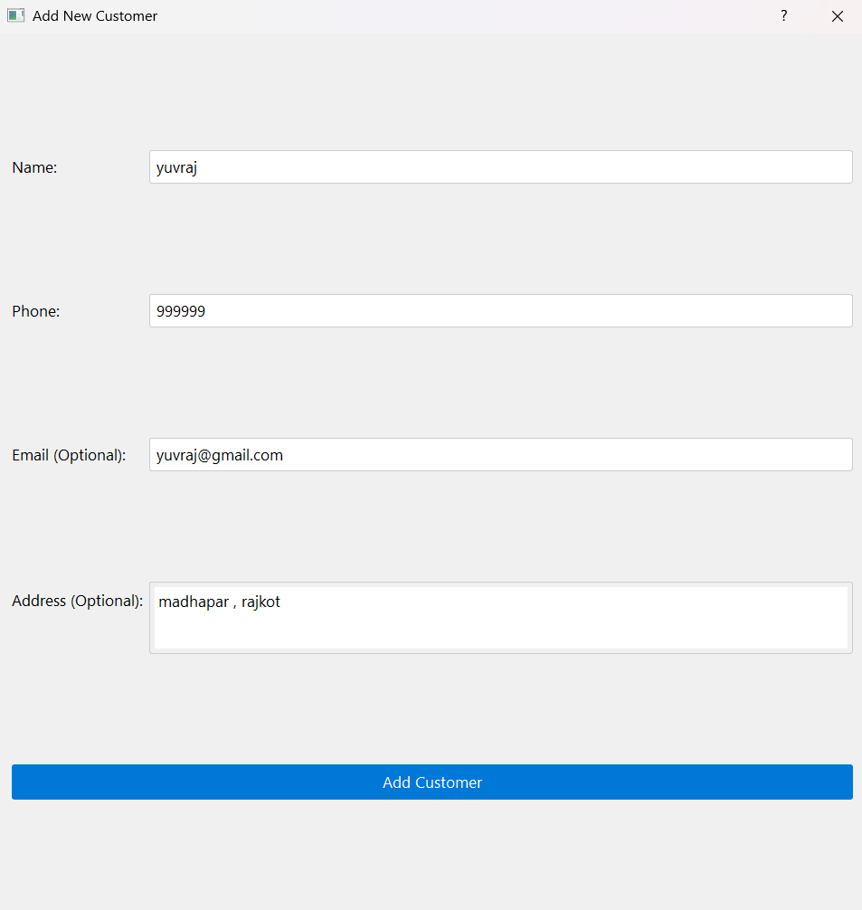
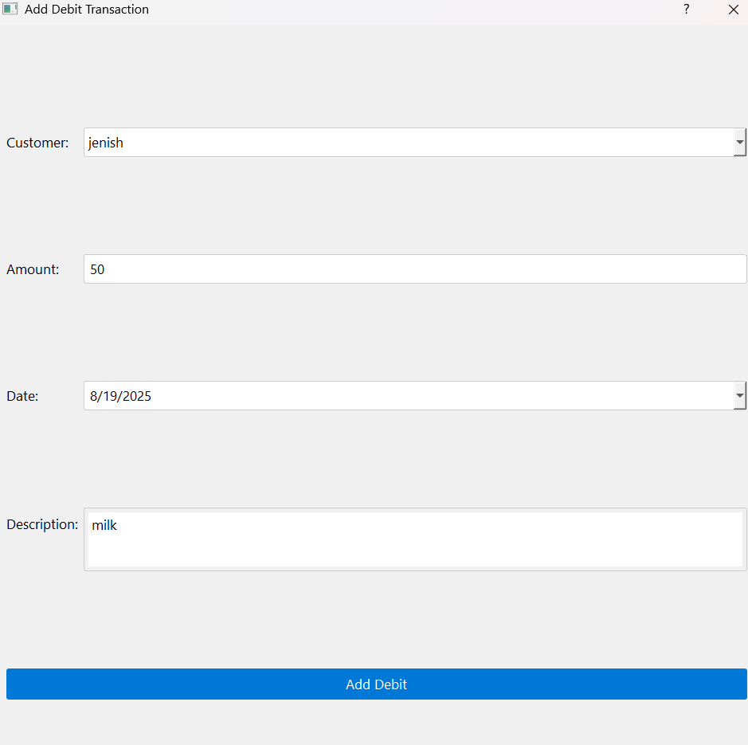
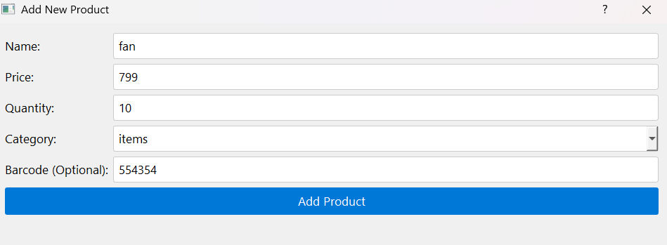
GUI Overview :

Slide 26
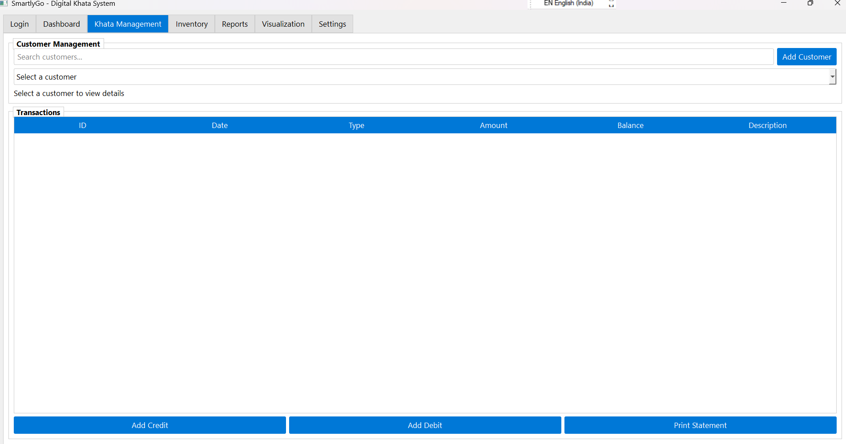
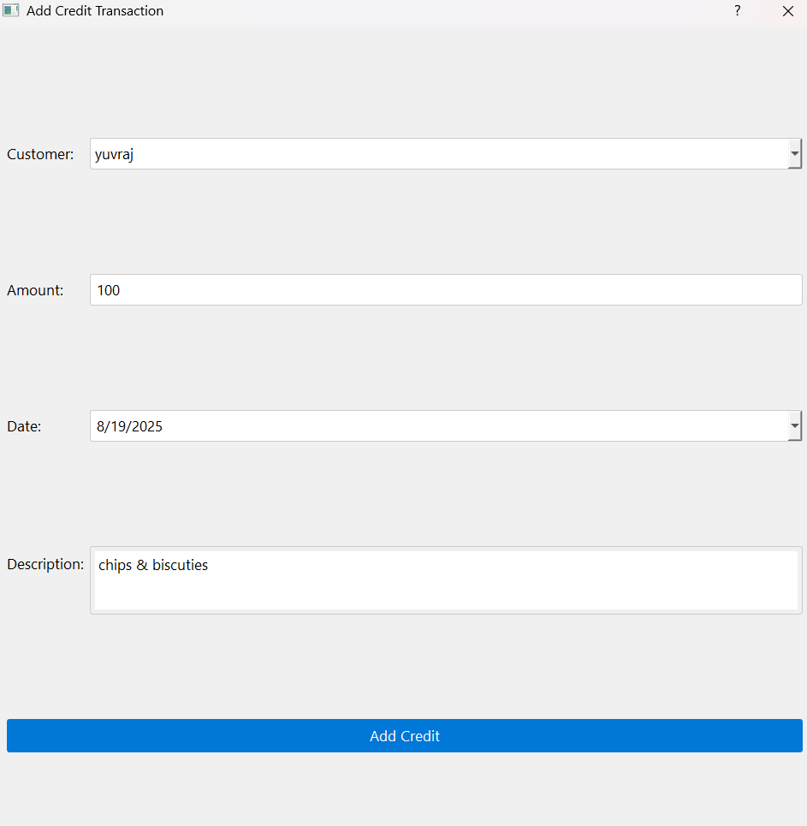
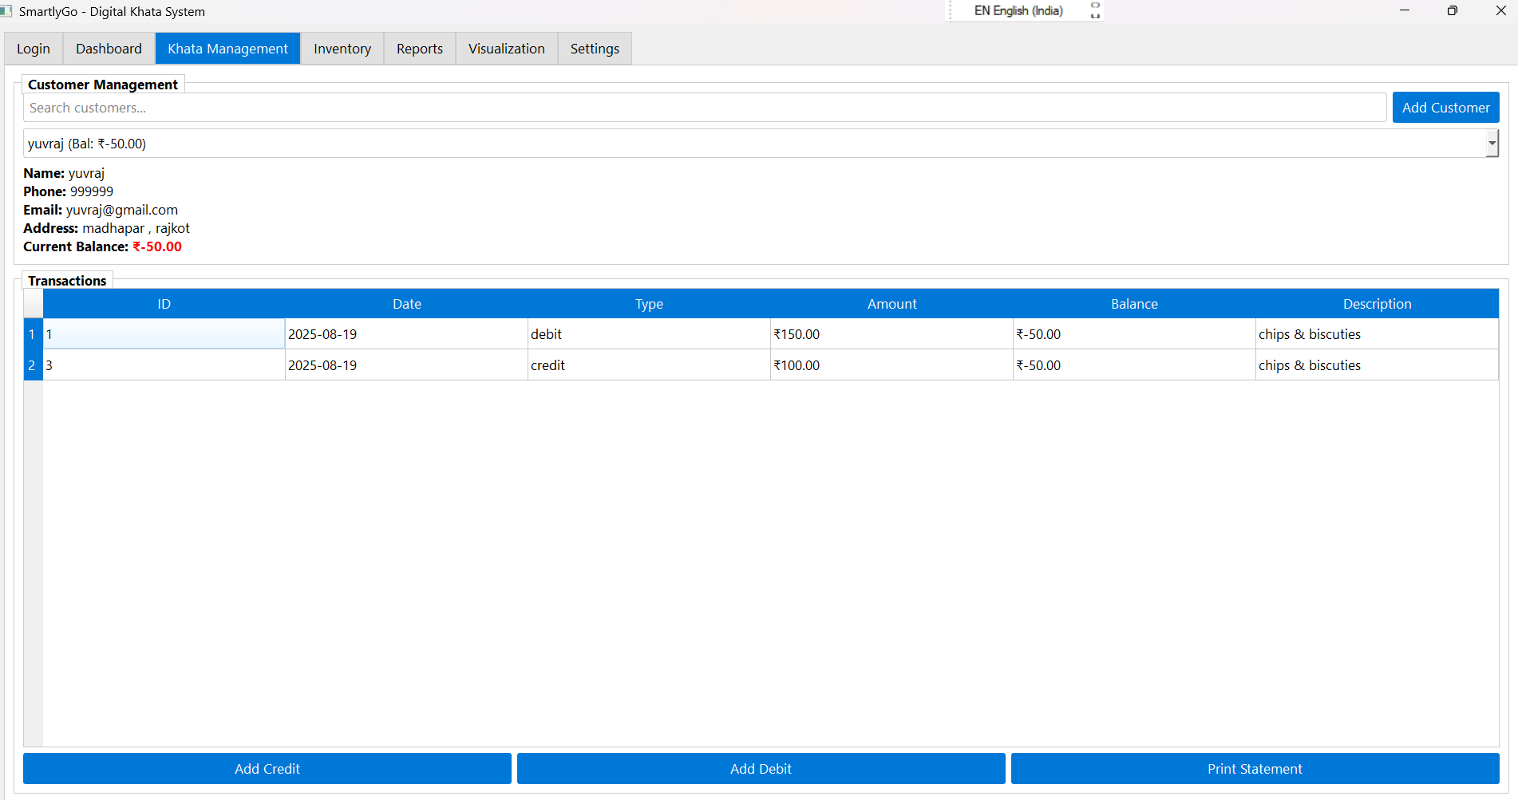
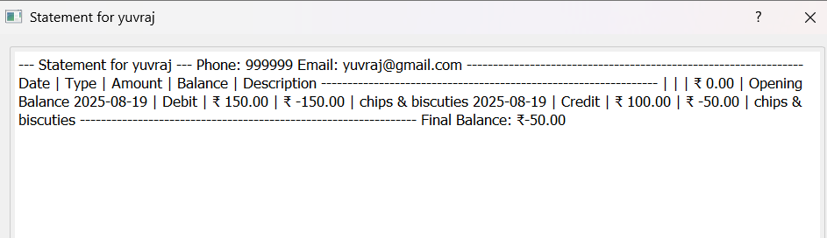
GUI Overview :

Slide 27
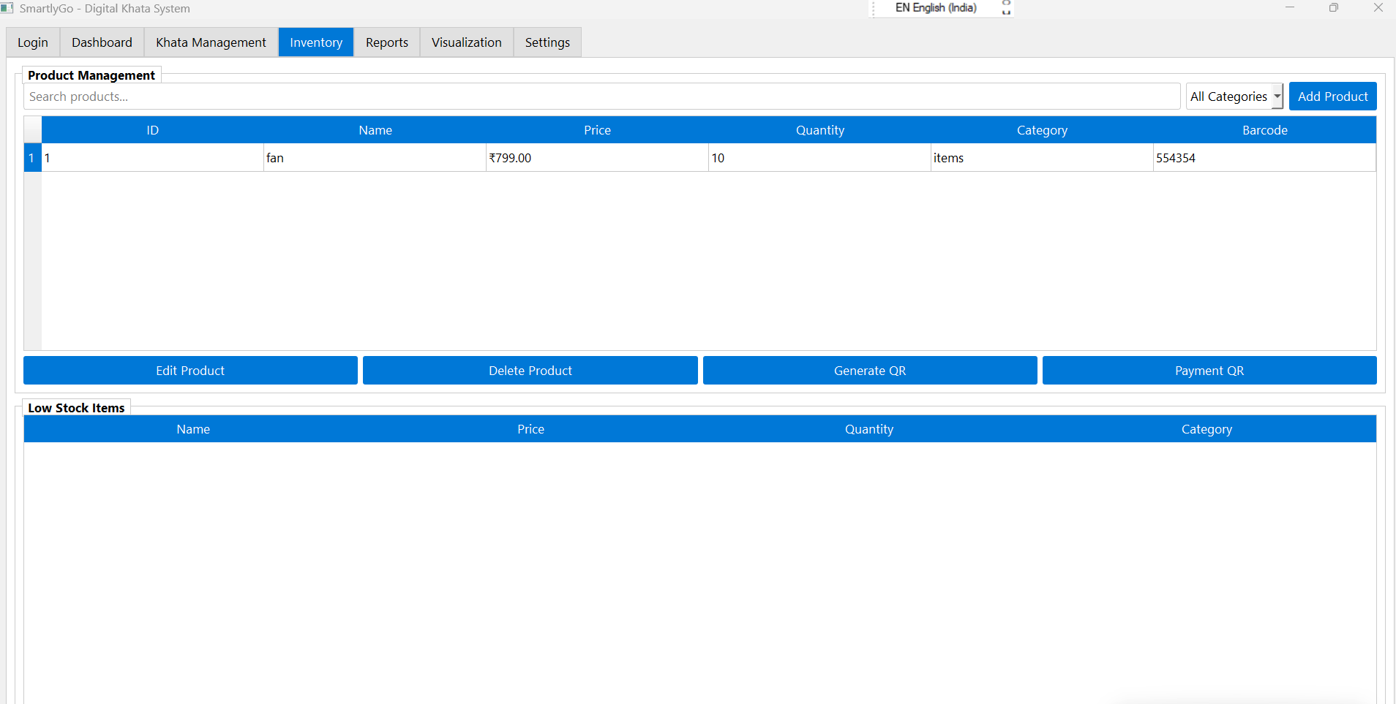
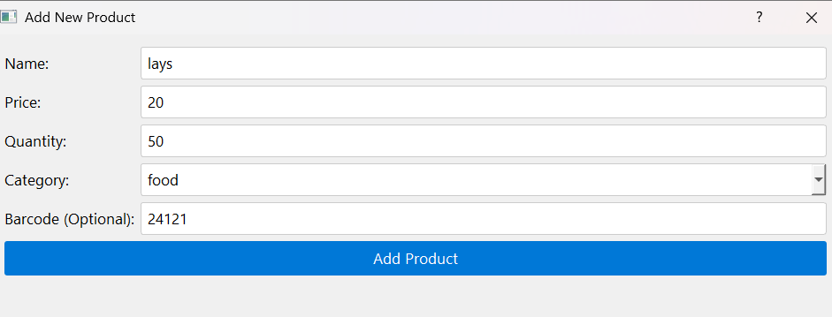
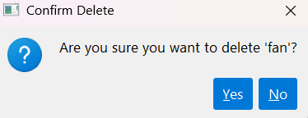
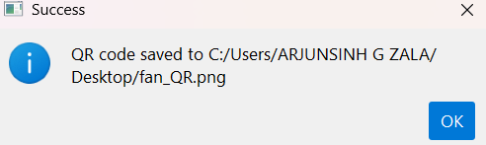
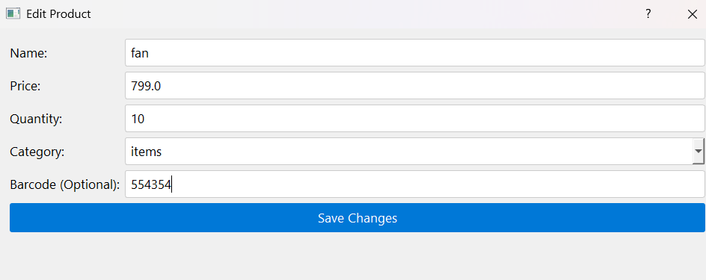
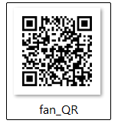
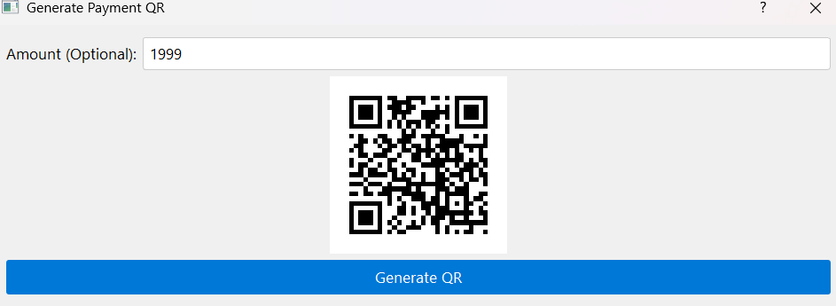
GUI Overview :

Slide 28
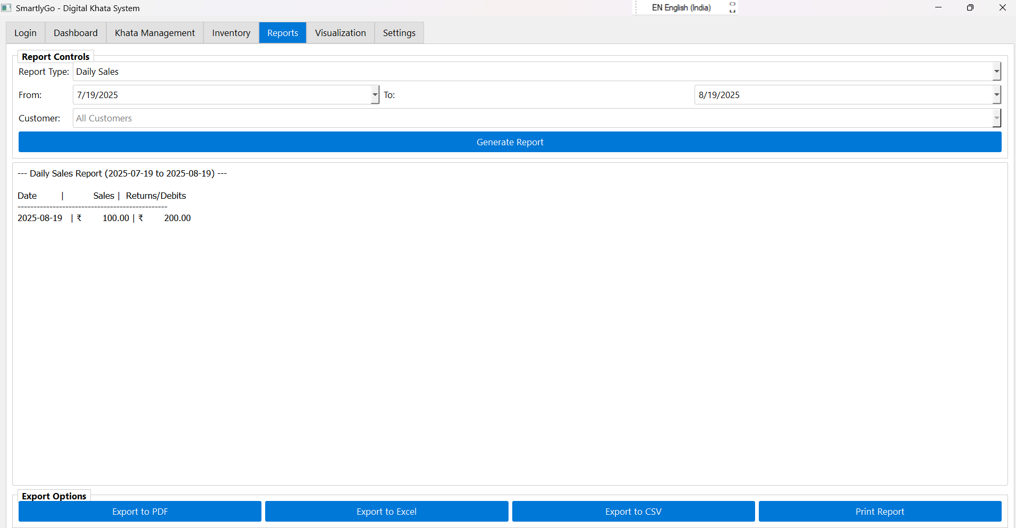
GUI Overview :

Slide 29
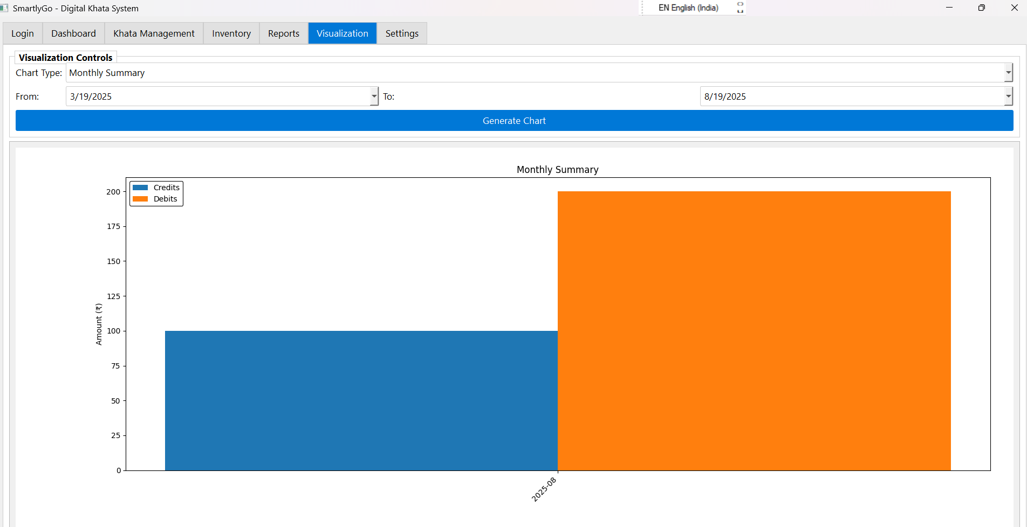
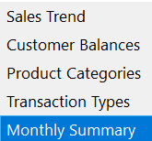
GUI Overview :

Slide 30
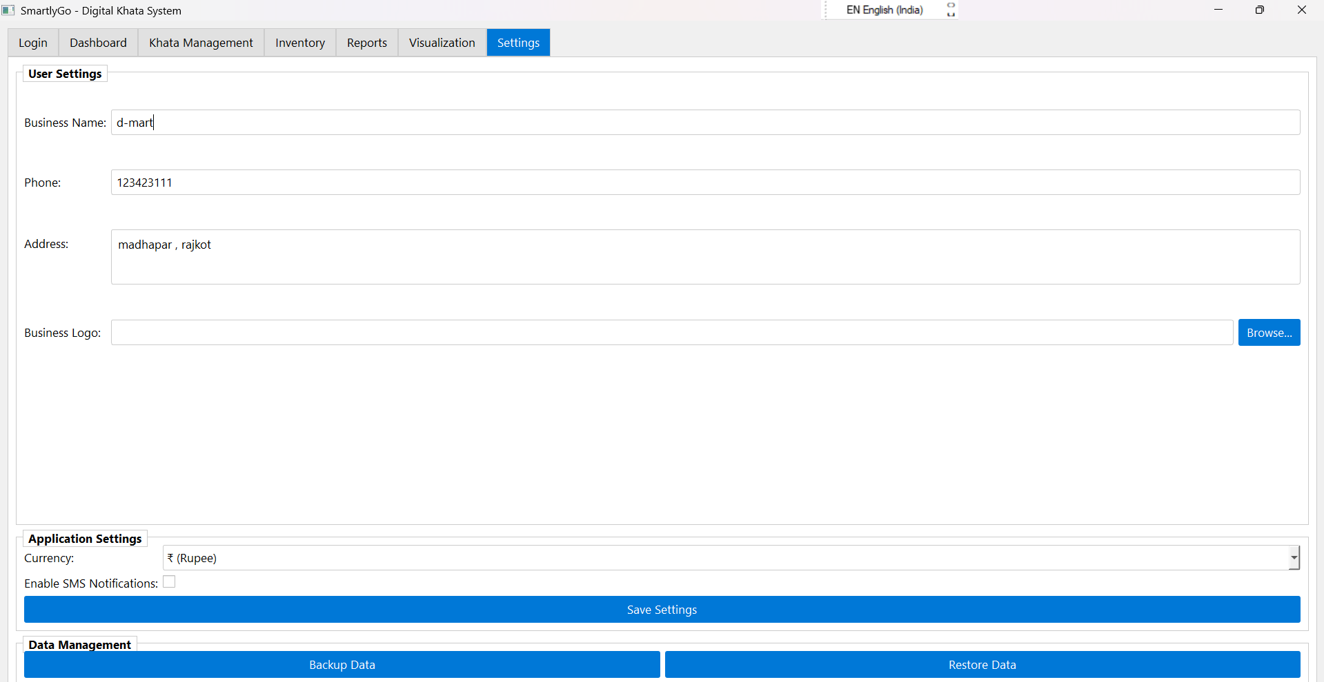
GUI Overview :

Slide 31
Learning During Project
Gained hands-on experience in Python (PyQt5) for developing professional GUI applications.
Learned how to design and manage a SQLite database with multiple interlinked tables.
Implemented secure authentication using bcrypt password hashing.
Explored report generation and export techniques (PDF, Excel, CSV, Print).
Understood the integration of data visualization with matplotlib for business insights.
Worked on QR code generation for products and payments.
Improved knowledge of software engineering practices like modular design, error handling, and UI/UX design.
Learned how to provide backup and restore functionality for data safety.
Enhanced skills in preparing system design diagrams (Flowchart, DFD, Use Case, Sequence, Activity, Class).

Slide 32
Bibliography
Online References :
Python Documentation – https://docs.python.org/
PyQt5 Official Docs – https://riverbankcomputing.com/software/pyqt/
SQLite Documentation – https://www.sqlite.org/docs.html
Matplotlib Docs – https://matplotlib.org/stable/
ReportLab – https://www.reportlab.com/documentation/
OpenPyXL – https://openpyxl.readthedocs.io/
bcrypt Library – https://pypi.org/project/bcrypt/
qrcode Library – https://pypi.org/project/qrcode/
Blogs, forums (Stack Overflow), and YouTube tutorials on Python GUI & Digital Ledger Systems.
Offline References :
Classroom lectures & faculty guidance on Software Engineering and Database Management Systems.
Standard textbooks on Database Systems and Software Design Patterns.
Project notes and reference material provided during coursework.

Slide 33
Conclusion
SmartlyGo successfully digitizes the traditional khata (ledger) system into a modern, secure, and user-friendly application.
It integrates customer, transaction, and inventory management with advanced features like reports, visualizations, and QR codes.
The project demonstrates how technology can simplify financial record-keeping for small businesses and individuals.
Key Outcomes :
Built a fully functional digital ledger system with GUI using Python (PyQt5).
Achieved secure authentication with encrypted user credentials.
Enabled efficient management of customers, transactions, and inventory.
Developed reports and visual insights for better decision-making.
Implemented data backup/restore and export options ensuring data safety.
Enhanced understanding of software development lifecycle & system design diagrams.

Slide 34


