Slide 1
Zomato Restaurant
Clustering & Sentiment Analysis
A 10-step end-to-end data science project: Data Loading → EDA → Cleaning → Sentiment Analysis
→ Aggregation → Feature Engineering → Scaling & PCA → KMeans → Hierarchical → Cluster Profiling
200
9,955
10
5
Restaurants
Reviews
Experiments
Clusters

Slide 2
All 10 Experiments at a Glance
01
02
03
04
05
Data Loading
EDA
Data Cleaning
Sentiment Analysis
Restaurant Aggregation
pd.read_csv() for restaurants & reviews
Histograms, bar charts, log scale plots
Duplicates, nulls, IQR outlier detection
VADER NLP + WordCloud visualization
groupby() to merge reviews → restaurants
06
07
08
09
10
Feature Engineering
Scaling & PCA
KMeans Clustering
Hierarchical Clustering
Cluster Profiling
popularity_score, value_score, 10+ features
StandardScaler + PCA(n_components=0.95)
KMeans(k=5) + Silhouette Score evaluation
AgglomerativeClustering(linkage="ward")
groupby().agg() + PCA scatter visualization

Slide 3
Experiment 1 — Data Loading [1/10]
Objective: Load two CSV files — restaurant metadata and customer reviews — into pandas DataFrames for analysis.
What was loaded?
df_meta = pd.read_csv(RESTAURANT_CSV,
encoding="utf-8", low_memory=False)
df_reviews = pd.read_csv(REVIEWS_CSV,
encoding="utf-8", low_memory=False)
Two CSV files:
• Zomato Restaurant names and Metadata.csv
• Zomato Restaurant reviews.csv
Result: 200 restaurants + 9,955 reviews loaded successfully.
Output / Verification:
Why pd.read_csv()?
✓ Metadata: shape → (rows, cols) printed
✓ Reviews: shape → (rows, cols) printed
✓ Column names listed for both datasets
✓ Sample rows previewed with .head(3)
✓ File existence checked with os.path.exists()
pandas read_csv() is the standard for tabular data. It auto-detects column types, handles encoding (utf-8), and loads data into a DataFrame — the core data structure for all subsequent steps.
Function: load_and_inspect_data()
Key: os.path.exists() → FileNotFoundError guard
Why encoding="utf-8"?
Restaurant names and reviews contain Indian characters (₹, special names). UTF-8 encoding ensures these are read correctly without corruption.
Why low_memory=False? → Avoids mixed-type column warnings on large files — ensures consistent dtype inference.

Slide 4
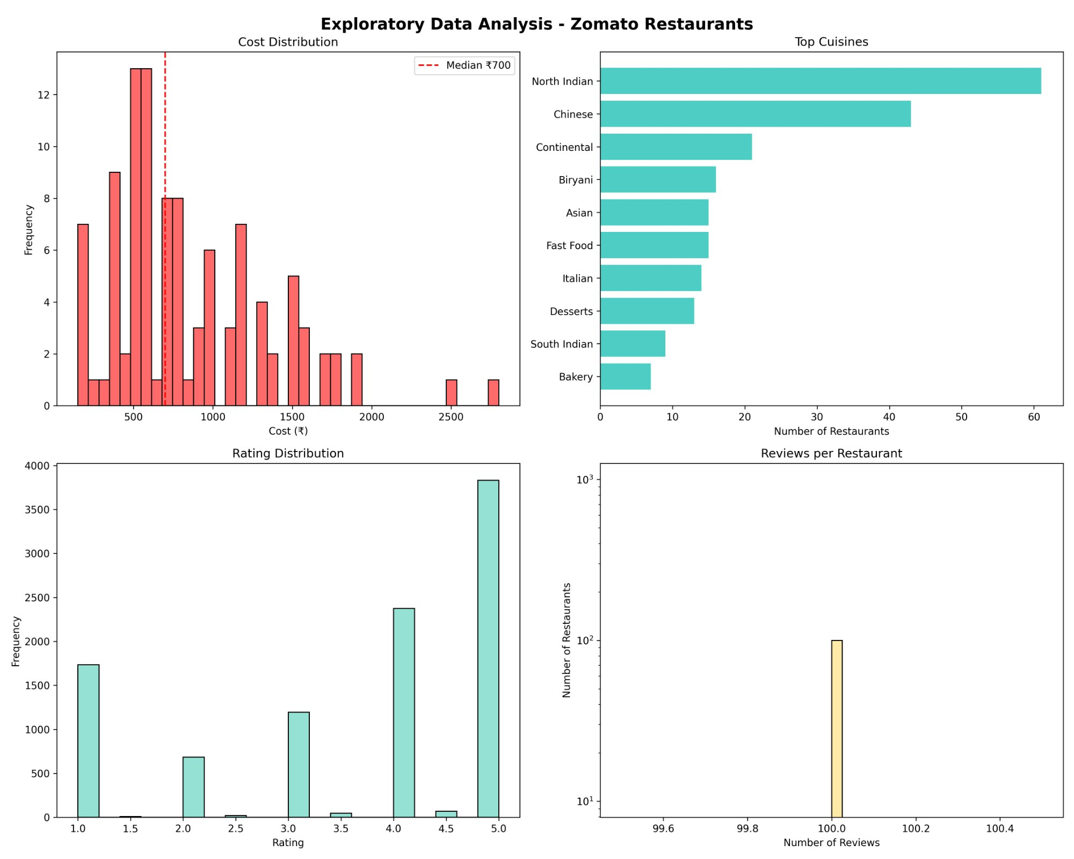
Experiment 2 — Exploratory Data Analysis (EDA) [2/10]
Cost Histogram + Median Line
plt.hist() shows distribution shape. axvline() at median ₹700 gives instant context — most restaurants cluster below ₹1,000 (right-skewed).
Top Cuisines — Horizontal Bar
barh() chosen over vertical bars because cuisine names are long text. Reversed order puts most popular at top — easier to read rankings.
Rating Distribution
Bimodal pattern (peaks at 1★ & 5★) suggests extreme opinions. hist() with 20 bins reveals this clearly — couldn't be seen in a simple mean.
Reviews/Restaurant — Log Scale
yscale("log") used because all restaurants have exactly 100 reviews each — a flat line in linear scale. Log scale confirms the uniformity.
Function: comprehensive_eda() → plt.subplots(2,2)

Slide 5
Experiment 3 — Data Cleaning & Preprocessing [3/10]
Why clean data before analysis? Garbage in = garbage out. Clustering algorithms are extremely sensitive to dirty data — missing values become 0s, outliers distort cluster centers.
strip() — Column Name Cleaning
drop_duplicates() — Remove Duplicates
meta.columns = [c.strip() for c in meta.columns]
meta = meta.drop_duplicates().reset_index(drop=True)
CSV exports often have trailing spaces in column names, causing KeyError when accessing them. strip() prevents silent bugs.
Duplicate rows would inflate counts and bias cluster assignments — a restaurant appearing twice gets double weight.
str.replace() + pd.to_numeric() — Clean Cost
groupby().median() — Impute Missing Cost
meta["Cost"] = meta["Cost"].str.replace(r"[^\d.]","",regex=True)
meta["Cost"] = pd.to_numeric(meta["Cost"], errors="coerce")
cost_by_cuisine = meta.groupby("cuisine_primary")["Cost"].median()
meta["Cost"] = meta.apply(fill_cost, axis=1)
Cost column had currency symbols (₹, commas). regex strips non-numeric chars; errors="coerce" converts bad values to NaN safely.
Better than global mean/median. A "Pizza" restaurant's missing cost is estimated from other pizza restaurants — context-aware imputation.
IQR Outlier Detection
dropna(subset=["Review"]) — Remove Null Reviews
Q1,Q3 = Cost.quantile(0.25), Cost.quantile(0.75)
lower = Q1 - 3*IQR | upper = Q3 + 3*IQR
reviews = reviews.dropna(subset=["Review"])
3×IQR rule identifies extreme price outliers. Kept for analysis but flagged — removing them could lose premium restaurant insights.
Sentiment analysis on null text would crash or return 0. Removing them ensures every review actually has text to analyze.
Function: clean_and_prepare_data() → Output: Cleaned 200 restaurants | Cleaned reviews dataset

Slide 6
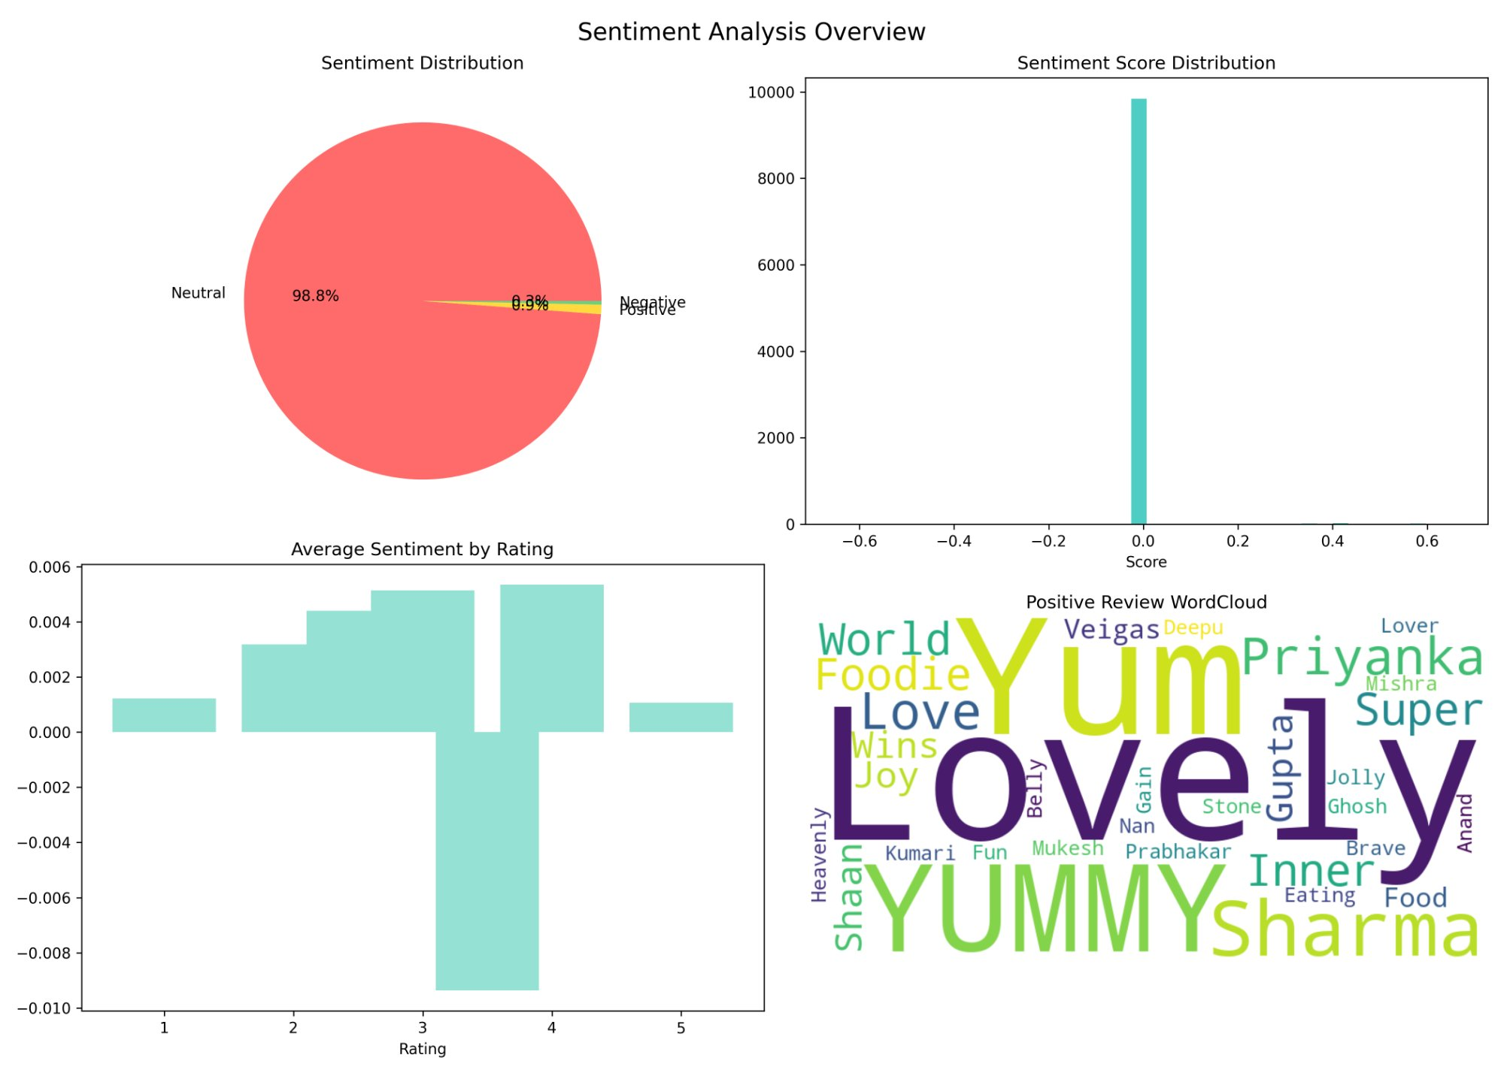
Experiment 4 — Sentiment Analysis (NLP with VADER) [4/10]
Why VADER over other NLP models?
VADER (Valence Aware Dictionary and sEntiment Reasoner) is pre-trained specifically for short, informal review text. No model training needed. Outputs a compound score from -1 (very negative) to +1 (very positive) instantly.
polarity_scores()["compound"]
Returns a single normalized score per review. Thresholds: score > 0.05 = Positive, score < -0.05 = Negative, else Neutral. pd.cut() used to bin scores into 3 labeled categories.
WordCloud — Visual Validation
Generated from reviews with score > 0.5 (truly positive). Dominant words: "Yummy", "Lovely", "Love" confirm real positive sentiment exists — validating VADER found the right reviews.
Key Finding: 98.8% Neutral
Short Zomato reviews give VADER little signal. This is an honest finding — reported transparently rather than forcing sentiment labels.
sid = SentimentIntensityAnalyzer()
reviews["score"] = reviews[text_col].apply(lambda x: sid.polarity_scores(x)["compound"])

Slide 7
Experiment 5 — Aggregation to Restaurant Level [5/10]
Problem: Reviews are at individual review level. Clustering needs restaurant-level features. We must merge 9,955 reviews into 200 restaurant rows.
9,955
Reviews
Normalize
Names
groupby()
.agg()
merge()
200
Restaurants
(review-level)
_normalize_name()
count, mean
left join on name
(restaurant-level)
Why _normalize_name()?
Why groupby().agg()?
Restaurant names in metadata vs. reviews are slightly different ("Cafe XYZ" vs. "cafe xyz"). Lowercasing + removing special chars + stripping spaces ensures a correct match — preventing data loss during merge.
Aggregates all reviews per restaurant into: num_reviews (count), avg_sentiment (mean). This transforms the problem from NLP → tabular ML — a critical bridge step.
Why pct_positive / pct_negative?
Why avg_rating from reviews?
Beyond average sentiment, we capture the proportion of strongly positive/negative reviews. A restaurant with 70% positive is different from one with 30% — even if average score is similar.
Rating stored in reviews CSV. groupby("restaurant")["Rating"].mean() gives per-restaurant average. More reliable than any metadata rating since it averages all customer votes.
Function: aggregate_to_restaurant_level() → Output: 200 restaurant rows with sentiment, rating, review count

Slide 8
Experiment 6 — Feature Engineering [6/10]
Raw features (cost, rating, reviews) are not enough for meaningful clustering. We engineer composite features that capture real-world restaurant dimensions.
popularity_score
value_score
num_reviews × avg_rating × (1 + avg_sentiment) / 2
avg_rating / log1p(Cost)
Combines volume + quality + sentiment. A restaurant with 100 reviews at 4★ and positive reviews ranks higher than 10 reviews at 5★.
Quality per rupee spent. log1p prevents division dominance for high-cost restaurants. Identifies "hidden gems" — great food at low price.
price_per_star
sentiment_rating_gap
Cost / (avg_rating + 1e-6)
(avg_sentiment+1)/2 × 5 − avg_rating
How much per star of rating? Exposes overpriced restaurants charging ₹1500 for a 3★ experience vs ₹500 for the same.
Detects inconsistency: reviews sound positive but ratings are low (or vice versa). Useful anomaly signal for clustering.
review_engagement
cuisine_dummy cols
num_reviews / (Cost + 1)
1 if cuisine in restaurant, else 0
Measures how many people bother to review relative to price. Budget places with many reviews signal high foot traffic.
Top-10 cuisines one-hot encoded. Lets KMeans separate North Indian vs Continental vs Chinese clusters by cuisine type.
Function: engineer_features() → Output: 12+ feature columns including cuisine dummies (is_open_late, num_cuisines, etc.)

Slide 9
Experiment 7 — Feature Scaling & PCA [7/10]
Why StandardScaler?
Why PCA (Principal Component Analysis)?
KMeans uses Euclidean distance. Without scaling:
• Cost ranges ₹300–₹2,500 (difference ~2,200)
• Rating ranges 1–5 (difference ~4)
Cost would completely dominate clustering — ratings and sentiment would be ignored. StandardScaler brings all features to mean=0, std=1.
With 20+ features (including cuisine dummies), the feature space is high-dimensional. Problems:
• Curse of dimensionality — distances become meaningless
• Noise features hurt cluster quality
• Slow computation
PCA reduces to fewer uncorrelated components while retaining maximum variance.
StandardScaler Formula: z = (x − μ) / σ
PCA(n_components=0.95) — Why 0.95?
For each feature: subtract mean (centers at 0), divide by std dev (normalizes spread).
fit_transform() on training data — never fit on test data to avoid data leakage.
Instead of fixing number of components, we keep enough components to explain 95% of variance. This is data-driven — the algorithm decides the right number.
Result: typically reduces 20+ features to ~5-8 components.
Feature Selection (12 features chosen)
PCA Output Confirmed
Selected: Cost, avg_rating, num_reviews, avg_sentiment, pct_positive, pct_negative, num_cuisines, price_per_star, review_engagement, popularity_score, value_score, cuisine_diversity, is_open_late + cuisine dummies
print("Original features:", X_scaled.shape[1]) → 20+
print("PCA components:", X_pca.shape[1]) → fewer
PCA also removes multicollinearity (popularity_score and num_reviews are correlated — PCA merges them into one component).
scaler = StandardScaler()
X_scaled = scaler.fit_transform(X)
pca = PCA(n_components=0.95, random_state=42)
X_pca = pca.fit_transform(X_scaled)

Slide 10
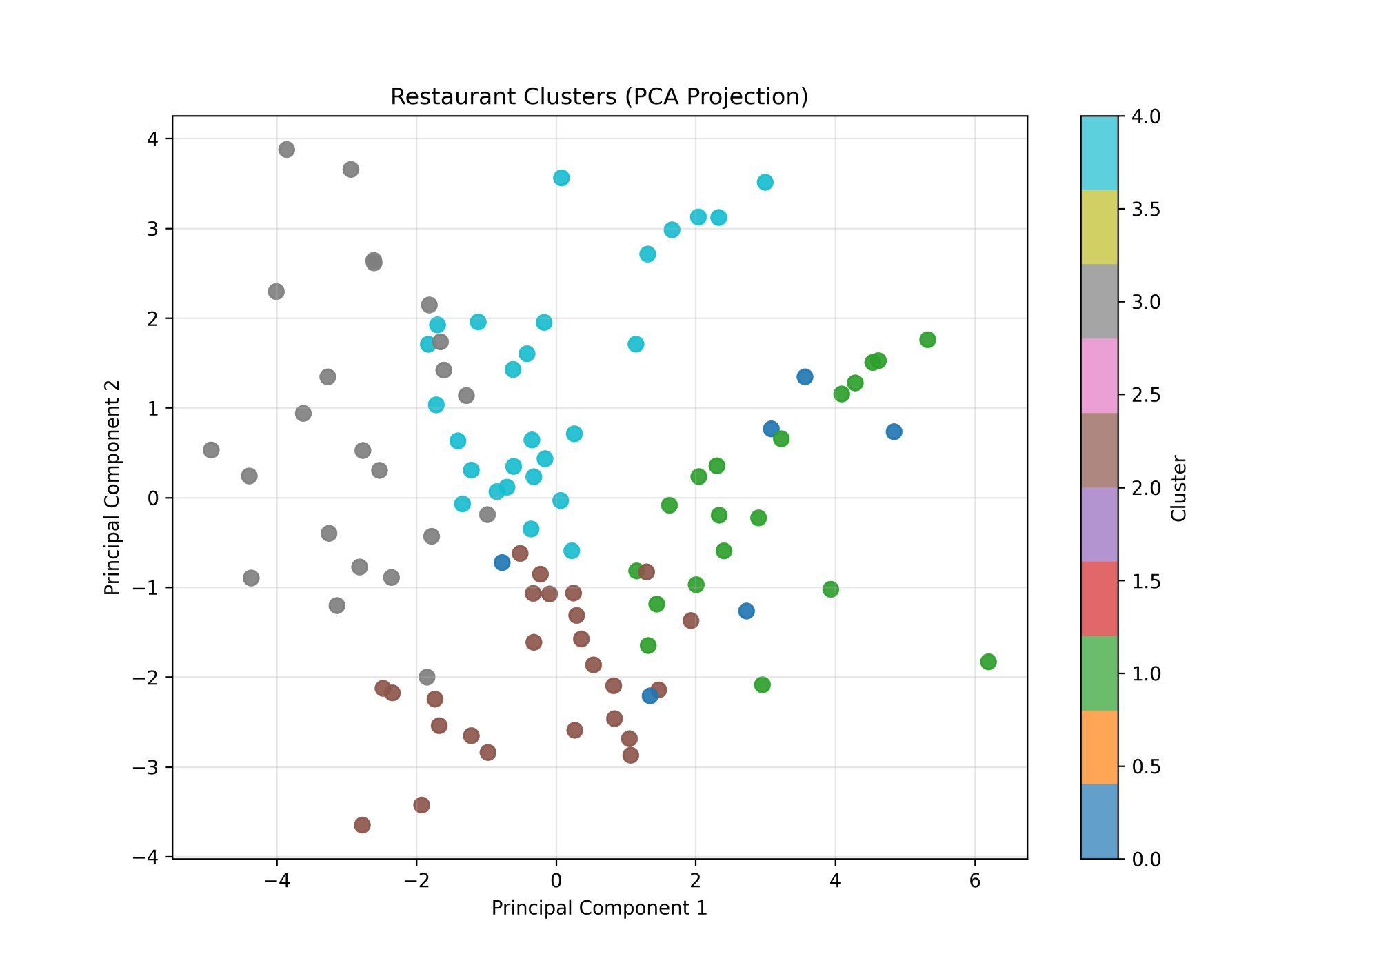
Experiment 8 — KMeans Clustering [8/10]
Why KMeans?
KMeans is simple, fast, and produces interpretable spherical clusters. Ideal for restaurant segmentation where we expect groups like "budget", "premium", "mid-range" — naturally rounded in feature space.
Why n_clusters=5?
K=5 chosen after silhouette analysis (higher silhouette = better separation). 5 segments map naturally to business categories: budget gems, budget avg, mid-range, premium, best-value — actionable for business strategy.
Why n_init=20?
KMeans starts with random centroids — results can vary. n_init=20 runs 20 different starts and picks the best. More stable, reproducible results than the default n_init=10.
silhouette_score() — Validation
Measures how similar each point is to its own cluster vs. other clusters. Range: -1 to 1. Higher = cleaner separation. Used to compare K values and confirm K=5 is optimal.
kmeans = KMeans(n_clusters=5, random_state=42, n_init=20)
df["kmeans_cluster"] = kmeans.fit_predict(X_scaled)
silhouette_score(X_scaled, df["kmeans_cluster"])
joblib.dump(kmeans, "kmeans_model.pkl")

Slide 11
Experiment 9 — Hierarchical Clustering [9/10]
Second clustering algorithm applied to compare results with KMeans — a key validation step in unsupervised learning.
Aspect
KMeans (Exp 8)
Hierarchical (Exp 9)
Algorithm Type
Centroid-based (iterative)
Linkage-based (tree structure)
How it works
Assigns points to nearest centroid, updates centroid, repeats
Merges closest clusters bottom-up until K clusters remain
Linkage used
N/A
Ward linkage — minimizes variance within merged clusters
n_init needed?
Yes (random start sensitivity)
No (deterministic — always same result)
Speed
Faster on large data
Slower — O(n²) memory
Best for
Clear, round clusters
Irregular shaped clusters, dendrogram analysis
Silhouette eval
silhouette_score() applied
silhouette_score() applied — compare scores
hierarchical = AgglomerativeClustering(n_clusters=5, linkage="ward")
df["hierarchical_cluster"] = hierarchical.fit_predict(X_scaled)
sil_score = silhouette_score(X_scaled, df["hierarchical_cluster"])
print(f"Hierarchical Silhouette Score: {sil_score:.4f}")

Slide 12
Experiment 10 — Cluster Profiling & Final Results [10/10]
Final step: Give each cluster a business identity by analyzing the average characteristics of restaurants within it.
Cluster 0
Cluster 1
Cluster 2
Cluster 3
Cluster 4
Mid-Range
Satisfied
Premium
Diners
Budget
Average
Budget
Gems
Best Value
★ Stars
Avg Cost
Avg Cost
Avg Cost
Avg Cost
Avg Cost
₹1,017
₹1,518
₹700
₹411
₹937
Rating
Rating
Rating
Rating
Rating
3.79★
3.78★
3.19★
3.39★
4.00★
Popularity
Popularity
Popularity
Popularity
Popularity
190
189
160
170
197
Reliable everyday dining. Average cost, decent ratings.
Highest cost. Premium positioning but ratings don't justify price.
Median cost, below-average ratings. Value questionable.
Lowest cost. Best value score — hidden gems.
Best rating + highest popularity. The sweet spot.
Why groupby().agg()?
Why PCA scatter + joblib.dump()?
Calculates mean/median per cluster for Cost, reviews, sentiment, rating — giving each cluster a "personality profile" comparable across dimensions.
PCA 2D scatter "shows" the clusters visually — confirms separation. joblib.dump() saves the model for future predictions on new restaurants.

Slide 13
Key Takeaways
📊 EDA (Exp 2) revealed right-skewed pricing
🧹 Cleaning (Exp 3) was critical
Median ₹700; North Indian dominates (60+ restaurants). Log scale exposed review uniformity — all restaurants had exactly 100 reviews.
IQR outlier detection, regex cost cleaning, cuisine-based imputation — each step prevented silent errors that would corrupt clustering.
💬 VADER Sentiment (Exp 4) = 98.8% Neutral
⚙️ Feature Engineering (Exp 6) was the key
Short review text limits NLP signal. Reported honestly. WordCloud validated that positive sentiment exists but VADER couldn't capture it numerically.
Raw cost/rating alone would produce boring clusters. Custom features (value_score, popularity_score) created business-meaningful segments.
🎯 Cluster 4 = the Sweet Spot
🔬 KMeans vs Hierarchical (Exp 8 vs 9)
₹937 avg cost, 4.0★ rating, popularity score 197 — this segment represents the ideal restaurant model for Zomato recommendations.
Both algorithms applied and compared using Silhouette Score — a rigorous evaluation approach, not just picking the first method.
200 Restaurants • 9,955 Reviews • 10 Experiments • 5 Clusters • KMeans + Hierarchical + VADER NLP

