Slide 1
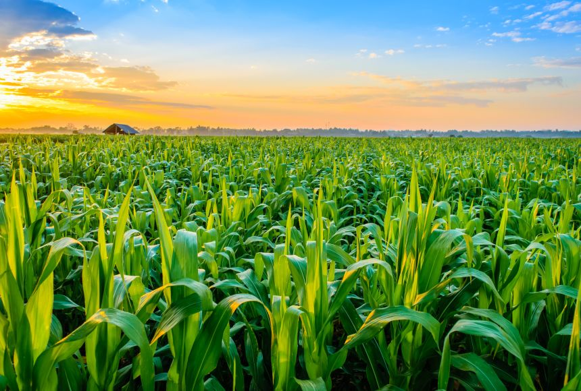
CROP PRODUCTION ANALYSIS IN INDIA
A detailed insight into India’s crop production and identifying the KPI’s associated with it.

Slide 2
Key Performance Indicators(KPI)
Production over the years
Increase/Decrease of Production Area
Most produced crop of each state
Geographic location

Slide 3
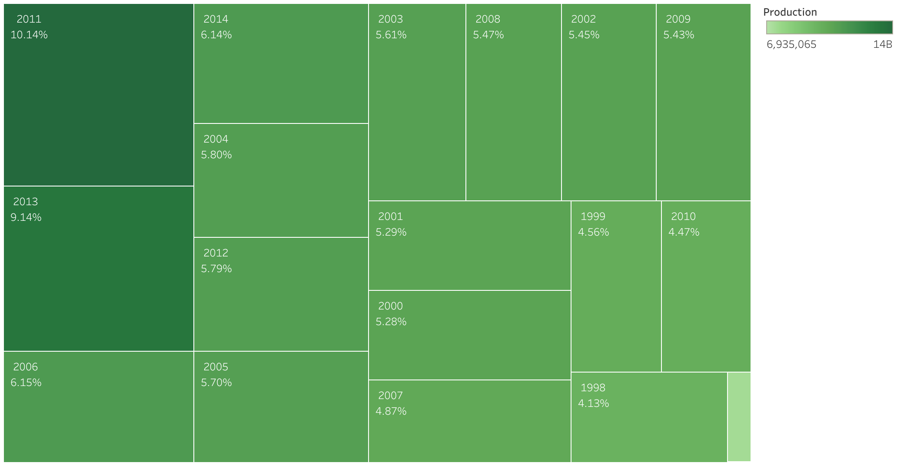
RANGE OF DATA COLLECTION
The given data has been collected from 1997 to 2014.
Production was at its lowest (relatively) during 1997 accounting to only 0.60% of the total production.
Production was at its relative highest during 2011 accounting to more than 10% of the total production.

Slide 4
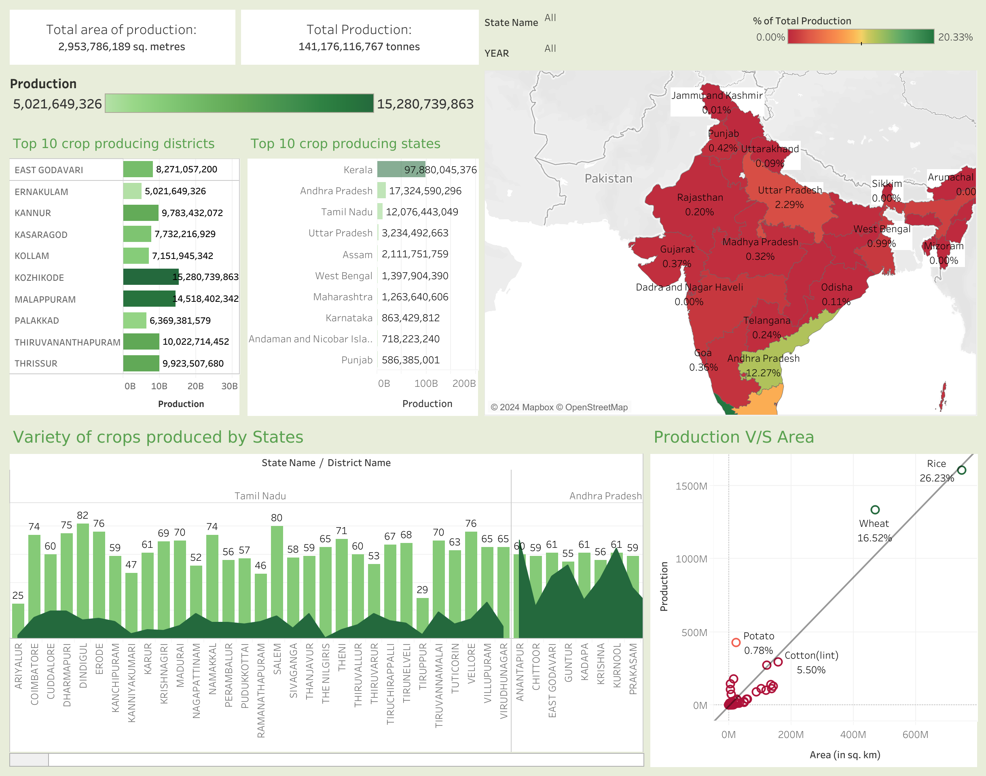
Crop production analysis (Dashboard 1)
CROP PRODUCTION ANALYSIS DASHBOARD.
This dashboard is based on the crop production data of India (1998-2015)
It provides insights into the major crops being produced along with the factors affecting them.
All the charts displayed are explained in the aforementioned slides.

Slide 5
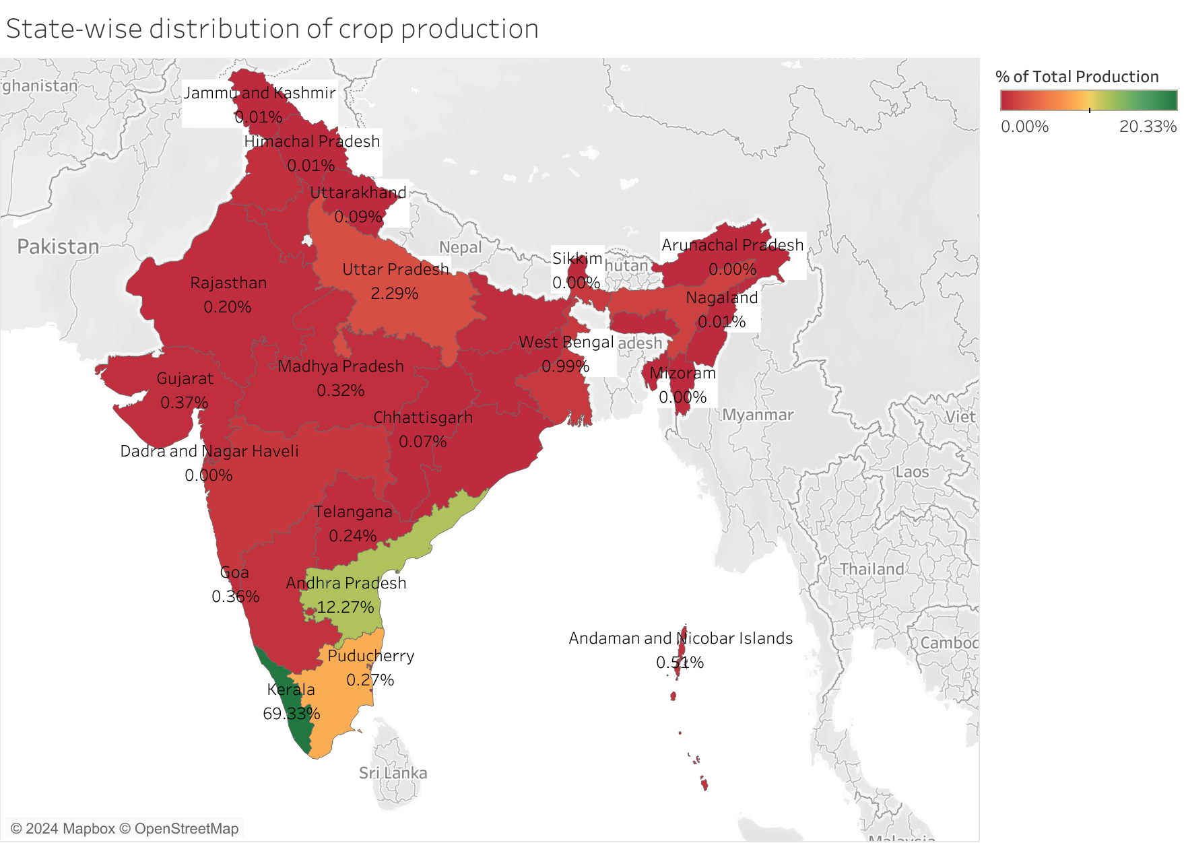
Map based on the quantity of crops produced by each state. The marks are labelled by state-name and percentage of the total crop production.
Kerela is the highest producer of crops in India accounting to almost 70% of India’s total crop production.
The southern states alone account for more than 80% of India’s total crop production.
The southern states mainly experience high rainfall meaning weather plays a vital role in crop production.

Slide 6
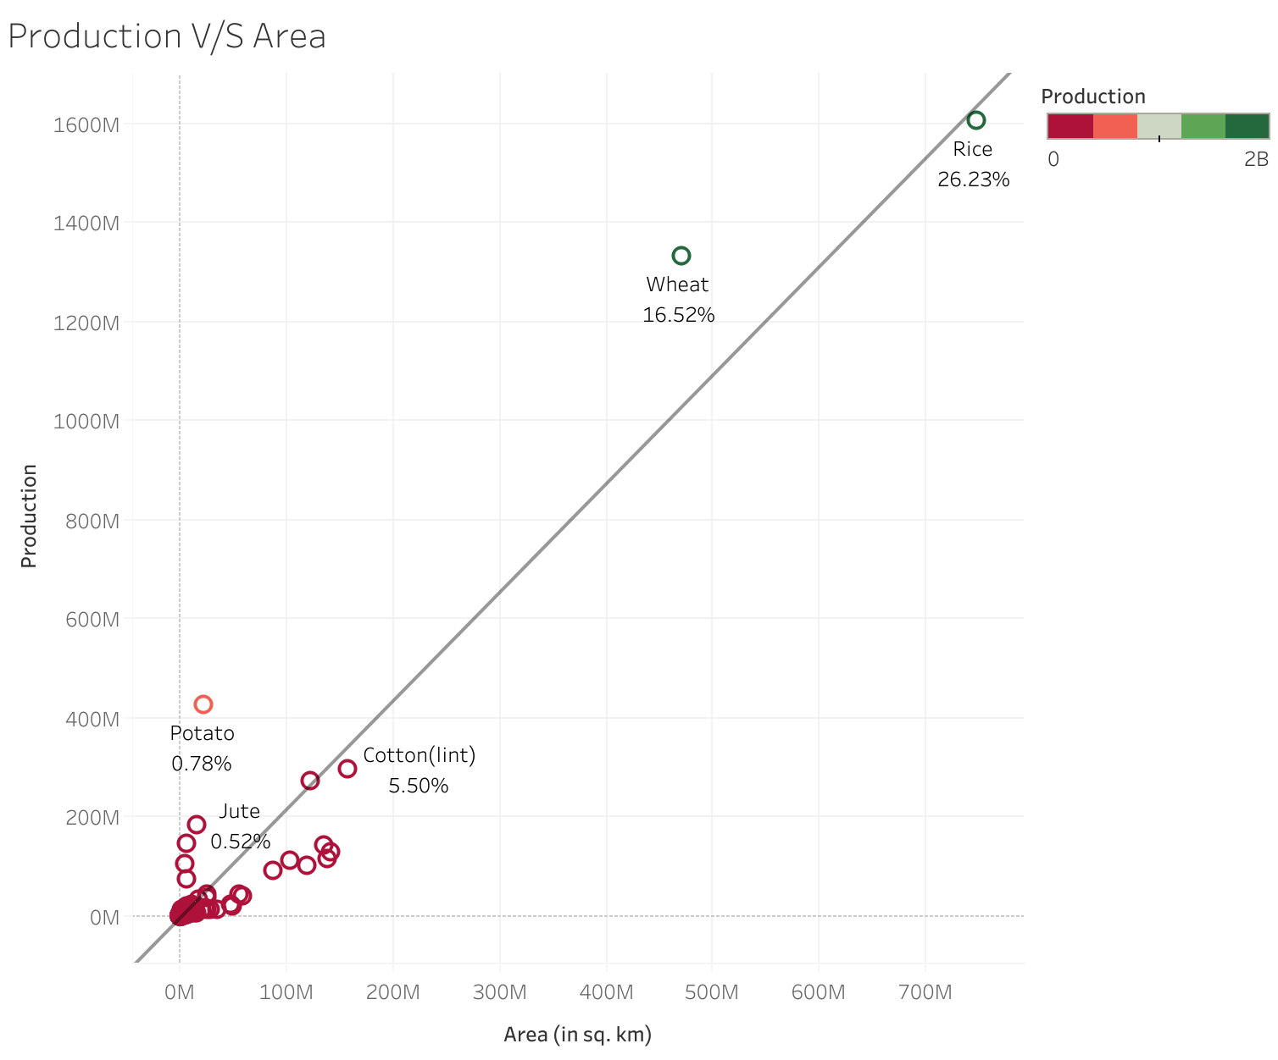
As shown in the chart, while having a large production area means more crop production, almost 50% of the total production area is dedicated to wheat and rice (these two being the most prevalent in our food habits)
There are crops like potato, jute etc. which require very less production area as compared to others meaning we can get ample production while taking up relatively less space.
Not shown in this chart are coconut and sugarcane being the main outliers. Both these crops give maximum production while taking up minimum space.

Slide 7
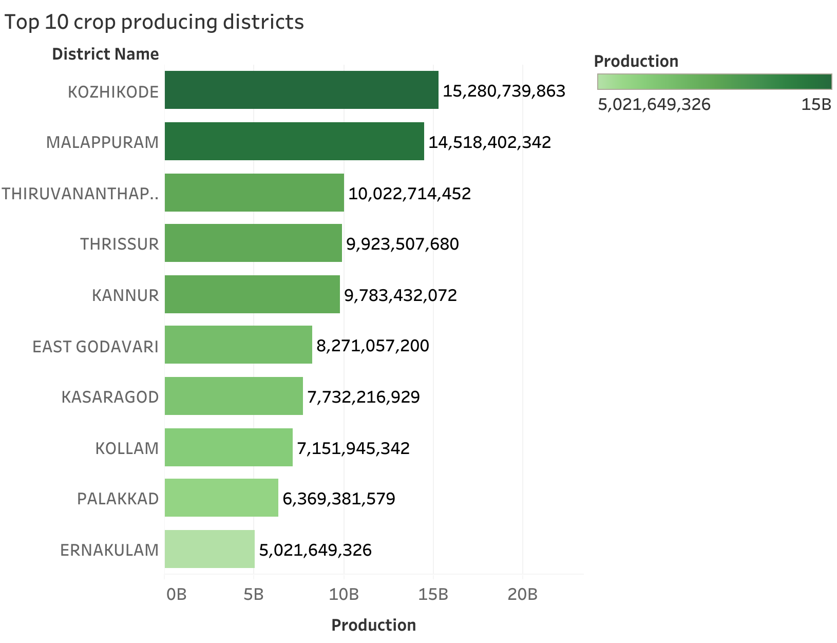
This data provides insights into the top crop producing districts of India with 9/10 of them being from Kerela itself.
The major crop being produced is coconut accounting to over 92% of the total crop production in the country.

Slide 8
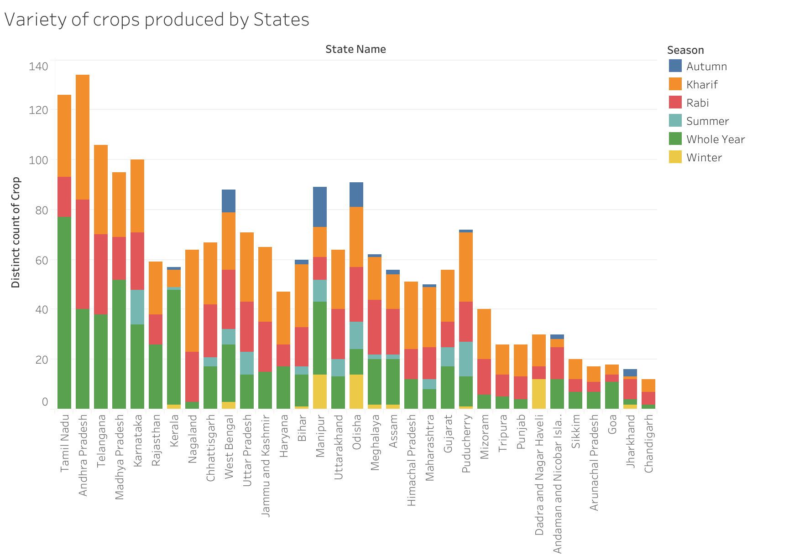
This chart provides data about the total variety of crops being produced state-wise.
The different colors highlight the various season in which the crops are produced.
Andhra Pradesh produces the highest variety of crops as compared to the other states followed by Tamil Nadu.
Season wise, it is very clear that the least number of crops are produced during autumn.

Slide 9
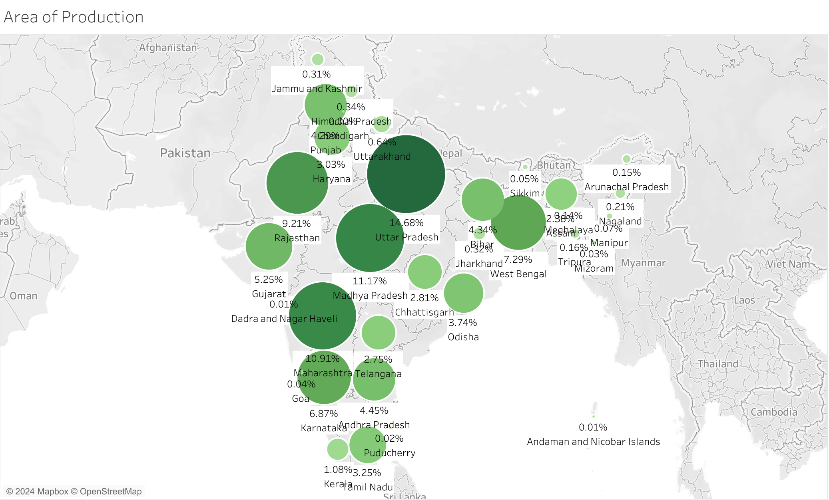
Uttar Pradesh accounts for the highest area in crop production as compared to the other states of India, holding over 14% of the total area.
Sugarcane is the most produced crop of Uttar Pradesh taking up about 62% of the overall produce.

Slide 10
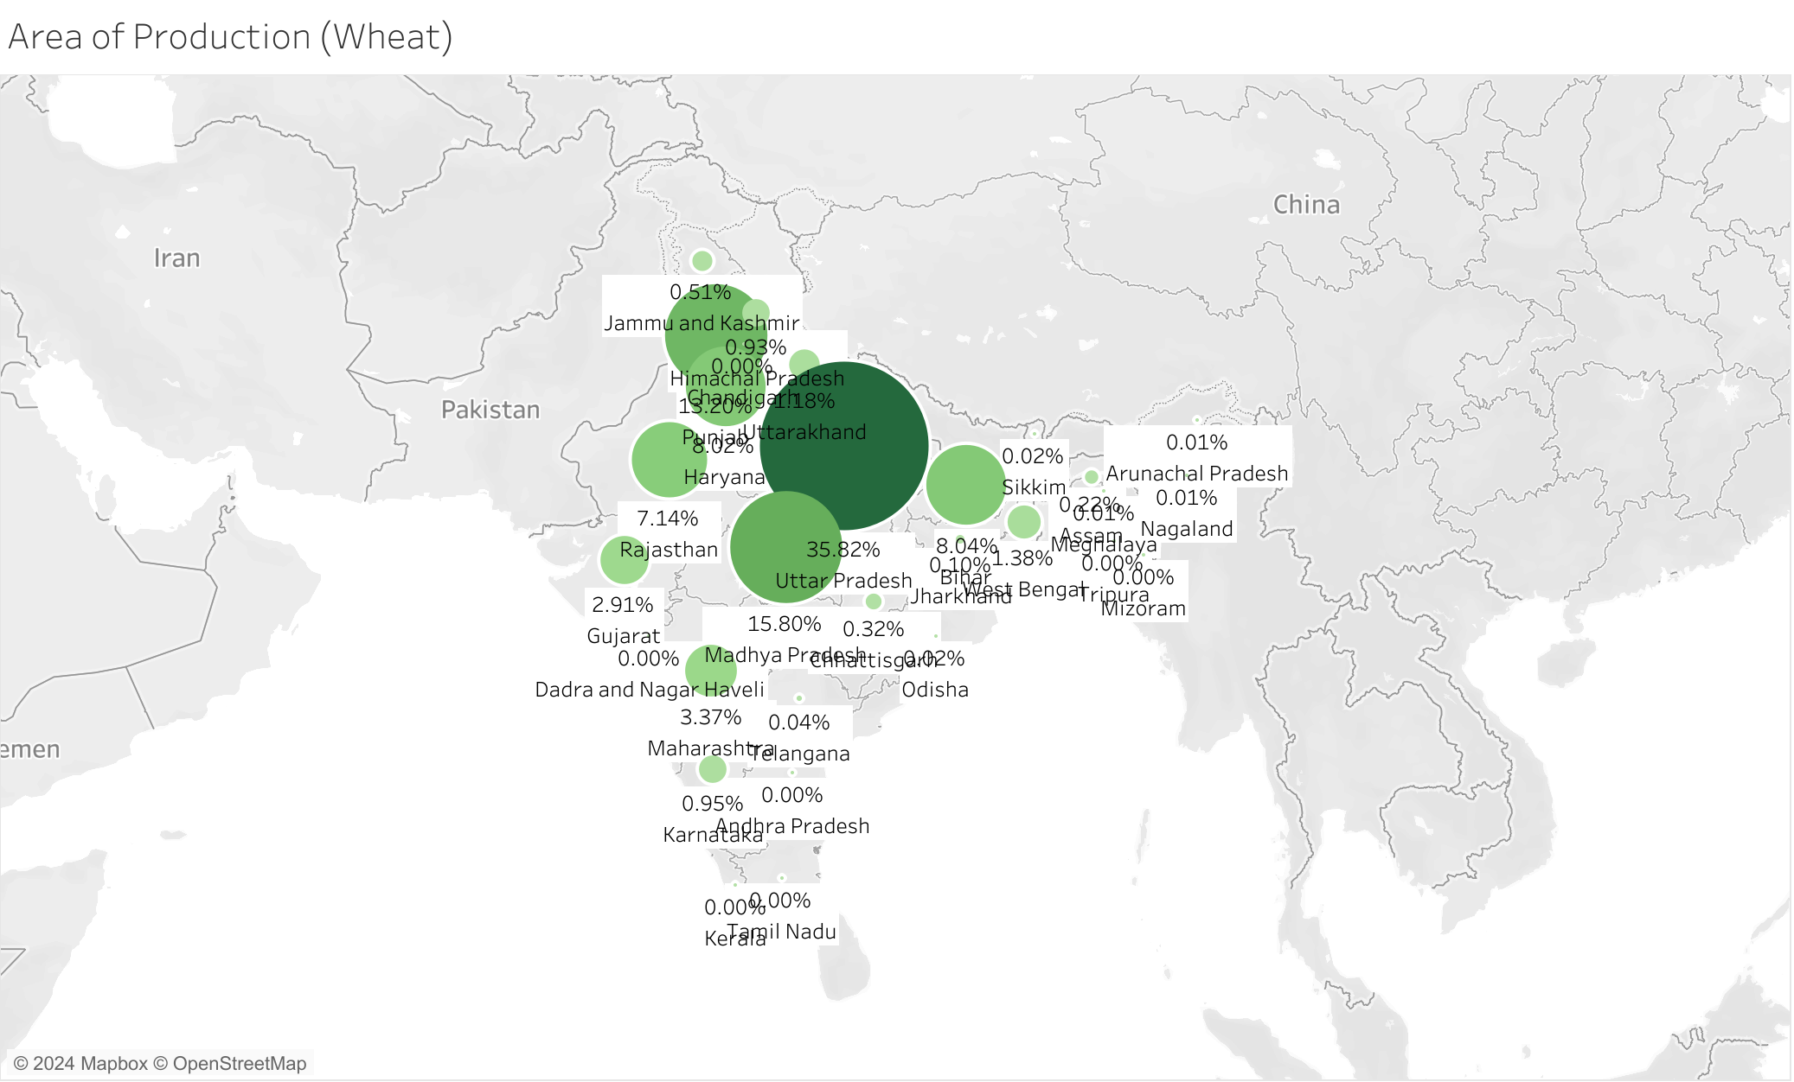
Wheat is mainly cultivated in the northern states owing to their food habits.
Uttar Pradesh is the largest cultivator of wheat spanning an area of over 35% of the total wheat production area.

Slide 11
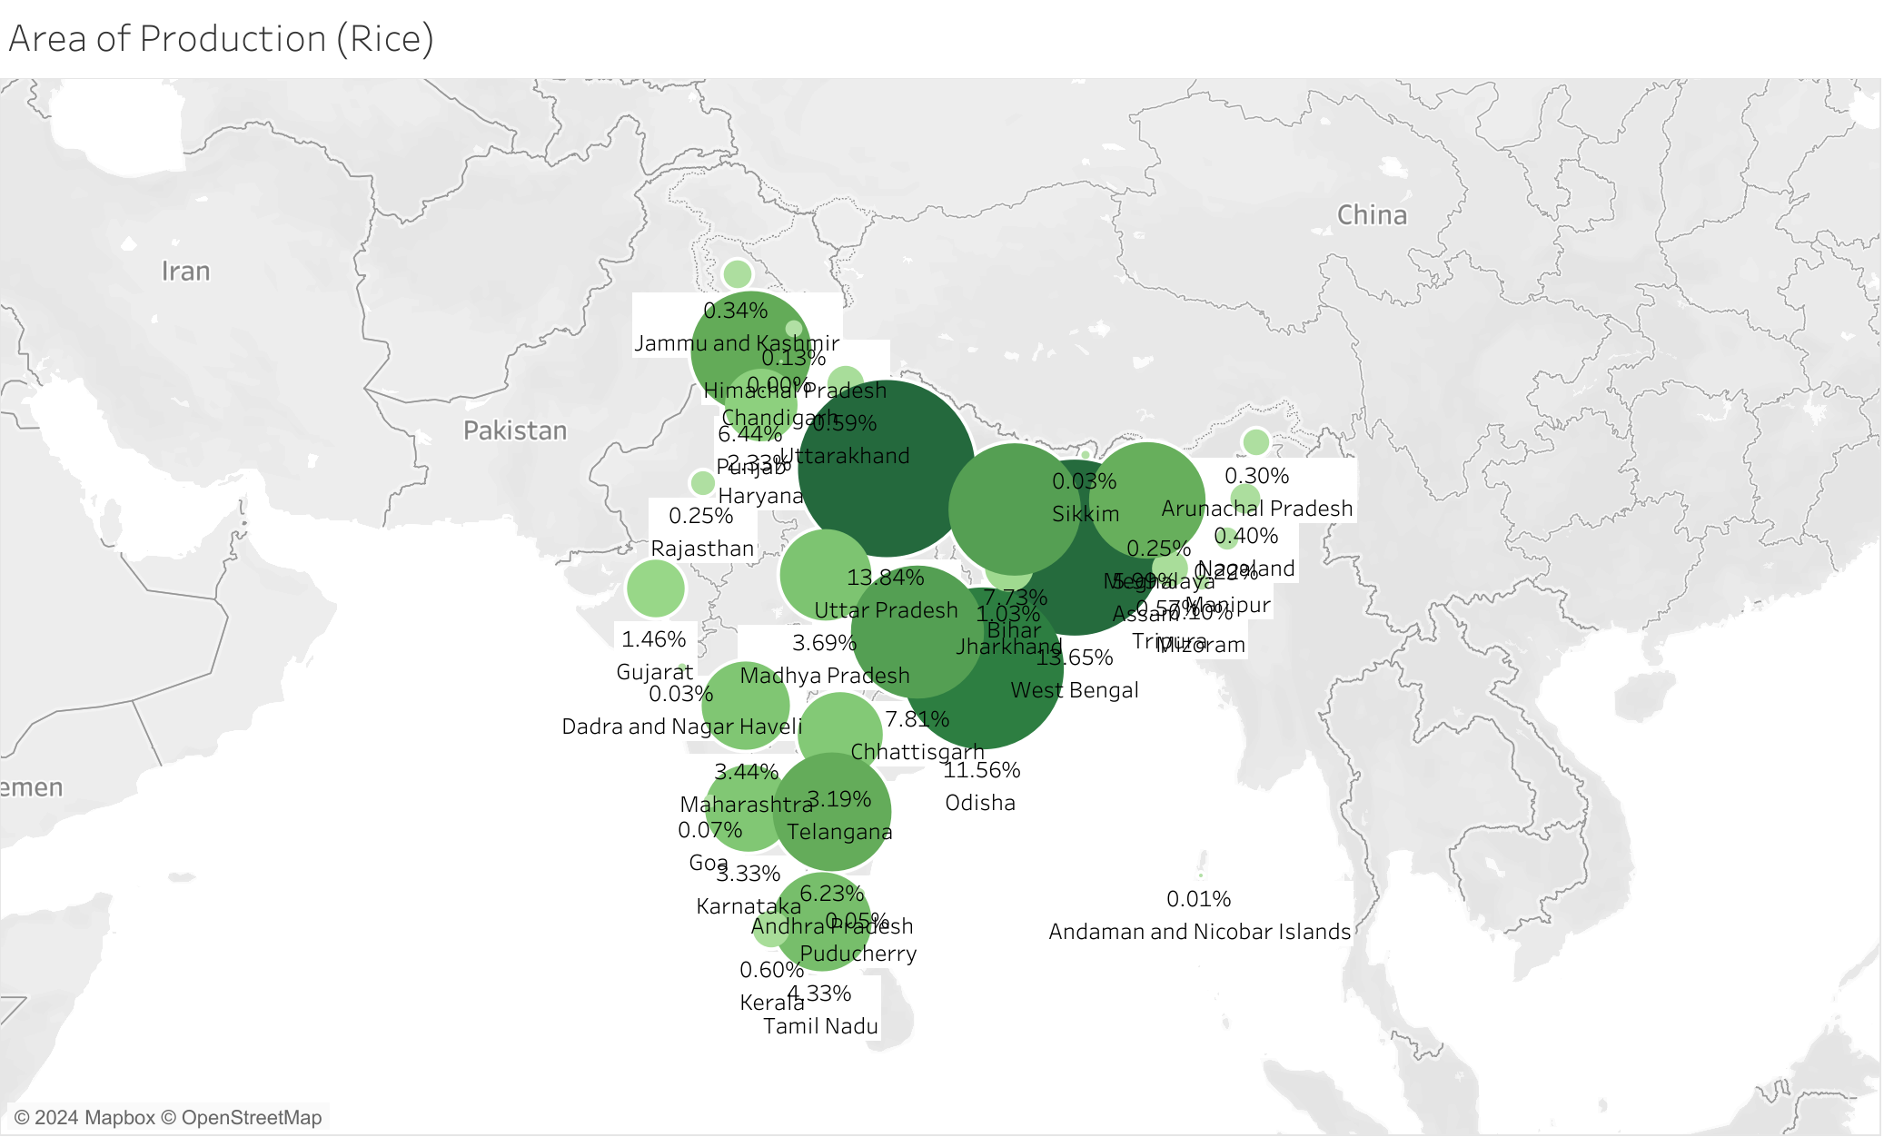
As we move farther from the north, the cultivation of rice becomes more prevalent.
West Bengal is the highest producer of rice, followed by Uttar Pradesh and Assam.
The southern states also account for around 15% of the total area for rice cultivation.

Slide 12
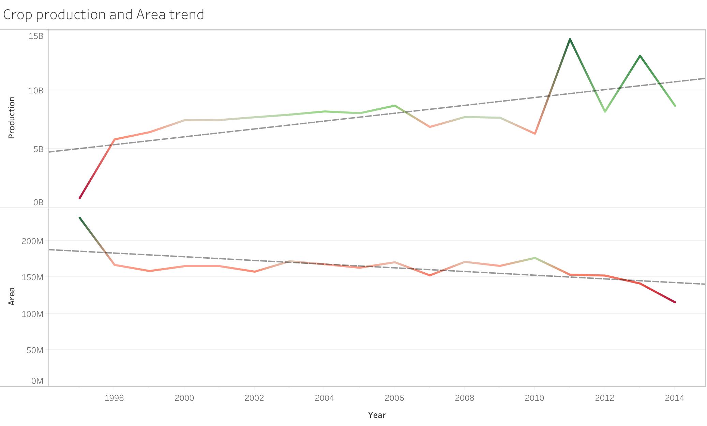
The chart provides a clear picture on how the land areas for farming and the sum total production of crops have fared since the beginning of the year 1998 to the end of the year 2014.
As derived from the chart, we can see that the trend line of production is fairly positive signifying that we have had an overall increase in crop production.
The production area on the other hand has seen a gradual decrease as signified by the negative trend line.

Slide 13
Conclusions:
Coconut is the highest produced crop but requires very less area for production, growing mainly in the southern states due to their tropical weather conditions.
The northern states mainly cultivate wheat but as we move towards the south and north-east, the cultivation of Rice becomes more and more prevalent.
Over the years, though production of crops have increased, the overall cultivation area has seen a significant decrease from over 200 million sq. meters in 1998 to less than 150 million sq. meters in 2014.
Though high cultivation area benefits more production, crops like coconut and sugarcane deter from this trend giving high production in minimal area.

Slide 14
THANK YOU

