Slide 1
INTRODUCTION
Interest in modeling traffic flow has been around since the appearance of traffic jams. Ideally, if we can correctly predict the behavior of vehicle flow given an initial set of data, then, in theory, adjusting the flow in crucial areas can maximize the overall throughput of traffic along a stretch of road. This is of particular interest in regions of high traffic density, which may be caused by high-volume peak time traffic, accidents or closure of one or more bones of the road.
The analysis of network flow analysis through a definite road channel during peak traffic hour shows how the system of linear equation can be used in practical life.

Slide 2
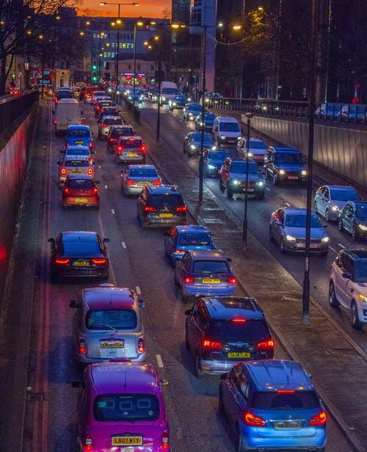
Project overview
Project domain: Traffic flow
Project title: Solve real life traffic problems using system of linear equations

Slide 3
Problem Statement
Identifying real-life traffic problem in Andheri East, Mumbai for one way consisting 6 intermediate junctions and solving them using system of linear equations

Slide 4
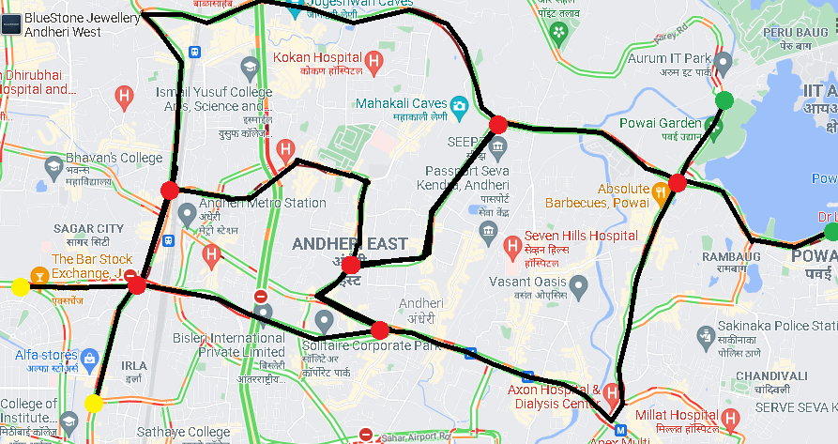
Traffic flow of Andheri East, Mumbai

Slide 5
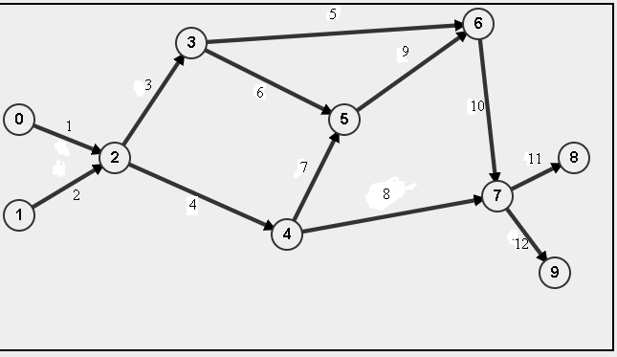
Graph of traffic flow

Slide 6
Graphical Information
Paths
Nodes
1. CD barfiwala road
2. Swami Vivekananda road
3. Swami Vivekananda road
4. Professor NS Phadke road
5. Jogeshwari – Vikhroli Link road
6. Mahakali caves road
7. Andheri road
8. Saki vihar road
9. MIDC central road
10. Jogeshwari – Vikhroli Link road
11. Saki vihar road
12. The view road
Mahindra NBS International
DCB Bank
Honda Big Wing Mumbai - Sales
MIDC
Speez village
Sakinaka Traffic Division

Slide 7
Rules to be applied
Node 0 and 1 are called source nodes. All the vehicles are enter from there.
Node 8 and 9 are called sink nodes. All the vehicles will exit from there.
All the other nodes are called intermediate nodes. At any given time number of vehicles entered and exited are remain unchanged at any intermediate node

Slide 8
CONTRIBUTIONS TO THE PROJECT
Raj Patel-He looked up the concept and ideas on the web and took part in team conversations to come up with an effective solution.
- Reproduced work on our network flow analysis was done by him and Soham.
Manthan Patel- He looked at a lot of web pages and articles for ideas on how to solve the answers perfectly.
-He was the mainframe for the plan of action of our project.
Vandan Shah- Designed the ppt for the final submission along with technical focus and team morale.
- He contributed the part of background, motivation.
Daksh Suthar-Along with his speed of execution single-handedly did the work of literature survey and references of the articles as well as helped a big-time during team chats.
Soham Jagrit- He contributed thoughts and suggestions to the project. Spend a significant amount of time advising other members on particular tasks involving their knowledge in their field.

Slide 9
Results
Problem 1:
Let’s assume e = 400; y = 900; z =1200; *
a = y - e = 500;
b = z - y = 300;
c = z - e = 800;
d = 4200 + e - y = 3700;
e = e = 400;
x = 4200 - y = 3300;
y = y = 900;
z = z = 1200;
*(each quantity in VPH - Vehicles Per Hour)

Slide 10
Problem 2:
Lets assume e = 1200; x = 900;
a = c = 4200 - e - x = 2100;
d = e + x = 2100;
e = e = 1200;
y = z = 4200 - x = 3300;
x = x = 900;

Slide 11
Conclusions
From numerical results we can conclude that,
Path d and x are the most congested roads in problem 1.
2. Path y is the most congested road and paths a, c, and d are equally congested roads in problem 2.
We can see that effect of blocking one road is huge.

Slide 12
References
[1] chapter 1 - Linear algebra and its applications, Lay, David C, 3rd edition Edition, Pearson Education India, ISBN:978-8177583335, Year: 2002
[2] Part IV topic 6 - Linear Algebra and Learning from Data, Gilbert Strang, 1st edition Edison, Wellesley-Cambridge Press; ISBN: 978-0692196380, Year:2019
[3] https://www.researchgate.net/publication/312498389_Application_of_System_of_Linear_Equations_to_Traffic_Flow_for_a_Network_of_Four_One-Way_Streets_in_Kumasi_Ghana

Slide 13
Group Details
Team 13 Algebros
1. Vandan Shah:- AU2040196
2. Manthan Patel:- AU2040123
3. Daksh Suthar:- AU2040167
4. Raj Patel:- AU2040115
5. Soham Jagrit:- AU2040060

